Slide 1
Lakehaven Water & Sewer District Redondo Electrical & Odor Control Upgrades
APPLICATION FOR APPROVAL TO UTILIZE GC/CM ALTERNATIVE CONTRACTING PROCEDURE
JUNE 24, 2021 PRESENTATION
The Lakehaven Water and Sewer District is committed to the continued delivery of safe, reliable and high-quality drinking water and environmentally responsible sewer service to our customers.

Slide 2
Agenda
Introductions
Lakehaven Water & Sewer District
The Project
Project Budget Project Schedule
Equity and Inclusion
Lessons Learned
Why GC/CM
Request for EC/CM & MC/CM Approval
Public Body Qualifications Organization Chart
Project Team APD Experience Summary

Slide 3
Introductions

Slide 4
The Project Team: Here Today
Lakehaven Water & Sewer District
Ron Nowicki, Commissioner
Peter Sanchez, Commissioner
Ken Miller, P.E., Engineering Manager
John Bowman, P.E., District General Manager
Howard Moreland, Electrical and Controls Manager/Project Manager
Molly Du, P.E., Assistant Engineering Manager & Project Manager
Steve Pritchett, District General Counsel
Parametrix
Jim Dugan, APD Principal in Charge and GC/CM Advisor
Dan Cody, GC/CM Procurement Manager & PM/CM Support
Dave Roberts, P.E., Civil Engineer/Design Principal in Charge
Gary White, P.E., Senior Electrical Engineer
Bryan Nicholson, P.E., Civil Engineer/Construction Manager
Connor Wittman, P.E., Electrical Engineer/Design Lead

Slide 5
The Project Team: Not Here Today
District External Legal Counsel
Graehm Wallace, Perkins Coie
Lead Odor Control Engineer
Neil A. Webster, P.E., Webster Environmental Associates

Slide 6
Lakehaven Water & Sewer District
Located between Seattle and Tacoma in King and Pierce Counties
Provides service within most of the City of Federal Way and small portions of the cities of Auburn, Pacific, Tacoma, Des Moines, Kent, Algona, Edgewood and Milton
Service area encompasses an area of approximately 35 square miles and serves a population of 135,000 people
The District has, under one name or another, provided service to the Federal Way/South King County area for more than 60 years.
On October 16, 2016 the name was officially changed to Lakehaven Water and Sewer District

Slide 7
The Project

Slide 8
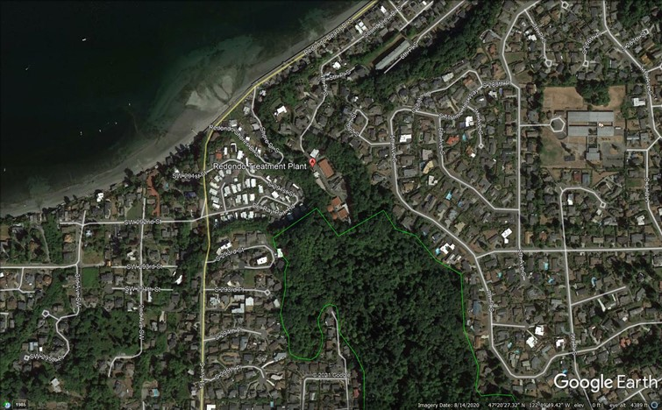
Redondo WWTP Aerial

Slide 9
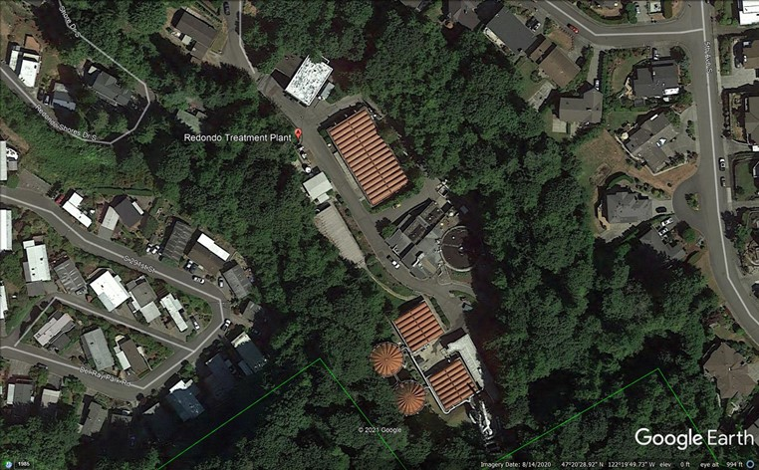
Site Aerial

Slide 10
Lakehaven Redondo Wastewater Treatment Plant – Electrical & Odor Control Upgrades
The proposed project will upgrade the existing electrical power distribution and west odor control systems at Redondo Wastewater Treatment Plant.
The scope of the Electrical Power Distribution Upgrade includes:
Replacement of the existing 480V electrical service with an enlarged electrical service. The enlarged electrical service is intended to support future process upgrades.
Demolition of existing equipment within the Solids Building to support a new Main Switchgear Electrical Room and new 2MW standby power generator.
New electrical distribution vaults and duct banks
Replacement and relocation of an existing 480V Switchboard with a new 480V Switchboard at the Digester Building
Transition of plant loads from the existing electrical distribution system to the new electrical distribution system

Slide 11
Lakehaven Water & Sewer District – Redondo Electrical & Odor Control Upgrades
The scope for the Odor Control System Upgrade includes:
Demolition of existing west odor control equipment within the Solids Building
Installation of new odor control equipment at a new location near the Solids Building
Various new instrumentation and permitting agency support tasks

Slide 12
Lakehaven Water & Sewer District Redondo Electrical & Odor Control Upgrades Project Budget
Category | Budget
Costs for Professional Services (A/E, Legal, etc.) | $ 3,119,000
Estimated project construction costs (including construction contingencies) | $ 15,597,000
Equipment and furnishing costs | $ included
Off-site costs | N/A
Contract administration costs (Owner, PM/CM, etc.) | $ 1,560,000
Contingencies (owner project contingency @ 5%) | $ 936,000
Other related project costs (Assessments/Fees & BR Insurance) | N/A
Sales Tax (Construction and FF&E @ 10%) | Included
Total | $ 21,212,000

Slide 13
Project Funding
The District currently has $52M in cash reserves on hand that could fully fund the design and construction costs for the project.
To preserve a portion of the cash reserves for other possible needs, the District is pursuing the issuance of up to $60M in phased revenue bonds to fund a portion of the project.
Funding for the engineering design, GC/CM advisor services and the GC/CM preconstruction services is being provided from the cash reserves until the revenue bonds are in place.
The remaining cost of the project manager/construction manager (PM/CM) services, design services and construction of the project will be funded from a combination of funds from the revenue bonds and cash reserves.

Slide 14
Redondo Electrical & Odor Control Upgrades Project Schedule Note that this schedule has been revised by approximately 1 month to allow additional prep time for RFP and RFFP documents.
GC/CM Schedule | Start | Finish
PRC Presentation |  | June 24, 2021
First publication of RFP for GC/CM Services |  | July 26, 2021
Second publication of RFP for GC/CM Services |  | Aug 2, 2021
Project Information Meeting |  | Aug 5, 2021
RFP Submittal Deadline |  | Aug 20, 2021
Review & Score RFP Submittals Received | Aug 21, 2021 | August 27, 2021
Notify Submitters of Most Highly Qualified Submitters & Invite to Interview |  | August 27, 2021
Interviews with Short-Listed Firms |  | September 8, 2021
Notify Shortlisted Firms of Most Highly Qualified Firms & Invite to Submit responses to RFFP |  | September 10, 2021
RFFP Submittal Deadline & Opening |  | September 23, 2021

Slide 15
Redondo Electrical & Odor Control Upgrades Project Schedule Note that this schedule has been revised by approximately 1 month to allow additional prep time for RFP and RFFP documents.
GC/CM Schedule | Start | Finish
Notify Submitters of Scoring and Most Qualified GC/CM |  | September 24, 2021
Board Approval of GC/CM Selection and Authorization to Negotiate Pre-Con Services Agreement |  | October 14, 2021
Pre-Con Work Plan Due From GC/CM |  | October 28, 2021
GC/CM Agreement w/Pre-Con Services Executed |  | November 11, 2021
Pre-Con Services | November 15, 2021 | November 2022
Board Approval of MACC and MACC Contract Amendment Executed |  | November 2022

Slide 16
Redondo Electrical & Odor Control Upgrades Project Schedule Note that this schedule has been revised to allow 8 months for permitting.
Design & Construction Schedule | Start | Finish
30% Design | August 2021 | January 2022
60% Design | February 2022 | May 2022
90% Design | June 2022 | October 2022
City of Des Moines Review & Permitting. SEEPA & PSCAA Permits | October 2022 | May 2023
MACC Negotiation (90% CDs) |  | November 2022
Board Approval of MACC and MACC Contract Amendment Executed |  | December 2022
100% Design | November 2022 | June 2023
Subcontractor Bidding | May 2023 | June 2023
Construction | June 2023 | August 2024
Substantial Completion |  | June 2024
Final Completion/Closeout | July 2024 | August 2024
Warranty Period | June 2024 | May 2025

Slide 17
Equity and Inclusion
The Lakehaven District is committed to diversity and inclusion in all aspects of its work and hiring.
District’s solicitations traditionally have encouraged SBE and MWBE participation for all contracts.
Our RFQ scoring/selection criteria will require the Proposers to:
Provide information on past utilization performance
Submit a project specific inclusion plan

Slide 18
Lessons Learned From Our Headquarters GC/CM Project
The collaborative approach to the project by the team is priceless.
The strong relationship between the contractor and the design team was well established prior to the beginning of construction.
Constructability Review and Value Engineering early on in the design development phase helped the District maintain the budget.
The whole GC/CM process was transparent and information was shared with all parties.

Slide 19
Why GC/CM Delivery Method for the Redondo Electrical & Odor Control Project

Slide 20
RCW 39.10.280 GC/CM Statutory Compliance
Complies with 3 of the 5 Statutory Criteria
Implementation of the project involves complex scheduling, phasing, or coordination.
The project involves construction at an occupied facility which must continue to operate during construction
The involvement of the General Contractor/Construction Manager during the design stage is critical to the success of the project.
The project encompasses a complex or technical work environment.
The project requires specialized work on a building that has historic significance.

Slide 21
Advantages to GC/CM Delivery
Allocation of Risk – The GC/CM process can reduce risks in the following manner:
“Open book” Cost Accounting
Collaboration Between GC/CM, A/E and Owner
GC/CM Involved During Development of Design
Ongoing Estimates by GC/CM During Design
GC/CM Participation in Value Engineering & Constructability
GC/CM Sets Construction Schedule
GC/CM Establishes Sub-Bid Packages
Reduced Risk of Claims & Litigation

Slide 22
EC/CM & MC/CM Delivery
In response to recent changes in statute, LWSD is requesting PRC approval to pursue EC/CM & MC/CM delivery.
Value of the Electrical and Mechanical Subcontract work are each anticipated to exceed $3M.
Major portion of the budget will be related to Electrical Subcontract work.
We anticipate that the use of EC/CM & MC/CM would be in the public interest, resulting in cost savings.
Will be beneficial to have an EC/CM & MC/CM to provide:
Ongoing, market-based cost estimating/forecasting.
Ongoing value engineering and constructability input.
Analysis of existing conditions and systems.
Recommendation on means/methods to keep facility operational during construction.

Slide 23
Public Body Qualifications

Slide 24
Lakehaven
This project will be LWSD’s second GC/CM project. We are currently using GC/CM delivery for our New Headquarters (Main Campus) project. We have completed design, developed a GMP and are ready to begin construction, but are awaiting final permit approval. The experience so far on that project has been favorable and the District is looking forward to utilizing the benefits of the GC/CM delivery method on this challenging project
Water & Sewer District Leadership Team
LWSD has contracted with Parametrix to provide services related to PRC application and approval, GC/CM procurement, PM/CM support services and GC/CM advisory services throughout the duration of the project. Parametrix is assisting on our LWSD New Headquarters project and has extensive experience in the GC/CM procurement and delivery process for public sector clients.
The District has also engaged the services of an external legal counsel (Graehm Wallace of Perkins Coie) to supplement their internal general counsel and provide assistance in contract development and negotiation. Perkins Coie has provided legal and contract related services to numerous public agencies utilizing the GC/CM delivery method and is currently providing counsel on our GC/CM Headquarters project.
LWSD’s past success in managing capital improvement projects, current experience with GC/CM delivery on the Headquarters project and previous successful projects with the design team combined with the GC/CM expertise of Parametrix and Perkins Coie creates a strong team that is well-suited to successfully execute the GC/CM delivery process for this project.
The Lakehaven Water & Sewer District satisfies the public body qualifications by staff augmentation with consultants experienced in GC/CM delivery and RCW 39.10.

Slide 25
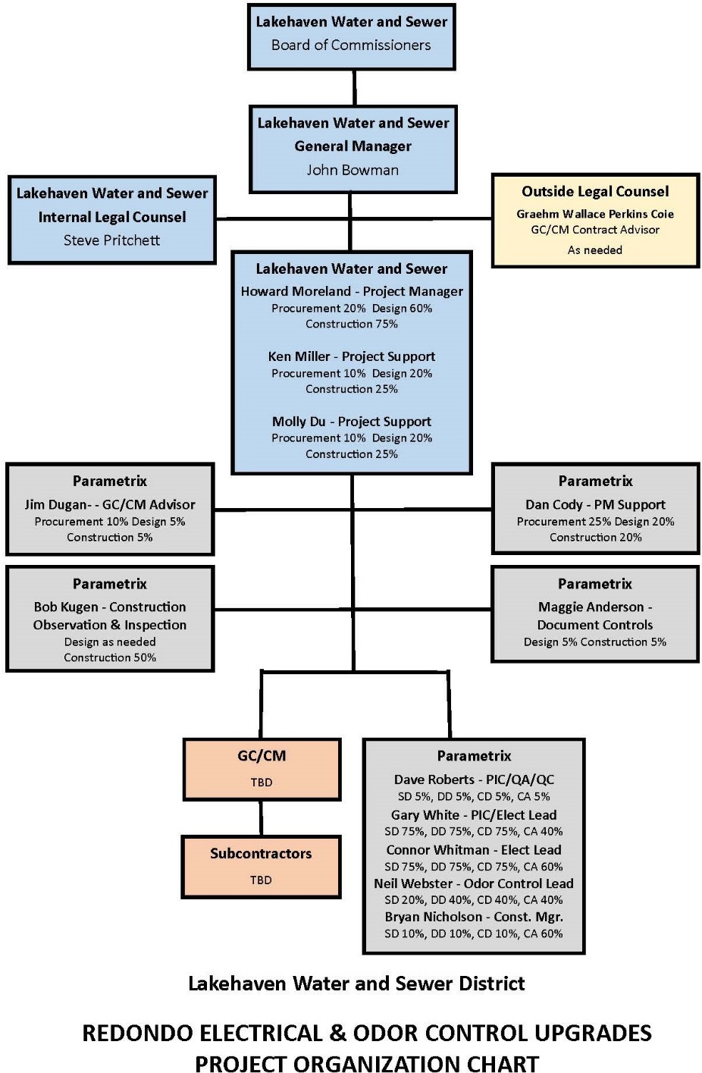

Slide 26
Project Team APD Experience

Slide 27
Name | Experience
John Bowman, P.E. Civil Engineer District General Manager Lakehaven Water & Sewer District | Appointed District General Manager of LWSD in 2011 27 Years as a licensed Civil Engineer 2 GC/CM Projects: Lakehaven New Headquarters, $187 million Water Filtration Plant built by City of Tacoma in partnership with Lakehaven, City of Kent and Covington Water District
Howard Moreland Electrical and Controls Systems Mgr. Project Manager Lakehaven Water & Sewer District | 31 Years with LWSD Journeyman Electrician, became a Master Electrician in 1995 Supports District Capital Improvement Program in electrical, instrumentation, control systems design, specification development, project management, construction management and capital improvement planning. 1 GC/CM Project: Lakehaven New Headquarters
Ken Miller, P.E. Engineering Manager & Project Manager Lakehaven Water & Sewer District | 40 Years experience in design and construction of public infrastructure 35 Years as a licensed Professional Engineer Currently performs the role of Engineering Manager for the District and is responsible for the planning, engineering and construction of the Capital Program for LWSD. 1 GC/CM Project: Lakehaven New Headquarters

Slide 28
Name | Experience
Jim Dugan APD PIC and GC/CM Advisor Parametrix | 43 yrs. Program/Project Management 30+ GC/CM Projects: Recent GC/CM: Lakehaven New HQ, VPS McLoughlin MS/Marshall ES, TPS Birney ES, TPS Grant ES, ASD Dick Scobee ES, ASD Olympic Middle School, LSSD Lake Stevens HS, MVSD Old Main Building, MVSD Madison Elementary, MVSD East Division Elementary, BISD Blakely Elementary School, MPT Eastside Community Center, TPS Browns Point Elementary School; CKSDCentral Kitsap HS/Central Kitsap MS, CKSD Olympic HS Project Review Committee: 2016-current. Appointed through June 2023
Dan Cody GC/CM Procurement and PM/CM Support Parametrix | 34 yrs. Design & PM/CM 4 GC/CM Projects: Lakehaven New HQ, VPS McLoughlin MS/Marshall ES, LSSD Lake Stevens HS, MPT Eastside Community Center 24+ GC/CM Procurement: Recent GC/CM Procurement: VPS McLoughlin MS/Marshall ES/Lieser, TPS Birney ES, ASD Elem #15/Elem #16/Lea Hill ES, TPS Grant ES, ASD Dick Scobee ES/Pioneer ES/Chinook ES/Terminal Park ES, ASD Olympic Middle School, LSSD Lake Stevens HS, MVSD Old Main Building, MVSD Madison Elementary, MVSD East Division Elementary, BISD Blakely Elementary School, MPT Eastside Community Center, TPS Browns Point Elementary School; CKSD Central Kitsap HS/Central Kitsap MS, CKSD Olympic HS
Bryan Nicholson, P.E., DBIA, Civil Engineer and Construction Mgr. Parametrix | 35 yrs. Construction Manager and Owner’s Representation 2 GC/CM Projects: Construction Manager, West Point WWTP Emergency; 2018, Construction Manager/Project Manager, Windermere CSO; 2011

Slide 29
Summary
Requesting PRC approval to utilize GC/CM, EC/CM and MC/CM project delivery.
GC/CM (EC/CM & MC/CM) delivery would result in substantial fiscal benefit.
Project meets qualifying RCW 39.10 criteria for GC/CM delivery.
With augmentation of GC/CM consultants, the LWSD team has:
GC/CM delivery knowledge and experience
Adequate PM/CM personnel with construction experience
Project Management Plan is developed and has clear and logical lines of authority
Appropriate funding and time to execute the project
PM/CM team with experience in project type/scope
Necessary and appropriate construction budget
LWSD has no unresolved audit findings.
Project team is prepared and ready to proceed.

Slide 30
Thank you

