Slide 1
Hunt Middle School
RCW 39.10 Alternative Public Works Contracting – Design/Build
May 24, 2018

Slide 2
Agenda
Introductions
Tacoma Public Schools
Agency Organization Chart
Capital Planning & Construction Org Chart
Capital Project History
Business Equity
The Project
Project Budget
Project Schedule
Why Design Build
Qualifications
Summary

Slide 3
Presenting Team
Morris Aldridge – Executive Director, Planning & Construction
Kris Anderson – Project Supervisor/Project Manager
Alicia Lawver – Strategic Program Analyst
Julius Pallotta – Internal D/B Technical Advisor/Project Supervisor
Jim Dugan – Program Manager, GC/CM Advisor
Dan Cody – D/B Procurement

Slide 4
Additional Team Members
Chris Williams – Chief Operating Officer
John Palewicz – External Design Build Advisor
Graehm Wallace – External D/B Legal Counsel
Michelle Langi – Project Support

Slide 5
Tacoma Public Schools
Founded in 1869
Comprised of:
36 Elementary Schools
11 Middle Schools
10 High Schools
Numerous Special Programs
4th largest school district in the State of Washington
Approximately 30,000 students
Over 5,000 employees
Serving Pre-K thru 12th grade
One of the largest employers in Tacoma

Slide 6
Tacoma Public Schools

Slide 7
Capital Planning & Construction Organization Chart

Slide 8
Business Equity: TPS Community Inclusion Plan
Tacoma Public Schools is committed to Community Inclusion, as partnerships are critical to student education and community health and sustainability.
By the end of 2018, Tacoma Public Schools will:
Maintain and increase contracts with local businesses by:
Increasing local share of total construction to 30%
Adopt Governor’s diverse business goals, including:
10% Minority-Owned Business Enterprises,
6% Woman-Owner Business Enterprises, and
5% Small Business Enterprises (SBE)

Slide 9
Business Equity: TPS Community Inclusion Plan
Additionally, Tacoma Public Schools will require prime contractors to:
Include “Voluntary Inclusion Plans” in all bid packages $300,000+ to utilize sub-contractors from:
Minority & Women Owned Business Enterprises (MWBE),
Small Business Enterprises (SBE), and
An Apprenticeship Utilization Plan
Report and make available to the District and Community partners:
Monthly percentages of MWBE and SBE utilized on the project
Prevailing wage intents and affidavits,
Monthly certified payrolls with quarterly compliance review
Monthly apprenticeship utilization percentages

Slide 10
Capital Project History

Slide 11
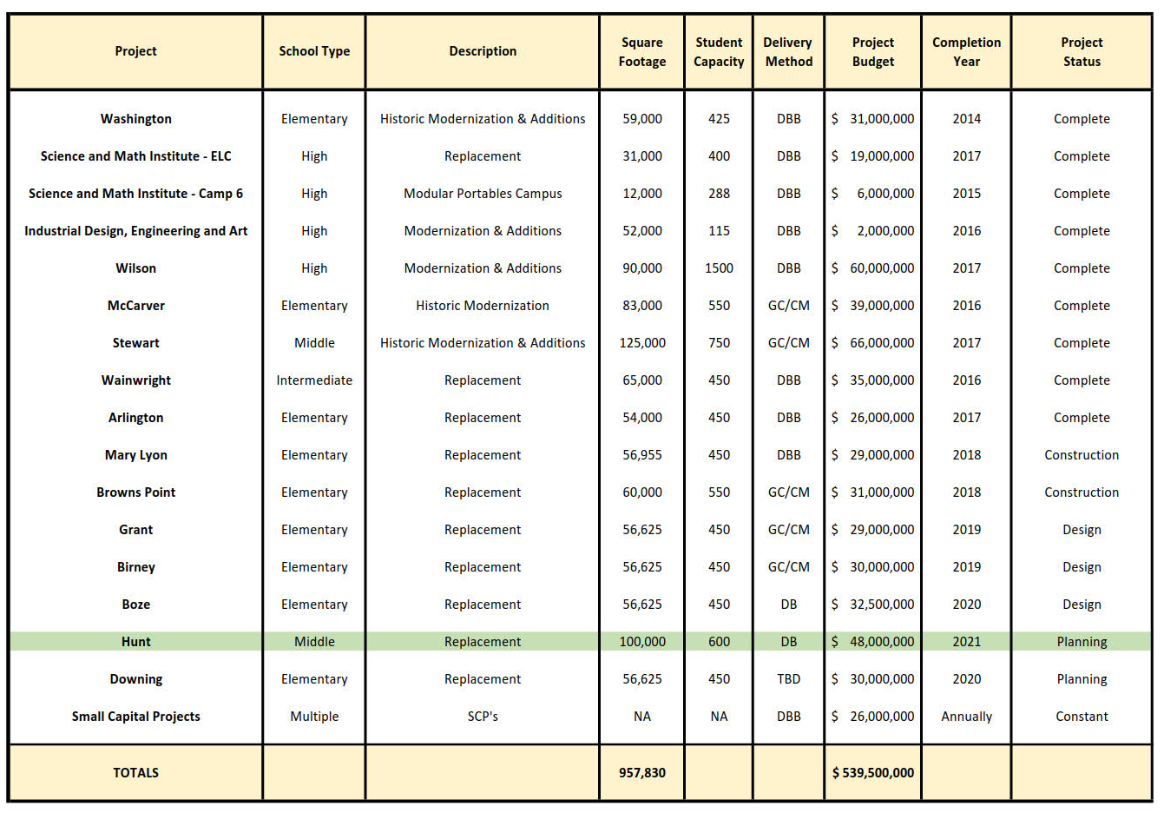
TPS 2013 Capital Bond Program
Notes:
Yellow Highlighted GCCM Projects
Green Highlighted- Just beginning or starting in the next couple of years
May or may not be occupied

Slide 12
TPS Public Body Experience: 2001 – 2016
Notes:
As a public body depth of public works experience
TPS is a major capital project builder

Slide 13
TPS Project Delivery Experience & Qualifications
Successfully passed $1.3 B in Capital Improvement Funds
$299 M between 1983 and 1997
$450M in 2001
$500M in 2013
From 2001 to 2018 alone, funds have been used for Modernizations, Replacements, and/or Building Additions to 35 public schools
28 projects complete
2 projects in construction Mary Lyon ES & Browns Point ES
3 projects in design stages Grant ES, Birney ES & Boze ES
2 projects remaining to begin Hunt MS & Downing ES

Slide 14
The Project

Slide 15
Project Location
Hunt Middle School

Slide 16
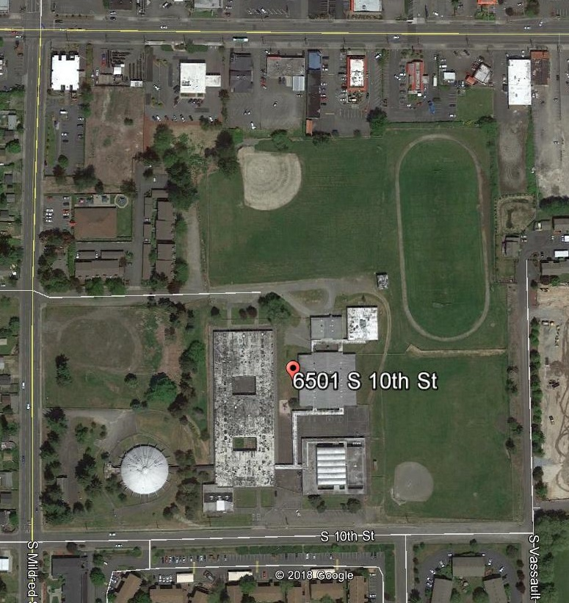
Current Site Overview

Slide 17
Project Description
Located in West Tacoma
24.8-acre site
Replace the existing facility
Build to house 600 students
Build new school first
Demolish existing buildings next - for development of parking, yards and playfields
Board approved total project budget: $48 M
Construction timeline: January 2020-June 2021
Occupancy –August 2021

Slide 18
Site Constraints
Urban residential/commercial site
Mildred Street – major arterial; feeder to TCC, UP & 6th Avenue
Required noise control, dust control and pedestrian access
Extensive off site improvements
Existing school to remain occupied
Complex phasing

Slide 19
Project Budget
Category | Budget
A/E Basic & Additional Services | $3,869,000.00
Project Construction Cost (including 3% D/B contingency) | $33,500,000.00
Owners Project Contingency (5%) | $1,868,450.00
Owners Soft Cost Budget (Proj. Admin., FF&E, Owners Other Consultants, Permits/Fees, Sales Tax, etc.) | $8,762,550.00
TOTAL: | $48,000,000.00

Slide 20
Project Schedule
PRC Presentation and Approval | May 24, 2018
Request for Qualifications Advertised | May 30, 2018
Pre-Proposal Meeting | June 8, 2018
Statement of Qualifications Due | June 20, 2018
Shortlist Announced; RFP Released | June 26, 2018
Proposals Due | July 10, 2018
Interviews | July 13, 2018
Scoring Complete; Notification of Most Qualified D/B | July 20, 2018
Contract Negotiations | August-September 2018
TPS Board Approval, Contract Awarded, NTP | October 1, 2018
Design Phase | November 2018 – December 2019
Construction | January 2020– June 2021
Occupancy/Move In | July 2021 – August 2021

Slide 21
Project Schedule
Advanced Notice of project published March 8, 2018.
Procurement schedule allows for team formation, questions, addenda as needed prior to SOQ’s due.
Assumes qualifications-based selection – limited document production by competitors.
Interviews will discourage design concepts by teams.
Assumes cost-reimbursable contract – negotiated GMP.
Possible early release of key subs and long lead items.

Slide 22
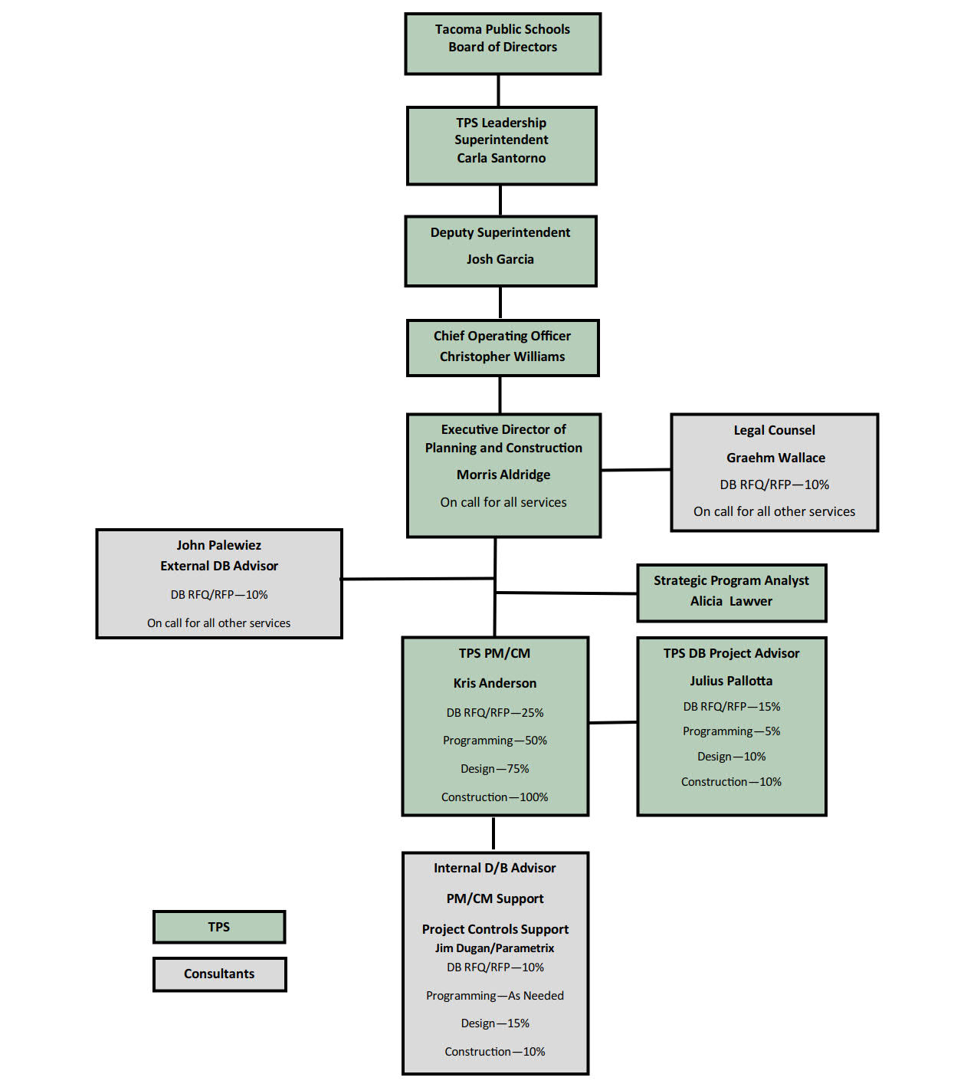
Project Organizational Chart

Slide 23
Why D/B Delivery Method

Slide 24
Market Conditions
In Washington State, between 2011 and 2017, voters approved $11.8 B in K-12 Funding
Voters Approved $1.4 B in 2018 YTD
More Than $2 B Planned for 2019
Total of $15.2 B in 9 Years - $1.7 B/Yr
Unprecedented Cost Increases in Bid Market @ $20 M to $30 M MACC Range
Budgets at $380/sf – Bidding at 30% to 50% Higher
Need to Reduce Owner Risk
Need to Improve Cost Control
Design/Build is the Owners Best Strategy

Slide 25
Cost Certainty
Need Earlier Certainty of Project Cost.
Cost Increases at Hunt MS – Puts Remaining Projects at Risk
Hunt Middle School Site – Flat, Not Complicated
Cost Known: Fall 2019
Design/Build is the Owners Best Strategy

Slide 26
Statutory Compliance
(5.1) If the construction activities are highly specialized and a D/B approach is critical in developing the construction methodology
(5.2) If the project provides opportunity for greater innovation and efficiencies between the designer and builder
(5.3) If significant savings in project delivery time would be realized

Slide 27
Public Benefit
Cost Savings
Risk Mitigation
Safety
Fulfill Bond Promise

Slide 28
Public Body Qualifications

Slide 29
Leadership Team
TPS has extensive K-12 capital projects experience including projects of similar scope and complexity
Currently delivering Boze ES utilizing Progressive D/B.
All previous projects have been delivered using Design-Bid-Build or GC/CM.
Long track record of building projects on-time and within budget.
Long track record of RCW 39.10 compliance.
TPS currently has one D/B underway and is a proponent of D/B delivery.
Kris Anderson: TPS Project Supervisor (Project Manager)
24 Years of Project Management experience; 7 Previous Design Build Projects
Julius Pallotta: Internal TPS D/B Technical Advisor/Project Supervisor
30 Years Construction Management Experience
Managed multiple projects ranging from $350,000-$90,000,000 using DB project delivery
Parametrix: PM/CM Support and Internal D/B Advisor
John Palewicz: External D/B Advisor
Graehm Wallace: External D/B Legal Counsel
TPS satisfies the public body qualifications by staff augmentation with consultants.

Slide 30
Design Build Experience

Slide 31
Summary
Project is funded with the appropriate budget
Project meets qualifying RCW criteria
Project Management Plan is developed and has clear and logical lines of authority
Project team has the necessary experience
Project team has the capacity
Project team is prepared and ready to move forward

Slide 32
Thank You

