Slide 1
McLoughlin Middle School, Marshall Elementary School and Lieser School
Application to use the GC/CM Delivery Method
May 25, 2017 Presentation
“In partnership with home and community, Vancouver Public Schools provides an innovative learning environment that engages and empowers each student to develop the knowledge and essential skills to become a competent, responsible and compassionate citizen. ”

Slide 2
Agenda
Introductions
VPS Capital Improvement Plan
The Projects
Project Budgets
Project Schedules
Why GC/CM
Qualifications
Organization
Summary

Slide 3
Introductions

Slide 4
The Project Team – Here Today
Vancouver Public Schools
Todd Horenstein, Assistant Superintendent, Facility Support Services
LSW Architects
Ralph Willson, AIA, Principal-in-Charge
Keith Livie, Associate, Project Manager
Don Luthardt, AIA, Associate Principal
Brent Young, AIA, Associate, Project Architect
Parametrix
Howard Hillinger, Internal GC/CM Program Manager
Jim Dugan, GC/CM Program Advisor
Dan Cody, GC/CM Procurement & PM/CM
Michelle Langi, Project Controls Specialist
Perkins Coie
Graehm Wallace, External GC/CM Legal Advisor

Slide 5
The Project Team: Other Team Members
Vancouver Public Schools
Brett Blechschmidt, CFO
Jennifer Halleck, Facility Planner
LSW Architects
Lydia Dominy-Burns, AIA, Associate
Kourtney Strong, AIA, Project Architect
Terry Werdel, AIA, Associate

Slide 6
Vancouver Public Schools Capital Improvement Program

Slide 7
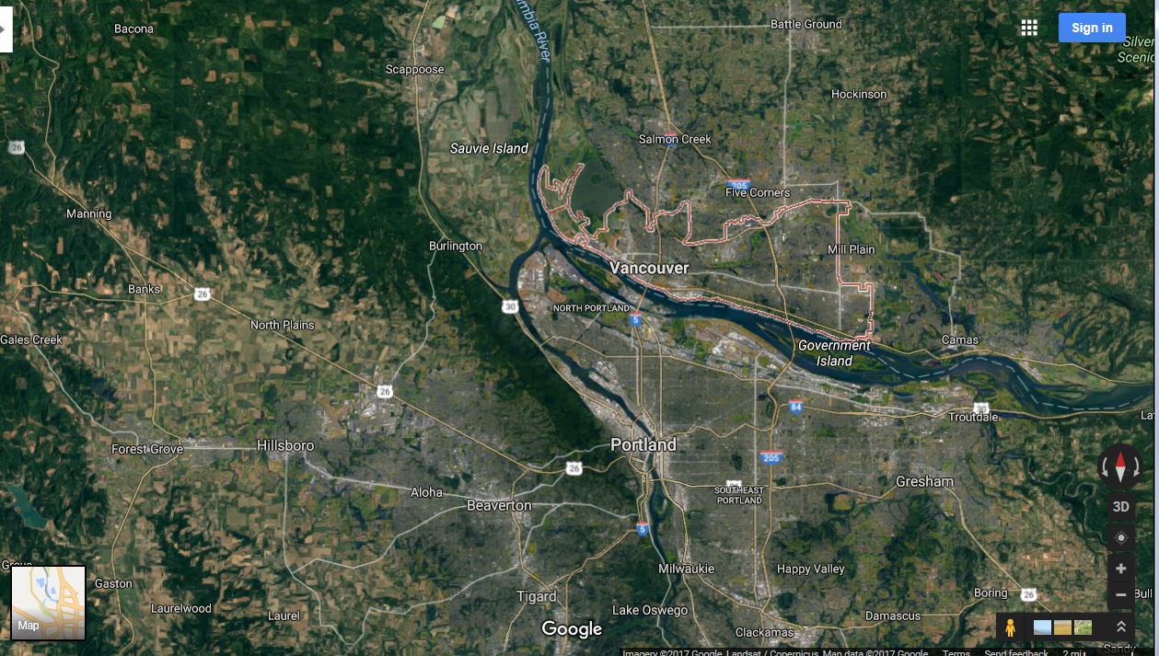
Vancouver Public School District

Slide 8
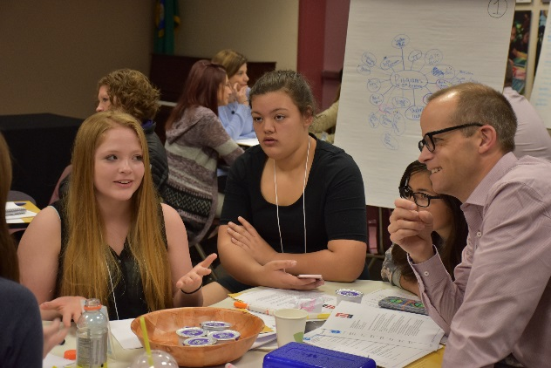
The District
Located in Clark County, Southwest Washington
Vancouver School District was formed in 1852
Approximately 24,000 student enrollment
Thirty-seven (37) schools comprised of:
Twenty-one (21) Elementary Schools
Six (6) Middle Schools
Five (5) High Schools
Three (3) Grade 6-12 Magnet Schools
One (1) Grades K-12 School of Choice
One (1) High School and Beyond
3,300 teachers, administrators and support staff
Last capital bond passed in 2001 - $400 Million
Current capital program - $563 Million, 2017-2022

Slide 9
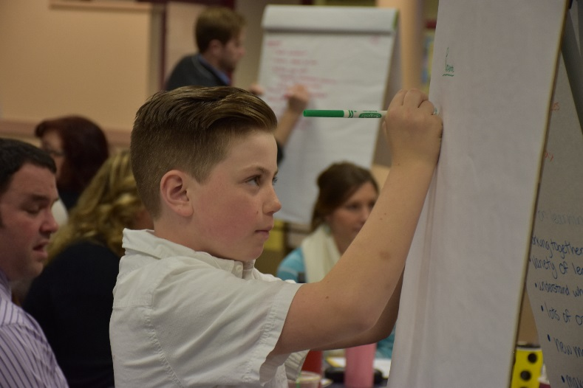
2017 Capital Bond Program
Today’s Presentation
McLoughlin Middle School (MMS)– Replacement
Marshall Elementary School (MES) – Replacement
Lieser School – Modernization (of Marshall ES)
22% of the Overall Capital Improvement Program

Slide 10
Business Equity: Community Inclusion Plan
Vancouver Public Schools is committed to Equity and Excellence. Developing strong business relationships and community partnerships are critically important to fulfilling the districts mission.
The District’s goals include:
Encouraging local small business participation – working with the SWWA labor Roundtable and local contractor associations for apprentice and minority entrepreneur participation
Contracting with local businesses
Working towards the Governor’s MWBE and SBE diversity goals
Encourage “Voluntary Inclusion Plans” in all large bid packages
Report Monthly percentages of MWBE and SBE utilization

Slide 11
The Projects

Slide 12
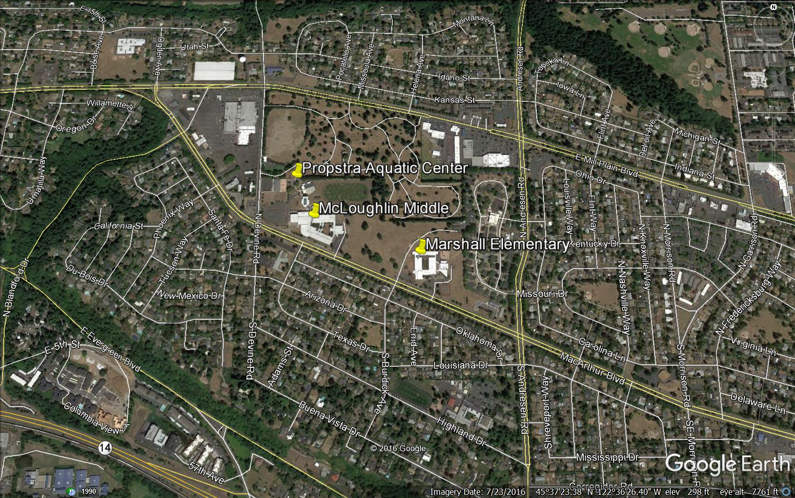
McLoughlin Middle School

Slide 13
Marshall Elementary School

Slide 14
Lieser School
New Home for Lieser School: Modernizing Old Marshall ES

Slide 15
Three Schools – One Site
Maintain Aquatic Center Operation
(2) Build Two New Schools
(3) Demolish One Existing School
(4) Modernize One Existing School
(1) Maintain Operation of Two Existing Schools While Two New Schools are Built

Slide 16
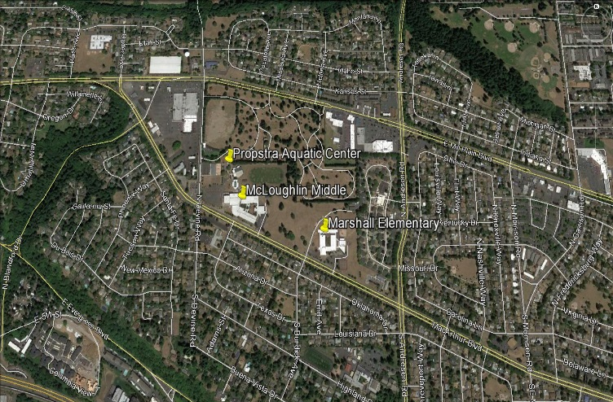
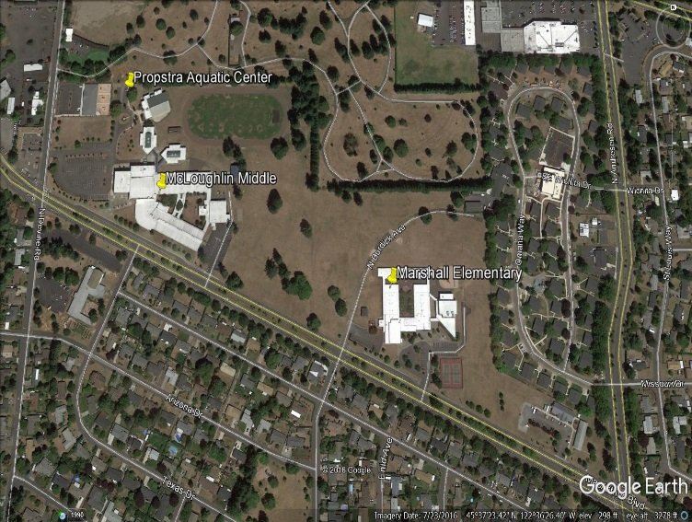
McLoughlin Middle School
Replacement School
Currently 145,581 SF
900 Students (Grades 6-8)
60 Staff Members
Proposed: One and Two Story Buildings
Anticipated MACC: $54 M
Phased Construction
Occupancy: September 2020

Slide 17
Marshall Elementary School
Replacement School
Currently 56,110 SF
420 Students (Grades K-5)
40 Staff Members
Existing Building Modernized to house the Lieser School Program
Proposed: One and Two Story Buildings
Anticipated MACC: $26 M
Phased Construction
Occupancy: September 2020

Slide 18
Lieser School
Modernization of the old Marshall ES
Currently 56,110 SF
350 Students (Grades K-12)
35 Staff Members
Anticipated MACC: $9.625 M
Occupancy: April 2021

Slide 19
Critical Phasing

Slide 20
MMS Project Budget
Category | Budget
Project MACC (includes GC/CM Risk Contingency @ 3% of MACC) | $49,721,860
GC/CM Fee, SGC’s, Pre-Con Services and NSS Allowance (8% of MACC) | $4,323,640
Owner’s Construction and Project Contingency (5% of MACC) | $5,404,550
Furnishings, Fixtures, Equipment, Data & Technology (5% of MACC) | $2,702,275
Professional Services (A/E) (8% of MACC) | $4,323,640
Owner’s Consultants (1% of MACC) | $540,455
Contract Administration (PM, CM) (2.5% of MACC) | $1,351,138
Other Related Project Costs (Permits Fees, Etc.) | $1,402,621
Sales Tax (8.4% of MACC) | $4,539,822
Total | 74,310,000

Slide 21
MES Project Budget
Category | Budget
Project MACC (includes GC/CM Risk Contingency @ 3% of MACC) | $23,575,000
GC/CM Fee, SGC’s, Pre-Con Services and NSS Allowance (8% of MACC) | $2,050,000
Owner’s Construction and Project Contingency (5% of MACC) | $2,562,500
Furnishings, Fixtures, Equipment, Data & Technology (5% of MACC) | $1,281,250
Professional Services (A/E) (8% of MACC) | $2,050,000
Owner’s Consultants (1% of MACC) | $256,250
Contract Administration (PM, CM) (2.5% of MACC) | $640,625
Other Related Project Costs (Permits Fees, Etc.) | $581,875
Sales Tax (8.4% of MACC) | $2,152,500
Total | 35,150,000

Slide 22
Lieser School Project Budget
Category | Budget
Project MACC (includes GC/CM Risk Contingency @ 3% of MACC) | $8,671,000
GC/CM Fee, SGC’s, Pre-Con Services and NSS Allowance (8% of MACC) | $754,000
Owner’s Construction and Project Contingency (5% of MACC) | $942,500
Furnishings, Fixtures, Equipment, Data & Technology (5% of MACC) | $471,250
Professional Services (A/E) (8% of MACC) | $754,000
Owner’s Consultants (1% of MACC) | $94,250
Contract Administration (PM, CM) (2.5% of MACC) | $235,625
Other Related Project Costs (Permits Fees, Etc.) | $255,675
Sales Tax (8.4% of MACC) | $791,700
Total | $12,970,000

Slide 23
MMS, MES & Lieser School GC/CM Schedule
Project Schedule | Start
PRC Presentation | May 25, 2017
First Publication of RFP for GC/CM Services | May 29, 2017
Second Publication of RFP for GC/CM Services | June 5, 2017
Project Information Meeting (date subject to change) | June 6, 2017
RFP Submittal Deadline | June 12, 2017
Open & Score Submittal Received | June 14 - June 15
Notify Submitters of Most Highly Qualified Submitters & Invite to Interview | June 16, 2017
Interviews with Short-Listed Firms | June 26, 2017
Notify Submitters of Most Highly Qualified Firms & Invite to Submit RFFP | June 28, 2017
RFFP Submittal Deadline & Opening | July 12, 2017
Notify Submitters of Scoring and Most Highly Qualified GC/CM | July 14, 2017
Pre-Con Work Plan Due | July 28,2017
School Board Approval of GC/CM Selection | August 8,2017
GC/CM Agreement with Pre-Con Services Executed | August 11, 2017

Slide 24
Combined MMS, MES & Lieser School Development Schedules
MASTER PROJECT SCHEDULE
Year |  |  | 2017 |  |  |  |  |  |  |  |  |  |  |  | 2018 |  |  |  |  |  |  |  |  |  |  |  | 2019 |  |  |  |  |  |  |  |  |  |  |  | 2020 |  |  |  |  |  |  |  |  |  |  |  | 2021
Projects |  |  | Jan | Feb | Mar | Apr | May | Jun | Jul | Au | Sep | Oct | Nov | Dec | Jan | Feb | Mar | Apr | May | Jun | Jul | Au | Sep | Oct | Nov | Dec | Jan | Feb | Mar | Apr | May | Jun | Jul | Au | Sep | Oct | Nov | Dec | Jan | Feb | Mar | Apr | May | Jun | Jul | Au | Sep | Oct | Nov | Dec | Jan | Feb | Mar | Apr | May | Jun | Jul | Au | Sep | Oct | Nov | Dec
Early Site Package |  |  |  |  |  |  |  |  |  |  |  |  |  |  |  |  | Building Permit |  |  | Construction
 |  |  |  |  |  |  |  |  |  |  |  |  |  |  |  |  | Sub. Bidding
Early Procurement |  |  |  |  |  |  |  |  |  |  |  |  |  |  |  |  | Early Procurement
McLoughlin Middle School |  |  |  | Predesign |  |  | SD |  |  |  | DD |  |  | Site Plan Review |  |  |  |  |  |  |  |  | Construction |  |  |  |  |  |  |  |  |  |  |  |  |  |  |  |  |  |  |  |  |  | Close-Out
 |  |  |  |  |  |  |  |  |  |  |  |  |  | CD |  |  |  |  |  | Building Permit
 |  |  |  |  |  |  |  |  |  |  |  |  |  |  |  |  |  |  |  | Sub. Bidding |  |  |  |  |  |  |  |  |  |  |  |  |  |  |  |  |  |  |  |  |  |  |  |  | Move In
Marshall Elementary School |  |  |  | Predesign |  |  | SD |  |  |  | DD |  |  | Site Plan Review |  |  |  |  |  |  |  |  | Construction |  |  |  |  |  |  |  |  |  |  |  |  |  |  |  |  |  |  |  |  |  | Close-Out
 |  |  |  |  |  |  |  |  |  |  |  |  |  | CD |  |  |  |  |  | Building Permit
 |  |  |  |  |  |  |  |  |  |  |  |  |  |  |  |  |  |  |  | Sub. Bidding |  |  |  |  |  |  |  |  |  |  |  |  |  |  |  |  |  |  |  |  |  |  |  |  | Move In
Lieser School |  |  |  |  |  |  | Predesign |  |  | SD |  | DD |  |  | Site Plan Review |  |  |  |  |  |  |  |  |  |  |  |  |  |  |  |  |  |  |  |  |  |  |  |  |  |  |  |  | Construction |  |  |  |  |  |  |  | Close-Out
 |  |  |  |  |  |  |  |  |  |  |  |  |  |  | CD |  |  | Building Permit
 |  |  |  |  |  |  |  |  |  |  |  |  |  |  |  |  |  | Sub Bidding |  |  |  |  |  |  |  |  |  |  |  |  |  |  |  |  |  |  |  |  |  |  |  |  |  |  |  |  |  |  |  |  |  | Move In
Critical Phasing

Slide 25
Why GC/CM Delivery Method for MMS, MES & Lieser School

Slide 26
Complies with 3 of the 5 Statutory Criteria
(1) Implementation of the project involves complex scheduling, phasing, or coordination.
(2) The project involves construction at an occupied facility which must continue to operate during construction.
(3) The involvement of the General Contractor/Construction Manager during the design stage is critical to the success of the project.
(4) The project encompasses a complex or technical work environment.
(5) The project requires specialized work on a building that has historic significance.

Slide 27
Projects involve complex scheduling, phasing, and coordination on an occupied site

Slide 28
Projects involve complex scheduling, phasing, and coordination on an occupied site

Slide 29
Projects involve complex scheduling, phasing, and coordination on an occupied site

Slide 30
Projects involve complex scheduling, phasing, and coordination on an occupied site

Slide 31
Project Chronology Complexity
Build/Modernize Three Schools on the Same Site
Build new MMS and MES Concurrently
Adjacent to the Existing MMS and MES
Maintain Operations of Both Existing MMS and MES
Maintain Operations of the Existing Aquatic Center
Maintain Operations of the Existing Day Care Center
Maintain Access and Use of Existing Tennis Courts
Move into new MMS and MES
Demolish old MMS
Modernize old MES into New Lieser School
Construct Fields and Site Improvements for all Schools
Complete MMS and MES in Fall of 2020
Complete Lieser School Modernization in Spring 2021

Slide 32
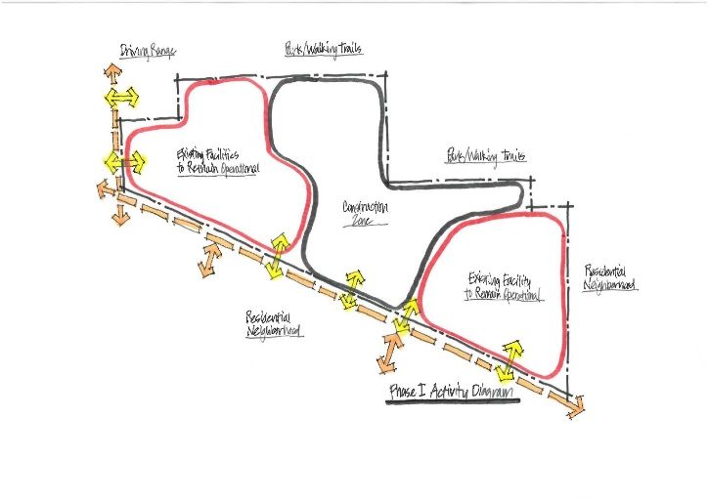
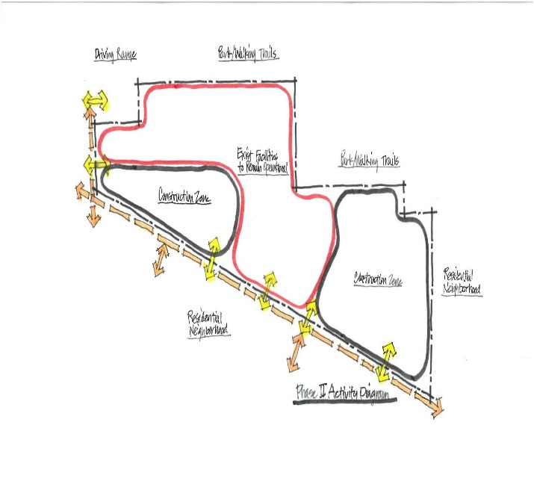
Other Critical Factors
Neighborhood Access/Egress & Traffic Management
Inflation - Escalating Market Costs
MMS is a Production Kitchen and Provides Food for Other District Schools
Early Site Package(s)
Early Procurement of Long Lead Items
Cost Savings – GC/CM Overhead Reduction with Three Projects and One GC/CM
Critical Need to Manage and Communicate with all Neighborhoods

Slide 33
Three Projects – One GC/CM
Experienced cost savings at Clover Park SD combined projects
Key factor to savings – same design team on both projects
Experienced cost savings at Tacoma Public Schools
McCarver ES and Stewart MS Modernizations
Projects maintain separate project teams
Savings achieved in reduced overall company overhead, combined procurement, and careful sequencing of the Work
Approximate savings in the $1 M range
GC/CM RFP includes demonstrating this kind of experience
Depth of experience by our leadership team and our design team and having the same design team for all three – forms the basis for this three project GC/CM approval request

Slide 34
Public Benefit: From this ….
Student, Community and District Safety
Enhanced Budget and Schedule Control
Community Stewardship
Appropriate Risk Allocation
Fiscal Accountability

Slide 35
Public Body Qualifications

Slide 36
VPS Leadership Team
The District
History of building and modernizing schools and support facilities.
First major capital projects in more than a decade
New to the GC/CM method of project delivery
GC/CM Training – June 8/9, 2017
Todd Horenstein (VPS)
Jennifer Halleck (VPS)
Keith Livie (LSW Architects)
Don Luthardt (LSW Architects)
Kourtney Strong (LSW Architects)
VPS GC/CM Team Experience
Parametrix: GC/CM Program and Project Management Services
Perkins Coie: GC/CM Legal Services
LSW Architects: GC/CM Design Services
VPS satisfies the public body qualifications by staff augmentation with consultants.

Slide 37
MMS, MES, & Lieser School Project Organizational Chart

Slide 38
Jim Dugan – Project Commitments and Capacity
GC/CM Program Advisor – Jim Dugan
TPS McCarver ES and Stewart MS GC/CM Procurement are Both Complete
TPS Browns Point ES GC/CM Procurement is Complete
MPT Eastside Community Center GC/CM Procurement is Complete
CKSD Olympic HS and Central Kitsap HS/MS GC/CM Procurement is Complete
Mount Vernon SD East Division ES, Madison ES and Mount Vernon HS – GC/CM Procurement is Complete
Auburn SD Olympic ES GC/CM Procurement is Complete
All Other GC/CM Principal and Project Executive Roles are Minimal
Ample capacity for the VPS GC/CM Advisor Role
Additional capacity for other needs

Slide 39
Project Team GC/CM Experience

Slide 40
Name | Experience
Todd Horenstein, AIA Assistant Superintendent of Facility Support Services Vancouver Public Schools | 35 yrs. Project Management 30 yrs in K-12: 2001 $400 M VPS Capital Improvement Program.
Jim Dugan GC/CM Program Advisor Parametrix | 38 yrs. Program/Project Management 13 GC/CM Projects: ASD Olympic Middle School, MVSD Old Main Building, MVSD Madison Elementary, MVSD East Division Elementary, BISD Blakely Elementary School, TPS Stadium High School, COT Tacoma Convention and Trade Center, TPS McCarver Elementary School; TPS Stewart Middle School; MPT Eastside Community Center, TPS Browns Point Elementary School; CKSD HS/MS and OHS Projects Tacoma Public Schools Board of Director: 2005 – 2011 Project Review Committee Member: 3 Year Term Ends June 2019
Howard Hillinger GC/CM Program Manger Parametrix | 30 yrs. Program/Project Management 8 GC/CM Projects: RSD Ridgefield Elementary School and HS additions ,TPS McCarver ES and Stewart MS; Seattle Multi-Modal Terminal at Coleman Dock; Washougal School District – Jemtegaard Middle school and Excelsior High School; Grays Harbor County Public Hospital SPMC Medical Office Building. Project Review Committee Member: 3 Year Term Ends June 2020
Dan Cody GC/CM Procurement & PM/CM Parametrix | 30 yrs. Of Design & PM/CM 10 GC/CM Projects: LSSD HS, ASD Olympic Middle School, MVSD MVHS Old Main Building Historic, MVSD Madison Elementary, MVSD East Division Elementary, CKSD CKSH and Middle School, CKSD Olympic HS, TPS Browns Point Elementary, Metro Parks Tacoma Eastside Community Center
Ralph Willson, AIA Principal-in-Charge LSW Architects | 35 yrs. Principal In Charge 4 GC/CM Projects: Ridgefield Elementary Schools, Ridgefield High School Modernization & Additions, Sherwood YMCA, Clark County YMCA 6 DBB: Roosevelt ES Additions, Chief Umtuch MS, Amboy Middle School, Kelso HS, Hockinson HS Additions and Modernization, Sherwood HS

Slide 41
Name | Experience
Keith Livie Project Manager LSW Architects | 36 yrs. Project Management 2 GC/CM Projects: RSD Ridgefield HS and SSD Sherwood High School 8 DBB: Clark College STEM Building, Clark College at CTC, CC Stout Hall, CC Renovation of AA-5, VPS Franklin Elementary School, SSD Sherwood High School, SSD Middleton Elementary, VPS Hudson’s Bay HS, VPS Lewis and Clark High School.
Brent Young AIA Project Architect for MMS LSW Architects | 19 yrs. Project Architect 1 GC/CM Project: Canby School District Remodels 7 DBB: PPS Sunstone Montessori School, Camas WA Bright Futures Christian School, Lebanon SD Lebanon HS, Newberg SD Newberg High School, Philomath SD Philomath Middle School .
Kourtney Strong, AIA Project Architect for MES LSW Architects | 18 yrs. Project Architect 4 GC/CM Projects: Jemtagaard Middle & Columbia River Gorge Elementary School, Wilkes Elementary School, District Wide Secured Vestibules Phase 1 and Phase 2 - Reynolds School District.
Terence Werdel AIA Project Architect for LS LSW Architects | 17 yrs. Project Architect 1 GC/CM Project: Sherwood YMCA 6 Negotiated Contract Projects: EPS Crestline Elementary School, St. Elizabeth Anne Seton Catholic High School, Trio Pointe Apartment Complex, Heritage Bank, HSP Corporate Office, Carbonics Commercial Building.

Slide 42
Summary
Projects are funded with the appropriate budgets
Projects meet qualifying RCW 39.10 criteria
Project Management Plan for all three projects are developed and have clear and logical lines of authority
Project team has the necessary experience in addition to continuity for all three projects
Project team has the capacity for all three projects
Project team is prepared and ready to proceed
GC/CM RFP is complete and ready to publish

Slide 43
Thank you

