Slide 1
LEADING OTHERS:
JOURNEY TO LEADERSHIP
THE POWERPOINT PRESENTATION
Orientation for HR Subject Matter Experts
Notes:
Hello and welcome. My name is Audrey Pitchford, and I’m one of the facilitators in the Leadership Development Program at the Department of Enterprise Services.
This Orientation is for the Human Resources Subject Matter Experts, who have volunteered to assist with Leading Others. It will last about 30 minutes.
To assist you with this Orientation, you may wish to download this PowerPoint presentation, the Leadership Scenarios with suggested responses, and the Participant Guide.
Let’s begin!

Slide 2
Presentation Overview
Orientation Overview
Leading Others overview.
Role of HR experts in the classroom.
Discuss Leadership scenarios.
Notes:
This orientation is broken into three topics. First, we’ll describe what Leading Others is. Next, we’ll talk about your role as HR experts in the classroom. And finally, we’ll discuss the Leadership Scenarios that the learners and you will be reviewing together in the classroom.

Slide 3
Presentation Overview
But first….
Notes:
But before we get into all that, Thank You! We appreciate your willingness to help us deliver this training, and your commitment to ensuring new leaders are knowledgeable and skilled. Many thanks for taking time out of your schedule to participate in Leading Others!
We’ve received positive feedback from other HR professionals who have helped us with this role. And, we recognize we can always learn and grow. We welcome your feedback, both positive and negative, about your experience helping with this class.

Slide 4
Presentation Overview
and….
Notes:
And…congratulations! HR staff who are helping with Leading Others received approval from their agencies’ Human Resource directors to be part of this training. We’re grateful for your skills and that your agency also supports you in assisting with this important work!
So far, we’ve also had more HR folks wanting to volunteer than we’ve had training dates available. We know this is a professional development opportunity for many folks in HR, and we’re grateful for your interest.

Slide 5
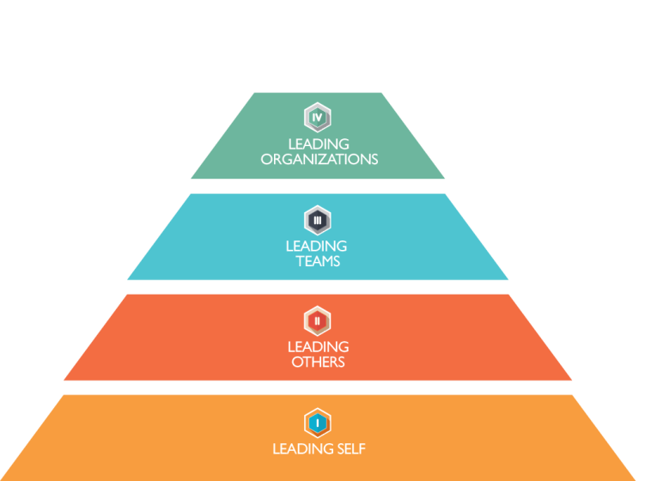
Leadership Development at all Levels
You are Here!
Notes:
So, what is Leading Others, and how does it fit in with leadership development at all levels of state service?
Before developing Leading Others, DES interviewed several leaders of various state agencies. We asked them to identify how we could help support state agencies’ training needs. Most state agencies identified a need for help in developing a pipeline of leaders - people prepared to step into key leadership roles.
A menu of training courses was envisioned for staff at all levels within state government. DES is working with our customers and stakeholders to develop these courses. Courses planned include:
Leading Self, which will be focused on self-awareness for individuals/employees at all levels
Leading Others - a 24-hour training that meets the WAC and statutory requirements for supervisors new to leadership in state service. (This is the first course launched in the Leadership Development model. It was developed and piloted in the summer and fall of 2016, and rolled out in early 2017.)
Leading Teams, which will be for mid-level managers and piloted in summer of 2017.
And Leading Organizations and Executive Onboarding, for agency executives and senior leadership.

Slide 6
Leading Others Vision
To provide an innovative, evidence-based leadership development experience to entry-level and developing leaders.
Notes:
Leading Others was developed with input from over 200 leaders at more than 100 state agencies. It addresses Leadership Competencies identified by deputy directors of multiple agencies. You can find a copy of these Leadership Competencies in the Participant Guide for this training.
Leading Others is based on data and neuroscience about how adults learn, and industry-wide best practices about adult learning.
This class replaces the class Supervision Essentials 1, and meets the WAC requirement of 24 hours of instruction for supervisors new to state service.

Slide 7
Enterprise commitment: Develop Leaders for the Present and Future of Washington State
Agency Build a culture of learning and leadership | DES Structured Learning and Tool Kits | Agency Sustain a culture of learning and leadership
Notes:
We know that most learning happens on the job. This is part of why our partnership with other agencies is so important, and why we value your participation in this course! We provide foundational information applicable to all new leaders, so agencies can focus their time on the agency-specific information they know best.

Slide 8
Leading Others
Using the leadership competencies developed by the Deputies (and others) as a foundation, Leading Others provides:
Foundation of technical supervisor knowledge.
Facilitation of a mindset shift.
Interpersonal skills necessary for success.
Notes:
The Leading Others course has three main components.
First, we provide a foundation of technical supervisory knowledge. This is through the six eLearning modules, which are available free of cost through the LMS system.
In the classroom, we focus on a mindset shift away from the idea of a leader as the expert, and toward the idea of a leader as a coach. We draw on Lean principles of leading with humility, leaders who are willing to go to line staff for input and to learn, and leaders who are continually open to feedback and growth. For some learners, this may not be a huge shift. But for others from more traditional backgrounds, this may be a very different picture of what leadership looks like.
We also focus classroom time on the interpersonal skills necessary for success – such as self-awareness, communication, listening, and so on.

Slide 9
Why include HR experts?
Class participants have asked for, and see value in, having HR experts in the room during the scenario discussions.
Class participants see the value of building relationships with HR professionals.
DES, with the support of agency HR Directors and Managers, and HR Development Committee believe this is a great development opportunity for HR professionals!
Notes:
What’s the value in having HR professionals in Leading Others?
Learners enjoy and appreciate having direct access to learning from HR Professionals
New leaders get a better sense of HR as their partner, and the value of building a relationship with HR.
This benefits HR professionals as well, by providing a professional development opportunity. As mentioned earlier, participating in LO requires your HR Manager’s approval, AND it’s a chance for you to network with other HR Professionals, and meet with and help develop new leaders.
It’s also an opportunity to mentor staff within your own unit or team. If you have an up and coming HRC1s or 2’s, you’re welcome to bring them to the class as part of their learning.

Slide 10
What is the role of HR experts?
Deliver expert-level advice (not agency specific) to the Leading Others audience.
Consult the group towards successful outcomes
To answer questions and articulate risks as the participants navigate options. Examples of questions so far:
reasonable accommodation
navigating the CBA
when to involve HR in performance issues
Notes:
In the classroom, HR professionals won’t be responsible for facilitating the class – the instructors will take care of that. You’ll only be responsible for the HR content.
We know some agencies do things differently. In the classroom, we ask you to provide guidance at a broad, enterprise level. Refer the learners to their own agency’s HR staff as needed. It’s okay to mention practices of specific agencies, but please identify if you are speaking about specifics of how a single agency conducts business.
We hope you also share with the learners any potential risks they may encounter based on their ideas on how to handle specific scenarios.

Slide 11
Leading Others Content Outline
Pre-work: Questions to reflect on leadership; Talk to manager; Take pre-assessment; Begin eLearning
Day 1 Leading Self | Day 2 Leading Others | Practice | Day 3 Leading Others
Cohort bond Communication styles Values Committed language | Building trust How to communicate Leader as coach Select Leadership Challenge | Coaching Talk with manager Connect with cohort Finish eLearning | What did I learn? Dealing with conflict Giving and receiving feedback Applying what I learned Celebrate success
Post-work: Continue to engage with manager; apply learning; take post-assessment
Notes:
By the time you join us in class, the learners will be almost at the end of a month of training.
They’ll have had pre-class assignments to reflect on leadership questions, and talk with their manager.
They’ll have spent two days in class, focusing on self-awareness, and using that self-awareness to practice leading others.
They are given about a month between Days 2 and 3 of class, to work on a leadership challenge and to put ideas from class into practice. Learners will be asked to complete the eLearning modules, and meet with others from their class to build their support network.
On the last day of class, before you arrive, students learn about conflict and feedback.
The Leadership Scenarios are the time for the learners to apply all they’ve learned!

Slide 12
Logistics
2:00 – 4:00 pm (last day of 3 day training)
Ideally 2 HR experts each class; may only be 1
Total of 8 scenarios
Up to 24 participants (5 pods of 4-5 learners)
Notes:
We usually review the Leadership Scenarios from 2-4pm on day 3.
We try to schedule 2 HR Professionals for each class – this way, if one of them is unable to make it, we have a back-up. AND, learners have the chance to ask twice as many questions! ☺
Class sizes vary, but will likely be from 17-24 participants.
We may not get through all 8 Leadership Scenarios in the 2 hours, because often the conversations are very rich. If you would like the facilitators to prioritize some scenarios over others, please let us know! ☺

Slide 13
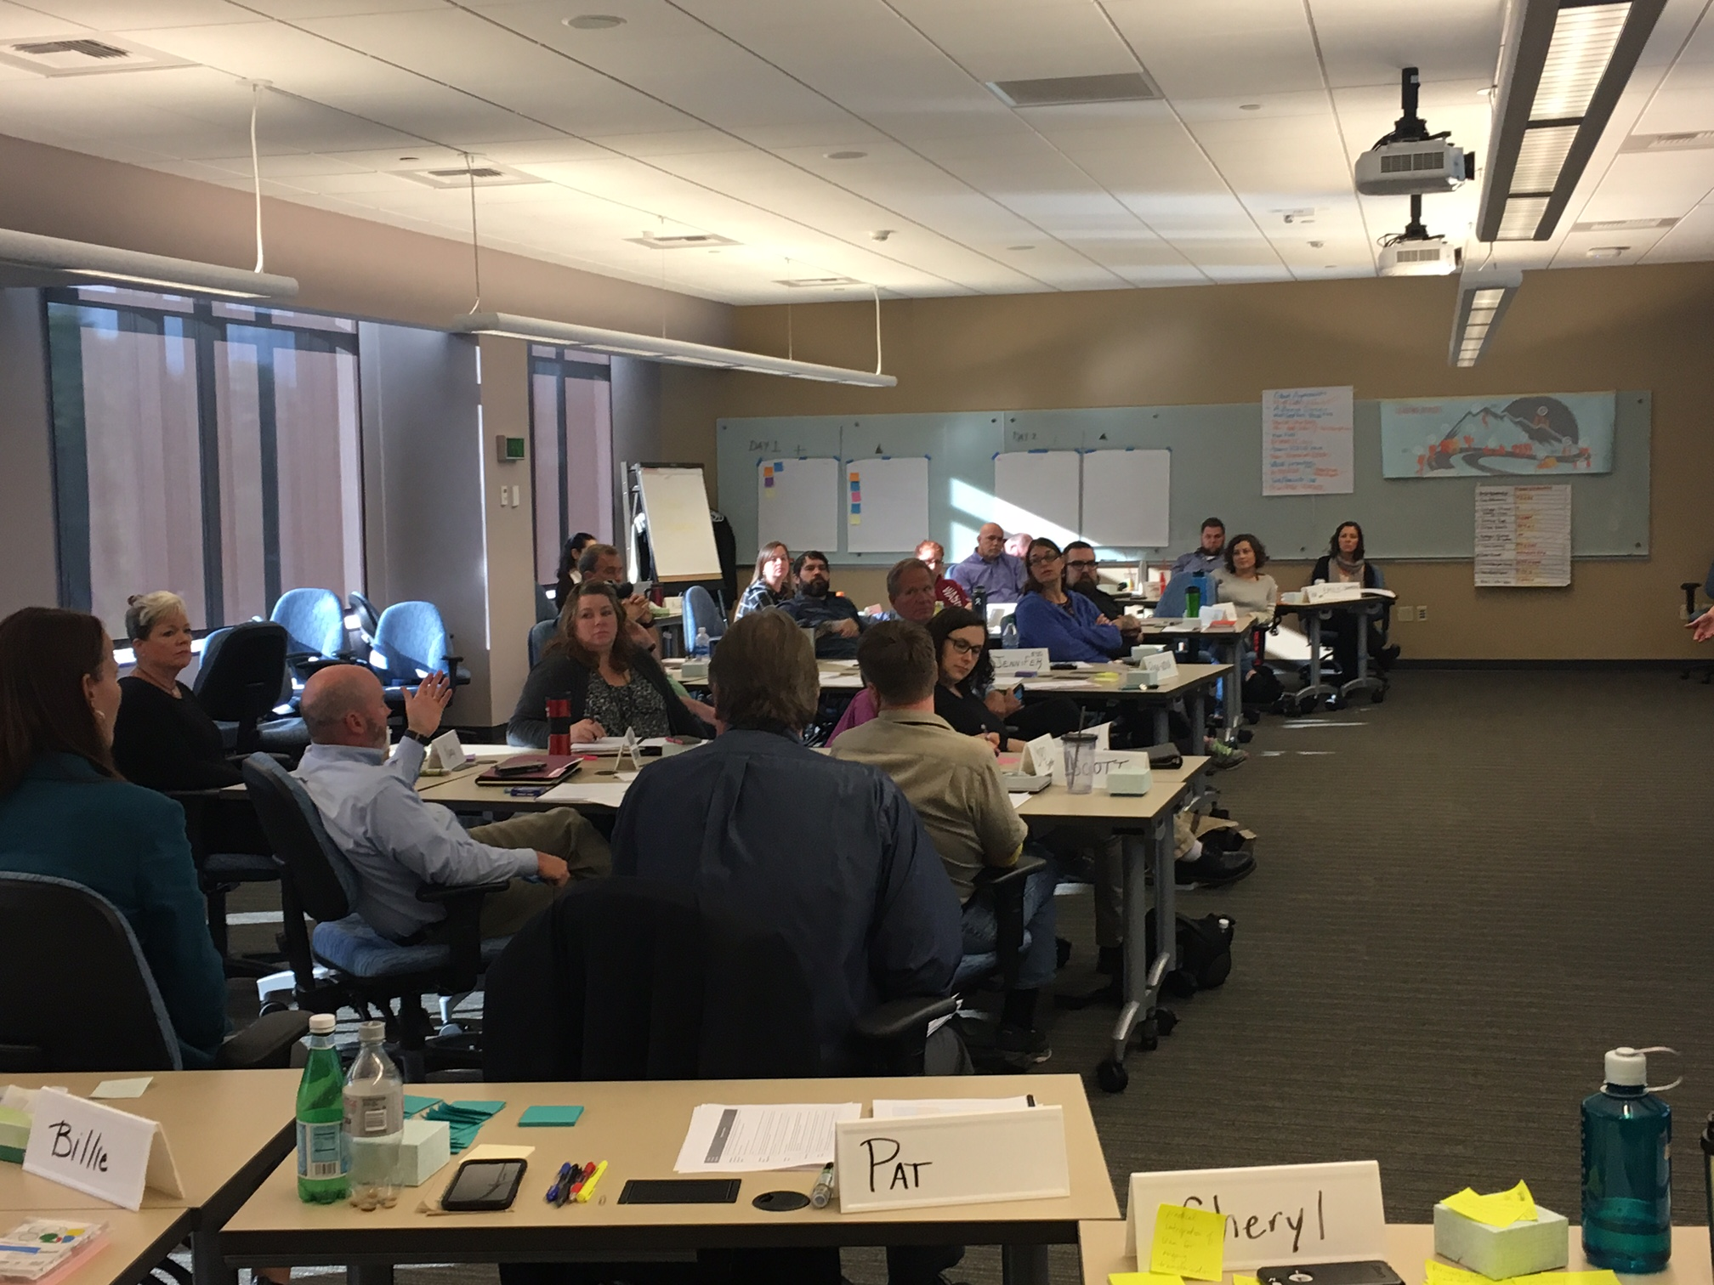
Classroom Layout
Notes:
This image shows how our classroom is typically arranged.
We have learners in pods of 4-6 people, so they can more easily network with and learn from each other.
During your time in the classroom, we’ll set up tables and chairs for you. You may walk around the classroom or join any of the pods, as you wish

Slide 14
THIS SLIDE IS FROM LEADING OTHERS COURSE
LEADERSHIP SCENARIOS
What eLearning topics may help?
Unlawful employment discrimination
Performance plans and reviews
Civil service rules and labor relations
Pay, leave and time
Hiring processes
Resolving performance issues
What steps will you take?
Who will you involve?
What tools and resources will help?
Etiam vitae dui congue, semper quam vitae, luctus ligula. Sed posuere nunc in leo commod else cuprum less. Etiam vitae dui congue, semper quam vitae. Etiam vitae dui congue, semper.
Sed posuere nunc in leo commod. Donec commodo fringilla mi, non dictum risus tempus ut. Donec quis auctor nisi, at rutrum metus. Morbi sed molestie nunc.
Notes:
The Leadership Scenarios are deliberately vague. They have far less information included than we have in “real life.” They don’t necessarily specify whether employees are represented or not, or how long specific situations have been occurring. This is because we want learners to think broadly about what kinds of questions they have about the scenario, what topics they might need to research, and what angles they may want to consider.
We ask the learners to identify whether any eLearning modules have a bearing on the scenarios. We also ask what steps they would take, who they would involve, and what tools/resources would help. The scenarios are not just about technical advice, but also about creating coaching moments for the new leaders to learn.
It’s helpful for the learners to hear that they should not ignore situations just because they’re challenging. They should consider the impact on teams as a whole.
Before you come to class, please take some time to review the Leadership Scenarios. The document available to you has the scenarios in black text. This is what the learners see.
The blue text on your document is not available to learners. It is a list of topics we hope the learners will talk about during their review. These ideas were identified by HR Professionals who assisted us in developing these scenarios.
If you have any questions about the scenarios or responses, please talk to your peers, or reach out to us directly at leadingothers@des.wa.gov.

Slide 15
Resources available to you
Electronic copies of:
Participant Guide (including Leadership Competencies)
Leadership Scenarios (including suggested responses)
eLearning modules
Partner HR SME
Other?
Notes:
When preparing for class, we hope you have an opportunity to review the Participant Guide and eLearning modules. Also, you may wish to take the opportunity to talk to your partner HR representative before class, or to other colleagues who’ve already assisted with Leading Others.

Slide 16
Summary of Key Takeaways
Thank you!
2:00 – 4:00 pm on day 3
Role:
deliver expert-level advice (not agency specific) to the Leading Others audience.
Consult the group towards successful outcomes and answer questions.
Notes:
In summary, your role in the classroom will be to deliver expert level advice to the Leader Others audience, and to coach the groups towards a successful outcome with the scenario.
Thank you again for taking the time to help us bring the next generation of Washington State leaders on board.

Slide 17
LEADING OTHERS
THE JOURNEY TO EFFECTIVE LEADERSHIP
THE POWERPOINT PRESENTATION
leadingothers@des.wa.gov

