Slide 1
Public Records DES SMALL AGENCY FINANCE
January 25, 2016

Slide 2
PRA…
…a strongly worded mandate for broad disclosure of public records.

Slide 3
…in 23 words
A public record is “…any writing containing information relating to government conduct prepared, owned, used, or retained by any state or local agency….”

Slide 4
OPEN GOVERNMENT…
TOOLS –
PUBLIC RECORDS ACT
OPEN MEETINGS
AGENCY COMMITMENT.

Slide 5
OPEN GOVERNMENT CONCEPTS
Agencies are more likely to be sued for withholding records than for what records actually contain. Antidote to secrecy is transparency Inertia complicates disclosure

Slide 6
Basics …
Public Records Officer
5 days to acknowledge
Fully assist requestor
Strictly comply
Liberal Disclosure
Limited Exemption

Slide 7
Basics …
Requestor- asks for records
Reason? not relevant
Identity? not relevant
Record holder- search and disclose

Slide 8
PUBLIC RECORDS PROCESS
5 days
Additional time
acknowledge
no records
request
respond
records
clarify
estimate
installment
Evaluate & communicate

Slide 9
Simple requests
simple
“…an electronic copy of all respondents’ proposals, including pricing, to the 05310 MPS RFP’s for Employment Security Department and the Department of Natural Resources.”
“…I just spoke to you on the phone and I wish to request all service records you can give me concerning this car vin # JTDKB22U553123099 also what price did this car sell for. Thank you so much for all your help.”

Slide 10
Complicated…
starts simple
complex
“…Under the Washington Public Records Act, §42.56 et seq., we are requesting to obtain copies of Hoffman Construction/Belay Architecture, Mortenson/SRG, and Sellen Construction/ZGF Architect’s submitted Request for Qualifications in response to 1063 Block Replacement Office Building (Project #2014-009 )…”
“…copies of Alliant’s written RFP response and evaluations of the Written Responses and Oral Interviews” related to RFP 13-600…”
“…We would also like to request copies of Wells Fargo Insurance’s written RFP response and evaluations of the Written Responses and Oral Interviews related to RFP 13-600-ACCO - Insurance Broker Services….”

Slide 11
Very Complicated……
complex
To each of the above named agencies; Pursuant to the Washington State Public Records Act (RCW 42.56 et seq and WAC 284-03-090 formerly 42.17 et seq), I request that the following records be made available for review and/or copying by myself and/or my designee. I request that these record(s) be made available as soon as possible within the five day time frame provided by law, and each request be treated independent and separate from any other such requests made by myself of your agency(s). For any documents you believe or claim to be exempt under this request, please list them with specificity so as ·to identify the document name and/or title, document date(s), names of all parties mentioned in the document, the document location and custody, document size (pages, kilobytes), document format (electronic, paper) and exemptions claimed as per RCW 42.56.210.

Slide 12
Very Complicated…
complex
Please make available for immediate review a full and complete copy of each and every electronic email record and Outlook electronic record in any way related to James D. Stanford. For clarification, James D. Stanford includes all spellings and abbreviations such as but not limited to James Stanford, J. D. Stanford, ALJ Stanford, Administrative Law Judge Stanford, ALJ James Stanford and J. Stanford, punctuation not withstanding. For clarification regarding email, this means every electronic email record complete with all email addresses, metadata and attachments sent by, received by, sent to or from, copied to or from, blind copied to or from or sent by, from or to using any and all email accounts used by James D. Stanford including any listserv that in any way related fo, referenced, copied to of from, blind copied to or from or made mention of James D. Stanford in any way or of any kind now held by or at any time past or present located on any computer system or filing system owned, leased, operated, maintained, used or controlled or for the use of, on behalf of or by the your agency for the dates January 1st, 2001 and all dates later up to and including the date on this request. For clarification regarding Outlook means Microsoft Outlook, Outlook Express or any similar contact management software and includes but is not limited to emails, tasks, notes, calendars, contacts, folder lists and journals. I hereby promise to pay the normal costs charged by your agency for CD-ROM's or DVD-ROM's. Please notify me by email (you may additionally use fax, regular mail or certified mail return receipt requested at your discretion in addition to email) as to when and where I can review these original public records requested an~/or related items during your normal business hours.

Slide 13
Very Complicated…
complex
Output Media Requested:
To be Earth Friendly, Environmentally Conscious and save agency resources, electronic media is requested. Paper records are to be avoided if at all possible. If cost of production is $50.00 or less no review or inspection is necessary, simply
produce and notify requester via email when ready for pickup (do not purposely delay notification by using USPS mail). If production is more than $50.00 then notify by email as to cost, when and where materials can be reviewed. electronic·or digital files 10 MB or less can be emailed and will be acknowledged by email. Send email records only in Outlook.pst format with all attachments, email addresses and meta data intact. Emails requiring redaction should be supplied Adobe Acrobat PDF format.
Notice:
You and each of you are hereby put on notice that the above requested electronic records are to be protected and shall not be disposed of, discarded, erased, damaged or in any other way infringed upon, marginalized or deleted. Recent eDiscovery federal law changes make you subject to sanctions and penalties for destruction of electronic records. For all correspondence, please reference my file number (also shown below and at bottom left corner of each page); 09-11-17 -PRA--Public-Records-Request-to--for-All-James-0-Stanford-Email-and-Outlook-Electronic-Records

Slide 14
Strict compliance or penalties

Slide 15
Why penalties?
Penalties:
Promote access to public records and government transparency.
Deter improper denials of access to public records.
Incentive to induce future compliance.
The court must consider entire penalty range set by legislature:
$0-$100/ record / day

Slide 16
Penalties
2013- (UW) $720,000 Fine for withholding 12,000 pages of public records from professor with EEOC complaint who believed she was wrongfully denied tenure.
2013- (L & I) Seattle Times wins Fees, Costs And Penalties Against L&I.

Slide 17
Penalty factors: (mitigating)
Unclear request.
Agency prompt response or legitimate follow-up clarification.
Good faith, honest, timely, and strict compliance with all PRA procedural requirements and exceptions.
Proper training and supervision of personnel.
Reasonable explanation for noncompliance.
Helpfulness of agency to requestor.
Public records tracking and retrieval systems.

Slide 18
Penalty factors (aggravating)
Delayed response, especially when time of the essence.
Lack of strict compliance with procedural requirements & exceptions.
Lack of proper training and supervision of personnel and response.
Unreasonable explanation for noncompliance.
Dishonesty, negligent, reckless, wanton, bad faith, or intentional noncompliance.
Potential for public harm, including economic loss, loss of governmental accountability or personal economic loss.
Penalty amount necessary to deter future misconduct considering agency size and the facts of the case.

Slide 19
MYTHS
Attorney – Client Privileged!
That’s private!
What the RCW meant..
That’s confidential
Always done it that way….
Drafts
“our” records
On my personal device…
Deliberative process!
Why do they need it?!

Slide 20
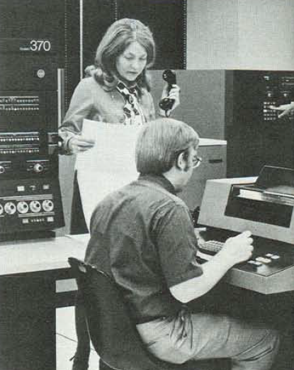
Electronic Records (70s)

Slide 21
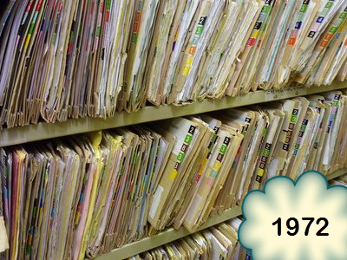
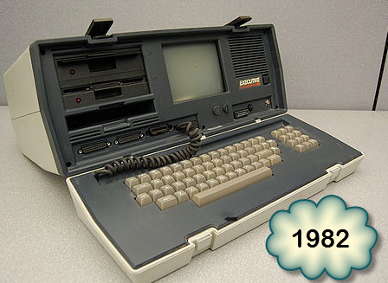
Public Records Everywhere
Since 1972 the paper public records that once only fit on a shelf…
Have become easier to create …
And forty years later are predominantly digital. They can be prepared, owned, used or retained by a computer in your pocket…
..or in a car

Slide 22
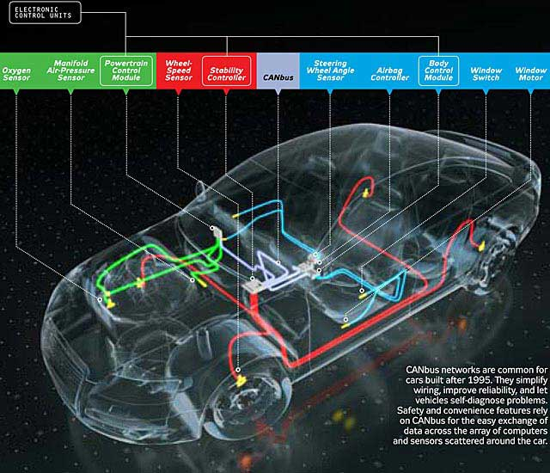
.. a computer in a car
… .. car computers coordinate and monitor sensors, components, the driver, and the passengers.
.. .. A typical luxury sedan contains over 100 MB of binary code in 50–70 independent computers communicating over shared internal network buses. (1)
GM OnStar:…automatic crash response, remote diagnostics, and stolen vehicle recovery over a long-range wireless link. (1)
In most 2014 cars, network-connected features provide driving directions, messaging, hands-free phone calls, safety monitoring, and entertainment (2)
Telematics is an example of this technology
Center for Automotive Embedded Systems Security
Ars Technica

Slide 23
PUBLIC RECORDS NOW

Slide 24
A RECENT PUBLIC RECORDS REQUEST TO OFM

Slide 25
September 8, 2015
Office of Financial Management
Washington State Office of Financial Management
To Whom It May Concern:
Pursuant to RCW Ch. 42.56 (Public Records Act), I hereby request the following records: A copy of the most recent database maintained by this agency detailing government employee compensation across the state.
I am specifically requesting that this release include, for each State employee, the following: Name of Employee, Age, Gender, Ethnicity, Job Title, Agency/department, City/location in which employee is stationed, and Earnings
…
Shane Snow
Filed via MuckRock.com
E-mail (Preferred): 20932-94998902@requests.muckrock.com

Slide 26
Who wants it?
Why do they need it?
I am specifically requesting that this release include, for each State employee, the following: Name of Employee, Age, Gender, Ethnicity, Job Title, Agency/department, City/location in which employee is stationed, and Earnings
I would also like to know what this person/business plans to do with my personal information.

Slide 28
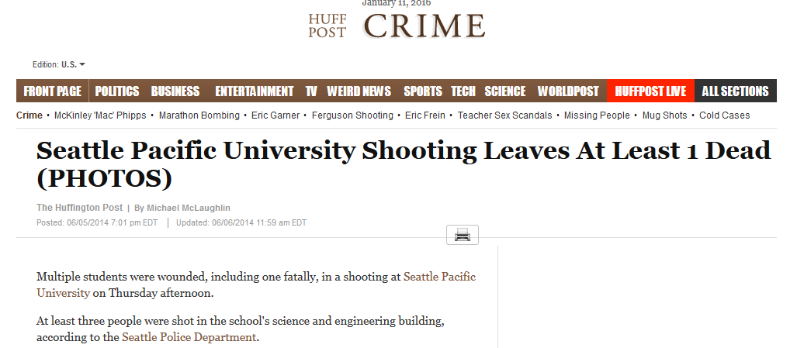
SPU PUBLIC RECORDS CASE

Slide 29
SPU surveillance cameras filmed June 2015 campus shooting
Media PRR
3 minute shooting video
20 hours video of shooter’s prior visits
SPU students objected …

Slide 30
3 minute video shows students and victims
Victims and witnesses objected to the release of entire 3 minute video.
Objection: Privacy Interest Protect identity
Solution -Students faces pixelated…
Court rejected Students' argument: entire 3 minute video should not be disclosed.
Washington courts have rejected attempts to withhold a record entirely where the record could be disclosed subject to redaction.

Slide 31
SPU Video also shows law enforcement and paramedics response
Court rejects greater redaction that would conceal student identity
..videos .. not taken in a private place such as a dorm room; … captured footage of areas of urban university campus. Under these circumstances, the Students do not have a protected right to privacy under the PRA

Slide 32
Nissen v. Pierce County text messages on personal cell phone

Slide 33
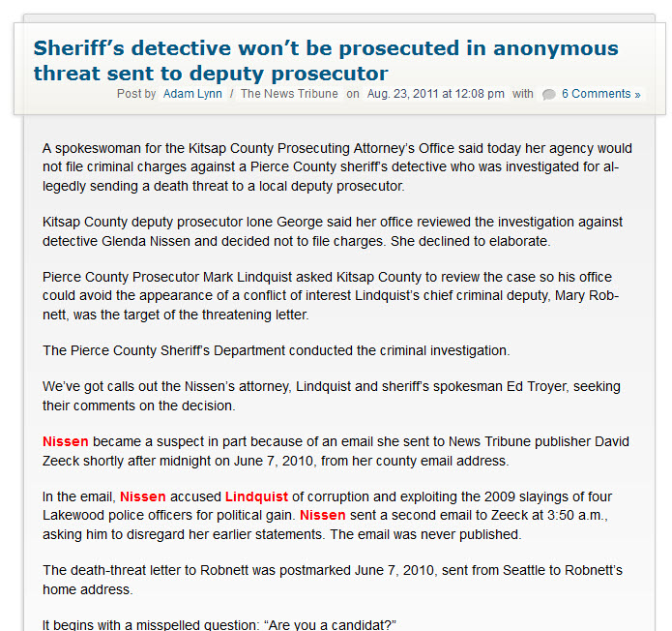
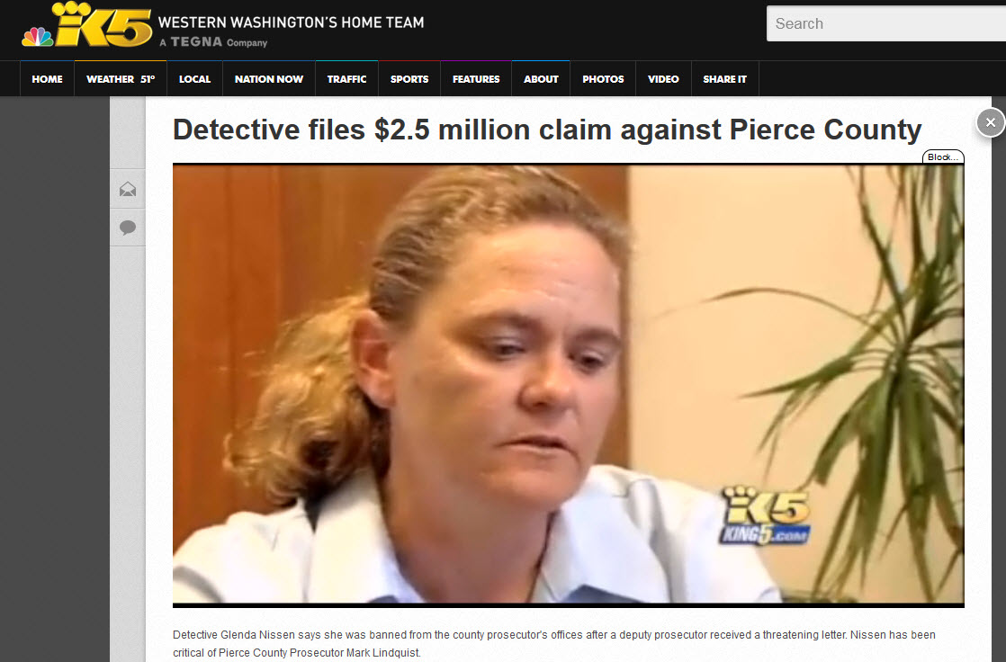
Long History

Slide 34
HISTORY : BACKGROUND
June / August/ Sept 2011- Nissen public records requests for records on Lindquist’s private phone
LINDQUIST Phone: Lindquist personally bought, paid for monthly and sometimes uses in course of job
LINDQUIST RECORDS: provides logs but not records revealing message content which Pierce Country and Lindquist admit “…might be work related…”
Almost half text messages Lindquist sent or received and many phone calls potentially related to his job as the elected prosecutor

Slide 35
HISTORY : PIERCE COUNTY ARGUES
Lindquist Records not public records … related to a personal cell phone rather than county-issued one.
Public employees can avoid PRA by using private cell phone, even if they use it for public business and even if the same information would be a public record had they used a government-issued phone instead
PRA controls agencies “.. does not expressly refer to individual employees as agencies

Slide 36
HISTORY – SUPREME COURT
Text messages sent and received by employee in employee's official capacity are employer’s public records even if employee uses a private cell phone
RECORD agency employee prepares, owns, uses, or retains in scope of employment is an agency record.
PRA does not support argument that only work product made using agency property is public record.
For information to be a public record, employee must prepare, own, use, or retain it within scope of employment.
Employee communication is "within the scope of employment" only when job requires it, employer directs it, or it furthers employer's interests.

Slide 37
Search Your Personal Device
Search files, devices, and accounts for records responsive to PRR.
Produce any public records to agency.
Agency proceeds as it would when responding to a request for public records in the agency's possession by reviewing each record, determining exemptions and disclosing the record to the requester.
If employee withholds personal records from the employer, employee must submit affidavit showing the information is not a "public record" under the PRA.

Slide 38
Text = Public Business?
Pierce County Prosecutor Mark Lindquist insisted that a text message wrote in 2011 to one of his employees had nothing to do with public business.
Employee disagrees and reveals text message:
“Tell allies to comment on TNT story.”

Slide 39
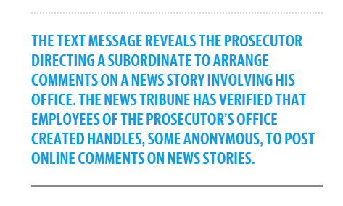
Robnett’s letter, obtained by public disclosure, is a stealth bombshell
It contradicts Lindquist’s recent sworn affidavit regarding the same text message.
“I do not believe any of these text messages were within the scope of my employment or have a nexus to the decision making process of the agency and are therefore not public records.”

Slide 40
Another view…
The private cell phone records of a public elected official or a public
employee are not public records. …. I believe that
[Lindquist] has a right to privacy as a valid exemption; … I do think that I have absolutely no power to require the third-party provider, without a search warrant application with probable cause, to disclose records.
… Whether or not [the PRA] violates the elected official or public official's constitutional rights, …, … just because you run for public office does not make you exempt in your maintaining of your right against search and seizure, either under the state constitution or the federal constitution, and that's my ruling.

Slide 41
Questions?

