Slide 1
FWPS Phase II CP18
Memorial Field Renovation
DB Presentation
September 23, 2021

Slide 2
Introduce - Our Team
Ashley Murphy – Chief Finance & Operations Officer
Michael Swartz – Executive Director of Capital Projects
Mike Benzien – Executive Director of Maintenance & Operations
David Beaudine – CBRE/Managing Director/DB Advisor
Delin Huang – CBRE/Project Manager
Jim Hansen – RJH Solutions LLC/DB Consultant
Notes:
Michael

Slide 3
Agenda
District Demographics
Team Qualifications
District Capital Program
District Capital Schedule
Memorial Field Budget
Project Details
Why use DB?
DB Benefits
Notes:
Michael

Slide 4
District Demographics
Notes:
Michael

Slide 5
Team Qualifications Project Team Structure
Owner:
Federal Way Public Schools
(FWPS)
Capital Project Team:
CBRE | Heery
Design-Builder
Notes:
Mike B

Slide 6
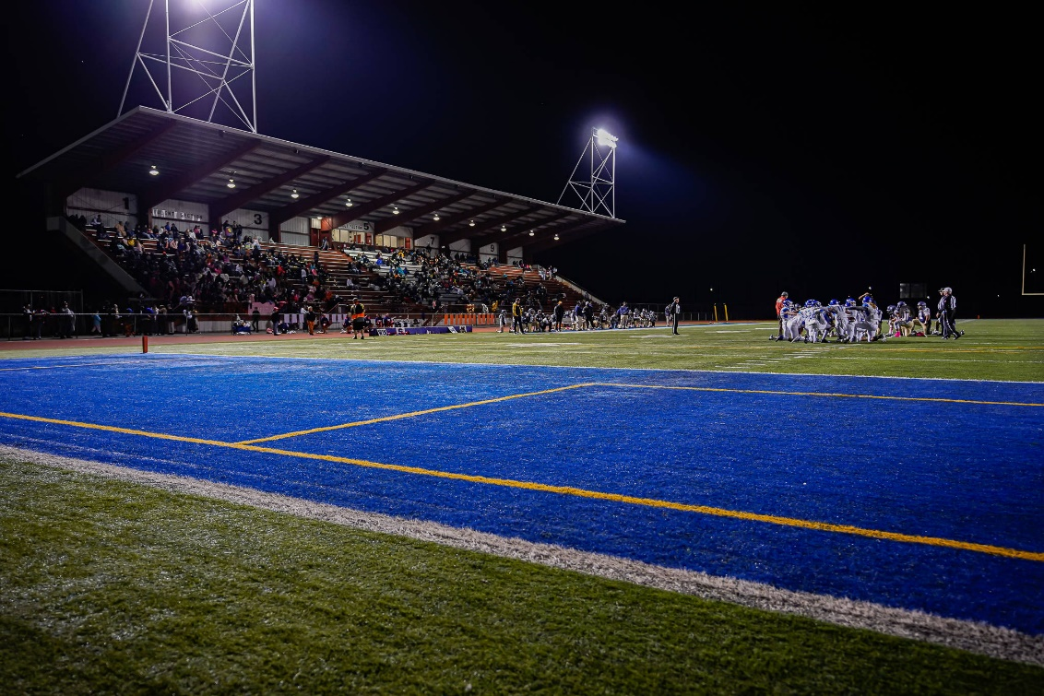
Team Qualifications - Owner
FWPS
Ashley Murphy: Chief Finance and Operation Officer – 12 Years Experience in Finance
Michael Swartz, Executive Director of Capital Projects – 28 plus Years Experience in Education
Mike Benzien, Executive Director of Maintenance and Operations – 32 Years Experience

Slide 7
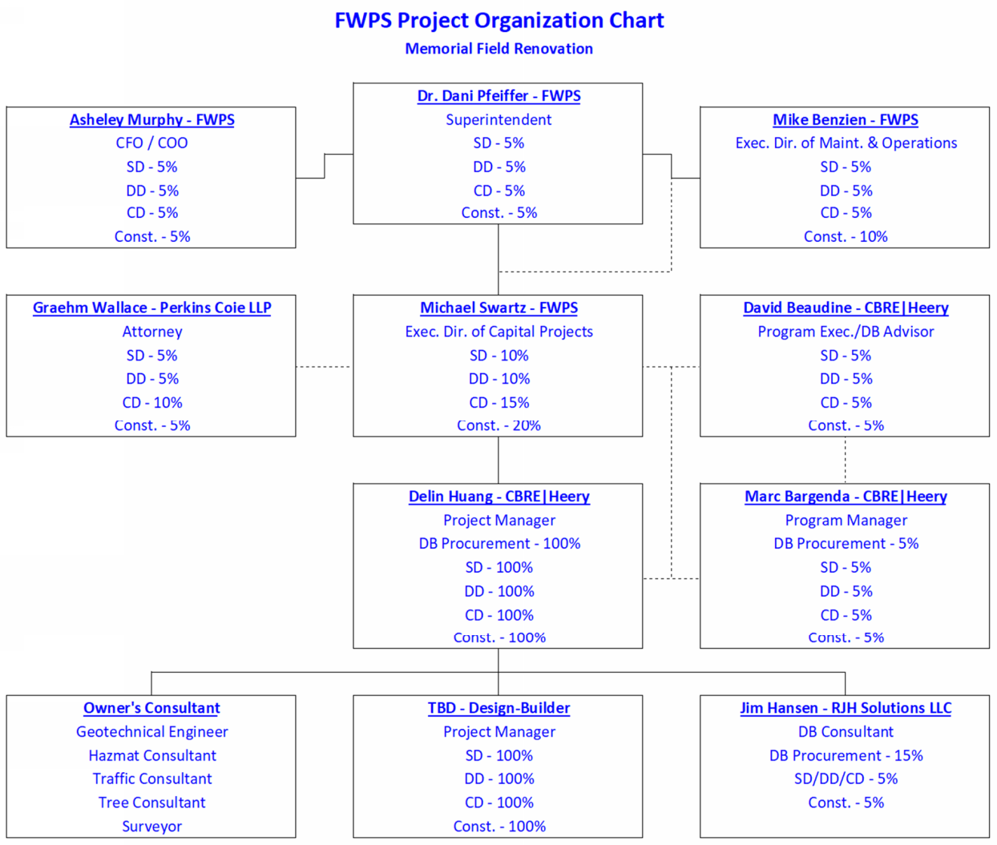
Team Qualifications Project Team Structure
Notes:
Mike B - Overview

Slide 8
Team Qualifications – PM Team
Delin Huang – Project Manager, CBRE|Heery
7 years of construction experienced
Has spent the last 2 years supporting the management of the Federal Way Public School projects
Licensed professional engineer
David Beaudine – Managing Director & GC/CM Advisor, CBRE|Heery
18 years of industry experience with majority working within Washington State K-12
Project Manager, Rogers and Ferris High Schools, in the Spokane School District
Most recently advising the West Valley Yakima, Mead and Puyallup School Districts on their current projects
Serves as CBRE | Heery’s Washington lead, as well as the company’s K-12 market leader for Washington
Recently was re-appointed as a member of the PRC
Provide guidance to the overall program related to best practices established and learned by the committee
Notes:
Michael introduces Mike K

Slide 9
Team Qualifications – Team
Marc Bargenda – Program Manager, CBRE|Heery
25 years of project management experience.
10 years in the k-12 industry
Marc’s experience include all types of project delivery methods: GC/CM, Design/Build, and Design-Bid-Build
He spent the last two years managing the construction of the new Thomas Jefferson High School for Federal Way Public School. The school opened on-time on September 1, 2021
Jim Hansen – DB Consultant, RJH Solutions LLC
47 years of construction experience.
Former Director of Construction and Planning for the Bethel Public Schools.
Under Jim’s leadership, Bethel Public Schools was the first public school district to utilize the Design-Build Project Delivery system in Washington State.
Notes:
Michael introduces Kris

Slide 10
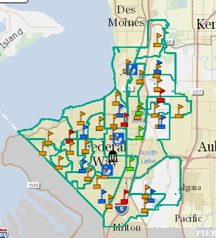
District Capital Program – Phase II
Star Lake ES
Memorial Stadium
Totem MS
Lake Grove ES
Thomas Jefferson HS
Olympic View ES
Wildwood ES
Illahee MS
Mirror Lake ES
Notes:
Sally – Michael backup, $450M bond, largest in history, involves these schools

Slide 11
District Capital Program Phase II Schedule
Notes:
Michael – focus on the current status, needs of schools in District, using GC/CM in current 6

Slide 12
District Capital Program – Memorial Field Renovation Budget
Notes:
Mike K

Slide 13
Memorial Field – Project Schedule
Notes:
Kris

Slide 14
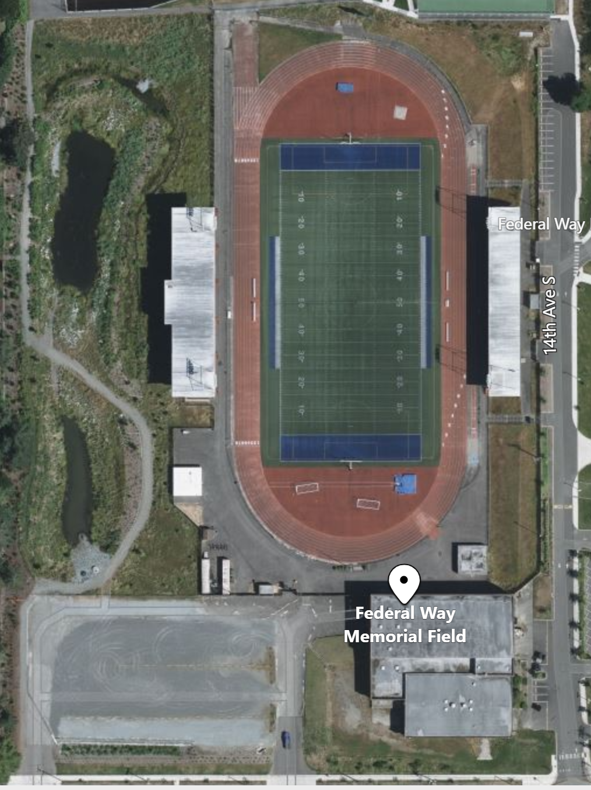
Memorial Field - Project Details
Replace existing grandstand bleachers to increase capacity from 3,800 to 4,300
Replace artificial turf and track surfaces
Replace supporting structures including entrances, ticketing booth, bathrooms, concessions, parking lot and etc.
Improve lighting, security, and technology infrastructure
Frontage and utility improvement as required
2626 SW 327th St
2626 SW 327th St

Slide 15
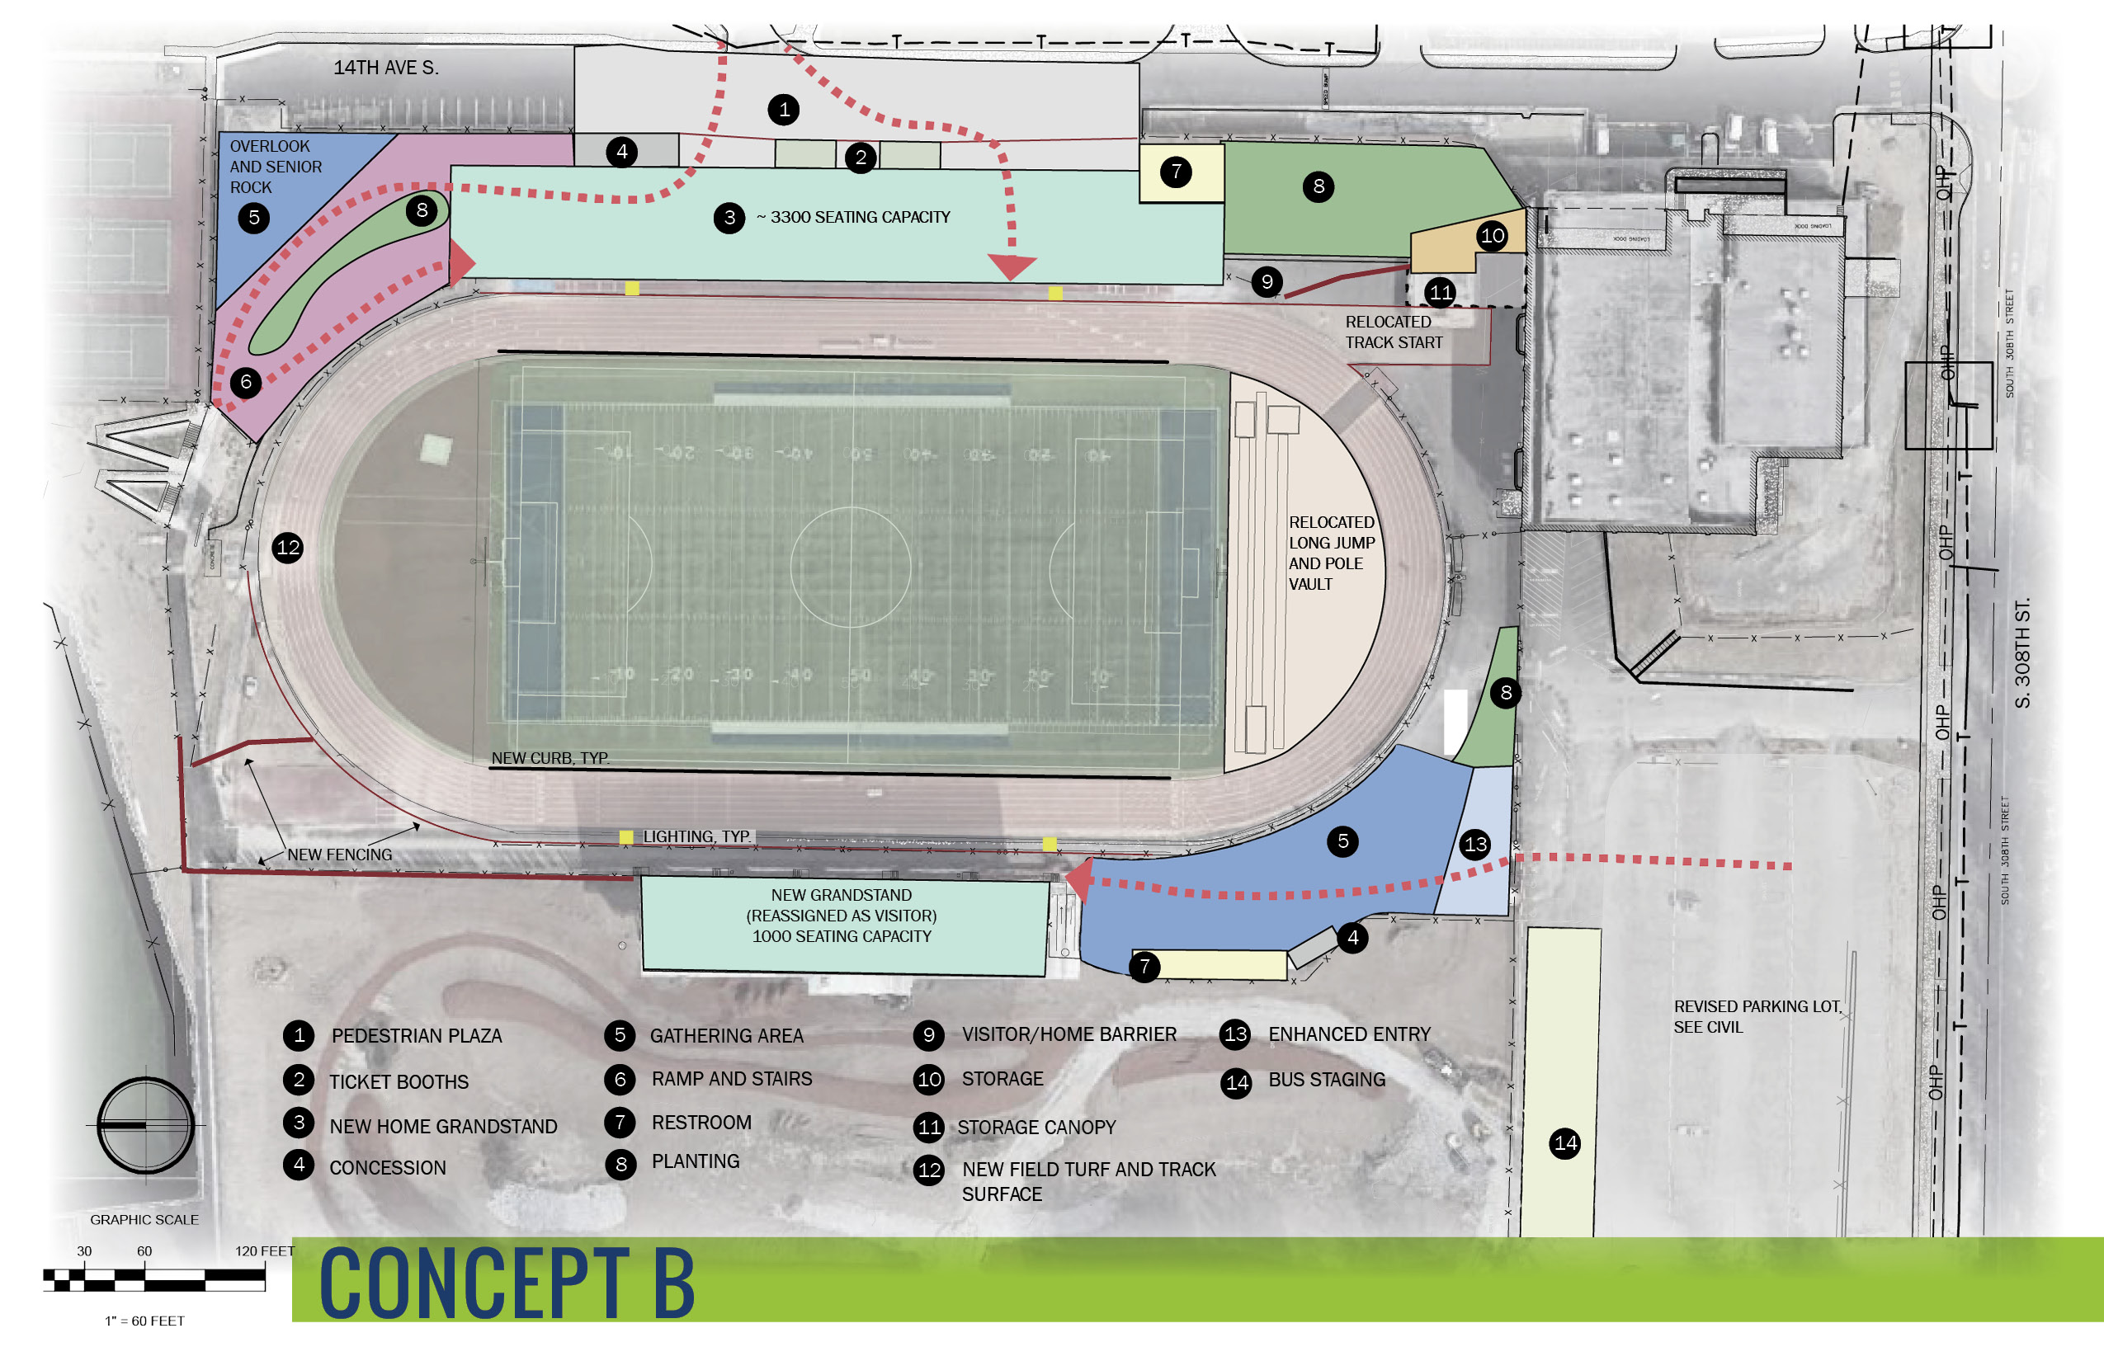
(ALTERNATE OPTION)
CONCEPT SITE PLAN

Slide 16
Why DB?
RCW 39.10.300
The projects selected provide opportunity for greater innovation or efficiencies between the designer and the builder
Early coordination with bidder-design elements
Minimize redesign after bid due to miscoordination
Early contractor input on site logistics and impact on neighboring Federal Way High School
Notes:
Mike K

Slide 17
Why DB?
The Project Involves Complex Scheduling, Coordination and Phasing:
The project mainly consists of bidder-designed-elements. It will benefit from early coordination with vendors and contractors that design and provide the bidder-designed elements to avoid redesign after bid
The District plans on improving the east frontage of the stadium, which is a main pathway into the neighboring Federal Way High School parking lot. Progressive DB will allow contractor to provide input on site logistics during the design process to minimize impact.
Notes:
Mike K

Slide 18
DB Benefits
Progressive DB provides the greatest predictability in cost
Last major project of bond program
Maximize value of remaining funds
Qualification based selection process
Design-builder’s approach to increase small, women, and minority-owned business participation will be part of the evaluation criteria.
Notes:
Mike K

Slide 19
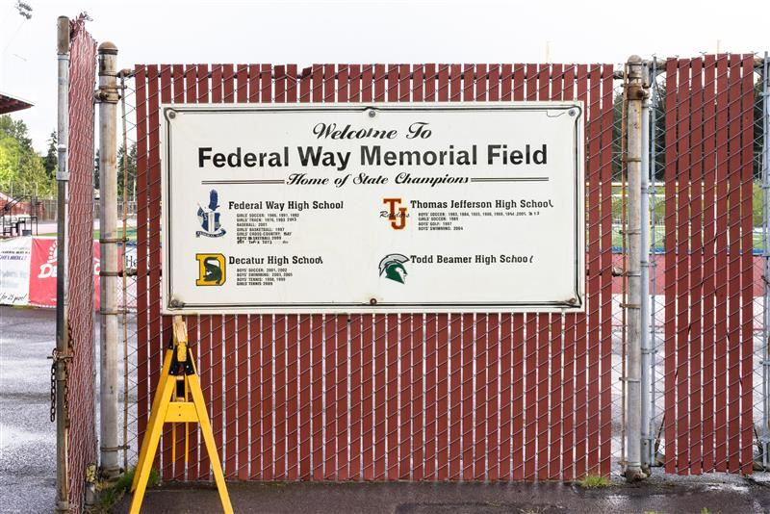
Questions & Answers
Notes:
Michael to call out

Slide 20
Thank you!!!

