Slide 1
CPARB Project Review Committee GCCM Project Application for Expansion and Modernization of Rochester High School
Rochester School District No. 401
Preparing Students for Lifelong Learning, Rewarding Careers & Productive Citizenship
Notes:
Good morning,
I’m Kim Fry the Superintendent of Rochester School District. I’ve served as an employee in RSD for the last 30 years, with the last 10 being in the role of superintendent. During my tenure, watched the district grow exponentially and have had the good fortune to participate in numerous construction projects ranging from small federally funded grant projects to being the planning principal during the planning, construction and occupancy of Rochester Primary School (A Design, Bid, Build project). My team and I are excited to be here today to talk with you about why we believe the GCCM is the best contracting method to use for the expansion and modernization of Rochester High School.
[ DEFINITION: GC/CM is collaborative project management involving early engagement of the contractor to work with the public owner/agency and design team in planning and executing a project to meet desired cost, quality, and schedule. ]

Slide 2
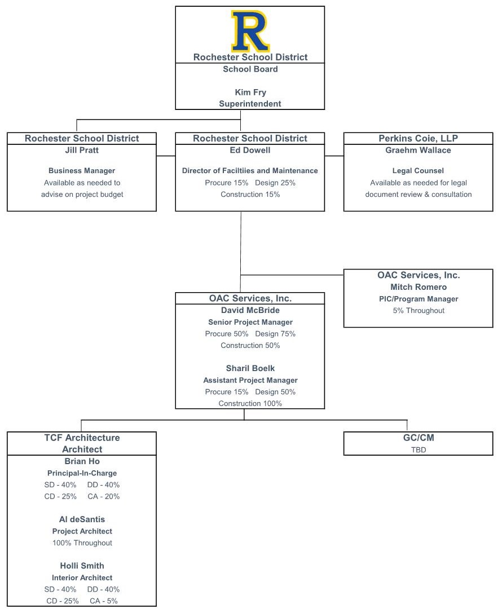
Project Team
Change from Application:
- Removed Anjie Collins (OAC)
- Increased David McBride’s (OAC) allocation
- Will supplement OAC team as-needed
- Al deSantis added to TCF team
- Changed Holli Smith’s (TCF) role
- Adjusted TCF team allocation
Preparing Students for Lifelong Learning, Rewarding Careers & Productive Citizenship
Notes:
We have a strong team of professionals that all believe the GCCM alternative project delivery method is the best option for the complex project we’d like to complete. As I introduce the members of our team, each will give you a brief glimpse into their background as it pertains to schools, construction and the GCCM process. [Introduce the RSD team first.] The district has also secured the services of Perkins Cioi, OAC and TCF.

Slide 3
District Overview
Located south of Tumwater and north of Centralia in unincorporated Thurston County
Current enrollment is 2,354 in (4) schools: RPS, GMES, RMS, RHS
District growth of 20% in last 20 years, with 30% growth at RHS.
Preparing Students for Lifelong Learning, Rewarding Careers & Productive Citizenship
Notes:
Being a school district in an incorporated community brings unique challenges and opportunities. Without a city government, parks department or other recreational facilities, RSD is lovingly referred to as the Heart of Community. Evidence of this is seen through the volume of community facility users we have on our campuses. RHS is in greatest demand, hosting over ______event in the last year.) We regularly host county town hall meetings, chamber of commerce events, scout and 4H meetings and youth sporting practices and competitions.

Slide 4
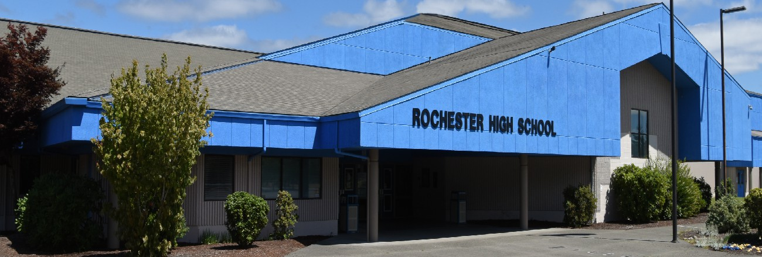
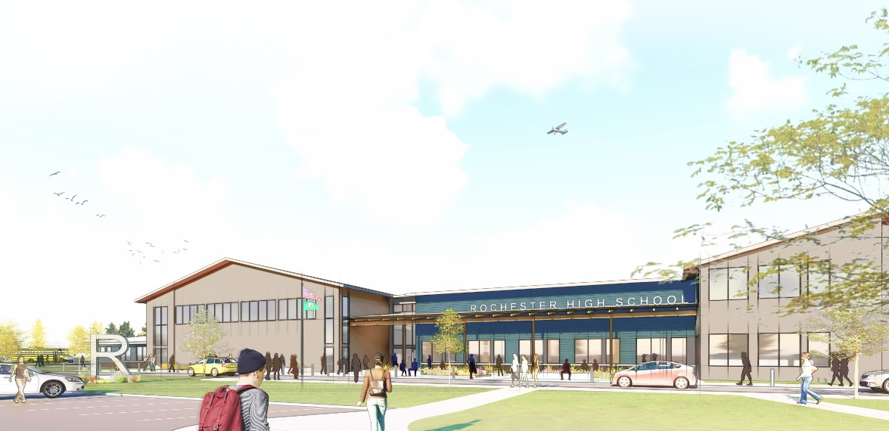
Project Overview
$57.49M Capital Bond Measure
$18.14M Expected SCAP
Bond Program:
Enhance Safety & Security at All Schools
Modernize & Expand Rochester High School
RHS was built in 1989; 50% of classrooms are in portables
Long Range Facilities Plan & Planning Committee
Bond Planning Committee & Conceptual Design
Preparing Students for Lifelong Learning, Rewarding Careers & Productive Citizenship
Notes:
On February 11th, our voters will be asked to pass a $57.49 million bond. The bond program has two main projects 1. Enhancing Safety & Security at all schools and 2. The expansion and modernization of RHS – The project for which we’re pursuing GCCM contracting method.
Our long range facilities plan, which set the priorities for our bond program, was facilitated by David McBride from OAC. David will now give you a brief overview of the planning process, and then Brian Ho of TCF will review the work he has lead in our district.

Slide 5
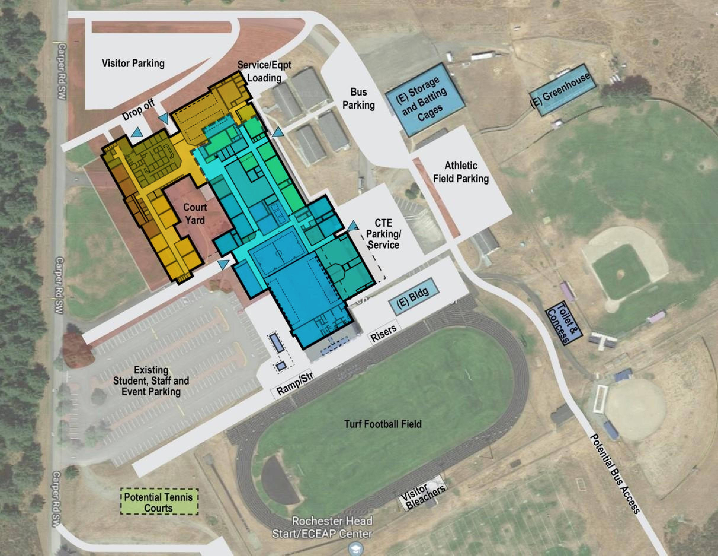
Project Conceptual Site Plan
Shared 77-acre site
Limited water rights
2-story classroom addition for 800 student capacity
CTE/Arts/Athletic improvements
Enhance safety & security
Relocate front entry
Separate bus and car traffic
Potential bus access
Design for phased implementation
Preparing Students for Lifelong Learning, Rewarding Careers & Productive Citizenship
Notes:
Brian

Slide 6
Why GC/CM is Appropriate
Rochester High School will remain occupied during construction
Construction cost uncertainty is high risk for single-project bond
Limited water rights for expansion and future needs
High risk for unforeseen conditions
District operations will be heavily impacted
GC/CM input at design will mitigate phasing impacts
System integration with expansion and modernization
Remote location will make attracting contractors difficult
Project involves complex scheduling, phasing and coordination.
Project involves construction at existing facility that must continue to operate.
Involvement of GC/CM is critical during the design phase.
Preparing Students for Lifelong Learning, Rewarding Careers & Productive Citizenship
Notes:
Ed

Slide 7
Project Budget and Funding
Costs for Professional Services (A/E, Legal etc.) $ 6,080,000
Estimated project construction costs (including construction contingencies) $48,900,000
Equipment and furnishing costs $ 2,800,000
Off-site costs $ 1,100,000
Contract administration costs (owner, cm etc.) $ 2,010,000
Contingencies (design & owner) – 8% $ 4,200,000
Other related project costs (permits, impact fees and utilities) $ 1,500,000
Sales Tax $ 3,950,000
Total $70,540,000
*Project funding is subject to the approval of $57.49M Bond measure on February 11th. The District has available funds in the Capital Fund to cover the costs of early Professional Services.
Preparing Students for Lifelong Learning, Rewarding Careers & Productive Citizenship
Notes:
Jill

Slide 8
Procurement and Project Schedule
GC/CM PROCUREMENT SCHEDULE
Activity | Date
PRC project presentation | 01/23/20
PRC Approval of GC/CM | 02/03/20
Special Election Day | 02/11/20
February 11, 2020 Vote Certification | 02/21/20
Advertisement of Request for Qualifications Published (1st Notice) | 02/24/20
Advertisement of Request for Qualifications Published (2nd Notice) | 03/02/20
Pre-Proposal Conference | 03/06/20
Statement of Qualifications Due | 03/13/20
SOQ Scoring and Short-Listing | 03/18/20
Notification to Short-Listed Firms with Draft Contract | 03/19/20
Interview Short-Listed Firms (Tentative) | 03/27/20
Notification to Most Highly Qualified Firms to Submit RFFP | 03/30/20
RFFP Submittal Deadline and Public Opening | 04/06/20
School Board Approve GC/CM Selection and Award Contract | 04/15/20
GC/CM Contract | 04/17/20
GC/CM Preconstruction Services | Apr-20
MACC Estimate/Negotiations | Apr-21
School Board Approval of MACC/GMP | Jul-21
DESIGN AND CONSTRUCTION SCHEDULE
Activity | Start | Finish
Architect Selection - Completed | Apr-19 | May-19
AE Consultant Selection | Jul-19 | Mar-20
Programming/Conceptual Design | Jul-19 | Mar-20
Schematic Design Phase | Mar-20 | Jun-20
Design Development Phase | Jun-20 | Oct-20
Construction Documents Phase | Oct-20 | Apr-21
Permitting | Aug-20 | May-21
Bid Package/Bid Phase | Mar-21 | Apr-21
Construction Phase | May-21 | Aug-23
Substantial Completion | Aug-23 | Aug-23
Occupy New Building | Aug-21 | Sep-23
Final Completion | Aug-23 | Nov-23
Warranty Phase | Aug-23 | Aug-24
Preparing Students for Lifelong Learning, Rewarding Careers & Productive Citizenship
Notes:
David

Slide 9
Summary
Meets (3) of the listed criteria from RCW 39.10.340
RSD has performed due diligence in planning for the project
Appropriate funding and contingencies have been established
Approval of GC/CM contracting procedure will provide substantial fiscal benefit to the public
Project Team has the necessary experience to successfully implement the GC/CM delivery method
GC/CM involvement during design and phase planning will ensure student and staff safety and limit operational impact to RHS
Preparing Students for Lifelong Learning, Rewarding Careers & Productive Citizenship
Notes:
I understand that while we only need to meet one of the criteria listed in the RCWs, we meet three.
As Jill mentioned we’ve taken great care to due our due diligence to reduce the changes our limited budget won’t be dwindled away on unexpected obstacles.
The majority of this bond program is locked up into one project that is going to require us to minimize risk by controlling costs. This projects takes us near to our debt capacity.
The complexity of this project makes the ability to gain input from the general contractor during the design in order to finalize a feasible, cost effective and quality project that can meet our established timelines is highly desired.
Our team members from OCA, TCF & Perkins Cioi have GCCM experience,
and above all else the GCCM process will allow us to have a longer and stronger partnership with our general contractor to enable us to plan for student safety from the onset and strategize together for ways to allow school to occur on-site during the construction process with the limited disruption.

Slide 10
Thank You!
Questions & Answers
Preparing Students for Lifelong Learning, Rewarding Careers & Productive Citizenship

