Slide 1

Roadmap for Improving
Small & Minority-, Women- and Veteran- Owned Business Participation in State Contracting
April 18, 2017
Chris Liu, Director
Department of Enterprise Services
Presenter:
Rex Brown, Administrative Director
Business Diversity Subcabinet
Department of Enterprise Services

Slide 2
Contact Info:
Chris Liu, Director
Department of Enterprise Services
Desk: 360.407.9201
Cell: 360.628.0058
Chris.Liu@des.wa.gov
Rex Brown, Administrative Director
Business Diversity Subcabinet
Department of Enterprise Services
Desk: 360.407.7926
Cell: 360.763.2744
Rex.Brown@des.wa.gov

Slide 3

Where We are Now: Velocity (Phase 2)
Speed with a direction

Slide 4
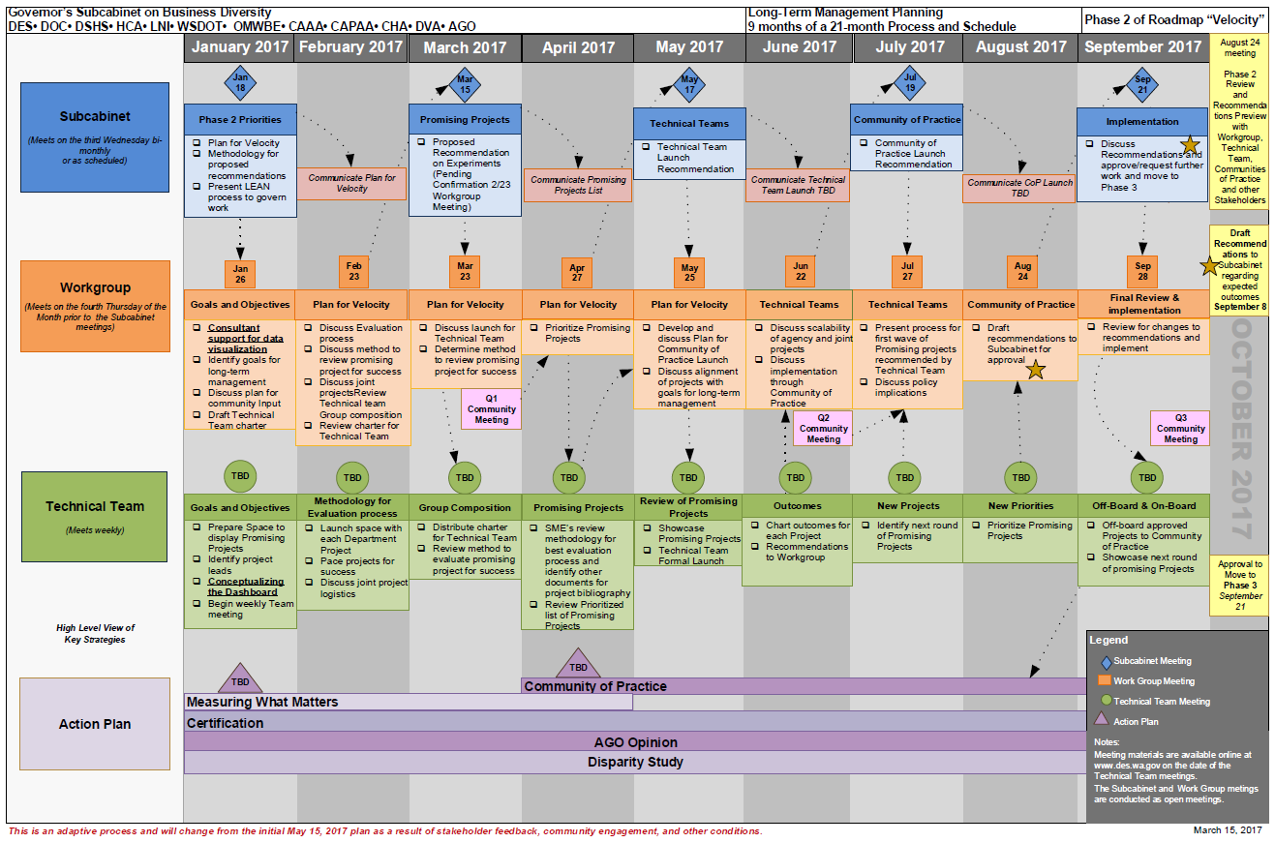

Slide 5

What the Public Wants:
Measurable and enduring results
Practical and sustainable solutions
Accountability and transparency

Slide 6

Achieving What the Public Wants
Through Technical Teams
The most important thing the Subcabinet is interested in is outcomes for our customers.

Slide 7






Our Technical Teams
Measurement
Framework
Improved
Certification
Technical Assistance
Diversity Culture &
Framework
Community of
Practice (CoP)
Engagement and
Assistance CoP
AGO Opinion Disparity Study
Legal Framework on a Parallel Path

Slide 8
Questions and Answers
Thank You!

