Slide 1

DES Small Agency Support
Diverse Business Participation
Presented by Servando Patlán
Business Diversity & Outreach Manager
Tuesday April 7, 2016

Slide 2
Small Business First Handshake
Dear Mr. Forrest Gillette, it was good to see you at the conference.
Please use this link http://www.des.wa.gov/services/ContractingPurchasing/Business/Pages/default.aspx to set your firm up in WEBS and to receive payment from the state of Washington.
Please use this link https://fortress.wa.gov/ga/apps/ContractSearch/ContractSearch.aspx to view the various state professional services master contracts that you may want to become a part of and contact the listed contract administrator for information about the next bid opportunities for contracts of interest to you.
Best wishes for success in your new business.
Sincerely,
Servando Patlán, Business Diversity & Outreach Manager
Servando.Patlan@des.wa.gov Phone 360-407-9390
Contracts Procurement & Risk Management Division of The Department of Enterprise Services
This email may become a public record

Slide 3
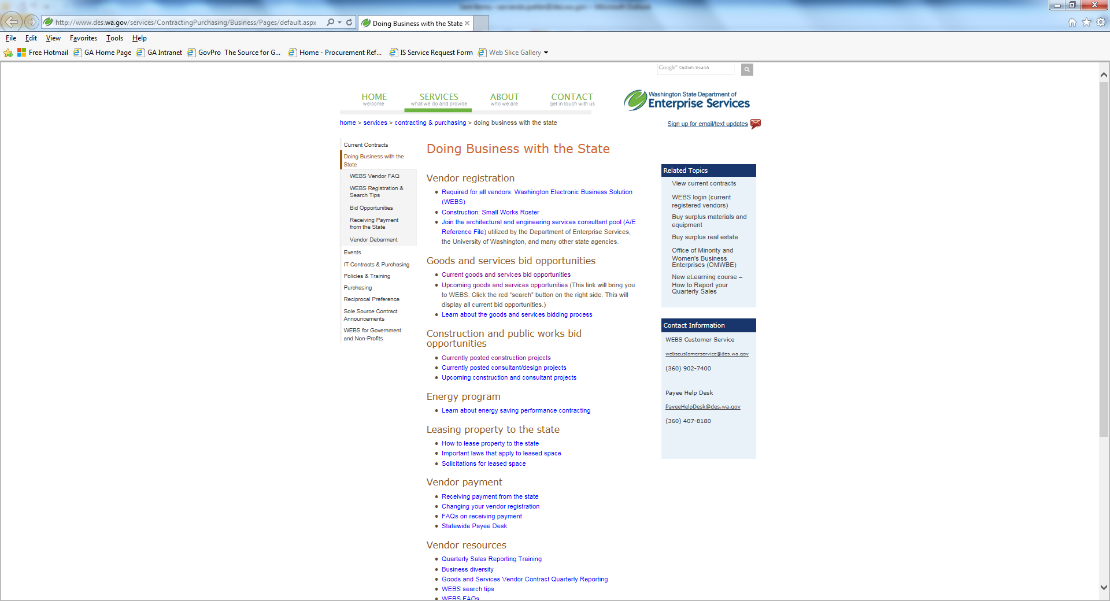
Small Business First Handshake http://www.des.wa.gov/services/ContractingPurchasing/Business/Pages/default.aspx

Slide 4
Small Business Second Handshake
Dear Mr. Forrest Gillette, thank you for submitting your proposal to the state of Washington. The agency has announced your firm is the apparent successful vendor, pending debriefing conferences, protest periods, and confirmation of your active vendor payment record in the state’s vendor payment system and confirmation of your firms active record in WEBS.
Please use this link http://www.des.wa.gov/services/ContractingPurchasing/Business/Pages/default.aspx to set your firm up in WEBS and to receive payment from the state of Washington.
Please use this link https://fortress.wa.gov/ga/apps/ContractSearch/ContractSearch.aspx to view the various state professional services master contracts that you may want to become a part of and contact the listed contract administrator for information about the next bid opportunities for contracts of interest to you.
Best wishes for success in completing pending agreement to proceed with the statement of work.
Sincerely,
Servando Patlán, Business Diversity & Outreach Manager
Servando.Patlan@des.wa.gov Phone 360-407-9390
Contracts Procurement & Risk Management Division of The Department of Enterprise Services
This email may become a public record

Slide 5
Small Business Says No to WA State Business
Cash flow is critical to small business success
WA State is perceived as a slow pay
WA State is perceived as a purchase-card only customer that includes Visa Interchange Fees that eat into small business profit margins.

Slide 6
Help Small Business Say Yes to WA State Business
Benefits of e-payment/direct deposit?
Improves cash flow critical small business success
WA State is perceived as a fast pay
WA State offers an alternative to purchase-card associated Visa Interchange Fees to improve small business success

Slide 7
Diverse & Small Business AFRS Reporting
e-payment preserves vendor detail in financial reporting
E-payment TIN match to WA State Diverse Business Databases
WA State is perceived as small business friendly
WA State Agency baseline for WA small and diverse business utilization plans

Slide 8
Washington Diverse Business Participation Reporting
http://omwbe.wa.gov/diversity-reporting/
Find your agency’s aspirational Diverse Business Participation Plan
Run your Agency’s AFRS Diverse Business Participation Report
http://omwbe.wa.gov/governor-business-diversity-initiative/
Governor’s Business Diversity Initiative

Slide 9
WA State Small Business Liaisons http://www.oria.wa.gov/site/alias__oria/publications_business_publications/433/business_publications.aspx
Diverse Business Contacts | WA State Agency: | e-mail: | Phone:
Servando Patlán | DES Small Businesses | servando.patlan@des.wa.gov | 360-407-9390
Erin Lopez | DES Small Businesses | erin.lopez@des.wa.gov | 360-407-8010
Jennifer Montgomery | DVA Veteran Businesses | Jenniferm@dva.wa.gov | 360-725-2169
Lawrence Coleman | OMWBE Minority Businesses Woman Businesses | Lawrencec@omwbe.wa.gov | 360-664-9759

