Slide 1
Design-Build Delivery
Robynne Parkinson
Thaxton Parkinson pllc

Slide 2
Traditional Design-Bid-Build Project
Owner
Contractor
Architect
Trade Subs
Trade Subs
Trade Subs

Slide 3
Liability Gap in Design-Bid-Build
Warranty
–Strict Liability–
Professional
Negligence
The Liability Gap
OWNER
GEOTECH
CONSTRUCTOR
DESIGNER
SUBCONTRACTORS
SUBCONSULTANTS

Slide 4
Design-Build Basic Structure
Owner
Professional
Subconsultants
Suppliers
Design-Build Consultant
Design-Builder
Trade Subcontractors
Design-Build Subcontractors

Slide 5
Benefits of Design-Build
Performance warranty from design-build team.
  Insures project quality
Ability to select team based on qualifications rather than price.
Faster delivery.
Fewer claims.
Able to fully utilize most advanced design and construction techniques.
  BIM
  Lean Construction
Knowledge and guarantee of project cost earlier than any other delivery model.
Notes:
Performance: Albro question in 3/11 mtg: “High Value Performance” connection time
Gregoire 3/11 mtg: How do we measure value?
Claims: Albro Service Tunnel: “Unknowns”
Bowman: Avoiding surprises like the Cell Phone Lot increase in cost
Budget: Gregoire: Measuring value
Creighton: At what point do we “go out for construction” Note self performance restriction

Slide 6
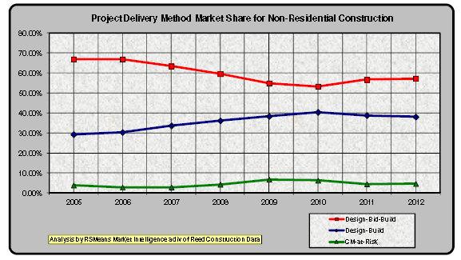
Design-Build Market Penetration

Slide 7
2012 Municipal Owners Satisfaction Survey of Water Design-Build Projects
Source: Water Design-Build Council; used with permission
155 Responses from 15 States
Asked about use of and satisfaction with Design-Build and CMAR
42% of survey respondents used progressive design-build
91% state that they will use alternative procurement again.
89% state that the use of innovative ideas in alternative procurement saves money and time and improves quality.

Slide 8
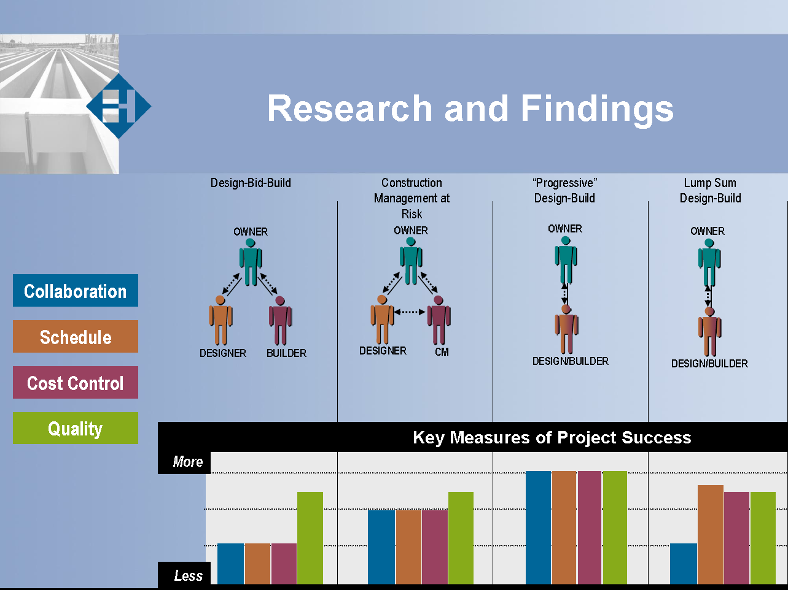
Success in Water/Wastewater Projects
Source: WDBC/Haskell Construction used with permission

Slide 9
Federal Highway Administration
2006 Design-Build Effectiveness Study
14% shorter duration
3% cost savings
No change in quality
“Significantly lower cost and fewer claims for design-build projects reflect a fundamental shift in transportation construction contracting. The less adversarial atmosphere bodes well for this procurement method, particularly for high visibility projects where cooperation between project owners and their design and construction contractors is essential to project success.”

Slide 10
Design-Build in washington
Approval by the Washington State Project Review Committee
Public body must show:
  Public body has personnel or consultants who are experienced in the delivery method
  Public body has an achievable plan for the project
  Project is over $10 million or is a pilot project between $2 and $10 million
  Project meets the statutory requirements for design-build
    The construction activities are highly specialized and a design-build approach is critical in developing the construction methodology; or
    The projects selected provide opportunity for greater innovation or efficiencies between the designer and the builder; or
    Significant savings in project delivery time would be realized.

Slide 11
Types of Design-Build
Bridging Documents
Design Competition
Progressive Design-Build

Slide 12
Bridging Documents
Owner develops design to approximately 30%
Design-Builder relies on the design for the purposes of pricing
Owner selects based on experience and price
Benefits
  Price established at procurement
  Owner involved in the design throughout the project
Detriments
  Longer time to prepare procurement
  Owner is responsible for the cost if the bridging documents do not accomplish the performance requirements
  Design-Builder restricted on innovation
  Most expensive for the Owner

Slide 13
Managing Risk: Bridging
Owner selects competent bridging designer
Validation Period:
  Thorough review of bridging documents to verify that documents are sufficient to build project
  Owner reserves contingency to manage changes at the conclusion of the validation period
Priced using both Guaranteed Maximum Price (GMP) and Lump Sum
Design-Builders include contingency in price and fee to account for risk in estimating the project early

Slide 14
Design Competition
Owner puts together performance requirements for the project
Shortlisted Finalists (usually 3) provide designs to schematics and cost
Owner selects based on experience, design ideas and price
Benefits
  Price established at procurement
  Owner gets to select between several different design ideas
Detriments
  Most expensive for design-build teams, particularly designers
  Less competition
  Owner not involved in the design until after schematics

Slide 15
Managing Risk: Design Competition
Owner selects Design-Build teams who are experienced in design competitions
  Requires heavy early collaboration and experience in conceptual estimating
  Most risk to Design-Builder
  Design-Builders put contingency in both the price and fee to account for the potential that the designers miss elements of the design and for estimating the price early
Priced using Guaranteed Maximum Price (GMP)
Incentivize Design-Builders to come in under GMP
  Savings
  Performance

Slide 16
Progressive Design-Build
Owner issues program describing the performance characteristics of the project
There is no design at the procurement stage
Owner selects based on experience, management plan and price element (usually fee)
Benefits:
  Fastest procurement and least expensive method because no designs required from Design-Builder or Owner
  Owner has input in the design throughout the project
  Design-Builder has more responsibility for the design
Detriments:
  Price not established until after procurement

Slide 17
Progressive Design-Build: Managing Risk
Validation/Proposal Development Period
  Subject to a guaranteed Not To Exceed amount
  Design-Builder verifies Owner provided information
  Design-Builder and Owner collaborate to develop final scope
  Deliverables From Design-Builder:
    Contract Price and Schedule
    Final Scope
  Contract Amendment with commercial terms
Notes:
Performance: Contract terms phrased in terms of meeting performance requirements
Cost: Robust cost accounting/Third party validation
Anyone who tells you they can price a project at this point is lying.

Slide 18
Progressive Design-Build: Managing Risk
Contract Execution Period
  Design-Builder completes design and constructs the project
  Design-Builder must meet the schedule and price
  The Owner’s engineer will oversee testing

Slide 19
Contract Protections
Design-Builder will always be subject to a Not to Exceed ceiling.
Design-Builder will be required to provide designs consistent with the agreed project scope and budgets.
Design-Builder provides robust financial and project information, including weekly updates on budget and schedule.
With a GMP, the Owner has the right to audit the Design-Builder’s books.
The Design-Builder collaborates with the Owner to determine final scope, schedule and cost.
The Owner incentivizes the Design-Builder to manage performance.

Slide 20
Design Excellence
DBIA Definition:
Memorable design solutions that exceed the Owner’s vision and defined functional requirements, include state of the art structures and facilities that are high performance and sustainable, and possess a holistic awareness that considers context, site and the environment.

Slide 21

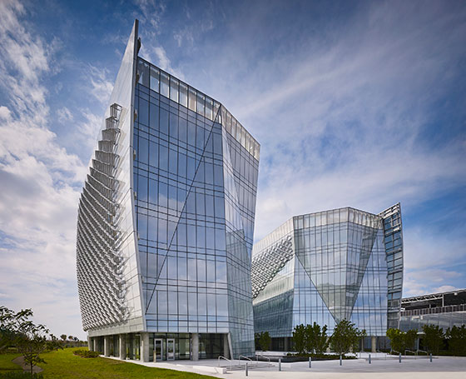
Merage School of Business
University of California, Irvine
Benjamin P. Grogan and Jerry L. Dove
Federal Building
Miramar, FL

Slide 22

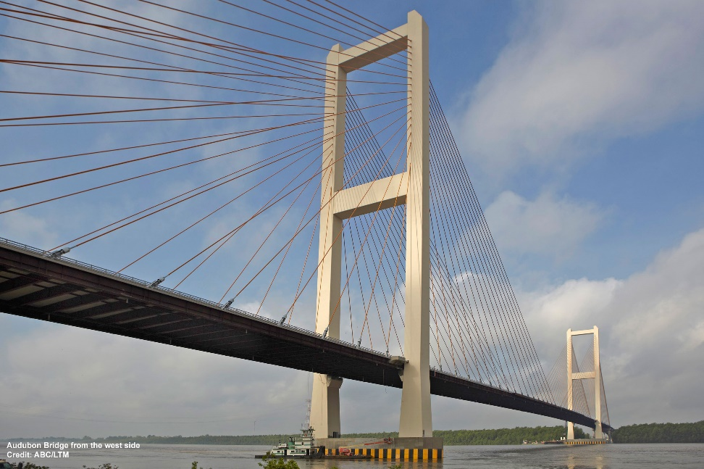
Denver Union Station
Transit Improvements
John James Audubon Bridge
New Roads, LA

Slide 23

Thaxton Parkinson PLLC
Robynne Parkinson is a Seattle based lawyer and a leading expert in construction law and alternative procurement both in Washington State and on a national basis. She served on the National Design Build Institute of America Board of Directors from 2010 – 2017 and currently serves on the American Arbitration Association National Construction Dispute Resolution Committee. In addition, she is the vice chair of the DBIA National Education Committee, is a past chair of the DBIA National Legal and Legislation Committee and is instrumental in revising the DBIA form Design-Build contracts and subcontracts. She served as the President of the Northwest Region for DBIA from 2008 to 2010 and continues on its Board of Directors. Robynne is AV rated by Martindale-Hubble, and named as a Washington Super Lawyer in 2010-2017. Robynne received her undergraduate degree from the University of Texas at Austin and her law degree from the University of Colorado, Boulder School of Law.
Robynne has represented public owners on a number of design-build projects, and her clients include the Port of Seattle, Los Angeles County, the State of Hawaii, and the Cities of Tacoma, Spokane, Richland, Airway Heights, and Liberty Lake.
9311 SE 36th St., Suite 103
Mercer Island, Washington 98040
(206)909-5290
www.rtp-law.com
www.designbuildlaw.blogspot.com
e-mail: rparkinson@rtp-law.com.com

