Slide 1


Meet DES
Delegated Contracting Authority
Curtis Pate
Roland Orr
Engineering & Architectural Services
Notes:
Pick a logo for the main page of your presentation. Delete the other logo.

Slide 2
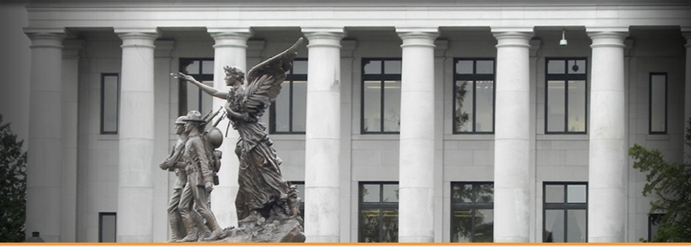

E&AS Contracts on Behalf of the State
…for new construction, repair, or alterations of state facilities in accordance with state public works laws.
(RCW 43.19.450)

Slide 3
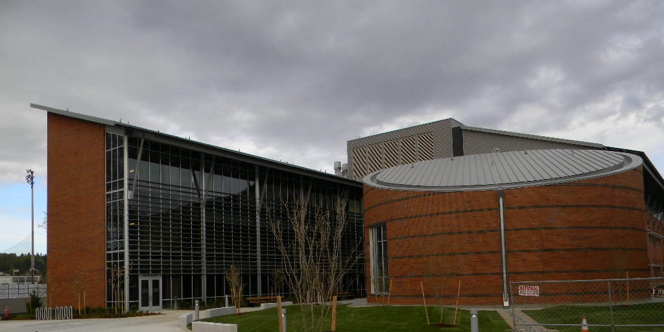
DES May Delegate to Clients
…any portion of its construction public works authority, to any agency, upon such terms and conditions as considered advisable by the Director of DES
(RCW 43.19.450)

Slide 4

Limited Public Works Authority
< $35,000 Construction costs
Single Project Authority
Blanket Authority – multiple projects
  For a stated period during a biennium
Bids solicited from Small Works Roster

Slide 5
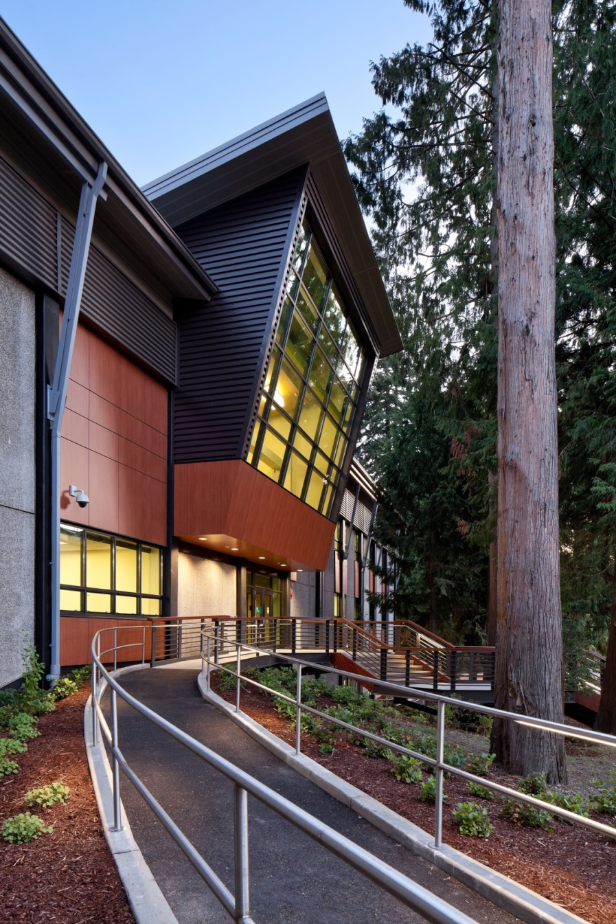
Partial Public Works Authority
< $300,000 Construction costs
Single Project Authority
Blanket Authority – multiple projects
  For a stated period during a biennium
Bids solicited from Small Works Roster

Slide 6

Delegating Authority is Based on:
Making Formal Request
Attending training
Accepting responsibility
Complying with laws
Building or property is state-owned
Capability, Competence, and
staff resources to manage such projects

Slide 7
Delegated Authority Letter:
…will be issued to each agency for which the authority is granted. The letter will stipulate the basic terms and notify the agency that E&AS may audit the agency’s contract files.
E&AS Contracts Specialists will write the contracts for the delegated agencies.

Slide 8
Limited Public Works Authority
A letter delegating the Public Works Authority for LPW will be issued to each agency for which the authority is granted. The letter will stipulate the basic terms and notify the agency that E&AS may audit the agency’s LPW contract files.
Notes:
A letter delegating the Public Works Authority for LPW will be issued to each agency for which the authority is granted. The letter will stipulate the basic terms and notify the agency that E&AS may audit the agency’s LPW contract files.

Slide 9
Limited Public Works Authority
By statute, DES cannot delegate the responsibility that is inherent in the Public Works Statutes as part of Public Works Authority Delegations
To ensure that the agencies are complying with the applicable laws, E&AS may audit the agency’s contract files, include an E&AS representative in project meetings, and/or take other steps necessary to monitor the design and construction process.
Notes:
A letter delegating the Public Works Authority for LPW will be issued to each agency for which the authority is granted. The letter will stipulate the basic terms and notify the agency that E&AS may audit the agency’s LPW contract files.

Slide 10
RCW 39.04.155
Small works roster contract procedures — Limited public works process — Definition
Small works roster contract procedures — Limited public works process — Definition.
(1) This section provides uniform small works roster provisions to award contracts for construction, building, renovation, remodeling, alteration, repair, or improvement of real property that may be used by state agencies and by any local government that is expressly authorized to use these provisions. These provisions may be used in lieu of other procedures to award contracts for such work with an estimated cost of three hundred thousand dollars or less. The small works roster process includes the limited public works process authorized under subsection (3) of this section and any local government authorized to award contracts using the small works roster process under this section may award contracts using the limited public works process under subsection (3) of this section.
(2)(a) A state agency or authorized local government may create a single general small works roster, or may create a small works roster for different specialties or categories of anticipated work. Where applicable, small works rosters may make distinctions between contractors based upon different geographic areas served by the contractor. The small works roster or rosters shall consist of all responsible contractors who have requested to be on the list, and where required by law are properly licensed or registered to perform such work in this state. A state agency or local government establishing a small works roster or rosters may require eligible contractors desiring to be placed on a roster or rosters to keep current records of any applicable licenses, certifications, registrations, bonding, insurance, or other appropriate matters on file with the state agency or local government as a condition of being placed on a roster or rosters. At least once a year, the state agency or local government shall publish in a newspaper of general circulation within the jurisdiction a notice of the existence of the roster or rosters and solicit the names of contractors for such roster or rosters. In addition, responsible contractors shall be added to an appropriate roster or rosters at any time they submit a written request and necessary records. Master contracts may be required to be signed that become effective when a specific award is made using a small works roster.
(b) A state agency establishing a small works roster or rosters shall adopt rules implementing this subsection. A local government establishing a small works roster or rosters shall adopt an ordinance or resolution implementing this subsection. Procedures included in rules adopted by the *department of general administration in implementing this subsection must be included in any rules providing for a small works roster or rosters that is adopted by another state agency, if the authority for that state agency to engage in these activities has been delegated to it by the *department of general administration under chapter 43.19 RCW. An interlocal contract or agreement between two or more state agencies or local governments establishing a small works roster or rosters to be used by the parties to the agreement or contract must clearly identify the lead entity that is responsible for implementing the provisions of this subsection.
(c) Procedures shall be established for securing telephone, written, or electronic quotations from contractors on the appropriate small works roster to assure that a competitive price is established and to award contracts to the lowest responsible bidder, as defined in RCW 39.04.010. Invitations for quotations shall include an estimate of the scope and nature of the work to be performed as well as materials and equipment to be furnished. However, detailed plans and specifications need not be included in the invitation. This subsection does not eliminate other requirements for architectural or engineering approvals as to quality and compliance with building codes. Quotations may be invited from all appropriate contractors on the appropriate small works roster. As an alternative, quotations may be invited from at least five contractors on the appropriate small works roster who have indicated the capability of performing the kind of work being contracted, in a manner that will equitably distribute the opportunity among the contractors on the appropriate roster. However, if the estimated cost of the work is from one hundred fifty thousand dollars to three hundred thousand dollars, a state agency or local government that chooses to solicit bids from less than all the appropriate contractors on the appropriate small works roster must also notify the remaining contractors on the appropriate small works roster that quotations on the work are being sought. The government has the sole option of determining whether this notice to the remaining contractors is made by: (i) Publishing notice in a legal newspaper in general circulation in the area where the work is to be done; (ii) mailing a notice to these contractors; or (iii) sending a notice to these contractors by facsimile or other electronic means. For purposes of this subsection (2)(c), "equitably distribute" means that a state agency or local government soliciting bids may not favor certain contractors on the appropriate small works roster over other contractors on the appropriate small works roster who perform similar services.
(d) A contract awarded from a small works roster under this section need not be advertised.
(e) Immediately after an award is made, the bid quotations obtained shall be recorded, open to public inspection, and available by telephone inquiry.
(3) In lieu of awarding contracts under subsection (2) of this section, a state agency or authorized local government may award a contract for work, construction, alteration, repair, or improvement projects estimated to cost less than thirty-five thousand dollars using the limited public works process provided under this subsection. Public works projects awarded under this subsection are exempt from the other requirements of the small works roster process provided under subsection (2) of this section and are exempt from the requirement that contracts be awarded after advertisement as provided under RCW 39.04.010.
For limited public works projects, a state agency or authorized local government shall solicit electronic or written quotations from a minimum of three contractors from the appropriate small works roster and shall award the contract to the lowest responsible bidder as defined under RCW 39.04.010. After an award is made, the quotations shall be open to public inspection and available by electronic request. A state agency or authorized local government shall attempt to distribute opportunities for limited public works projects equitably among contractors willing to perform in the geographic area of the work. A state agency or authorized local government shall maintain a list of the contractors contacted and the contracts awarded during the previous twenty-four months under the limited public works process, including the name of the contractor, the contractor's registration number, the amount of the contract, a brief description of the type of work performed, and the date the contract was awarded. For limited public works projects, a state agency or authorized local government may waive the payment and performance bond requirements of chapter 39.08 RCW and the retainage requirements of chapter 60.28 RCW, thereby assuming the liability for the contractor's nonpayment of laborers, mechanics, subcontractors, materialpersons, suppliers, and taxes imposed under Title 82 RCW that may be due from the contractor for the limited public works project, however the state agency or authorized local government shall have the right of recovery against the contractor for any payments made on the contractor's behalf.
(4) The breaking of any project into units or accomplishing any projects by phases is prohibited if it is done for the purpose of avoiding the maximum dollar amount of a contract that may be let using the small works roster process or limited public works process.
(5)(a) A state agency or authorized local government may use the limited public works process of subsection (3) of this section to solicit and award small works roster contracts to small businesses that are registered contractors with gross revenues under one million dollars annually as reported on their federal tax return.
(b) A state agency or authorized local government may adopt additional procedures to encourage small businesses that are registered contractors with gross revenues under two hundred fifty thousand dollars annually as reported on their federal tax returns to submit quotations or bids on small works roster contracts.
(6) As used in this section, "state agency" means the *department of general administration, the state parks and recreation commission, the department of natural resources, the department of fish and wildlife, the department of transportation, any institution of higher education as defined under RCW 28B.10.016, and any other state agency delegated authority by the *department of general administration to engage in construction, building, renovation, remodeling, alteration, improvement, or repair activities.
[2009 c 74 § 1; 2008 c 130 § 17. Prior: 2007 c 218 § 87; 2007 c 210 § 1; 2007 c 133 § 4; 2001 c 284 § 1; 2000 c 138 § 101; 1998 c 278 § 12; 1993 c 198 § 1; 1991 c 363 § 109.]
Notes:
*Reviser's note: The "department of general administration" was renamed the "department of enterprise services" by 2011 1st sp.s. c 43 § 107.
Intent -- Finding -- 2007 c 218: See note following RCW 1.08.130.
Purpose -- 2000 c 138: "The purpose of this act is to establish a common small works roster procedure that state agencies and local governments may use to award contracts for construction, building, renovation, remodeling, alteration, repair, or improvement of real property." [2000 c 138 § 1.]
Part headings not law -- 2000 c 138: "Part headings used in this act are not any part of the law." [2000 c 138 § 302.]
Purpose -- Captions not law -- 1991 c 363: See notes following RCW 2.32.180.
Competitive bids -- Contract procedure: RCW 36.32.250.
Notes:
RCW 39.04.155
Small works roster contract procedures — Limited public works process — Definition.
(1) This section provides uniform small works roster provisions to award contracts for construction, building, renovation, remodeling, alteration, repair, or improvement of real property that may be used by state agencies and by any local government that is expressly authorized to use these provisions. These provisions may be used in lieu of other procedures to award contracts for such work with an estimated cost of three hundred thousand dollars or less. The small works roster process includes the limited public works process authorized under subsection (3) of this section and any local government authorized to award contracts using the small works roster process under this section may award contracts using the limited public works process under subsection (3) of this section.

Slide 11

Meet DES
Any Questions?
Curtis Pate
Contracts Specialist
curtis.pate@des.wa.gov
(360) 407-7913
Notes:
Pick a logo for the main page of your presentation. Delete the other logo.

