Slide 1

How do you create a collaborative, integrated design-construction culture on your project that capitalizes on the latest technologies?

Slide 2
Options in WA Public Procurement
I. Design-Bid-Build (Plan & Spec Lump Sum Bid)
Or
II. Alternative Procurement
GCCM
Design-Build
Job Order Contracting

Slide 3
Best Value Selection
Looks beyond price to consider other factors in selection such as:
Past performance
Experience
Project specific approach
Personnel

Slide 4
Best Value Selection
1. Choosing a trusted partner for your project, not just a contractor.
2. Looking for them to be engaged from the start (of design), with expertise and ideas
Staying on budget
Optimum schedule
Best constructability
Quality/performance - value interface
Solid execution approach

Slide 5
Comparing DBB, GCCM, DB
PROJECT | Design-Bid-Build | GCCM | Design-Build
Best Value Selection Process |  | X | X
GC |  | X | X
MEP (any size) |  |  | X
MEP (over $3.5M) |  | X | X
Other Trades |  |  | X
Early Involvement (Precon) |  | X | X
GC |  | X | X
MEP (any size) |  |  | X
MEP (over $3.5M) |  | X | X
Other Trades |  |  | X
Potential For Superior Virtual Construction Process | Low | Med-High | High

Slide 6
UWB3 Case Study
Initial Theories
Assemble project team early for trust, collaboration, and value creation.
Integrated approach and ideas during preconstruction, create a return on investment.
Early involvement by construction team, allows for building it virtually (BIM), first, solving issues before fabrication and installation and creates more prefabrication opportunities.

Slide 7
UWB3 Case Study
Additional Benefits
Integrated approach overall:
Creates early value that can be re-invested into a better project
Creates esprit de corps among project team that is very beneficial in solving problems as they arise
Solves problems early, eliminating costly change orders and rework, while increasing quality of installation
Leads to much more predictable results
Minimizes unpleasant surprises (budget, schedule, quality)

Slide 8
UWB3 Project Overview
Program:
Science/Technology/Engineering/Math Focus
Laboratories, Classrooms and Faculty Offices
Flexible Student Meeting/Study spaces
Crescent Path, Central Plaza
75,000 GSF, $41M construction cost, $68M TPC
Extensive campus infrastructure improvements to accommodate future campus growth

Slide 9
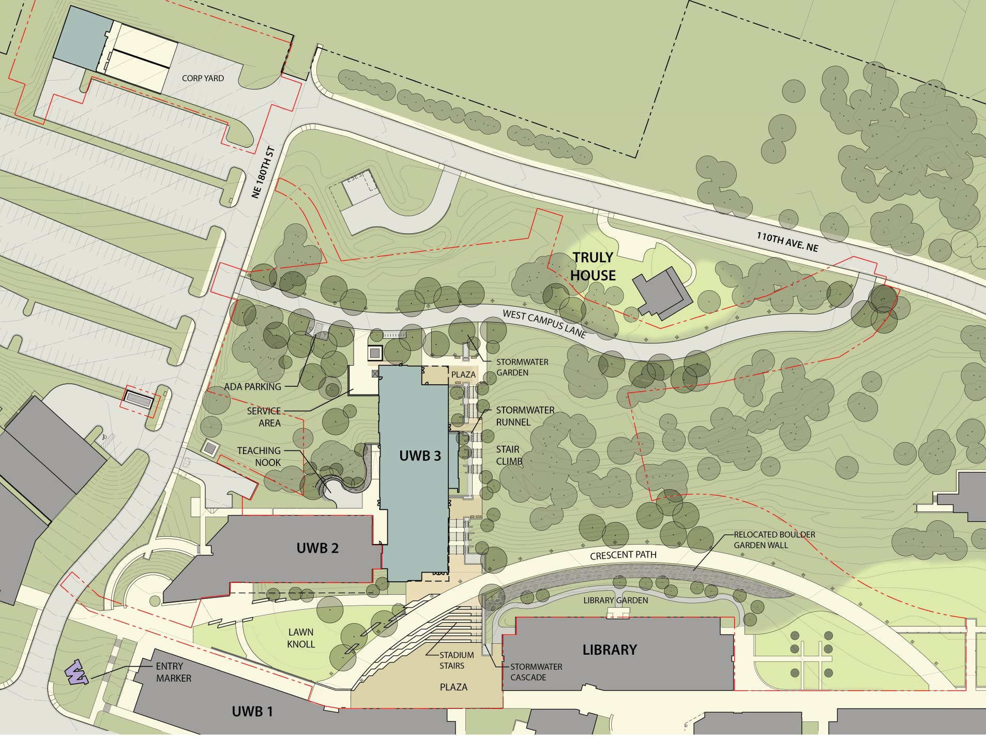
DRAFT
Site Plan
Notes:
Final site Plan, plaza, crescent walk stair climb, west campus way

Slide 10
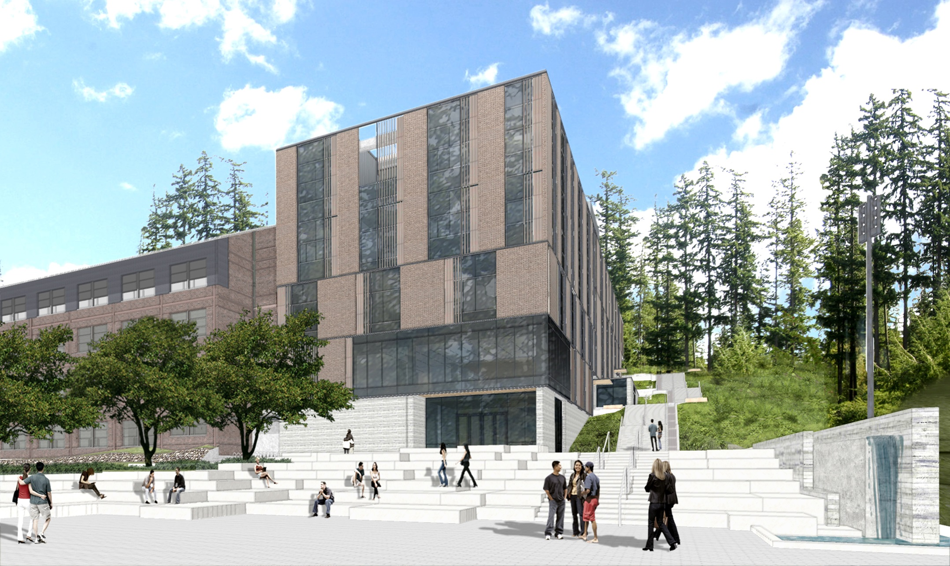
Notes:
Perspective from Plaza

Slide 11
Project Principles
Objective:
  Increase project quality and decrease project costs through collaboration, innovative thinking and use of technology
Tenets:
  Promote Partnership
  Streamline Processes
  Embrace Innovation

Slide 12
Project Principles
Trust your partners
  Goals, decision-making, meeting responsibilities
Collaborate, don’t duplicate
  Small teams, efficient documentation
Make the process work for the project, not vice versa
  Streamlined input and reviews, make linear
Embrace and reward innovation
  Willingness to accept risk, failure

Slide 13
Contract Considerations
  Adapt Standard UW Contract to a Collaborative Process
  Defined “Project Partners”
    “Collaborative and cooperative”
    Not a contractual relationship- but act like it
  Mandated Building Information Modeling- not just for MEP
  Simplified Attachment B- Design Document and Attachment C- Document Review Process Requirements
  Belief that Precon investment will more than pay for itself
  A/E Participation in GCCM, MCCM, & ECCM selection

Slide 14
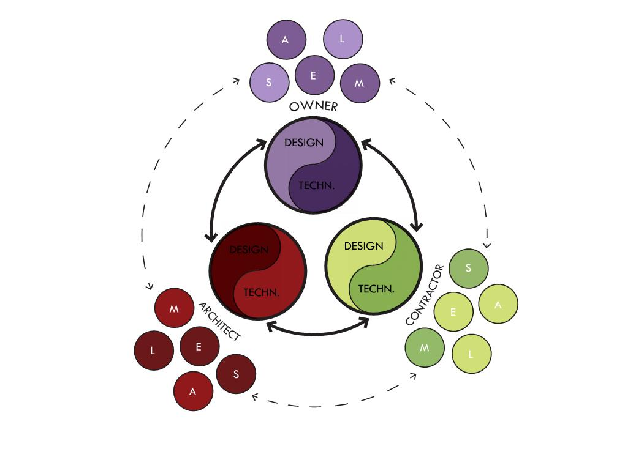
Three Legged Stool

Slide 15

UW Key Principles and Approaches:
LEAN- Project partners shall be guided by the principles of eliminating waste, minimizing cost, maximizing efficiency, and achieving the Owner’s program and quality objectives.
Target Value- Develop cost model to establish initial budget parameters. As the design progresses, provide real-time, continuous cost estimating to evaluate against the cost model to keep the project on budget.
Early selection and participation of major sub trades- including beyond mechanical and electrical.
BIM- From design commencement through commissioning, use BIM as a tool for collaboration, information sharing, estimating, planning and coordination.
Completion of Construction Documentation- Major sub trades to virtually share complete shop drawings and incorporate into the BIM model for coordination with project team, in lieu of complete construction documents by the design team.
Notes:
Eric: introduces project and team.

Slide 16
IPD Guiding Principles
Relationship based
Trust, which encompasses the following (in no particular order):
Candor
Have fun – personal relationships
Clear communication – active listening
Mutual respect
Timely, honest feedback
Transparency
Competence
Assume others have good intentions
“Our” products and deliverables, not mine or yours. We are in this together, decisions are for the good of the project
Accountability
Flexibility
Process based
Commit to continual improvement – lean processes
Apply technology appropriately – commit to BIM
Project goals (owner’s) are paramount – process adapts as required
Open book
Common alignment and prioritization of goals; schedule; quality; and cost.
Notes:
Stating the Challenges – Lowrey 5 minutes

Slide 17
Early Hiring of MCCM and ECCM
Mechanical Contractor as Construction Manager
Electrical Contractor as Construction Manager
Alternative delivery model within the GCCM delivery which allows early selection of MEP subcontractors for providing input during preconstruction
Three step best value process- RFP response, interview, GCs and fee proposal. Highest overall point score wins.

Slide 18
MC/ECCM Sought Benefits
Best-fit, quality people, (aspect of competition)
Establishment and “buy-in” of early cost model by construction team
Right mind-set, assist designers to stay with-in cost model and achieve performance quality objectives
Competitive, early selection of equipment, allowing effective design and coordination process
Final coordination in model vs. late CDs
Collaboration, esprit de corps of project team

Slide 19
Cost Model Management
(Target Value)
  GC/CM as sole cost estimator
  Target Values- Project team “owns” the cost model
  Buyout Process
  MEP Pricing Process- establishing the target value
    3 mechanical, 4 electrical contractors
    Independent MEP cost model by design team
    Final MEP targets based on reconciled estimates and scope
  EC & MC/CM become sole estimators going forward
  MEP process has worked very well
  Validating the MEP budgets
Notes:
Add detail about TL corralling and coordinating input for constituents. Avoindig stop-review- respond delays

Slide 20
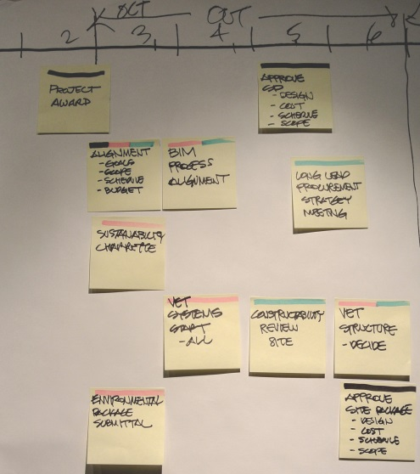
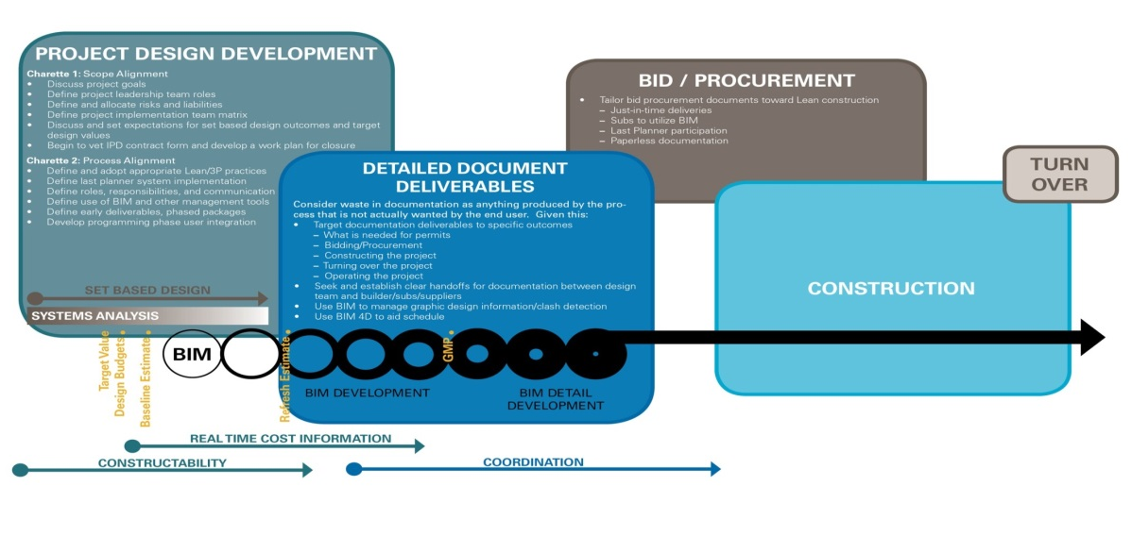
Integrated Design / Construction Work Plan
Phased Design Packages
Phased Permits
Phased Bid Packaging
Initial Construction Activities

Slide 21
Co-Location During Design
Proximity leads to communication
Communication leads to understanding
Understanding leads to respect
Respect fosters cooperation
Time and value are key, projects can’t afford a loss of forward momentum during design due to slow cost and constructability feedback.

Slide 22
Co-Location Conversation Examples
Understanding the challenges other team members face
  Client program changes in early CDs, while breaking ground
Building team atmosphere of trust and respect
Helping each other prioritize efforts
  Extra design efforts invested in enclosure and early foundation wall
  Push out of design milestone for finishes

Slide 23

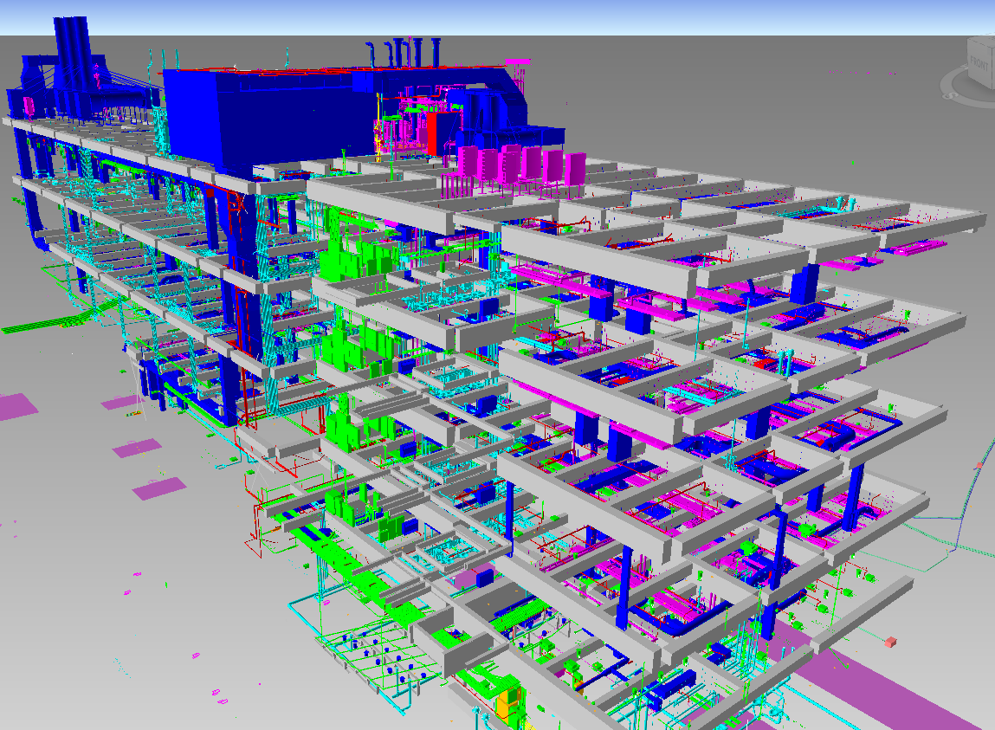
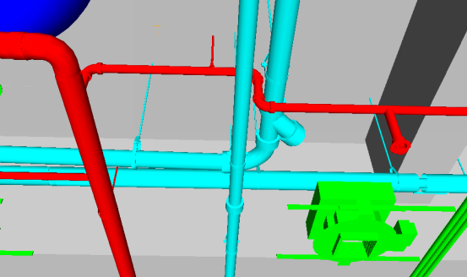
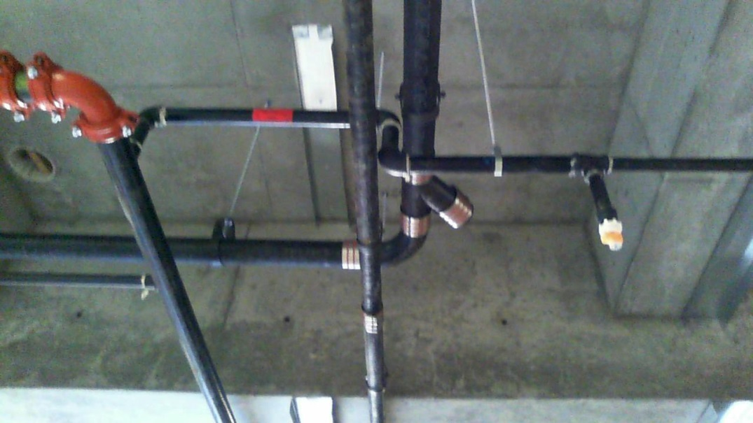
Implementing MEP Drawing Handoff
Organizing the team
Permit submission and approval
Implementing the BIMx
MEP Scheduling
Clash Detecting
Designer Review
Notes:
Brian and Robin

Slide 24
Beyond MEP:
Early Subcontractor Involvement
What other opportunities are there for trades to add value during preconstruction?
Goal is to build a better mouse trap!
Maintain or improve quality or performance
More cost effective? Or stay within budget.
Prefabrication opportunities?
Optimize or expedite project delivery schedule?

Slide 25
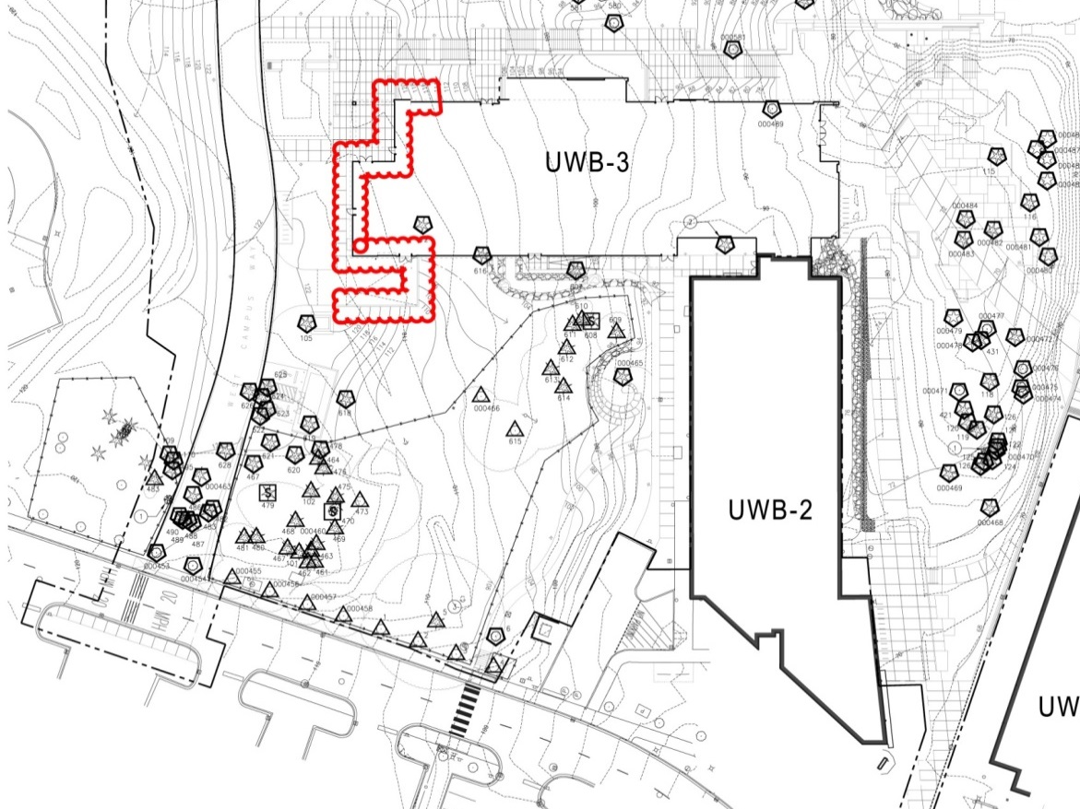
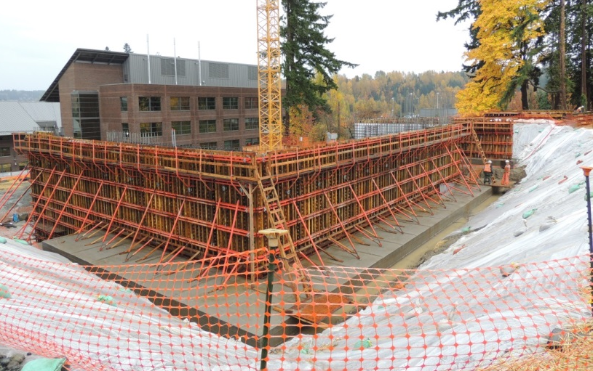
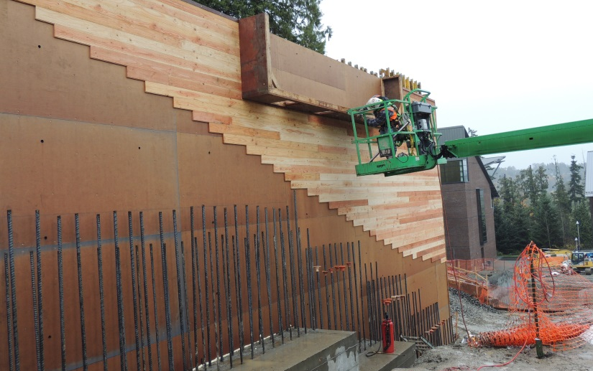
Beyond MEP: Early Sub Involvement
Site Earthwork Case Study
Kept 8000TCY of native material on-site, in place, saving approximately $200k, and eliminating 400 truck-trips.

Slide 26
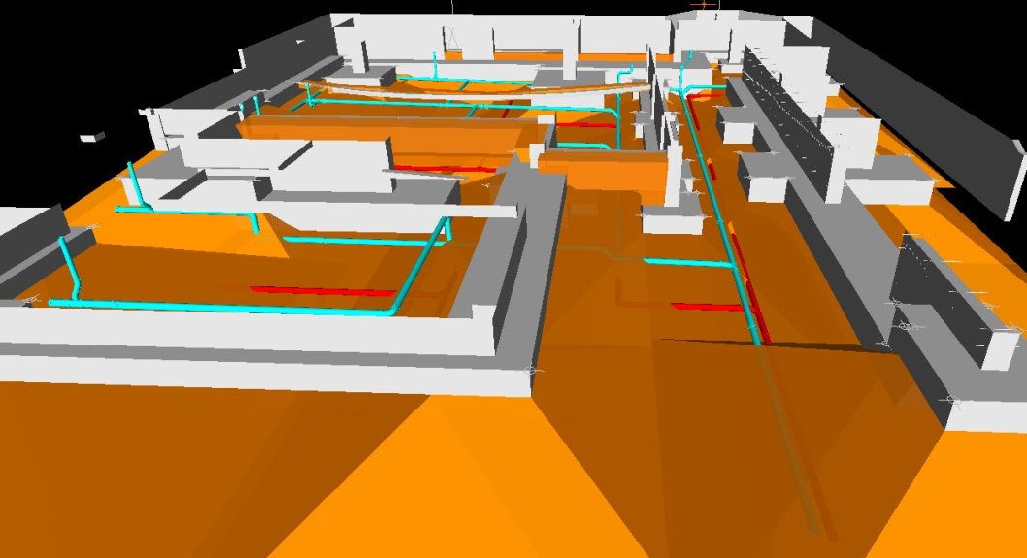
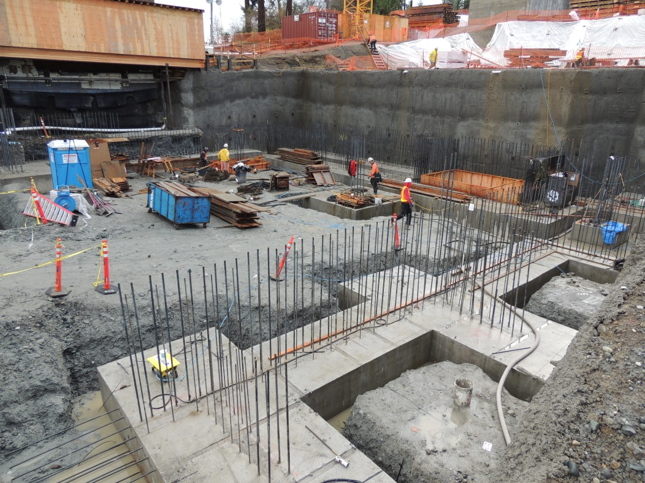
Beyond MEP: Early Sub Involvement
Waterproofing Case Study
Early modeling demonstrated to the project team that an effective route could be identified to “daylight” an underslab drainage system, saving the cost of a full WP system. $125K+
Notes:
Waterproofing Case Study
Further investigation, take away guess work

Slide 27
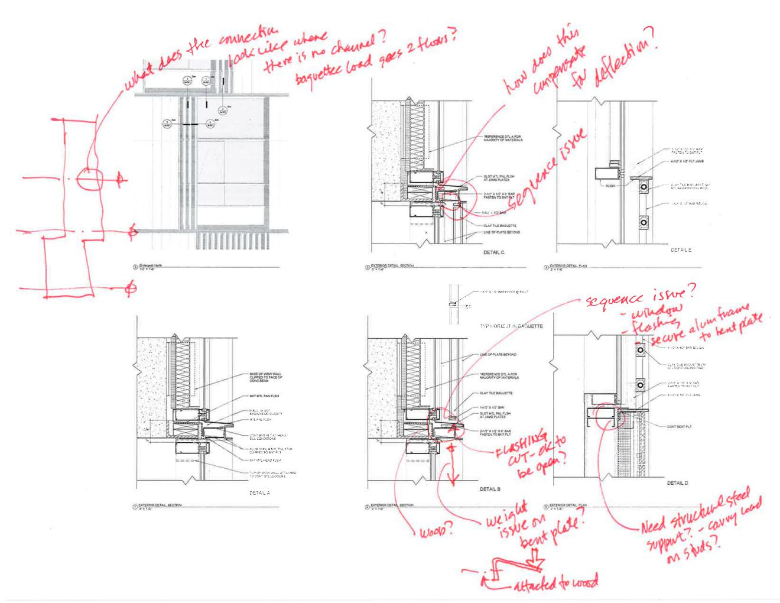
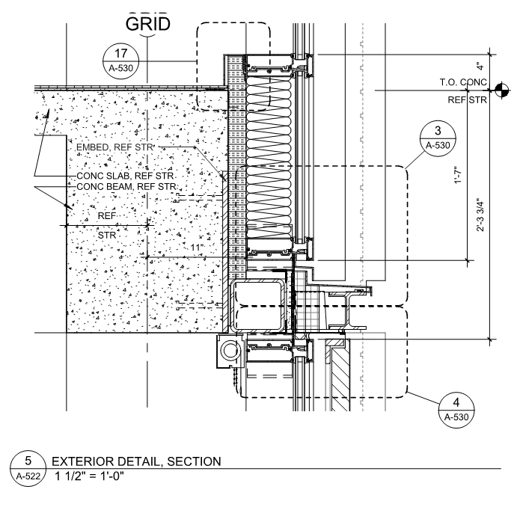
Beyond MEP: Early Sub Involvement
Curtainwall Case Study
Simplification of details for spandrels,
Reduced size of panels to minimize struct’l reinforcement in mullions, CW system that could be glazed from interior or exterior, savings $325K+

Slide 28
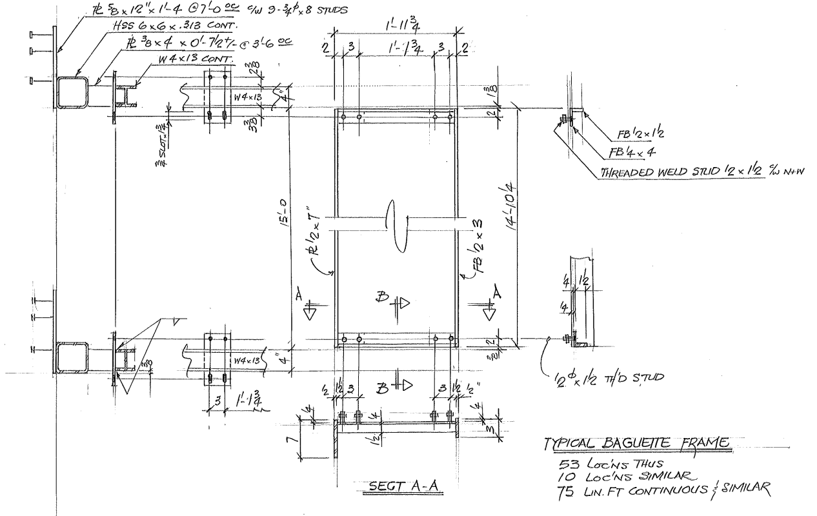
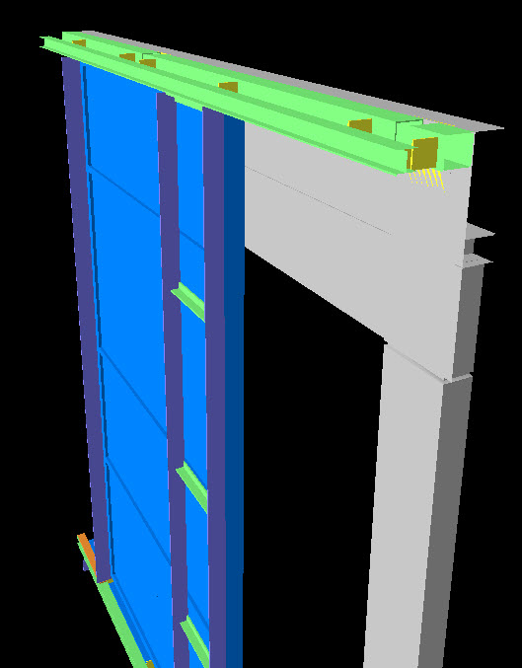
Beyond MEP: Early Sub Involvement
Exterior Steel Case Study
Modularization of frames and lintels, to allow pre-fab, simplification of flashing details, 1000ea, minimal field welding and paint touch-up allowing for high quality, high perf., shop finish, saved $175K+
Notes:
Exterior Steel Case Study
Pre-fabrication opportunities
Spiral Stair

Slide 29
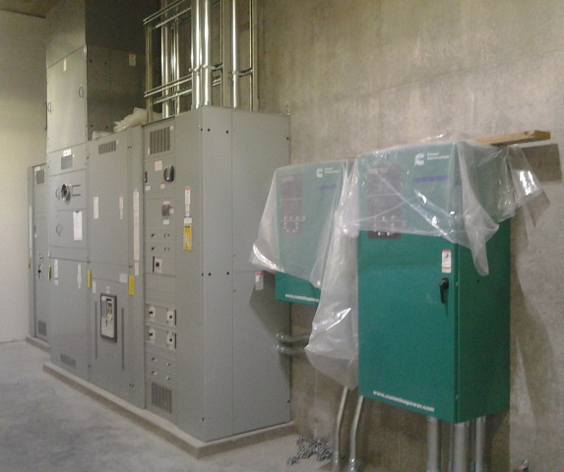
Beyond MEP: Early Sub Involvement
ECCM Case Study
Switchgear
  Preference was for campus standard however open spec resulted in $60K savings
Lighting Review
  In house lighting designer provided knowledge of local energy codes
  Fixture package was reviewed for constructability
  Assisted with fixture selections and allowable alternates to drive competitive pricing
  Accurate budgeting early in process
Generator & Utility Transformer
  Provided cost data associated with different locations ($600/LF)
Notes:
Waterproofing Case Study
Further investigation, take away guess work

Slide 30
Early Integration Works!
Team-work atmosphere
Constructability issues discussed as design evolved
Cost (VE) ideas put forth as design evolved
Clients/users better informed of issues and decisions – fewer surprises
Decrease in substitution requests and RFIs
Keep score, and praise/ recognize team for efforts

Slide 31
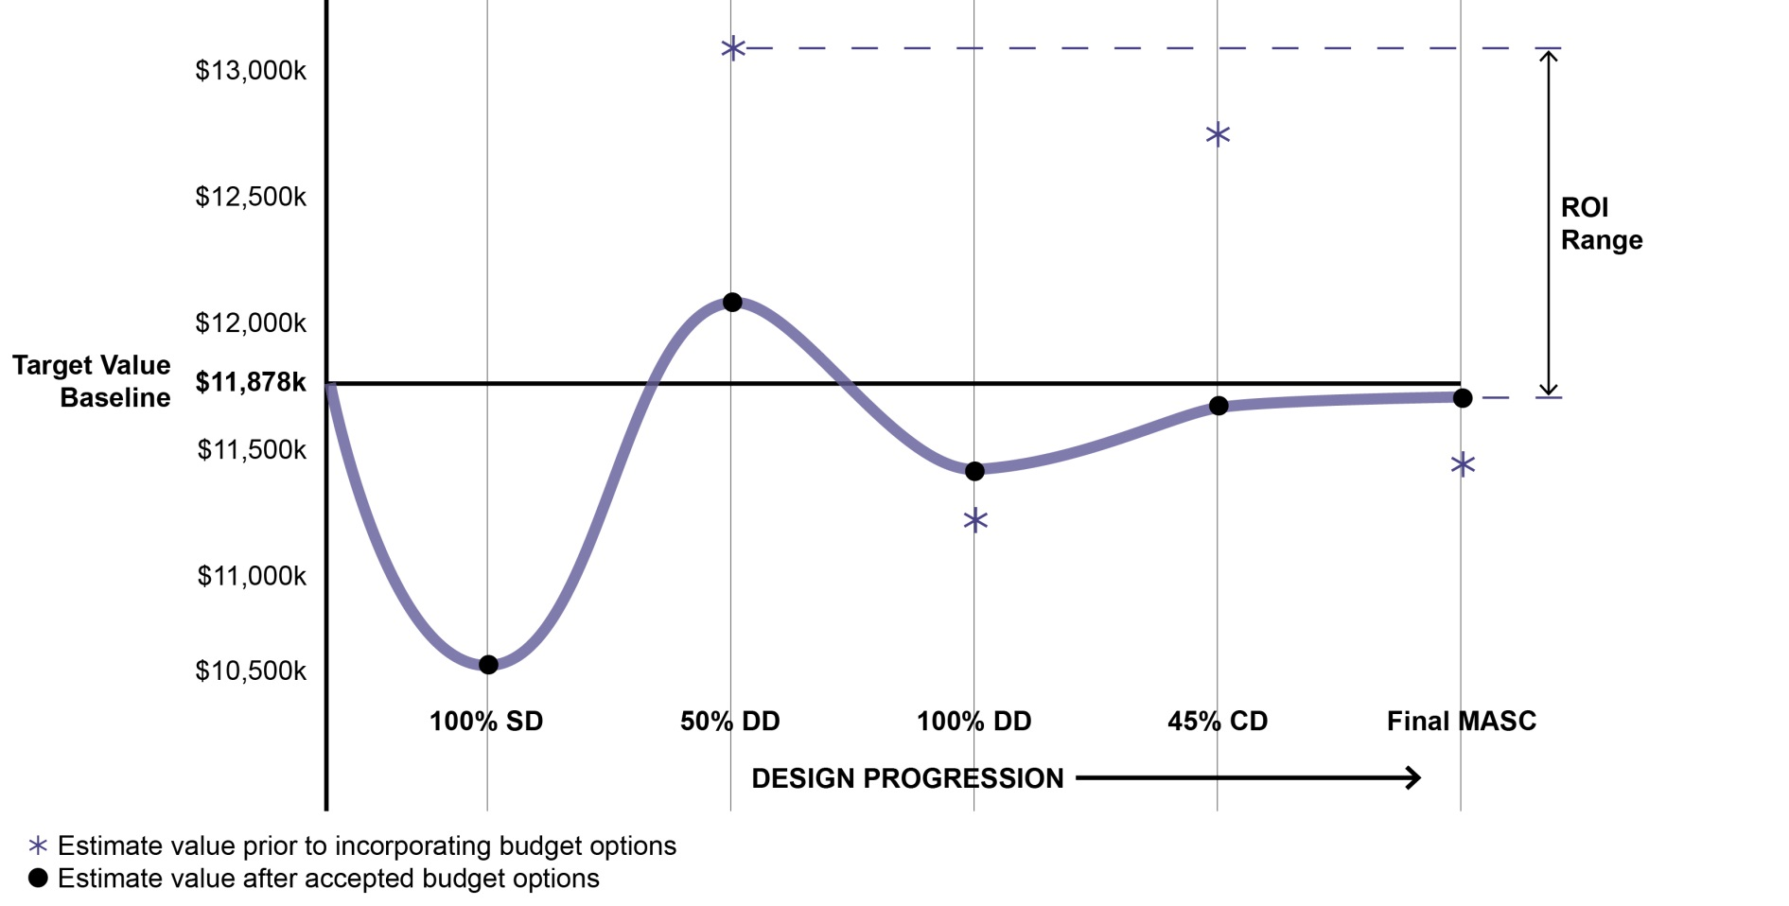
MCCM-ECCM Preconstruction ROI
ROI of M&E Precon Cost of up to:
1,378,912 – 245,884 = 461% ROI
(potential savings) (precon investment)
245,884

Slide 32
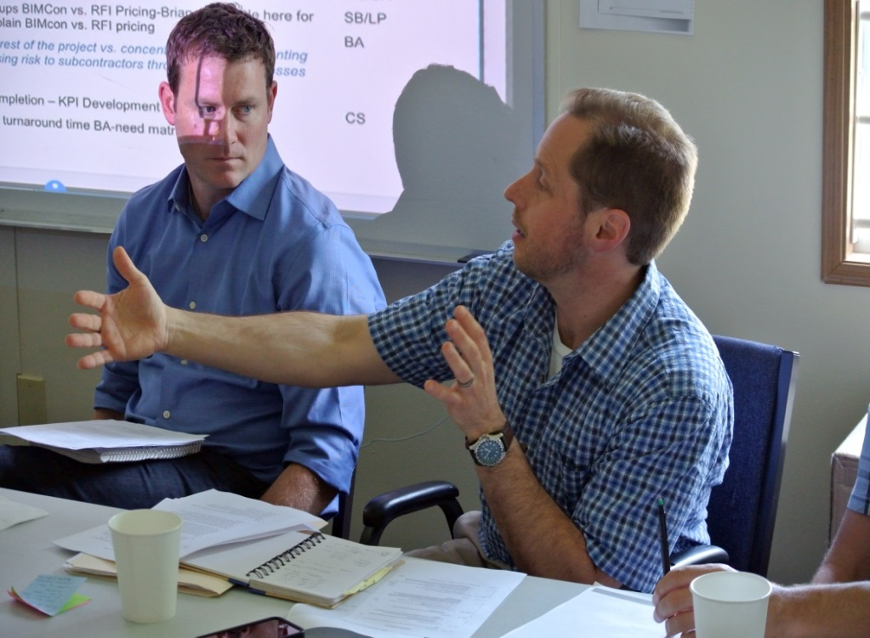
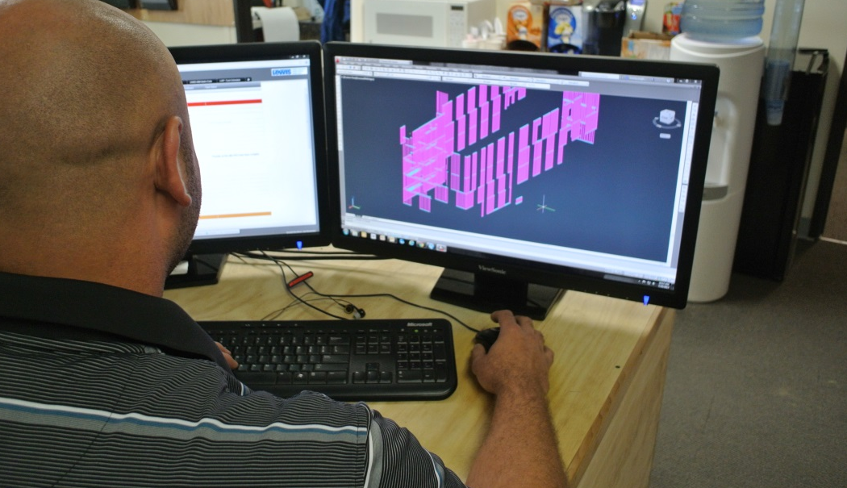
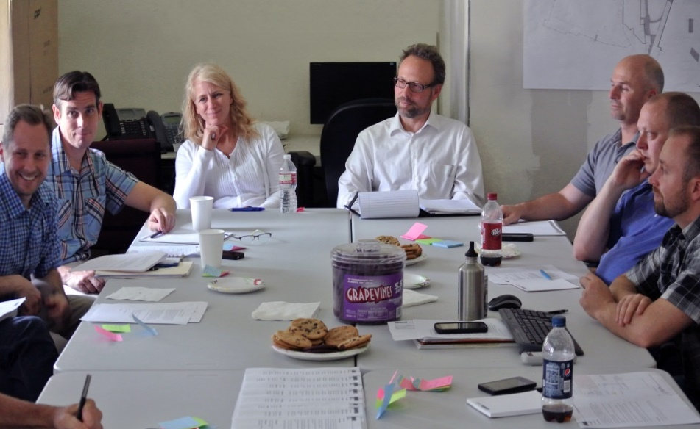
Preconstruction Metrics & ROI
Preconstruction Investment $380k
Co-location Investment $10k
1.2M – 390k
(savings) (precon invstmt) = 208+% ROI
390k
Time Savings, 1yr, $2.1M of avoided escalation
Notes:
Brian and Robin

Slide 33

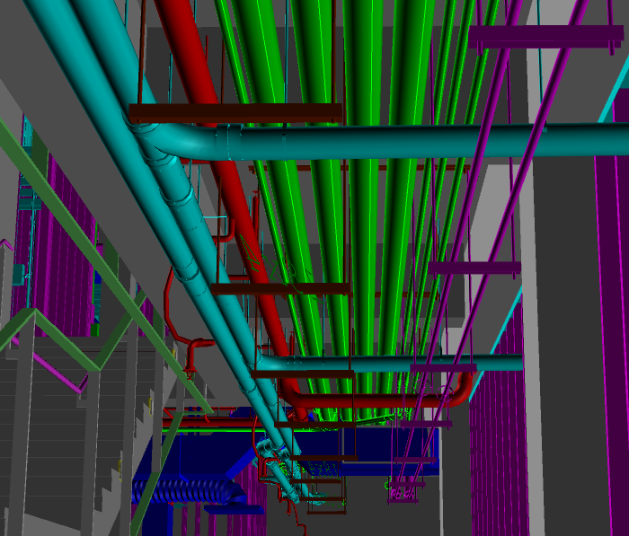
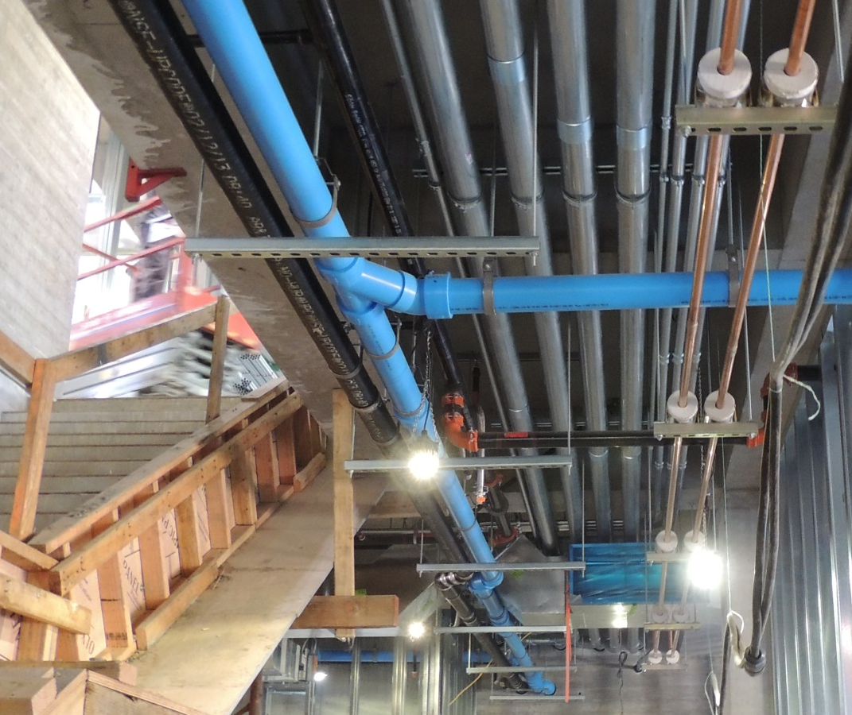
Federated Model Approach
& Building from the Model

Slide 34
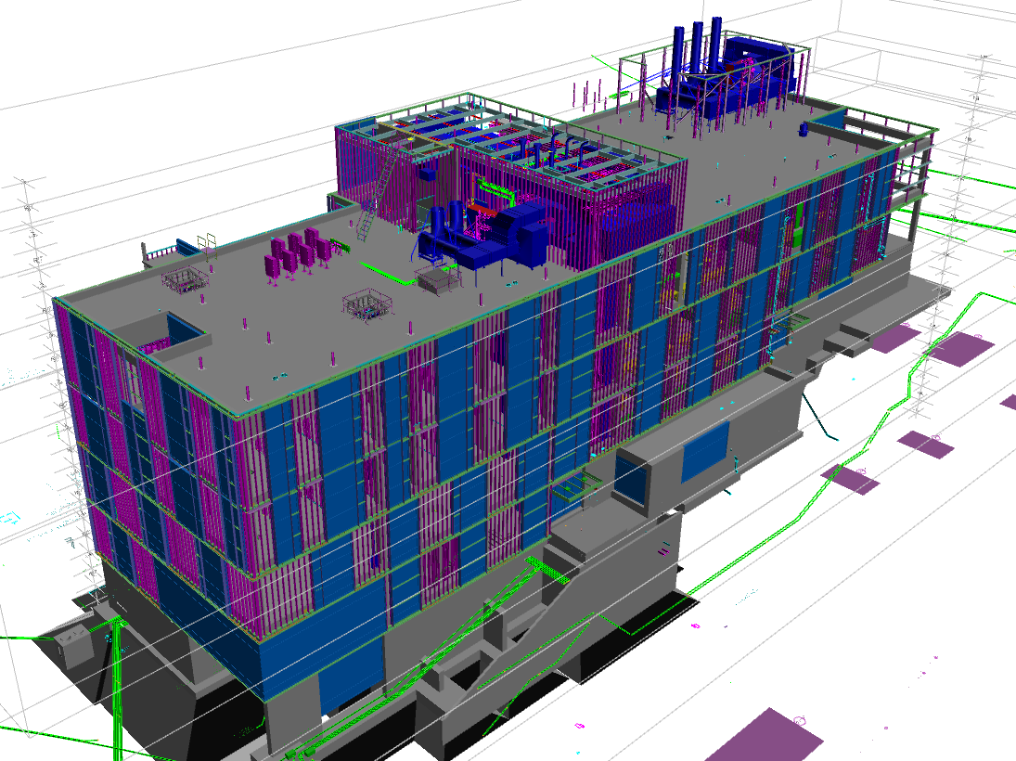
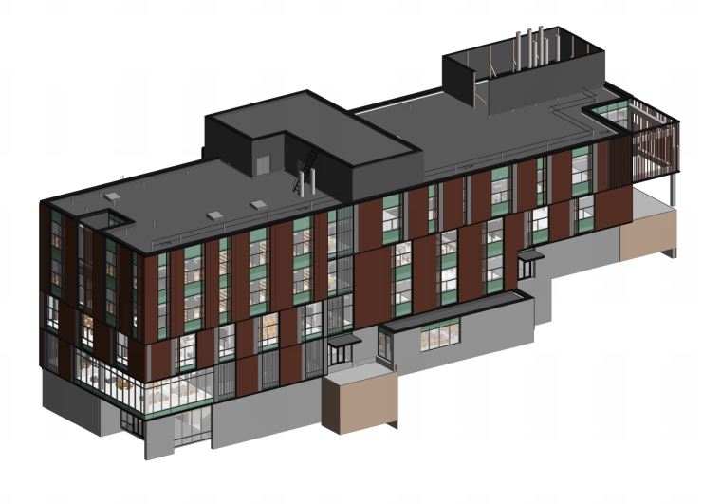
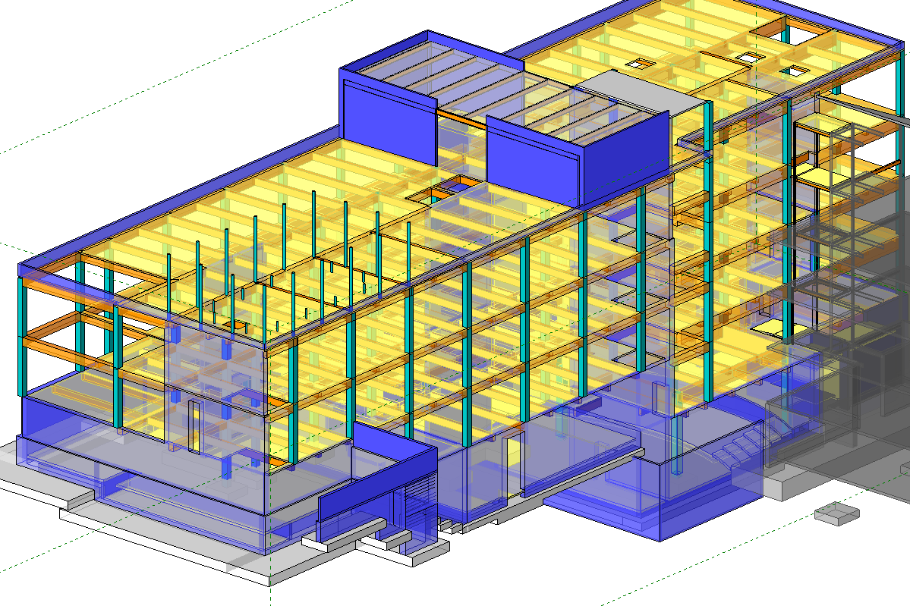
How we use design models
Creation of a Federated Model
Build concrete model from construction documents assisted by model overlays when available
Vet inaccuracies through coordination processes
Federated model becomes the source model for all subcontractor trade models.
Federated model is maintained through the VDC and Construction phase
Incorporates ASIs, BIM Cons, RFIs, etc..
350-450 Level of Development (LOD)
Can be exported in a number of formats
Federated Model
Architectural Base Model
Structural Base Model

Slide 35
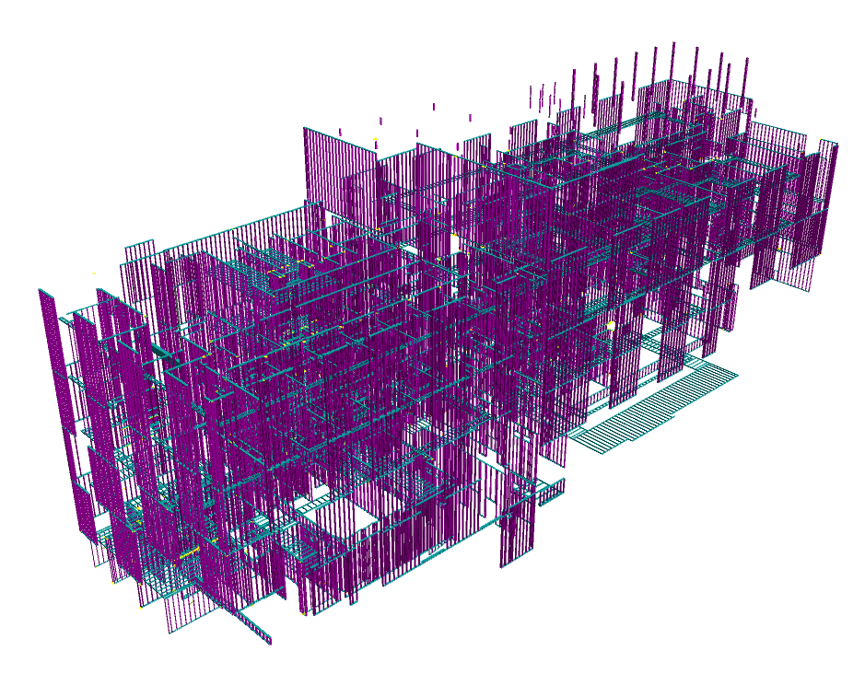
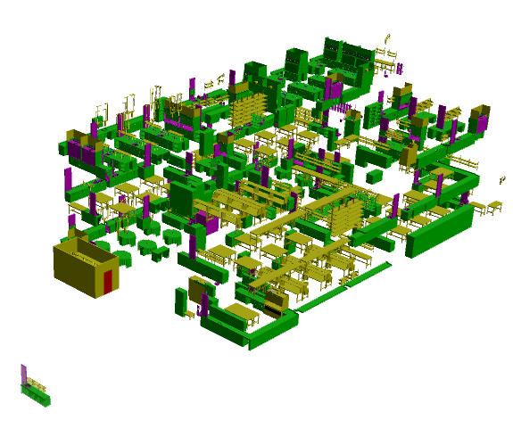
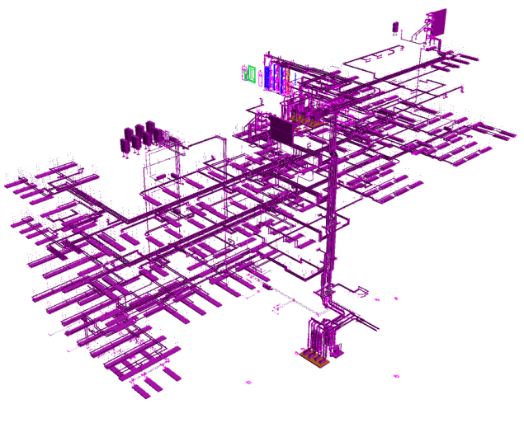
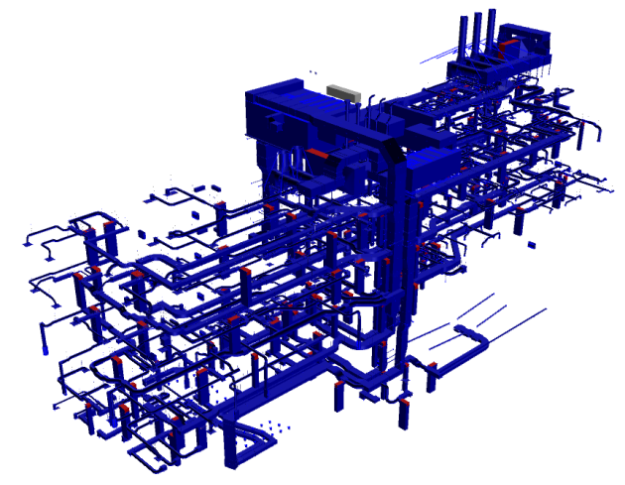
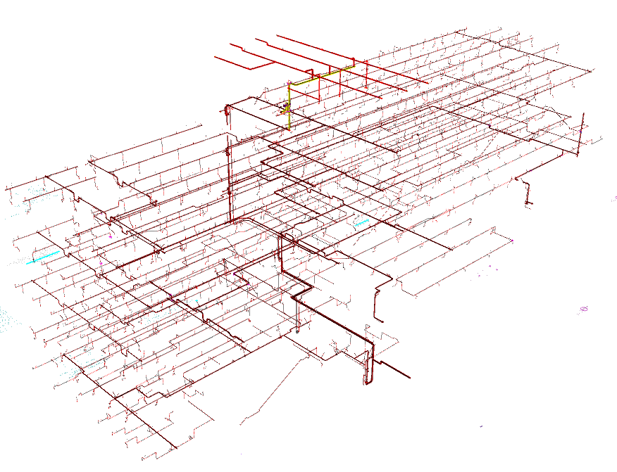
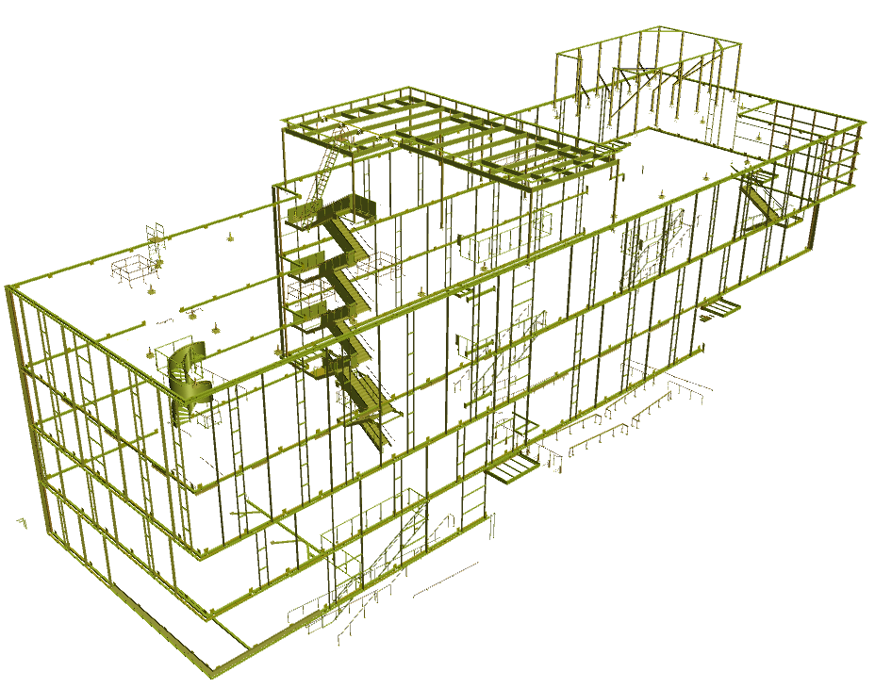
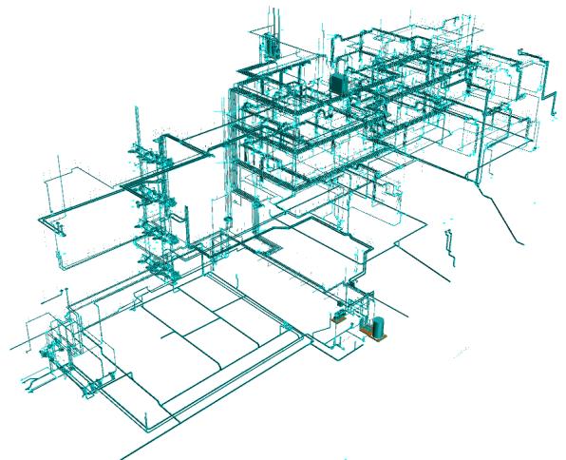
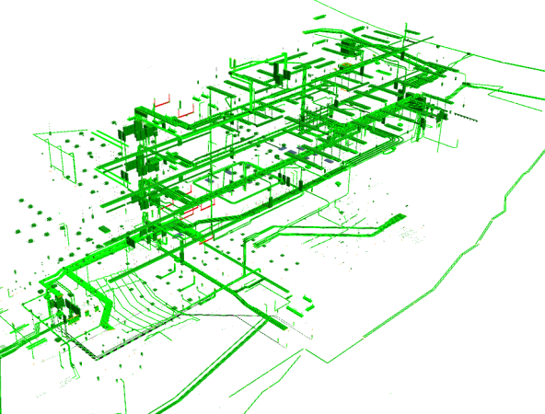
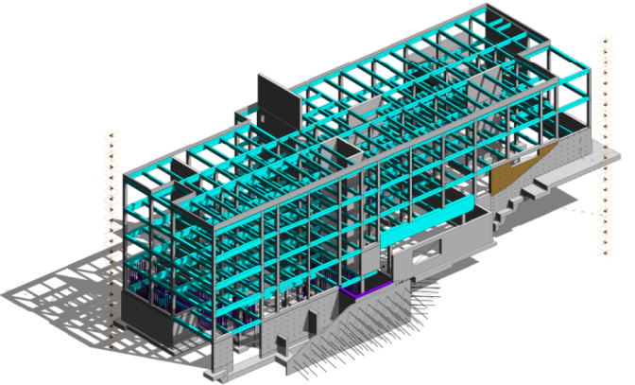
How we use trade models

Slide 36
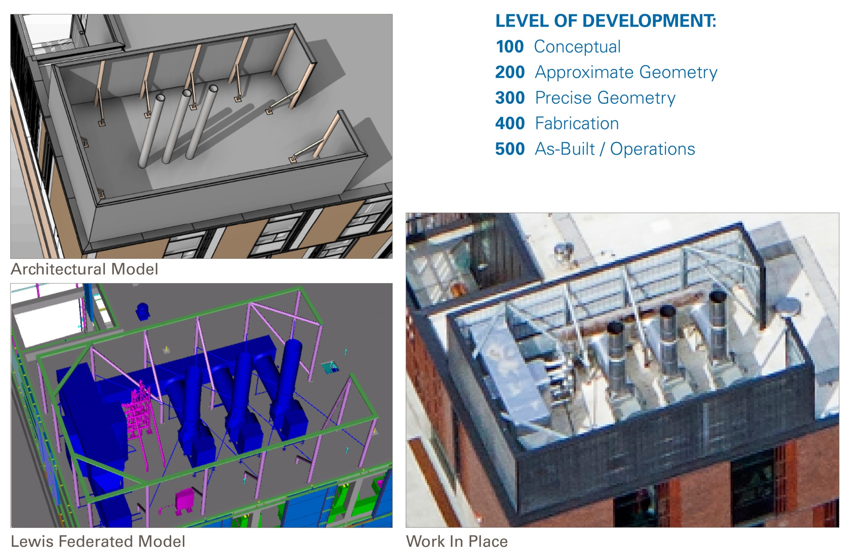
Building From the Model

Slide 37
Examining the process
BIM CON Workflow
Identified Issue
Captured in PDF*
Post to Blue Beam Studio
Collaborative Working Session**
Post to WebPM Log
A/E Confirms
Issue is closed on WebPM
Lewis - Notification to subs, Provide Official Direction
Changes are integrated into trade contractors’ models and keyed to electronic documents.
*Can be a screen shot of the model or snapshot of the design documents or 3D PDF, etc.
**Items are reviewed by the Architect, Engineer, Lewis Staff, and subcontractors whose scope is involved during weekly conference call.

Slide 38
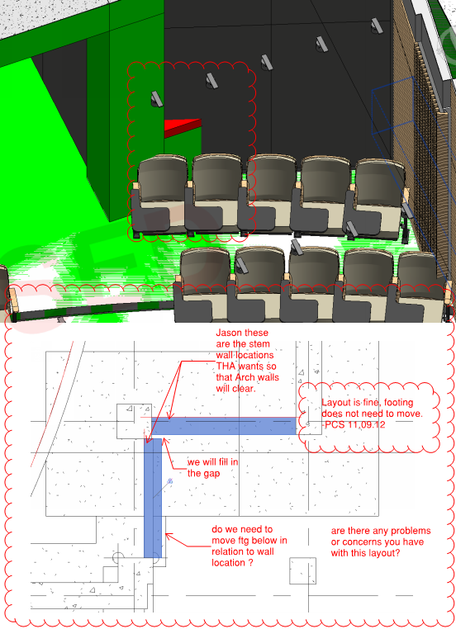
Definition
What is a BIM CON?
A BIM-CON at its core addresses a question that typically arises in the virtual construction phase of a project.
VDC (Virtual Design and Construction)
Extensive process of detailing
Coordination of space
Fabrication of parts

Slide 39

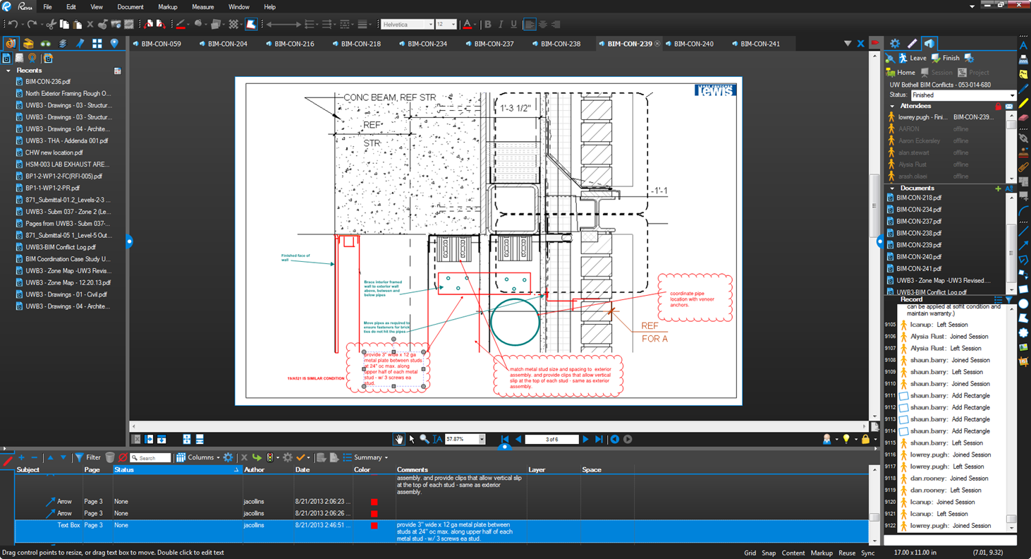
Tools involved
Blue Beam Studio

Slide 40
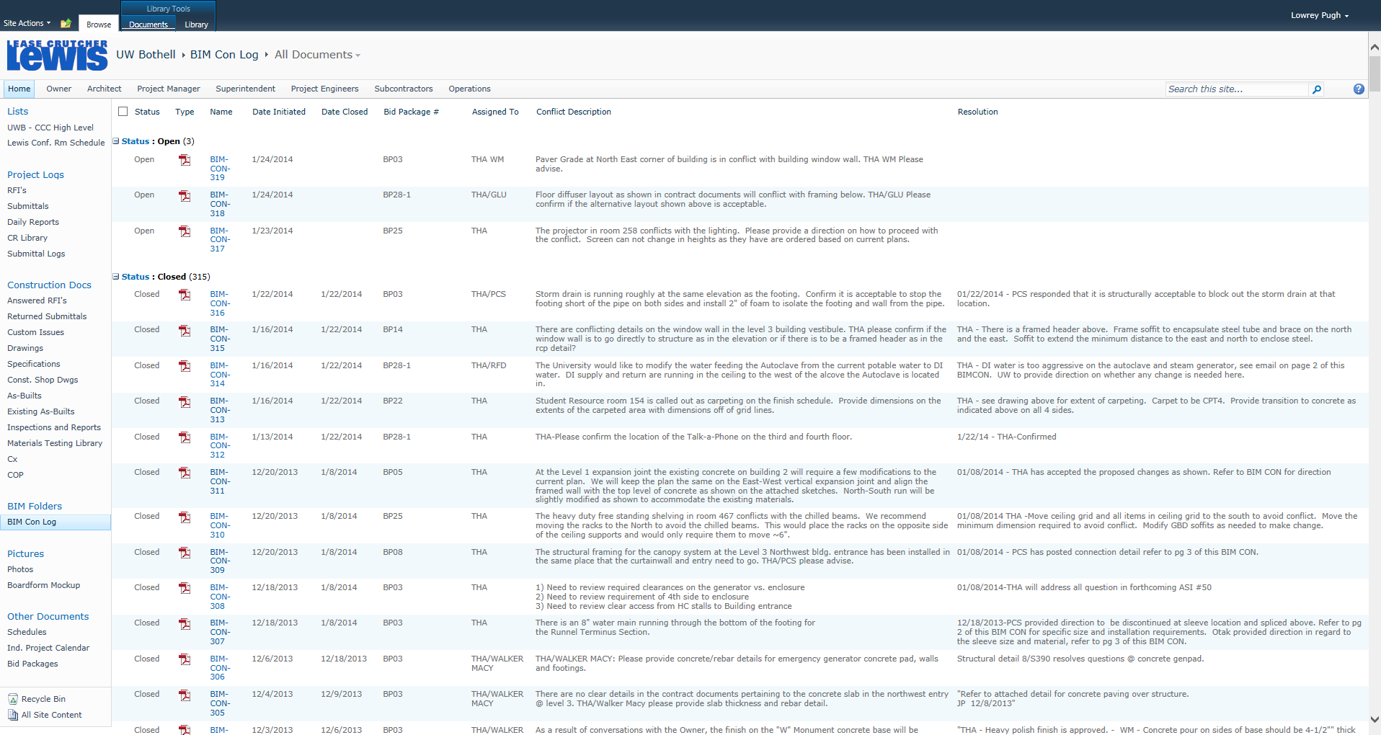
Tools involved
WebPM

Slide 41
Comparison
Why is it not an RFI?
BIM CON
RFI
Majority of conflicts are discovered weeks or months prior to construction
Encourage a collaborative approach to finding a solution.
Can address multiple issues that may arise form an initial solution
Statistically have a lower cost impact than RFI’s. Due to being solved virtually and or using material or installation options that have input from the installer
Team is given time and opportunity to find best value solution.
Majority of conflicts are discovered as work is going in place
Often limits feedback from stakeholders when finding a solution.
Response typically address only the surface issue. All subsequent issues that may arise have to be re sent as .1, .2, etc..
Cost is subject to design teams best guess on constructability and material availability

Slide 42
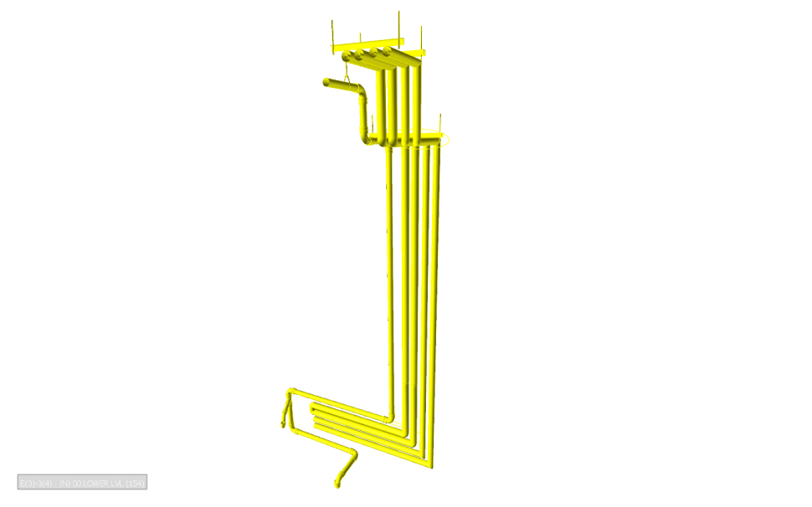
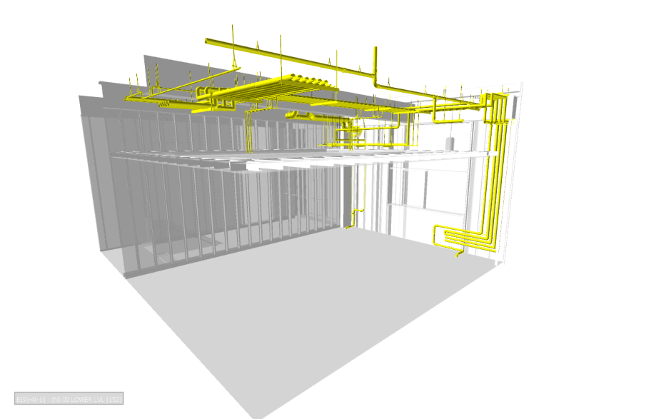
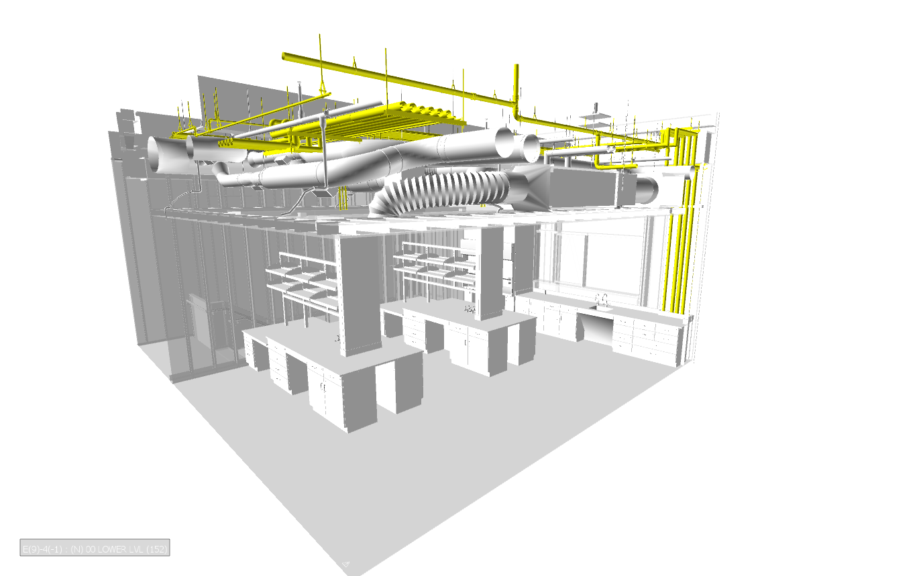
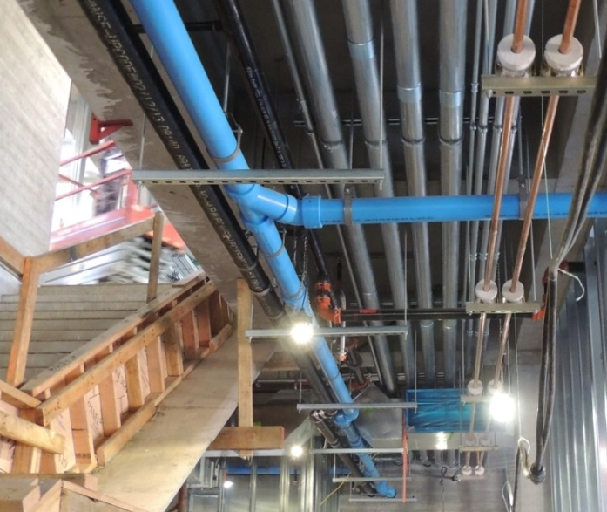
FACILITATING PREFAB
Facilitating Pre-Fabrication
Notes:
Make a collage – ask Don annotations

Slide 43
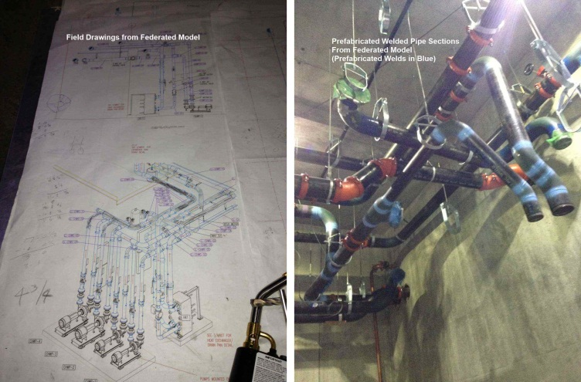
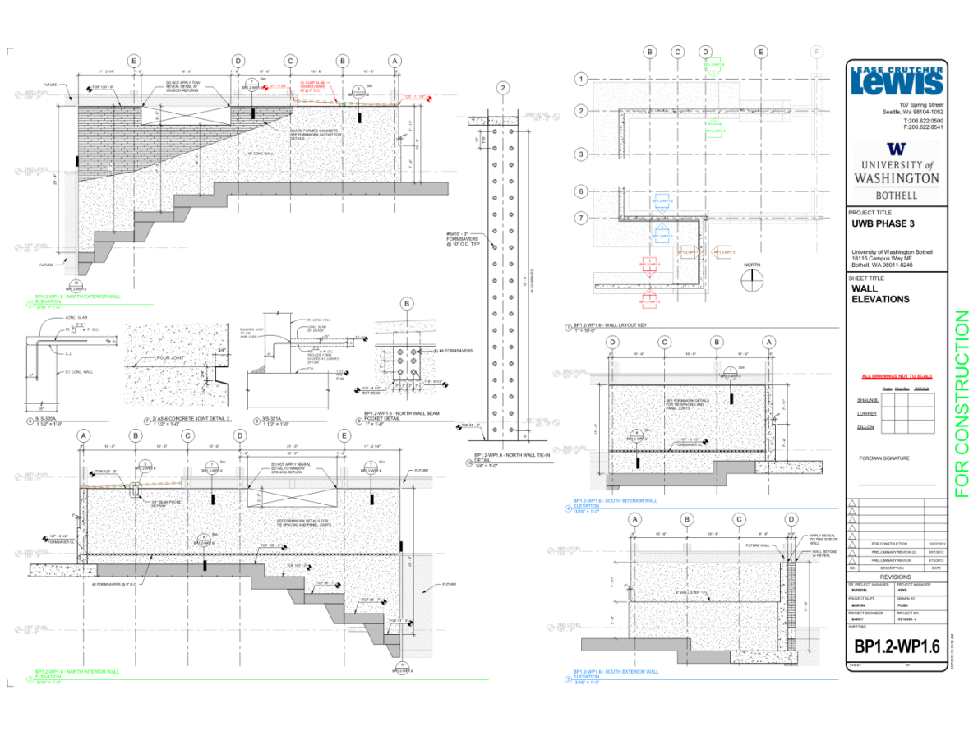
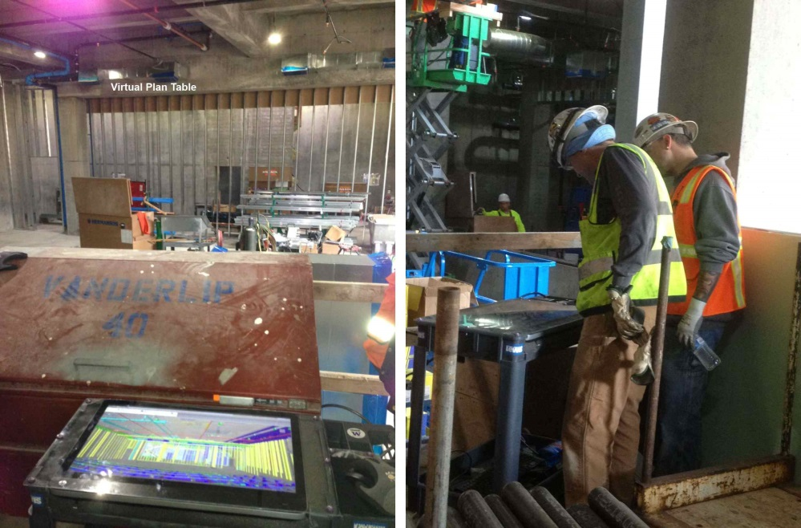
Building From The Model
LOD/ Use/ Fabrication
Site logistics
Survey data
Extracting quantities
Accurate construction documents
Resolving conflicts in virtual space
Communicating to the field

Slide 44
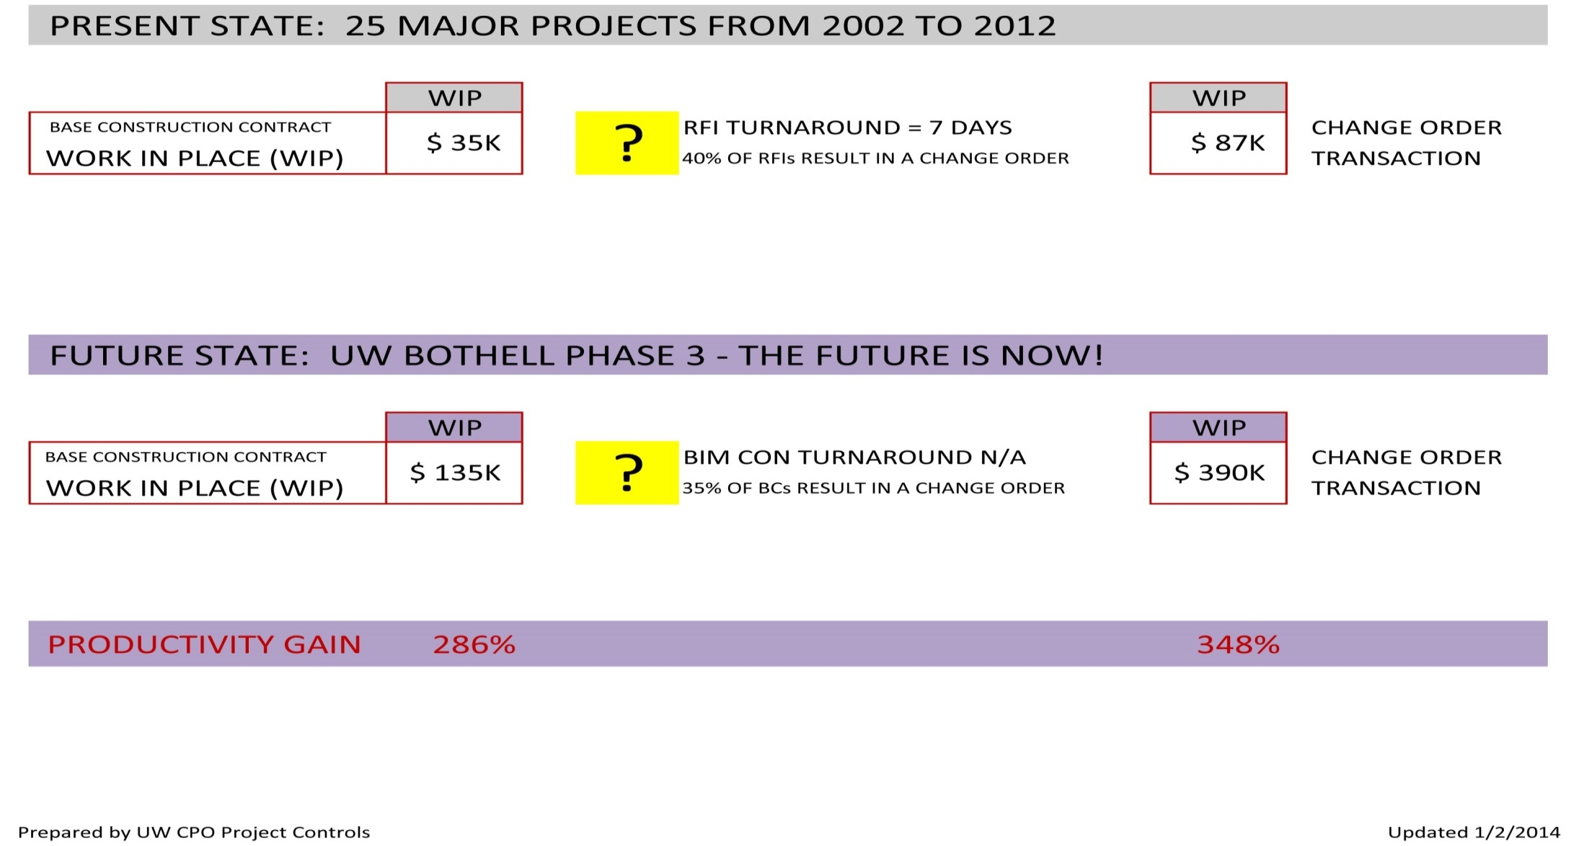
UW Study Results, Overall Metrics
Would anticipate 1298 RFIs on UWB3, instead 334 BIMCons
Would anticipate 522 CO Transactions,
instead 163 quantity-cost adjustments
75% Fewer Questions/ Clarifications
70% Fewer CO Transactions
Better Quality of In-place Work
Virtually eliminate “Field Fixes”
Higher Worker Morale, Better Productivity

Slide 45
VALUE ADDED APPROACH
SIGNIFICANTLY REDUCED CHANGE ORDER COST
PROJECT | QUANTITY OF STRUC QUESTIONS | STRUC CHANGE COSTS | OVERTIME CO COSTS FOR STRUCTURE | AVG. CHANGE COST PER QUESTION | AVG. STRUC CHANGE COST / SF
UW MOLECULAR ENGINEERING | 324 | $76,106.00 | $65,370.00 | $436.65 | $1.57
UW PH1 PACCAR | 190 | $154,800.00 | $86,481.00 | $1,269.90 | $1.83
UW PH2 DEMPSEY HALL | 224 | $138,948.00 | $21,307.00 | $715.42 | $2.67
COMPARABLE PROJECT TOTALS | 738 | $369,854.00 | $173,158.00 | $735.79 | $1.93
UWB3 | 115 | $26,000.00 | $0.00 | $226.09 | $0.35
Traditional
UWB3 Approach
STRUCTURE SAVED 82% OVER TRADITIONAL APPROACH
PROJECT | PROJECT GSF | TOTAL PROJECT BUDGET | QTY OF MEP CHANGES | MEP CHANGE COSTS* | MEP OVERTIME CO COSTS | TOTAL MEP CHANGE COSTS | AVE. CHANGE COST | MEP CHANGE COST / SF
UW MOLECULAR ENGINEERING | 90,000 | 64,000,000 | 36 | $312,923.00 | $7,671.00 | $320,594.00 | $8,905.39 | $3.56
UW PH 1 PACCAR | 132,000 | 78,000,000 | 205 | $1,137,726.00 | $95,206.00 | $1,232,932.00 | $6,014.30 | $9.34
UW PH 2 DEMPSEY HALL | 60,000 | 47,000,000 | 114 | $536,041.00 | $0.00 | $536,041.00 | $4,702.11 | $8.93
UW COMPARABLE TOTALS | 282,000 | 189,000,000 | 355 | $1,986,690.00 | $102,877.00 | $2,089,567.00 | $5,886.10 | $7.41
UWB3 | 75,000 | 45,000,000 | 12 | $35,212.00 | $0.00 | $35,212.00 | $2,934.33 | $0.47
*Excludes program "upgrades"
Traditional
UWB3 Approach
MEP SAVED 94% OVER TRADITIONAL APPROACH
Notes:
Based on typical, average MEP changes, anticipated cost would have been:
75,000 SF x $7.41/SF = $555,750
Pro-rated BIM integrator effort = $81,886
(555,750-35,212) – 81,886 = 535% ROI
81,886

Slide 46
Risk Contingency
PROJECT | PROJECT GSF | RISK CONTINGENCY AMOUNT | COORDINATION ISSUE USAGE (Est.) | % USED FOR COORDINATION
UW MOLECULAR ENGINEERING | 90,000 | $799,428 | $200,000 | 25.0%
UW PH 1 PACCAR | 132,000 | $1,133,290 | $200,000 | 17.6%
UW PH 2 DEMPSEY HALL | 60,000 | $560,479 | $140,000 | 25.0%
UWB3 | 75,000 | $753,366 | $10,565 | 1.4%
Risk contingency of 2-2.5% of contract value
Used for buyout errors, coordination issues and interference issues between sub-sub and sub-GC
At 99% of project complete small amount used for coordination issues

Slide 47
Change Orders
PROJECT | CONTRACT AMOUNT | BILLED TO DATE | % COMPLETE | CHANGE ORDERS | CHANGE ORDER AS % OF WORK IN PLACE
STRUCTURE | $5,180,000 | $5,206,000 | 100% | $26,000.00 | 0.5%
MECHANICAL | $8,968,693 | $9,151,835 | 100% | $183,142.00 | 2.0%
ELECTRICAL | $6,258,963 | $6,108,056 | 98% | $61,873.00 | 1.0%
Final equivalent scope of UWB3 within .7% of Target Budget
Returned 60% of GCCM Contingency
University was able to add $3.4M of enhancements during construction

