Slide 1
Get Results: SOWS and Evaluation Models
Presented by Kevin Greene (SAO) and Scott Smith (DES)

Slide 2
What we will cover
Statement of Work
6 questions
8 elements
MIA
Q&A (5 minutes)
Evaluation
Team
Process
Technique
Q&A (5 minutes)
Wrap up and resources

Slide 3
What is a Statement of Work (SOW)?
A statement of work (SOW) is a formal document that captures and defines the work activities, deliverables, and timeline a vendor must execute in performance of specified work for a client. The SOW usually includes detailed requirements and pricing, with standard regulatory and governance terms and conditions. It thus overlaps in concept with a contract, and in fact SOWs are often legally equivalent to contracts.
Wikipedia Definition
Notes:
Binding contract that captures and defines:
Governance
Activities
Deliverables
Pricing
Timeline

Slide 4
SOW should answer 6 questions
What is the work to be performed?
How is it managed?
What are the benefits?
Are there special requirements?
What are we supplying?
When is it finished?

Slide 5
What is the work?
Notes:
Explain the background, where you are now and where you want to be.
State the results you want to be achieved by the vendor.
State the deliverables the vendor is to provide.
Define the schedule for the results, deliverables and acceptance.
Define the service levels that you want and the measurements.

Slide 6
How is it managed?
Notes:
Daily, weekly, monthly, quarterly. Red-flag reporting.
Achievement to date, achievements planned.
Identification of problems to date.
On-site meetings, progress meetings, acceptance process meetings, etc.
Project managers with authority to make decisions for the results.
Milestone reviews.
Payment for performance.

Slide 7
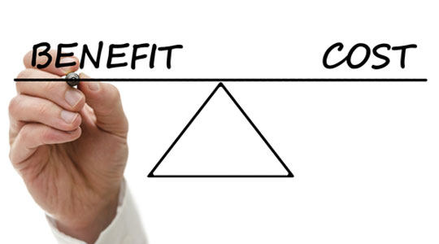
What are the benefits?
Notes:
When the results are achieved, what benefits do we expect?
Vendor needs to know the benefits of results for full understanding.
These were likely expressed to get internal buy-in of project.

Slide 8
Are there special requirements?
Notes:
Technical requirements (specifications).
Government and legal requirements.
Contract requirements (SLAs if not specified elsewhere).
Location of work and access requirements.

Slide 9
What are we supplying?
Notes:
Define the customer-supplied items (data, hardware, etc.).
Specify the dates.
Note that vendor has to report on issues with our items
Any item not specified as contractor supplied, is vendor responsibility

Slide 10
When is the project completed?
Notes:
Specify the dates.
What does completion look like? Define the service levels that you want and the measurements.

Slide 11
8 SOW Elements
Introduction/Background
Scope of Work
Not to be confused with Statement of Work
Period of Performance
Place of Performance
Work Requirements
Schedule/Milestones
Acceptance Criteria
Other Requirements

Slide 12
Introduction/Background
Notes:
This section should provide a general description of the project as well as highlight the project’s background and what is to be gained by the project.
As the SOW often accompanies a request for proposal (RFP), the SOW introduction and background is necessary for bidding vendors to familiarize their organizations with the project.

Slide 13
Scope of Work
Notes:
Brief statement of what you expect to accomplish as a result of this scope of work.
While specific deliverables and tasks will be presented in the Work Requirements section, this section should highlight what is and is not included in the scope of the project in broader terms.
Explain the background, where you are now and where you want to be.
State the results you want to be achieved by the vendor.
State the deliverables the vendor is to provide.

Slide 14
Period of Performance
Notes:
Define the time period over which the project will occur.
The timeframe for the project can be pre-determined or based on a completion date to coincide with some external requirement (i.e. new Government regulation).
It is important to define the period of performance since this is usually a variable in the project’s cost.
Additionally, if there are delays in a project and it will not be completed within the defined period of performance, a contract modification may be required and the costs of the project will increase as well.

Slide 15
Place of Performance
Notes:
Where the work will be performed by the vendor.
In some cases the vendor may perform all or some of its work on site at the customer’s location.
This is usually dependent on the type of industry or work being performed.
It is important to define this in case the customer requires the vendor to work at the customer’s site and to clarify any equipment and/or work space that will be provided.

Slide 16
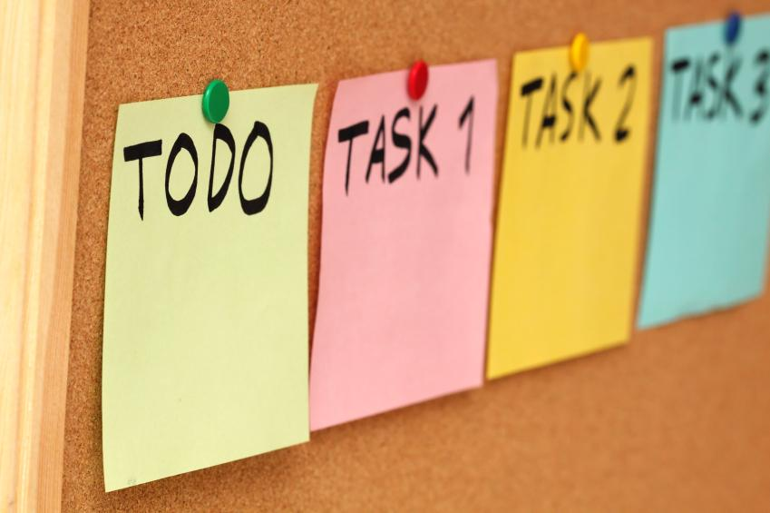
Work Requirements
Notes:
This section should include a description of the actual tasks which the project will require.
This should include what tasks need to be completed in order for successful completion of this project/contract.
As with all other portions of the SOW, every effort should be made to include as much detail as possible

Slide 17
Schedule/Milestones
Notes:
This section should define the schedule of deliverables and milestones for this project.
Since the SOW often accompanies the RFP for the project, it is imperative that all milestones, tasks, and schedule information are as accurate as possible since vendors will need to consider these items in their proposals.

Slide 18
Acceptance Criteria
Notes:
This section defines how the customer will accept the deliverables resulting from this SOW.
The acceptance of deliverables must be clearly defined and understood by all parties.
This section should include a description of how both parties will know when work is acceptable, how it will be accepted, and who is authorized to accept the work.

Slide 19
MIA Discussion
What happens if any elements are missing?
Lessons Learned

Slide 20
What are your questions?

Slide 21
Evaluating Proposals
Notes:
One of the big risks in any contracted procurement is selecting the vendor. The evaluation team is responsible for recommending that vendor. It can be the first step in a successful project or a disaster.
When selecting the evaluation team select a diverse group. While you want members to be familiar with the work needed you’ll want people who will think about it from different perspectives.

Slide 22
Getting Started
Notes:
The internal project lead (typically the person who will Manage the Contract) should review the project with the evaluation team. They should review the background, why you need the work done, the important deliverables, the timeline and what is in and not within scope. You are forming a team who will need to work together to identify the best solution.
Get everyone involved early and keep them engaged throughout the process.
Before evaluating proposals, evaluators should:
Think about - the BIG Picture?
Gain Insight
Understand Background, why are you procuring this?

Slide 23
Evaluation Team
Notes:
The evaluation team should be formed early and be made up of people with knowledge of the subject.
Each evaluator brings a uniquely valuable set of experiences.
Evaluation teams are typically made up of an odd number of evaluators normally 3 sometimes 5 persons.
They should attend any pre-proposal conference and evaluation training even if they have evaluated before as it helps form and focus the team on the specific scope of work at-hand.

Slide 24
Required Reading
Notes:
Read the procurement document, RFP; you need to know what is being asked for and how you said you would evaluate prior to reading the proposals.
Read each proposal and score against the requirements of the RFP.
Once you start, resist the temptation to compare notes with other evaluators before completing your first round of evaluation.
If you have questions start with your Procurement Professional.

Slide 25
Notes
Notes:
Write notes in the score sheet! Make notes especially when scoring high or low as you and the team will benefit from your notes at the consensus meeting. The notes are extremely valuable when debriefing unsuccessful vendors as well. Write them in a manner that will help improve the vendor’s future proposals.
So what is meant by making notes that will help proposers improve? Always keep your notes positive for several reasons. First they help steer any debrief in a good direction. Second, they are public record and can spark protests if the proposer believes they are treated unfairly. Vendors are our resources, treating badly only costs us in the long run.
Your job is as much about being able to explain why someone didn’t win the bid as identifying an Apparent Successful Vendor.

Slide 26
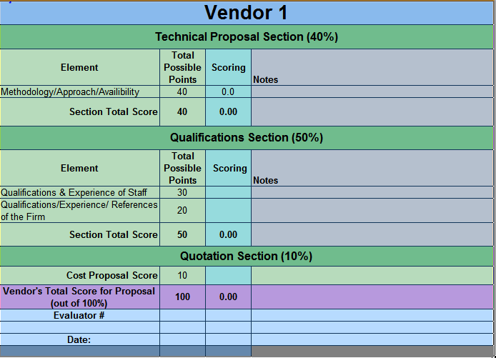
Review Your Scores
Notes:
Review your scores! After reading and scoring all of the proposals go back and review your scoring, giving consideration to equal weighting of your scoring of each element and each proposal. As you go from one proposal to the next it’s not unusual to change your view of other proposals. Adjust your scores as you see fit keeping in mind that your first impression is likely the most accurate. There are many differing approaches to reviewing and scoring proposals. Be logical - use what works for you.

Slide 27
Criteria
Preliminary Score | Weight assigned
Requirements/Criteria
Approach/Methodology/Availability | 40%
Qualifications and Experience of Staff | 30%
Qualifications/Experience/References of the Firm | 20%
Price Proposal | 10%
Oral Presentation/Interview (if used) | Pass/Fail
Notes:
Scoring criteria can be as simple as what’s shown or incredibly complicated. Use a method that aligns with the work being bid. The table below is simple and based on 100 points. Keep it simple if you can. But make sure you able to break down responses to adequately assess value.
I’ve heard of scoring criteria that was in excess of 3,000 different scored items.

Slide 28
The Process
Notes:
The process must provide a consistent opportunity for all.
We must say what we’re going to do and do what we said.
Vendor selection is the starting point of the project outcome.
Your job as an evaluator is important.
Vendors expend significant time, effort and energy (which translate to costs) in proposing.
They will adamantly compete for the business and respond accordingly if they feel they are not treated fairly. In other words they will protest. We all know a protest can blow up your procurement and project schedule.

Slide 29
Evaluation
Notes:
The evaluator is often most interested in the Management and Technical sections of the proposal. However, you will also want to know about the References, Resumes, Quality of previous performance, reputation and Work Samples etc., to establish Qualifications & Experience. You may want to review the proposal and Certifications & Assurances to determine if they took exceptions to terms and conditions. Evaluate each proposal against the solicitation requirements.

Slide 30
Technical Evaluation
Notes:
Technical (Approach/Methodology/Availability)
Understanding of project and proposed methodology
How do the proposed deliverables match RFP deliverables?
Are they proposing what you want done within your scope of work?
Do they have experience/process in place or will you pay them to create something new?
Project Management, internal controls and team structure
Who’s going to manage the contractor’s team?
What’s the reporting structure?
What internal controls are identified?
Quality of proposed work plan and description of deliverables

Slide 31
Competence
Notes:
Collective Professional Competence
Is their proposal succinct well written and easy to follow? The proposal should be their best work and indicative of the work they would do for us.
What do their sample reports look like? Can you work with their format and are they easy to follow?

Slide 32
Price Proposal
Notes:
Price Proposal The price proposal is typically calculated as a ratio and proportion. The lowest price gets the highest score and the rest are proportioned down either from the lowest or the average. There are many ways to calculate price scores. You need to score according to the way your procurement document states.

Slide 33
Oral Interviews & Demos
Notes:
Oral Interviews and Demonstrations: Are valuable to sort slick proposals from consultants who really know what they are doing but didn’t write well (determines winner, if required). Never let the interview turn into a sales pitch.
Be prepared with a list of questions that are the same for all interviews. Interviews need to be scheduled for a set time length. Have someone be the timekeeper and don’t go over for one and not another. That is a sure way to open up for protest.
You might provide the interviewees some general topics for the interview but if you send your questions in advance you’ll likely get canned answers. You want their answers on-the-fly. If they know their stuff is shouldn’t be difficult. However, if they mailed-it-in they will not show well.
The live interview also gives you an opportunity to see how team members and subcontractors interact. If the interaction is not good in the interview it will likely get worse under pressure to produce.
From memory have the Project Manager draw their project on whiteboard with the project, timelines, milestones and where they see any risks that are beyond their control.
If you require a software demo require that they get one of their customers who are using the software to provide the demo (teleconference if necessary). Have them walk through all the features and explain how they use them. This will prevent you from getting vaporware.
One method of conducting oral interviews is to interview each member of the team separately.

Slide 34
Final Selection
Notes:
Consensus Meeting: Come to the Consensus Scoring meeting with an open mind ready to see what others saw and to share your thoughts and experiences. If others evaluated differently ensure all understand why. Come to consensus on each proposal’s overall ranking.
Be prepared to select the vendor who is most likely to provide the best overall product or solution as seen by the group.
As you might guess there will always be someone who scores higher and someone who scores lower. It is generally not an issue as long as they are consistent. When graphing, look for score(s) out of sync with the others. If each evaluator’s score for that bidder trends in the same direction then there is general consensus. It is an opportunity to discuss what the evaluator saw that caused them to buck the trend. Sometimes they have experience that will cause the rest of the team to rethink their scoring. Remember you are drawing on each evaluator’s unique background and experience.
When reading proposals’ does the proposal show that the vendor interprets your intent of the work the same way you do or does the proposal show different intent? If the proposer starts with different objectives it’s usually impossible to swing the work back in line with the intent of the project. Is the vendor proposing to do your scope of work, or theirs?

Slide 35
Insights
Notes:
1 Project Manager - Review Intent with team
What’s important to success?
What is the background?
Why are we doing the work?
What results are expected?
What is the timeline for the work?
Read the solicitation
Read the Proposals
Read between the lines what’s said and what’s not said? Were they in the room or did they lead the discussion?
Put yourself in the proposer’s shoes.
What is being highlighted and what’s not?
Does the proposers plan fit together?
Do they demonstrate good organization and controls?
Does their business attitude/temperament match your specific need?
Are they proposing to do the work you need or are they proposing something different?
You’d like to have a high wow factor.
Wow they tied everything together and even thought of things we had not (without scope creep).
Wow this team is the best in the business.
Wow this is the best most succinct proposal I’ve ever seen (if the proposal is well written and succinct the work is more likely to be the same).
Do they walk-the-walk and talk-the-talk?

Slide 36
Questions

Slide 37
Contacts
Kevin Greene
State Auditor’s Office
360-725-5574
Kevin.greene@sao.wa.gov
Scott Smith
Department of Enterprise Services
360-407-8722
Scott.Smith@des.wa.gov

