Slide 1
Welcome to GREENING your workplace
Location or Date

Slide 2
Today’s Topic
Why Green?
Installing Organic Composting & Recycling In Your Facility
Buying GREEN off Master Contracts

Slide 3
Why Green?
There are a number of important reasons to Go Green with your facility. The most significant being that preserving the world’s natural resources is the responsibility of every individual both at work and at home.
Additional reasons for your agency to Go Green include:
Setting a positive example for employees which boosts morale and agency loyalty
Improving efficiency and potentially lowering operating costs
Providing a cleaner and healthier work environment

Slide 4
Installing Organic Composting & Recycling In Your Facility
Cory Noffsinger – DES Facility Planning & Management
November 5, 2015
Notes:
Pick a logo for the main page of your presentation. Delete the other logo.

Slide 5
What’s in our trash?
About 40-50% is recyclable material
Aluminum & tin cans
Paper/cardboard/corrugated paper board
Plastics of all kinds
Batteries
About 25-30% is organic compost
Food
Food contaminated paper
Pizza boxes
Coffee grounds/filter
Unwaxed paper plates, napkins
About 20-35% is trash
Old binders, pens, plastic packaging, paper clips etc.
Restroom & cleaning trash
Building maintenance
Electronic waste
CDs/DVDs
Chargers
Surplus items
Desk furniture – in/out boxes, name plates etc.

Slide 6
Organic Composting
Getting Started
Executive Support
Gov. Inslee Results WA Goal 3 – Sustainable Energy & a Clean Environment
Leased or owned facility?
May need to discuss service with waste resources contractor
Leased facility may need to have the lease altered to support commercial compost hauling
Local haulers have restrictions on accepted material and collection bags
Local haulers may have “canned” programs with hauling plans, signage & container options

Slide 7
Organic Composting
Getting Started
Executive Support
Gov. Inslee Results WA Goal 3 – Sustainable Energy & a Clean Environment
Leased or owned facility?
May need to discuss service with waste resources contractor
Leased facility may need to have the lease altered to support commercial compost hauling
Local haulers have restrictions on accepted material and collection bags
Local haulers may have “canned” programs with hauling plans, signage & container options

Slide 8
Communication
Stakeholder buy in
Communicate with all staff
Communicate about participation
Is it voluntary?
Help people understand that if they aren’t sure to err on the side of caution and place in trash
Lots of signage

Slide 9
Thurston County Signage

Slide 10
Installing a Recycle Program
Getting Started
Executive Support
Gov. Inslee Results WA Goal 3 – Sustainable Energy & a Clean Environment
Leased or owned facility?
May need to discuss service with waste resources contractor
Leased facility may need to have the lease altered to support commercial recycle hauling
Local haulers have restrictions on accepted material and collection bags
Local haulers may have “canned” programs with hauling plans, signage & container options

Slide 11
Communication
Stakeholder buy in
Communicate with all staff
Communicate about participation
Is it voluntary?
Help people understand that if they aren’t sure to err on the side of caution and place in trash
Lots of signage

Slide 12
Recycle Materials
Easily Recyclable Materials
Paper
Plastic
Bottles
Dairy containers (rinsed out)
Plastic around large deliveries
Metal
Aluminum & Tin cans
Glass

Slide 13
Less Easily Recycled Materials
Batteries
Work with a vendor
Fluorescent light tubes
Return to place of purchase
Packaging Material
Styrofoam

Slide 14
Closing
Thank you
Q&A

Slide 15
Green Products on Master Contracts
Kimberly Ward
Contracts, Procurement, & Risk Management
November 5, 2015
Notes:
Good Afternoon Everyone. My name is Kimberly Ward and I have the privilege of working for DES in Contracting with the Facilities, Grounds, and Recreation team. I have been asked to spend a few minutes with you on Green Products available on our master Contracts.

Slide 16
What is Green?
Energy efficient, durable and often have low maintenance requirements.
Free of Ozone depleting chemicals, toxic compounds and don’t produce toxic by-products.
Often made of recycled materials or content or from renewable and sustainable sources.
Obtained from local manufacturers or resources.
Biodegradable or easily reused either in part or as a whole.
Notes:
Before I tell you about what “Green” products are available, we have to understand what the definition of a green product is. Green, earth friendly. Eco friendly and many other buzzwords make you feel warm and fuzzy about the purchase, but sometimes is nothing but a Marketing word. Going green is about sustainability, ensuring that earth is habitable in years to come. So another good reason to go green is for the sake of future generations and family members that are yet to come. We describe a green product as one that has less of an environmental impact or is less detrimental to humans or the environment than the traditional product equivalent. There are select attributes that describe green products and services; Green products are…

Slide 17
How do you know it is Green?
Energy Star
A labeling program for energy efficient homes, building products, electronics and appliances. ENERGY STAR is a joint program of the U.S. Environmental Protection Agency and the U.S. Department of Energy helping protect the environment through energy efficient products and practices.
The Green Seal
Green Seal Certification ensures that a product meets rigorous, science-based leadership standards. It is a lifecycle assessment based labeling program for building products, green operations and maintenance procedures. A green seal can be found on anything from a coffee filter to a hotel.
Forest Stewardship Council
A certification program for wood products that come from forests that are managed in an environmentally responsible, socially beneficial and economical viable way. They are a non-profit organization, not affiliated with the government, working to promote responsible management of the world’s forests since 1993.
Leadership in Energy and Environmental Design (LEED)
The LEED certification was created by the U.S. Green Building Council in 2000, it in an internationally recognized standard for green building and design. The rating system works off 5 categories and is associated to both business and residential buildings. LEED focuses on whole building sustainability which can be used by diverse professionals and government agencies.
USDA Organic Certification
USDA certified organic foods are grown and processed according to federal guidelines addressing, among many factors, soil quality, animal raising practices, pest and weed control, and use of additives. Organic producers rely on natural substances and physical, mechanical, or biologically based farming methods to the fullest extent possible.
WaterSense:
The WaterSense label allows consumers to recognize products and programs that save water without sacrificing performance or quality.
Notes:
How do we know it is truly a “Green” product? A good rule of thumb is to look for the certification labeling. This leads us into what certification labels are available and what do they mean. We have put together this list . This is not a complete list, it will however provide you with the most common certifications and their meaning.

Slide 18
Green Products on Master Contracts
How do I find Green Products on Master Contracts?
Look for the green tree on the top of the project page
Select the “Contracts with green or recycled content” in the drop down for the Contract Search Tool
Notes:
DES has contracts for thousands of products and services needed by state government. Many of these contracted products and services are healthier and safer for people and protect our environment. These contracts are available for use by state agencies, colleges and universities, local governments, public utility districts, fire districts, and qualifying nonprofit organizations. State contracts leverage the purchasing activity of many entities for the best pricing while supporting the purchase of environmental preferred products and services.

Slide 19
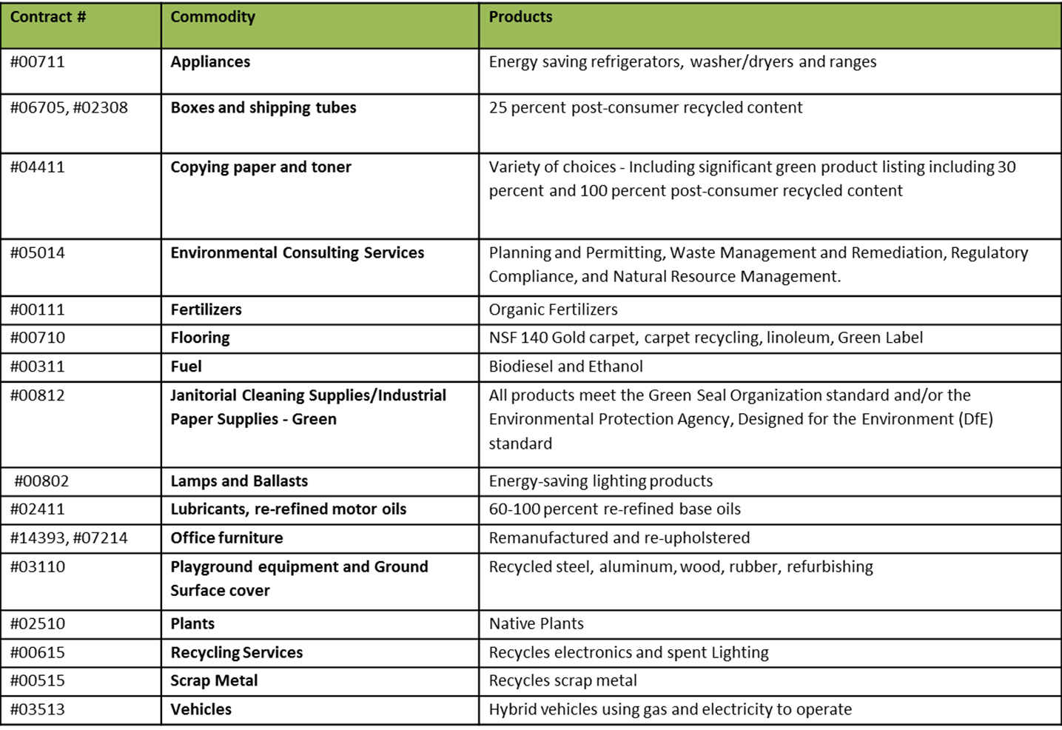
Notes:
What are some environmentally preferable products and services available on state contracts?
The state contracts referenced on the screen include products and services that have some environmentally preferable attributes.

Slide 20
Closing
Thank you
Q&A

