Slide 1
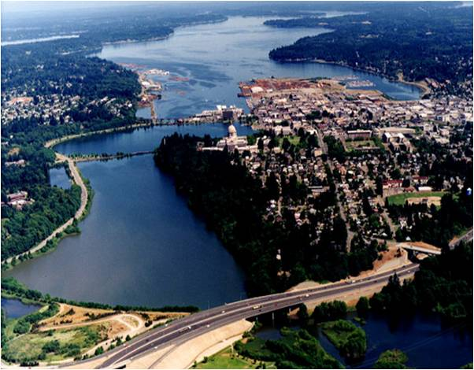
Briefing on Capitol Lake Planning
House Capital Budget Committee
March 24, 2011
General Administration
Fish & Wildlife
Ecology

Slide 2
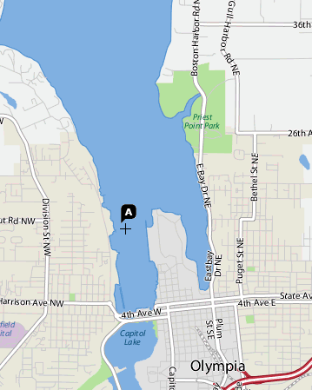
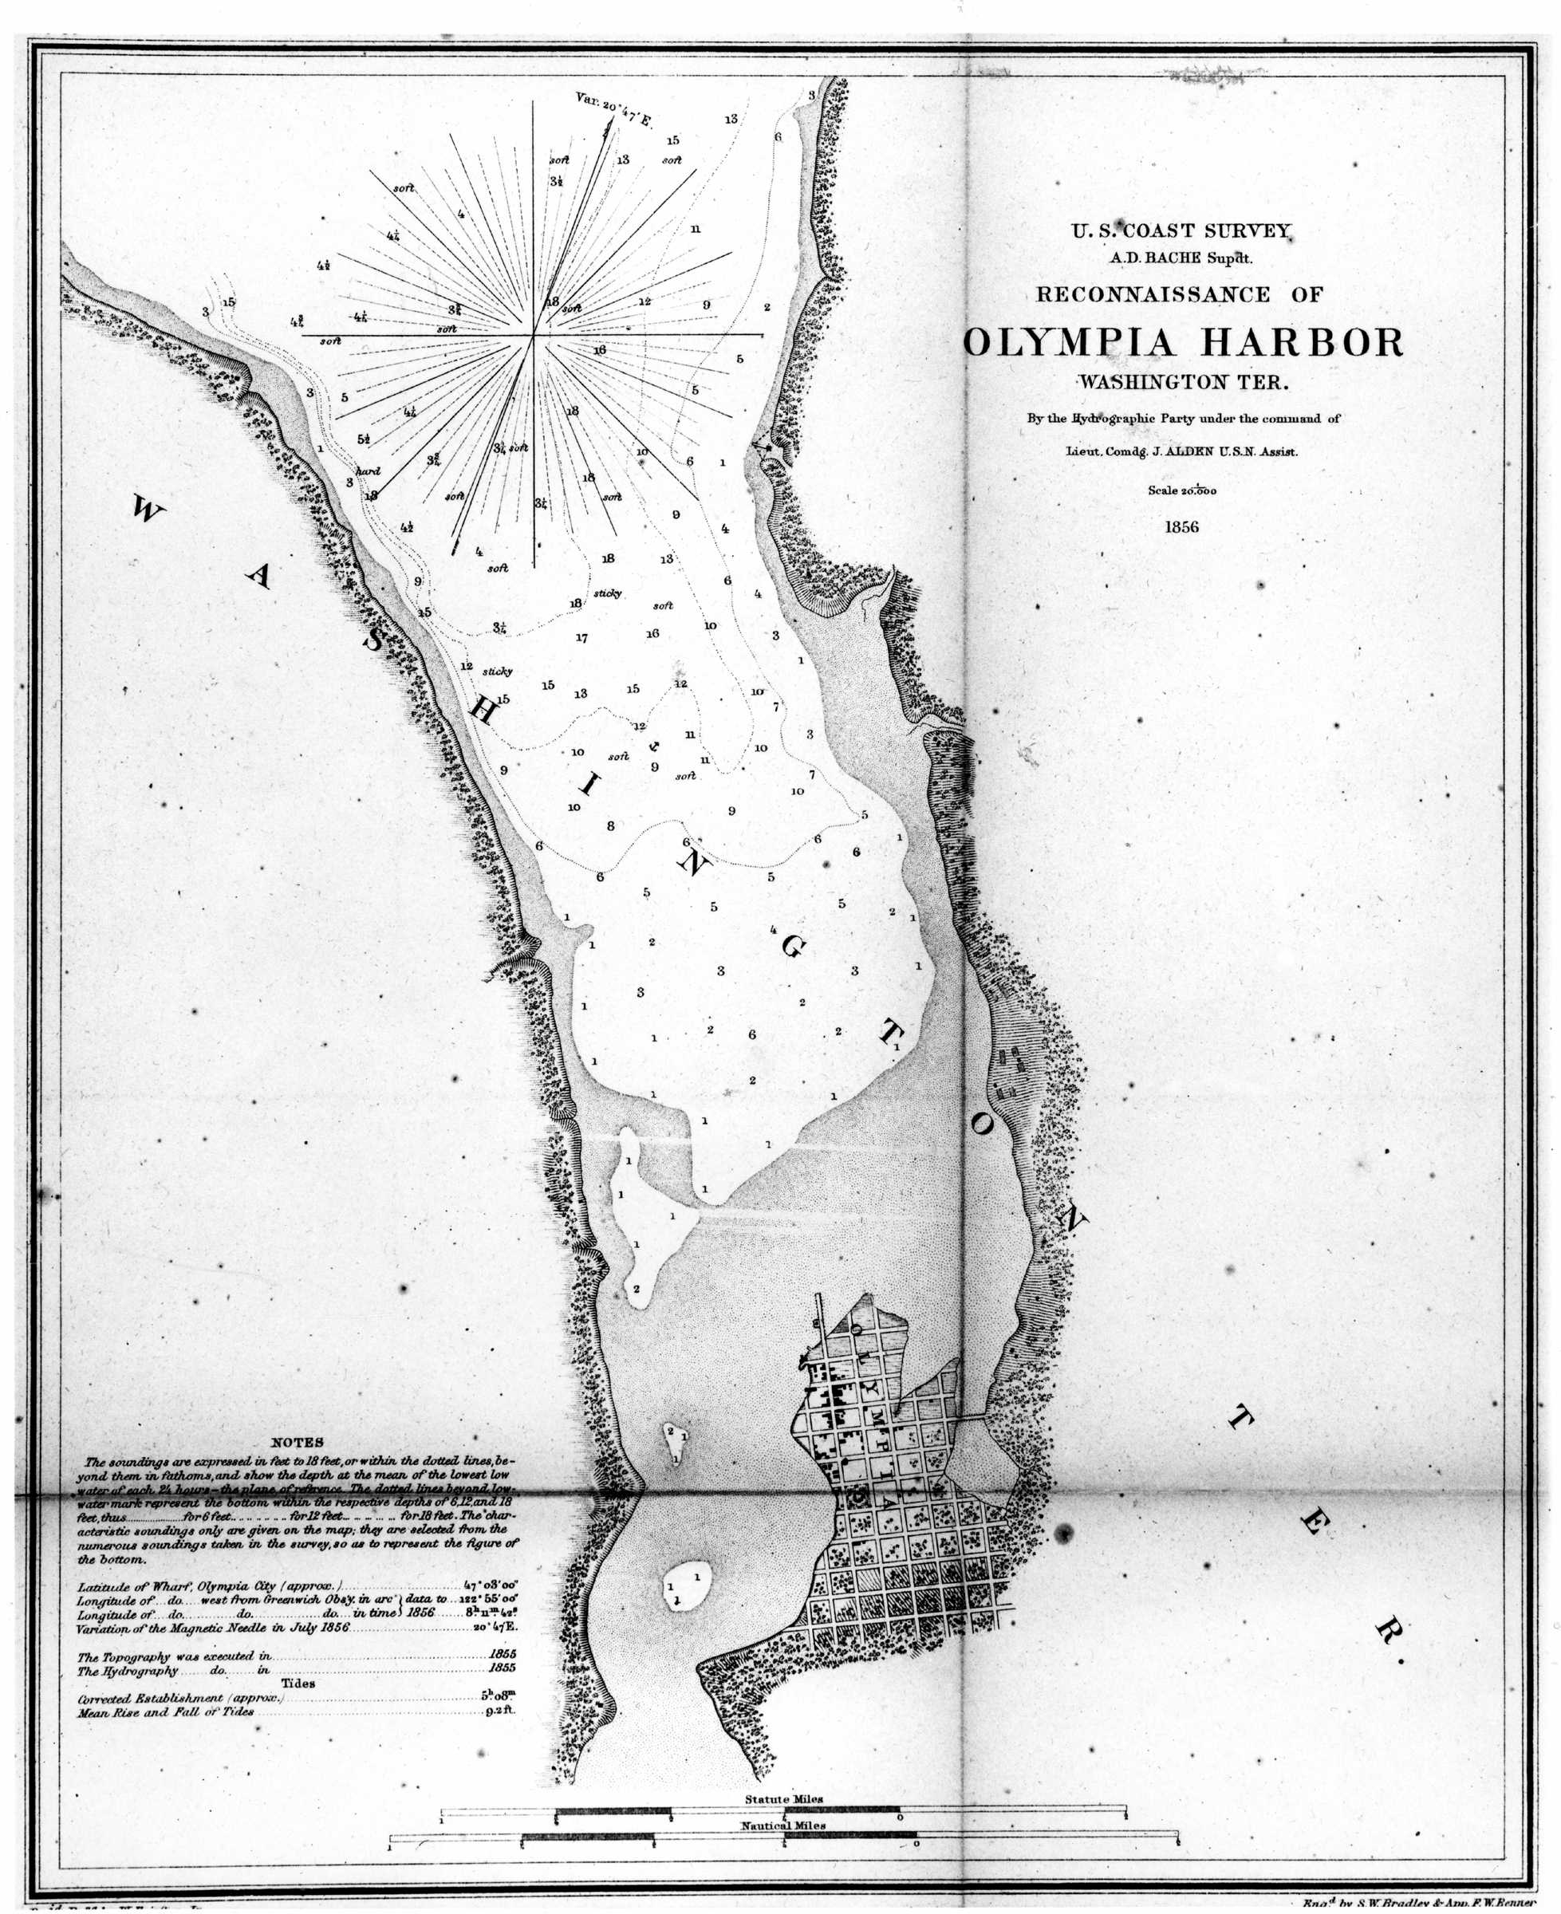
Capitol Lake – Background
1855 - Edmund Sylvester donates 12 acres on a bluff overlooking Budd Inlet for construction of a state capitol building.
1856 - U.S. Coast Survey, Department of the Navy (right).
1893 - Ernest Flagg completes a plan for Capitol buildings, but construction is halted in an ensuing economic downturn.

Slide 3
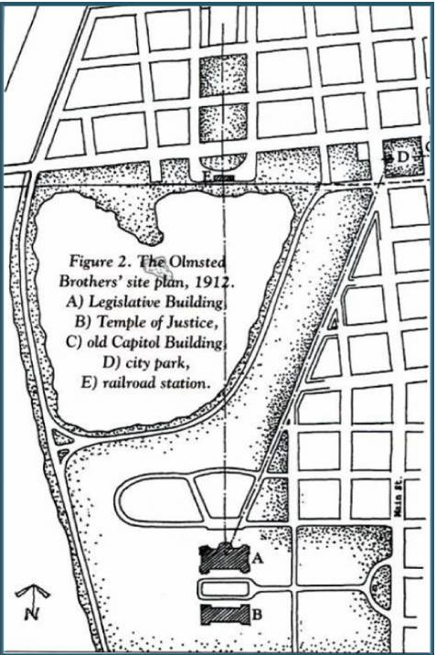
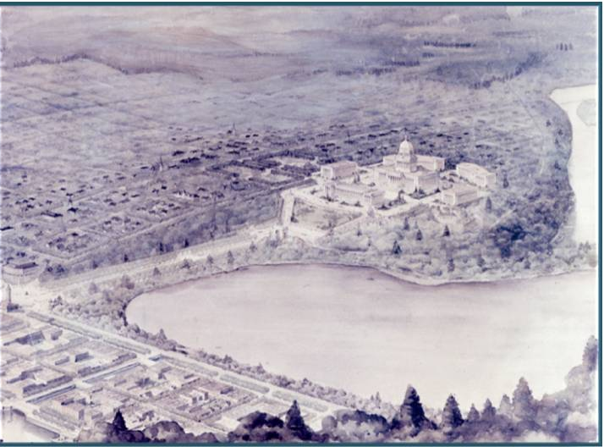
Capitol Lake – Background
1911 - State Capitol Commission hires Wilder and White (architects) and Olmsted Brothers (landscape designers) to develop the Capitol Campus.
Wilder & White Perspective Drawing - undated
Olmstead Plan Drawing - 1912

Slide 4
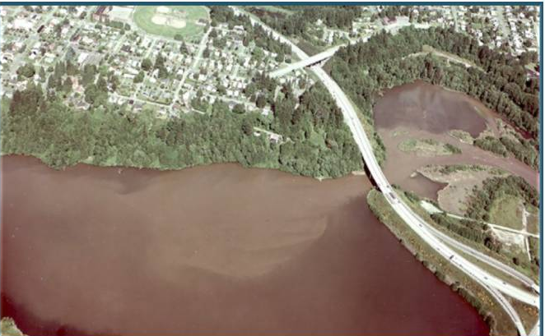
Creation of CLAMP
1951 - Present ~2,000,000 cubic yards of sediment build up in the lake basin (Dredging from 1978 to 1986 moved ~314,000 cubic yards within the basin to create parks or wetlands).
1995 - GA prepares proposal to dredge for lake management.
Sediment flowing in under I-5 bridge
1997 - GA withdraws dredge proposal - Capitol Lake Adaptive Management Plan (CLAMP) agreement is signed.
Initial members are GA, Ecology, WDFW, Thurston County, City of Olympia, City of Tumwater, and the Squaxin Island Tribe - DNR and the Port of Olympia join in 1999.

Slide 5
CLAMP 10-Year Plan (2002)
Adaptively manage the Capitol Lake basin.
Complete an estuary feasibility study to determine a long-range management decision.
Restore earthquake damaged state infrastructure within the basin.
Complete the development of Heritage Park.
Expand and enhance public use of State owned lands and adjacent public spaces within the Capitol Lake Region.
Develop and implement a flood hazard management strategy to protect lands adjacent to Capitol Lake.
Rehabilitate the fish ladder in the Capitol Lake dam to provide year-round fish passage into and out of Capitol Lake.
Relocate the Percival Cove fish rearing operation and rehabilitate Percival Cove for other users
Improve lake edges to be fish, wildlife and people friendly.
Maintain Capitol Lake with fewer than 100 resident Canada geese.
Improve the water quality in Capitol Lake to meet State standards.
Eliminate the Purple Loosestrife and Eurasian Milfoil noxious weed infestations throughout Capitol Lake.
Develop and implement a comprehensive sediment management strategy for the Capitol Lake basin.
Communicate with the community, legislators, and the State Capitol Committee on a routine basis regarding Capitol Lake.

Slide 6
CLAMP Studies
Study expenditures from 2003 through 2009 totaled $1,064,000.
Deschutes Estuary Feasibility Study – considered four estuary alternatives
DEFS - Net Benefit Analysis - Stakeholder Involvement (June 2006)
DEFS Restoration Study Biological Conditions Report (September 2006)
DEFS - Hydrodynamics and Sediment Transport Modeling (October 2006)
Addendum to the DEFS Restoration Study Biological Conditions Report (January 2007)
DEFS - Engineering Design and Cost Estimates (February 2007)
DEFS Net Social and Economic Benefit Analysis (June 2007)
DEFS - Independent Technical Review (October 2007)
Deschutes Estuary Feasibility Study Final Report (June 2008)

Slide 7
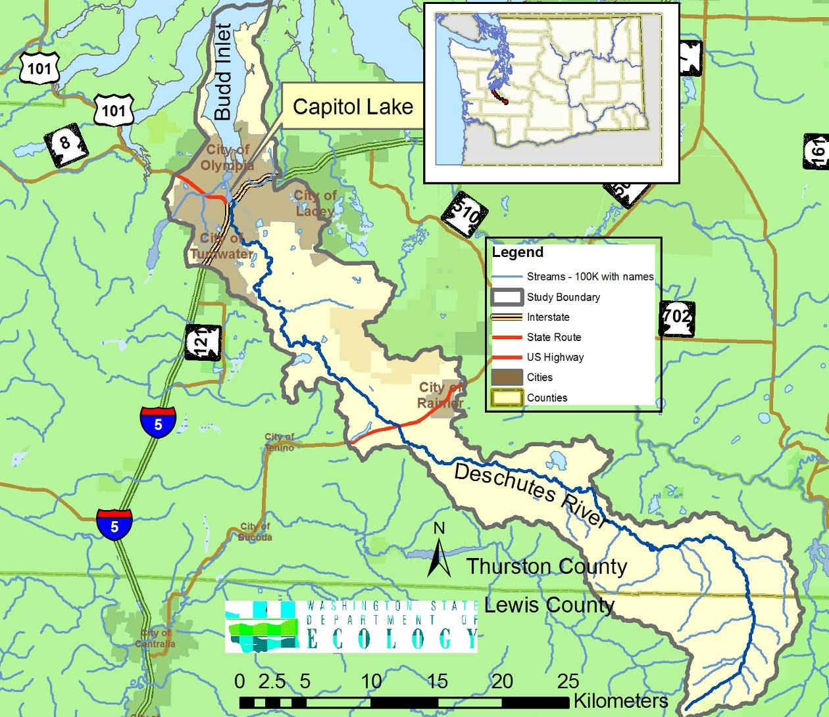
CLAMP Studies
Ecology delivers water quality report (TMDL) for Deschutes Watershed (2008).
[NOTE: Not a CLAMP expenditure, but included modeling and analysis that helped to inform the CLAMP process.]
The watershed does not meet standards for:
Dissolved Oxygen
Temperature
Fine Sediment
pH
Fecal Coliform

Slide 8
CLAMP Studies
Alternatives Analysis Studies
Implications of Capitol Lake Management for Fish and Wildlife (Sept. 2008)
Capitol Lake Alternative Analysis - Dredging and Disposal (August 2008)
Capitol Lake Dam Condition Assessment And Life Expectancy (Oct. 2008)
Capitol Lake Alternative Analysis - Low Lying Infrastructure (Nov. 2008)
Capitol Lake Alternative Analysis - Hydraulic Modeling (Nov. 2008)
Capitol Lake Alternatives Analysis: Incorporation of Fine-Grained Sediment Erodability Measurements Into Sediment (2008)
Study of Cultural & Spiritual Values Associated with Future Alternatives for Capitol Lake Basin (2009)
Alternatives Analysis - Dredging and Disposal Addendum (March 2009)
Community Economic Values for the Capitol Lake Basin (May 2009)
Capitol Lake Alternatives Analysis Final Report (July 2009)

Slide 9
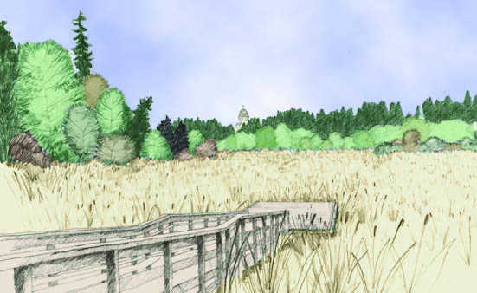
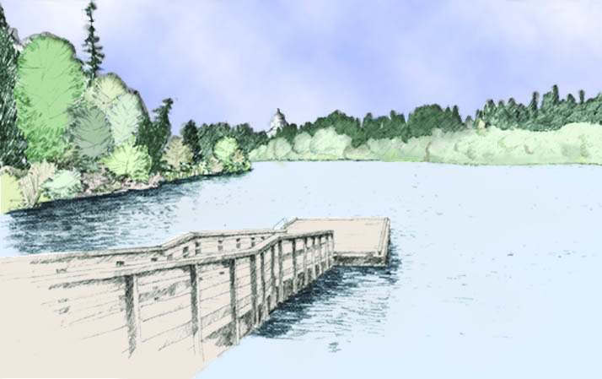
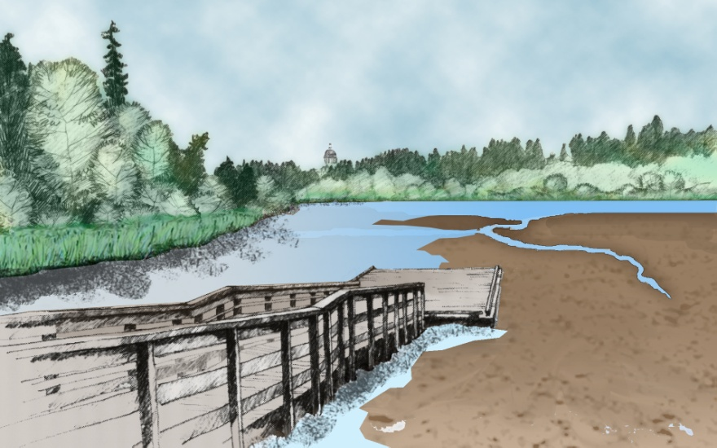
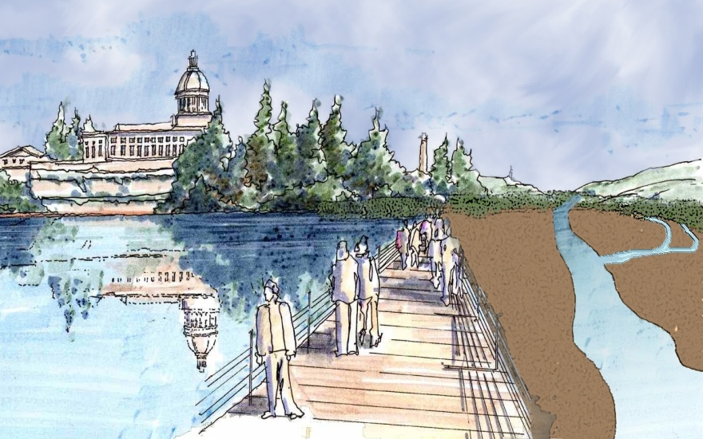
CLAMP Alternatives Analysis
Status Quo
Managed Lake
Estuary
Dual Basin

Slide 10
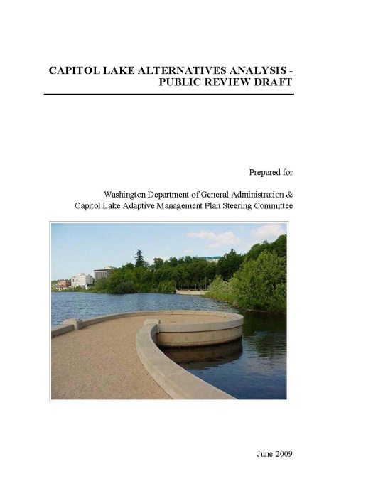
CLAMP Alternatives Analysis
Environment:
Sediment Management
Plants and Animals
Water Quality
Economy:
Infrastructure
Downtown Flood Risk
Long Term Cost
People:
Public Recreation
Cultural and Spiritual Values

Slide 11
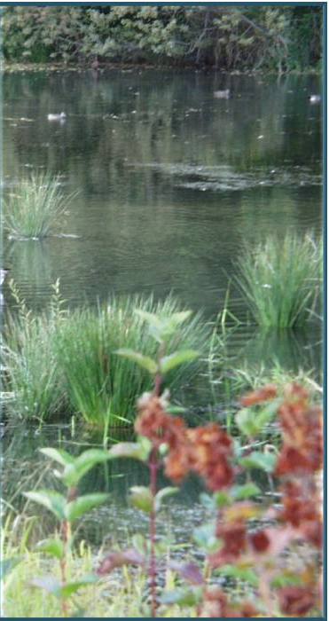
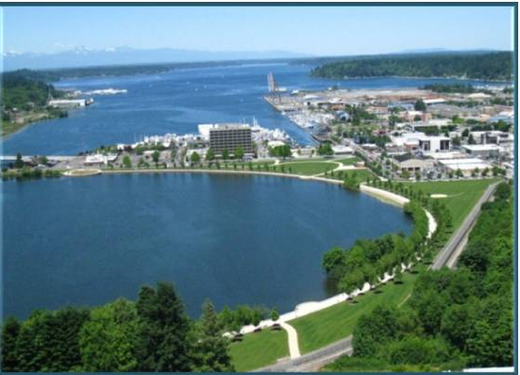
CLAMP Alternatives Analysis
Environment
  Sediment Management
  Plants and Animals
  Water Quality

Slide 12
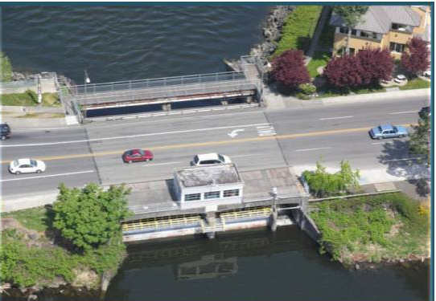
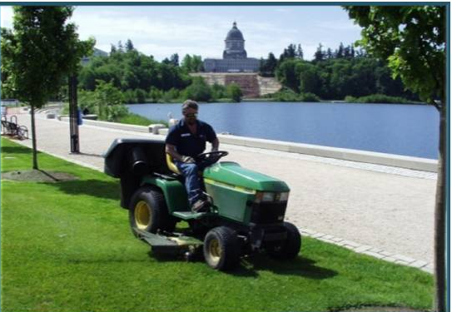
CLAMP Alternatives Analysis
ECONOMY
  Infrastructure
  Downtown Flooding
  Long-term costs
SOCIAL
  Public Recreation
  8. Cultural & Spiritual values

Slide 13
Total Costs - (50 Years)
CLAMP Alternatives Analysis
 | Infrastructure |  | Flood Control |  | Initial Dredge |  | Maintenance Dredges |  | Total
 | Low | High | Low | High | Low | High | Low | High | Low | High
status quo | $2 | $4 | $2 | $4 | $0 | $0 | $0 | $0 | $4 | $8
managed lake | $2 | $4 | $2 | $4 | $74 | $146 | $113 | $168 | $191 | $322
estuary | $57 | $63 | $2 | $4 | $16 | $23 | $40 | $135 | $115 | $225
a dual basin | $85 | $92 | $2 | $4 | $16 | $23 | $40 | $135 | $143 | $254
All Figures in Millions

Slide 14
CLAMP Community Engagement
The CLAMP steering committee engaged the community by:
  Hosting thirteen open forums in the community
  Posting 10 interpretive signs around the north basin
  Taking public comments at monthly CLAMP meetings since 1997
  Maintaining a website with all the reports and agendas
  Publishing nine factsheets
  Making presentations to schools and civic groups
  Sponsoring focus groups
  Soliciting comments on the Values Report
  Soliciting comments on the Alternatives Analysis Report
  Briefing local governments, CCDAC, SCC, and others
  Collecting emails, letters, website feedback, and public comments
  Cooperating fully with the press to get information out

Slide 15
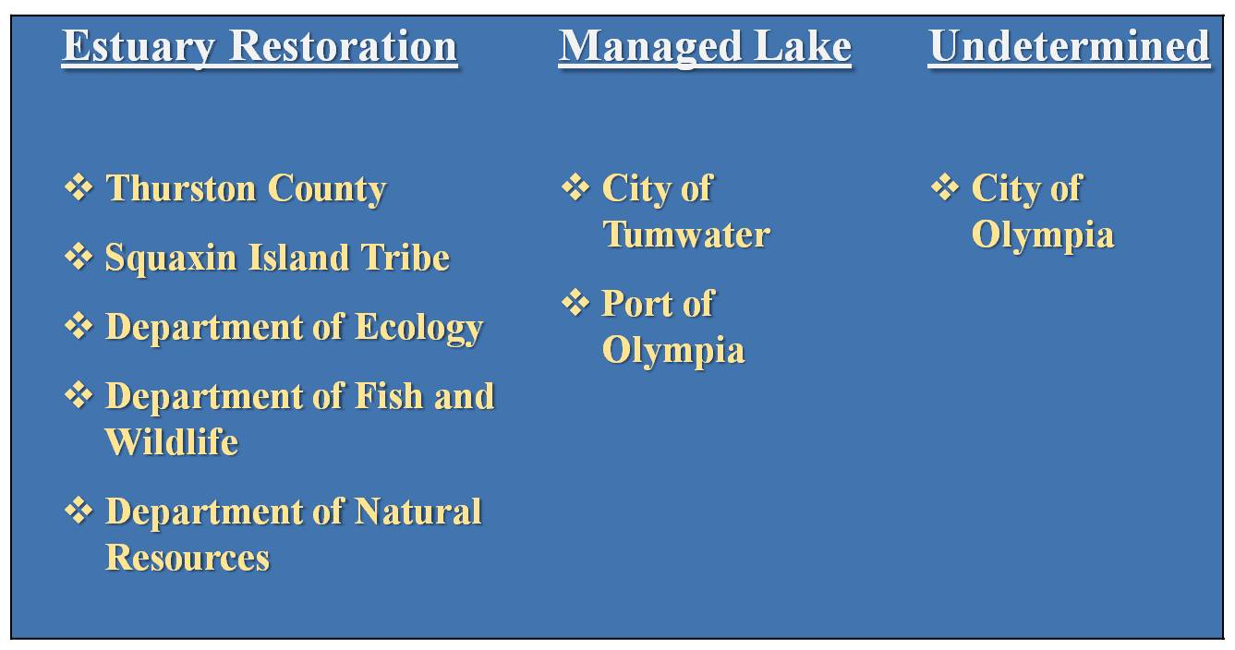
CLAMP Recommendation

Slide 16
CLAMP Recommendation
The comprehensive estuary recommendation calls for cleaning up lower Budd Inlet, addressing upstream issues, and revising governance of the basin.
All members supported certain common outcomes:
Development of an implementation plan which recognizes:
  the placement of the lake within the larger watershed,
  the need for long-term solutions which are economically durable, and
  community interests through coordinated and collaborative approaches
Protection of fish passage for the Deschutes River;
Development of an equitable cost sharing structure between all relevant stakeholders and beneficiaries;
Development of a sediment management strategy for the lake basin; and
Identification of potential funding opportunities.

Slide 17
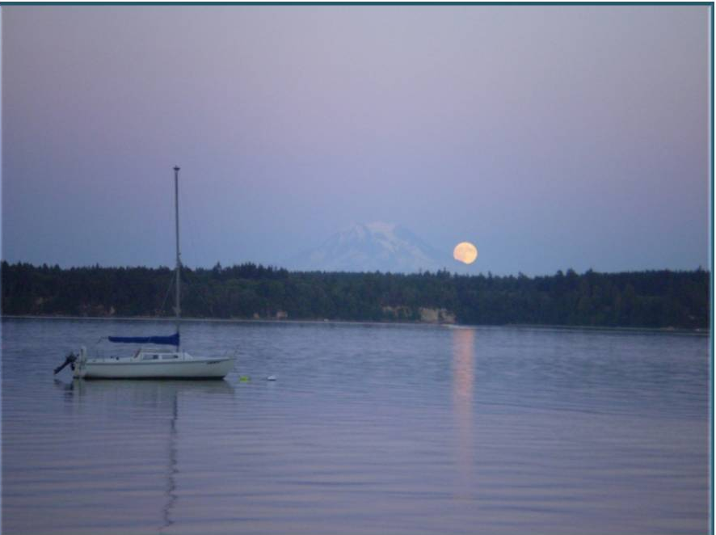
Concurrent Activities
Deschutes Water Quality Planning
Puget Sound Restoration
Budd Inlet Toxics Cleanup
South Sound Dissolved Oxygen

Slide 18
Capitol Lake - Next Steps
The State Capitol Committee and the State Legislature are responsible for determining any long-term management strategy (lake, estuary, dual-basin, or other option).
Permitting for such a management strategy is projected to take four to six years and involve more than 20 different federal, state, local, and tribal government authorities.
GA continues to manage day-to-day operations of the Capitol Lake basin, including invasive species control, dam operations, and maintenance of current infrastructure.

