Slide 1
Form I-9
https://www.uscis.gov/i-9
The purpose of this form is document verification of the identity and employment authorization of each new employee whether they are a citizen or a noncitizen hired after November 6, 1986 to work in the United States.
When Do I Fill an I-9 Out?
This form needs to be completed whenever you are hiring someone into your agency
Transfer from one agency to your agency
Rehire
New Hire
Notes:
***Pass out a copy of form I-9***
The I-9 form can be pulled directly from the US Citizenship and Immigration Services website where they also have helpful information about the form such as fees, special instructions, and the form in different languages.
You will fill out this form for every new hire, re hire, and transfer employee to your agency.
This requirement does not apply to employees hired on or before November 6, 1986 who are continuing employment
Form I-9 is not required for independent contractors, employees employed by a contractor providing contract services (such as an employee leasing or temporary agencies) and are providing labor to you

Slide 2

Does Form I-9 Expire?
Every few years Form I-9 gets updated. Be sure to confirm which form you are using to check you are in compliance with your new hire.
Current Employee Form I-9’s do not need to be updated to the newest version unless there is reverification then only Section 3 needs to be updated.
Notes:
Be sure to check the expiration date of the Form I-9 for all new hires, transfers, and rehires. You do not need to go back and update all old forms to the newest version.

Slide 3

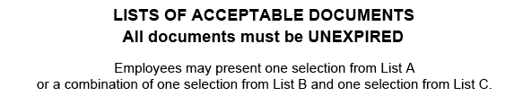
Instructions for Employees
All pages of the instructions and Lists of Acceptable Documents must be available, in either print or electronically, to all employees completing this form.
The Lists of Acceptable Documents is located at the end of Form I-9.
The Instructions are located at www.uscis.gov/i-9
Notes:
The most current instructions for Form I-9 along with the Lists of Acceptable Documents must be available to all employees who are completing this form.

Slide 4
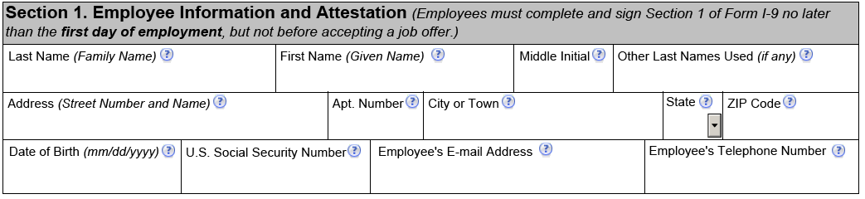
Section 1. Employee Information and Attestation
Employee must complete section 1 no later than their first day and never before they have accepted a job offer
Use a pen or a pencil
Every box must have something in it
Notes:
The very first page of Form I-9 is for the employee to complete. They must complete this section no later than their first day of hire but not before the job is offered.
Every box must have something in it whether it is N/A or the employee’s information

Slide 5
Section 1. Employee Information and Attestation Cont.
Last Name (Family Name) field: Enter full legal last name (ex: De La Cruz, O’Neill, Garcia Lopez, Smith-Johnson, Nguyen)
First Name (Given Name) field: Enter full legal first name (ex: Jessica, John-Paul, Tae Young, D’Shaun, Mai)
Middle Initial field: First letter of the middle name, if any. If multiple middle names, enter the first letter of the first middle name. Put N/A if no middle name.
Notes:
Last Name Field: The employee will enter their full legal last name. If they have two last names or a hyphenated last name, include both names in the Last Name field. If the employee only has 1 name, they will enter it in this field and then enter “unknown” in the First Name Field.
First Name Field: The employee will enter their full first name. If they only have one name, they will enter it in the last name field and enter “unknown” in this field.
Middle Initial Field: The first letter of their middle name. If the employee has multiple middle names, they will only place the first letter of their first middle name in this field. If they have no middle name, they must place N/A in this field.

Slide 6
Section 1. Employee Information and Attestation Cont.
Other Last Name (If Any) field: Provide all other last names used, if any (maiden names). Enter N/A if no other last names.
Address (street number and Name) field: Enter the street name and number of their current residence. PO Box’s cannot be used.
Apt. Number field: Enter apartment number. If they do not live in an apartment, enter N/A
Notes:
Other Last Name Field: If the employee legally changed their last name they will enter their previous last name in this field. If they never changed their last name, they will place N/A.
Address Field: Enter the street name and number of the current address of the employee’s residence. If their residence does not have a physical address, enter a description of the location of their residence, such as “3 miles southwest of Any-town post office near water tower”
Apt. Number field: Enter apartment number. If they do not live in an apartment, enter N/A

Slide 7
Section 1. Employee Information and Attestation Cont.
City or Town field: Enter city, town, or village in this field. If the residence is not located in a city, town, or village, enter the county, reservation, etc. in this field.
State field: Enter the abbreviation of the state in this field
Zip code field: Enter the 5-digit ZIP code
Date of Birth field: Enter the date of birth as a 2-digit month, 2-digit date, and 4 digit year (mm/dd/yyyy)
Notes:
City or Town field: Enter city, town, or village in this field. If their residence is not located in a city, town, or village, enter their county, reservation, etc. in this field.
State field: Enter the abbreviation of their state in this field
Zip code field: Enter their 5-digit ZIP code
Date of Birth field: Enter their date of birth as a 2-digit month, 2-digit date, and 4 digit year (mm/dd/yyyy)

Slide 8
Section 1. Employee Information and Attestation Cont.
U.S. Social Security Number field: Providing the 9-digit social security number is voluntary unless the employer participates in E-Verify. E-Verify is a web based system that allows enrolled employers to confirm eligibility of their employees to work in the US.
Employee’s E-Mail Address field: This is an optional field. This can be a personal email or a work email or N/A.
Employee’s Telephone Number field: This is an optional field. This can be a personal phone number or a work phone number or N/A.
Notes:
U.S. Social Security Number field: Providing their 9-digit social security number is voluntary unless the employer participates in E-Verify. E-Verify is a web based system that allows enrolled employers to confirm eligibility of their employees to work in the US.
Employee’s E-Mail Address field: This is an optional field. This can be a personal email or a work email or N/A.
Employee’s Telephone Number field: This is an optional field. This can be a personal phone number or a work phone number or N/A.

Slide 9
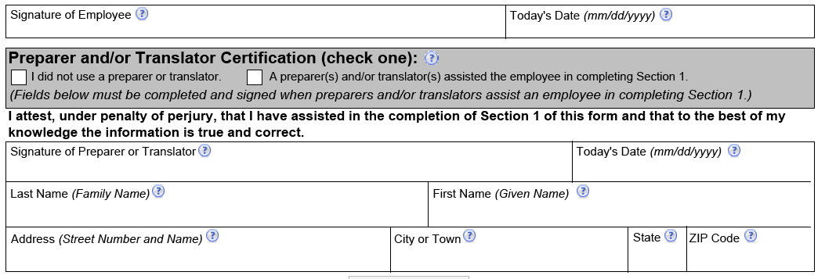
Section 1. Signing, Dating & Preparing/Translator
After Section 1 is complete, the employee will sign their name and place the date they completed the form in the date field
They will also check the box of whether they used a preparer and/or translator or not
Notes:
If the employee used a preparer/translator with the I9, the box indicating this must be checked. The preparer/translator will then fill out their personal information below

Slide 10
Presenting Form I-9 Documents
Within 3 business days from hire
Unexpired
Either 1 document from List A or 1 document from List B and 1 document from List C
Review the documents presented and confirm they reasonably appear to be genuine
Whoever reviews the documents must complete Section 2
Copies can be made and kept with the I-9 but are not required
Documents must be reviewed in front of the employee
Oddities to be Aware Of
Social Security Card does not need to be signed
Social Security Card cannot be laminated
Social Security Card does not need to have current last name on it
Passport cannot be expired
Tribal Document must be from a recognized tribe (www.bia.gov)
No photocopies (except for certified copies of birth certificates)
Notes:
Within 3 business days of starting work for pay, the employee must present to the employer documentation that establishes their identity and employment authorization. For example, if the employee begins work on Monday, they must present the documentation on or before Thursday of that week. However, if the employee is hired to work less than 3 business days, they must present the documentation no later than the first day of employment.
All documents cannot be expired at the time they are given to you
A receipt showing that the employee has applied to replace a document that was lost, stolen, or damaged can be given to you. The employee must present the actual document within 90 days from the date of hire.
A tribal document or Tribal card can be presented to you but it must be from a recognized tribe. To check to see which tribes are recognized by the U.S. Federal Government go to www.bia.gov

Slide 11
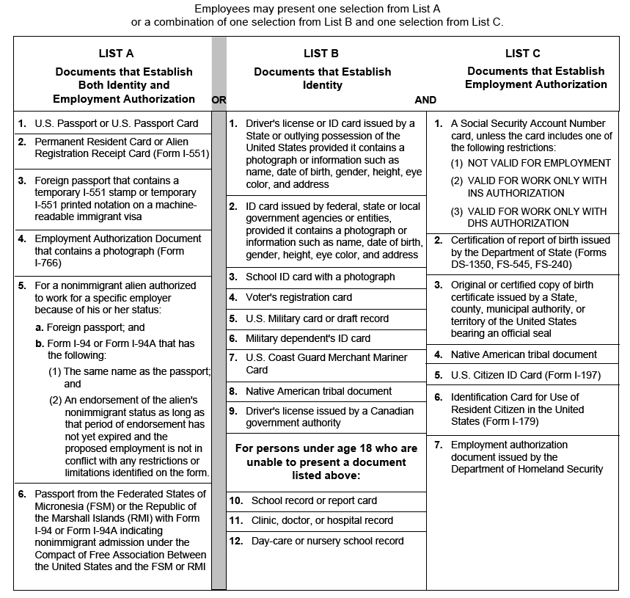
Acceptable Documents for I-9

Slide 12
Section 2. Employer or Authorized Representative Review and Verification
Make sure all parts of Form I-9 are properly completed by the employee in Section 1 before starting Section 2
If any errors are found, have the employee make the correction, initial, and date any corrections made

Slide 13
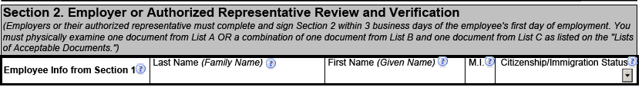
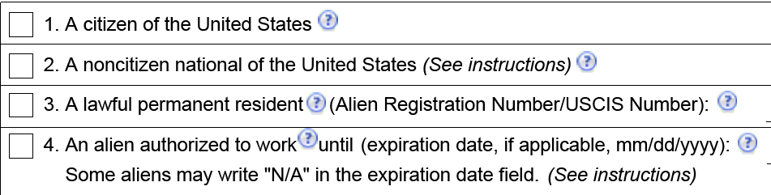
Section 2. Employer or Authorized Representative Review and Verification Cont.
You will enter the employee’s last name, first name, middle initial and citizenship/immigration status number that they placed on page 1 here
  The immigration status number is number 1-4 next to the checkbox of which type of citizen/immigration status they are
If they do not have a middle initial or a first name you will put N/A copying what the employee put
This ensures that the two pages of the form remain together

Slide 14
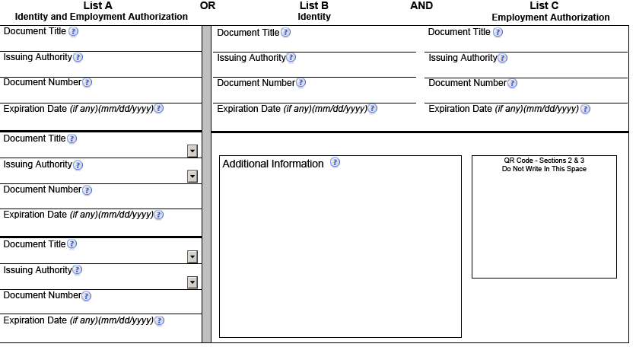
Section 2. Employer or Authorized Representative Review and Verification Cont.
Notes:
You, the employer or authorized representative, must physically examine, in the employee’s presence, the unexpired document(s) the employee presents from the Lists of Acceptable Documents to complete these fields.
You cannot specify which document(s) an employee may present from the lists.
It is your job to ensure that each document is unexpired, original (no photocopies, except for certified copies of birth certificates) documents.
Photo copies of the documents presented to you can be taken and retained with the I-9 if that is your policy but you must do photocopies of the documents for all new hires to avoid discrimination.

Slide 15
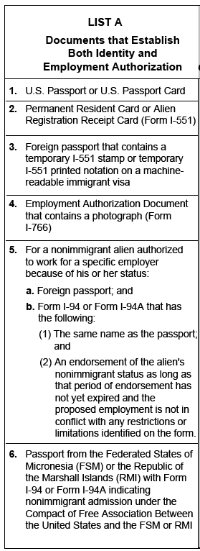
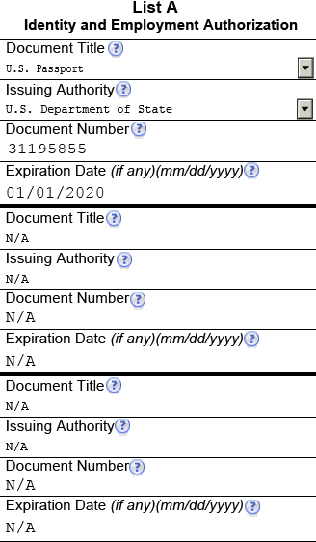
Section 2. Employer or Authorized Representative Review and Verification Cont.
Only an unexpired document from List A can be captured on the I-9 under List A.
You will need to capture what the document is (ex: U.S. Passport) under “Document Title”
You will need to capture who issued the document (ex: US Dept. of State) under Issuing Authority
You will need capture what the document number (ex: 31195855) is under Document Number
You will need to indicate the expiration date
Notes:
If the employee brings you a document from List A, you will need to capture it appropriately under List A column. List A documents establish both identity and employment authorization. No other documents needs to be provided and/or captured.

Slide 16
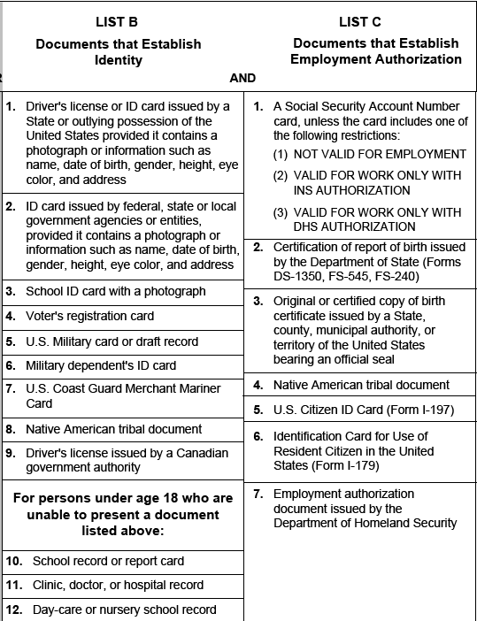
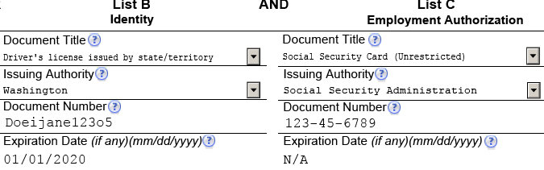
Section 2. Employer or Authorized Representative Review and Verification Cont.
If an employee does not bring a document from List A, they will need to provide a document from both List B and List C.
Capture what the document is under Document Title
Who issued it, for example – Washington for a WA drivers license or SSA (Social Security Administration) for a newer social security card
Document number and expiration date
Social Security cards do not have an expiration date – N/A can be placed here
Notes:
A document from both List B and List C must be provided if an employee does not have a document from List A. You cannot indicate what types of documents the employee must provide but you can provide common examples such as a passport, drivers license with a social security card.
The issuing authority must indicate which department issued the document. Department of Licensing issues drivers licenses and identification cards. Social Security Administration issues newer social security cards where as Department of Social Health Services issued later prints. The ring around the social security card will indicate which department issued the document.

Slide 17
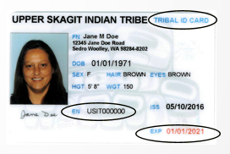
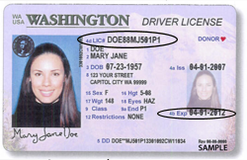
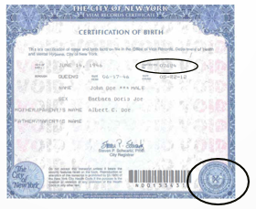
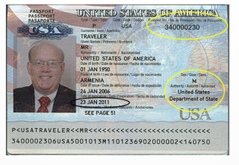

Where do I Find Who Issued the Documents?
Notes:
Here are some common documents that are presented to us at DES. This is where to locate the document number, the issuer, and the expiration date on these forms. Some documents may differ depending on when and where they were issued.
Be sure to confirm on www.bia.gov that the tribal card presented to you is from a Federally recognized tribe. If it is a recognized tribe, it can be placed in Both List B and List C to complete Section 2.

Slide 18
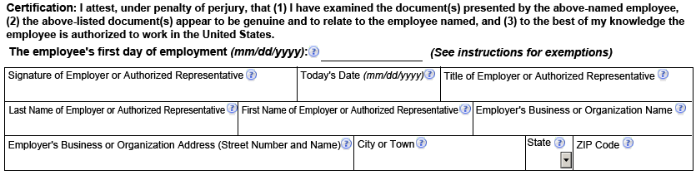
Section 2. Employer or Authorized Representative Review and Verification Cont.
Put the employee’s day of employment (this is not necessarily the first day in paid status)
Sign your name once the form is complete, the date, and your title
Write your last name, first name, and the agency you work for
List the organization’s physical address (if multiple, use the most appropriate address that identifies the location of the agency)
Notes:
Place the employee’s first day working for your agency. This isn’t always the first day in paid status. Sometimes, if an employee transfers from another state agency they will start on a Saturday or Sunday to avoid a break in state service. Check the completed PPDS from the HRMS team to verify.
Sign your name stating the information is accurate to the best of your knowledge.
Place the date the form is 100% complete
Your title
Write your legal last name and first name
Write the agency you work for
Write the agencies physical address down. If the agency has multiple locations, write the address that best identifies the location of the agency.

Slide 19
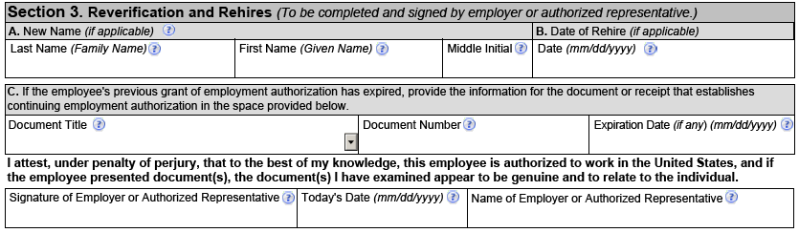
Section 3. Reverification and Rehires
This section applies to name changes, reverification from expired documents that require reverification, and rehires to your agency
Part A is only required if there is a name change
Notes:
Section 3 is only required to be filled out if you need to verify expired documents, a previous employee to your agency is being rehired and you have the original I9, or there is a name change.
For Name Changes, you will confirm they updated their name with the Social Security Administration and then place the new name in Part A.

Slide 20
Section 3. Reverification and Rehires Cont.
Part B is only required if the employee is rehired to your agency
  Rehired in 3 years from the date the Form I-9 was previously executed, you may rely on either the employee’s previously executed Form I-9 or complete a new Form I-9. After 3 years, a new Form I-9 is required
If the employee’s previous documents are not expired yet, provide the employee’s rehire date, any name changes if applicable, and sign and date the form
If the employee’s previous documents are expired, then reverification is required in Section 3 in addition to providing the rehire date. If the Form I-9 is not the most current version of the form, you must complete section 3 on the current form
Notes:
Rehires: If you rehire an employee back to your agency within 3 years from the date that the original Form I-9 was previously executed, you may either rely on the employee’s previous Form I-9 or complete a new Form I-9. If the employee is being rehired after 3 years, a new Form I-9 is required.
If you choose to rely on a previous completed Form I9, follow these guidelines
Confirm employment authorization has not expired in Section 1 and Section 2. If nothing is expired yet, provide in section 3 the employee’s rehire date, any name changes if applicable, and sign and date the form
If expired authorization in Section 1 or Section 2 that is subject to reverification, then re-verify new document(s) in Section 3 in addition to providing the rehire date. If the previous executed Form I-9 is not the current version of the form, you must complete Section 3 on the current version of the form
If you already used Section 3, but are rehiring the employee within 3 years, you may complete Section 3 on a new Form I-9 and attach it to the previously executed form.

Slide 21
Section 3. Reverification and Rehires Cont.
Part C is only required if the previous employment authorization has expired and is required to be verified upon expiration
  You should not verify U.S. citizen and noncitizen nationals, or lawful permanent residents (including conditional residents) who presented a Permanent Resident Card. Reverification does not apply to List B documents.
  An employee must present an unexpired document(s) (or a receipt) from either List A or List C showing they are still authorized to work. The employee is not required to show the same type of document that they presented previously.
If anything is added into Section 3, sign at the bottom
Notes:
Reverification: If the employment authorization documents have expired and are required to be reverified you will need to complete Part C for a current or rehired employee. Enter the information from List A or List C document(s) (or receipt) that the employee presented to reverify their employment authorization. All documents must be unexpired.

Slide 22
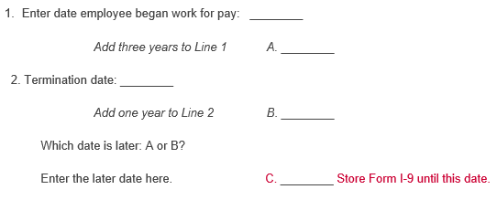
Retention of Form I-9
07/17/16
07/17/19
01/01/18
01/01/19
07/17/19
Employers are required to retain the pages of the form on which the employee and employer entered data on
If copies of documentation presented by the employee are made, those copies must be retained with the individuals Form I-9 in a secure location that can be presented within 3 days of an inspection request
Once the individual’s employment ends, the employer must retain Form I-9 and any applicable attachments for either 3 years after the date of hire or 1 year after the date of employment ended, which ever is later.

Slide 23
Commonly Asked Questions
Q. May I fire an employee who fails to produce the required documents within three business days of their start date?
A. Yes. You may terminate an employee who fails to produce the required document or documents, or an acceptable receipt for a document, within three business days of the date employment begins.
Q. May I accept a photocopy of a document presented by an employee?
A. No. Employees must present original documents. The only exception is that an employee may present a certified copy of a birth certificate.
Q. My new employee presented two documents to complete Form I-9, each containing a different last name. One document matches the name she entered in Section 1. The employee explained that she had just gotten married and changed her last name, but had not yet changed the name on the other document. Can I accept the document with the different name?
A. You may accept a document with a different name than the name entered in Section 1 provided that you resolve the question of whether the document reasonably relates to the employee. You also may wish to attach a brief memo to Form I-9 stating the reason for the name discrepancy, along with any supporting documentation the employee provides. An employee may provide documentation to support their name change, but is not required to do so. If, however, you determine that the document with a different name does not reasonably appear to be genuine and to relate to her, you may ask her to provide other documents from the Lists of Acceptable Documents on Form I-9.

Slide 24
Commonly Asked Questions
Q. My employee entered a compound last name in Section 1 of Form I-9. The documents she presented contain only one of these names. Can I accept this document?
A. DHS does not require employees to use any specific naming standard for Form I-9. If a new employee enters more than one last name in Section 1, but presents a document that contains only one of those last names, the document they present for Section 2 is acceptable as long as you are satisfied that the document reasonably appears to be genuine and to relate to the employee. It is helpful for individuals attesting to lawful permanent resident status who have more than one name to enter their name on Form I-9 as it appears on their Permanent Resident Card (Form I-551)
Q. The name on the document my employee presented to me is spelled slightly differently than the name they entered in Section 1 of Form I-9. Can I accept this document?
A. If the document contains a slight spelling variation, and the employee has a reasonable explanation for the variation, the document is acceptable as long as you are satisfied that the document otherwise reasonably appears to be genuine and to relate to the employee.

Slide 25

Questions? Comments?

