Slide 1

Leasing 101
Notes:
Pick a logo for the main page of your presentation. Delete the other logo.

Slide 3


DES Leasing Team
Jim Morgan – Accounting Services Manager
George Schuetz – Tech Leasing Consultant
Aaron Pittelkau – Business Operations Mgr.
Chris Dickinson – Asset Procurement & Mgt.
Brandy Evans – Fiscal Analyst, A/R & Billing

Slide 4
What is a lease?
A contractual arrangement between the Lessee (the customer)
and the Lessor (DES Financial Services).
DES purchases the equipment from technology suppliers (i.e. Dell, HP, or IBM) and leases it to the agency for a fixed, regular payment.

Slide 5

DES Capital Lease
A continuation of the leasing program agencies have used for years.
  DES acquires PCs for the agency and arranges COP financing with the State Treasurer.
  Agencies can take ownership of PCs or return them at the end of the lease.
DES is responsible for asset management and holds title to the equipment.
Warranty coverage is included in the lease. It coincides with the useful life of the PC
The agency chooses whether to deploy and decommission PCs with their own staff or acquire this life cycle service via master contract for an additional fee.
The agency makes monthly lease payments to DES through the term of the COP
Notes:
NOTE: Define COP

Slide 6
DES Capital Lease cont…
The maximum COP financing term equals the useful life of this asset class in the SAAM manual.
  DES must obtain OFM written approval for a shorter or longer term.
At the end of the lease term, the agency can choose for DES to:
  Remove the PCs. DES can replace them with new PCs through a new lease, or the agency can otherwise acquire new equipment as needed. DES transfers the used PCs to the Computers for Kids Program.
  Transfer ownership of the PCs to the agency. No further acquisition related payments are due.
  Extend the lease for an agreed period of time. Lease payments do not continue but service fees remain through the extension.

Slide 7

Accounting for the DES Capital Lease
DES owns the equipment and is responsible for accounting for the assets.
Agencies records lease payments as operating expenses.

Slide 8
Accounting for the DES Capital Lease
The DES Capital leasing
model will minimize
operating budget
“spikes”
due to equipment refresh
requirements
Notes:
NOTE: Maybe your audience will understand this but for me I would want more explanation of this

Slide 9
Why Do Washington State Agencies Lease Equipment?
Leasing is flexible
Leasing is practical
Leasing is cost effective
Leasing helps conserve your operating capital
Key advantage: DES Leasing Program permits 100 percent financing, and the term of the lease can be matched with the useful life of the equipment.

Slide 10
Pros-DES Capital Lease
DES Capital Lease
• Easy to refresh equipment every three to four years
• Avoid large lump sum cash outlay
• Expenditure predictability for budgeting
• Agency has flexibility in services and equipment leased, within COP criteria
• Ownership can be transferred to the agency at the end of the lease
• Agency could get more life out of equipment after lease expires
• DES provides asset management
• Tax exempt financing
• Spreading equipment costs over the useful life meets Federal regulations
Warranty service through equipment vendors or manufacturers, therefore reducing IT cost.

Slide 11

Benefits to leasing other than financial
Leasing can help expedite equipment replacement and modernization creating a positive impact across all aspects of an Agency.
Notes:
Additionally, most lease arrangements free managers from worrying about technology end-of-life disposition issues, including environmental considerations, data security and destruction, and compliance with ever-changing disposition laws. These become the responsibility of DES.

Slide 12
Can I cancel my lease?
A lease is by design, a non-cancelable contract. Agencies are responsible for all payments throughout the course of the lease.

Slide 13

Why Leasing Makes Sense for Your Agency
Leasing saves time and money.
Leasing assures your equipment is current
Notes:
The lease program offers flexible 36- to 60-month terms for equipment with a total value of at least $5,000.
As lease participants, agencies can replace old or obsolete equipment with the new technology, or acquire more cost-effective solutions and manage that solution throughout its lifecycle.
This disciplined technology replacement strategy helps agencies get current and stay current, apply best practices, and meet state standards.

Slide 14
Advantages to leasing
Pricing advantages through participation in the Western States Contracting Alliance (WSCA)
Predictable expenses month-to-month, that facilitates budget reporting and planning.
Equipment that complies with state configuration standards matching the right capacity with the productivity needs of staff.
Technology obsolescence is avoided.
Safe and environmentally sustainable end-of-life disposal practices.
Notes:
DES participation in the Western States Contracting Alliance (WSCA), which negotiates best discounts with equipment manufacturers for state agencies.
Save your capital budgets for other expenditures.

Slide 15


Slide 16
Who are eligible to participate?
All
Washington State Agencies may participate.

Slide 17
What can I lease?
Equipment must have value of $5,000.00
Desktop and Laptop computers
Servers plus Network Switches and routers
Printers & Scanners from several manufacturers
Tablets

Slide 18
Can I order equipment with custom configurations?
The OCIO may grant request for custom configurations based on clear business case
DES will forward request for custom configuration to ICIO for approval.

Slide 19
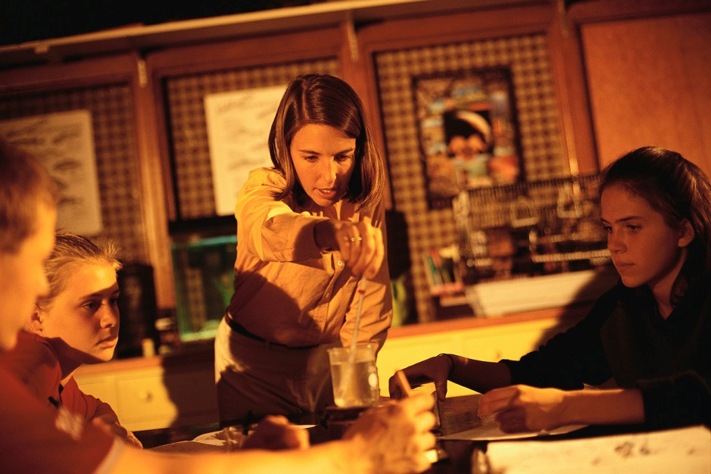
What happens to returned equipment?
The DES Leasing Program redistributes returned computers to Washington school districts and schools through the C4K program.

Slide 20
Technology Leasing Services
Master Lease Agreement
Number T12-LSE-XXX
for
Information Technology Equipment
and
Related Services Between the
Department of Enterprise Services (Lessor)
and
Lessee’s Name (Lessee)
Effective Date: ________________

Slide 21
Who are Current customers?
Board of Industrial Insurance Appeals
Department of Corrections
Department of Fish and Wildlife
Department of Agricultural
Department of Labor and Industries
Department of Retirement Services
Department of Social and Health Services
Board of Volunteer Fire Fighters
Health Care Authority
Liquor Control Board
Military Department
Veterans Affairs, Department of

Slide 22
Intrinsic Value of DES Leasing
Your Agency’s Lease:
Help’s smooth budget spikes
Facilitates rapid technology deployment
Facilitates standardization efforts
Provides an effective disposal strategy
Reduces Acquisition costs
Reduces Asset Management costs
Reduces IT Support costs

Slide 23

http://www.k12.wa.us/c4kids/default.aspx

Slide 24
School buildings and districts we served in past years
School District | City/County | # Computers Received
SD 112 | ESD 112 Special Ed Coop | 72
SD 112 | Multiple Schools in Ridgefield | 96
SD 112 | Clark County Skills Center in Evergreen | 24
SD 112 | Multiple Schools in Camas | 312
SD 112 | Klickitat High School in Klickitat | 24
SD 112 | Multiple Schools in Willapa Valley | 48
SD 113 | Multiple Schools in Montesano | 48
SD 113 | Multiple Schools in Toledo | 48
SD 113 | Multiple Schools in Olympia | 288
SD 113 | Multiple Schools in Hoquiam | 144
SD 113 | Multiple Schools in Kalama | 48
SD 113 | Multiple Schools in Rochester | 24
SD 113 | Multiple Schools in North Beach | 72
SD 114 | Multiple Schools in Sequim | 72
SD 114 | Clallam Bay Elementary in Cape Flattery | 24
SD 189 | Highline CHOICE Academy in Highline | 24
Notes:
Based on a projected average of standards-based surplus computers available monthly from DIS lease returns for the Computers 4 Kids program, the following list of school buildings and districts will likely receive their computers during 2009. For a total of 1368 computers distributed.

Slide 25

Feedback from Schools
“Just wanted to let you know what a great success story the Laptops you gave from surplus to Tenino High School were.”

Slide 26
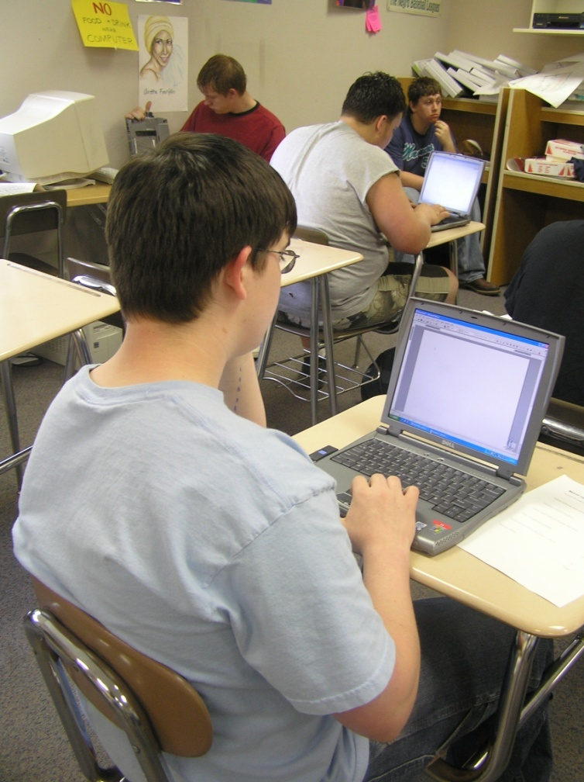
Feedback from Schools
“We have them in a cart, and wheel them from classroom to classroom. They are in continuous use and have been used for 120 straight school days! Thanks again!”

Slide 27
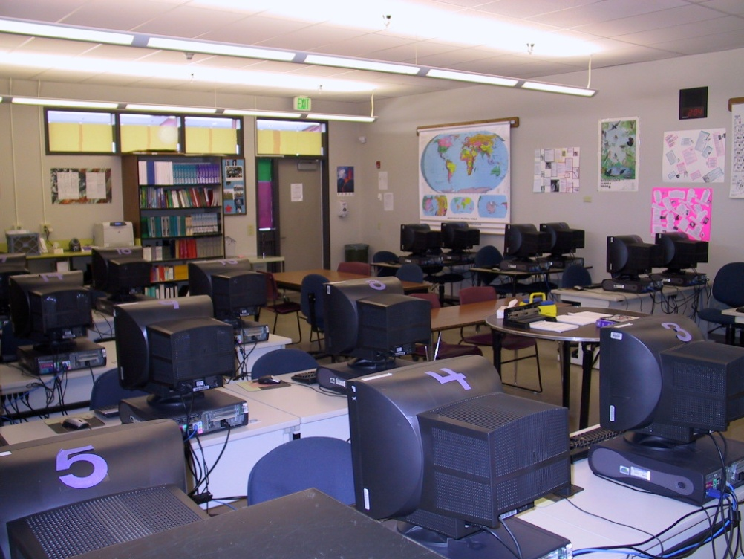
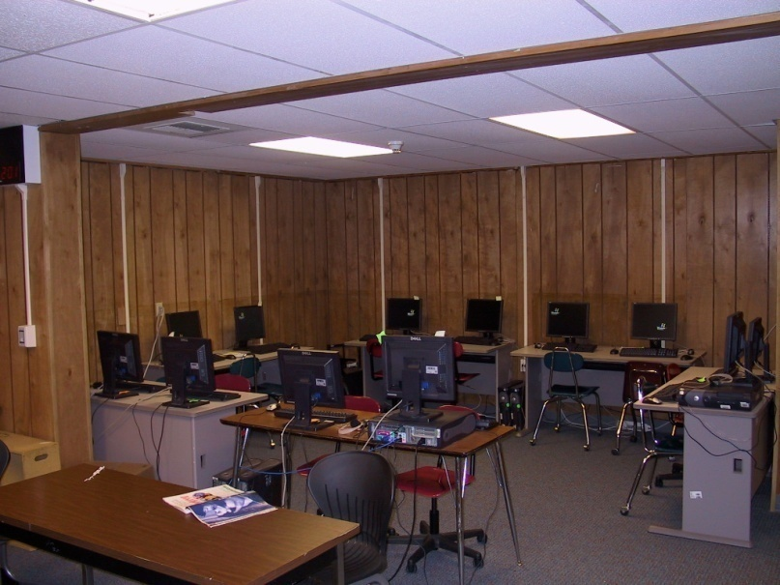
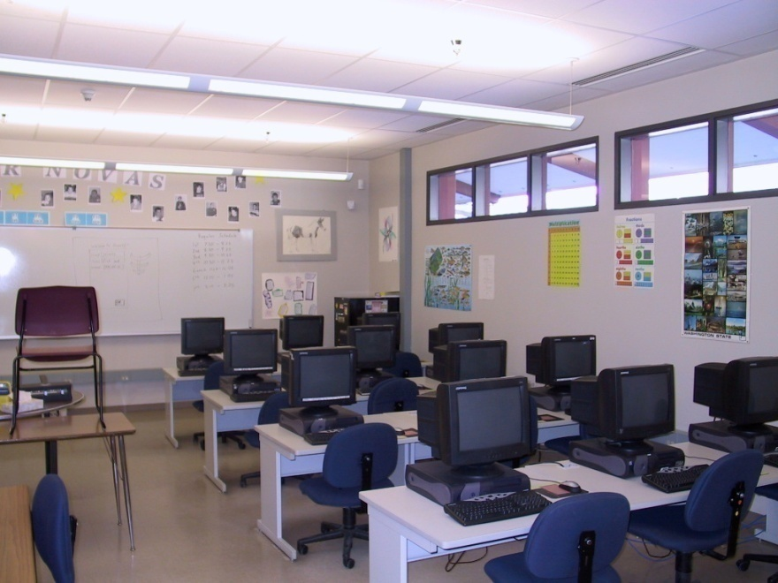
Yelm Community Schools
Thank you!

Slide 28
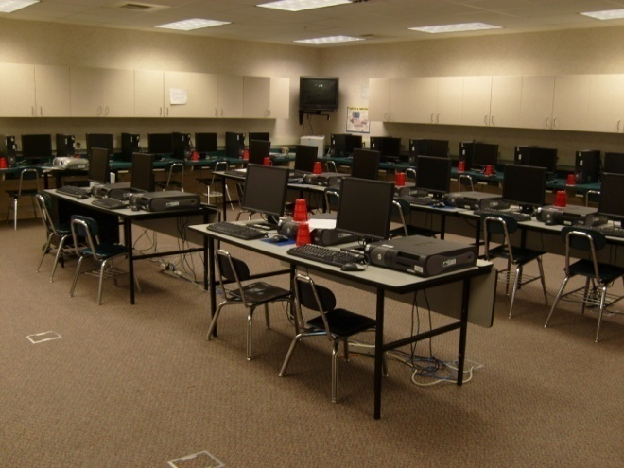
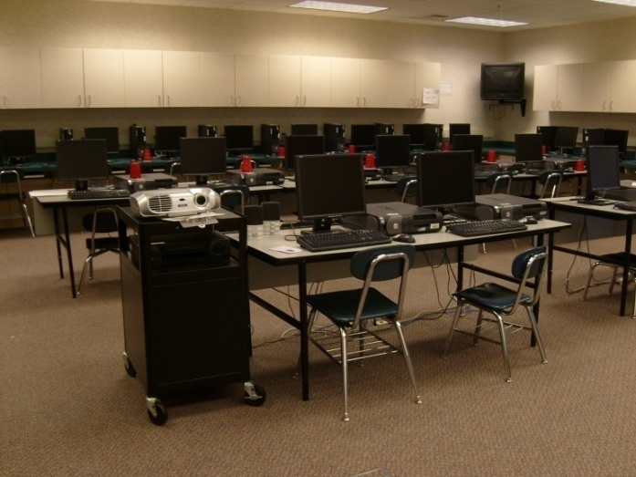
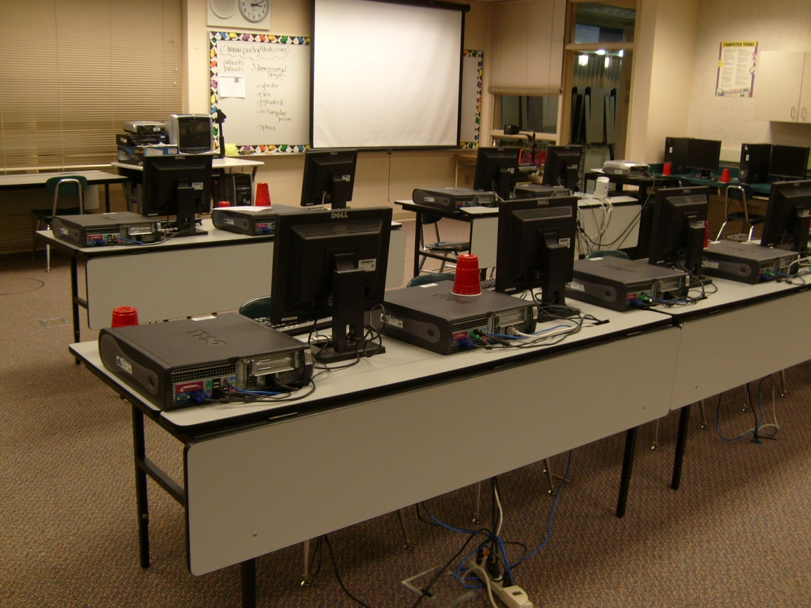
Liberty Lake Elementary
Central Valley School District
“All equipment is computers for kids.
Thank you so much for what you have done for Central Valley School District.”

Slide 29
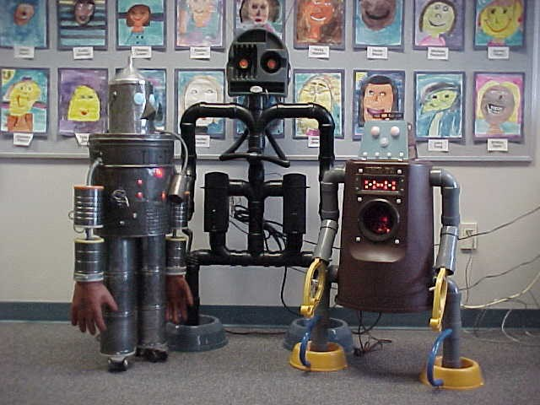
Meredith Hill Elementary School

Slide 30
Thank you
Questions?

