Slide 1
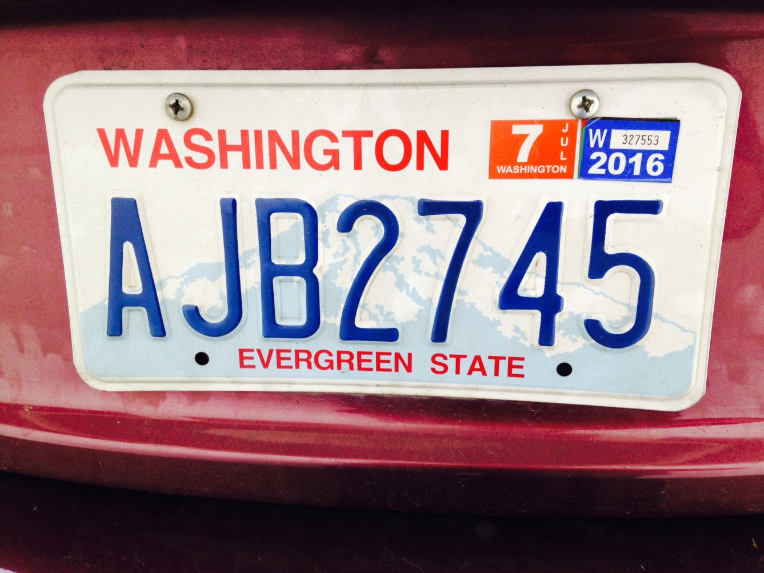

DES Energy
Notes:
We already have a great example here in Washington state, where making services better for our customers reduced GHG emissions. Remember when you had to go to a waiting room to get your vehicle license renewed? DOL has a great website, where I renew my vehicle license in just a few minutes, without leaving my house. Now I don’t know why DOL did this. They didn’t do it to reduce GHG emissions, as far as I know. They did make their services better for their customers, and it certainly must cost less than maintaining large waiting rooms. Is there a great opportunity out there for your agency and your customers? I don’t know. Only you know your services and what your customers need.

Slide 2
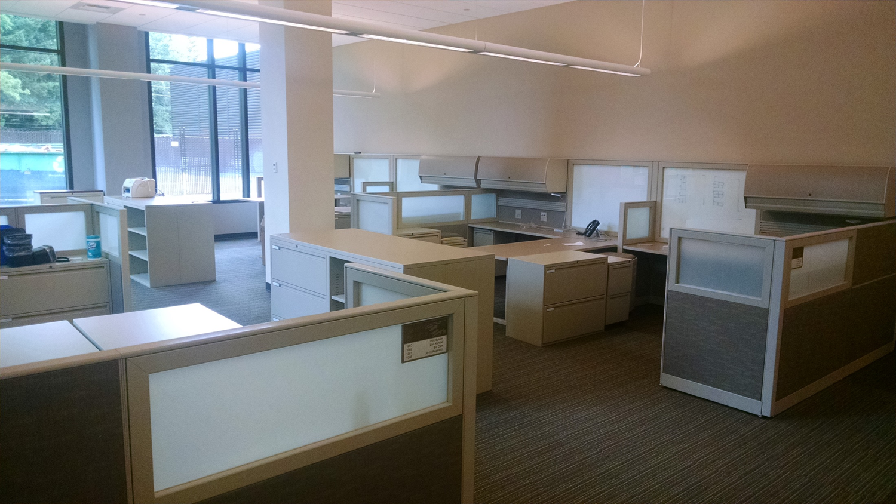
DES Energy
Notes:
So back to reality (cubicle farm). How do we get from here.

Slide 3
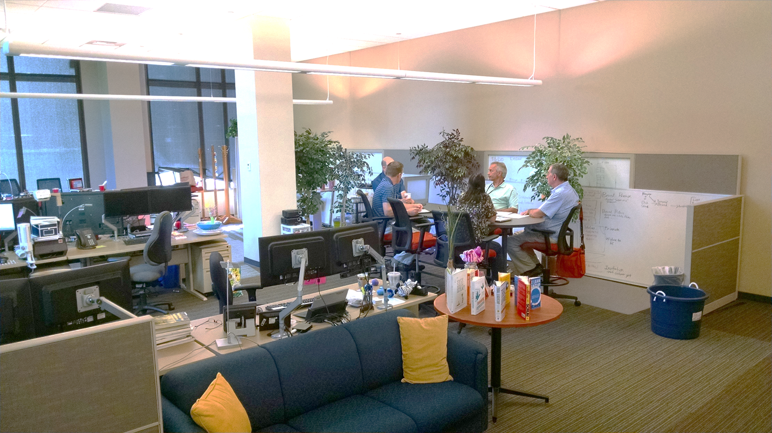
DES Energy
Notes:
To here?
How do you eat an elephant? A bite at a time. Start with MOBILITY and GREAT IT SUPPORT. GET EXEC LEADERSHIP BUY IN. TRY A SMALL PILOT PROJECT OR TWO, TO LEARN WHAT WORKS WELL FOR YOUR AGENCY. Several state agencies are trying out pilots. Here are some examples from WaTech and DES:

Slide 4
DES Energy
Occupant Configurable Space
WaTech Example
(before)
Notes:
Here’s a WaTech Configurable Space example: photo of space before, 8 cubicles

Slide 5

DES Energy
Occupant Configurable Space
WaTech Example
(after)
Notes:
WaTech Configurable Space example: photo of space after
Young, creative employees at WaTech prefer flexible space to cubicles.
They increased density by 25%
From 8 cubes to 10 desks
Avoiding approximately $16k/year in space costs
They are creative and frugal
Used the desks from the original cube
Used furniture moving disks instead of
wheels
Used the partitions to distribute power
They let the team own the space
The team moves the furniture to accommodate their needs
They minimize personal space to maximize shared work space

Slide 6
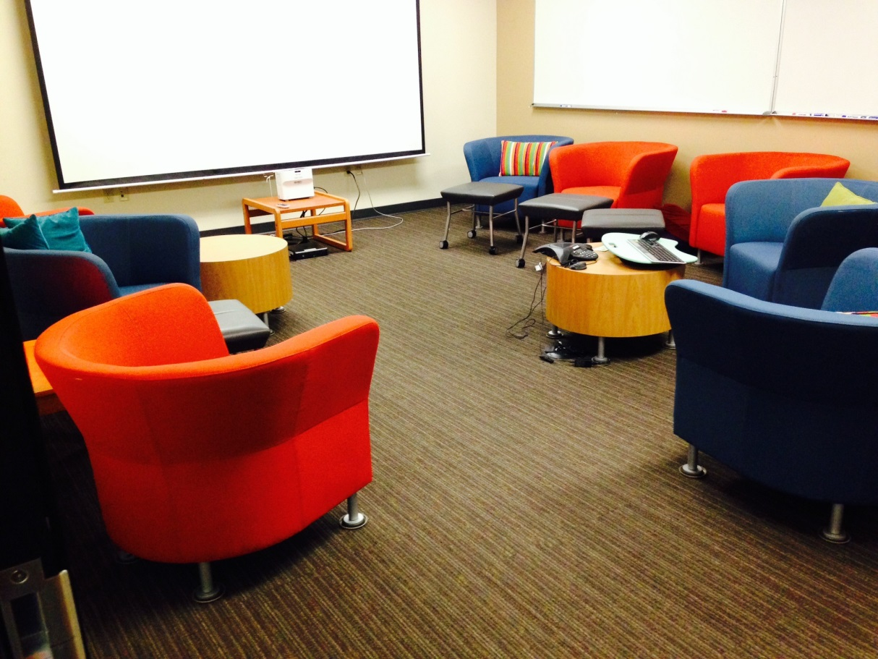
DES Energy
Configurable Conference Room
WaTech Example
(after)
Notes:
WaTech Configurable Space example: photo of space after (conferenced room)

Slide 7
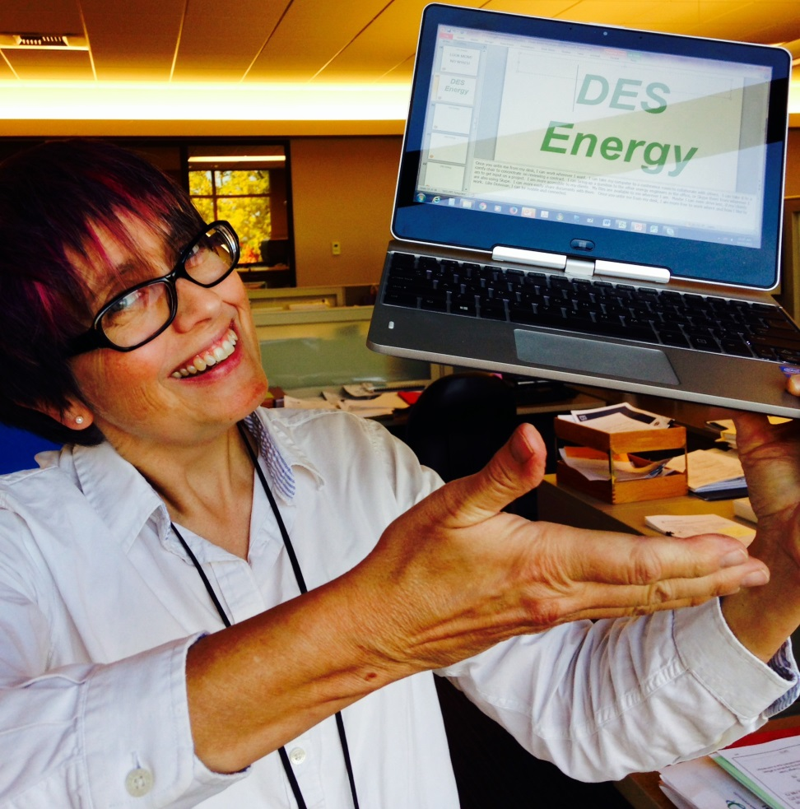
DES Energy
Work Anywhere Anytime
WaTech Pilot Project
Notes:
Here’s another WaTech example (started as DES pilot, WaTech is a new agency): The Work Anywhere Anytime Pilot provided VPN for everyone who works in the Jefferson Building. I can unplug my computer and it connects itself automatically to the secure wi-fi – I can take it to a conference room, or to collaborate with another engineer on a document, no problem.

Slide 8
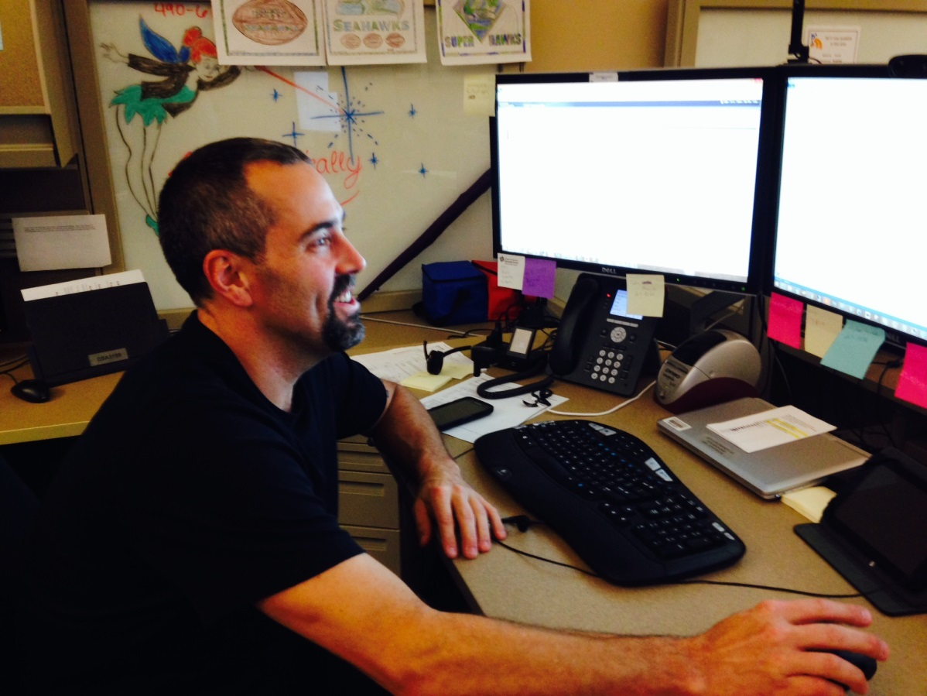
DES Energy
Field Services
WaTech Pilot Project
(after)
Notes:
Another example is the Wa Tech Field Services Pilot. WaTech Field Services moved technicians closer to their clients – they used to all be stationed in one location, now they are stationed closer to their customers at Capital Campus, at Jefferson Building, at The Governor’s office, in Tumwater – they are connected by Skype and Instant Messaging. Travel time and emissions are reduced. Service is improved.

Slide 9
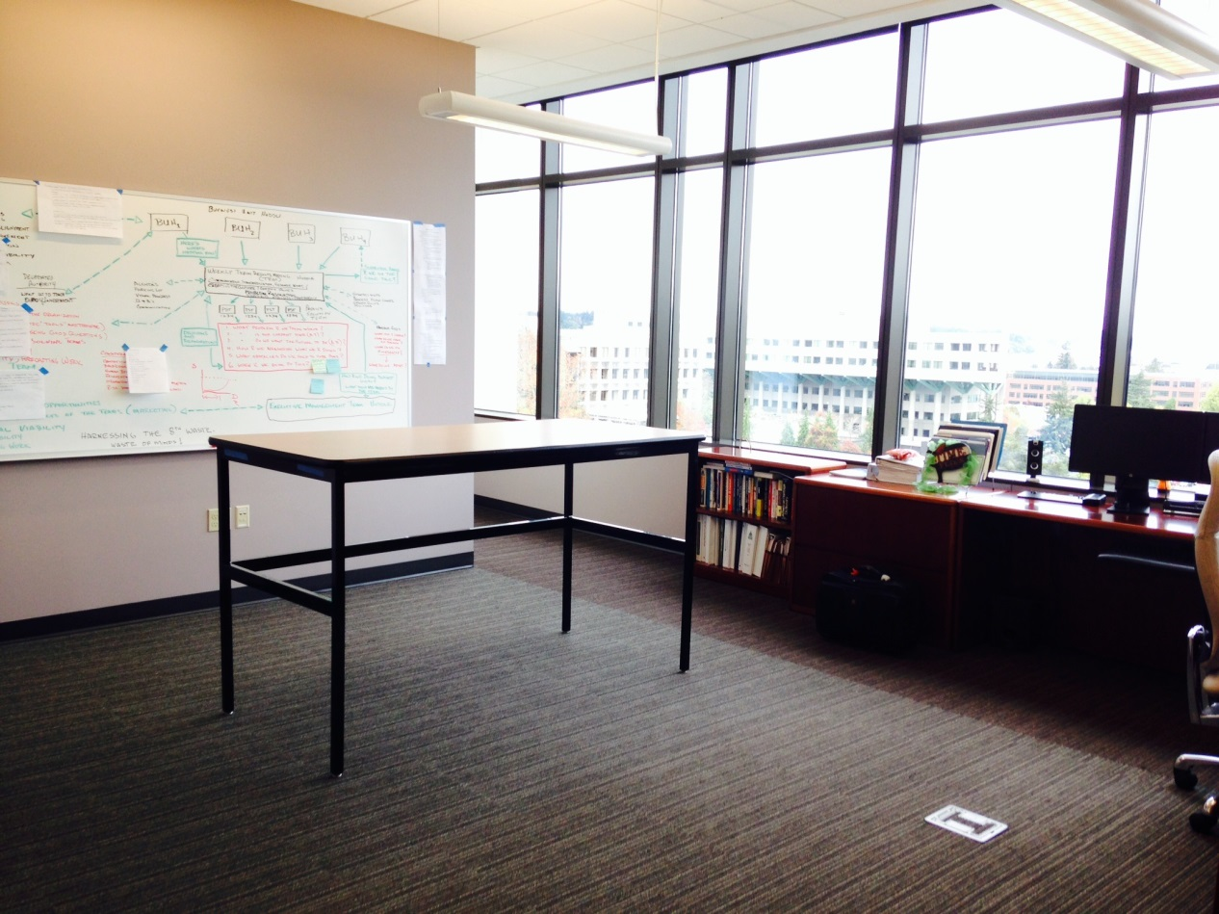
DES Energy
Executive Suite
DES Pilot Project
Notes:
Here is a DES example: The Exec Suite Pilot – our Agency Director leads by example. He moved out of his office. It’s now a shared stand-up conference room with a great view. He works at any unoccupied desk in the Jefferson Building.

Slide 10
DES Energy
HR Telework
DES Pilot Project
Notes:
Another example is the DES HR Pilot. This DES HR office developed and tested the HR tools YOU need to start your own teleworking pilot program.
Here’s the case study (bring it with me – read the bullets and the quotes).

Slide 11
DES Energy
For more information:
GSA Total Workplace website
OFM Workplace Strategies website
Notes:
So where can you get more information about getting more mobile, and making your space better for how you work? Here’s a link to the OFM website, and a link to the GSA website.

Slide 12
DES Energy
Any questions about workforce mobility?
How are your needs changing?
Donna K. Albert, PE, MCE, CEM, LEED-AP, Energy Project Manager
Developmental Job Assignment, DES Workplace of the Future
Department of Enterprise Services, Energy Program
Cell Phone: (360) 489-2420
E-mail: donna.albert@des.wa.gov
DES Energy Website: http://www.des.wa.gov/services/facilities/Energy
Notes:
Your HR, IT, Facilities and other logistical needs are constantly changing. DES wants to be responsive to your changing needs. Give feedback or ask questions on the cards you have been given. Make sure to include your email and phone if you want a response. Thanks.

Slide 13
Questions
Department of Enterprise Services
Donna.Albert@des.wa.gov
Tara.Kimbrough@des.wa.gov
Cara.McClarty@des.wa.gov
www.des.wa.gov

Slide 14


