Slide 1
Lick Your Last Envelope How DES Can Save You Time and Money While Increasing the Quality of your Mass Mailings and Print Products
Presented by Judy Lorenzo – Operations Manager, Print & Mail Services
Vanessa Simpson – Program Manager, Consolidated Mail Services
Larry Berg – Outreach & Marketing Specialist, Printing & Imaging

Slide 2
Your Strategic Business Partner
We Know Government
We Can Help You Save Time and Money
We Offer a Wide Range of Print and Mail Services
Steps to a Successful Mailing
Important Initiatives for State Agencies
Notes:
Judy

Slide 3
Print and Mail Consultation Benefits
Postage Savings for Customers
Competitive Print Prices
Ease of Procurement – Take the guesswork out of solving your print and mail challenges
Sustainability Goals – Our union shops are environmentally friendly
Diversity Goals – Our pre-qualified vendor pool supports local economies
Notes:
Judy

Slide 4
We Know Government: Printing
We specialize in:
High quality full color specialized printing
Full service digital and variable-data printing
Custom binding and finishing
Complete fulfillment, storage, distribution, and inventory management services
Envelope manufacturing and printing
Integrated and accountable print and mail services
Notes:
Judy

Slide 5
Save Time and Money
Notes:
Larry

Slide 6
High Speed/High Volume Printers
Notes:
Larry

Slide 7
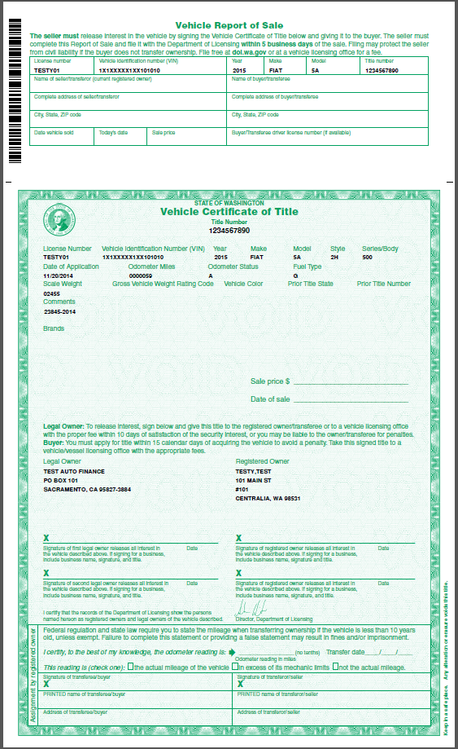
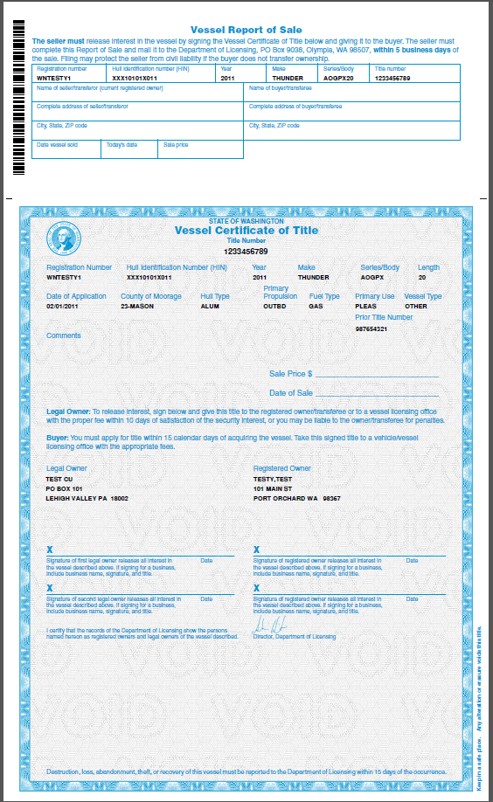
Full Service Digital and Variable
SAMPLE ONLY
Notes:
Larry

Slide 8
Quality Full Color Specialized
Notes:
Larry

Slide 9
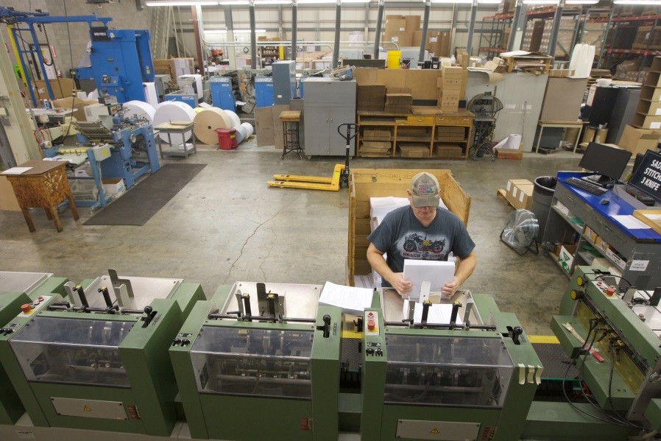
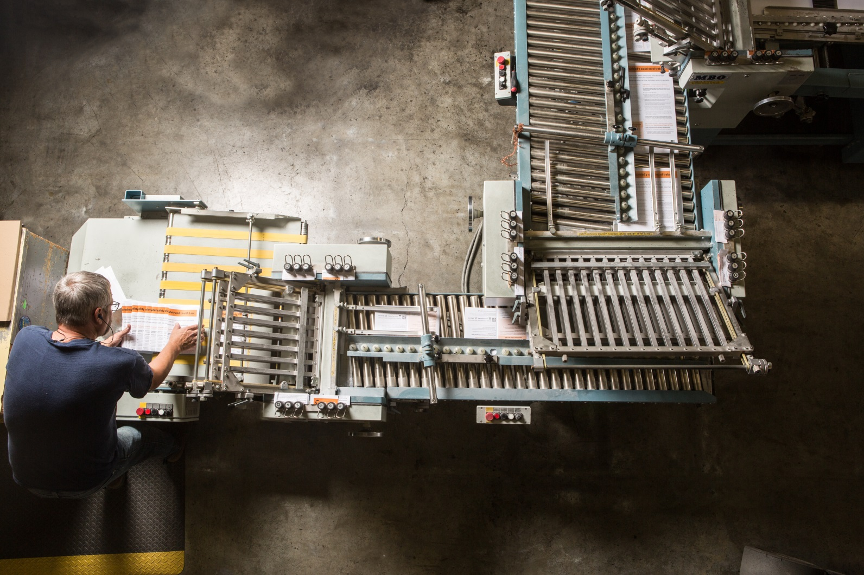
Custom Binding and Finishing
Notes:
Larry

Slide 10
Fulfillment and Inventory Management
Notes:
Larry

Slide 11
We Know Government: Mailing
98504
Notes:
Vanessa

Slide 12
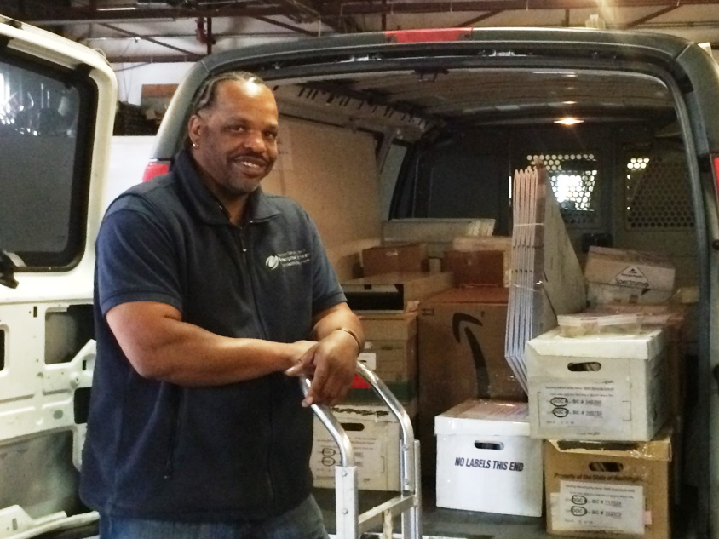
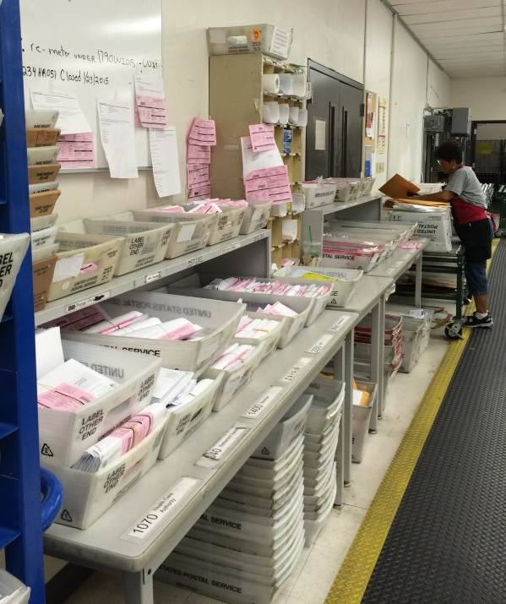
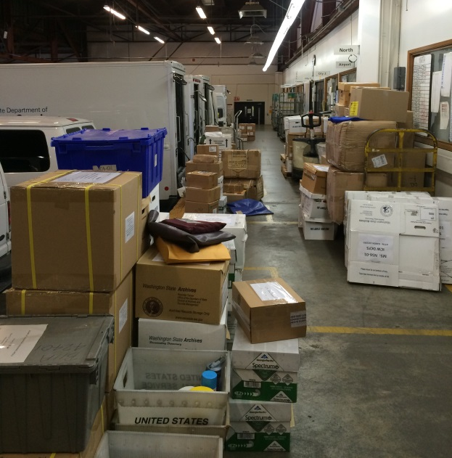
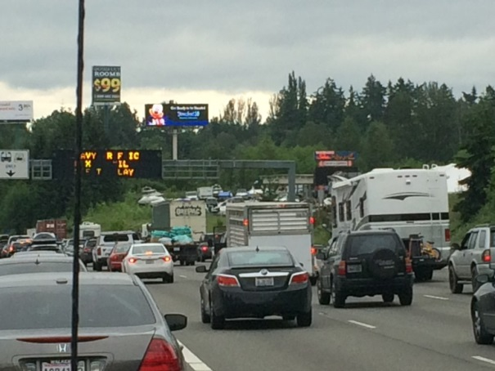
Your Mail Team = Dependability
Notes:
Vanessa

Slide 13
Metering and Small Packages
Notes:
Vanessa

Slide 14
High Speed Intelligent Inserting
Notes:
Vanessa

Slide 15
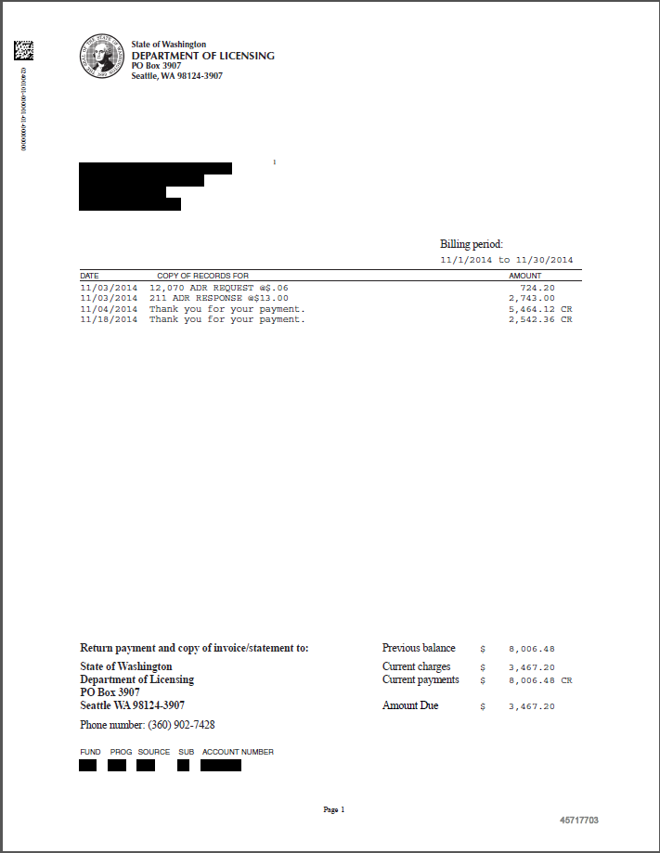
Print Re-engineering = Integrity
Before
After
Notes:
Vanessa

Slide 16
Zip Code Sorting = Postage Savings
Notes:
Vanessa

Slide 17
Steps to a Successful Mailing
Plan
Consultation
What is the goal and desired outcome?
Taking the concept and making it functional and valuable within budget
Create
Determine project components
Print – Design, paper stock, envelope, postage type
Data – Both personalized and mailing data
Modify
Flexibility with continued consultative services
Changes in design and proofing stages to meet desired outcomes
Notes:
Larry – Plan, Create, Modify

Slide 18
Steps to a Successful Mailing
Print
To print or not to print? Or rather, should I print on my own equipment or send to DES, the state’s print and mail service provider?
Insert
What are the consequences of someone not getting their mail? Or getting someone else’s mail?
Deliver
How much did I spend on postage this past year?
Notes:
Vanessa – Print, Insert, Deliver

Slide 19
Enhancements to Online Ordering
We are doing outreach to our customers
Improvements planned for the MyPrint digital storefront system will streamline your experience when ordering:
Print
Mail
Fulfillment Products and Services
Share your ideas with us today.
Notes:
Larry

Slide 20
Print Management
There are new requirements for managing print operations that apply to all state agencies.
DES is here to help you understand what is required.
Who leads print management in your agency?
Join the Print Management Strategies Team and fill your toolbox with ideas.
Notes:
Judy

Slide 21
Recap
Strategic Business Partner
Savings
Sustainability
Diversity
Let us do the work for you
Notes:
Judy

Slide 22
Questions
Notes:
Kari

Slide 23
Thank you!
Feel free to contact us
www.DES.WA.GOV/PrintingMail
Judy Lorenzo Operations Manager, Print and Mail Services
judy.lorenzo@des.wa.gov | 360-664-4330
Vanessa Simpson Program Manager, Consolidated Mail Services vanessa.simpson@des.wa.gov | 360-586-0022
Larry Berg
Outreach & Marketing Specialist, Printing and Imaging larry.berg@des.wa.gov | 360-664-4357
Notes:
Judy

