Slide 1

Lions and Tigers and Twitter Oh My!
Managing Texts, IM, Blogs, Wikis, Facebook, Twitter, the Cloud and more…
Presented by Leslie Turner

Slide 2
Overview
Are texts, blogs, and social media considered public records?
We’re not in the paper world anymore Toto!
Tips and strategies for managing other media/devices/communications

Slide 3
So what is a public record?
Definition and classification of public records
“Public records shall include any paper, correspondence, completed form, bound record book, photograph, film, sound recording, map, drawing, machine-readable material.…
regardless of physical form or characteristics,
and including such copies thereof, that have been made by or received by any agency of the state of Washington in connection with the transaction of public business”
(RCW 40.14.010)

Slide 4
Yes, that includes texts!
Related to and used for the conduct of the business of government:
Regardless of format:
Clay tablet, pen and paper, phone, e-mails, word docs, excel spreadsheets, databases, websites, blogs, wikis, social media, or any other emerging applications or platforms
Regardless of device used to create it:
Main frame computer, PC, laptop, smart phone, notebook, tablet, Google glasses or any other emerging technologies
Regardless of location/where it’s stored or accessed:
PC, laptop, flash drive, smart phone, notebook, tablet, or the cloud

Slide 5
Supreme Court agrees:
Nissen v. Pierce County: In a unanimous opinion, the Court held that even when a public employee uses a private cell phone, text messages sent and received in the employee’s official capacity are the employer’s public records. Employee communication, including a text message, is a public record which must be produced “if the job requires it, the employer directed it, or it furthers the employer’s interests.”
Therefore, an employee’s text message telling their spouse they’ll be working late is not a public record…..(August 2015)

Slide 6
Retention in a Nutshell...
Agencies are to:
  Retain all public records for at least the minimum retention period as listed on the approved Records Retention Schedule
  Transfer archival records to Washington State Archives for preservation and access for research

Slide 7
Technology du jour and your records
Chances are the media will NOT outlive the records
Know before you click “I agree”
Obsolescence or failure is going to happen
It’s all about the record, not the media used nor WHO is using it

Slide 8
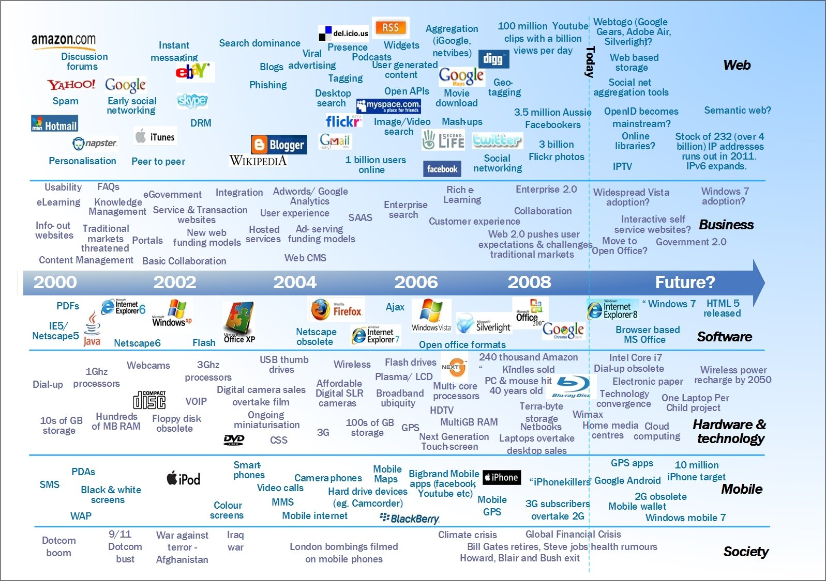
What HAS Changed

Slide 9





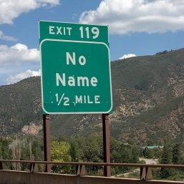

RM Best Practices Haven’t Changed
Create/receive a record – regardless of physical form…
If GO, get rid of it!
Consider content
Should it stay or go?
If STAY, properly ID/file/store
until retention is met
If ARCHIVAL, Transfer for preservation
DESTROY and document destruction
If NON-Archival, Prepare and approve for destruction

Slide 10
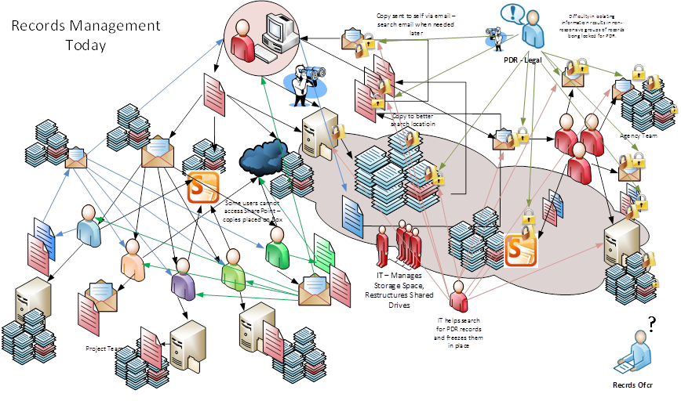
How we work today

Slide 11
Know “going in”
The decisions on what technology/devices/software/services an agency uses has a direct impact on public records
An agency needs to have “governance” over its records and information and “governance” over user behaviors and the devices/software being used by agency and staff

Slide 12
Have a plan
All electronic records can be “filed” and managed as appropriate
The agency is the one to:
Make decisions as to what users are allowed to do
Draw boundaries and direct behavior
If allowed certain media, make sure there is a pre-determined file plan or structure and procedures for users to follow
Maintain and regularly schedule disposition actions – disposition is a verb!

Slide 13

Policies
Policies are a very good thing!
Create and approve prior to using any new media
Outline expectations and rules about behaviors
Helps protects the agency and the agency‘s records

Slide 14
Can you manage?
Know going in what and plan for any potential public disclosure requirements
Be confident you can manage the records before starting, going back to figure it out is much more difficult and increases liability
  It’s the agency that will be held liable, not the providers and not the users

Slide 15

What to Keep and
What to Throw Away

Slide 16
Legal authority
For Washington State, records retention schedules are approved by committees and are the legal ongoing authority to get rid of records once retention has been met
Exercise your authority!
There is no requirement to keep everything!
Just know what you are required to keep, and what you are not

Slide 17
Meeting requirements
  Are you required to keep it?
  Know your business
  Know your processes
  What are the functions of a business unit?
  What activities support those functions?
  What other regulations/requirements are there for that particular business unit and business process?

Slide 18
Keeping it all
Keeping it all is not a sustainable nor effective option
Keeping everything is not MANAGING anything, you are just using a version of an endless closet
Keeping everything is NOT cost effective nor an effective business practice

Slide 19
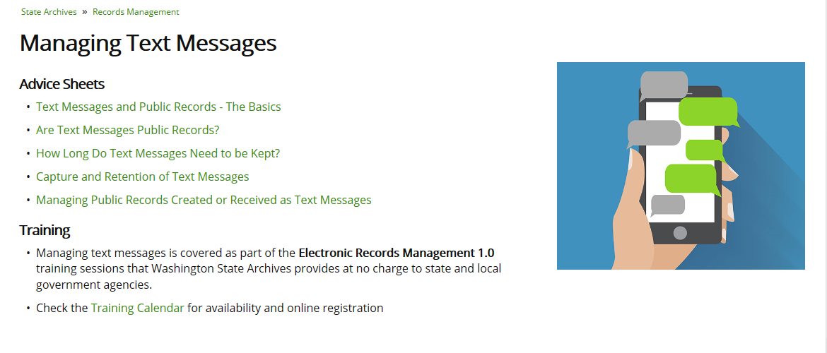
Texting

Slide 20
What About Text Messages? IM?
Content is key – are you conducting business?
Have policies regarding use
Agency responsibility to capture texts and other messaging that need retention according to approved schedules
3rd party tools/applications available
Cannot rely on provider to retain!

Slide 21
Ok, Not Ok

Slide 22
Develop “cheat sheets”
A thank you to Kyle Stannert, City of Bellevue and Terri Cole, Benton County PUD for their gracious permission to use these examples!

Slide 23












Do you?

Slide 24
“Social” Media
Make sure use is appropriate and someone is “minding the store”
Make a good business case
  Do you really need this?
    It’s called “social media” for a reason!
  Can you take it on and manage?
  READ THE TERMS OF SERVICE AGREEMENT
    Are you executing “click-through” contracts?

Slide 25
Applying to Blogs, Twitter, any “social media du jour”
Other considerations for social networking sites:
  How does this help agency meet mission?
  Are they public records with retention value?
  Are they primary or secondary copies?
  How long do they need to be kept?
  How are they to be retained and managed by the agency?
  (Reminder, keeping it all is NOT management of the information, it’s simply storing it)
Key considerations for posts and comments on social networking sites:
  Are they public records with retention value?
  Are they primary or secondary copies?
  How long do they need to be kept?
  How will they be retained by the agency?
  Is this technology appropriate?

Slide 26
Stop, look, analyze
There are challenges in maintaining all of the different forms/formats
If agency is using more than one social media again – look at business case and purpose of use
  Who are your demographics and have they changed?
  Are you delivering services through social media or notifications only?
  Is it worth the effort to maintain/post on multiple sites?

Slide 27
Read the terms of service agreements!
“a worldwide, non-exclusive, royalty-free license to use, copy, reproduce, process, adapt, modify, publish, transmit, display and distribute such Content in any and all media or distribution methods (now known or later developed).” TWITTER

Slide 28
TOS Agreement = Contract
Security, identity “hijacking”
Indemnity issues
Privacy, data ownership
Rights of company to edit/display/advertise
Addressing merger/acquisitions
Will use meet overarching regulations?
  FOIA, ADA, RCW’s, WAC’s
Notes:
Some issues to discuss – you will never be able to rely on cloud providers i.e. social media to manage your information.

Slide 29
Tips and tools to aid social media retention
  Can use email exchanges on content, when posted, when withdrawn, updates, etc as your evidence of the posts
  Spreadsheets can work too – any kind of systematic management for your social media
  While better than nothing - be aware that most 3rd party systems capture everything and do not generally offer any real “management” of the posts
  3rd party tools are available:
      TwInbox
      TweetTake
      SocialSafe
      ArchiveSocial

Slide 30
Thinking ahead
Close to master contracts completed for Enterprise Content Management (ECM) Systems
ECM Systems are effective tools to help manage an agency’s “content” enterprise-wide, including:
  Emails
  Word, Excel, other unstructured data
  Photographs, audio, AND video files
  Some offer social media help too

Slide 31
It doesn’t matter
Regardless of what communication platform used, and regardless of the tools used (such as body cams) an agency is required to manage the resulting public records
Once created, all the public records requirements (including disclosure)
kick in!

Slide 32
Going to the cloud
CLOUD
Issues to consider:
Custody and jurisdictional boundaries
Co-mingling of data (will probably not be held separately from others using storage server)
Privacy, security are HUGE concerns
Data transmission/flow
(Where is the server located?)
THEIR Disaster preparedness and recovery

Slide 33
Clouding the issue
What about the vendor:
  How stable? What’s their history?
  Do they outsource or sub-contract ?
  How proprietary are their applications?
  Their hiring practices for employment? Are there background checks, etc?
  Their overall audit / security processes?
  Can your rules apply?

Slide 34
Is it appropriate?
Consumer level services/providers are not appropriate for government use
Avoid shoveling records into the cloud just to reduce storage costs – moving the mess doesn’t solve anything
Does not absolve agency from their responsibility for public records
CAVEAT EMPTOR / USER!

Slide 35
Do your homework
Do not assume that all sites/providers are equal
  Some do offer some levels of security, but you have to do your own background investigations and rely on their claims
  Once it goes in there, can you get it back?
  Take steps to mitigate YOUR risks – this is YOUR data!

Slide 36
You are not alone
Questions?
recordsmanagement@sos.wa.gov
Thank you!
Washington State Archives
Partners in preservation and accesss

Slide 37


