Slide 1



DES Client Services Stakeholders
February 7, 2018

Slide 2
Agenda
One Washington
Momentum and Achievements
Why an ERP
What’s in it for me
How and when will this happen
Organizational Change Management
Survey Questions

Slide 3
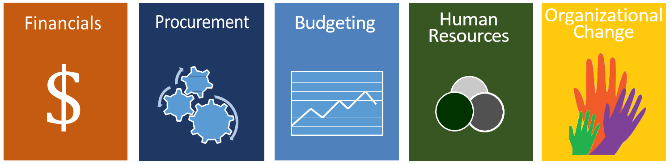
One Washington
One Washington is a comprehensive business transformation program to modernize and improve aging administrative systems and related business processes that are common across state government.
One Washington Enterprise Business Processes
Notes:
Program Background:
One Washington is a comprehensive business transformation program to modernize and improve aging administrative systems and related business processes that are common across state government.
In the months and years ahead, we will take an all-inclusive, continual look at the state’s collective business processes and then identify key functions that need to be connected, consistent and managed in a unified, cohesive manner to provide reliable data. One Washington will help ensure we have access to data that is accurate, available in a timely fashion and meets the business needs of decision makers.
The State of Washington currently relies on:
Cumbersome and time consuming financial processes with an aging financial infrastructure
Antiquated budgeting infrastructure that limits visibility and transparency
Non-uniform procurement processes and systems
An HR system implemented ten years ago
Financials first

Slide 4
Investments and Deliverables
4
Notes:
Suggested speaker: Stacey
2015-17 Biennium – Transformation and Readiness Activities
The legislature funded transformation and readiness activities that included Business Readiness activities and selection of a Strategic Partner.
Business benefit: laid the groundwork for continued planning
Strategic Partner Evaluation process created and partner selected
Chart of Accounts Improvements
Procurement Readiness
WSDOT Readiness
Facilities Management Tool
Budget System Improvements

Slide 5

Enterprise Resource Planning (ERP)
An ERP can be defined as common business practices across the enterprise and the technology that support them
ERPs pull together data on an organization’s main resources – its people, money, information, and assets – and combine it into information that decision makers use to guide and manage.
Notes:
Suggested speaker: Bill

Slide 6
What are the benefits?
An integrated system replacing hundreds of disparate legacy systems
Transparent, reliable information, dashboards and analytics for decision makers
Data accuracy through consistent, common business processes and common systems
Statewide collection of critical information and consolidated business intelligence

Slide 7
Enterprise Resource Planning Functional View
General ledger accounting
Specialized accounting, e.g. project accounting, cost accounting
Budgetary control
Accounts payable
Accounts receivable
Grant management
Asset management
Treasury management
Travel and expense
Master data, e.g. chart of accounts, payees, customers
Reporting
Time and attendance
Payroll
Benefits administration
Position classification
Compensation planning
Labor relations
Recruitment
Development
Performance evaluation
Health and safety
Master data, e.g. positions, job descriptions
Reporting
Finance
HR / Payroll
Procurement
Budgeting
Requisitions and purchase orders
Sourcing, e.g. RFP, RFQ, RFX
Supplier Relationship management
Category management
Inventory management
Contract management
Catalog purchasing
Receiving
Master data, e.g. suppliers, commodities
Reporting
Operating and capital budget
Revenues and expenses
Scenario planning and forecasting
Master data, e.g. appropriations, allotments
Reporting

Slide 8
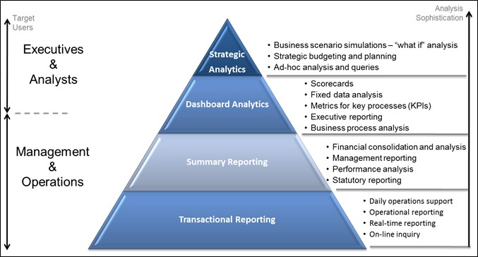
Tools you can benefit from
Notes:
To set the context for how the state defines its reporting approach, one must first understand the difference between transactional reporting and business intelligence. Transactional reporting supports the day-to-day operations of an organization. Every modern ERP comes with delivered reports for transactional reporting, and these delivered reports form the basis of the One Washington reporting approach. In contrast, BI enables business performance improvement by providing actionable information for decision making, and is typically delivered separate from an ERP system. BI can be segmented into descriptive analytics (what happened and why), and predictive analytics (what will happen next). Transactional reporting is usually best consumed by individuals close to the business process, while BI reports show the “bigger picture” and are usually consumed by senior leadership and executives. Transactional reporting and BI reporting should be developed as complementary tools as they provide distinctly different advantages, but often leverage the same data sources. It is critical that values presented in operational reports correspond directly with values contained in BI tools.

Slide 9
Our Strategic Partner, Accenture
A respected, global consulting firm experienced in helping public sector ERP implementations
Accenture has helped 12 states transform business processes to modern outcomes
Accenture’s expertise is helping One Washington along the journey to design, configure, test and deploy an ERP solution

Slide 10
Accenture has helped 12 states implement ERPs
California
Connecticut
Delaware
Georgia
Kansas
Minnesota
Montana
New York
Ohio
Texas
Virginia
Wisconsin
States with ERPS
States Accenture helped
States without ERPS
Notes:
Suggested speaker: Mark

Slide 11
One Washington Timeline
FY19
FY20
FY21
FY22
FY23
FY24
FY25
FY26
Procure Fin/Proc/BI
Implement Fin
ance & Procurement
Procure
Budget & HR/Payroll
Implement
Budget
Implement HR/Payroll
Implement
Business Intelligence
Procurement
Implement
Go
-
Live
Notes:
Budget Implementation timeline extended 6 months due to following factors (in order or significance):
Better alignment to budget schedule, a January Go live will provide a few months of stabilization before the start of Budget activities (typically starting around May)
Complexity of systems and integration (For example: SPS)
Large numbers of systems (70 plus)

Slide 12
Change Management
Notes:
Suggested speaker: Mark

Slide 13
Change Activity
Think about the times in your life when you had to adapt to change.
  How did you become aware?
  When did you really understand the change?
  When and how did you accept the change?
  When did you commit to the change?
Share with a neighbor.

Slide 14
Importance of Change Management
Change Management is the process, tools and techniques to manage the people side of change to achieve the required business results.
Increase probability of project success
Manage employee resistance to change
Build change competency into the organization
Notes:
Suggested speaker: Mark

Slide 15
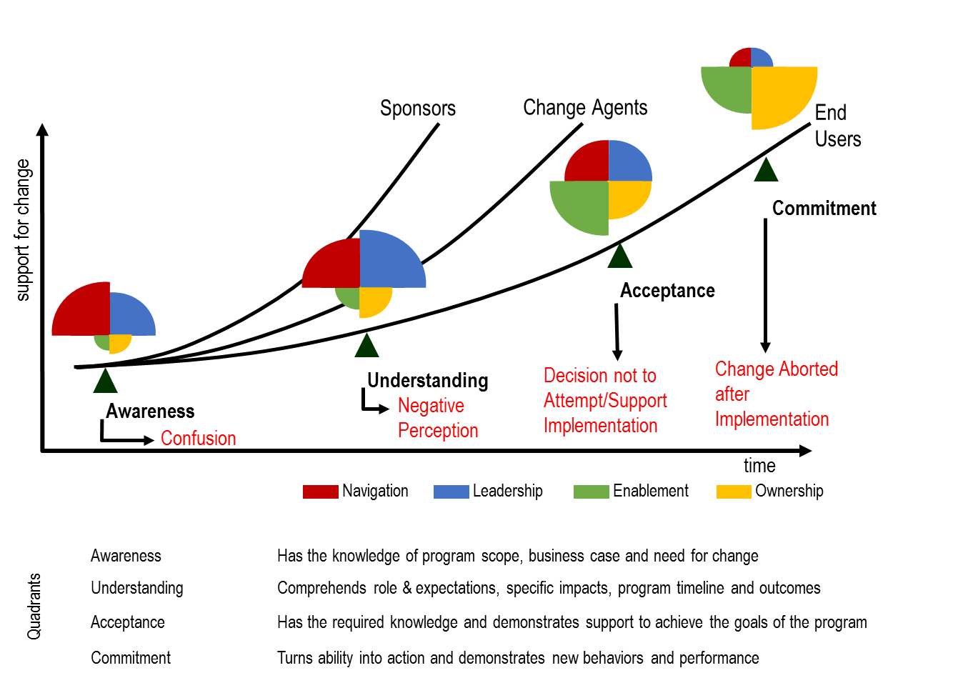
The Change Process

Slide 16
One Washington Change Management Strategy
Meet with Agencies
Meet with DES clients and send survey
Record information in stakeholder analysis for review
Establish Transformation Advisory and Network groups
Begin regular outreach with multiple communication mediums (newsletter, advisory groups, share with communities of practice)

Slide 17


Change Management Strategy –
Stakeholder Interviews: Themes and Opportunities
 | Themes |  | Opportunities
 | Cautious Support for One Washington |  | Seek to build positive momentum and trust by sharing the incremental advances and wins. Consider a statement from the Governor
 | Need to understand timeline |  | Socialize timeline and expected resourcing requests to allow agencies to budget and prioritize for One Washington
 | In person communications are the most effective |  | Include content and channels in the Comms plan and stress in person communications to the agencies
 | Change investment by agencies |  | Agencies with a change culture will be well positioned for One Washington. They should share stories and best practices with other agencies
 | Expand website |  | Website as a push as well as a pull for information: up to date information on timelines, status of program, scope, program team, etc.

Slide 18
Survey Questions
Will be sent via Survey Monkey
From the One Washington mailbox on February 8
Please complete by February 23
Thank you for your time and attention-your participation is important

Slide 19
Survey Questions Purpose
Change Initiatives
Adoption of change
Communications
Training

Slide 20
A Few Survey Questions clarified
Pain Points
Magic Wand
This question is designed to help understand what business processes or outcomes are challenging-not a reflection of the DES service-focus is on the systems and technology, not your service provider.
This question is to help understand what are ideal business outcomes/information you would benefit from or help add value to your agency.

Slide 21
A Few Survey Questions clarified
Agents of change
Shadow systems
This question is designed to help understand who would be the best contact to communicate to regarding the One Washington program.
This question is to help understand what other systems or reports you use in your job that may be outside of the services that DES provides.

Slide 22
Questions?

Slide 23

How to learn more
http://one.wa.gov
OneWa@ofm.wa.gov

