Slide 1
Small Agency Financial Services Workshop
April 6, 2021
Contracts & Procurement Division

Slide 2
Agenda
Contracts & Procurement
DES C&P Team Introductions and Roles
Master Contracts – Search tricks & tips | Cindy Zielinski
WEBS (Washington Electronic Business Solutions) | Katie Holder
Delegated Authority | Drew Zavatsky
  Requesting increased spending authority

Slide 3
Agenda continued…
Procurement Options – 39.26 RCW | Cindy Zielinski
  Direct Buy | Drew Zavatsky
  RFP/RFQ/etc. – when they are needed | Cindy Zielinski
    Socio-economic requirements (i.e. environmental preferences, supplier diversity, etc.)
  Sole Source Process | Brooke Jensen
Covered in workshop PART 2 on May 27 and in separate presentation.
  Emergency Process | Brooke Jensen
Contract & IT Reporting | Nicole Johnson
Possible DES Contracts expansion for small agency support | Cindy Zielinski

Slide 4


C&P Staff and roles
Procurement Policy
Procurement Strategy
Master Contracts
Business Development Operations
Policy Guidance
Sole Source & Emergency Contracts
Delegated Authority
Contracts Training
Contracts Consulting
Solicitation Review/Strategy
Master Contracts Assistance
Analytics
Data & Metrics
WEBS Support
Contract Reporting
Cindy Zielinski
Drew Zavatsky
Brooke Jensen
Zoe Mroz
Katie Holder
Nicole Johnson

Slide 5
Master contracts
Cindy Zielinski | Contracts Liaison

Slide 6


Qualified Master Contracts
Cooperative contracts that conform to all applicable Washington State procurement laws, rules, policies and trade agreements. DES will maintain a list of cooperative contracts that meet state requirements.
“Master Contract” - A contract for specific goods or services, or both, solicited and established by [DES] in accordance with procurement laws and rules on behalf of or for general use by agencies as specified by [DES]. RCW 39.26.010(15)
Notes:
DES is the authorizing agency to establish master contracts as well as entering into cooperative agreements.
Procurement bridge for goods and/or services
Developed with customer engagement/involvement
Meets procurement laws and rules (RCW 39.26)
Focuses on Washington state procurement preferences
Current cooperative agreements include NASPO and Sourcewell.

Slide 7

DES Master Contracts
Master contracts leverage the state's collective buying power and are established for most frequently purchased products
Master contracts are available for use by state agencies, local and tribal governments, public school districts and colleges, and nonprofit organizations throughout Washington
State agencies are required to purchase from master contracts – unless the contract does not justifiably meet their needs
Notes:
Who can use master contracts
Eligible purchasers include local governments, public schools, higher education, tribes, non-profit organizations, etc. – use is optional
Agencies however are required to use existing “qualified master contracts” prior to engaging in any exception, if it meets business needs. Document your decision!
Agencies have unlimited delegated authority when using master contracts… However, in the case of Two-Tiered master contracts, agencies are required to perform a competitive solicitation and unlimited delegation does not apply.
Master Contracts Usage Agreement (MCUA) may be required.

Slide 8
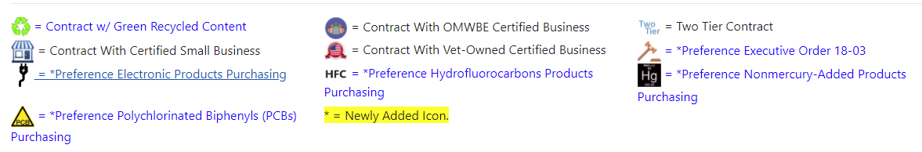
Master Contract Search Tips
Where to find the search tool
How to use the search tool
Finding contracts with preferences
Who to contact for help
Resource:
Contracts Connection Bulletin
Master Contracts search engine: https://apps.des.wa.gov/DESContracts/
Notes:
Brooke to let Cindy use Search Tool and go over FAQ document.

Slide 9

Master contracts
Cindy Zielinski | Contracts Liaison
Cindy.Zielinski@des.wa.gov

Slide 10
WEBS
Katie Holder | Management Analyst

Slide 11
WEBS Overview
Washington’s Electronic Business Solution
Agencies post solicitations per RCW 39.26
Search for vendors and view vendor information;
Create solicitation records and post solicitation documents accessible by the vendor community;
Manage notification lists of vendors;
Access reports to help understand the solicitation posting activities for your organization
Notes:
All solicitations from agencies will go through WEBS per RCW 39.26

Slide 12
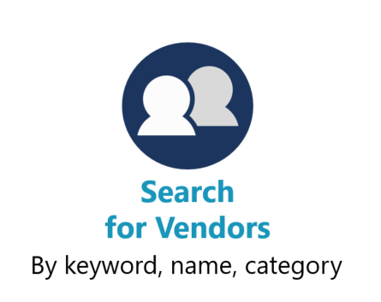
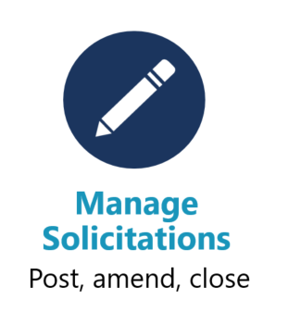
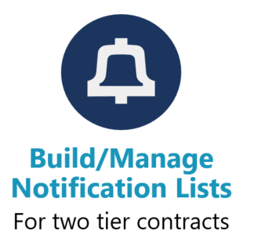
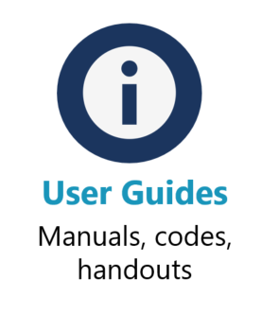



WEBS Tools
Notes:
Notifications lists: designed for two-tier contracts, where DES does the first tier which establishes a grouping of vendors or meet minimum qualifications and then the end customer posts to only those vendors who des said met the initial qualifications.

Slide 13
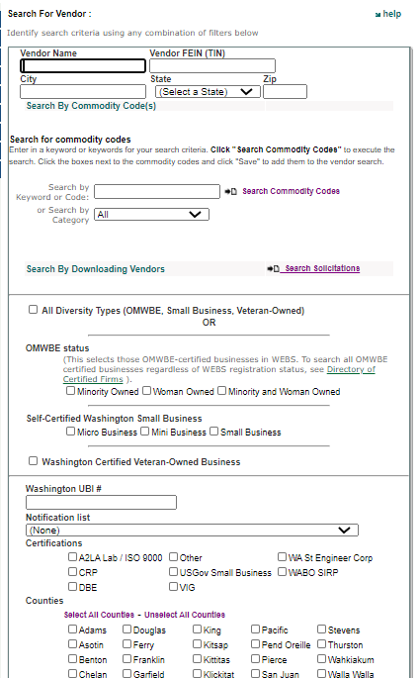



Slide 14
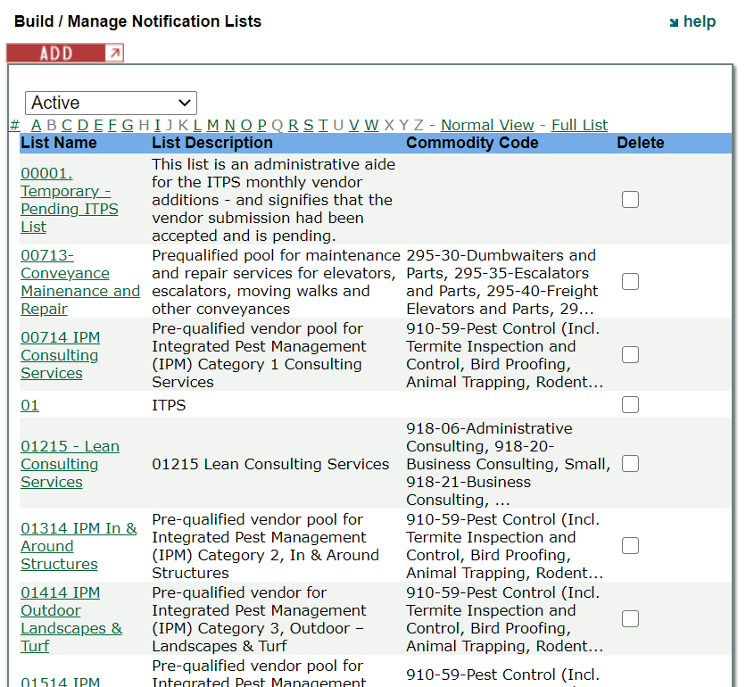

Slide 15
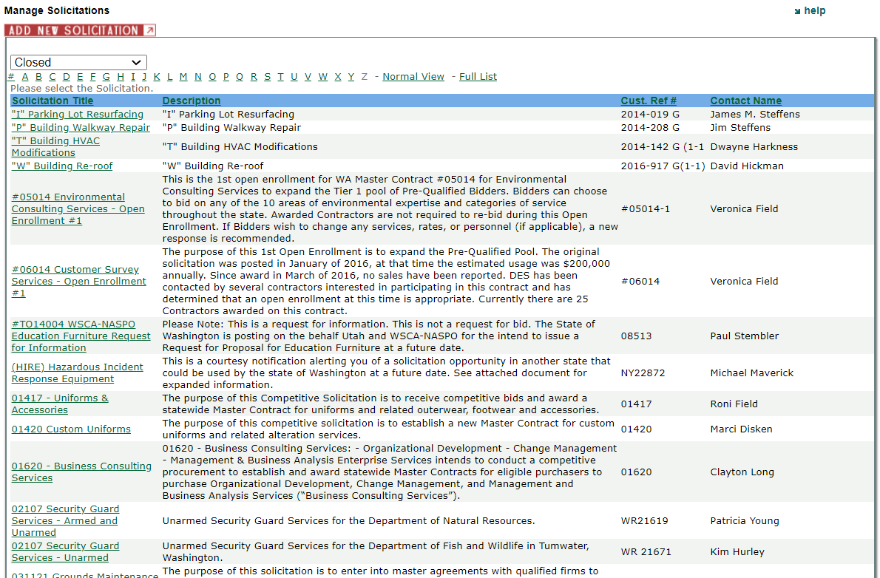

Slide 16
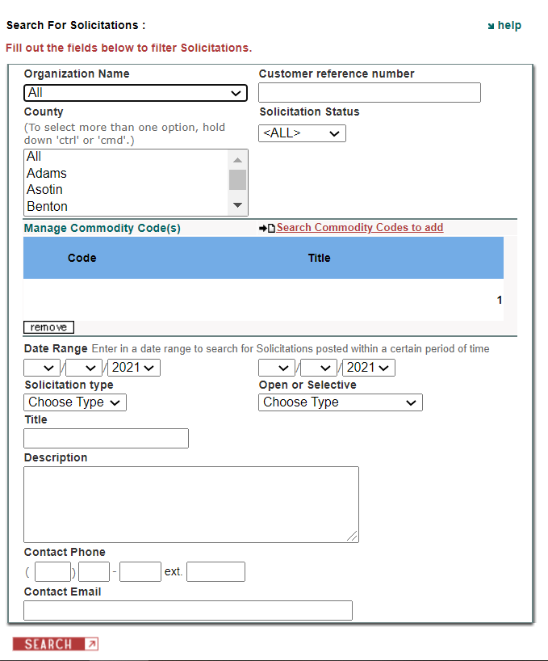

Slide 17
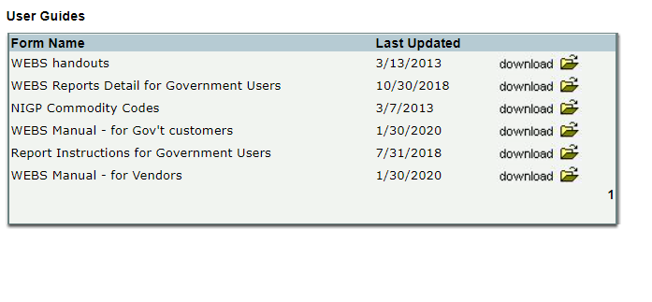

Slide 18
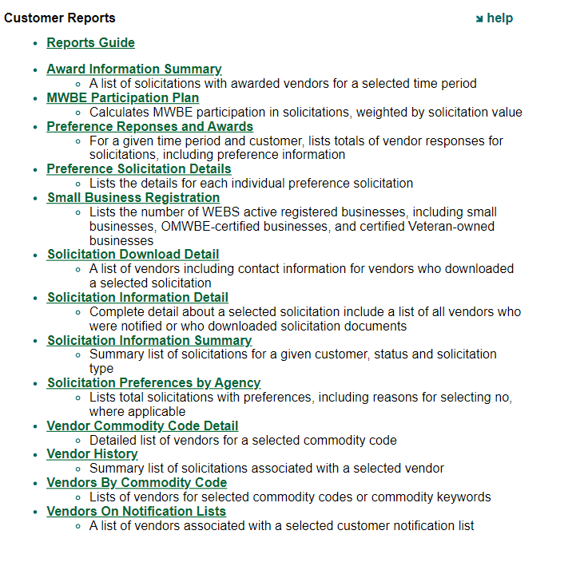

Slide 19


How to sign up
webscustomerservice@des.wa.gov
360-902-7400

Slide 20
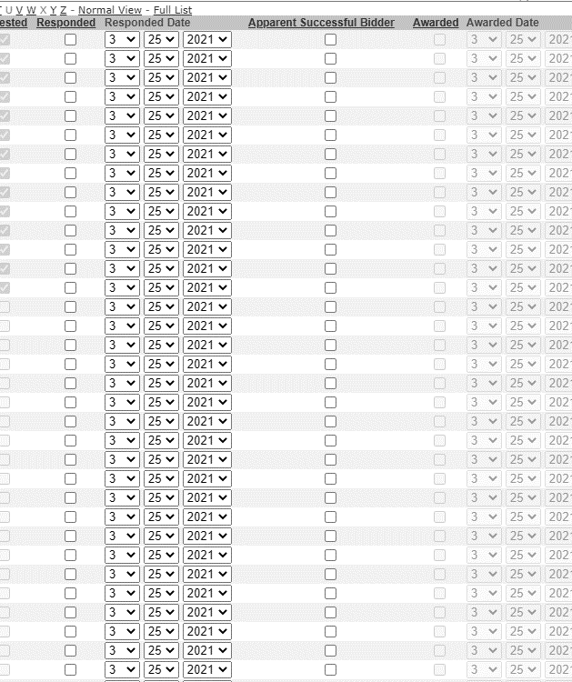
WEBS
Enhancements
User group: bi-monthly
Post and award done in WEBS, ASB outside of WEBS
Target date: end of April
Notes:
DES, LNI, SOS, DOR, DSHS, AGR, ESD
Only making enhancements required by RCW or Policy
Systems are in phase 1b of OneWA, next year.

Slide 21
Delegated Authority
Drew Zavatsky | Procurement Risk Assessment Administrator

Slide 22
DES-090-00 | Delegation of Authority Policy
This policy provides the following information:
Different delegated authority types.
Delegated authority is based on the agency’s risk assessment.
Provides agencies with unlimited delegations when making purchases from DES master contracts or DES approved cooperative contracts or when making emergency purchases.
Additional delegations of authority are of limited duration.
Resource:
DES-090-00 Delegation of Authority Policy
Notes:
*Click on the link to show customers the policy.
Purchases of goods and services shall be made in accordance with RCW 39.26.090.
Each executive agency will receive General Delegated Authority.

Slide 23
DES Delegated Authority EXAMPLE:
All contracts must comply with the following Contract Delegated Authority
The following conditions apply to this Delegation:
  AGENCY will consult with DES prior to conducting any non-routine competitive procurement
  AGENCY will coordinate with and obtain approvals, as necessary, with the OCIO for IT projects
Commodities (projected amount per purchase event) | Services (projected amount of initial contract term) | Information Technology (projected amount of the initial contract)
$100,000 | $250,000 | $1 million
Resource: Delegated Authority Policy FAQ Document
Notes:
Additional Delegated Authority:
One of the key elements of Procurement Reform, RCW 39.26, was the assignment of delegation of authority based on a risk assessment of each agency initiated by the Department of Enterprise Services.
It’s important that agencies know what their current delegation of authority is for Commodities, Services, and IT Goods and Services.
Agencies have unlimited authority when purchasing directly from a “qualified master contract”. Unlimited authority if DES conducts a second tier competition, BUT limited to the delegation authority if the agency conducts the 2nd tier competition.
What if the contract exceeds the agency’s delegated authority? (1) the agency must notify DES in advance; (2) DES will either select to conduct the procurement, monitor the agency conducting the procurement, or delegate full authority for that procurement to the agency.
Request General, Interim, or Additional Delegated Authority: Use the Delegated Authority Procedure as a resource to obtain General Authority, Interim Authority, or Additional Authority.

Slide 24
Requesting additional authority:
AGENCIES NEED TO ANSWER THE FOLLOWING QUESTIONS:
What is the purpose, the scope and the specific nature of the request?
What is the projected dollar value of the request, including analysis that determined the cost estimate?
How might the state/agency benefit should the request be approved?
What are the risks should the request be denied?
Does the agency possess the necessary experience and expertise to conduct the procurement and/or to manage the contract? If so, explain.
What measures have been established to ensure that all applicable procurement requirements will be met?
Contact information of the person responsible for implementing the requested delegated authority included in request.
Resource: PRO-DES-090-00A
Notes:
Walk the agencies through the basic process of requesting additional delegated authority.
How long does it take to receive additional delegated authority when agencies submit requests? – Address this question and how long agencies should submit requests in advance of a contract starting.

Slide 25

Procurement Risk Assessment
Our ten-point FREE inspection service:
1. Previous Assessment
2. Previous Delegation
3. Training records
4. WEBS participation
5. Audit history
6. MWBE spending
7. Add’l delegation req’s
8. Sole Source Ks sought
9. Emergency purchases
10. Proc. protests filed
Two prerequisites: (a) are you trained? (b) do you have sufficient delegated authority?
Notes:
Failure to conduct direct buy, sole source, and emergency purchases appropriately may affect an agency’s delegated authority
Beginning late 2013, DES asked for pertinent information related to your agency’s procurement and contracting processes and sent a Risk Assessment Tool for agency’s to complete.
Risk assessments will be conducted typically every two years and should there be solicitation or contracting related audit findings these could effect your agency’s overall delegation of authority.
It’s really important to use best practices, related laws and policies, and to write strong contracts – all which in turn, reduce risk.
Keep in mind – this Risk Assessment is Director to Director correspondence (it gets sent directly to your agency head from the DES agency head).

Slide 26
Procurement methods
Cindy Zielinski | Contracts Liaison

Slide 27

Chapter 39.26 RCW
Requires procurements to be based on a competitive solicitation (RCW 39.26.125) process, with exceptions that include:
  Direct Buy (RCW 39.26.125 (3)) Policy #DES-125-03
  Sole Source (RCW 39.26.140) Policy #DES-140-00
  Emergency (RCW 39.26.130) Policy #DES-130-00
Gives Oversight of state procurement of goods & services to the Department of Enterprise Services (DES) –
Including delegation of authority,
sole source, and emergency contracts
Notes:
Talk about Risk Assessment:
DES conducts periodic risk assessments to determine agencies’ delegated authority.
DES wants to get out of your way and allow you to conduct procurements that meet your business needs without numerous prescriptive rules that add no value.
Agencies need to use sound discretion and best business practices – and document decisions –especially “riskier” areas of procurement.
Failure to conduct direct buy, sole source and emergency purchases appropriately may affect an agency’s delegated authority

Slide 28
Direct Buy
Drew Zavatsky | Procurement Risk Assessment Administrator

Slide 29

Direct Buy
    A procurement not requiring a competitive process.
    The DES director shall establish policies to define criteria for direct buy purchases. These criteria may be adjusted to accommodate special market conditions and to promote market diversity for the benefit of the citizens of the state of Washington.
The Direct Buy Policy states the following designations shall apply:
  a. Direct Buy Level 1: $30,000
  b. Direct Buy Level 2: $40,000 if the purchase is being made from a small business as defined by RCW 39.26.010(22); or from a certified veteran-owned business
Notes:
Under 39.26 DES must develop policies that define the criteria for direct buy thresholds.
Threshold may be adjusted as necessary to:
Accommodate special market conditions
To promote market diversity
The additional $10,000 (Level 2) for a Direct Buy applies to microbusinesses, minibusinesses, and small businesses. RCW 39.26.010 defines each as follows:
(16) "Microbusiness" means any business entity, including a sole proprietorship, corporation, partnership, or other legal entity, that:
(a) Is owned and operated independently from all other businesses; and
(b) has a gross revenue of less than one million dollars annually as reported on its federal tax return or on its return filed with the department of revenue.
(17) "Minibusiness" means any business entity, including a sole proprietorship, corporation, partnership, or other legal entity, that:
(a) Is owned and operated independently from all other businesses; and
(b) has a gross revenue of less than three million dollars, but one million dollars or more annually as reported on its federal tax return or on its return filed with the department of revenue.
(22) "Small business" means an in-state business, including a sole proprietorship, corporation, partnership, or other legal entity, that:
(a) Certifies, under penalty of perjury, that it is owned and operated independently from all other businesses and has either:
(i) Fifty or fewer employees; or
(ii) A gross revenue of less than seven million dollars annually as reported on its federal income tax return or its return filed with the department of revenue over the previous three consecutive years; or
(b) Is certified with the office of women and minority business enterprises under chapter 39.19 RCW.
IF NOT OMWBE CERTIFIED: Self-certification

Slide 30

Direct Buy (updated 5/27/21)
Apply on a per transaction basis, not an annual basis
Avoid repetitive purchases – aggregate when warranted
Direct Buy total costs include shipping and handling costs, but exclude taxes and finance charges
Cannot unbundle or manipulate into smaller purchases if the purpose is to avoid the competitive process by reducing the cost of the transaction to a direct buy amount
May unbundle if the purpose is to promote increased sales with small, diverse, and/or veteran-owned businesses
Notes:
Repetitive purchases –
With regard to repetitive purchases, if an agency makes the same types of purchases over and over again, even if from different vendors, it should enter into a competitive procurement.
Example – one time or single purchase for a contractor to provide specialized training to staff for $25K – OK
If original intent/training plan was that the training would be provided by the same contractor in increments over a 3 month period – i.e. basic, advanced, etc.. @$25K each – that is a single purchase and over the direct buy limit
Purchases from a large business's e-commerce marketplace (e.g. Amazon) are only authorized for Direct Buy Level 1.
Can’t break up large purchases in order to remain under the direct buy threshold!

Slide 31
RFP | RFQ | RFQQ | RFI
Cindy Zielinski | Contracts Liaison
Notes:
Below is the DIRECT LANGUAGE from RCW 39.26.125
Competitive solicitation—Exceptions.
All contracts must be entered into pursuant to competitive solicitation, except for:
(1) Emergency contracts;
(2) Sole source contracts that comply with the provisions of RCW 39.26.140;
(3) Direct buy purchases, as designated by the director. The director shall establish policies to define criteria for direct buy purchases. These criteria may be adjusted to accommodate special market conditions and to promote market diversity for the benefit of the citizens of the state of Washington;
(4) Purchases involving special facilities, services, or market conditions, in which instances of direct negotiation is in the best interest of the state;
(5) Purchases from master contracts established by the department or an agency authorized by the department;
(6) Client services contracts;
(7) Other specific contracts or classes or groups of contracts exempted from the competitive solicitation process when the director determines that a competitive solicitation process is not appropriate or cost-effective;
(8) Off-contract purchases of Washington grown food when such food is not available from Washington sources through an existing contract. However, Washington grown food purchased under this subsection must be of an equivalent or better quality than similar food available through the contract and must be able to be paid from the agency's existing budget. This requirement also applies to purchases and contracts for purchases executed by state agencies, including institutions of higher education as defined in RCW 28B.10.016, under delegated authority granted in accordance with this chapter or under RCW 28B.10.029;
(9) Contracts awarded to companies that furnish a service where the tariff is established by the utilities and transportation commission or other public entity;
(10) Intergovernmental agreements awarded to any governmental entity, whether federal, state, or local and any department, division, or subdivision thereof;
(11) Contracts for services that are necessary to the conduct of collaborative research if the use of a specific contractor is mandated by the funding source as a condition of granting funds;
(12) Contracts for architectural and engineering services as defined in RCW 39.80.020, which shall be entered into under chapter 39.80 RCW;
(13) Contracts for the employment of expert witnesses for the purposes of litigation; and
(14) Contracts for bank supervision authorized under *RCW 30.38.040.

Slide 32
Contracting Process
Pre-Contract
Identify business need & requirements
Solicitation Development
Review & Approval
Agency’s legal review
Do market research
Create solicitation documents
Define performance requirements
Develop billing & payment structure
DES procurement review
Agency approval process
Contract Execution
Send out Contract to Contractor
Receive back signed contract
Secure evidence of insurance & other requirements
Execute Contract
Send executed Contract to Contractor
Post Contract Execution
Manage Contract
Monitor Contract
Audit Contract
Amend Contract
Terminate Contract, if necessary
Close out activities (retention) when contract expires
Determine if a competitive process is needed (RFP, RFQ, etc.)
File signed contract
Conduct Risk Assessment & Monitoring Plan
Develop a procurement strategy
Create sample contract
Post solicitation in WEBS
Resource: contractsliaison@des.wa.gov
Resource:
RECYCLED CONTENT PRODUCTS ENVIRONMENTAL PREFERENCE (EP) DESK AID
Notes:
Pre-Contract: Most effort is spent in this step
Understanding the business problem
Understanding the market (using RFIs, vendor fairs/demos, etc.)
Is there a master contract?
Develop the procurement strategy, including;
Business requirements (mandatory, desirable)
Draft solicitation schedule
What preferences apply
Pricing structure
Evaluation plan / scoring matrix (points, demonstrations or interviews, preferences points, etc.)
Unique terms and conditions for the sample contract that will be attached to the solicitation
Contract Development: Build your solicitation and sample contract using all the information gathered in the 1st step
Create the solicitation ensuring transparency using the agency’s procurement format. Including;
Clearly defined scope
Significant dates
How bidders will be evaluated/scored
Develop the contract the sample contract (be sure to include all special requirements and/or unique terms and conditions).
Contract helps Bidders understand what is expected of them should they be awarded the contract
Key to building performance-based contracts
Involve your legal counsel… AAG
Review & Approval: Internal review process.
DES Contract Liaison review (allow for a 2 week lead time)
Ready to post!!

Slide 33

Procurement consulting services
Procurement strategies
Statement of work development
Risk assessment and mitigation strategies
Requirements review
Evaluation and financial scoring models
Negotiation strategies and dispute resolution
Performance-based contracting analysis, and process or performance resolution
Coordination with DES Enterprise Procurement Policy Team and with representatives of the Office of the Chief Information Officer (OCIO) for large IT projects
Resource:
Procurement Consulting Services
Notes:
The contracts liaison position within the DES procurement strategy team is available to consult for state agencies and institutions of higher education on procurement and contracting laws, policies, and best practices. In some instances the agency's delegated procurement authority may require working with the DES contracts liaison. The contracts liaison and procurement strategy team is able to provide recommendations in the following areas:
Procurement Strategies
Statement of work development
Risk assessment and mitigation strategies
Requirements review
Evaluation and financial scoring models
Negotiation strategies and dispute resolution
Performance-based contracting analysis, and process or performance resolution
Coordination with DES Enterprise Procurement Policy Team and with representatives of the Office of the Chief Information Officer (OCIO) for large IT projects

Slide 34
Sole source contracts
Brooke Jensen | Sole Source Oversight Administrator

Slide 35

Presentation Objectives
Basic overview of the timelines
How to gain access to the Sole Source Contracts Database (SSCD) system
How to avoid multiple questions on your filings
When is a procurement an emergency?
When to file sole source or emergency procurements and amendments
Notes:
Because we are so limited on time today - I will quickly give:
A basic overview of the sole source and emergency contract requirements and timelines.
Give you information on how you can gain access to the SSCD system;
Give guidance on how you can avoid DES asking a ton of questions on your filings;
How you can make the determination on whether your procurements are considered an emergency or not; and
Cover when to submit Sole Source and Emergency filings including amendments.

Slide 36
Chapter 39.26 RCW
Requires procurements to be based on a competitive solicitation process (RCW 39.26.125), with exceptions that include:
  Emergency (RCW 39.26.130) Policy #DES-130-00
  Sole Source (RCW 39.26.140) Policy #DES-140-00
  Note: Agencies must use existing “qualified master contracts” prior to engaging in any exception above, if it meets business needs. Document your decision!
Notes:
As Cindy covered earlier on, Sole Source and Emergency contracts are exceptions to the competitive solicitation process. It’s important to know that DES has policies for each of these procurement methods. I urge you to become familiar with these policies.
**Note that agencies still need to look to see if there is a Master Contract that will meet their need prior to using a procurement exception.
(FOR MY NOTES ONLY – NOT TO BE SHARED UNLESS ASKED)
Higher Ed is subject to RCW 39.26
RCW 39.26.010(1): "Agency" means any state office or activity of the executive and judicial branches of state government, including state agencies, departments, offices, divisions, boards, commissions, institutions of higher education as defined in RCW 28B.10.016, and correctional and other types of institutions.
RCW 28B.10.016(4): "Institutions of higher education" or "postsecondary institutions" means the state universities, the regional universities, The Evergreen State College, the community colleges, and the technical colleges.

Slide 37
Sole Source
Definition:
  "Sole source" means a contractor providing goods or services of such a unique nature or sole availability at the location required that the contractor is clearly and justifiably the only practicable source to provide the goods or services.
Resources:
RCW 39.26.140
Policy DES-140-00 | Sole Source
Notes:
The sole source definition is defined in RCW 39.26.010.
Practicable – meaning - the vendor may not be the only one who can provide the services or the goods. Examples:
They have the unique skills and expertise to meet your business need
They are the most capable to do the work at hand
Choosing the vendor is the most feasible – it makes the most sense. It saves time and money – less risk; maybe:
They built the original application or designed the process
They wrote the original assessment
Although not the only vendor, they are the most optimal or suitable.
Your job is to know when you should compete and when you should sole source. Some things you need to consider:
Use a Master Contract if it meets your needs
Validate why a competition is not feasible; and then ask yourself:
Does your sole source meet the definition?
DES Enterprise Procurement Policy team can help you with this!!!

Slide 38

What is a “Sole Source Filing”?
Agencies must submit information to DES through the Sole Source Contracts Database (SSCD)
  Basic information about Contractor and Contract
  Justification information
  Contract/Amendment, including all attachments/exhibits (final version, not signed)
Sole Source Filing Period is 10 working days prior to start date
Resources:
Sole Source Justification Form
Sole Source Contracts Database (SSCD)
Sole Source Procedure
Policy DES-140-00 | Sole Source
Notes:
Per DES sole source Policy DES-140-00: agencies must use the Sole Source Contracts Database (SSCD) to submit their contract and justification to DES.
There is a ten (10) day Sole Source Filing period
This period doesn’t count the day filed and submitted to DES – it also excludes weekends and holidays.
Your agency has to wait at least 10 working days – even if DES approves the contract filing early
After the filing is submitted to DES:
DES reads and reviews the filing, including justification and the actual contract and/or amendment document.
If the justification or contract is not complete & correct, DES sends questions/comments back to the listed agency contact person via the system.
Correspondence questions must be answered before DES can complete and approve the filing.
Filings can be processed quickly when all information is correct and complete –including compelling justification for sole source.
REMEMBER, AMENDMENTS TO SOLE SOURCE CONTRACTS NEED TO BE FILED AS WELL – with the only exception being amendments that are “administrative in nature” – meaning there are no changes to contract performance term, consideration, etc.
The SSCD automatically calculates the 10 working days – giving you the first possible start date; keep in mind though that the start date in the SSCD must reflect the actual contract start date.
If work starts before the filing period and approval is in place, DES will disapprove the filing and it will effect your agency’s delegation of authority.

Slide 39
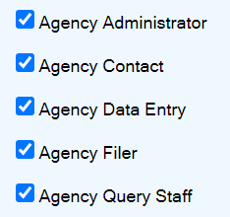
Getting access to the sscd
Each agency has a “system administrator”
Access levels
Email: des.contracting@des.wa.gov
SSCD User Manual
Notes:
Before you can file a sole source, you’ll need to gain access to the system:
Find your “agency administrator” – if you don’t know who that is, email DES Contracting to see if you have one assigned (or to update records if someone retired or left the agency)
There are many access levels to the system. The user manual goes more in depth with what each of these levels will allow you to do. For example: Agency Query Staff only have permission to look up and view their agency’s filings, but not submit them on behalf of their agency.
Once you have access, you can use the SSCD User Manual as a resource to walk you through submitting a filing.
If you need help, I am always happy to assist.

Slide 40
Sole Source Timelines
Three (3) basic actions & timelines required:
  Post on WEBS intent to procure sole source on goods/services
      Post for no less than 5 working days
  Make all contracts available for public inspection
      Post on agency website at least 10 working days prior to intended contract start date
  Submit to DES/file through the Sole Source Contracts Database (SSCD)
      File at least 10 working days prior to intended contract start date
Resources:
Policy DES-140-00 | Sole Source
Sole Source Procedure
Notes:
Three (3) basic actions (or timelines) required. The next few slides will dig into each of these actions.
Post your intent (referred to often as a legal notice) to procure sole source. I am happy to provide you with examples of legal notices – just give me a call or email me. Keep in mind that the 5 business/working days doesn’t include the day you post in WEBS and it also excludes any holidays.
Post on your agency website the notice and that the contract is available for public inspection (some agencies just post a copy of the contract, some post a notice that it’s available upon request). Make sure you take a screen shot of the posting on your website that also includes a time/date stamp for auditing purposes. I always recommend agencies take another screenshot the day they take the posting down; This way, when you are audited in the future, you have a complete record in the contract file that you met the transparency requirements.
Submit filing to DES via SSCD. The system will automatically calculate the days and tell you the first possible start date for your contract. The day you file in SSCD doesn’t count towards the 10-day period.

Slide 41


Sole Source – WEBS Posting
Post on WEBS – Intent to Sole Source
    Post for no less than 5 working days
  Postings should include at a minimum:
    Brief scope of work
    Vendor name, contract value and period of performance
    Any options for extension
    THE CRITERIA OR RATIONALE FOR MAKING THE SOLE SOURCE DECISION
    Instructions to vendors – how to respond:
      Who to contact with questions?
      When are capability statements due?
      What information should be included in the response?
  This is not an invitation to bid!!!
Resource:
Sole Source Procedure
Notes:
Post the intent to sole source on WEBS for no less than 5 business days – again, the day you post doesn’t count. If you aren’t completely sure of the market, this is a great way to test the vendor community to see if it really is a sole source.
This is not a request for bids.
Be sure that the “Intent to Sole Source” contains compelling and detailed information to:
Convince other vendors that this is really a sole source
Allow vendors who feel it is not a sole source to submit capability statements that allow you to evaluate what they can do.
Agencies should develop a process for responding to all sole source inquiries. Don’t leave the vendors wondering (1) what they should submit (2) who to submit questions and/or capability statements to and (3) when capability statements are due by. You must respond to all vendor inquiries in writing. Inquiries may or may not result in actual capability statements.
If vendors submit capability statements that shows they can do the work, you may need to withdraw your filing for sole source and begin competition.

Slide 42

Sole Source – Agency Website Posting
Make all contracts/purchase documents available for public inspection
    Post on agency website at least 10-working days prior to intended contract start date
    May post notice and instructions on how to obtain a copy
Resource:
Sole Source Procedure
Notes:
This step is all about TRANSPARENCY to the public!!!
Make all contracts available for public inspection by posting on your agency’s website for at least 10 working days prior to intended contract start date. We get questions around using the WEBS posting or filing in SSCD to satisfy this step, but neither will meet the transparency requirements for the public as only vendors have access to WEBS (the general public does not); and the SSCD is not open to the public.
I’ve seen some agencies post the actual documents (legal notice, contract) to their website and then other agencies advertise their intent to sole source and state that the contract is available upon request,; and then include contact information.

Slide 43
Sole Source – SSCD Filing
3. Submit to DES (file) through the SSCD
RCW 39.26.140(2) requires that [DES] must approve sole source contracts before any such contract becomes binding and before any services may be performed or goods provided under the contract.
Approval is obtained by filing the sole source contract or amendment in the Sole Source Contract Database (SSCD) with DES.
Resources:
Sole Source Justification Form
Sole Source Contracts Database (SSCD)
Notes:
Submit to DES/file through the Sole Source Contracts Database (SSCD). Another helpful thing to know when it comes time to file or use the system, is that the system will time out. So be prepared to always save your answers frequently to avoid potential rework –
Note that DES must approve sole source contract before contract becomes binding. Avoid invalid contracts – Do not start work until you have received DES approval!
Contracts that begin before filing will be disapproved.
The next couple of slides I will show you what the justification questions look like that the system will prompt.
Also: The ten-day period is a minimum – it’s not a deadline for DES action. DES needs this time to manage our workload and ensure that each filing receives meaningful and comprehensive analysis.
Contract work can start on the 10th working day, date of execution or the day of DES approval, whichever is later
Working days’ for filing purposes excludes Saturdays, Sundays, and state legal holidays.
Doesn’t count the day filed/submitted to DES
MUST wait 10-working days to start the contract, even if DES approves early
SSCD counts the ten working days

Slide 44
Sole Source Justification
Sole source contract justification questions
  Business need or problem that requires this contract?
  How did the agency conclude that the costs, fees, or rates negotiated are fair and reasonable?
  Unique features, qualifications, abilities or expertise of the contractor
  Market research conducted to conclude that alternative sources were inappropriate or unavailable?
  Detailed and compelling description of the costs and risks mitigated by contracting with this contractor
Notes:
DES really wants to say “yes” to your filings – your job is to provide enough information to convince us; and
Our job is to help you ensure that your filings stand up to public scrutiny
Answer all questions fully - they must give:
Detailed
Compelling; and
Convincing answers
Do your research, homework – due diligence
We don’t want KOMO moments – which could eventually cause more prescriptive rules again
INCOMPLETE or NON-COMPELLING JUSTIFICATIONS COULD DELAY YOUR CONTRACT START DATE!!
Unique qualifications:
If proprietary – provide documentation
Cautionary – don’t consider your procurement proprietary if similar services/goods are available but you choose a specific vendor you want to do the work. Provide the business reason for that decision!
Market research – show that you have done due diligence. Where have you researched, with who, etc.
Costs and risks mitigated – how did the contractor save you time, money – and how risks were mitigated

Slide 45
Sole Source Justification
Sole source contract justification questions (con’t):
  Special circumstances such as confidential investigations, copyright restrictions, etc.
  Unavoidable, critical time delays or issues that prevented the agency from completing this acquisition using a competitive process
  Geographic limitations
  Consequences of not having this sole source filing approved (include impact to the agency and to services it provides)
  Considerations were given to providing opportunities in this contract for small business, including but not limited to unbundling the goods and/or services acquired?
Notes:
Special Circumstances, such as Confidential investigations, copyright, etc.
Unavoidable, critical times delays – what caused them, who caused them
Was it a Budget proviso, legislative decision? – what would happen if you didn’t meet the timelines?
Keep in mind: TIME IS NEVER A SOLE FACTOR – ONLY A CONTRIBUTING ONE
Geographic limitations
Consequences of not having the filing approved
Considerations for small business – including unbundling….
Caution – unbundling must make sound business sense and not done to fall under the direct buy thresholds!

Slide 46

Sole Source – What DES Looks for:
  Do the answers address the questions?
  Do they convince the reader that a sole source exists?
  Do similar services or goods exist from other vendors?
  Are they complete and compelling?
  Are they understandable to a 3rd party?
  Will they stand up to scrutiny?
Notes:
When you give your Sole Source Justification Responses to the questions – DES is looking for specific information.
So, as procurement experts, don’t just cut and paste from the program responses. Review the justification that business partners have provided. Do they make sense? Are they understandable? Are acronyms spelled out at least once? You should be the first test of whether the responses are compelling.

Slide 47

Sole Source – What DES Looks for:
What DES looks for:
  Attachments
    Contract/Purchase Order
    WEBS posting
    Sole Source notification
    Other documents to support the filing
Notes:
The attachments are important elements to the filing. Here’s a checklist of the required attachments.
Contract/PO should include all exhibits and attachments that are referenced
WEBS posting – a screen shot or e-mail verifying the date it was posted to WEBS. Not required as an attachment (as we have the assertion from the agencies in the filing criteria), but helpful
Sole Source notification – the posting language describing the agency’s intent (legal notice) (should include: who the vendor is, cost of the contract, why they want or feel it is a sole source, proposed term of contract)
Other helpful things to remember and check for when submitting your filing as these are all things DES staff are analyzing:
Are the dollars correct?
Do the starting and ending dates match?
Is the contract performance-based? Does it contain deliverables, measures, outcomes, etc. - - if not, why?
Does language in the clauses make sense? Do any of terms contradict (example: vendors terms and then agency incorporates their own set of General Terms & Conditions – what takes precedence?)
Are the terms and conditions transactionally relevant?
Does the information in attachments and exhibits match what is in the contract and filing?
Agencies should attach the sole source notification posting to the filing. What we would like is a copy of the WEBS notification - it often has details that should match up with the contract and filing justification. Since the WEBS notification is the actionable item, it is the one we look for in our analysis and has often resulted in improvements to the agency contracts that help support their relationship with the contractor (for instance, ensuring the contract can be extended if necessary). As for the agency website posting, it should be the same except not invite potential vendors to submit capability statements, so there is no need to attach that document.

Slide 48
Sole Source Amendments
Amendments require filing if the original contract was filed except:
    “Minor or administrative change” means:
    Revisions to the terms of a contract that do not affect the substantive rights of any party to that contract, such as a contractor's address change, etc. Changes to contract performance or compensation, etc. would be examples of substantive changes.
Resources:
Policy DES-140-00 | Sole Source
Amendment Justification Form
Policy Glossary Supplement
Notes:
We ask that you attach all executed copies of any administrative amendments, (if you have any) with your next amendment requiring filing. This is for transparency and shows all amendments to the contract in consecutive order.
“Minor or administrative change” means revisions to the terms of a contract that do not affect the substantive rights of any party to that contract, such as a contractor's address change, etc. Changes to contract performance or compensation, etc. would be examples of substantive changes. (Defined in our POL-DES-140-00 Glossary Supplement.).
Agencies are not allowed to use a subsequent “proper” amendment to cure failing to submit previous substantive amendments.
I want to add caution that:
Amendments should not substantially change the scope of work!!! This can be seen as circumvention of the competitive process.
Amendments shouldn’t substantially change the period of performance/dollar amount – unless option to renew was included in original contract.

Slide 49

Sole Source – Late filings
Late filings
How to avoid “Disapprovals”
  Work cannot begin on a Contract/PO until approved by DES
Resources:
Policy DES-140-00 | Sole Source
Late Filing Justification Form
Notes:
If filed late – let DES know so that we can prioritize them for you – don’t start the contract. Late filings that comply with all other requirements, will be marked “Late Filings” – otherwise, disapproved. A resource for you to use is the Late Filing Justification Form – it contains all the same questions you’ll be asked in the SSCD so it can help you better prepare to file.
Remember any late sole source filings could affect your agency’s overall delegation of authority.
Legislative issues – when the legislation session runs later than the expected end date, there have been late filings due to budget decisions not decided until late. DES recommends a way in which an agency can avoid a late filing resulting from late legislative budget decisions. The Agency should file the contract in June, allowing for the 10-working day filing period, regardless of whether the legislature has approved funding at that time. The Agency can file the contract based on the information that they have at that time, working closely with DES Policy Team. If funding is approved, DES will assist the agency with making any necessary changes and process the contract in a timely fashion. If the funding is not approved, the filing will be deleted.

Slide 50
Exemptions to Sole Source
Exemptions to sole source filing requirements:
  20 Exemptions listed in Policy DES-140-00
  Agencies may request exemptions for specific contracts or category of contracts
    Request must be in writing to DES Director
    Must meet all other sole source requirements
Resource:
Policy DES-140-00 | Sole Source
Notes:
There are many exemptions – always refer to the DES sole source policy.
Separate from the 20 exemptions listed in the sole source policy, agencies may request exemptions for specific contracts or categories of contracts. This is a separate process from the sole source filing process. The policy team at DES can assist you.
RCW 39.26.140(4) states that higher education is exempt from sole source requirements when contracts awarded from non-state funds. Higher Ed examples using mixed funds:
Contract for $10,001
Direct buy threshold is $10K
Non-state funds = $5,001
50% would be $5,000.00
Not subject to filing
Contract for $20K
Direct buy threshold is $10K
Non-state funds = $9K
Subject to filing

Slide 51
THANK YOU!

