Slide 1
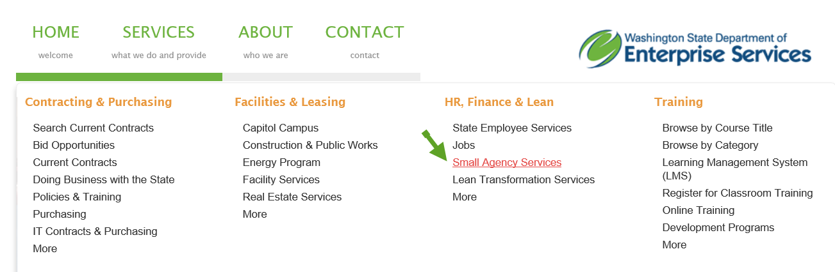
HR Toolkit
All action forms and guidance are located on the HR Toolkit.
https://des.wa.gov
Notes:
All forms are located on HR Toolkit.
Pull forms from Toolkit frequently in order to make sure you have most current version.
Click link to show route to Toolkit (Services, Small Agency Services, Human Resources Services, HR Toolkit).
Click on PPDS (point out Related Topics to show guidance documents)

Slide 2
Personnel/Payroll Data Sheet (PPDS)
This form should be used whenever you are hiring or changing the status of an employee.
Appointment changes
Status changes
Separations
Salary increases
Position Action Form (PAF)
This form should be used whenever you are making changes to or creating a new position.
Duty station changes
Working title changes
Flextime/telework/compressed workweek eligibility changes
Notes:
2 types of action forms:
PPDS makes changes to an employee’s appointment or status.
New hires, promotions, demotions, salary increases, separations, etc.
PAF makes changes to a position.
Changing a working title, a duty station, etc.
Some types of actions require both.
Reallocation: You are reallocating a position, but also the employee. There are different questions that are answered on each form for the PPDS (employee side) and the PAF (the position side).

Slide 3
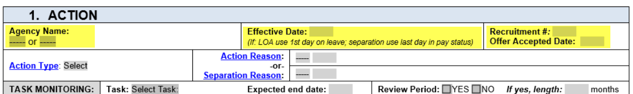
Personnel/Payroll Data Sheet (PPDS)
Agency Name
Effective Date (Required for ALL Actions!)
  1st day in agency, new appointment, or new status
    If employee is transferring from another agency, this date could fall on a weekend.
  Separation: Last day in pay status
  Leave of Absence: First day out on leave
Recruitment Information
  Used to track time to hire. Enter this information if known.
Notes:
Effective date:
1st day working in agency/in new appt/new status.
If currently with state, could fall on weekend to insure no break in service. (leaves Friday, the 15th, could start w/ your agency Saturday, the 16th. New to state-first working day.
If separation, last day on status (could be on leave on last day).
Leave of absence-use first day out on leave.
Recruitment:
If you use our recruitment services and this resulted from a recruitment, our recruitment team tracks time to hire.

Slide 4
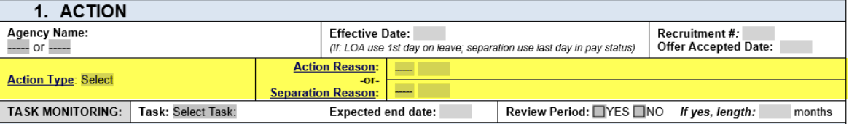
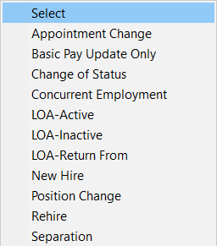
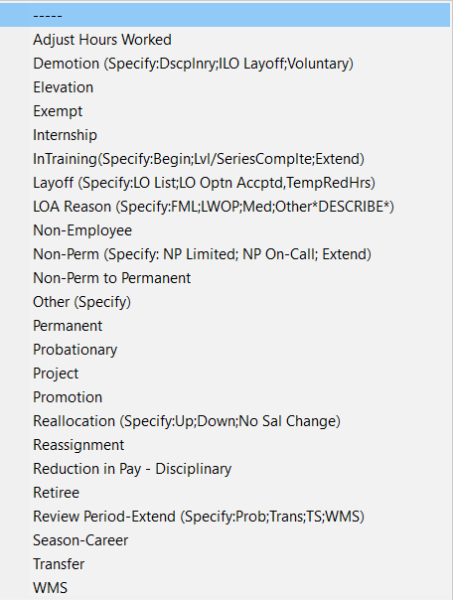
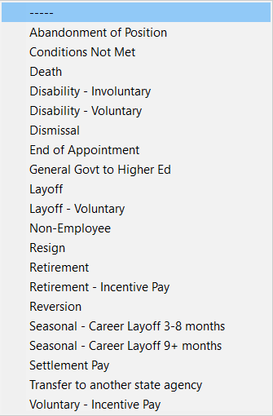
Action Type
Action Reason
Separation Reason
Notes:
Action Type: Click link. Some of most common:
Appt. Change –a change to an employee within an agency or between agencies (when there is no break in service). Promotions, transfers, demotions, etc….these are appointment changes.
Change of Status - to change the status of an employee in their position. In review period, use to extend. In Non-Perm, use to extend.
LOA - There’s an action type to put someone on leave…both active (paid) and inactive (unpaid). Submit PPDS to put someone on leave AND another one to take them off.
New Hire - when an employee is hired and doesn’t have either prior state service or a personnel #. Movement between agencies, isn’t considered a new hire.
Action Reason OR Separation Reason: Click link.
Here are the definitions for the reasons. Don’t hesitate to reach out to SAA email box if you need guidance on action reason!

Slide 5
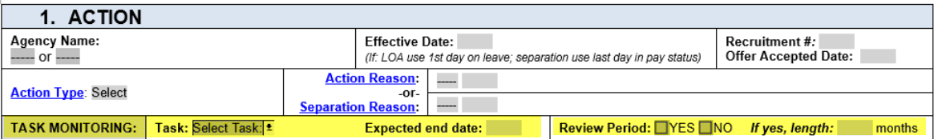
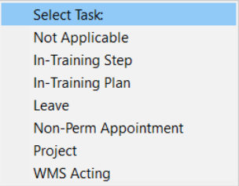
Task Monitoring
  Tracks ends dates for certain appointments.
  This is not used to key these end dates! This is only used as reminder to request paperwork for these actions.
Review Period (Required if a new appointment)
Tasks
Notes:
Task Monitoring:
How we track end dates for certain appointments like non-perms and projects. Or to indicate when an in-training is going to end.
This DOES NOT indicate to our team to key the action, it is just a reminder to reach out to the agency to request paperwork in order to key action! Example: If a non-perm is expected to end on 12/31/2018. We are not going to key the separation for 12/31/2018.
Review Period: Required if a new appointment. Work with your HR Consultant if you have questions about when a review period is required or not.

Slide 6
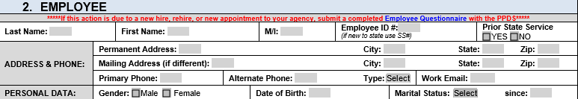
Employee Name
  Legal Name (Should match what is on file w/ Social Security Administration)
Employee ID/SSN
Prior State Service
  Not all history is in HRMS. (2006 - Present)
Address & Phone
  Work Email – Used for ESS login.
Personal Data:
  In addition, to these fields, new hires into agencies should complete Employee Questionnaire to collect affirmative action data used by OFM. Click the link to the Employee Questionnaire.
Notes:
Employee Name: Should match what’s on file with the Social Security Administration (what is on SS Card.)
Prior State Service: important to know. Not all history is in HRMS. Anything prior to 2006, we have to request from another system. Want to make sure they get credit towards their anniversary date/leave accruals.
Address/Phone: Don’t need to enter for every action unless there is a change.
Work Email: Include if new to agency. How employee creates ESS account.
Personal Data: Click on Employee Questionnaire in red writing section. Should be filled out by employees new to agency. How we collect affirmative action data used by OFM to report on workforce data such as ethnicity, education, military status and disability. Can be sent later than PPDS!

Slide 7
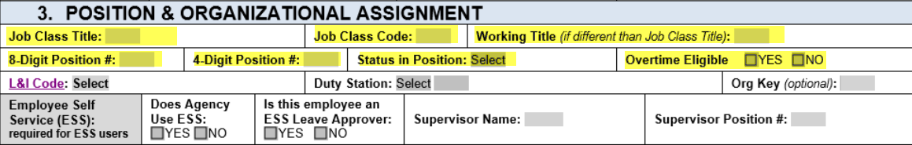
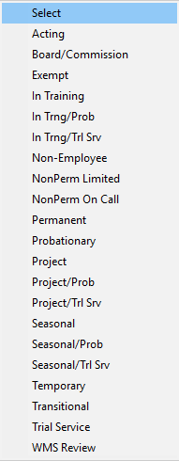
Status in Position
Job Class Title
Job Class Code
Working Title
  This isn’t to change the working title of a position (use Position Action Form)
Position #s
Status in Position
  Choose from drop-down. Your HR Consultant can assist with the choices if you need assistance.
Overtime Eligibility
  In most cases, this should match eligibility of position. Unless the position is salary and the employee is hourly.
Notes:
Job class/code/working title: Should all match the position unless you are under filling or this is an in training.
Position #s (if both are known)
Status in Position. This tells us if someone is serving a review period, if the employee is acting in a position, if this is a non-perm, etc. You can consult w/ HR Consultant if you need assistance.
Overtime eligibility – should match position overtime eligibility (unless employee is under filling in a lower position, or the employee is hourly.)

Slide 8
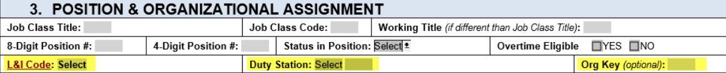
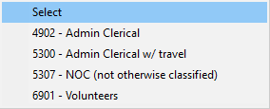
L&I Code
  Determines the rate for the employee and the employer for Worker’s Comp Insurance.
  Click link for a worksheet to assist in making this determination.
Duty Station
  The location where an employee is assigned to conduct work from.
  Used for Unemployment tax rate.
Org Key
  Optional field. Only a few agencies use.
L&I Code:
Notes:
L&I Code:
Determines the amount employee AND employer pay for workers comp insurance.
Based on duties of the position
Click on the link for worksheet to help determine the right code.
Duty Station:
Identifies what county the employee is working in for unemployment tax purposes.
Org Key
Only a few agencies use this field.

Slide 9
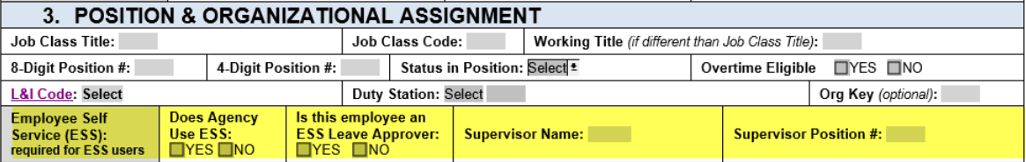
Employee Self Service (ESS)
  Helps us determine if we need to key supervisors in HRMS.
  Supervisor = Leave Approver in this case
Notes:
Employee Self Service
for agencies that use ESS
This helps us determine if changes to leave approvers need to be made in HRMS.
In this case, a supervisor is considered the person that approves leave for the employee. In some agencies, an employee has a supervisor at the agency, but someone else approves the leave (like an administrative assistant, a small agency liaison).

Slide 10


Reason (Indicate why an adjustment to pay was made)
    Most common reason is an appointment change when an employee is moving positions, or a reallocation.
Band/Range/Salary
  Part time employees: If Exempt/WMS, enter part time pay. General service: HRMS will calculate automatically.
Assignment Pay
  Is a premium added to the base salary for specialized skills or assigned duties? Must select type of assignment pay if answer is YES.
Shift Differential
  Does employee’s regular or temporary schedule work shift to include hours after 6:00 pm and before 6:00 am?
  If this an increase for an Exempt employee, a copy of approval letter is required.
Notes:
Reason
Indicate why an adjustment to pay was made
Most common reason is an appointment change. Typically when your action type is appointment change, your pay adjustment reason is appointment change.
Salary/Band/Range
Part time employees: If Exempt/WMS, enter part time pay. General service, HRMS will calculate automatically.
Assignment Pay
Is a premium added to the base salary for specialized skills or assigned duties? Must select type of assignment pay if answer is YES.
Only two types of assignment pay that we have found that applies to small agencies. Both receive 2 additional ranges.
full-time assignment to a floor care crew and the operation of heavy-duty floor cleaning and waxing equipment.
proficient use of written and oral English and proficiency in speaking and/or writing one or more foreign languages, American Sign Language, or Unified English Braille, provided that proficiency or formal training in such additional language is not required.
Shift Differential
Does employee’s regular or temporary schedule work shift to include hours after 6:00 pm and before 6:00 am?
If this an increase for an Exempt employee, please provide a copy of approval letter.

Slide 11
Work Schedule
  Choose the appropriate Work Schedule from drop down. If there isn’t one that matches, work with Small Agency Assistance to see what works best. Hourly (24/7) may need to be used.
Shift Hours
  Important to include hours so we can determine need for either partial or full shift diff
Full Time / Part Time Percentage
  Part time: please indicate percentage. If you need help determining it, let us know. Including this percentage makes sure the employee will be meeting eligibility for insurance benefits.
Teleworking
  Indicate if the employee will be teleworking. This information is used to track percentage of employees teleworking.
Notes:
Work Schedule
Choose the appropriate Work Schedule from drop down. If there isn’t one that matches, work with Small Agency Assistance to see what works best. Hourly (24/7) may need to be used if there isn’t an option that matches.
Shift Hours
Please indicate the employees working hours. This helps us determine if there is a need for partial or full shift diff.
Full Time/Part Time
If an employee is part time, please indicate their percentage. If you need help determining it, let us know. Including this percentage makes sure the employee will be meeting eligibility for insurance benefits.
Teleworking
Indicate if the employee will be teleworking. This information is used to track percentage of employees teleworking.

Slide 12

These fields are REQUIRED if this is a new hire. Check No Change if applicable.
There are questions under each field to help answer Yes or No.
Insurance Eligibility
  Expected to work an average of 80 hrs/month for more than six months
Retirement Eligibility (Based on the position’s eligibility)
Eligible for Personal Holiday
  Is the employee scheduled to be, or has been continuously employed for 4 months?
  If yes, employee will receive PH right away.
Eligibility for Personal Leave Date (Only for represented staff)
  Is the employee scheduled to be, or has been, employed for 4 months? (6 if Coalition)
  Employee will receive PLD after working for 4 months (consecutive 4 months)
Notes:
These fields are REQUIRED if this is a new hire. Check No Change if applicable.
There are questions under each field to help answer Yes or No.
Insurance Eligibility
Expected to work an average of 80 hrs/month for more than six months
Retirement Eligibility (Based on the position’s eligibility)
Eligible for Personal Holiday
Is the employee scheduled to be, or has been continuously employed for 4 months?
If yes, employee will receive PH right away.
Eligibility for Personal Leave Date (Only for represented staff)
Is the employee scheduled to be, or has been, employed for 4 months? (6 months if Coalition)
Employee will receive PLD after working for 4 months (not just in a represented position – if an employee transfers from a position that wasn’t represented and they worked for more than 4 months, they would get PLD right away when moving into represented position.)

Slide 13

Budget Coding
  Indicate if there is no change.
  Work with Small Agency Budget if you need coding assistance.
Authorization is required for ALL actions.
Comments: Anything additional we need to know to key this action?
  Waiving a review period
  Accelerated leave accruals
  Giving additional pay
  Under filling positions in a higher level position
  Counting time in a non-perm to count towards a review period
Notes:
Budget Coding
Indicate if there is no change.
Work with Small Agency Budget if you need coding assistance.
Authorization is required for ALL actions.
Comments: Anything additional we need to know to key this action? The more the better. It saves us having to reach out to ask additional questions. Examples are:
Waiving a review period
Accelerated leave accruals
Giving additional pay
Under filling positions in a higher level position
Counting time in a non-perm to count towards a review period

Slide 14
All final PPDS forms should be sent to SAA@des.wa.gov.
(Email address is listed at the bottom of the form)
Forms should be sent in as soon as possible and close to hire date or appointment change in order to enter the action before payroll runs.
HRMS/payroll calendars can be located at the below address:
https://watech.wa.gov/payroll/hrms-payroll-calendar

Slide 15
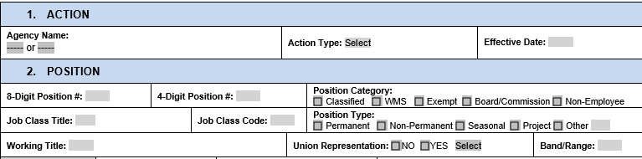
Position Action Form (PAF)
Agency Name
Action Type
  Creating a new position, Delimiting (getting rid of a position), reallocating a position, or updating information about a position
Position #’s (if there already is one)
Position Category & Type
Job Class Title/Code
Working Title (if different than job class)
Union Representation
Band/Range
Notes:
Position Action Form – fields are a little more self explanatory.
The action type tells us what we are doing….creating a new position, delimiting (or getting rid of an old position), reallocating a position, or updating information on a position.

Slide 16
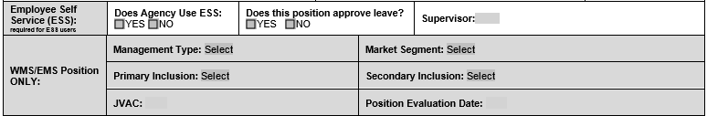
Employee Self Service (ESS)
  Supervisor = leave approver
WMS/EMS Position Information
  Consult w/ your HR Consultant if you need assistance determining the fields
Determine if the position will be full time or part time and if the employee will be paid salary or hourly.
Overtime Eligibility
  If you need assistance making the determination if the position is overtime eligible or exempt, use the Overtime Eligibility Determination worksheet. Click the link
Notes:
Employee Self Service (ESS) box tells us if we need to add leave approvers in HRMS.
WMS/EMS Position Box:
If we are creating a new WMS/EMS position, these fields are required. You can work with your HR Consultant to assist in figuring out the Management Type, Market Segment, Primary Inclusion, Secondary Inclusion (if there is one), and the JVAC points.
Work Schedule:
Determine if the position will be full time or part time and if the employee will be paid salary or hourly.
Overtime Eligibility
If you need assistance making the determination if the position is overtime eligible or exempt, use the Overtime Eligibility Determination worksheet. Click the link on overtime eligibility.

Slide 17

Retirement Eligibility
  If this is a new position, the question to determine eligibility is:
    Is this position expected to require at least 5 months of at least 70 hours for two consecutive years?
  If this is an already established position and you are trying to determine if there is a need to re-evaluate the eligibility, the question to ask is:
    Will this position require at least 5 months of 70 or more hours of compensated service at least every other year?
The important thing to remember is that if a position is retirement eligible, the employee going into the position will be retirement eligible.
Retirement eligibility is based on the position.
Notes:
Retirement Eligibility
If this is a new position, the question to determine eligibility is:
Is this position expected to require at least 5 months of at least 70 hours for two consecutive years?
If this is an already established position and you are trying to determine if there is a need to re-evaluate the eligibility, the question to ask is
Will this position require at least 5 months of 70 or more hours of compensated service at least every other year?
If a position was established and wasn’t supposed to last for more than 2 years, so it was NOT retirement eligible, now the position is expected to last more than 2 years, send in a new PAF marking the position as eligible in this section.
The important thing to remember is that if a position is retirement eligible, the employee going into the position will be retirement eligible. Eligibility is based on the position.

Slide 18

Telework/Flextime/Compressed Workweek
  Answer the questions to determine the position’s eligibility for telework, flextime, and compressed workweek.
  These choices don’t necessarily mean that the employee in the position will be participating.
Duty Station Address
  The location where a position is assigned and/or where an employee is assigned to conduct work from.
Notes:
Telework/Flextime/Compressed Workweek
Answer the questions to determine the position’s eligibility for telework, flextime, and compressed workweek.
These choices don’t necessarily mean that the employee in the position will be participating.
Duty Station Address
The location where a position is assigned and/or where an employee is assigned to conduct work from.

Slide 19
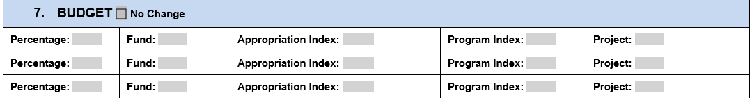
Budget
  Indicate if there is no change
  If this PAF is to create a new position, budget coding is required.
  Work with Small Agency Budget if you need assistance with cost coding.
Authorization is required for all actions.
Use the comments/notes section to include any additional information we may need to enter this action.
Notes:
Budget
Indicate if there is no change
If this PAF is to create a new position, budget coding is REQUIRED.
Work with Small Agency Budget if you need assistance with cost coding.
Authorization is required for ALL Actions!
List any comments in the comments section that may help us enter the action.

Slide 20
All final Position Action Forms should be sent to SAA@des.wa.gov.
(Email address is listed at the bottom of the form)
You may need to work with your assigned HR Consultant to make sure the job classification is correct by sending in a Position Description.
If the position is a WMS/EMS position, you may need to work with your assigned HR Consultant to determine the correct banding.
Notes:
All final Position Action Forms should be sent to SAA@des.wa.gov.
(Email address is listed at the bottom of the form)
You may need to work with your assigned HR Consultant to make sure the job classification is correct by sending in a Position Description.
If the position is a WMS/EMS position, you may need to work with your assigned HR Consultant to determine the correct banding.

Slide 21

Questions? Comments?
Suggestions?

