Slide 1

Payroll Workshop
Helping Us Help You
Presented by your Payroll Team
Thursday, October 12, 2017

Slide 2
Housekeeping
Sign in sheet
Restrooms
In case of an emergency
If visiting, please be sure to return badge at front desk when you sign out

Slide 3
Agenda Items
Payroll Contacts: Who Does What in Payroll
Leave:
  Leave Without Pay (LWOP)
  Annual Leave
  Sick Leave
  Timeliness
Holiday Pay & LWOP
Timesheet Standardization
Supervisor Training: ESS Roles and Responsibilities
Transfer In/Out vs. Appointment Changes
Healthcare Benefits/Open Enrollment
Questions

Slide 4
Payroll Contacts: Who Does What in Payroll?
You have a team of 8 full-time staff dedicated to processing your payroll and available to help answer any questions you may have. Combined, this calculates to over 23 years of state experience at your fingertips.
            Tanya Brogan Payroll Manager
            Carrie Winslow Payroll Supervisor
            Vacant Benefit Specialist
            Vanno Non Payroll Lead
            Rebecca Brown Payroll Processor
            Bona Brewer Payroll Processor
            Tinoi Ma’afala Payroll Processor
            Brittany Keeling Time and Attendance

Slide 5
Payroll Contact Numbers
Tanya Brogan Manager 360.407.8445
Carrie Winslow Supervisor 360.407.8021
Vacant Benefit Specialist 360.407.8036
Vanno Non Payroll Lead 360.407.8118
Rebecca Brown Payroll Lead 360.407.7946
Bona Brewer Payroll Processor 360.407.7960
Tinoi Ma’afala Payroll Processor 360.407.9391
Brittany Keeling Time and Attendance 360.407.8574
Fax: 360.586.0021
Email: despayroll@des.wa.gov

Slide 6
Leave Types
Holiday Pay and LWOP

Slide 7
Leave Types
Vacation Leave
  Employees earn 12-22 days of paid vacation per year depending on the length of employment. Qualified employees may also donate leave to assist other employees through an extended absence. (See following slide for chart of accruals)
Sick Leave
  Full-time employees earn one eight hour day of sick leave each month.
  Part-time employees earn sick leave on a pro rata basis.
Both leave types need to be submitted on time.
  If an employee separates before the leave is submitted it could result in an overpayment or underpayment, depending on the situation, which would require actions after the employee has separated.
  If leave is not submitted timely it could result in being forgotten. Employers risk giving employees “free” days off that employees have not earned.

Slide 8
New Annual Leave Accruals Effective 07/01/2017
New Annual Leave Accruals as of 07/01/2017
Full Years of Service | Hours Per Year | Hours Per Month
During the first and second years of current continuous employment | One hundred twelve (112) | 9.33333
During the third year of current continuous employment | One hundred twenty (120) | 10.00000
During the fourth year of current continuous employment | One hundred twenty-eight (128) | 10.66667
During the fifth and sixth years of total employment | One hundred thirty-six (136) | 11.33333
During the seventh, eighth and ninth years of total employment | One hundred forty-four (144) | 12.00000
During the tenth, eleventh, twelfth, thirteenth, and fourteenth years of total employment | One hundred sixty (160) | 13.33333
During the fifteenth, sixteenth, seventeenth, eighteenth, and nineteenth years of total employment | One hundred seventy-six (176) | 14.66667
During the twentieth, twenty-first, twenty-second, twenty-third, and twenty fourth years of total employment | One hundred ninety-two (192) | 16.00000
During the twenty-fifth year of total employment and thereafter | Two hundred (200) | 16.66667

Slide 9
Leave Types
LWOP – Leave Without Pay
  May be granted for prolonged illness, maternity causes, educational pursuit or other valid reason.
  Though the employee retains his or her relative job status, no pay or other compensation is received during this leave.
  For the sake of the employee it is important that LWOP is entered on time. If a salaried employee does not submit LWOP for the current pay period, an overpayment will occur. If the employee enters LWOP after the payroll cutoff, the system will automatically take the money back, leaving with the employee without earnings for that pay-period. This may cause financial hardship on the employee.
  Entering late LWOP can cause the system to give an employee accruals that they may not have earned. Causing the system to take back the accrual, leaving a negative balance, which in turn could possibly result in an overpayment.
  NOTE: Timeliness of submitting leave is essential in all aspects to avoid issues with leave and/or pay.
  Reminder: If an employee is out of the office they can remotely submit leave or the supervisors have the ability to do so. This will help alleviate these issues.

Slide 10

Leave Types
Questions?

Slide 11
Holiday Pay and LWOP
Who is eligible?
  Full-time employees are paid for the holiday when they are employed before the holiday and are in pay status for the entire work shift preceding the holiday OR for at least 80 non-overtime hours during the month of the holiday.
  Part-time or hourly employees who are in pay status during the month of the holiday qualify for holiday pay on a pro rata basis and will be paid out on the first payroll the following month.
    Pro-rated calculations are based off hours worked and leave time submitted.
    LWOP, overtime, earned comp time, shift diff., standby pay and call back do not contribute to hours worked.
    Personal holiday and personal leave day (represented) are also calculated on a pro rata basis for part-time or hourly employees.

Slide 12
Holiday Pay and LWOP
Eligibility requirements:
  Employees must work or submit paid leave for either the last scheduled day before OR the first scheduled day after the holiday.
  If an employee takes leave without pay (LWOP) the day before AND the day after the holiday they will forfeit their holiday pay.
  An employee can take LWOP either before OR after the holiday to remain eligible for holiday pay.
  If LWOP is taken the whole week of the holiday, the holiday will now turn into LWOP.
Notes:
Communication has to happen between the agency & Payroll because there is action needed on our end in HRMS.

Slide 13
Holiday Pay and LWOP
Questions?

Slide 14
Timesheet Standardization

Slide 15
Timesheet Standardization
Fun Facts:
Each pay period we process payroll for over 1,100 employees in 39 Small State Agencies
We also process over 750 timesheets for DES employees and the programs we support
Every timesheet and action we process is reviewed for accuracy
We have a two to three day turn around time to complete this process

Slide 16
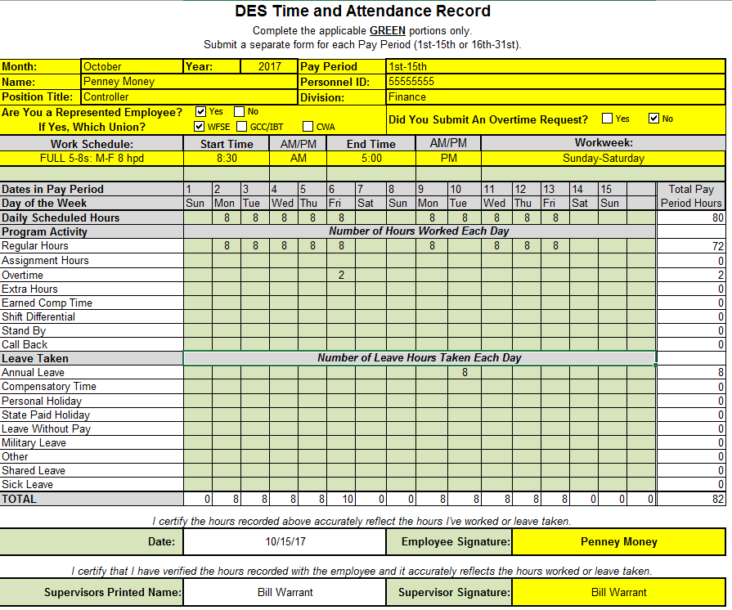
DES Timesheet (Time and Attendance Record) Example

Slide 17
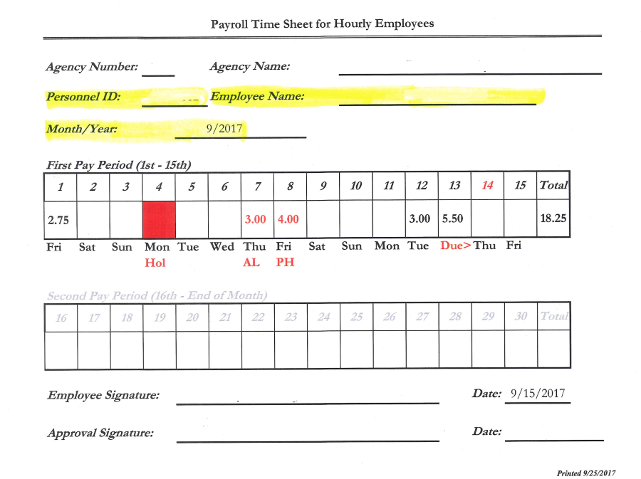
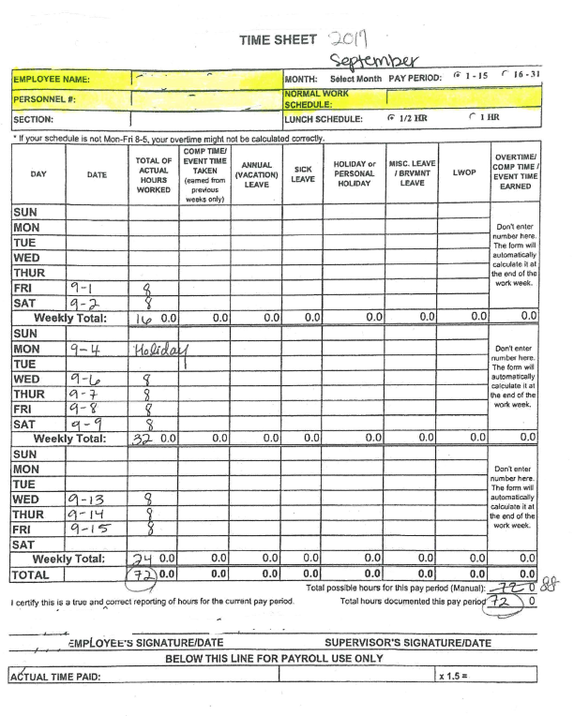
Examples of Several Small Agency Timesheets

Slide 18
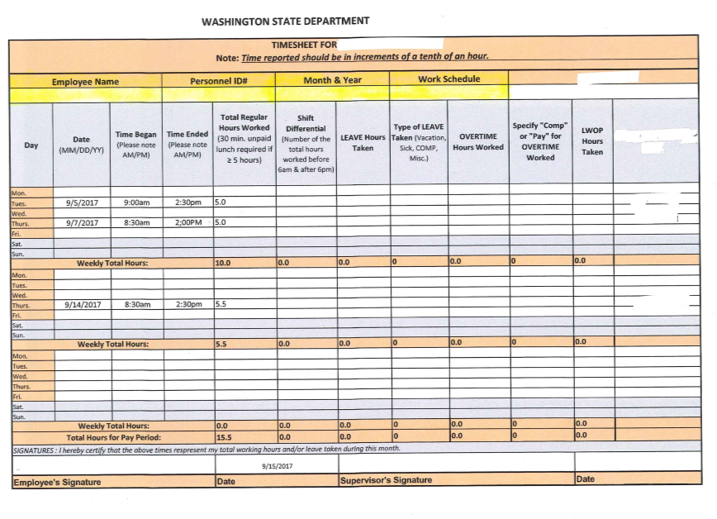
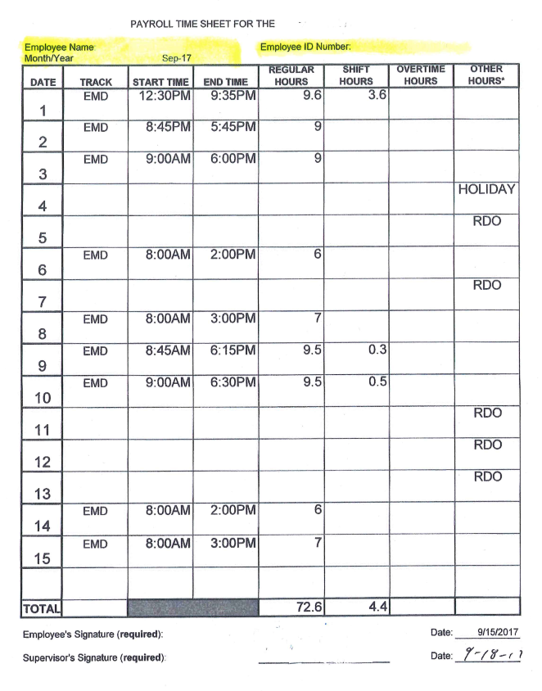
Examples of Several Small Agency Timesheets

Slide 19
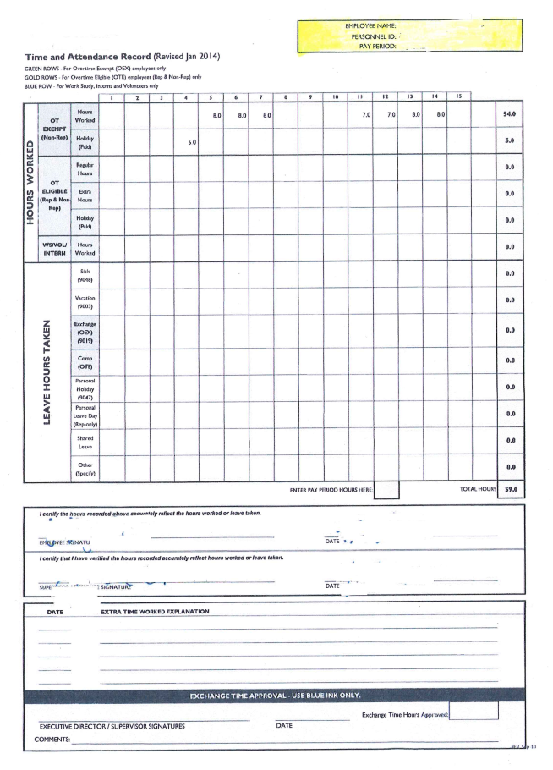
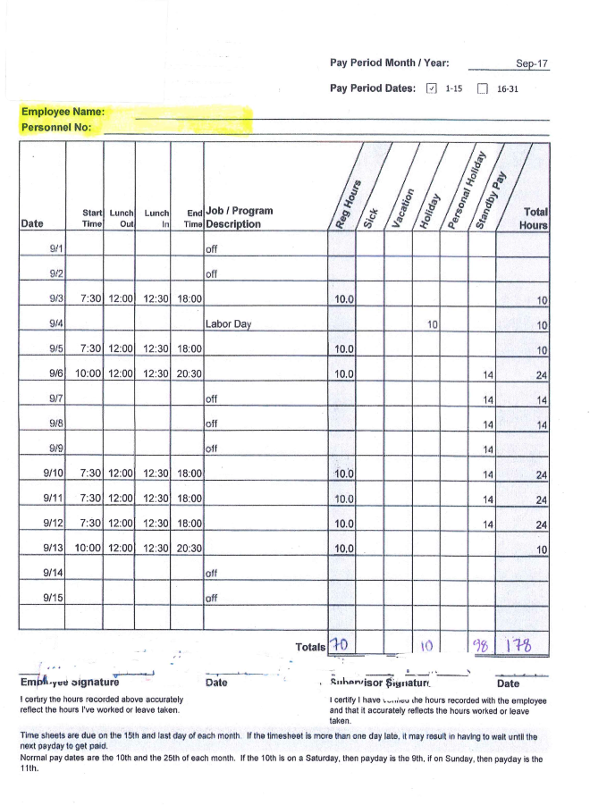
Examples of Several Small Agency Timesheets

Slide 20
Our Goal
To provide the best customer service by utilizing a standard timesheet process.
Benefits:
  Process timely and efficiently
  Less room for mistakes
  Less questions and confusion
  Easy for any Payroll Analyst to process

Slide 21
Timesheet Information
Ensure employees’ Name and ID number is on the timesheet.
Month – Year and Pay Period clearly identified.
Is this employee represented? If so, which Union.
Indicate employees Working Schedule and Start Time/End Time.
  Example: M-F, 8am-5pm
  Example: Tu-Sat, 6:30pm-1:30am
Hours worked: Regular Hours, Extra Hours, Overtime, Shift Differential, etc.
“Leave hours” such as “Annual Leave” clearly marked and entered in ESS or with a signed “Approved Leave Request form”.
Timesheet signed by the Employee and Supervisor.

Slide 22
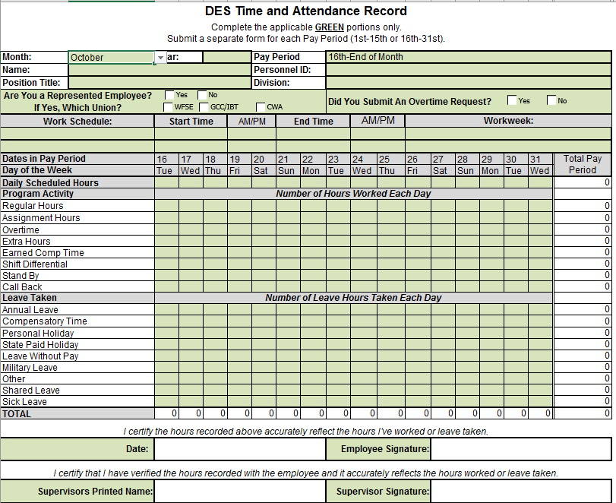

OFM Timesheet
If you would like more information on obtaining a copy of this timesheet, or if you have any questions, please contact your payroll liaison. We are more than happy to assist.

Slide 23
Timesheet Standardization
Questions?

Slide 24
Supervisor Training:
Employee Self-Service (ESS)
Roles and Responsibilities

Slide 25
ESS.. What is it and How Does it Work?
Employee Self Services, also known as ESS, is a leave tool used by both employees and supervisors alike. It is a program where employees can print out their earning statements or update their emergency contact information. But most importantly, it is a tool used by all employees to submit leave that is eligible for use. Most common leave types are sick leave, vacation leave and leave without pay. Once this information has been entered into the program and approved by the supervisor, it feeds into our payroll system and then processed through payroll.
Below are some helpful links to get you started:
https://watech.wa.gov/payroll/employee-self-service/ess-leave-tool

Slide 26
The Role of the Supervisor
Regarding Leave & Timesheets
Supervisors have the responsibility to make sure all timesheets and leave submitted are correct.
Supervisors need to confirm that employees are taking the correct leave type and amount before approving it on their timesheet and in ESS.
If a supervisor is going to be out of the office they need to have their manager approve the leave on his/her behalf for their direct reports.

Slide 27
The Role of the Supervisor
Regarding Leave & Timesheets
The supervisor is responsible to ensure that:
  Timesheets for all overtime eligible employees are submitted to payroll timely.
  Leave submitted in ESS is complete and accurate.
  The timesheet and any leave taken match ESS.
What is the potential impact?
  Not doing so could result in underpayments and/or overpayments which could become costly both for your program and your employees.

Slide 28
Leave Without Pay (LWOP)
When an employee is out of the office and on leave without pay there IS action that needs to be taken.
  Similar to vacation and sick leave, leave without pay needs to be entered into ESS.
  If leave without pay is not entered this will cause the employee to get paid for days they did not work, resulting in an overpayment.
  If the employee is unable to submit the leave without pay their supervisor/manager can submit on their behalf.
  If you submit leave on your employee’s behalf, you must also approve that submission.

Slide 29
The Role of the Supervisor
Regarding Leave & Timesheets
Reminders:
  Leave must be submitted timely.
  Leave must be reported accurately.
  If paid leave is exhausted, LWOP must be submitted for all hours the employee did not work.
  Supervisors can submit leave on their employee’s behalf.
  Managers can approve leave on behalf of their supervisors.
  If an employee is out on LWOP it is the supervisor’s responsibility to submit leave on the employees behalf.

Slide 30
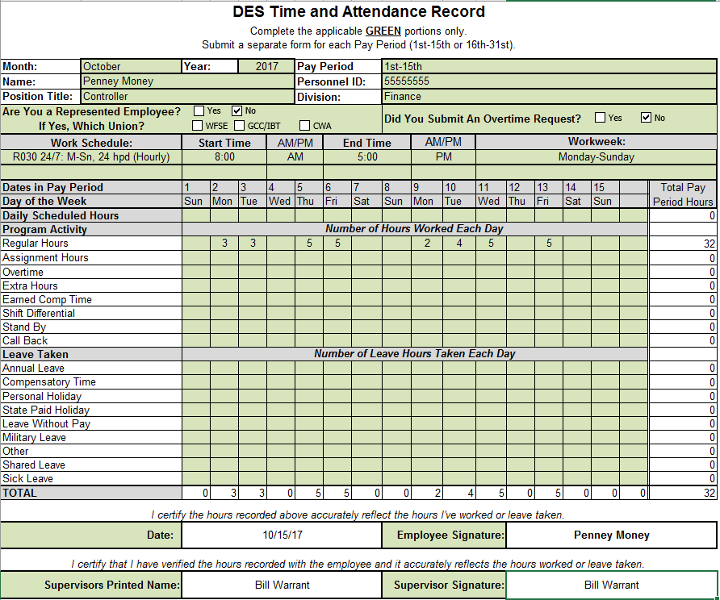
Timesheets
Timesheet Auditing
Step 1: Collect timesheets from ALL overtime eligible employees. Required by federal law.

Slide 31
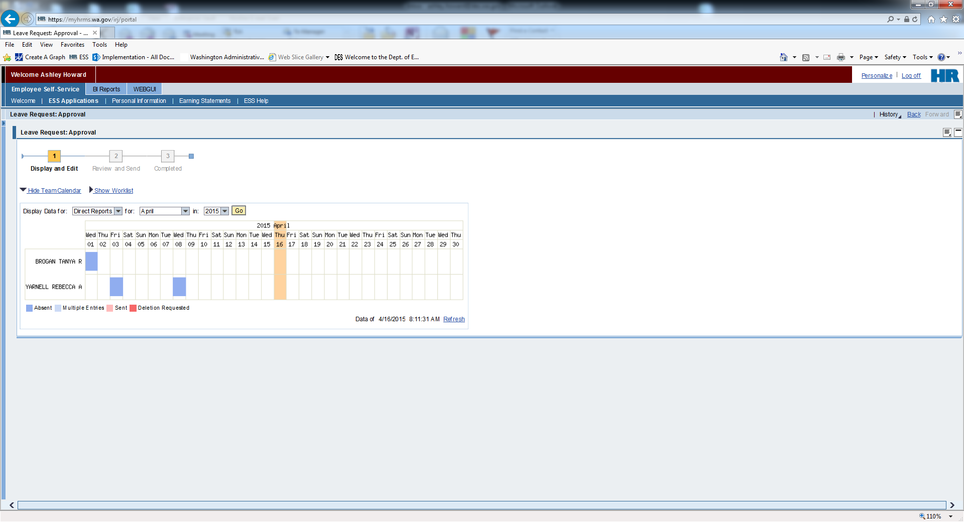
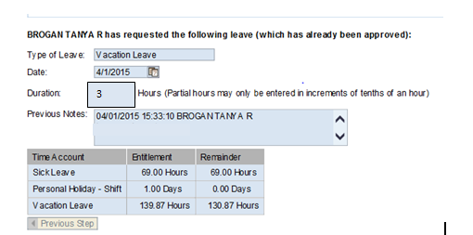
Timesheets
Timesheet Auditing
Step 2: Cross reference ESS to all timesheets to ensure all leave reported on the timesheet is submitted in ESS

Slide 32

Timesheets
Timesheet Auditing
Step 3: Sign and submit completed timesheet to payroll for processing.

Slide 33

Transfers In/Out
Friendly reminders:
  On the PPDS/PAR please note the Action Type as “Transfer In or Transfer Out”
  Under comments and notes indicate which agency the employee is “Transferring To or From”

Slide 34
Transfer In – Forms Needed
  PEBB Worksheet A-5; Transfer Employee:
    When an employee transfers from one employing agency to another without a break in PEBB coverage their insurance coverage remains the same.
  Retirement Status Form:
    We use this form to validate the retirement status of all new employees.
  FSA Transfer Form:
    If an employee is enrolled in Medical Flexible Spending Account (FSA) or Dependent Care Assistance Program (DCAP) the employee must submit the form to payroll no later than 30 days after the date of transfer.
    An agency transfer is not a qualifying event to change your Medical FSA or DCAP election.
  Retirement Member Information Form (PERS 3 only):
    Because PERS 3 members have 90 days to choose a new retirement rate, these employees will be set up in HRMS as PERS 3 Rate 0 until we receive a Member Information Form (MIF). What this means is that active PERS 3 members that transfer in will not be contributing employee contributions to PERS 3 until we receive this form or 90 days default occurs. Default rate is Rate A (5%) Self. Employer contributions will continue during this 90 day window.
  W-4
  EFT Form

Slide 35
Supervising Training and Transfers In/Out
Questions?

Slide 36
2018 Open Enrollment

Slide 37
2018 Open Enrollment
Annual Open Enrollment
November 1 through November 30
All forms must be received no earlier than November 1 and no later than November 30
  The signature date on the form must not be prior to November 1
  The request must be on the 2018 Employee Enrollment/Change form
Changes are effective January 1, 2018

Slide 38
What Can Employees Do?
During open enrollment, employees may:
Change medical and/or dental plans.
Reinstate previously waived medical coverage without proof of loss
Waive medical if they have other employer-based group medical, TRICARE or Medicare
  Coverage under the Health Benefit Exchange (HBE) is not considered employer-based coverage
Remove dependents
Change premium deduction to pre- or post-tax (IRC Section 125)
Change the tax status of a dependent (IRC Section 152)

Slide 39

What Can Employees Do?
Add eligible dependents without proof of loss of previous coverage
  Dependent verification (DV) documents are required
  A list of valid DV documents are available online at:
    https://www.hca.wa.gov/public-employee-benefits/employees

Slide 40
Medical Flexible Spending Arrangement (FSA) & Dependent Care Assistance Program (DCAP)
Employees Can:
Enroll or re-enroll in a Medical FSA and/or DCAP
Employees must re-enroll every year if they wish to continue to participate, even if the contribution amount remains the same

Slide 41

Medical Flexible Spending Arrangement (FSA)
Employees Cannot:
Enroll in a Medical FSA and a Consumer Direct Health Plan (CDHP) with a Health Savings Account (HSA)
Employees who enroll in both will be dis-enrolled from the Medical FSA by December 31, 2017

Slide 42
Medical FSA & DCAP Contribution Limits for 2018
Medical Flexible Spending Account (FSA)
  Minimum annual contribution – $240
  Maximum annual contribution – $2,600 (up from $2,500 in 2017)
Dependent Care Assistance Program (DCAP)
  $5,000 annually for a single person or married couple filing a joint tax return
  $2,500 annually for each married participant filing separate tax returns

Slide 43
Employee Communications
For Your Benefit newsletter:
  Two versions mailed or emailed on October 13:
    State agency and higher education institutions
    Employer group/K-12 school districts
  This is the only notice the PEBB Program sends to employees about open enrollment

Slide 44


Employee Communications
For Your Benefit newsletter changes for 2018:
  It will arrive in a mid-sized envelope from HCA that says “For Your Benefit” on the outside.
  Highlighted in the September For Your Benefit Newsletter

Slide 45
Employee Communications
Email messages to forward to your employees
  Sent through GovDelivery before and throughout open enrollment
Open enrollment video for employees
  Available on the PEBB website in October

Slide 46
The PEBB Program’s My Account
Employees may make plan changes online
  On My Account November 1–30
New mobile redesign this year:
  Mobile access to My Account
  Tablets and smartphones
    Make plan changes
    Attest to the spouse or state-registered domestic partner coverage premium surcharge

Slide 47
The PEBB Program’s My Account
Employees may also use My Account to:
  View their medical and dental coverage
  View their basic life insurance coverage
    Optional Life Insurance is available at the MetLife website
  View their basic and optional long-term disability coverage
  Subscribe to email notifications from PEBB
  Print a Statement of Insurance (SOI)
    The SOI will display current enrollment only, changes will not display on the SOI until the change is effective.

Slide 48
The PEBB Program’s My Account
Employees may also use My Account to:
  Attest to the tobacco use premium surcharge when any enrolled family member age 13 and older has a change in tobacco use (available all year)
  Attest to the spousal or state-registered domestic partner coverage premium surcharge

Slide 49
The PEBB Program’s My Account
Employees may not use My Account to:
  Add a dependent who is not currently enrolled
  Remove a spouse or state-registered domestic partner due to divorce or dissolution of a partnership
    A COBRA packet is not sent if dependent is removed online
  Make an address change
  Make life and LTD insurance changes
  Elect FSA and DCAP enrollment
  Change HSA contributions

Slide 50
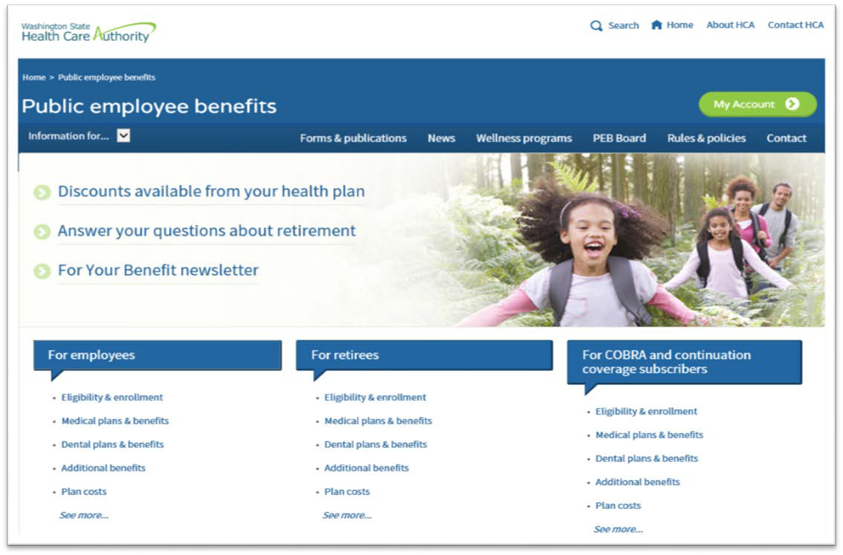
The PEBB Program’s My Account

Slide 51
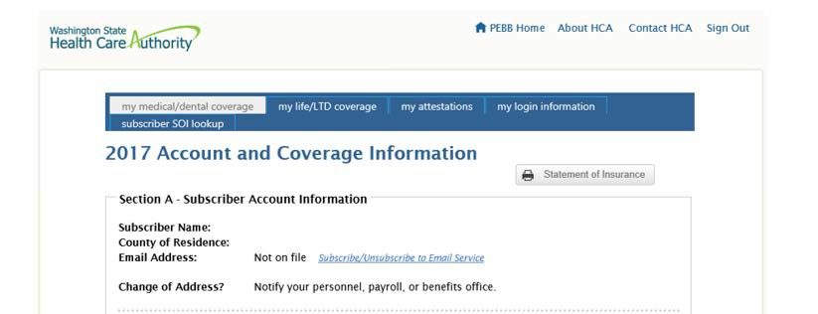
Statement of Insurance (SOI)
Employees may print a Statement of Insurance (SOI)

Slide 52
Medical Plan Changes for 2018

Slide 53
Medical Plan Changes for 2018
Kaiser Permanente WA (formerly GH) Classic:
  Medical deductible reductions
    $175/person (was $250 in 2017)
    $525/family (was $750 in 2017)
  Added prescription drug out-of-pocket limit
    $2,000/person
Added prescription drug deductible (waived for “value” and tier 1 drugs)
    $100/person
    $300/family

Slide 54
Medical Plan Changes for 2018
Kaiser Permanente WA (formerly GH) Value:
  Added prescription drug out-of-pocket limit
    $2,000/person
  Added prescription drug deductible (waived for “value” and tier 1 drugs)
    $100/person
    $300/family

Slide 55
Medical Plan Changes for 2018
Kaiser Permanente WA (formerly GH) SoundChoice:
  Medical out-of-pocket maximum reductions
    $2,000/person (was $3,000 in 2017)
    $4,000/family (was $6,000 in 2017)
  Added prescription drug out-of-pocket limit
    $2,000/person
  Added prescription drug deductible (waived for “value” and tier 1 drugs)
    $100/person
    $300/family
  Reduced coinsurance to 15% on several benefits

Slide 56
Medical Plan Changes for 2018
Kaiser Permanente WA (formerly GH) CDHP w/HSA:
Switched the network to CORE HMO from Access PPO, adding:
  A Consulting Nurse Helpline for advice 24/7
  Access to CareClinics at Bartell Drugs at select Seattle locations
  Diagnosis and treatment for routine issues with an online visit

Slide 57
CDHP w/HSA Contribution Amounts
The HSA employer contribution amount remains at:
  $700.08 per year ($58.34 per month) for an individual
  $1,400.04 per year ($116.67 per month) for a family
The IRS maximum* contribution amounts for 2018:
  Increased to $3,450 for an individual (up from $3,400)
  Increased to $6,900 for a family (up from $6,750)
  Employees age 55 or older may contribute additional $1,000 per year
*Employer, employee contributions and wellness incentives if earned, may not exceed the IRS maximum

Slide 58
Employee Premium Changes
State and Higher Education Employees
Plan Name | EMPLOYEE |  | EMPLOYEE & SPOUSE/PARTNER |  | EMPLOYEE & CHILD(REN) |  | FULL FAMILY
 | 2017 | 2018 | 2017 | 2018 | 2017 | 2018 | 2017 | 2018
KP NW Classic | $131 | $137 | $272 | $284 | $229 | $240 | $370 | $387
KP NW CDHP | $26 | $27 | $62 | $64 | $46 | $47 | $82 | $84
KP WA Classic | $147 | $162 | $304 | $334 | $257 | $284 | $414 | $456
KP WA CDHP | $25 | $25 | $60 | $60 | $44 | $44 | $79 | $79
KP WA SoundChoice | $46 | $51 | $102 | $112 | $81 | $89 | $137 | $150
KP WA Value | $69 | $78 | $148 | $166 | $121 | $137 | $200 | $225
UMP Classic | $94 | $102 | $198 | $214 | $165 | $179 | $269 | $291
UMP CDHP | $25 | $25 | $60 | $60 | $44 | $44 | $79 | $79
UMP Plus | $66 | $45 | $142 | $100 | $116 | $79 | $192 | $134

Slide 59

Dental, Life and LTD Benefit Changes
No changes to benefits or rates.

Slide 60
SmartHealth
In addition to the $125 SmartHealth incentive:
  A $25 Amazon gift card will be awarded for completing the Wellbeing Assessment between January 1, 2018 and December 31, 2018
  Eligibility for the gift card is the same as the incentive
  Once the Wellbeing Assessment is completed, an email will be sent. To claim the gift card, click on the link
  More information will be available from SmartHealth soon

Slide 61
Reminders

Slide 62
CDHP/HSA
Employees changing plans from a CDHP with an HSA to a traditional plan must:
  Stop any automatic payroll deduction for their HSA
  Stop any direct contributions to HealthEquity
Employees are not eligible for the HSA if:
  They or their spouse enrolls in a Medical FSA for 2018
    Unless the Medical FSA is made “limited purpose”
      − PEBB Medical FSA cannot be made limited purpose
  Other exclusions apply. Refer to IRS publication 969 for other exclusions

Slide 63
CDHP/HSA
Employees age 65+ or turning 65 in 2018:
  Should be discouraged from enrolling in a CDHP with HSA without seeking professional tax advice
    Medicare can be enrolled up to 6 months retro unless a specific request is made to Medicare

Slide 64
Medical FSA
Employees may enroll on Navia Benefit Solutions’ website at pebb.naviabenefits.com
Employees may not enroll or re-enroll in a Medical FSA if:
  Employee or spouse/state-registered domestic partner is enrolled in a CDHP in 2018
  Employee changes to a CDHP plan in 2018
2017 Medical FSA enrollees who enroll in a CDHP for 2018:
  Must use all their funds and have all claims paid by December 31, 2017
  If all Medical FSA funds are not used and all claims paid by December 31, 2017, no contributions – employer or employee – may be made to their HSA account until April 1, 2018

Slide 65
Employee and Agency Resources
PEBB website (for employees) hca.wa.gov/pebb
Individual plan websites (see employee enrollment guide)
Navia Benefit Solutions (Medical FSA/DCAP)
    Website: pebb.naviabenefits.com
    Customer Service: 1-800-669-3539
Health Equity (HSA)
    Website: healthequity.com/pebb
    Customer Service: 1-877-873-8823

Slide 66
Employee and Agency Resources
MetLife customer service and website:
  Customer Service: 1-866-548-7139
  (Inform representative you are a Washington State PEBB employee)
  Website: https://mybenefits.metlife.com/wapebb
SmartHealth Wellness Program:
  Customer Service: 1-855-750-8866
  Website: www.smarthealth.hca.wa.gov
  Email: support@limeade.com

Slide 67
Open Enrollment
Questions?

Slide 68
Q&As
Q. We have employees that are classified or exempt and some are non-represented. Why do they still have to complete a
timesheet?
A. Only classified employees, represented or non-represented, that are overtime eligible and are required by
federal law to complete timesheets. If employees are overtime exempt, they do not need to complete a
timesheet.
Q. Why do we need to indicate the employee’s work schedule on their timesheet?
A. This information is necessary for the payroll staff to calculate shift differential rate and what hours are
applicable to ensure employees are being paid correctly.
Q. If a transfer employee submits a new retirement Member Information Form (MIF) to their new employing agency,
does their selected contribution rate retro back to the start date with the new agency?
A. No, the employee is entered into the system at 0 contribution rate until the payroll office receives the signed
MIF. The deductions will start on their next payroll. Employer contributions will continue to be paid during
this transition.
Q. Has a transfer employee always needed to submit a new Flexible Spending Account (FSA) form to their new agency?
A. No, this process went into effect in 2014.

Slide 69
Q&As
Q. When employees make open enrollment changes online, will the employer receive notification of the changes?
A. No, we suggest employees take screen shots of the changes they are making.
Q. If a state employee’s spouse also works for the state, do they have to have separate health coverage accounts?
A. No, if you and your spouse are both state employees and both are eligible for medical insurance, you can
share one health coverage account. For example, a wife can waive the medical coverage with her state
employer and be placed on her husband’s state coverage. However, both employees must keep dental
coverage through their employer.
Q. Does the SmartHealth incentive apply to all healthcare carriers?
A. Yes
Q. What is Health Equity?
A. It is the organization that administers the health savings accounts (HSA). https://healthequity.com/
Q. If an employee is on Family Medical Leave (FMLA), can a supervisor submit leave on behalf of the employee?
A. Yes, it is the supervisor’s responsibility to ensure all leave related to FMLA is designated as such and
to submit leave on the employee’s behalf.

Slide 70

…for joining us!

