Slide 1
Official Agency
Payroll Journal
A Useful Resource

Slide 2
What is it?
The Official Agency Payroll Journal is….
Created and emailed to agencies after each payroll processing (twice a month).
Lists all the payments to employees processed that pay period by DES Payroll.
Gives information about each payment such as….
      Employee personnel #
      Name
      Hours paid for
      Gross pay amount
      Mandatory and voluntary deductions
      Net pay

Slide 3
Useful information when reading it…
Warrant # (ACH payment or warrant/check number)
  An ACH payment number begins with a letter and includes 6 numbers.
  X123456
  A warrant number includes 6 numbers and ends with a letter.
  123456X
Non-Cash Wages
  Non-cash wages are taxable fringe benefits such as taxable meals.
  The total non-cash wages are at the bottom of the report.
  Details per employee are listed on a second line below each employee’s name.
Retro
  Prior pay period adjustments to pay that can be increases or decreases.

Slide 4
Agency Responsibility…
Review
Ensure that each employee in the agency entitled to a paycheck is listed on the report.
Check the salary rate for salaried employees.
Check the number of hours worked for hourly employees to make sure they are correct.
If employee is on LWOP, check paid hours for accuracy and that they are offset by any LWOP hours.
Confirm that only employees of the agency are paid. Employees that have left the agency or retired should not be getting paid.

Slide 5
Agency Responsibility…
Certification Requirements per SAAM 25.20.30a
RCW 41.06.270 specifies that before paying an employee, an agency head (or authorized designee) must certify the payroll using the following language on the last page.
    "I hereby certify that to the best of my knowledge amounts listed in this payroll are true and correct charges and that employees holding a position covered by Chapter 41.06 RCW or other applicable employment contract, have been employed in accordance with the rules, regulations, and orders issued thereunder."
Certify that the payroll journal is correct by signing the certification at the end of the report.
Return the signed payroll journal to DES Payroll.

Slide 6
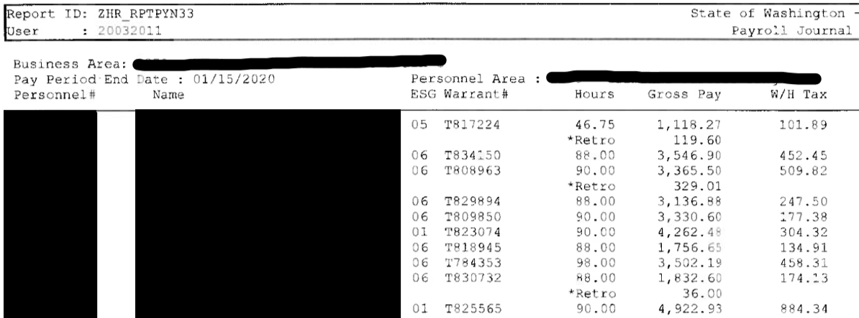
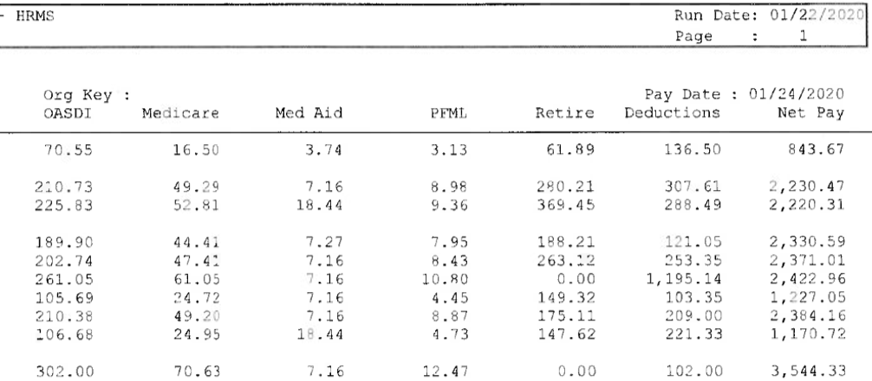
Sample Payroll Journal
      Employees’ personnel # and names
      Retro pay indicator and amount
      Amount paid
      ACH or check/warrant number

Slide 7
Issues…
If you notice…
  An error in the employee’s pay (wrong hours paid, wrong gross pay after a pay change)
  A new employee missing from the report
  A separated employee still being paid - overpayment
  …notify DES Payroll right away.
  Immediate action will be taken to remedy the issue.
DESPayroll@des.wa.gov

Slide 8
Summary…
The Official Agency Payroll Journal is a useful resource that helps you identify who has and hasn’t been paid that pay period.
After printing and auditing the Official Agency Payroll Journal, certify that the Payroll Journal is correct by signing the certification at the end of the report and scan back to DES Payroll
DESPayroll@des.wa.gov
Thank you!

