Slide 1
Personal Kanban: Effective Visual Management for Everyone
Crystal Hart, Senior Lean Consultant
Lean Transformation Services
Location or Date

Slide 2
Today’s Agenda
What is Lean?
Lean Culture and Daily Lean Practices
Visual Management – Personal Kanban
Exercise
Questions
Note: There will be a link to this presentation on the
DES Events page following the conference.
2

Slide 3
What is this Lean thing I’ve heard about?
3

Slide 4
Little “l” or Big “L” Lean?
Not little “l” lean: This just means doing some process improvement events.
Big “L” Lean is a way of working where everyone is…“maximizing customer value while minimizing waste” every day.
– Lean Enterprise Institute
4

Slide 5
In a Lean culture we ALL keep trying to…
Increase safety
Decrease cost
Increase quality
Increase timeliness
Increase customer satisfaction
Increase employee engagement
5

Slide 6
Washington is leading the way in adapting Lean principles and tools to state government operations so we can deliver better value to Washingtonians and make public service a delightful experience.
6

Slide 7
How is this Lean transformation different?
7

Slide 8
Everyone uses the scientific method to solve problems, improve and innovate. Every leader is a coach. Every employee is a problem solver.
8

Slide 9
“Lean is not just another improvement methodology, but a very different set of behaviors and management systems.”
Daniel T Jones, Founder of Lean Enterprise Academy, UK
“Lean is a culture and a way of life.”
Source: Lean Enterprise for Service chapter 2 (pg. 23)
Built on respect, trust, learning, collaboration, and openness.
9

Slide 10
Lean Culture: Flipping the Pyramid
10

Slide 11
In a Lean Culture:
Mindset
(values, beliefs, and assumptions):
Safety, respect, customer focus, transparency, collaboration.
Employees can be trusted.
Mistakes are valuable for learning.
We’ll never be done improving.
Improving work is everyone’s job.
We can see:
Huddles, visual management.
Engaged employees solving problems.
Leaders listening, observing, and coaching.
Celebrating learning.
11

Slide 12
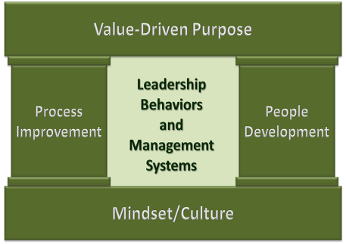
Daily Lean Practices
The Key to
Sustaining Lean Culture:
The Washington State Results Model
Leader behaviors
Employee behaviors
Shared Lean mindset
Huddles
Visual management
Continuous improvement
The Results Model was adapted from the Lean Transformation Model articulated by John Shook, Chairman and CEO of the
Lean Enterprise Institute, with permission from LEI.
12

Slide 13
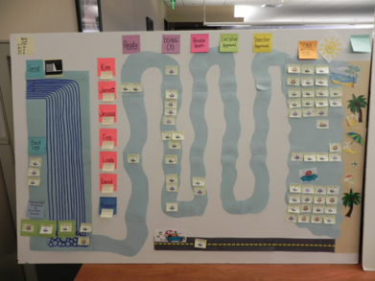
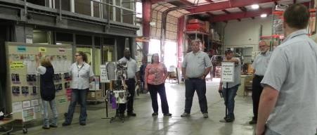
Visual Management in Daily Practice.
See…the work, and the waste.
Goal: To see in real time if we are ahead or behind so that we can take immediate action to stay on target and meet our goals.
13

Slide 14
Lean Knowledge Worker Challenge?
Seeing your work.
14

Slide 15
Make a list: Take 2 minutes to brainstorm a list of your work responsibilities.
What are you working on now?
What work is waiting for you to do it?
What work will be coming up soon?
15

Slide 16
Take a look: How easy is it to see this work in your list?
16

Slide 17
Visual Management allows us to:
See status in real time so we can take action.
See progress to goals and targets.
See irregularities.
See crucial quality, timeliness, or safety data.
Maintain focus on action plan.
Monitor results during testing or after implementation.
17

Slide 18
Want to sleep better? Want to manage your workload?
Try using
a Personal Kanban!
Based on the book, Personal Kanban: Mapping Work | Navigating Life, by Jim Benson and Tonianne DeMaria Barry, 2011, First Modus Cooperandi Press.
18

Slide 19
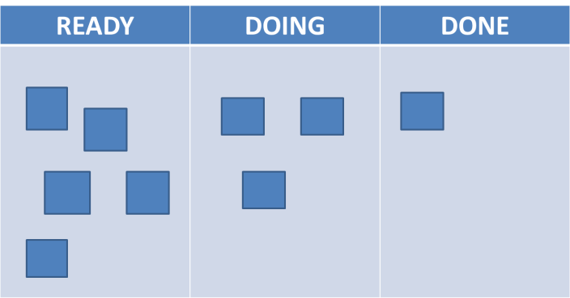
Personal Kanban
Based on the book, Personal Kanban: Mapping Work | Navigating Life, by Jim Benson and Tonianne DeMaria Barry, 2011, First Modus Cooperandi Press.
19

Slide 20
Personal Kanban – A Visual Management Tool
Personal Kanban Agenda:
What is it and what is it for?
Two simple rules.
How to do it.
Why the rules are important.
Adapting and improving.
Other uses.
Q&A.
Based on the book, Personal Kanban: Mapping Work | Navigating Life, by Jim Benson and Tonianne DeMaria Barry, 2011, First Modus Cooperandi Press.
20

Slide 21
The Two Rules of Personal Kanban
Rule 1: Make work visible
So you can manage it!
Communicate more information, faster.
Provide context to prioritize and make decisions.
Facilitate communication, coordination, & collaboration.
Rule 2: Limit work in process
Increase efficiency (multi-tasking is a myth).
Improve quality / reduce errors.
Reduce stress.
Facilitate learning (process, integrate, improve).
Based on the book, Personal Kanban: Mapping Work | Navigating Life, by Jim Benson and Tonianne DeMaria Barry, 2011, First Modus Cooperandi Press.
21

Slide 22
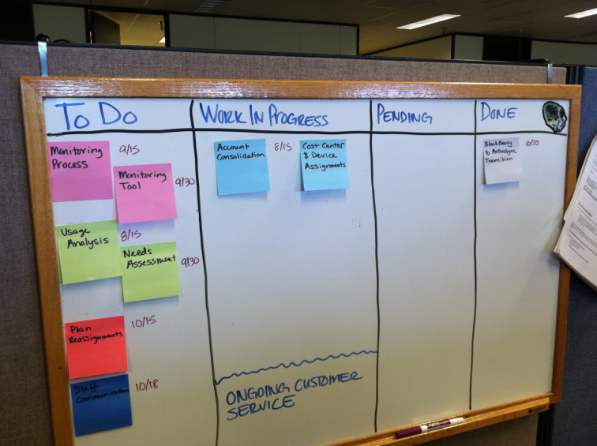
Personal Kanban Example
22

Slide 23
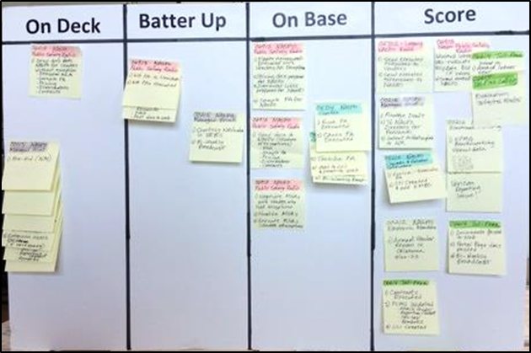
Personal Kanban Example
23

Slide 24
Kanban for Improvement Ideas
24

Slide 25
Kanban for Improvement Ideas
25

Slide 26
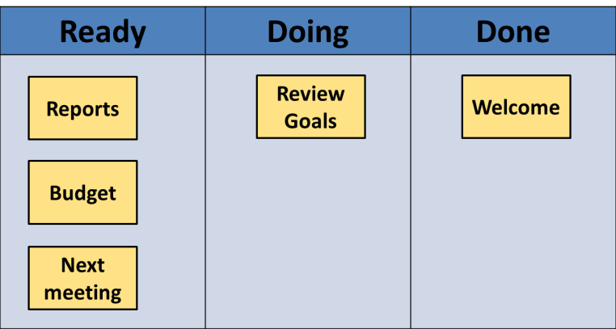
Kanban for a Meeting Agenda
26

Slide 27
Kanban for Development (Leadership Competencies Example)
27

Slide 28
Kanban for a Work Team
28

Slide 29
Kanban for a Work Team
29

Slide 30
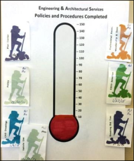
Kanban for a Project
30

Slide 31
Kanban for a Project
31

Slide 32
Questions?

Slide 33
How to Create a Kanban Board
Decide key milestones (ready, doing, done – or…).
List the work waiting to be done (individually on post-its).
Set work in process (WIP) limits (usually 3-5).
Pull work into WIP and begin.
Use, learn, adapt.
Gain clarity, manage stuff, and sleep better!
Based on the book, Personal Kanban: Mapping Work | Navigating Life, by Jim Benson and Tonianne DeMaria Barry, 2011, First Modus Cooperandi Press.
33

Slide 34
Practice – Make Your Own Visual Board
Choose what you will track. Possibilities:
A key aspect of your work.
A project you need to complete.
Progress on skill development.
34

Slide 35
Check-In
How did that go?
35

Slide 36
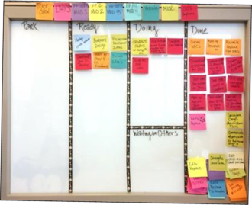
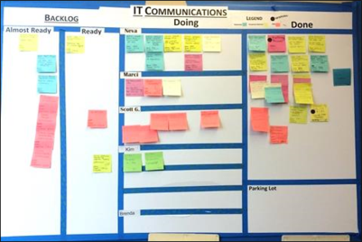
Visual Management – A Daily Lean Practice
Purpose: To see in real time if we are ahead or behind so that we can take immediate action to stay on target and meet our goals.
36

Slide 37
Goal of Daily Lean Practice:
Every leader is a coach.
Every employee is a
problem solver.
37

Slide 38
Personal Kanban – Key Points
A Personal Kanban board can help you:
Manage your work.
Practice using visual management.
Learn.
Set the example, be a role model.
Kanban/visual boards can be portable. Use them in meetings and throughout the day.
Start simple, experiment and improve.
Be creative and have fun!
Based on the book, Personal Kanban: Mapping Work | Navigating Life, by Jim Benson and Tonianne DeMaria Barry, 2011, First Modus Cooperandi Press.
38

Slide 39
What will you try?
39

Slide 40
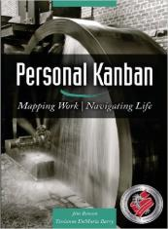
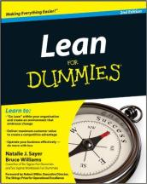
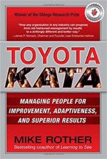
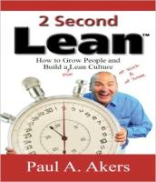
Further Reading
40

Slide 41
Lean Culture Development Opportunities
Problem Solving the Washington Way – 4 hours
How to apply 9 Step Problem Solving and the gPDCA method. Learn it so you can both do it and coach it.
Coaching the Washington Way – 8 hours
How to develop coaching relationships and use Humble Inquiry to coach others to be problem solvers.
Lean Facilitation Training – 40 hours
How to facilitate Lean process improvement projects.
Register for classes in the LMS (state employees), or contact
Deb Rossow (other government or public benefit non-profits).
41

Slide 42
Thank you!
Crystal Hart
Lean Transformation Services
Enterprise Services
lean@des.wa.gov
42

