Slide 1


Meet DES
Planning the Biennium to Avoid the Last Minute Rush
Nancy Deakins, P.E.
E&AS Assistant Program Manager
Notes:
Pick a logo for the main page of your presentation. Delete the other logo.

Slide 2


We Provide
Centralized leadership in
  efficiently and
  cost-effectively
managing resources
  necessary to support the delivery
  of state government services.

Slide 3
No More Minor Works Reapprops
SBCTC won’t be requesting in the future
Before 2015-17 Reapprops at 40%
2015-17 Reapproped ~ 10%
  & Lapsed Millions Unspent $
(and the Legislature wants it spent)

Slide 4
Master Schedule Early in Bien
DES PMs will help you:
    Strategize the packaging
    Schedule all the work
    To get done by June 2017

Slide 5
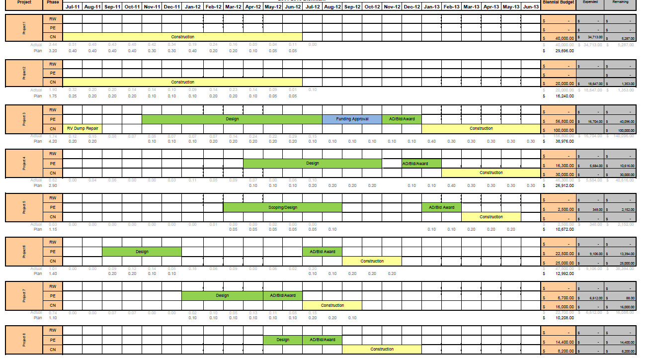
Master Schedule Early in Bien

Slide 6
Schedule Considerations
    Staff workload
    Class/Client Schedules
    Weather Sensitivity
    Project Delivery Methods
    Bundling into larger packages

Slide 7
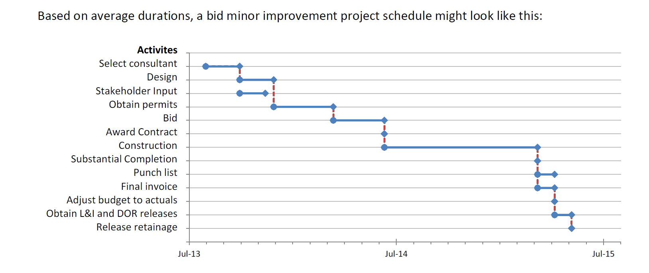
Typical Schedule Durations
Source: SBCTC Minor Project Allocation Notes http://www.sbctc.edu/college/admin/2015-17-SBCTC-Minor-Project-Allocation-Notes-22Jul15.pdf

Slide 8
How You Can Help Us Help You
    Set up a minor works strategy meeting with your PM
    Communicate expectations early
    Discuss all projects
      Funded & trying to get funds
    Be open to schedule options

Slide 9

Meet DES
Any Questions?
Nancy Deakins, P.E.
Assistant Program Manager
Nancy.Deakins@des.wa.gov
(360) 407-9333
Notes:
Pick a logo for the main page of your presentation. Delete the other logo.

