Slide 1

Agency Policy:
Theory & Practice
Notes:
Pick a logo for the main page of your presentation. Delete the other logo.

Slide 2
First. The Theory
Notes:
Pick a logo for the main page of your presentation. Delete the other logo.

Slide 3

Outline
Getting on the same page
  The theory and language of policy
The Policy Process
  Putting theory into practice
Closing the Gap
  Improving the Training
  Improving the Process

Slide 4

Hierarchy of Government Authority
Constitution
  Law – RCW
    Rule – WAC
      Policy
        Procedure
          Forms

Slide 5
Why are polices important?
  Provides direction for decision-making and actions
  Establishes responsibilities and accountability.
  Helps ensure compliance and reduce institutional risk.
  Used to establish and/or defend a legal basis for action.

Slide 6
The words we use
What is a Policy?
  Derives from the statutory authority of the Director.
  States an agency position;
  Describes mandates, community beliefs and boundaries;
  Has consequences for violation.

Slide 7
The words we use
What is a Procedure?
  Tells us how
  Includes who, what, when and where
  The customary or standard practice way of handling situations

Slide 8
The words we use
What is a Standard?
  A level of quality that is required to be followed;
  Serves as a basis for comparison;
  Whenever possible standards should support a policy or procedure and be included in them.

Slide 9
The words we use
What is a Guideline?
  Provides guidance to appropriate action but may be optional;
  Recommends a way but alternatives may be possible;
  Whenever possible guidelines should support a policy or procedure.

Slide 10

Leaving the Theory Zone
Notes:
Pick a logo for the main page of your presentation. Delete the other logo.

Slide 11
Policy Development Process
Best Practices
Notes:
Pick a logo for the main page of your presentation. Delete the other logo.

Slide 12
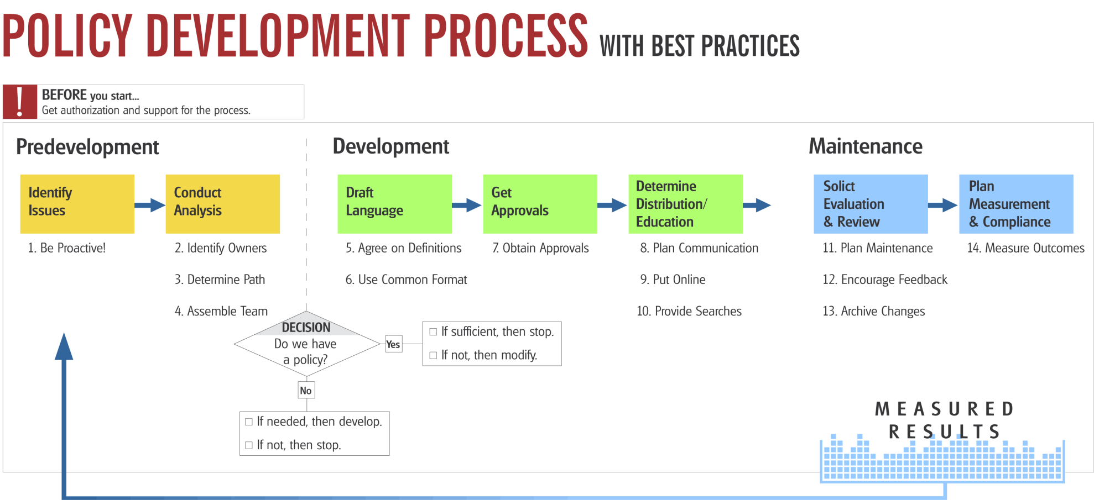
Best Practices

Slide 13
Policies:
  Supports mission and goals;
  Applies agency-wide;
  Impacts a substantial number of employees or communities;
  Promotes consistency, efficiency, and effectiveness and/or mitigates or manages significant agency risk.

Slide 14
How is agency policy categorized?
  Agency policy typically falls into two categories:
  Administrative (internal)
    Agency wide
    Divisional or program
  Enterprise (external)
    Statewide

Slide 15
What does a Policy Office do?
  Oversees and coordinates policy development;
  Supports policy owners;
  Assists decision making by executives and managers;
  Maintains the agency policy library.

Slide 16
Why use a standard format?
  Defines the various optional and mandatory parts of a policy.
  By standardizing the way that policies are presented to the reader, policies are easier to read and understand.

Slide 17
Use a feedback loop
  Designed for learning and constant improvement;
  Reviewed with both the policy owner and agency leadership;
  Used when considering revisions to the policy and procedures.

Slide 18
A practical approach
Notes:
Pick a logo for the main page of your presentation. Delete the other logo.

Slide 19
Notes:
Pick a logo for the main page of your presentation. Delete the other logo.

Slide 20
Initiate

Slide 21
Develop Initial Draft

Slide 22
Gain Approval

Slide 23
Communicate and Rollout

Slide 24
it’s the gap between policy and practice where things start to get interesting…
Notes:
Pick a logo for the main page of your presentation. Delete the other logo.

Slide 25
Manage and Maintain

Slide 26
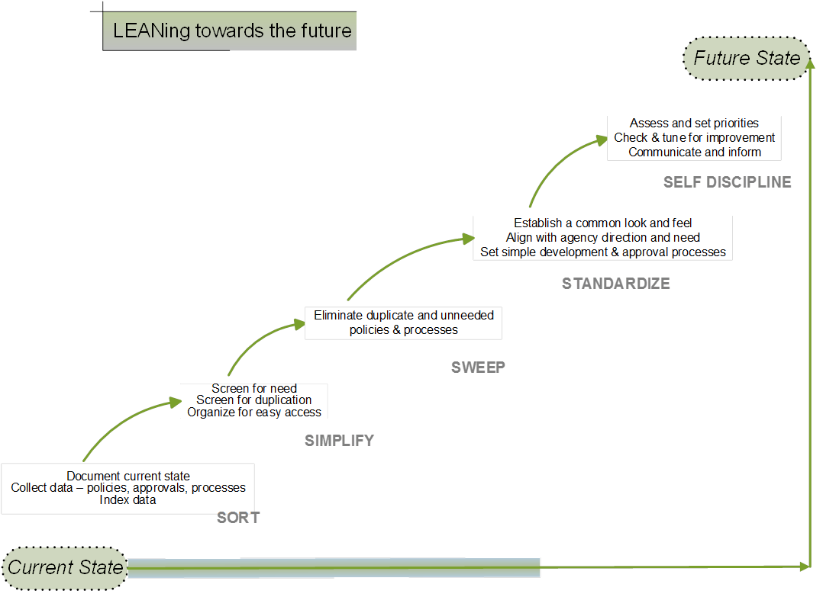
Notes:
Pick a logo for the main page of your presentation. Delete the other logo.

Slide 27
Learning Loop
Closing the Gap
      Improve the Training
      Improve the Process

Slide 28
A time for discussion
  An opportunity for you to address any additional areas

Slide 29
Resources
DES Small Agency Services
  Contact DES Small Agency Services
Jack Zeigler, DES Policy and Rules Manager
  Phone: 360-407-9209
  Email: jack.zeigler@des.wa.gov

Slide 30

Thank you.

