Slide 1
Managing Risk to
Reduce Construction Claims
(And Improve Project Success)
Presented by Laurie Dennis, PE, CVS-Life, FSAVE

Slide 2
Presentation Objectives
What is the definition of project risk
Why managing risk is important
When to use risk assessments
An overview of the risk assessment process
How to identify and assess risk
Treating the risk
Managing the risk assessment process
Integrating risk into your organization

Slide 3
What Is The Cause?
Escalating construction costs due to:
  Incomplete plans
  Design issues not mitigated and pushed into construction
  Constrained design schedules; issues not resolved
  Very little discussion of risk and impacts
  Not understanding the true impacts related to the risk

Slide 4
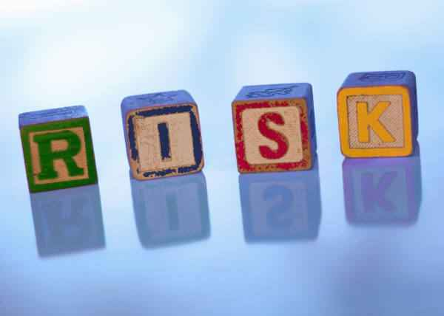
What is a Risk
An uncertain event or condition that, if it occurs, has a positive or negative effect on at least one project objective. A risk may have one or more causes and, if it occurs, one or more impacts.

Slide 5
Threats vs Opportunities
A negative risk is described as a Threat – causing an adverse impact on a project goal.
A positive risk is described as an Opportunity – causing a positive impact on a project goal.

Slide 6
What is a Risk
Risk can typically be divided into the following three categories;
  Political – this can be defined as communities, permitting, management priorities, users, approvals, media, and internal stakeholders/ project team issues.
  Technical – this is the most common for design and construction projects and is typically represented by requirements, regulatory, technology, data, design, construction, maintenance, operations, life cycle asset management, and cost. (i.e., health, safety, environmental, etc.)

Slide 7
What is a Risk
  Contractual – this is most commonly related to funding, negotiations, scope of work, qualification requirements, certification requirements, incentives, penalties and defaults.

Slide 8
Importance of Managing Project Risk
Avoid and/or minimize adverse impacts
  Planning
  Design
  Construction
  Commissioning
Maximize opportunities to improve project objectives
Avoid and/or minimize management by crisis
Better decision-making; understanding
all impacts
Help keep management apprised of project issues

Slide 9
Risk and Project Management
All phases will benefit from the analysis
  Planning
    Programmatic decision-making
    Formulates initial approaches to determine level of effort and potential cost implications
  Project Initiation
    Developing project scope/complexity
    Budgetary impacts
  Project Feasibility/Pre-Design
    Reducing potential risks during concept development
    Alternative selection

Slide 10
Risk and Project Management
  Design
    Managing project risks
    Minimizes construction impacts (cost & schedule)
  Construction and Commissioning
    During the Partnering session
    Informs construction of risks identified through the design process
    Provides new information from a contractors perspective – helps to reduce or eliminate risks impacting the schedule, budget and delivery
    Identifies potential impacts to avoid commissioning problems and challenges

Slide 11
Risk and Project Management
  Alternative Delivery
    GCCM/CMAR
      Used by the GCCM/CMAR team to develop an understanding and provide ideas for risk mitigation in their proposals
      Formalized workshop with all parties
    Design/Build
      Used by the owner developing and finalizing the RFP documents
      Used by the D/B team to develop an understanding and provide ideas for risk mitigation in their proposals

Slide 12
What is a Risk Assessment
It is a focused effort to discover and act on risks and opportunities that can affect a project’s scope, schedule, budget or quality early in the project and continuously throughout the project life cycle.
It is a quantitative and qualitative approach to identifying risk, which includes both the negative sides of risk and opportunities, and evaluates the likelihood and potential impact.

Slide 13
Risk Approaches
Quantitative – electronically modeling the project schedule and/or cost estimate. Uses a Monte Carlo-type simulation.
Qualitative – using a simplified tool, such as a risk register to identify and then track, using an order of magnitude impact to cost and schedule.

Slide 14
Risk Assessment Process
Planning for the Workshop
Initial Risk Assessment Workshop
  Stand-alone
  Jointly with a value engineering study
Risk Register Updates
Follow-up Workshops
Risk Database Updates
Transfer Risk Information to Construction
  Combine with a Partnering workshop
  Part of the project start-up

Slide 15
Risk Assessment Process
With Value Engineering Study
  Identify Risks
  Evaluate Risks Using Risk Register
  Creative Mitigation or Elimination Risk
  Develop Ideas
  Define Potential Impacts

Slide 16
Risk Assessment Process
Project Close-out
  Update the risk database (knowledge transfer)

Slide 17
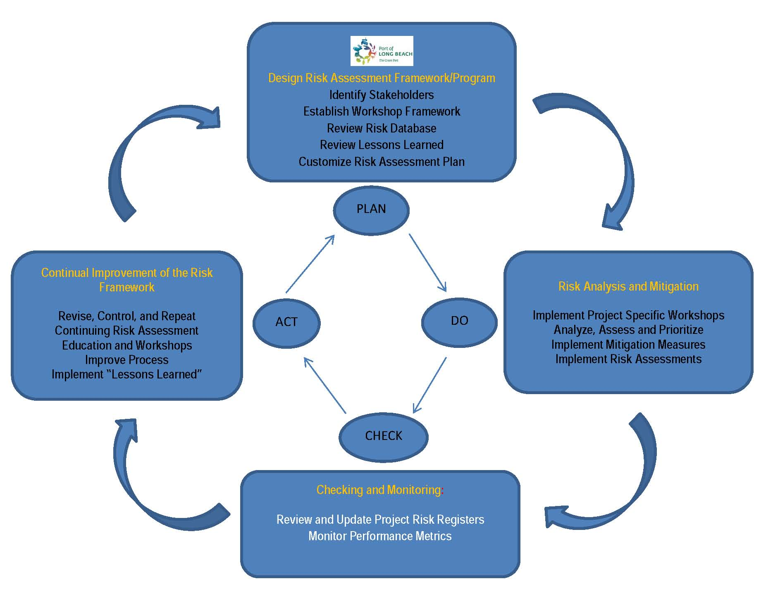
Continuous Improvement Cycle

Slide 18
Risk Planning
Information and Data Gathering
Stakeholder Identification and Involvement
Risk Assessment Team
Determine Level of Project Complexity
  High complexity/consequences
  High importance
Review Existing Data
  Including the Risk Database
Workshop Logistics
Workshops/Meetings

Slide 19
Risk Identification and Analysis

Slide 20
Status of Risk
Threats
  Avoid/Eliminate
    Clarifying requirements, obtain information, improve communication, acquire expertise.
  Transfer/Share
    Gives the risk to a third party, does not eliminate the potential costs or exposure. Where is the best place for the risk to borne.
  Mitigate/Reduce the Likelihood
  Accept
    There are many risks that will occur regardless of mitigation measures, these are accepted and then accounted for in the scope, schedule and budget.

Slide 21
Status of Risk
Opportunities
  Accept – Ensure that the opportunity is realized. Might include escalating a schedule for early completion.
  Share – Apportioning ownership between two or more. Might include using performance specifications.
  Enhance – Increasing the probability that it will occur. Might include facilitating the cause to increase the probability.

Slide 22
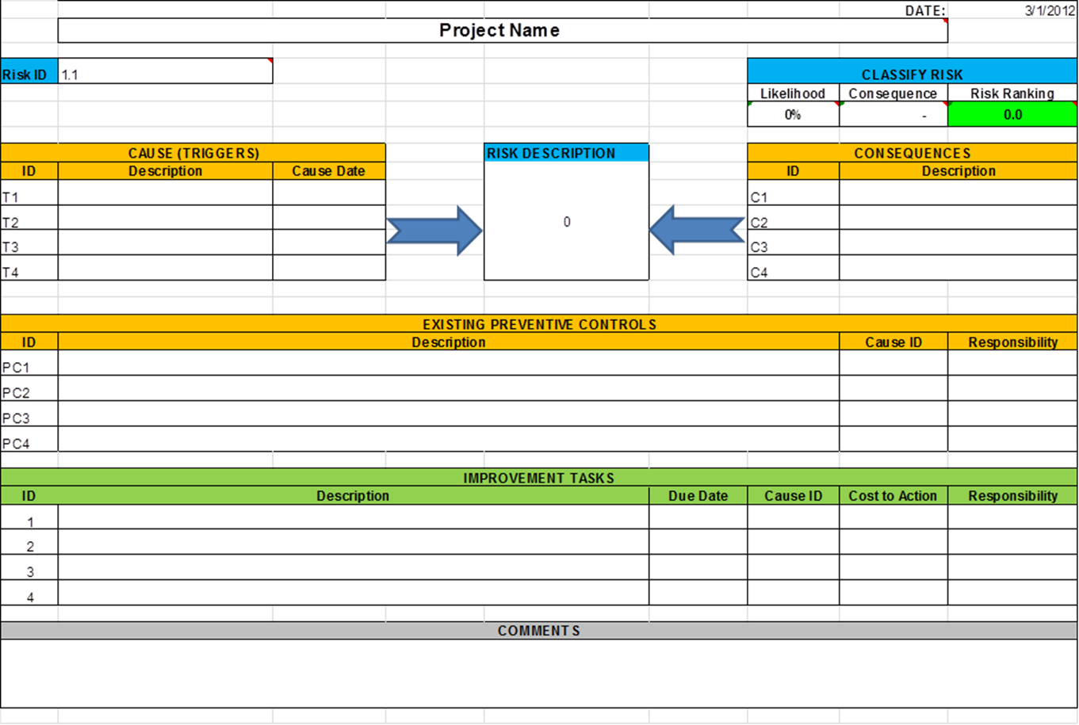
Treating the Risk

Slide 23
Managing the Plan
Manage and update the risk register and treatment plan
Track assignments for completion
Monitor the “watch list”
Decision-making and keeping management informed

Slide 24
Integrating Risk Assessments
Establish a formal process and integrate into your project management plan
Establish a risk data-base
Identify a risk coordinator for each project (May be the Project Manager)
Establish management support and “buy in”
Track statistics and share the data to support the process and the successes

Slide 25

Questions

Slide 26
Presenter
Laurie Dennis, PE, CVS-Life, FSAVE
RHA, LLC
(206) 200-9798
email: lmdennis@earthlink.net

