Slide 1

DES Energy Program
Energy Performance Contracting:
Using future Energy Savings to help finance the cost of construction
Notes:
Introduce myself and DES Energy.

Slide 2
DES Energy Program Mission
The Energy Program provides comprehensive project management and other services to help our clients reduce energy and operational costs, and reach sustainability goals.
Notes:
Read slide.

Slide 3
Program Services
Energy Performance Contracting
Energy Life Cycle Cost Analysis
Building Energy Benchmarking
Building Commissioning
Resource Conservation Management
Accomplishments:
Completed over $600 million in public facility efficiency projects since 1986
  Satisfied clients in over 450 public facilities
  Saved over 280 million kWh and 15 million therms
Saved customers nearly $32 million in annual energy costs
Notes:
These are the services DES Energy offers. I am going to talk about Energy Savings Performance Contracting, and Building Energy Benchmarking.

Slide 4
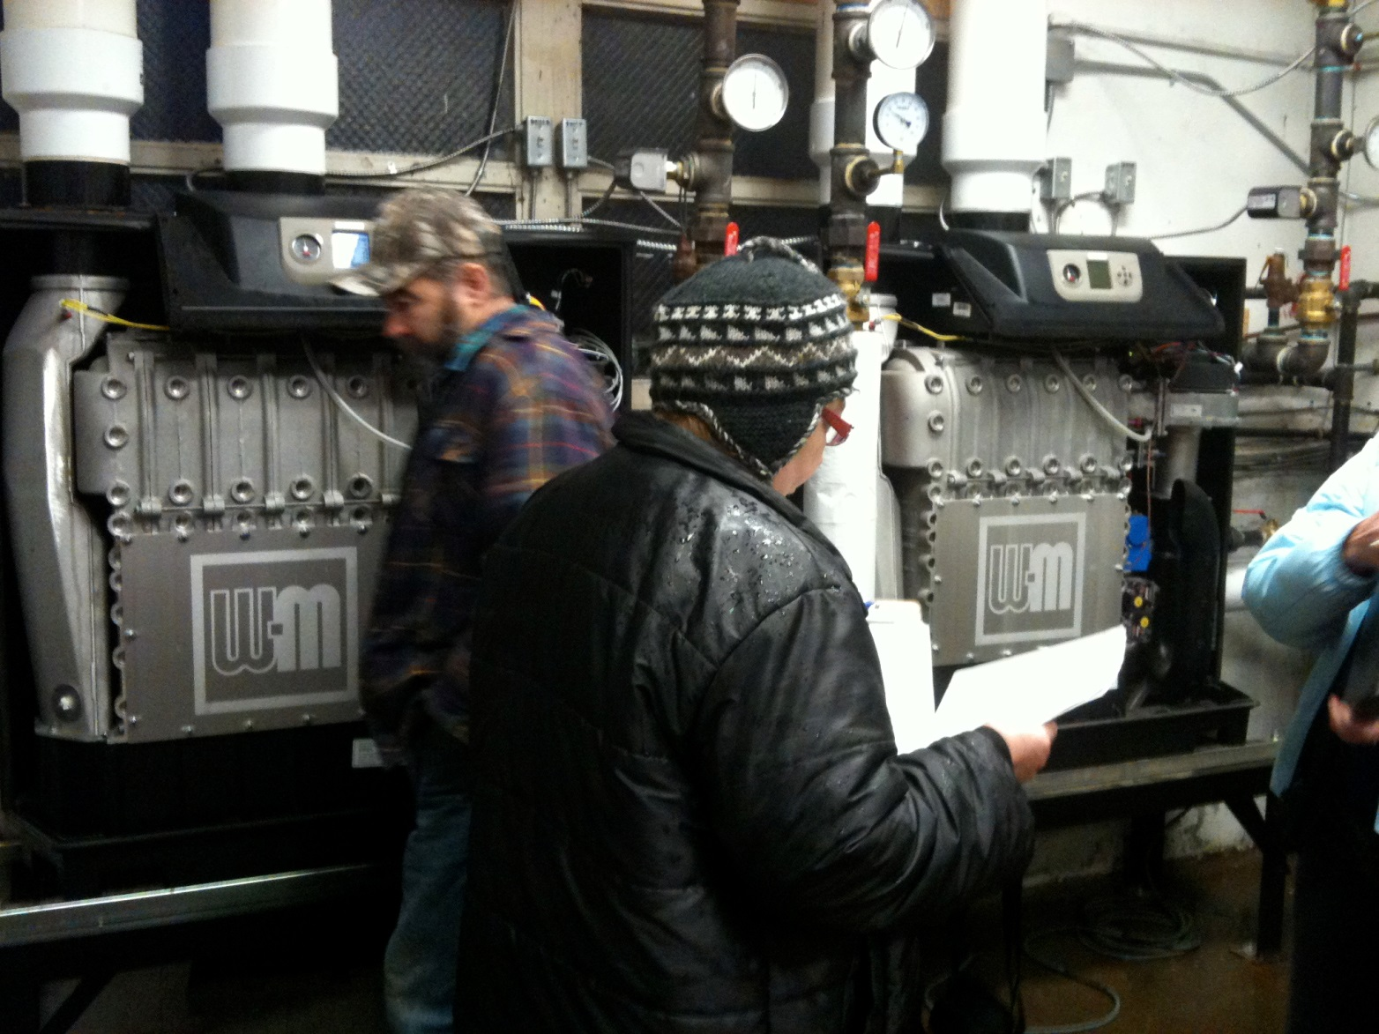
PERFORMANCE CONTRACTING
Notes:
How many of you have done a DES Energy Savings Performance Contracting project? (Go into more or less detail depending on the response)

Slide 5
What does an Energy Savings Performance
Contract (ESPC) do?
Identifies, designs and constructs energy and utility conservation projects
Leverages energy and utility dollars saved to pay for the project costs, using available funding
Guarantees total project cost, performance and energy savings before construction starts
Notes:
Energy Savings Performance Contracting, or ESPC, is a project delivery method. DES ESPC projects must save energy or water. The project budget is determined by the funds you have available, and the energy savings and utility incentive funs the Energy Services Company finds. Project first cost, performance and energy savings is guaranteed before the work starts.

Slide 6
Energy Savings Performance Contracting
Current Program Highlights:
Managing over 200 active projects
$300 Million in total project costs
Saving customers $8 Million annually in avoided utilities expenses
Cities | Counties | Port | Other Municipalities | State | Schools | Community Colleges | Universities
31 | 20 | 3 | 16 | 22 | 79 | 30 | 14
Notes:
Here is a snapshot of our active projects. We are managing about $300M in ESPC work right now. About a third of our current projects are State Agency, College and University projects. About a third are Municipalities, and about a third are K-12 Schools.

Slide 7
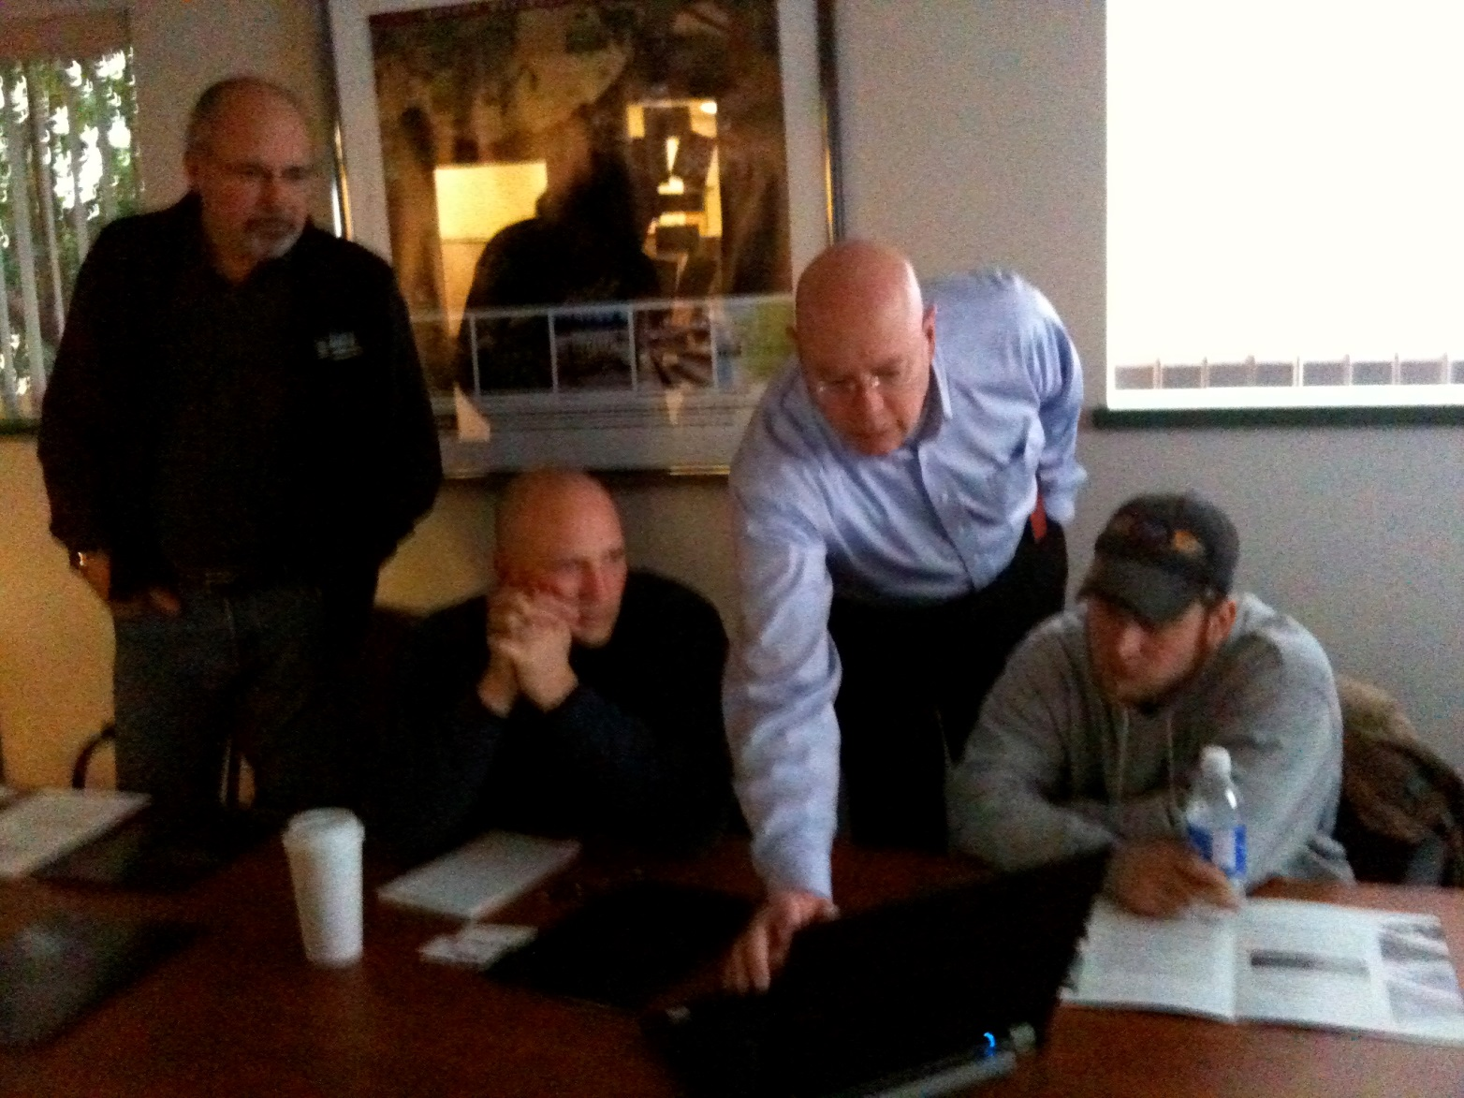
BUILDING ENERGY BENCHMARKING
Notes:
Building Energy Benchmarking: DES manages the Portfolio Manager master account, and reports to the legislature on progress in compliance with the Buildings Energy Benchmarking law.

Slide 8
Benchmarking Requirements
RCW 19.27A.190 Energy Benchmarking Law
EO 12-06 (for Executive Agencies)
Helpful resources are on the DES Energy website: http://www.des.wa.gov/services/facilities/Energy
(click on “Energy Star Portfolio Manager”)
Notes:
RCW 19.27A.190, known as the Energy Benchmarking Law, requires agencies and colleges benchmark buildings and campuses over 10,000 sf in Portfolio Manager, and share with DES.
There are four steps required by the Energy Benchmarking Law:
1.Benchmarking building energy use
2.Preliminary energy audits
3.Investment grade audits
4.Building energy retrofits
Step 4: Building Energy Retrofits
Agencies, colleges or universities are to implement cost effective measures identified during the investment grade audits. The implementation of the measures is to be completed by July 1, 2016.

Slide 9
Portfolio Manager: Track Progress
Greenhouse Gas Goals
Energy Reduction Goals
By building, by campus, by agency
Notes:
You can use Portfolio Manager to track your progress toward GHG and Energy reduction goals.

Slide 10
Energy Performance Gap
Normalized EUI for existing office buildings varies widely
30 kbtu/ft2 to 340 kBtu/ft2
Age and equipment not significant drivers of EUI
Number of Buildings
100
75
50
25
1
29.9
86.0
121.1
165.7
339.4
EPA Rating &
Energy Intensity
(kBtu/ft²-year)
Best Performers
Worst Performers
Notes:
I want to show you the potential for energy savings, if we benchmark and closely manage the energy use of our buildings. This is a typical office building energy use distribution from EPA. One startling thing about this distribution is the wide variation of energy use per sq. ft. Buildings in the worst performing 25% use more than TWICE as much energy on average as buildings in the best performing 25%.
Age of the building and the presence of efficient technologies are not significant predictors of energy use. As many new buildings and good technologies are among the top as they are in the bottom.
There is a tremendous amount of energy wasted in buildings. There is huge savings possible if we properly maintain and operate our buildings, and create a culture of sustainability throughout all our agencies, top to bottom. (Look at graph, explain percentiles, quartiles and EUI)

Slide 11
Identifying Opportunities
Notes:
You can use Portfolio Manager to identify lowest performing campuses or buildings, by comparing similar facilities across your portfolio. Then track your progress toward goals. Which buildings do you think have the greatest potential for energy conservation?

Slide 12
Identifying Opportunities
Notes:
These two buildings use more energy per square foot. They have a higher Energy Use Intensity, or EUI. You can use Portfolio Manager to identify poor performing campuses or buildings, by comparing similar facilities across your portfolio. Then track your progress toward goals. How did we know how much energy these buildings use? They are metered!

Slide 13
Metering Guidelines
DES Metering Guidelines, Fall 2014
  Metering Guidelines for State Colleges in Washington
  Metering Guidelines for State Agencies in Washington
These guidelines provide recent metering experiences of agencies and colleges
  What buildings to meter
  How to set budgets and find funding
Notes:
Millions of square feet of buildings on college and agency campuses are not metered. This has been the norm in the past, due to cheap energy. However, this is not good energy management practice. You can’t manage what you don’t measure. Metering guidelines will be provided by DES in the coming months. Two separate guidelines will be coming out soon. One is for Colleges, the other for State Agencies. These guidelines provide recent metering experiences of agencies and colleges that have metered their campuses. The guideline will help you determine what buildings to meter, how to set budgets, and how to find funds to meter your campuses.

Slide 14
Thank You!
DES Energy Program
Donna Albert, PE, MCE, CEM, LEED AP
360-489-2420
donna.albert@des.wa.gov
http://des.wa.gov/services/facilities/Energy
Notes:
Introduce Sidney, DES Green Building Advisor

