Slide 1

Client Workshop
April 18, 2017
Public Works Request Form
Notes:
Please mention:
Restroom locations
Emergency Exits
There will be a break in the morning, boxed lunches, and an afternoon break

Slide 2

Public Works Request Form
Curtis Pate, Contract Specialist
Contracts Section

Slide 3
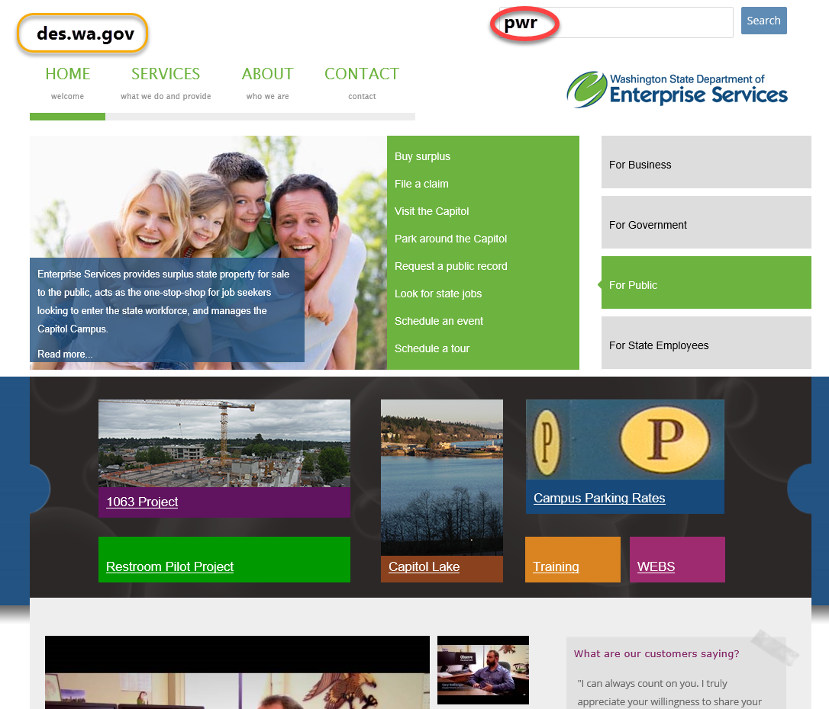
Public Works Request Form

Slide 4
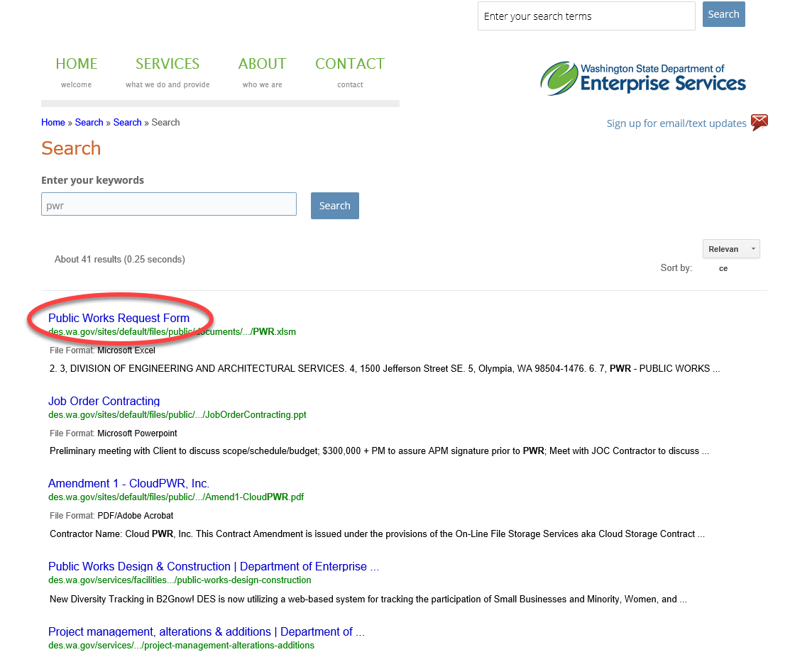
Public Works Request Form

Slide 5
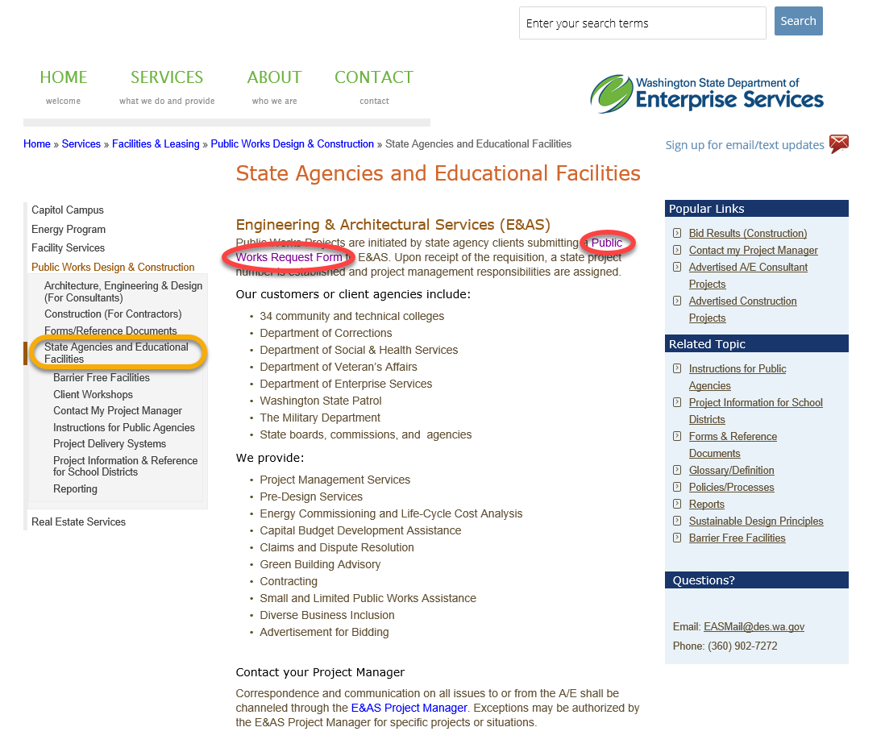
Public Works Request Form

Slide 6
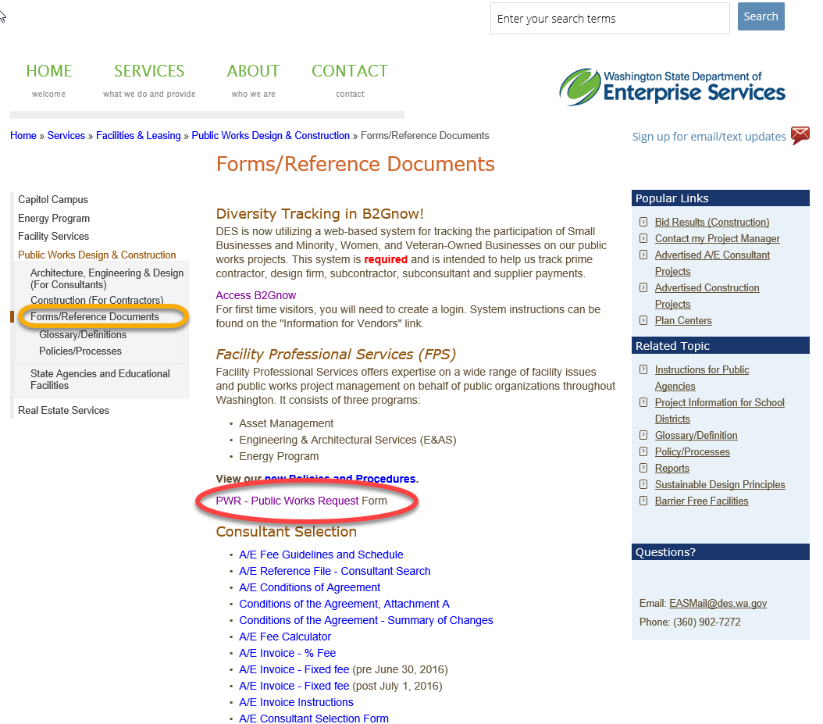
Public Works Request Form

Slide 7
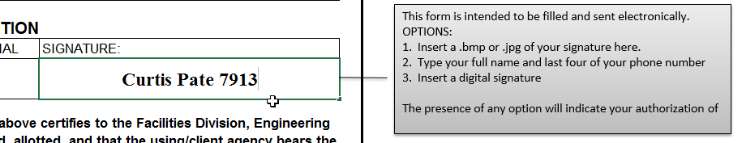

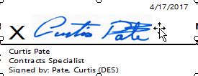
‘Signing’ the PWR

Slide 8
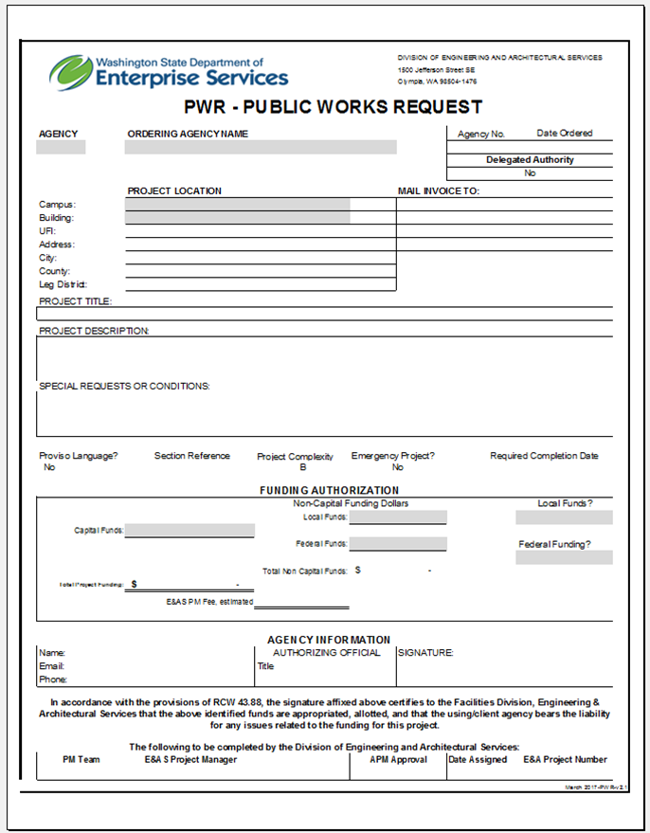


The Form – MS Excel

Slide 9
Public Works Request Form
State Agency and Educational Facilities can find the form at:
http://des.wa.gov/services/facilities-leasing/public-works-design-construction/state-agencies-and-educational-facilities
Forms/Reference documents can be found at:
http://des.wa.gov/services/facilities-leasing/public-works-design-construction/formsreference-documents
Email the form to:
eas-pwr@des.wa.gov

Slide 10
Public Works Request Form
Thank you!
Curtis Pate, Contract Specialist
Contracts Section
Curtis.Pate@des.wa.gov
(360) 407-7913

