Slide 1

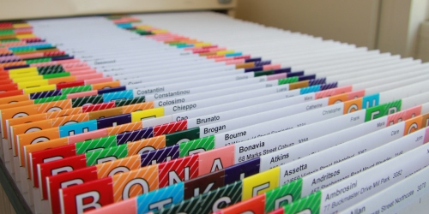
Records Management 101:
The Basics and Why It Matters
Leslie Koziara Turner, CRM
Electronic Records Management Consultant
leslie.koziara@sos.wa.gov (360) 586-4893

Slide 2
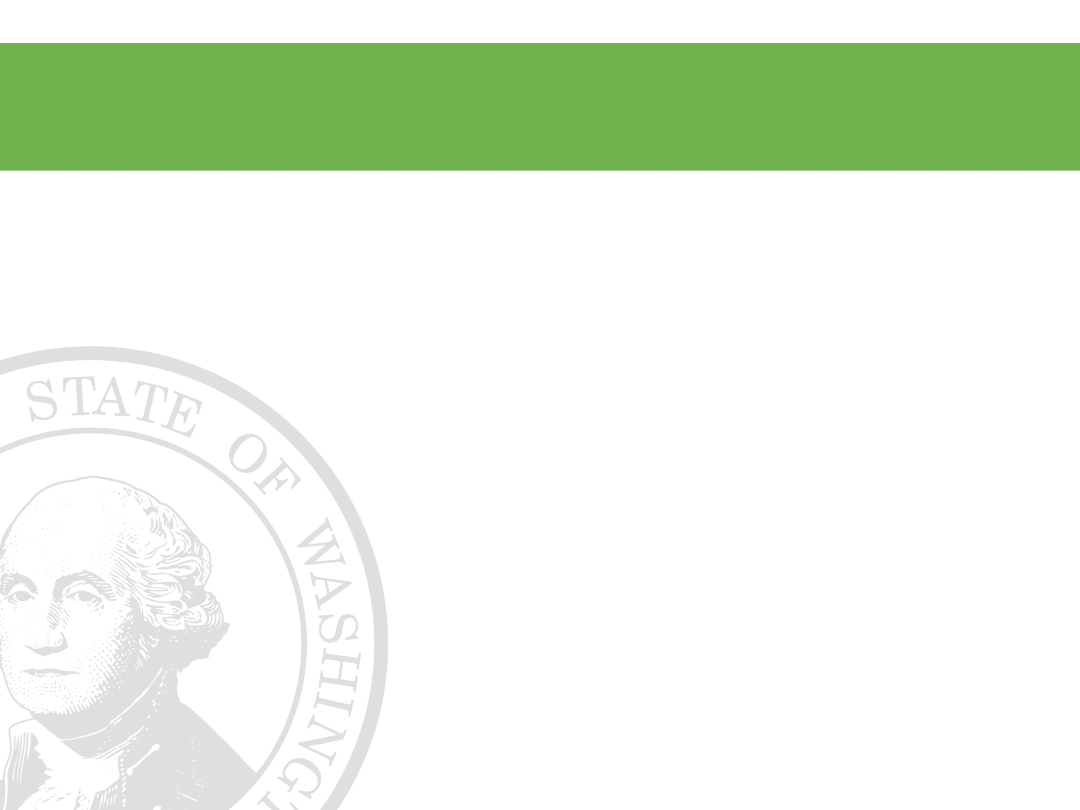

Overview of Today’s Session
What is a public record?
What is records management?
What is a retention schedule?
What about electronic records?
Resources
Notes:
As public employees, everyone needs to have a level of responsibility for the public records they create, receive and use. Records Management is a team sport!

Slide 3

40.14 RCW vs. 42.56 RCW
Chapter 40.14 RCW – Preservation and Destruction of Public Records
Requirements for the retention, protection and legal destruction or transfer of all public records
Under the authority of the Washington State Archives, a division of the Office of the Secretary of State

Slide 4
Regardless of who creates it
    Elected and appointed officials
    Public employees
    Contractors and volunteers
Anyone who creates, receives, uses public records while working on behalf of a government agency, commission, board or committee
Notes:
As public employees, everyone needs to have a level of responsibility for the public records they create, receive and use. Records Management is a team sport!

Slide 5
RCW 40.14.010
Definition and classification of public records
“Public records shall include any paper, correspondence, completed form, bound record book, photograph, film, sound recording, map, drawing, machine-readable material.…
regardless of physical form or characteristics,
and including such copies thereof, that have been made by or received by any agency of the state of Washington in connection with the transaction of public business”

Slide 6
Regardless of format, device and location
Related to and used for the conduct of the business of government:
Regardless of format:
Clay tablet, pen and paper, phone, e-mails, word docs, excel spreadsheets, databases, websites, blogs, wikis, social media, or any other emerging applications or platforms
Regardless of device used to create it:
Main frame computer, PC, laptop, smart phone, notebook, tablet, Google glasses or any other emerging technologies
Regardless of location/where it’s stored or accessed:
PC, laptop, flash drive, smart phone, notebook, tablet, or the cloud

Slide 7
What else is a public record?
Public records are
informational assets
While ordinary and mundane to most, records are a vital necessity!
People come and go, leadership changes – agencies continue on the business of government
Records provide the continuity for the ongoing operations and mission of the agency

Slide 8
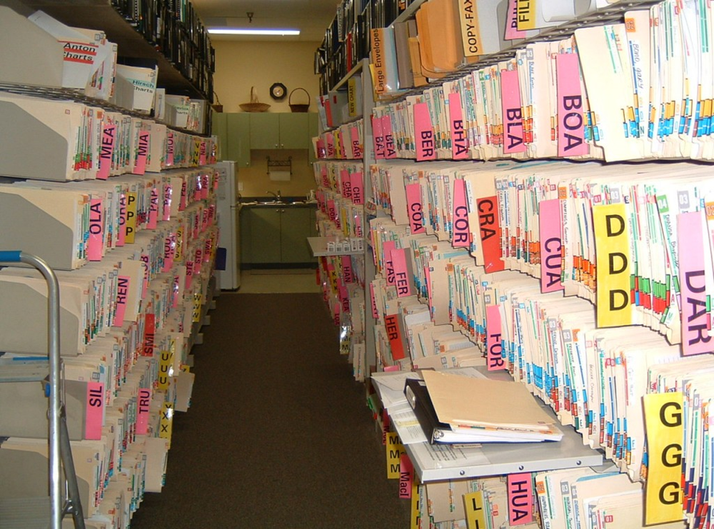
Once upon a time
Records were
organized and stored
in a central location - it was part of the business process!
It was a controlled environment and sometimes even locked!
File cabinets
File rooms
Employees KNEW:
Where and how to file or
handed over to secretary/file clerk
Where to go or who to ask to retrieve files

Slide 9

Losing governance
With technology, tasks and development work shifted into the hands of end users
There were no tools or any strategies put into place up front to assist or organize electronic records, and the traditional secretaries and file clerks* went away
*fka dragon ladies (no offense to dragons or ladies)

Slide 10
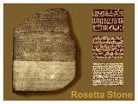
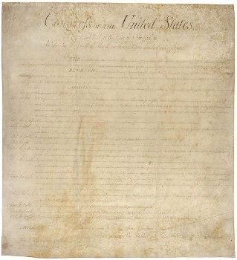
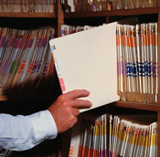

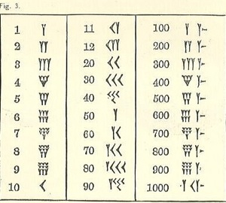

It’s a part of business - THEN
For centuries, humans have created and “managed” records
Merchants tracked their inventory and goods, accounts receivable, payables, payroll, ordering, and performed audits and so on if they wanted to be competitive, protect their assets and STAY in business

Slide 11
Doing business now
Oh, and by the way.. directly from Chapter RCW 42.56.100 “Agencies shall ..........provide full public access to public records, to protect public records from damage or disorganization...”

Slide 12
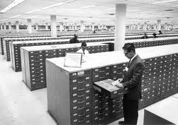
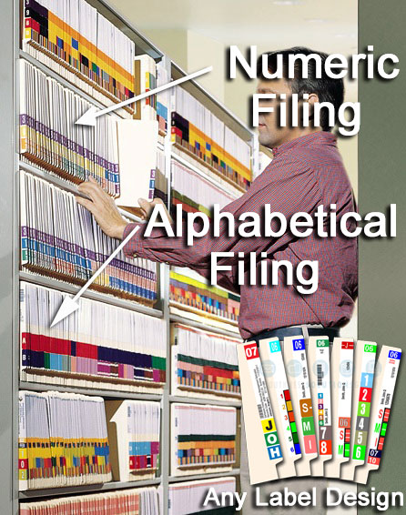
Filing structures and systems
We’ve been using “records management” to organize paper for hundreds of years because it works!
You can apply it to electronic records and information too!

Slide 13


It’s All About Classification
Everything has a place, and there’s a place for everything
Store things so you can find them and get rid of (or transfer as appropriate) anything that has expired (met retention or is not required)
(In a way that’s convenient, timely, accurate, and cost effective)
That way you don’t have to pay for more storage and continue to accumulate stuff!

Slide 14
What is Records Management?
….field of management responsible for the efficient and systematic control of the creation, receipt, maintenance, use and disposition of records, including the processes for capturing and maintaining evidence of and information about business activities and transactions in the form of records“ (ISO 15489)

Slide 15

Disposition is a VERB
It means to take action to get rid of records that you are either not required to keep in the first place
OR
to destroy/transfer once retention requirements have been met

Slide 16
Who cares? And why should I?
Managing your process + managing your information = Happiness
  Happy Users – they can find what they need to do their job, more effective and efficient (saves money)
  Happy IT – the less volume and mess things are, the less costs for storage and maintenance involved (saves money)
  Happy Records Requesters – if you can find the requested information quickly and fulfill requests in a timely and effective fashion (saves money and avoids lawsuits)

Slide 17
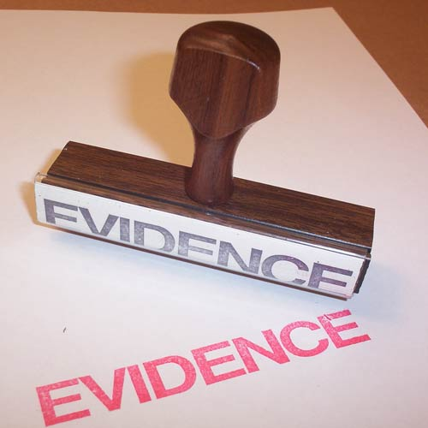
Why do you keep records?
Administrative value
Audit value
Fiscal value
Historical value
Legal value
Records are the evidence and proof of an agency’s business

Slide 18
Highlight: Fiscal and Accounting
Any business needs to know about the money:
Where the money is, where it’s coming from and where it’s going:
Accounts payable/receivables
Invoices, purchases, orders
Checks, cash, debit or credit cards, receipts and other payment information

Slide 19
Show me the money
Banking – deposits, withdrawals
Budgets – allocations, expenditures
Payroll – Salaries, timesheets, deductions, taxes, retirement benefits

Slide 20

Accountability and audits
What does an auditor want to see?

Slide 21
Every agency is accountable
If you are using a vendor, the agency is the one on the hook for the care and feeding of THEIR records
You cannot rely on nor should you consider the vendor the responsible party

Slide 22
What is a Retention Schedule?
Records retention schedules provide for the ongoing LEGAL authority for the disposition of public records
They are a legal document approved by committees:
Local Records Committee
State Records Committee
Exercise your authority!
Records retention schedules grant agencies ongoing LEGAL authority for the management and disposition of public records

Slide 23
All schedules include:
Table of Contents and Subject Indexes
They outline:
  Types of records/description
  (Record Series)
  Minimum required period of time to keep AND a trigger to start the retention clock
  (Retention Period and Cut-Off)
  Is it Non-Archival, Archival or Essential?
  (Designations)
  www.sos.wa.gov/archives - click on appropriate tab
  Services for State Government
  Services for Local Government

Slide 24
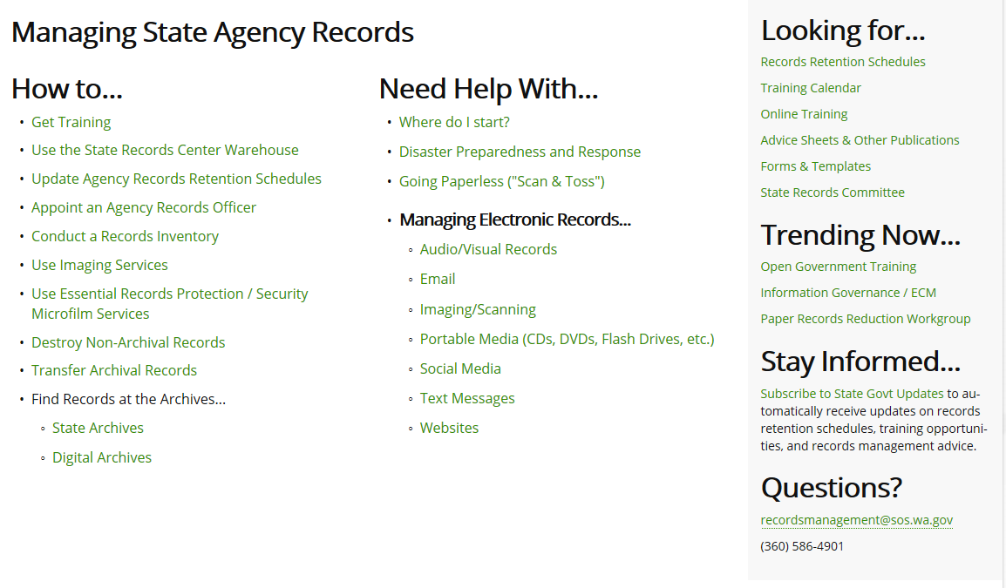
State Government

Slide 25
First line of defense
Retention schedules are the foundation for implementing records management
What you are required to keep
What you are not required to keep
What to do when retention is met
Supports “defensible disposition*”
*can prove/support actions and decisions and defend same

Slide 26
Meeting requirements
  Are you required to keep it?
  Know your business
  Know your processes
  What are the functions of a business unit?
  What activities support those functions?
  What other regulations/requirements are there for that particular business unit and business process?

Slide 27

CONTENT AND CONTEXT
All retention is driven by CONTENT AND CONTEXT about the business processes of the agency
What is being said/done?
Who is doing what to whom and why?
Is this a business transaction and part of a business process?
Is this the proof or evidence of the execution of business or a transaction?
Is there an action/decision that needs to happen?
Does it support accountability and transparency?
What about emails? – See above
OR Are emails simply delivering an attachment?
In several instances, the attachment is the record, not the email
There are exceptions, it’s important you know your records and processes and identify up
front what you may be required to keep!
For example, if you are in Human Resources and accep job applications via email –
you may be required to have a date/time stamp to validate acceptance of application

Slide 28
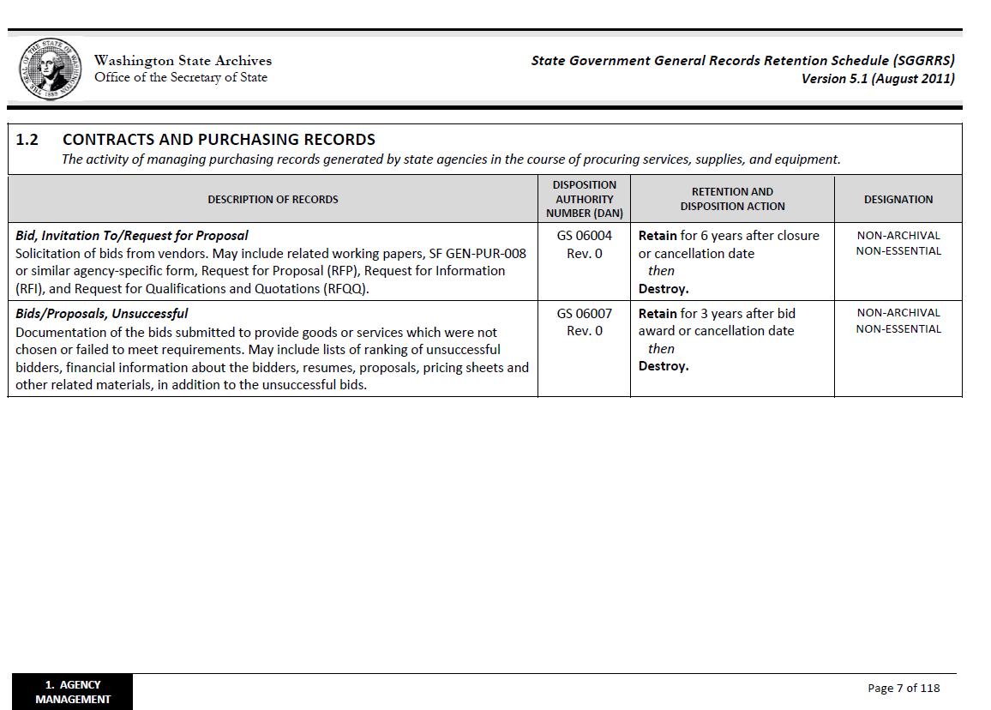
STATE Example
A retention period is the minimum required period of time you are to keep
that record.
The “cut-off” is a trigger for when the retention clock starts to tick.
Common cut-offs are a particular date i.e. “end of calendar year”
or an event such as “after closure”.

Slide 29
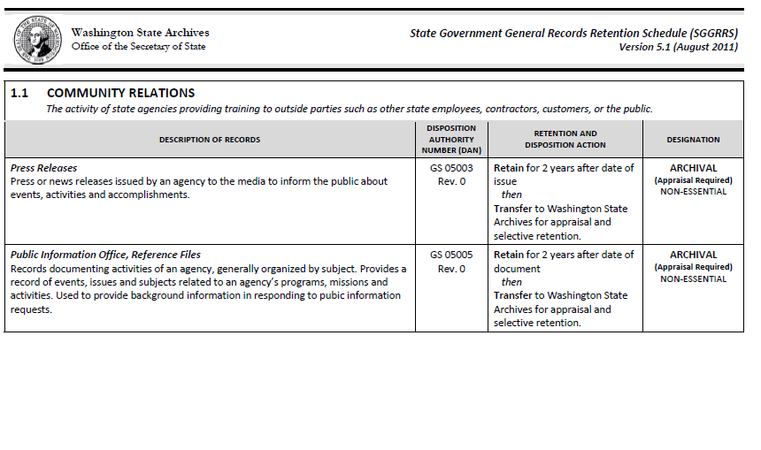
      Certain designations
      require special attention.

Slide 30
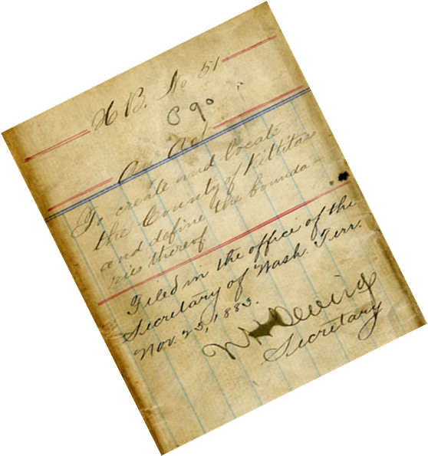
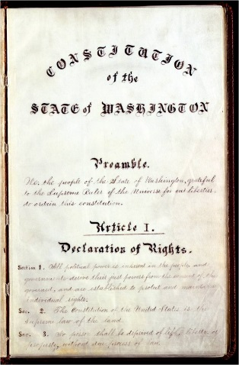
Archival Records
Archival records must not be destroyed
Local Government Agencies must:
  Keep the records indefinitely; OR
  Arrange with Washington State Archives for appraisal/transfer (at no cost)
For certain records, there is an intrinsic
archival value to the paper itself and the signature or seals affixed.
For other archival records the value
is in the information itself, and not the piece of paper it is captured nor where it’s stored in (i.e. database)

Slide 31
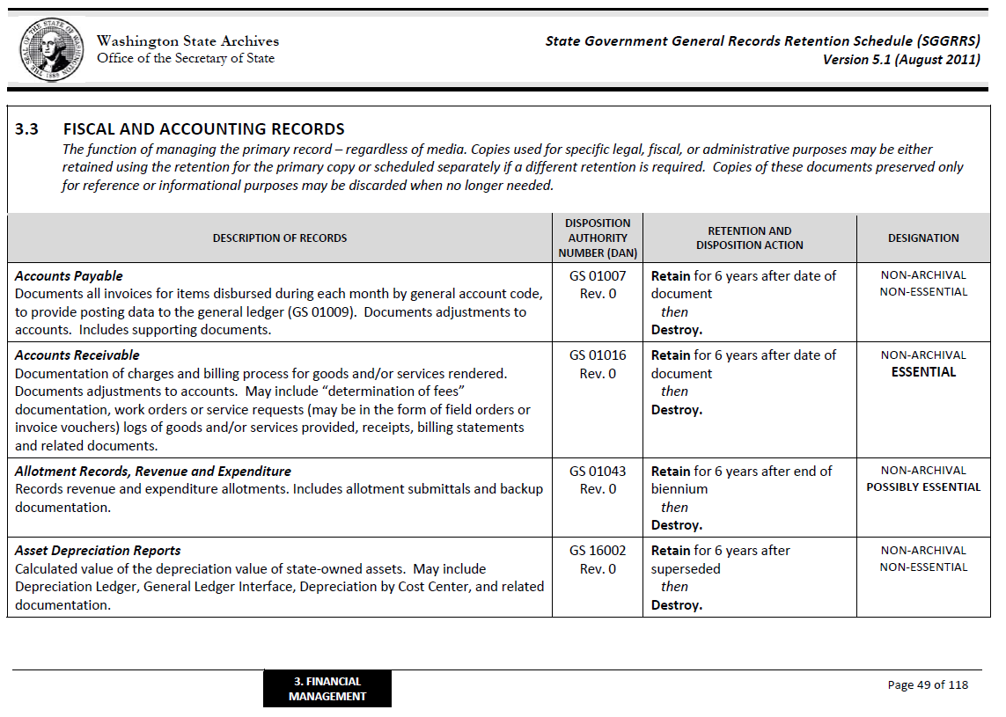
Essential records should have extra
protection and back up to be available for recovery and restoration to provide for the continuity of operations as soon as possible (RCW 40.10) and according to a disaster plan formulated by the agency.

Slide 32
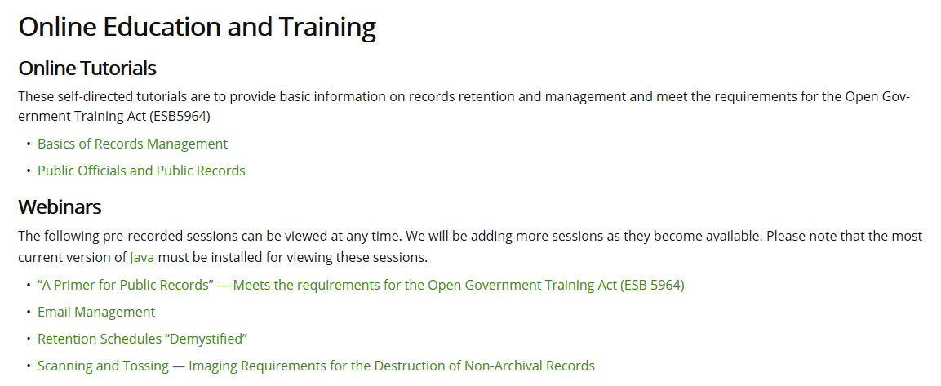
For more information
Check out our webinars:
“
Retention Schedules “Demystified” for a closer look at how to use and interpret retention schedules

Slide 33

What about electronic records?
The exact same rules and requirements apply equally to all
records, information and data
(created, received and used in connection with the transaction of public business)
“Regardless of physical form and characteristics....”(Chapter RCW 40.14)

Slide 34
Paper or Electronic?
Regardless of how it was created:
If the transaction of public business occurs in paper then the paper record is considered the primary copy and needs to be retained and managed
If the transaction of public business occurs electronically or “born digital” then the electronic record is considered the primary copy and needs to be maintained and managed
Notes:
The fundamentals are the same whether created in paper or electronic formats:
Format doesn’t matter
Location doesn’t matter
Content matters!!!
Regardless of format:
Clay tablet, pen and paper, phone, e-mails, word docs, excel spreadsheets, databases, websites, blogs, wikis, social media, or any other emerging applications or platforms
Regardless of device used to create it:
Main frame computer, PC, laptop, smart phone, notebook, tablet, Google glasses or any other emerging technologies
Regardless of location/where it’s stored or accessed:
PC, laptop, flash drive, smart phone, notebook, tablet, or the cloud

Slide 35
Born Digital? Keep It Digital!
  WAC 434-662-040
Electronic records must be retained in electronic format and remain usable, searchable, retrievable and authentic for the length of the designated
retention period
Printing and retaining a hard copy is not a substitute for the electronic version

Slide 36
“Born-Digital”
Metadata associated with “born digital” records establishes the authenticity of the record, providing evidence of the transaction taking place
Printing electronic records (e.g. emails) removes/disconnects that record from the metadata that authenticates it as an electronic record

Slide 37
Paper or Electronic?
Example #1:
  Employee contracts are drafted using Microsoft Word and then printed
  New hire and agency staff sign the printed contract
  Transaction of public business occurs in paper so the signed paper contract need to be retained

Slide 38
What is “Born Digital”? #2
  A request to change a student’s address is submitted in hard copy to the school
  Information is transcribed into database
  Transaction and authority given to make change occurs in paper, so the submitted hardcopy record need to be retained – that form is the evidence and the authority to make the change requested

Slide 39
Bridging the gap
Scanning and tossing
Still have a lot of paper!
Want to transition from hybrid to completely digital processes

Slide 40
“Scanning and Tossing”
You can consider “scanning and tossing” paper based primary records and convert them to a digital format
For more information, check out the webinar “Scanning and Tossing - Requirements for Imaging” on the online training webpage

Slide 41

RM = Housekeeping
Every job has some required administrative processes as part of job (like it or not, comes with the territory) – managing information and housekeeping is one!
Frequently remind staff of their “to-do” list of chores– create policies (maybe make it part of their performance evaluations)
Spring and fall cleaning (disposition) needs
to be regularly scheduled as well
Make training on public records
mandatory for everyone in agency!
RM supports an
open and
transparent
government!

Slide 42
Don’t worry, be happy
(and organized!)
Keeping it tidy and organized means
you don’t have to worry about having unexpected guests drop in!
(like the auditor or a
public records requestor)
Keep your records specialists, IT , legal and risk team in the loop!

Slide 43

Important to remember
Records are informational assets
Manage your assets!
Records management is the key to success!

Slide 44
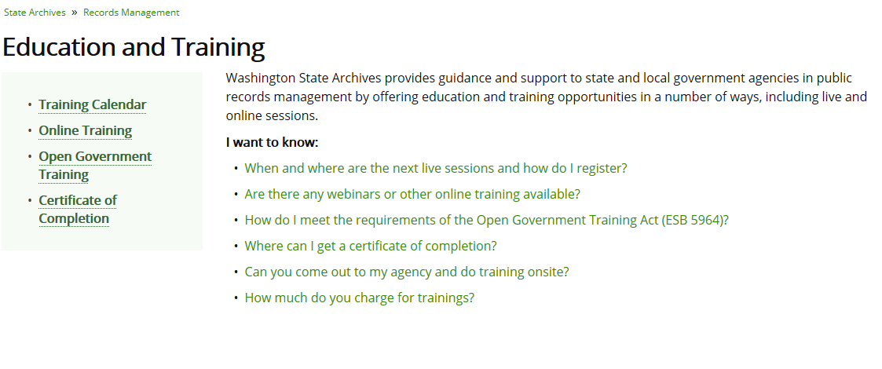
How To Stay Current
CONTINUOUS UPDATES TO TRAINING
Subscribe to our listserv for notifications and updates

Slide 45
You are not alone!
Thank you for attending!
Questions?
recordsmanagement@sos.wa.gov
Washington State Archives
Partners in preservation and accesss

