Slide 1

Contract Remedies
Presented by Greg Tolbert & Mark Lyon

Slide 2
Agenda
Table Setting
Introduction to Contract Damages
Contract Damages
Strategies & Tips
  Contract Negotiating
  Contract Drafting
  Contract Administration
Takeaway Messages
Additional Resources
Notes:
Contract law is a big, big area. We won’t cover all of contract law (that’s a year long class in law school). Rather, we will cover:
Remedies for breach of contract (which is a separate law school class)
Damages
Strategies and tips for negotiating, drafting, and administering contract damage provisions

Slide 3
Goals
Notes:
I know! This was not part of the agenda. A bonus section.
Let’s spend a moment and identify your goals … and our goals for this session.

Slide 4
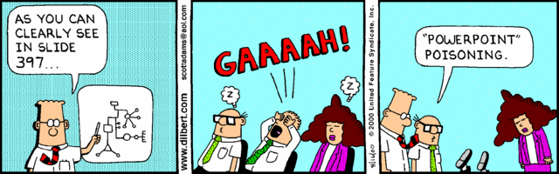
Avoid PowerPoint Poisoning
Notes:
Okay - not too worry, your PowerPoint Poisoning risk may be acceptable. The Wall Street Journal had a story - on February 27, 2010 about former Ford CEO & President Alan Mullaly (who moved on to Boeing). Turns out the guy nearly lives for PPT slides. His business review meetings typically include 300 slide decks. And he’s the guy that actually made money selling autos.

Slide 5

Notes:
Avoid your co-workers for 90 minutes.
They may be looking for you to ‘bless’ their contract – i.e., cover their bottoms if that agreement is a mess. You, of course, were not involved in assessing risk, developing strategies, or even participating in the negotiations. But, hey, this thing could fall apart and they’d like to expand the ‘circle of blame’ or maybe even get you to accept that responsibility.

Slide 6

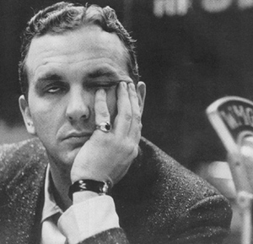
Stay Awake
Notes:
I brought a camera and may need to update this slide. So, feel free to catch up on your sleep.

Slide 7

Remember to preface my personal legal questions with “Say, I have a friend who …”
Notes:
People make mistakes … but, still …have some pride

Slide 8
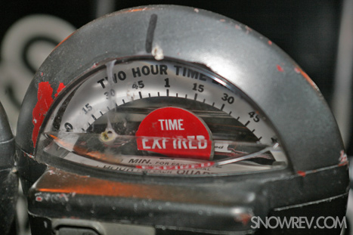
Notes:
And, maybe your top goal – make sure these guys end on time.

Slide 9

Our Goals
Overview of contract damages and remedies
Identify problem areas
Suggest some practical tips
Notes:
Our goals are modest.
Provide background … hopefully this will be an educational resource that you can use
Identify problem areas
Offer some practical strategies and tips
Get done on time

Slide 10
Table Setting
Government Contracts & Remedies
Notes:
For those who ended up in the wrong room, this is a great time to act confused and escape this presentation.
For those who may be worried that their name might come up, keep calm … very few people are named.

Slide 11
Public Expectation
Efficient
Effective
Accountable
Notes:
Washingtonians expect – rightly so – efficient, effective, and accountable government.
Several reasons, including:
There is a tension between government and liberty. Accordingly, as we reduce liberty, in exchange for government, we expect accountability.
Government operates on ‘taxpayer money.’ Accordingly, we expect its activities to be efficient and cost-effective.
Every year, huge sums of taxpayers’ money are spent by governments on goods and services. Much of this is done pursuant to government contracts.

Slide 12

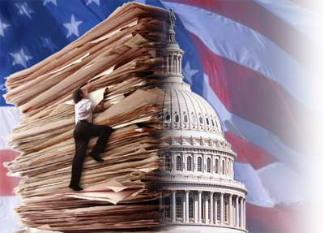
The Reality
Contracts often can be
  Complicated
  Nuanced
  Adversarial
  Protracted
Notes:
Often times, public perception can be informed by rearview mirror analysis … not every deal turns out great.
This means that some agreements end up bad. Oftentimes, this assessment is ‘rearview mirror,’ but it has consequences.
SAO audits
Press coverage

Slide 13

Government Contracts
Notes:
Government contracting … As Chrissy Hinde would say, we’re special, so special
Why you are special – this is good news / bad news situation
Public money – stewardship obligation
Taxpayers should not be bound by fools

Slide 14
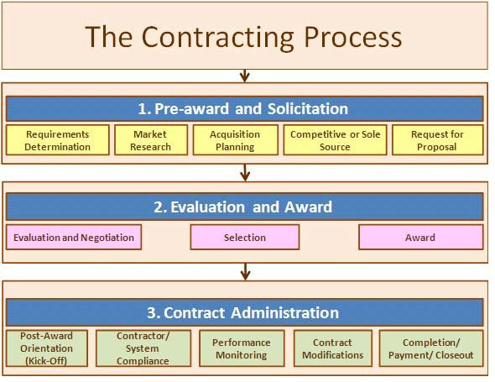
Government Contracting
Notes:
We’re a ‘big deal’ at grandma’s – our process tends to be disruptive
Government contracting process:
Usually requires a competitive process
It is an expensive, time-consuming process
Government often has special/required provisions
Sometimes does not keep pace with market dynamics
Usually cannot use supplier’s form contract (which is the only form they use)

Slide 15
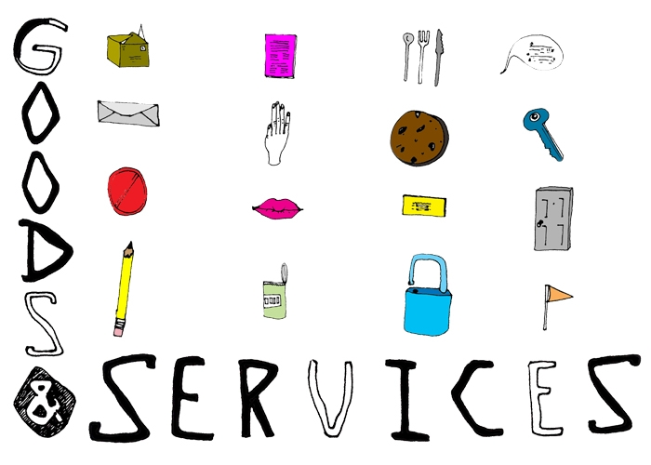
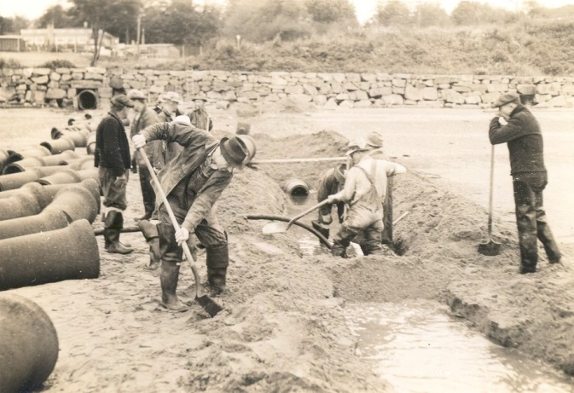
Government Contracts
Types
  Goods
  Services
  Public works
  Real Property
Deal side
  Government usually is the buyer
Notes:
Contract Types
Goods – e.g., rubber gloves, ink toners, Rx, computers, cars
Services – e.g., consulting contracts, elevator maintenance
Public Works – e.g., buildings
Real Property – e.g., acquisition of land
Deal Side
Government usually is the ‘buyer’
What does this mean? – Just like any other buyer,
We want our stuff
On time
Meeting specs

Slide 16
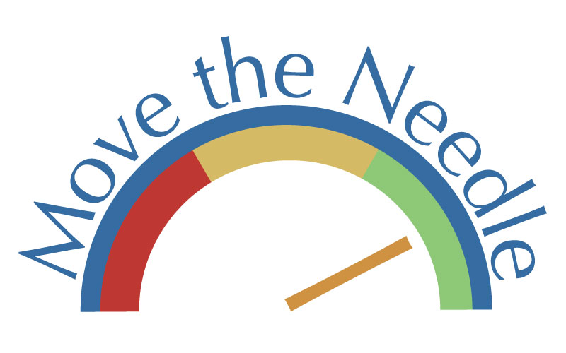
Strategic Implications
Focus efforts
  Minimize deal risk
  Minimize transactional risk
  Incentivize performance
Think about counterparty perspective
  Their risk containment strategy
Notes:
Focus your contract negotiating, drafting, and administration efforts where you can make a difference
Minimize deal risk
Negotiate contract-specific specifications (e.g., delivery times for armored car service; liner specs for trash bags)
Negotiate Reps & warranties to enhance contract value proposition
Include a prohibition on assignment (avoid empty sack)
Minimize transactional risk
Insurance
Bonding
Force majeure
Indemnification
Dispute resolution
Incentivize performance
Don’t constrain the pain – i.e., don’t minimize consequences for nonperformance (e.g., limitation of liability; waiver of damages; exclusive remedies)
Counterparty Perspective – They likely want to:
Make money … now … which means revenue recognition often drives deal terms
Minimize obligations & risk
Not bet the company on any single contract

Slide 17
Introduction to Contract Damages

Slide 18
A Contract Is
“An agreement between two or more parties creating obligations that are enforceable or otherwise recognizable as law.”
Black’s Law Dictionary
Notes:
Simply stated, a contract is an enforceable promise.
The law of contracts covers what makes the promise enforceable and how a contract can be enforced.
Agreement and obligations – means a set of promises exchanged between the parties
Enforceable – means that if a party fails to do what they promised to do (breach), a court of law will enter an order to remedy the breach, i.e., make the offended party whole.
For a contract to be enforceable, the parties must have reached a meeting of the minds, or in other words, agree on the same terms, conditions, and subject matter.
Therefore, contracts must be clearly written and must clearly communicate the terms and conditions, i.e., obligations; promises.
The terms, conditions, and obligations must be consistent throughout the document or an explanation given as to why they are not and which controls (i.e., order of precedence list)

Slide 19

Typical Contract
Party A has a duty to perform:
  Deliver goods
  Provide a service
  Construct a building
  Convey real estate
Party B has a duty to pay money.

Slide 20
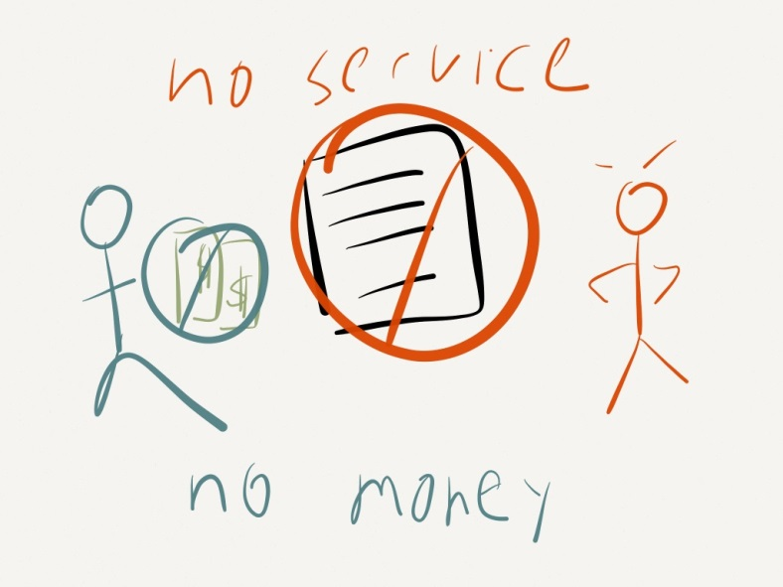
Breach of Contract
Breach: Any deviation from promised performance
Breach by the performer may take the form of –
  Nonperformance
  Defective performance
  Delayed performance
Breach by payer –
  Nonpayment
  Partial payment
Notes:
Normally, both parties to a contract perform their part of the bargain and everything works out.
If, however, a party fails to perform, the party is deemed to be in “breach” of the contract i.e., breach occurs when a contracting party fails to perform that which such party is under a duty to perform.
Black’s Law Dictionary: Breach of contract means the “failure, without legal excuse, to perform any promise which forms the whole or part of a contract.”

Slide 21
Type of Breach
Material breach
  Undermines the substantial benefit of the bargain
  Right to suspend performance obligation & sue for damages
Minor breach
  Slight deviation from promised performance
  Sue for damages
Notes:
Contrary to what you may see on television, not every contract breach is a big deal.
There is a big difference between material breach and minor breach.
Material breach: “Violation of contract which is substantial and significant and which usually excuses the aggrieved party from further performance under the contract and affords a right to sue for damages.”
NEXT SLIDE

Slide 22
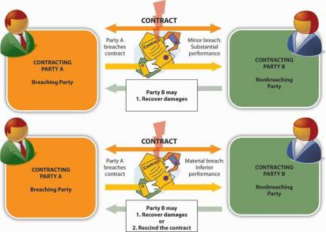
Distinction
Notes:
Minor Breach: Recover damages
Material Beach: Recover damages or rescind the contract

Slide 23
When Have You Breached?
What constitutes breach of contract?
  Failure to perform
  Breach of representation or warranty
  Breach of a restrictive covenant
What does the contract say?
  Is it an immediate breach or does it require notice/cure period?
Was the breached waived?
Notes:
Now this may come as a surprise – but folks have an absolute right to breach a contract – they just have to be willing to accept the consequences.
Certain breaches are a big deal –
Failure to perform
Breach a rep or warranty … in preschool, we just called this ‘lying’
Sometimes, however, your counterparty bails you out – and waives breach.
Waiver:
A pattern of conduct that waives a number of successive breaches will operate as a continued waiver
Nonbreaching party can still recover damages, but contract is not terminated
Nonbreaching party should give notice to the breaching party that full performance will be required in the future

Slide 24
Defenses
Capacity
Interference
Impossible performance
Mutual mistake
Fraud
Duress
Doctrine of unconscionability
Accepted performance
Illegal purpose or act
Notes:
There are many valid defenses that can be raised to a claim of breach of a contract. These, however, often depend upon the particular facts and circumstances of the contract and the actions of the parties. Going it alone is not the wisest choice and competent legal help almost always is required.
The more common defenses to a breach of contract claim are:
(1) One side was not competent to enter into the contract, either due to age or mental illness;
(2) One side had a "free way out" and really never provided any form of "consideration";
(3) One side was under pressure and duress or other undue influence to sign;
(4) One side engaged in "fraud" to procure the contract;
(5) One side prevented the other from fulfilling its/her/his end of the bargain;
(6) The original contract was changed with the agreement of all parties;
(7) There was a mistake of fact or mistake of law prior to signing the contract;
(8) The contract has an illegal purpose or act;
(9) Something happened, through no fault of either side, making the duties under the contract impossible to perform;
(10) The side claiming the breach accepted the performance without claiming a breach had occurred.

Slide 25
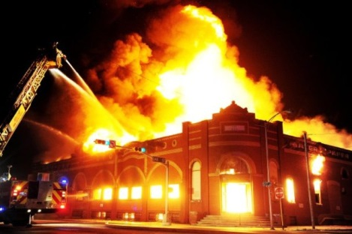
Doctrine of Impracticability
Contractual defense
A court may refuse to enforce a contract if it becomes truly impossible for one of the parties to perform
Notes:
Example: Suppose that an orchestra contracts with a college to use its auditorium for an upcoming concert and then the auditorium is destroyed in a fire. A court may not enforce the contract because it has become impossible for the college to provide the auditorium.

Slide 26
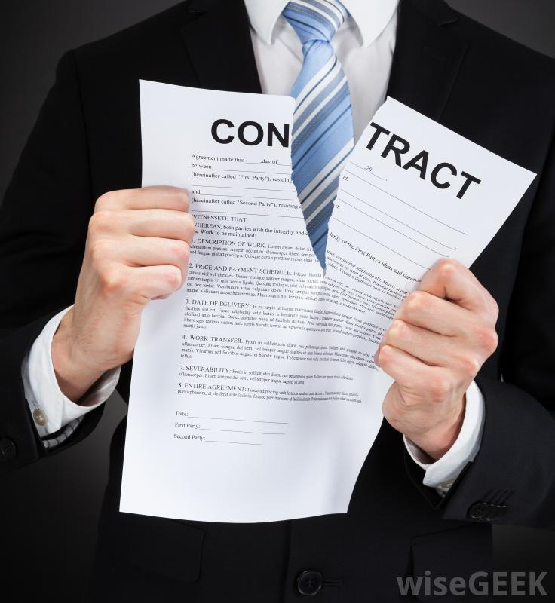
Doctrine of Unconscionability
Contractual defense
Court may refuse to enforce a contract because it is extremely unfair to one of the parties
Notes:
This is another defense to contract breach.
Do NOT count on this as a defense to breach in government contracting.
Contract terms must be incredibly unfair ("unconscionable") for a court to set aside a contract
Often courts require that the terms of the contract and the way in which the contract was formed both be grossly unfair before it can be set aside.
Procedural unconscionability
Substantive unconscionability

Slide 27


Not Defenses
Failure to read the agreement
Did not understand the agreement
Unilateral mistake
Notes:
“The agreement was long … so, I didn’t read every word.” – NOT a defense
“The agreement was boring.” -- NOT a defense
“I feel asleep” - NOT a defense
The fact that the agreement is complicated does not excuse you from understanding it.
Unilateral mistake - has a definition. Sucks to be you. A bad deal is still a deal.

Slide 28
Remedies
Upon breach: Nonbreaching party can choose one or more remedies
Damages are the primary remedy for breach of contract
General rule: Unless damages would be inadequate, courts will award money damages
Notes:
When a party breaches a contract, the other party often has to resort to court for enforcement of the contract. This means remedies – a remedy to the problem.
There are a variety or remedies, but the default remedy is money damages.
Specific performance: Only available if legal remedy (i.e., money) is inadequate. Examples: land; art.
Election of Remedies:
Doctrine created to prevent double recovery
Nonbreaching party must choose which remedy to pursue
UCC rejects election of remedies
Cumulative in nature and include all the available remedies for breach of contract

Slide 29
Contract Provisions
Limiting Remedies
Exculpatory clauses
  Provisions stating that no damages can be recovered
Limitation of liability clauses
  Provisions that affect the availability of certain remedies
Liquidated damages
  Contract provides a specific amount to be paid as damages in the event of future default or breach of contract
Notes:
These are tools that sellers use to manage their deal risk. These strategies are designed to:
Decrease risk
Cap downside
Allow accountants to books sales revenue now
Exculpatory Clauses: These are the part of the agreement that relieves one party from liability. It is a provision in a contract which is intended to protect one party from being sued for their wrongdoing or negligence.
Limitation of Liability: Precisely that – these are provisions designed to limit – cap, excuse, reduce liability
Liquidated Damages: May be a fraction of your total actual damages.
Other:
Notice requirement
Payment equals waiver clause
Time period for a claim to be raised

Slide 30
Most Common Remedies
Rescission and restitution
Specific performance
Reformation
Recovery based on quasi contract
Damages
Notes:
We’ll walk through these - including the various types of damages.

Slide 31
Rescission & Restitution
Rescission
  A remedy whereby a contract is canceled and the parties are restored to the original positions that they occupied prior to the transactions
Restitution
  Both parties must return goods, property, or money previously conveyed
Notes:
Note:
Rescission does not always call for restitution.
Restitution is called for in some cases not involving rescission.
Rescission is an equitable remedy that wipes out the existing contract and restores the parties to their situation prior to entering into the contract.
In general terms, rescission refers to the cancellation of a contract. If money has been paid by one party to another, that money is returned as part of the rescission process.
Rescission can occur as a result of innocent or fraudulent representation, mutual mistake, lack of legal capacity, an impossibility to perform a contract not contemplated by the parties, or duress and undue influence.
Example: Assume you agreed to sell and the buyer agreed to buy two acres of land that you thought you owned. Later, it turns out that you did not have title to the property. Rescission would be the proper remedy.

Slide 32
Specific Performance
Equitable remedy
  Requires performance of the act promised in the contract
Special remedy
  Used in cases where the consideration is unique or scarce
Not allowed -
  Remedy not available in contracts for personal services
Notes:
Specific Performance is a special remedy.
Examples:
Land, art (require seller to convey … this is the only one)
Also used in injunctive relief - e.g., confidentiality agreements
There are certain circumstances where an order of specific performance would not be granted. Such circumstances include:
1. Specific performance would cause severe hardship to the defendant
2. The contract was unconscionable
3. The claimant has misbehaved (no clean hands)
4. Specific performance is impossible
5. Performance consists of a personal service
6. The contract is too vague
7. Contracts terminable at will
8. Contracts requiring constant supervision
9. Contract lacking mutuality
10. Contract made for no consideration

Slide 33
Reformation
Equitable remedy
  Court reforms (rewrites) the contract to reflect the parties true intentions
Available when an agreement is imperfectly expressed in writing
Notes:
Reformation is an equitable remedy in which a court modifies or revises a contract, deed, or other written instrument to make it conform to what the parties understood or agreed to.
Reformation is most likely to occur when the parties have entered into a binding agreement and some related writing does not conform to their agreement, either due to mistake or fraud.
Example: If you agreed to sell two acres of land and the deed you deliver covers only 1.5 acres, the court would likely reform the deed to cover the full two acres.

Slide 34

Recovery Based on
Quasi Contract
Equitable theory
Party seeking quantum meruit must show the following:
  A benefit was conferred to the other party
  Party conferring did so with the reasonable expectation of being paid
  The benefit was not volunteered
  Retaining benefit without paying for it would result in unjust enrichment of the party receiving the benefit.
Notes:
Equitable theory imposed by courts to obtain justice and prevent unjust enrichment.

Slide 35
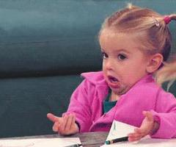
Damages – Potential Problem
Notes:
There are many different types of damages.
The terms used to describe them are not always fully understood by the lawyers and business professionals using those terms.
Using a misunderstood term in a damage limitation provision can drastically limit your recovery or increase your liability

Slide 36
Purpose of Damages
In the context of contract law, the award of direct and consequential damages is intended to compensate the nonbreaching party for the injury suffered as a consequence of the breach.
  Floor Exp., Inc. v. Daly, 138 Wn. App. 750 (2007)
Primary purpose of damages for breach of contract is to protect the promisee’s expectation interest in the promisor’s performance
Damages should put the plaintiff is as good a position as if the defendant had fully performed as required by the contract.
Notes:
The general concept of damages in contract is based on the idea of compensating the nonbreaching party by putting her in the position she would be in had a breach not occurred.
Expectation Interest: Purpose of damages is to protect the promisee’s expectation interest.

Slide 37
Limitation on Damages
Damages must have been reasonably foreseeable.
  This is a significant limitation on damages
Damages that are NOT recoverable:
  Speculative damages
  Remote damages
  Avoidable damages
Notes:
These are commonsense rules –
Before compensating a party for injury, the law requires that the injury must have been reasonably foreseeable to the other party.
Damages that could not have been reasonably foreseen by the breaching party at the time they entered the contract are NOT recoverable
Neither of these types of damages are recoverable under contract law.
Speculative Damages: Damages that have not actually occurred, may never occur, and cannot be proven.
Remote Damages: Damages that lack an appropriately close causal link to the breach.

Slide 38
Contract Damages: Measure of Recovery
Expectation Interest
Reliance Interest
Restitution Interest
Notes:
Courts think about contract damages from 3 perspectives:
Expectation Interest
Reliance Interest
Restitution Interest
The measure of damages varies depending on the interest.
Traction for damages: In the event of breach, the nonbreaching party is entitled to a remedy.
The amount and type of damages awarded to the nonbreaching party will vary depending on the circumstances of the case

Slide 39
Expectation Interest
This is the general rule. “Benefit of Bargain”
Party injured by breach of contract is entitled to recover:
  All damages that accrue naturally from the breach; and
  An amount sufficient to put the injured party in a position monetarily equivalent to the position she would have been in if the breaching party had performed.
  Westlake, LLC v. Engstrom Properties, LLC, 169 Wn. App. 700 (2012); Eastlake Construction Co. v. Hess, 102 Wn. 2d 30 (1984)
Notes:
The general rule is expectation interest.
Primary purpose of damages for breach of contract is to protect the promisee’s expectation interest in the promisor’s performance.
Damages should put the plaintiff is as good a position as if the defendant had fully performed as required by the contract.
Contract, of course, can change the general rule.
NEXT SLIDE

Slide 40
Expectation, cont.
Proof of Damages
  The amount of damages must be proven with reasonable certainty. Does not have to be precise.
    Lester N. Johnson Co. v. Spokane, 22 Wn. App. 265 (1978)
Duty to Mitigate
  Injured party must make reasonable efforts to minimize or avoid damages resulting from another party’s breach. Avoidable damages are not recoverable.
    Westland Construction Co. v. Christ Berg, Inc., 35 Wn. 2d 824 (1950)
Notes:
Still must mitigate damages – no ‘free play on a flag’
No recovery for avoidable damages.

Slide 41
Reliance Interest
Measure of Recovery:
  Expenditures made in preparation for performance or in the course of performance, less any loss the injured party would have incurred had the contract been performed
    Family Medical Bldg v. DSHS, 37 Wn. App. 662 (1984), rev’d on other grounds, 104 Wn.2d 105 (1985)
  Note: Lost profit is not recoverable
Based on Cost; not Value
Notes:
Alternative to expectation damages.
Get reliance measure when expectation measure is uncertain or speculative (or when promissory estoppel is asserted).
If expectation damages are unavailable due to limitations of certainty, foreseeability, or mitigation, the promisee may measure damages by the reliance interest. In other words, when the monetary value of the ‘benefit of the bargain’ cannot be proven with sufficient certainty, a court can award an injured party reliance damages.
Based on Cost: Reliance damages are based on the cost, not the value, of injured party’s performance.
The purpose of measuring damages by the reliance interest is to put the plaintiff in as good a position as if the contract had not been made, by compensating for losses caused by the plaintiff’s reliance on the contract.
NEXT SLIDE

Slide 42
Restitution Interest
Purpose of restitution is the prevention of unjust enrichment
Measure of restitution damages is the reasonable value of the injured party’s performance
  Note: Restitution damages are not limited by the contract price
Measure of recovery often is the value of the benefit conferred
  Dravo Corp. v. L.W. Moses Co., 6 Wn. App. 74 (1971)
Notes:
Restitution is an alternative remedy to damages for TOTAL breach of contract.
Restitution measure permits recovery based on the value of the plaintiff’s performance under the contract, rather than the loss sustained as a result of the defendant’s breach.
Restitution appropriate when:
Total breach of an indivisible contract occurs after partial performance by the injured party.
Duties are discharged by agreement of the parties or by operation of law.
A defective contract is rescinded

Slide 43
Example
Greg agrees to pay Mark $50,000 to build a shop. Greg gives mark a deposit of $10,000 and, in reliance on the contract pays an architect $8,000 for plans and permits.
Before work begins, Mark repudiates the contract.
Greg discovers that no one will accept less than $60,000 to do what Mark promised to do.
If Greg sues Mark, what are the damages under various theories?
Notes:
These all are things that can be addressed in a contract – if you think through issues, risk, exit strategy, etc.
NEXT SLIDE

Slide 44
Possible Damages
 | Measure of Damages |  |  | Total Damages
Theory of recovery | Benefit conferred | Other Costs of Reliance | Lost Value of Performance
Restitution | $10,000 Deposit | --- | --- | $10,000
Reliance | $10,000 Deposit | $8,000 Architect fee | --- | $18,000
Expectation | $10,000 Deposit | $8,000 Architect fee | $10,000 Contract difference | $28,000
Notes:
Restitution: Compensation for benefits conferred on another.
Reliance: Compensation for expenses incurred in reasonable reliance on another’s performance.
Expectation: Compensation for the net expected benefits of another’s performance, plus other losses.
Note: These are huge differences.
It pays to be purposeful and plan ahead.

Slide 45
Contract Damages

Slide 46
Types of Damages
Compensatory
Consequential
Punitive
Incidental
Liquidated
Nominal
Notes:
Inexperienced people will use these terms carelessly. That is a mistake. These terms have specific meanings.
Waiving or excluding certain types of damages can have big consequences.

Slide 47
Compensatory Damages
“Compensatory damages are such as will compensate the injured party for the injury sustained, and nothing more; such as will simply make good or replace the loss caused by the wrong or injury.”
Black’s Law Dictionary
Notes:
When there is breach, the law attempts to give compensatory damages.
The standard measure is expectation interest.
Compensatory Damages: To cover direct losses and costs. Compensate injured party for damages actually sustained
Sale of Goods: difference between contract and market price.
Sale of Land: specific performance.
Construction Contracts: varies
NEXT SLIDE

Slide 48
Terminology
Also known as -
  Actual damages
  Direct damages
Includes
  General damages
  Special damages
Notes:
Compensatory damages are best understood as damages that one reasonably would expect to arise from the breach in question, without taking into account any special circumstances of the nonbreaching party.
Compensatory or actual damages consists of BOTH general and special damages.
General damages: The natural, necessary, and usual result of the wrongful act or occurrence in question.
Damages such as the law itself implies or presumes to have accrued from the wrong complained of.
The immediate, direct, and proximate result, or such as necessarily result from the injury.
Special damages: Those which are the natural, but not the necessary and inevitable result of the wrongful act.
Damages which do not arise from the wrongful act itself, but depend on circumstances peculiar to the infliction of each respective injury.
In contract law, damages not contemplated by the parties at the time of the making of the contract. To be recoverable, they must flow directly and immediately from the breach of contract, and must be reasonably foreseeable.
NEXT SLIDE

Slide 49
Compensatory Damages Measure
Measured by the loss in value of the promised performance.
Difference between the promised performance and the actual performance.
Notes:
Damages designed to compensate the injured party for damages arising directly from the loss of the bargain caused by the breach of contract.
Replaces what was lost because of the breach of contract.

Slide 50
Consequential Damages
“Consequential damages resulting from a seller’s breach of contract include any loss resulting from general or particular requirements and needs of which the seller at the time of contracting had reason to know and which could not reasonably be prevented by cover or otherwise, and injury to person or property proximately resulting from any breach of warranty.”
Black’s Law Dictionary
Notes:
Consequential Damages: To cover indirect and foreseeable losses.
Foreseeable damages: The breaching party is aware – or should be aware – of that cause damage as a consequence of the original injury, cause the injury party additional loss.
See also UCC 2-715(2).
See also Hadley v. Baxendale (1854)
NEXT SLIDE

Slide 51
Terminology
Also known as –
  Indirect damages
Consequential damages:
  Damages caused by special circumstances beyond the contract.
  Damages that do not flow directly and immediately from a breach.
  Damages that flow from the consequences, or results, of a breach.
Notes:
Consequential Damages: Damages which do not derive directly from the breach, but from the results of the breach; they are more indirect in nature.
Consequential damages differ from direct damages in that they are caused by special circumstances beyond the contract itself.
Consequential damages are best understood as including all losses sustained by the nonbreaching party that are attributable to any special circumstances of the nonbreaching party that the parties were aware of when they entered into the contract.
In other words, consequential damages encompass all contractually recoverable damages that aren’t either direct or incidental damages.
If Supplier Breaches the Contract, the Buyer’s Consequential Damages include losses Buyer incurs which the Supplier had reason to know at the time of contracting and which Buyer could not reasonably have prevented; and injury to person or property resulting from any breach of warranty.
Example: Supplier is delayed in its delivery of the $5 products. These components are critical and Buyer can’t find replacement product. As a result, Buyer’s production line is down for 1 day and the cost to Buyer is $50,000 in loss of production. The $50,000 is an example of consequential damages.
NEXT SLIDE

Slide 52
Recoverable When:
The consequential damages were in the contemplation of the parties when the contract was made;
The consequential damages were the proximate result of the breaching party’s nonperformance; and
The amount of the consequential damages is proven with reasonable certainty.
  Farm Crop Energy v. Old Nat’l Bank, 109 Wn.2d 923 (1988)
Notes:
Consequential damages are awarded if special circumstances of the plaintiff (nonbreaching party) cause her to suffer loss as a result of the breach.
NEXT SLIDE

Slide 53
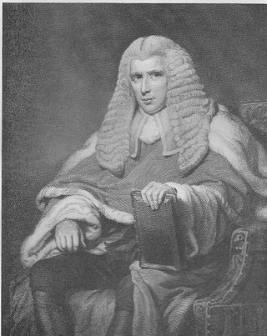
Key Test
The breaching party must know (or have reason to know) that special circumstances will cause the additional loss.
  Hadley v. Baxendale, 9 Exch. 341 (1854).
Notes:
Hadley v. Baxendale (1854): Sets out the basic rule to determine consequential damages from a breach of contract: A breaching party is liable for all losses that the contracting parties should have foreseen.
FACTS:
Mr. Hadley was a miller and proprietor of the City Steam-Mills in Gloucester. He cleaned grain, ground it into meal and dressed it into flour and bran.
A crankshaft of a steam engine at the mill broke and Hadley arranged to have a new one made by W. Joyce & Co. in Greenwich. Before the new crankshaft could be made, W. Joyce & Co. required that the broken crankshaft be sent to them in order to ensure that the new crankshaft would fit together properly with the other parts of the steam engine.
Hadley contracted with defendant Baxendale to deliver the crankshaft to the engineers for repair by a certain date at a cost of £2 sterling and 4 shillings (current value of about £240.00).
Baxendale failed to deliver on the date in question, causing Hadley to lose business.
Hadley sued for the profits he lost due to Baxendale's late delivery, and the jury awarded Hadley damages of £25 (present value about £2500).
Baxendale appealed, contending that he did not know that Hadley would suffer any particular damage by reason of the late delivery.
APPEAL:
Issue was whether a defendant in a breach of contract case could be held liable for damages that the defendant was not aware would be incurred from a breach of the contract.
The Court of Exchequer, led by Baron Sir Edward Hall Alderson, declined to allow Hadley to recover lost profits in this case.
Court held that Baxendale could only be held liable for losses that were generally foreseeable, or if Hadley had mentioned his special circumstances in advance. The mere fact that a party is sending something to be repaired does not indicate that the party would lose profits if it is not delivered on time.

Slide 54

Do Not Panic
Consequential damages do NOT include
  Remote losses
  Speculative losses
Notes:
But, keep in mind that many people do not understand consequential damages and think that – if they don’t exclude consequential damages – they would be on the hook for remote or speculative losses.
Many sellers, for example, purport to require waivers of consequential damages because they believe consequential damages relate to losses beyond those that the breaching party would ordinarily and reasonably have foreseen or contemplated.
Remote/speculative losses can lead uninformed people to engage in a lot of endless (and useless) ‘what if’ negotiating sessions.
NEXT SLIDE

Slide 55
Examples
Lost profits
Lost use
Damage to business reputation
Business interruption
Material escalation costs
Additional energy costs
Personal injury
Notes:
Lost profits: Seller sells goods to buyer that seller knows buyer will resell. Breach means liability for lost profits.
Business Interruption: Hadley v. Baxendale
NEXT SLIDE

Slide 56
Why the Fuss?
Why do parties seek to preclude consequential damages?
  Limit potential risk
  Reduce uncertainty
  Reduce incentive of the nonbreaching party to escalate the dispute
Notes:
Bookending your liability is always a great idea for sellers.
People like certainty.
People fear the unknown.

Slide 57
Liquidated Damages
“Liquidated damages is the sum which party to contract agrees to pay if he breaks some promise and, which having been arrived at by good faith effort to estimate actual damage that will probably ensue from breach, is recoverable as agreed damages if breach occurs.”
Black’s Law Dictionary
Notes:
Liquidated damages: An amount of damages agreed to by the parties and stipulated to in the contract as an appropriate measure of damages in the event of a breach of the contract.
NEXT SLIDE

Slide 58
Terminology
Also known as –
  Stipulated damages
  Agreed damages
Unlike other damages
Notes:
There is a huge difference between liquidated damages and the other damages that we’ve been discussing.
Liquidated damages – if properly done – greatly minimizes the role of third parties (e.g., judges).
Other damages require third party resolution (court; arbitration) with higher transaction costs.
NEXT SLIDE

Slide 59
Allowed
Liquidated damages are favored in Washington and are enforceable if they do not constitute a penalty or are unlawful.
  Jenson v. Richens, 74 Wn.2d 41 (1968)
Note: A party will not be allowed to recover liquidated damages for a breach to which she has contributed.
  Baldwin v. Nat’l Safe Depository Corp., 40 Wn. App. 69 (1985)
Notes:
Liquidated damages are legal.
But, there are rules.
If you contribute to the breach, you do not get liquidated damages. Any guesses as to what your counterparty may claim?
NEXT SLIDE

Slide 60
Test for Enforceability
Two-part test for valid liquidated damages provision:
  When the contract was entered into, was it apparent that damages would be difficult to ascertain in the event of a breach?
  Was the amount set as damages a reasonable estimate?
If the answer to both questions is yes, the provision may be enforced.
Notes:
In Washington, liquidated damages provisions will be enforced if: (1) The amount specified is a reasonable forecast of just compensation for the harm caused by the breach; and (2) The actual damages would be very difficult, if not impossible, to ascertain.
Cases:
Knight, Vale & Gregory v. McDaniel, 37 Wn. App. 366 (1984).
NEXT SLIDE

Slide 61
Risk Costs are More than Just Contract Price
Liquidated damages are intended to cover things that can be hard to prove:
  New procurement posts
  Lost opportunity costs
  Sunk resource costs
  Administrative costs
  Reputational or “political” costs of failed project
  Public or third-party costs
  Enforcement or collection costs
Notes:
A liquidated damages provision permits parties to allocate risks, lend certainty to the parties' agreements, and permits parties to resolve disputes in the event of a breach.
Burgess Vineyards, LLC v. Beveridge, 188 Wash. App. 1002 (2015), 2015 WL 3542329
NEXT SLIDE

Slide 62
Cannot Be A Penalty
To be valid and enforceable, liquidated damages cannot constitute a penalty.
Note: Too low is okay. That’s not a penalty.
  Mahoney v. Tingley, 85 Wn.2d 95 (1975)
Notes:
NEXT SLIDE

Slide 63
Example
Provision requiring a construction contractor to pay $100/day for every day she is late in completing the construction.

Slide 64
Incidental Damages
Refers to a very limited category of costs incurred by the nonbreaching party -
  Expenses incurred by a buyer in connection with rejection of nonconforming goods.
  Expenses incurred by a seller in connection with wrongful rejection of delivered conforming goods.
Example: Safeguarding defective goods until the seller removes them
Such expenses –
  Must be commercially reasonable
  Must occur in relation to the breach
Notes:
UCC 2-710
Incidental damages seem of little concern, but can be very substantial in some situations, and should not be waived lightly.
NEXT SLIDE

Slide 65
Seller’s Incidental Damages
Any reasonable expenses incurred in:
  Stopping delivery
  Transportation, care, & custody of goods after the buyer’s breach
  Returning or reselling goods
  Other expenses incident to the breach
Notes:
NEXT SLIDE

Slide 66
Buyer’s Incidental Damages
Any reasonable expenses incurred in:
  Inspection or receipt of goods later rejected
  Care and custody of goods later rejected
  Charges incurred in replacing (covering) the goods
  Other expenses incident to the delay or breach

Slide 67
Nominal Damages
When no actual damages result from a breach of contract; just a technical injury
Typically $1
Notes:
Nominal Damages: To recognize wrongdoing when no monetary loss is shown (Defendant is liable but only a technical injury).
Example: DES contracts with Dragonfly LLC to purchase pencils at $2/case. Dragonfly LLC breaches the contract and fails to deliver the pencils. In the meantime, however, the price of pencils has fallen. DES now is able to buy pencils at $1/case. DES clearly is better off because of Dragonfly’s breach. As a result, although there is a breach of contract, DES would be entitled only to nominal damages for the technical injury. There was no monetary loss to compensate.

Slide 68
Punitive Damages
Also known as
  Exemplary damages
Designed to punish
Unless there is an express statutory right, punitive damages are not awarded.
  Dailey v. North Coast Life Ins. Co., 129 Wn.2d 572 (1996); Kammerer v. Western Gear Corp., 96 Wn.2d 416 (1981)
Notes:
Punitive Damages: These are a tool to punish wrongdoing; Generally not recoverable for mere breach of contract.
Contract damages are designed to compensate; not punish.
Contract law does not, as a general rule, provide punitive or exemplary damages. It focuses on enforcing specific promises made, rather than punishing the motivations or outrageousness of a breach.
Statutory right – e.g.,
Uniform Trade Secret Act
Consumer Protection Act.

Slide 69
Strategies & Tips
For Negotiating, Drafting, & Administering Contractual Damage Provisions
Notes:
We’ll walk through some strategies and tips for negotiating, drafting, and administering contract damages provisions

Slide 70
The Rules
The first rule of contracts is Think!
The second rule of contracts is Think!
The third rule of contracts is Words Matter.
The fourth rule of contracts is: Remember the first two rules.
Notes:
Four simple rules.
It’s not Fight Club, but ….
Now, thinking is hard work … that’s why people don’t like to do it.

Slide 71

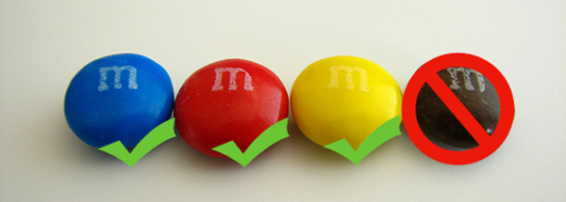
Seriously, Words Matter
Notes:
Perhaps the most famous contract in rock history is Van Halen’s 1982 World Tour rider.
It contains the legendary requirement that the band be provided with a bowl of M&M’s in the dressing room, with all brown M&M’s removed from the bowl. Actually, the rider states, on the topic of Munchies: M&M’s (WARNING: ABSOLUTELY NO BROWN ONES)
Until recently, the famous Brown M&M’s rider seemed nothing more than an example of the frivolity of the rock star ego. But, there is a business reason for the M&M's clause of the rider. Apparently, beyond the backstage food and drink requirements, tour riders contain very important instructions that affect how smoothly the show will run -- for example, electricity or weight requirements for the band’s gear. Well, if the promoter at the local venue does not read the rider, it is likely that something will go very wrong at the show. So, Van Halen used the M&M’s for signaling purposes: if there were no brown M&M’s in the bowl, the band knew that the local promoter read the rider. If the brown M&M’s were there, the band knew that the local promoter had not read the rider carefully, and technical and safety requirements might not have been met.
NEXT SLIDE

Slide 72
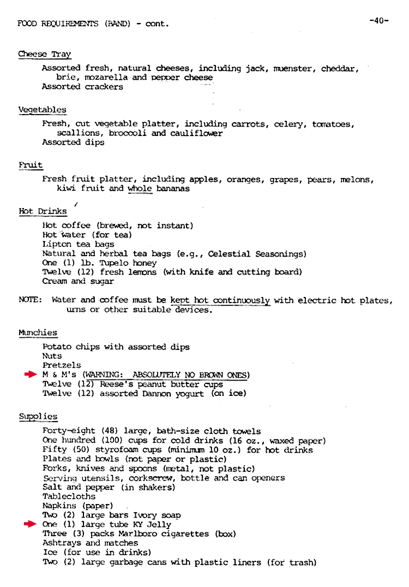
Notes:
Now, it was Van Halen … ah, the stories their lawyers could tell.

Slide 73
Contract Negotiations
Strategies & Tips for Negotiating Contractual Damage Provisions

Slide 74

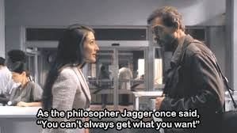
Professor Jagger Had it Right
Notes:
Okay … too much television. Here – in the pilot episode of House, Dr. Lisa Cuddy is trying to negotiate with Dr. Gregory House to get him to perform his clinic hours. House, of course, informs Cuddy that “You can’t always get what you want.”
Later on, however, Dr. Cuddy – after some research – notes that, while true, you can’t always get what you want, “but if you try sometime, you find
You get what you need.”
It’s the same with contracts. You have to try.

Slide 75

Have A Plan
Know your goals
Structure the negotiations
Be proactive
Notes:
Do not just be a tumbleweed in the wind.
BEFORE you start negotiations, develop a plan to done
Your counterparty likely has a plan. After all, this is about business, money, risk.

Slide 76

Value for Effort
Focus negotiating effort where you can move the dial:
  Money
  Risk
Don’t over buy
Notes:
Focus:
Understand the major inherent risks of the transaction and negotiate express provisions for the types and amount of damages that are likely to occur.
Over-buy:
Don’t give up meaningful contract rights to get a liquidated damages provision that you are unlikely to utilize.

Slide 77
What Do We Mean By Risk?
What could go wrong?
How likely is this to happen?
What are the consequences?
  For you?
  For the vendor?
What can be done to reduce the frequency or consequences?
Tools:
  Use formal assessment to document your anticipated risks
  Risk is dynamic! update your assessment regularly
Notes:
High frequency with low consequences can still be high risk
Low frequency with High or catastrophic consequences can still be high risk

Slide 78

Key Questions
What damages does your party think it should be able to recover to make it whole if the counterparty breaches the contract?
What damages does your party think it should be obligated to pay if it breaches the contract?
Notes:
As a contract manager, there are key questions you should consider on behalf of your customer.
You and your customer need to think through these questions BEFORE you start negotiating

Slide 79
Process Matters
Don’t just ‘split the difference’
Agreements should be purposeful
Have a discussion
Notes:
Splitting the difference:
Instead, think about the right result
What was the provision at issue designed to accomplish?
Difference splitting diverts focus and incents bad behavior
Purposeful Agreements:
The deal isn’t just a series of compromises. Sure, that get’s you to done. But, is this the deal you need or want?
Discussion
Actually talk to your counterparty
Avoid battle of email drafts
Understand the issue

Slide 80
Mutuality Myth
Just because a clause applies to both sides, does NOT mean that it is fair or appropriate – e.g.,
  Indemnification
  Mutual waiver of consequential damages
  Force majeure

Slide 81
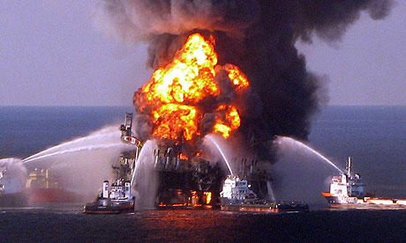
Why Limit Damages?
To manage deal risk
Revenue recognition
Notes:
Things can go wrong (BP Deepwater Horizon)
This is the seller’s perspective – they don’t want to hand out signed, blank checks. That’s bad for their business.

Slide 82
Damage Limitation Should Make Sense
In a sales transaction
  Seller’s principal risk is that the buyer will not pay the purchase price of the goods
  Buyer’s risk is that it may lose profit on an expected resale or suffer loss of goodwill if it resells a defective product
Mutual waiver of consequential damages – in most instances – only benefits the seller
Mutual waiver may not be appropriate
  Parties’ damages may be very different
Notes:
Buyer’s risk: May not have needed goods/services (could be critical)
Mutual waiver of consequential damages only benefits the seller. That is why such a provision is included in so many limited warranties.
Not just ‘boilerplate’
Contract clauses regarding consequential damages are not just ‘useless boilerplate’ but have real consequences.

Slide 83
Contract Drafting
Strategies and Tips for Drafting Contractual Damage Provisions

Slide 84

Negotiate the Deal First
Before you start drafting the agreement, negotiate the deal
Consider -
  Using a term sheet
  Using a letter of intent
Notes:
This problem happens far too often. People do not have a meeting of the minds on the deal points for which the contract is being drafted.
End up blindly swapping contract drafts which create the deal points.
Negotiate as many of the deal points as possible before you start drafting the agreement.
If the person drafting the agreement was not involved in the negotiations, explain the deal to the person so that it is possible to draft an accurate agreement.
Term sheets reduce the risk of getting pencil whipped by attorneys - or senior business folks.
If using a Letter of Intent, include a Pennzoil Clause – i.e., no deal until you have a deal.

Slide 85
Best Practices
Plan ahead
  Is breach likely?
  What are the likely consequences of breach?
Choose the right tool(s)
  Damage provision
  Damage limitation
  Damage cap
  Liquidated damages
  Third party determination
  Reps & warranties
Hedge risk
  Insurance
  Bonding
  Split contracts
Notes:
Insurance – e.g., contract to purchase cargo vessel
Split contracts: This fall under ‘what would grandma do?’ – She would not put all of her eggs in one basket if this was a mission critical contract.

Slide 86
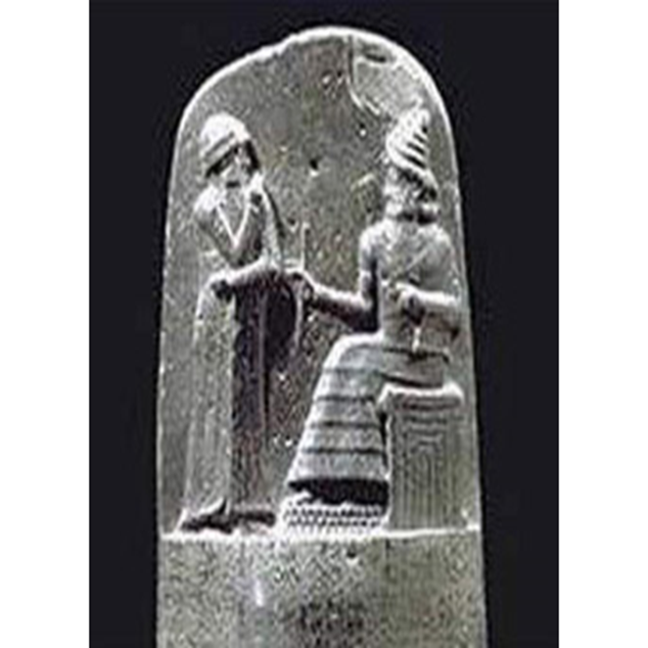
Include ‘Intermediate Remedies’
Steps short of termination:
  Delay credits
  Performance Incentives
  Payment holdbacks
Notes:
Delay credits are a reduction in payments for deliverables or milestones not delivered on time by the vendor (usually expressed in $/day). Best practice is to structure contract so that vendor can “ern back” delay credits by bringing contract back on schedule by the next milestone. Delay credits can be a type of liquidated damages (if not earned back)

Slide 87
Beware of Embedded Limitations
Examples
  Warranty clauses and limitations
  Dispute resolution clause
  Definition
Notes:
Embedded limitations are found elsewhere in the contract.
Typical warranty limitation: Repair, replace, or refund

Slide 88
Variables
The contractual damages provision(s) should depend on:
  Goals and objectives of the parties
  Risk/return perspective
  Relative bargaining power (negotiating leverage)
  Market conditions
  Type of agreement
  Particular circumstances
Notes:
The provision – generally speaking – should not just be what you saw in the last agreement. They may not have known what they were doing.

Slide 89
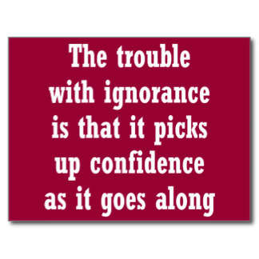
Things to Avoid
Ignorance
  Don’t ignore the issue
  Understand the deal
  Understand how and why the agreement allocates risk and reward
Formatting Fever
  Don’t just ‘cut and paste’ the ‘legal stuff’
Notes:
DO NOT, however, avoid taking time to understand the deal
Sink your teeth into the deal.

Slide 90
Form Agreements
Can be helpful
But … don’t let a form substitute for thought
  Form may be poorly crafted
  Form may not be current with case law, prevailing custom, marketplace
Consider whether the form really is the right tool for the particular transaction
Avoid the other side’s “standard” terms
Notes:
Standard Terms: There rarely, if ever, are Standard Terms. If there were, we’d need a lot fewer lawyers. Rather, this code phrase often is used to try to gain the moral high ground in negotiations – e.g., these are standard industry terms … you must be pretty unreasonable to have a problem with this.

Slide 91
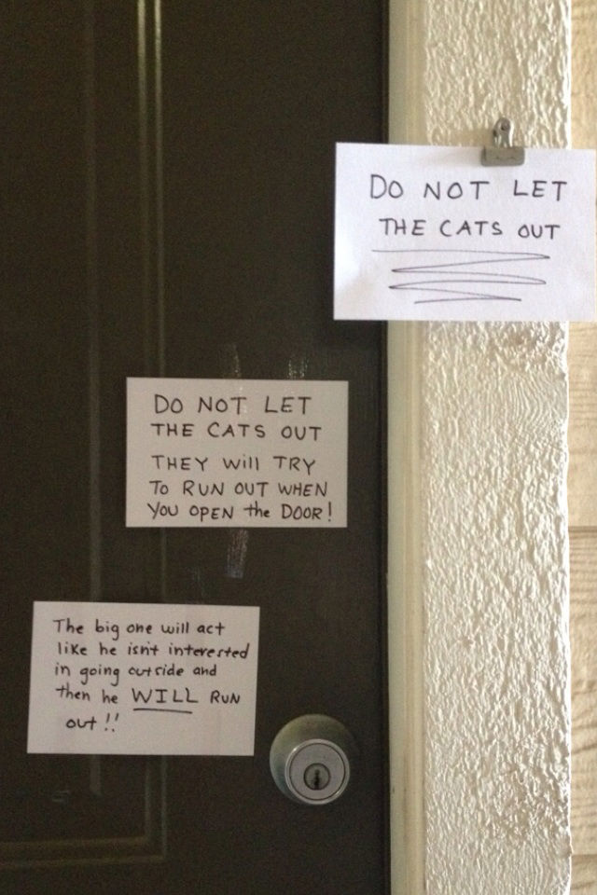
Drafting
Be clear & precise
Notes:
Clear & Precise: If necessary, use an example or a formula
Think about the appropriate or desired damages (and risks) pertaining to the transaction
The contract is your opportunity to create a plan for success … even if bad things happen … especially if bad things happen.

Slide 92
Default & Remedies
Define what will constitute default under the agreement
  Be specific
Notice requirement?
Cure period?
Specify remedies available to non-defaulting party
Notes:
Default: Omission or failure to perform a contractual duty
Notice & cure periods are important. If things are going bad, you want it corrected … quickly. Also, if this is going to end, you do not want to be a hostage.
Remedies: Consider liquidated damages. Note: Cannot be a penalty; must be a reasonable approximation of likely damages that are difficult to calculate.

Slide 93
Limiting Damages
Be very precise about what damages are being excluded
  Incidental?
  Consequential?
Is there a business basis to exclude certain categories of damages?
Notes:
Incidental damages are not the same as consequential damages

Slide 94
Precluding Consequential Damages
Example –
  Notwithstanding any provision to the contrary, neither party shall be responsible or held liable for any consequential losses or damages.
Why?
  Sellers wish to limit their risk.
What is being precluded?
  Far more than remote or speculative damages.
Notes:
Keep in mind, however, that contract damages do NOT compensate parties for losses that are remote. So, even without the limitation on damages, there is no liability for remote damages.
Better practice –
Notwithstanding any provision to the contrary, neither party shall be liable for breach of contract damages that the breaching party could not reasonably have foreseen on entry into this agreement.

Slide 95

Actual Damages
(True/False):
A provision specifying that only “actual” damages are recoverable limits recovery to direct or general damages.
Notes:
Next three slides –common misconceptions regarding contract damages
False. Actual damages include BOTH general and consequential damages.
Recovery would NOT be limited to just direct damages.
Drafters should keep in mind that consequential damages will not be waived under such a provision.

Slide 96
Lost Profits
(True/False):
Lost Profits are always consequential damages.
Notes:
False. This is a very common and dangerous misconception.
Although courts regularly find lost profits to constitute direct damages, lost profits can be considered consequential damages.
The important question is whether the lost profits would follow naturally and necessarily from a breach of the contract. If the profits would have been earned in the ordinary course of business and not just under special circumstances, they then are direct, not consequential.
Drafters should be wary of specifically excluding lost profits along with consequential damages in limitation-of-damages provisions, lest they unwittingly deprive a client of what would otherwise be recoverable direct damages (and possibly the only damages).

Slide 97
Liquidated Damages
Contract cannot just include a liquidated damages provision
  Include ONLY if damages meet the two-part test for liquidated damages
  Include a precise amount
Never refer to liquidated damages as a penalty
Notes:
Amount of liquidated damages: You can use a formula – e.g., $XX/day of delay

Slide 98
Contract Administration
Strategies & Tips for Administering Contracts When Breach and Damages Occurs

Slide 99
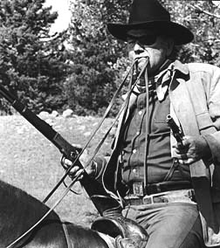
Declaring Breach
Contract breach can be okay
Who declares?
Options other than breach
Notes:
People are allowed to breach contracts. Just need to be prepared to face the music.
‘Efficient breach’ means that you are better off breaching the agreement (even if you pay damages).
Declaring breach is ‘bold talk.’
If they declare breach: Why?
If you declare breach (as buyer)
Chicken little issue
What type of breach – material?
Options other than breach
Talk
Read the contract – what does it say?
Notice & cure
Suspension

Slide 100
What to Do When Breach Occurs
Develop a strategy for resolution
  Enforce agreement
  Modify agreement
  Do nothing
Action Plan
  Act promptly
  Provide notice
  Mitigate damages
  Think end game
Contact your attorney
Notes:
This depends on whether you breached – or you were the victim
Read the agreement - don’t just fly by the seat of your pants
Follow the contract's rules - e.g., written notice specifying nature of default.
Document the breach.
Don't pussyfoot around.
People seem to be quite reluctant to be "confrontational" with a supplier or customer.
If someone breaches, you need to be clear and speak plainly.
Oftentimes, the best strategy is to be strong and prompt in asserting that a breach has occurred and state that something has to be done quickly – but remain flexible on what should be done.
Neglect seldom is benign and oftentimes makes problems worse.
End Game: Keep in mind, however, that you cannot get blood out of a turnip.
You want the best reasonable response the other side can deliver – even if it falls short of what the parties originally agreed.

Slide 101
What You Must Do
Mitigate damages. Avoidable damages are not recoverable.
  Westland Construction Co. v. Christ Berg, Inc., 35 Wn. 2d 824 (1950)
Comply with contract – e.g.,
  Notice
  Dispute resolution

Slide 102
Takeaway Messages

Slide 103
Remember
Contracts are business tools
Plan ahead
Be prepared
Know your limits
Notes:
Agreements are business tools:
Not a creative writing class
Not a bickering session
Plan ahead
Before contracting
Think about the deal
Think about exit strategy
Be prepared/Avoid common problems
Avoid common problems
Understand contract damages
Minimize the opportunity to get pencil whipped
Know your limits
Get expert help – business, accounting, insurance, legal

Slide 104
Additional Resources

Slide 105
Terms: Damages
Term | AKA | Examples
Compensatory Damages | Actual Damages Direct Damages | Direct losses & costs
Consequential Damages | Indirect Damages | Lost profits Lost use Damage to business reputation
Incidental Damages |  | Any reasonable expenses incident to the breach
Nominal Damages | Symbolic Damages | $1
Punitive Damages | Exemplary Damages
Liquidated Damages | Stipulated Damages Agreed Damages | $100/day of delay
Notes:
Kinds of compensatory damages:
Compensatory Damages (actual) damages: Includes BOTH general and special damages.
Consequential & Incidental Damages go BEYOND compensatory damages. These are incurred by nonbreaching party after the breach.

Slide 106
Thank You

Slide 107


