Slide 1

Socio-Economic Jenga Panel
Presented by Servando Patlan, Steve Krueger, and Cheryl Shaw

Slide 2

Socio-Economic Jenga
Business Diversity
Presented by Servando Patlán
Business Diversity & Outreach Manager
Email servando.patlan@des.wa.gov
November 2015

Slide 3
Balancing Socio-economic goals in public procurement or public works
Economic Equity
State Anti-discrimination Law
Federal Equal Rights Law
For Certified Diverse Businesses
WA State Minority Owned, Woman Owned, Veteran Owned, Small - Mini – Micro
Federal DBE, 8a, Hub Zones
Diverse Business Assistance
WA State ORIA, OMWBE, DES, Commerce, Ethnic Commissions
WA State Agencies EEO Office or Business Diversity Offices
Federal US SBA, PTAC, SBDC, Commerce
Diverse Business Economic Value Add
Stronger state government business link to majority of businesses driving the Washington State Economy
Diverse Business Relationship Value Add
Improved synergy between Washington businesses and Washington State Government Programs where businesses assists the State and the State strengthens WA businesses & workers.

Slide 4
Moderator Questions for Business Diversity?
Why Business Diversity?
Why so many goals: federal goals, state goals, and agency goals?
What is the Governors Diversity Subcabinet about?
Is Business Diversity about counting certified firms or discrimination?
Where do I get help?
Notes:
Diverse business is future business
Small and Diverse business are the majority of the business in the state of Washington; including veteran owned, minority owned, and woman owned businesses
The state of Washington is home to many cutting edge emerging businesses
Goal 2:4.1a
Increase state agency and educational institution utilization of state-certified small businesses in public works and other contracting and procurement by 2017 to:
MBE goals – 10%
WBE goals – 6%
Small Business goals – 5% (Free)
Department of Veterans Affairs (DVA) goals – 5% (Free)
This Governor subcabinet is directed to develop a cohesive statewide strategy instead of relying on the agency-by-agency strategies of the past.
LEAN PDCA fits well with business diversity Present State – Future State – Gap Analysis – Problem Statement – Counter Measures See OMWBE Website for Diversity Subcabinet updates WEBS is a good monitoring tool and data source.

Slide 5
Socio-Economic Jenga
Sweatfree Purchasing
Presented by Steve Krueger
Procurement Policy & Protest Manager
Email steve.krueger@des.wa.gov
(360) 407-9400

Slide 6
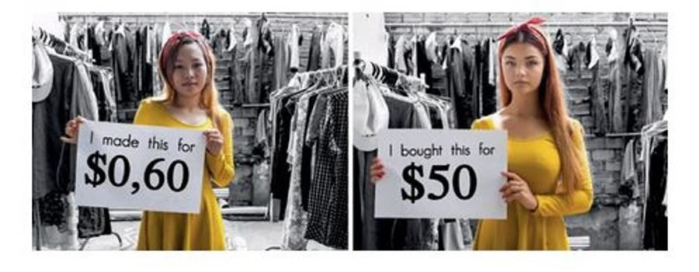
Fair Labor Practices

Slide 7
Moderator Questions for Sweatfree Purchasing?
Which commodities are most affected?
Can businesses that practice fair labor practices compete with sweatshops?
What kinds of abuses do workers face?
How can resellers know if the products they sell are produced by sweatshops?
How might sweatfree purchasing be incorporated into a bid?

Slide 8

Socio-Economic Jenga
Washington-Grown Food
Presented by Tricia Kovacs
Small Farm Direct Marketing & Farm to School
Email tkovacs@agr.wa.gov
(206) 256-6150

Slide 9
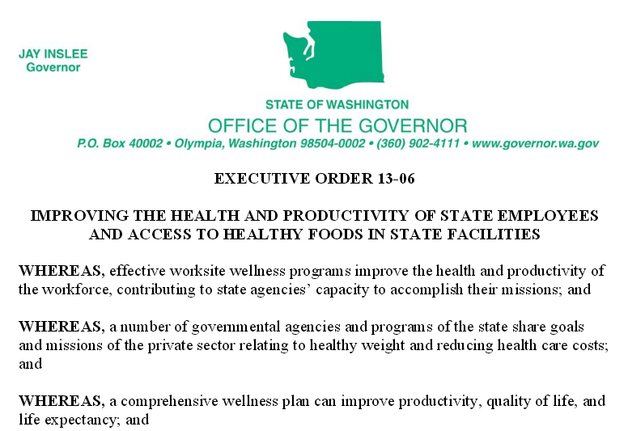
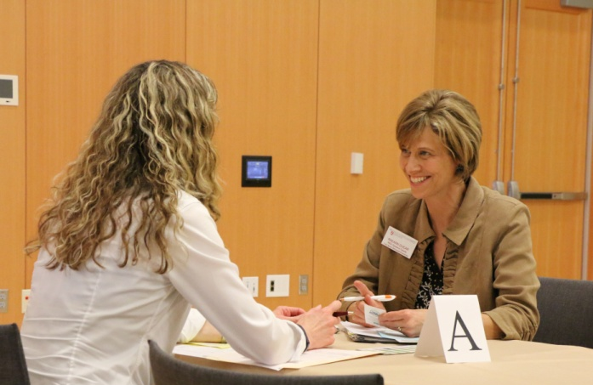

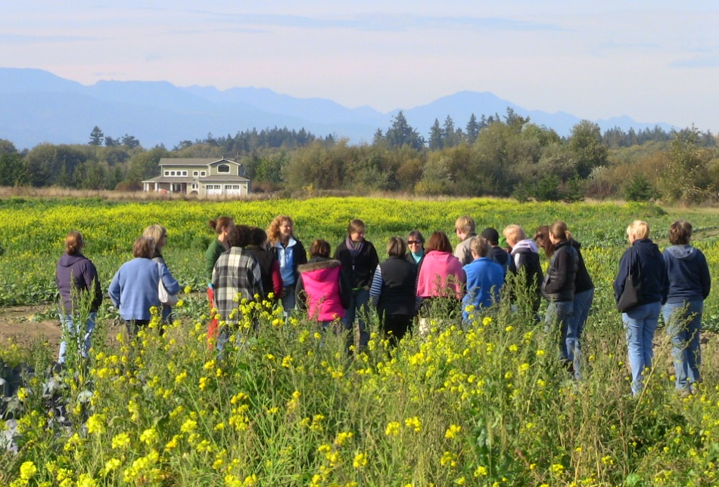
Public purchases to support Washington farms

Slide 10
Moderator Questions for Washington-Grown Food?
What rules apply to food purchasing when using state or federal funds?
How do we go about buying locally-grown food?
How will this affect our profitability?
How will this help farmers?
What other operational changes might be helpful to serve more locally-grown food?

Slide 11
Socio-Economic Jenga
Green Purchasing
Presented by Tina Simcich
Environmentally Preferable Purchasing Coordinator
www.ecy.wa.gov/swfa/epp
Email tina.simcich@ecy.wa.gov
(360) 407-7517

Slide 12
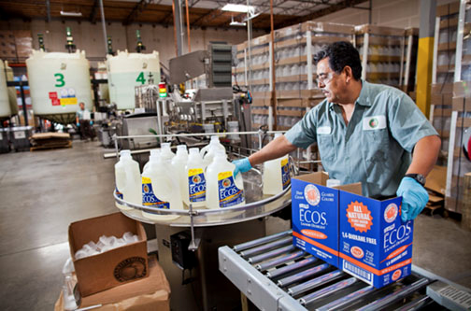
Green Innovation

Slide 13
Moderator Questions for Green Purchasing?
Don’t most green products cost more?
Are green products on state contract?
How can purchasers know if the products are ok for the environmental and human health?
How can my agency comply with the 2014 PCB legislation?
How can I incorporate green purchasing into my bid process?

Slide 14


