Slide 1
Washington State Procurement Risk Assessment - 2016
Presented by Drew Zavatsky
Location or Date

Slide 2
History
RCW 39.26, effective January 1, 2013 – why are we doing this? Reduced costs and risks – better service!
Initial (interim) delegations based on agency size & FTEs
Risk Assessment Pilot Project – diversity
-- large, medium, small agencies
-- also higher education and commissions
Departments of Transportation, Social and Health Services, Labor & Industries, Health, Enterprise Services, Health Care Authority, Parks, Board of Community & Technical Colleges, Early Learning, Auditor’s Office, Investment Board, Treasurer, Office of Minority and Women’s Business Enterprise, University of Washington, The Evergreen State College, Olympic Community College
Notes:
We’re here to help everyone become better stewards of public resources.

Slide 3
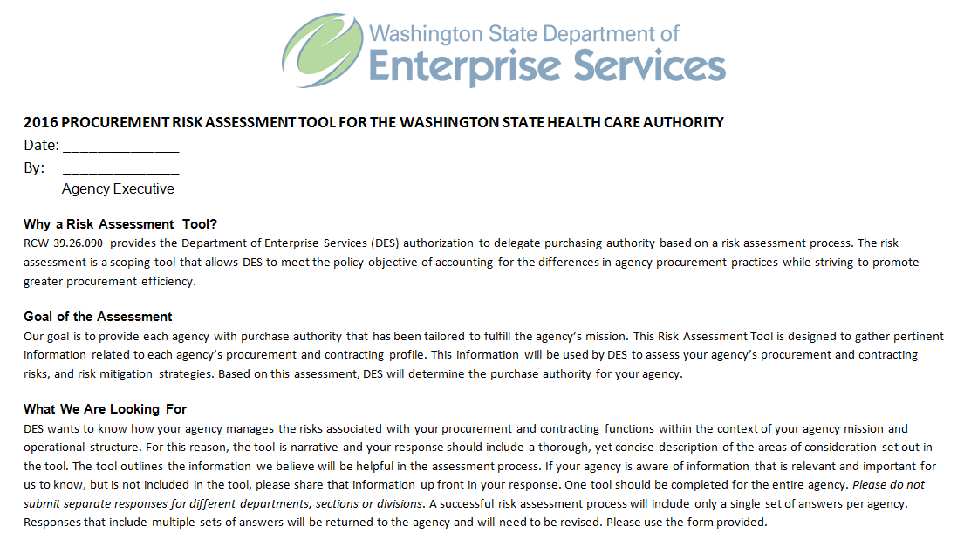
Assessment Tool
2014 Risk Assessment Tool
Good news, good ideas
Nearly 30 agencies gave feedback that we used to improve the new tool
Features of the 2016 Tool

Slide 4
Definitions of risk, mitigation, and residual risk
Carried over your responses from the 2014 Assessment
Completing the Tool much simpler!
 | Question | FY 2014 Response | FY 2016 Response
8. | Forecasting Please provide a copy of your agency’s 2016-2017 Procurement Plan. Describe how your agency forecasts its future procurement needs. Describe how your agency uses historic spend data to develop forecasts. Please provide the steps used to capture the data and to develop forecasts. | [PO-1] Procurements are jointly developed in partnership with the program staff and purchasing/contracting professionals. One of the first steps is assess need and once a contract is established, use an agency-wide system for monitoring performance and payment. Identify the appropriate procurement methodology, followed by the development of a procurement timeline. Standard forms and processes are then used and once a contract is established, use an agency-wide system for monitoring performance and payment. [PRN-1] Executive Management has become very experienced in "right-sizing" resource needs with anticipated acquisitions. Major projects are vetted with the Executive Leadership Team where resourcing needs are discussed and strategized. | ◻ No change from FY2014 response, because: ___________________________________ ◻ Describe the change: ___________________________________
OBJECTIVE: we need to know if your delegation is right-sized, so we are encouraging review of how you are managing the risks associated with your procurement process (including a description of how your personnel have changed)

Slide 5
Questions?
Drew Zavatsky
Risk Assessment Administrator
Contracts, Procurement & Risk Management
Enterprise Procurement Policy Group
Department of Enterprise Services
1500 Jefferson Street SE
Olympia, WA 98501

