Slide 1
WEBS: Queries, Reports, and Notifications
Presented by Rebecca Linville
WEBS System Administrator
November 2015
Location or Date

Slide 2
WEBS Queries
Notes:
Searching for vendors

Slide 3
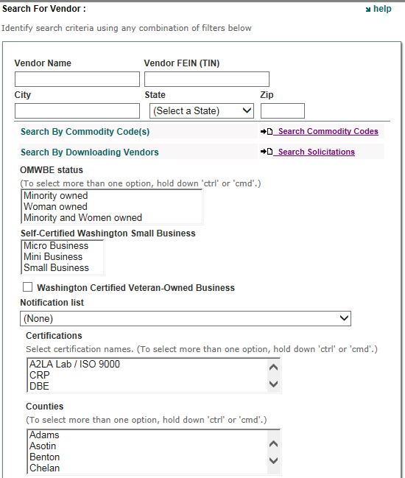
WEBS Queries

Slide 4
WEBS Queries

Slide 5
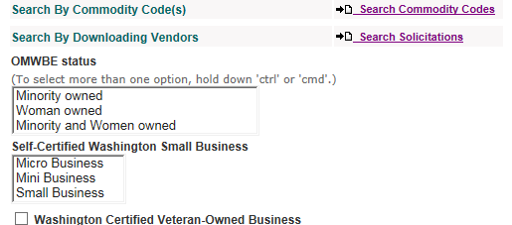
WEBS Queries

Slide 6
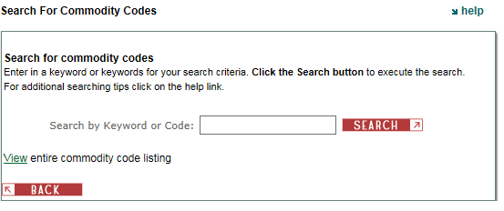
WEBS Queries

Slide 7
WEBS Queries
Roofing
Roofing Materials vs. “Roofing Materials”
643
643 679 428

Slide 8
WEBS Queries
Roofing and Materials
Roofing + Materials
643, 679, 428
643 and 679 and 428
Drop down categories by 3-level code

Slide 9
WEBS Queries

Slide 10
WEBS Queries
Ability to view selected commodity codes with the option to deselect

Slide 11
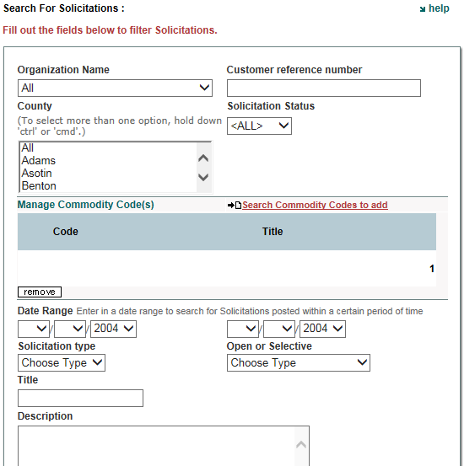
WEBS Queries

Slide 12
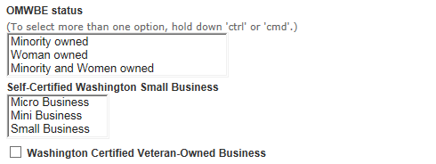
WEBS Queries

Slide 13
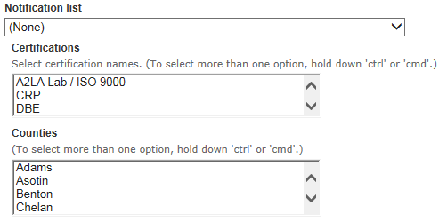
WEBS Queries

Slide 14
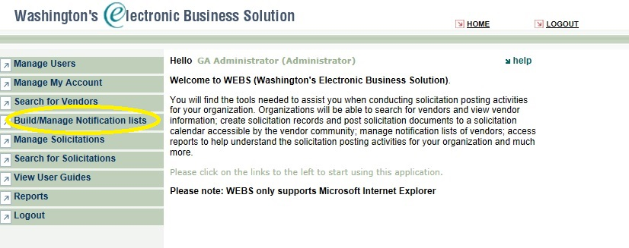
WEBS Notification Lists

Slide 15
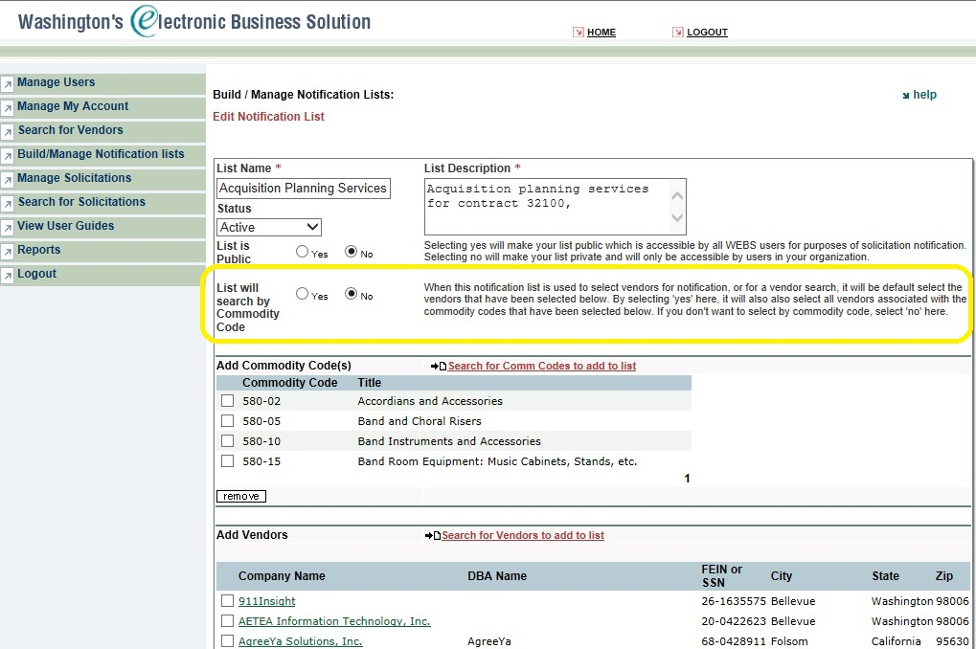
WEBS Notification Lists
Notes:
Once inside the Build/Manage Notification lists page, each notification list has a “List will search by Commodity Code” option.
If the “yes” option is selected, then when the list is chosen to add vendors to a solicitation, WEBS will add all vendors that are associated with commodity codes that are saved on that list. If the “no” option is selected, then at the time the list is chosen to add vendors to a solicitation, WEBS will only add those specific vendors that are saved on that list.
How this is practical for customers: If you normally selected vendors by commodity code, and there are a number of commodity codes that you regularly choose, you might save time by creating a notification list with all your usual commodity codes – then, when the time comes to select vendors, rather than entering all the codes in, you can select the notification list instead.
There is also the option to make the list public (next slide)

Slide 16
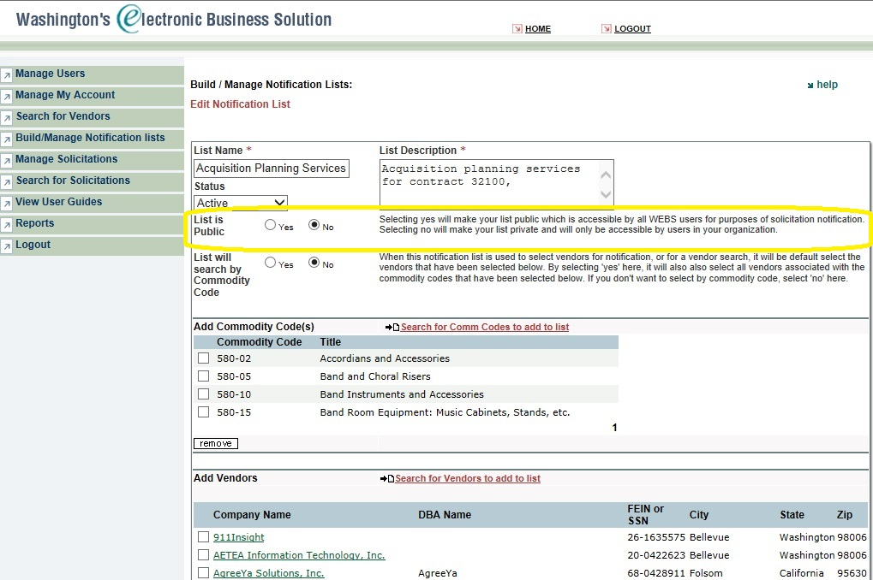
WEBS Notification Lists
Notes:
Lists selected to be public will be available for all WEBS users to view/use. However, they will not be able to modify the list. Only the creator of the list will be able to modify. Lists not made public will be only accessible by users in your organization.

Slide 17
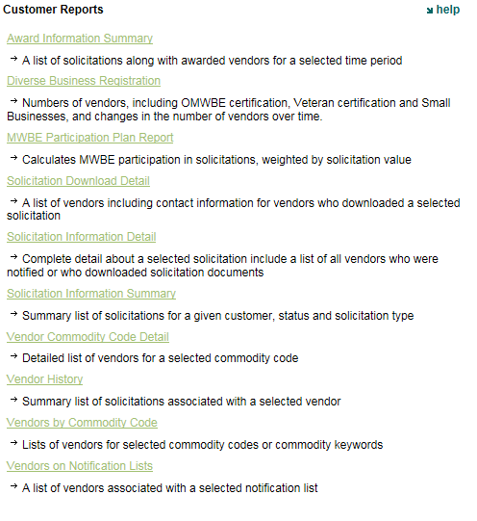
WEBS Reports

Slide 18
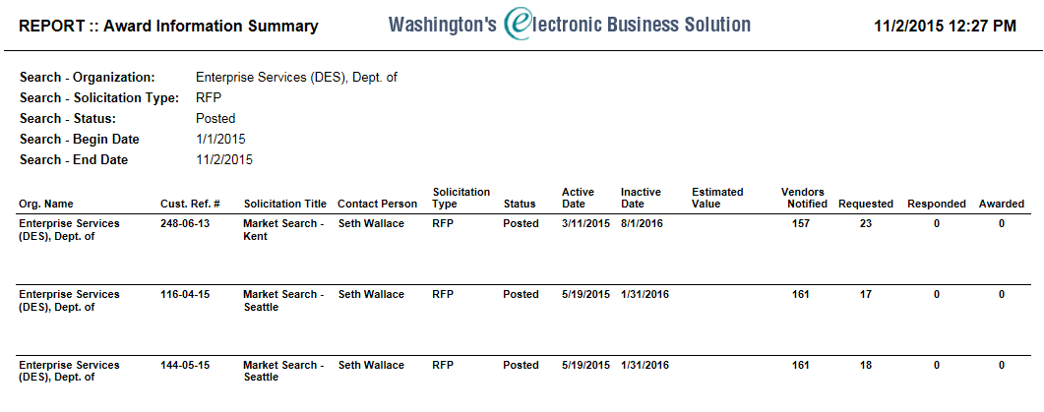
WEBS Reports

Slide 19
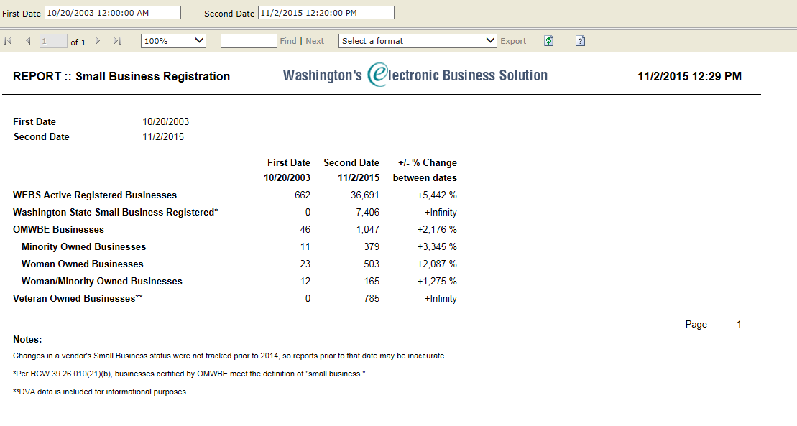
WEBS Reports

Slide 20
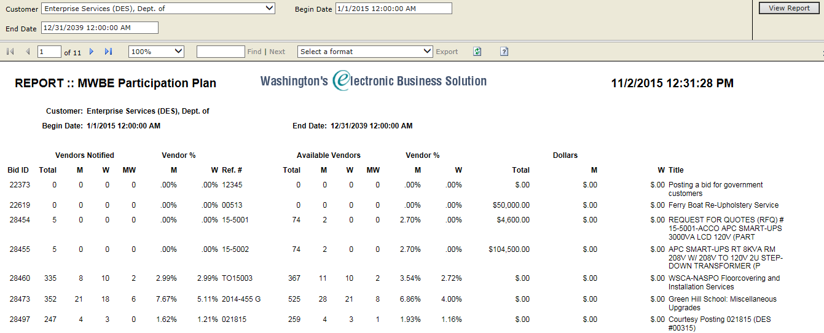
WEBS Reports

Slide 21
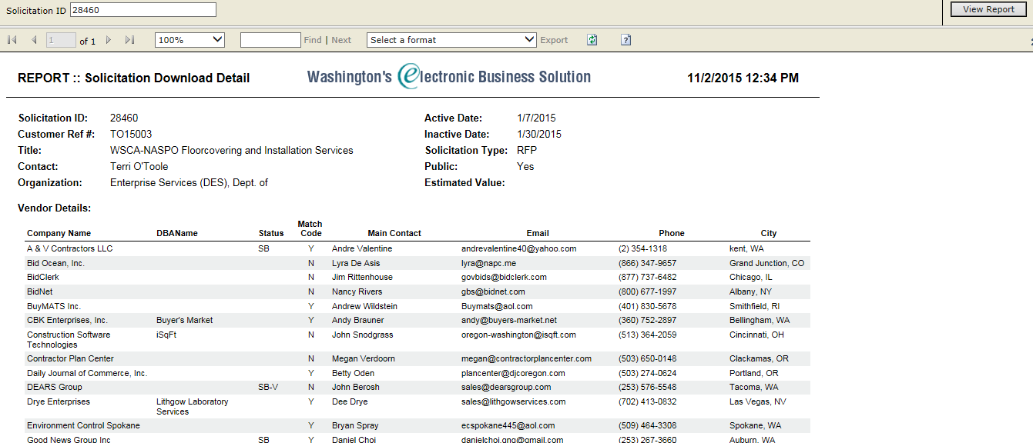
WEBS Reports

Slide 22
WEBS Reports

Slide 23
WEBS Reports

Slide 24
WEBS Reports

Slide 25
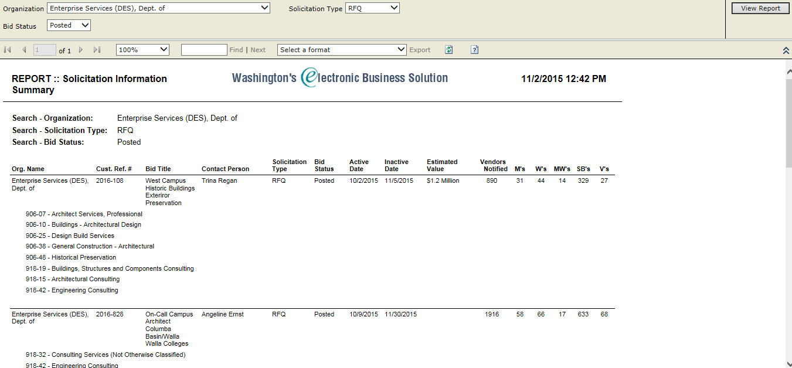
WEBS Reports

Slide 26
WEBS Reports

Slide 27
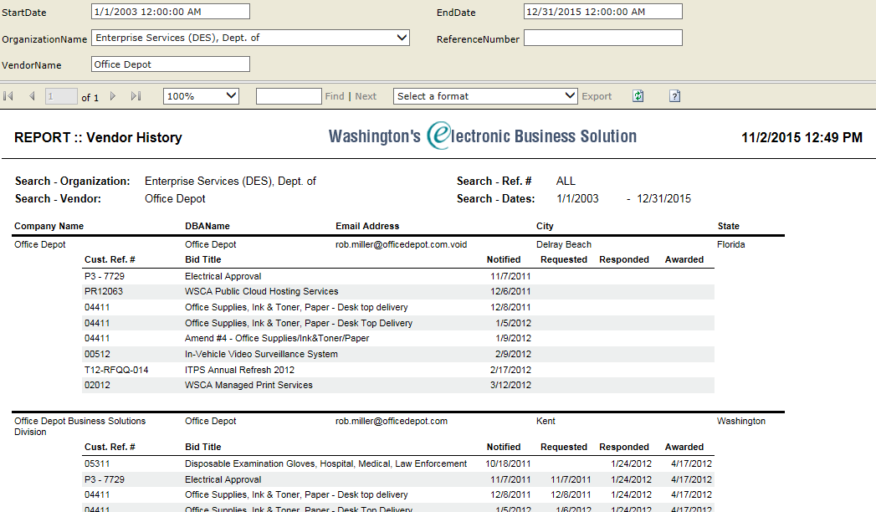
WEBS Reports

Slide 28
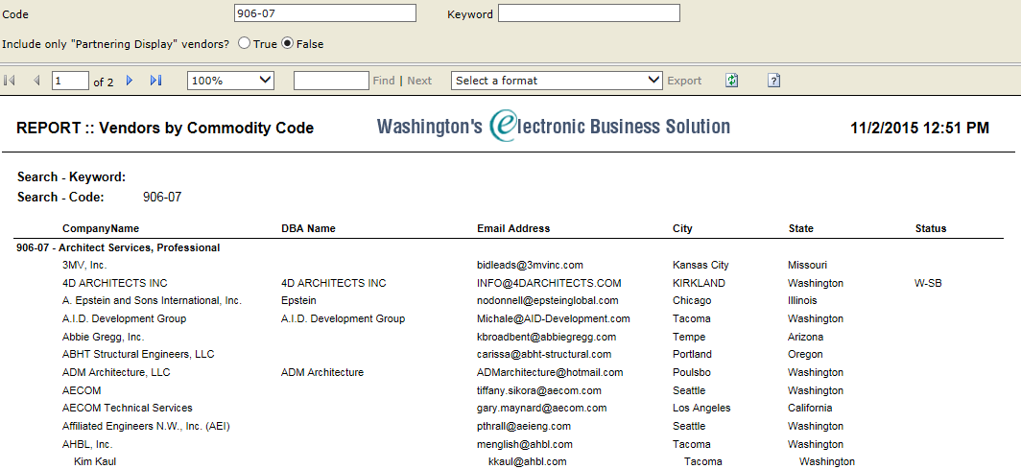
WEBS Reports

Slide 29
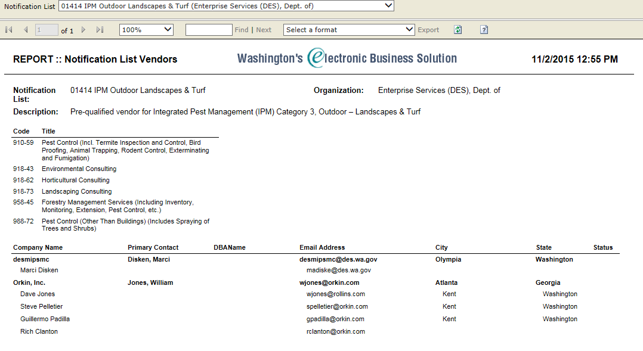
WEBS Reports

Slide 30
WEBS Queries, Reports and Notifications

