Slide 1
WEBS Vendor Training
Washington’s Electronic Business Solution

Slide 2
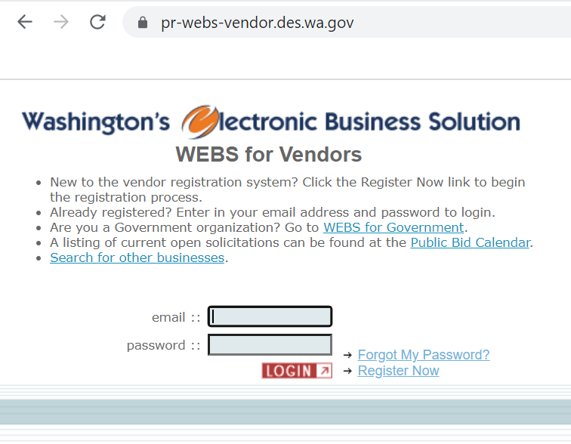
WEBS for
Vendors

Slide 3
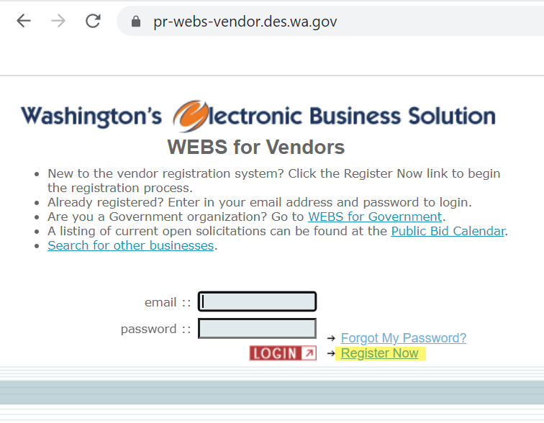
WEBS For Vendors
Registration
Importance
Agencies can post to more than WEBS, but RCW 39.26 requires agencies to post solicitations on WEBS.
Other entities (cities, counties) have their own system for posting solicitations, but many customers use WEBS as they know the RCW requires it.
Benefits vendors to be in WEBS because you will see all agency postings.

Slide 4
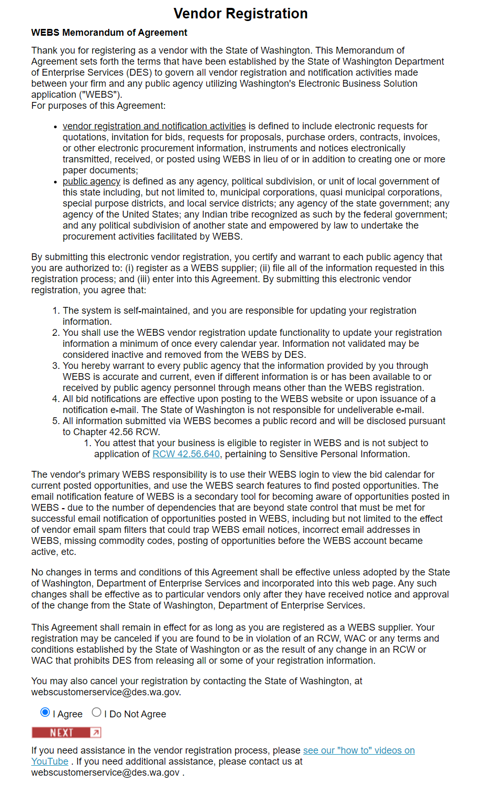



WEBS For Vendors
Registration
Defines
terms
Certify
authorization
Purpose

Slide 5
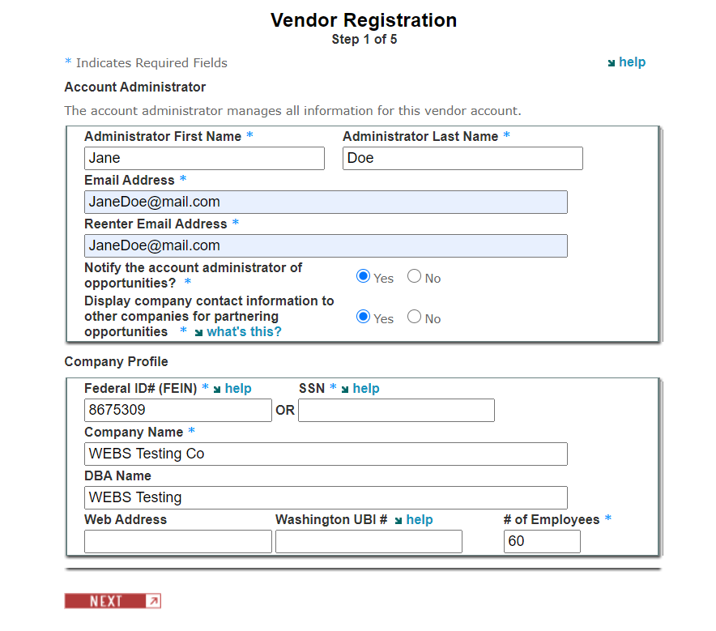
WEBS For Vendors
Registration step 1
Receive solicitation opportunities from customers based on commodity codes that match those selected in vendor account.
Benefit to share/display your information as it allows other vendors the ability to search and find and find you and is a way for subcontracting to occur.
Notes:
WEBS is a vendor managed system, the vendors have to maintain their accounts.
They receive notifications of solicitations opportunities from customers based on NIGP Codes
- NIGP Codes are a national code that we contract to use every 2 years, it is similar to NAICS codes, WEBS has a crosswalk to NIGP codes in WEBS. Vendors or customers can type NAICS codes when using the system and it will pull the appropriate NIGP Code
Email notifications are explained in the registration consent page. Some vendors turn off notifications and then claim they missed an opportunity. Email notifications are not the main form of getting the opportunity, we explain to vendors that they can search in webs for all solicitations posted.
When vendors register they have a button option to select whether or not they wish to share their information, we tell vendors it is a benefit to share their information as it allows other vendors the ability to search and find them. As a contracts specialist you will want to tell vendors this when you talk to them because we push for diversity, small, veteran, etc. and this is a way for subcontracting to occur.

Slide 6
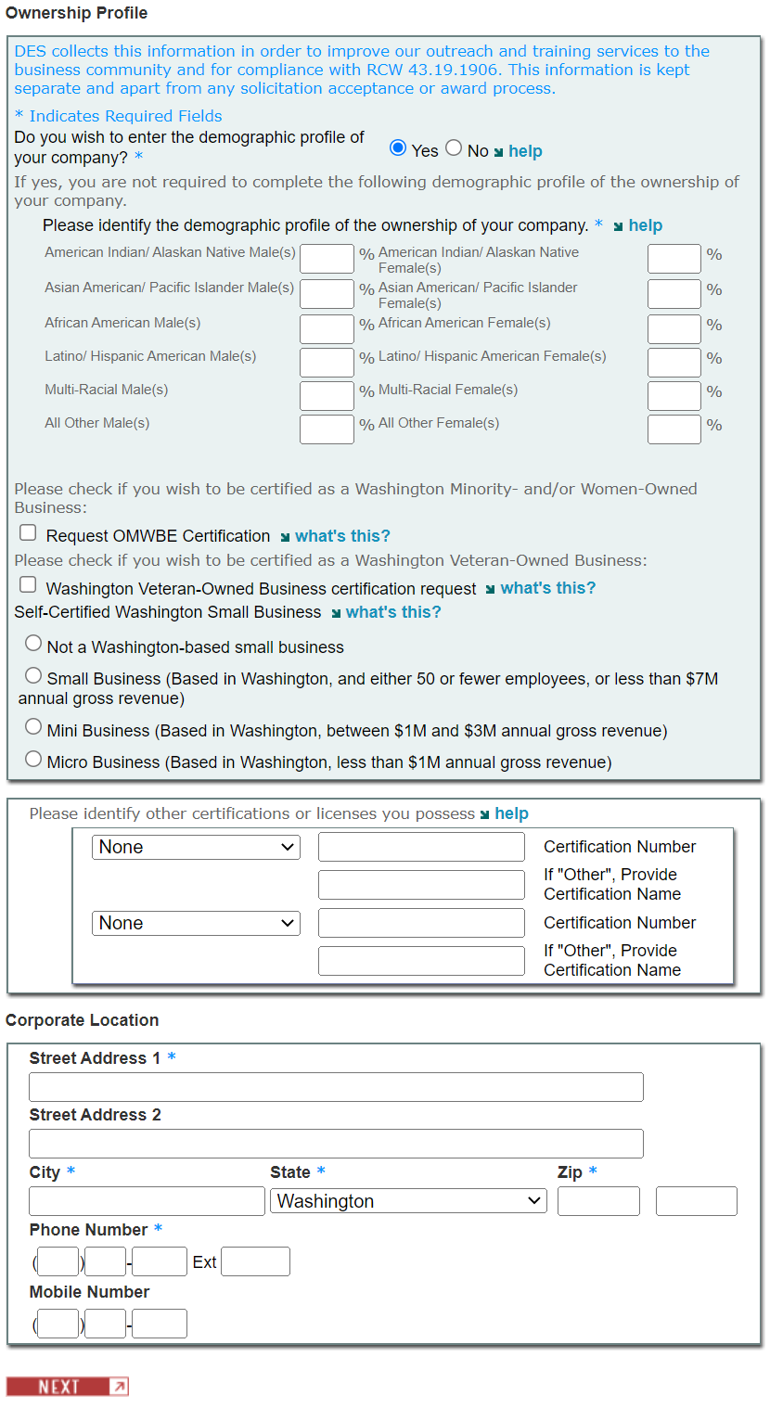
WEBS For Vendors
REGISTRATION STEP 2

Slide 7
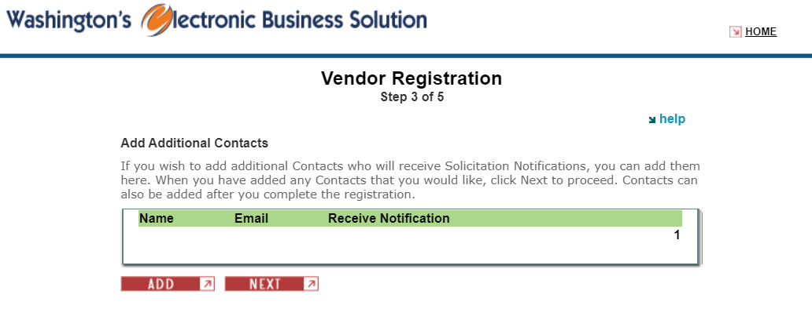
WEBS For Vendors
REGISTRATION STEP 3

Slide 8
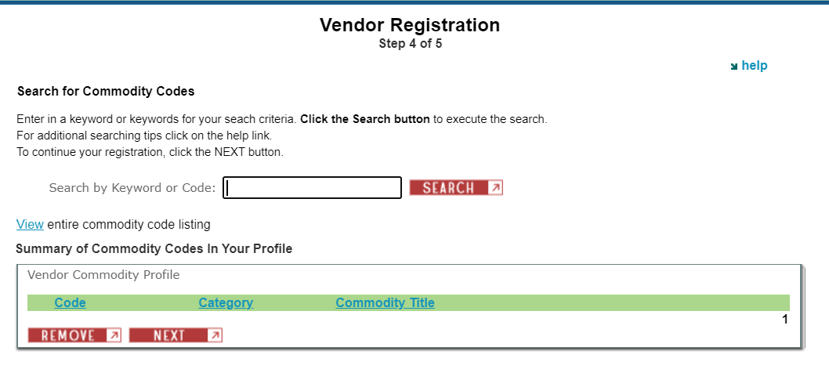
WEBS For Vendors
REGISTRATION STEP 4

Slide 9
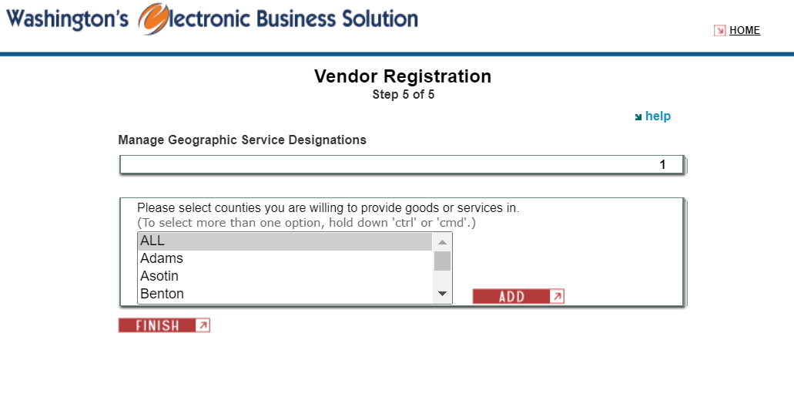
WEBS For Vendors
REGISTRATION STEP 5

Slide 10
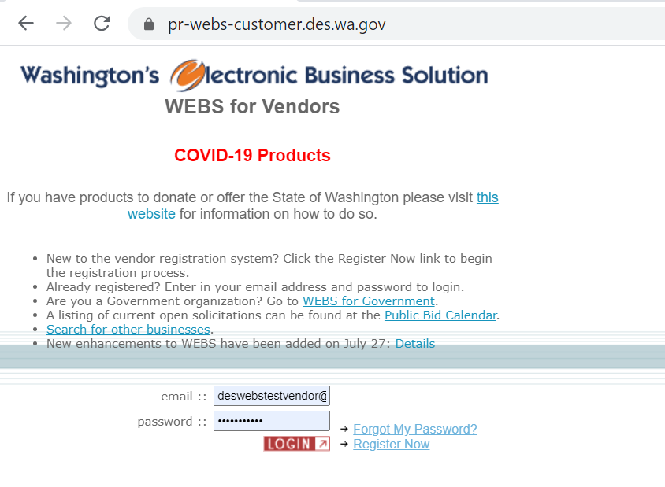
WEBS For Vendors
LOGIN PAGE

Slide 11
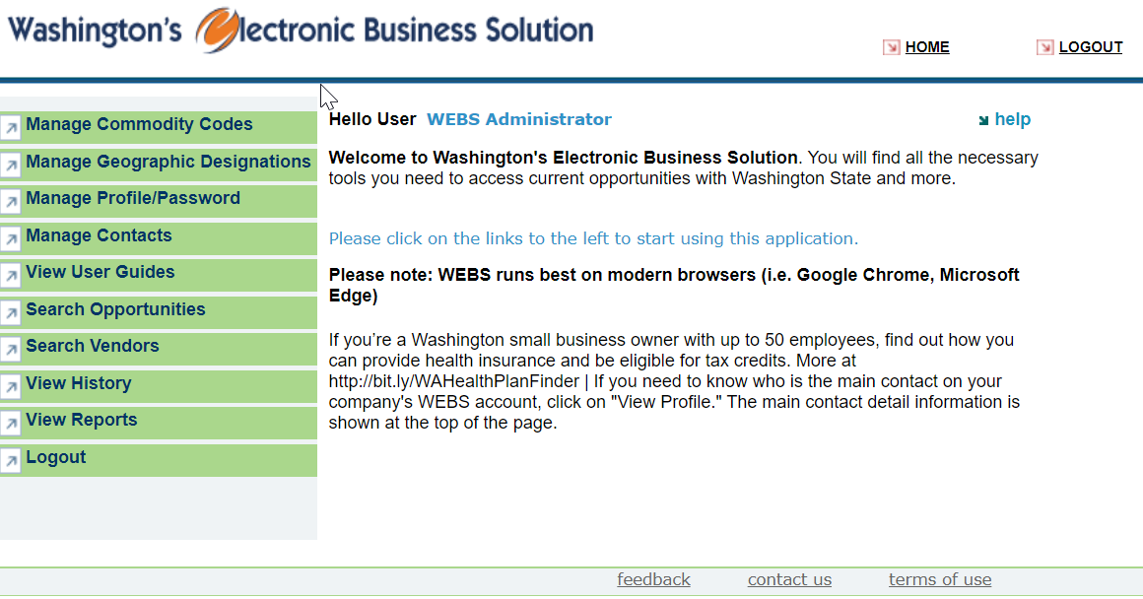
WEBS For Vendors
HOME PAGE

Slide 12
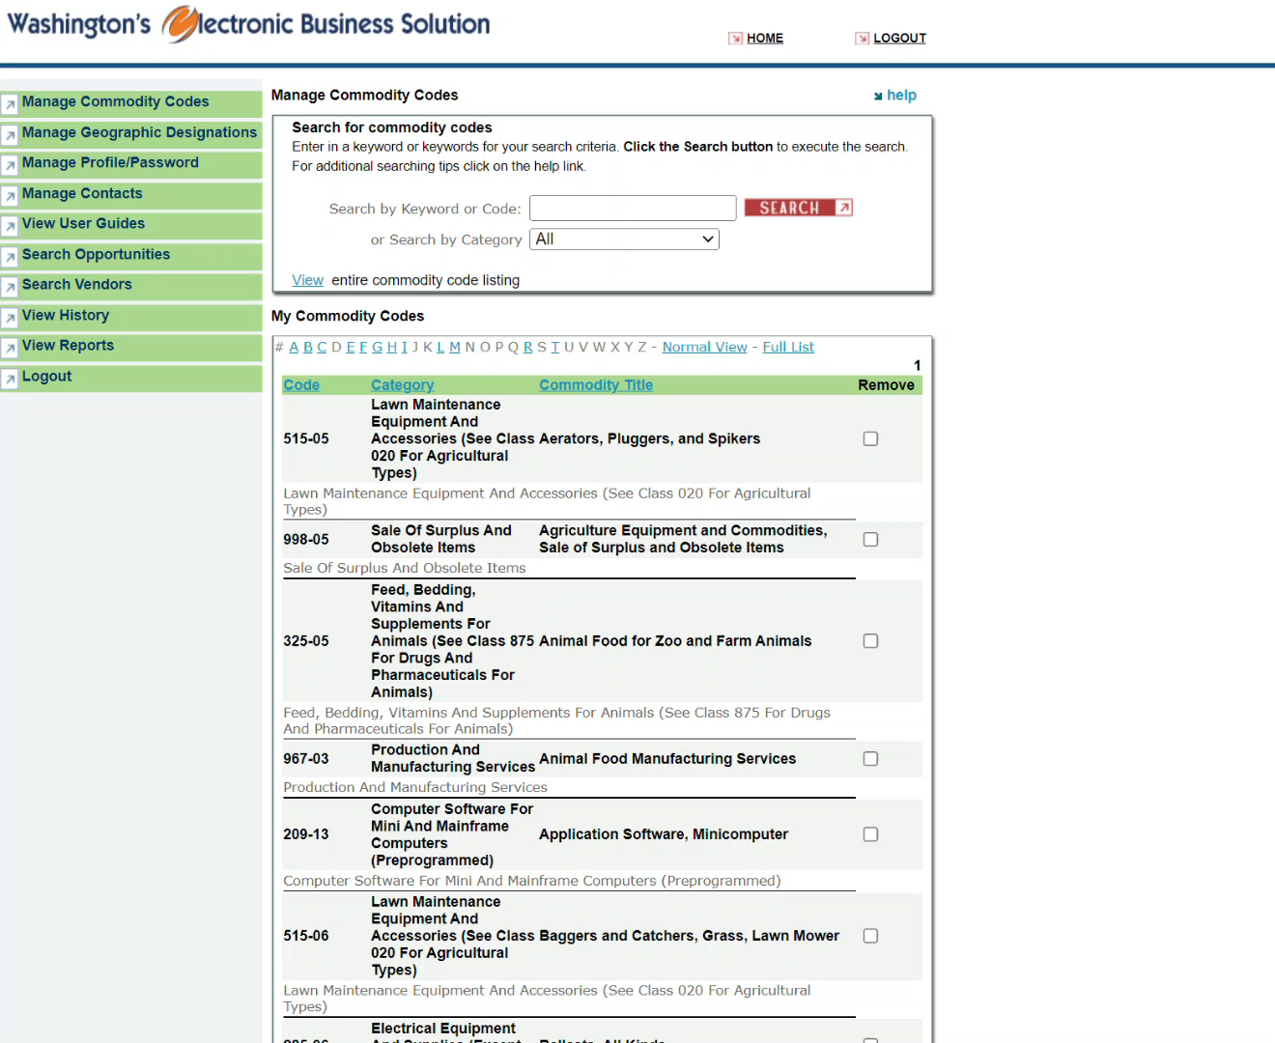
WEBS For Vendors
MANAGE COMMODITY CODES
Notes:
Click on “manage commodity codes” on the left-hand menu. Click in the Search by Keyword or Code box and type in a search criteria. In this example I type “janitorial” and then click Search. All of the codes that match your search criteria will appear after you click Search. Read through them and select which codes are relevant to you by click on the checkbox to the right of the code. Scroll back up and select the Add button to add the codes to your account.
You can also search by category, using the Search by Category box below the Search by Keyword or Code section, in which you can select a category from a drop-down menu. In this example, I’ve selected the Abrasives category from the list. Click Search and again, all of the codes that match your search criteria will appear after you click Search. If you would like to add all of the codes that appear to your account, select the Check All Codes checkbox at the top of the list and click Add.

Slide 13
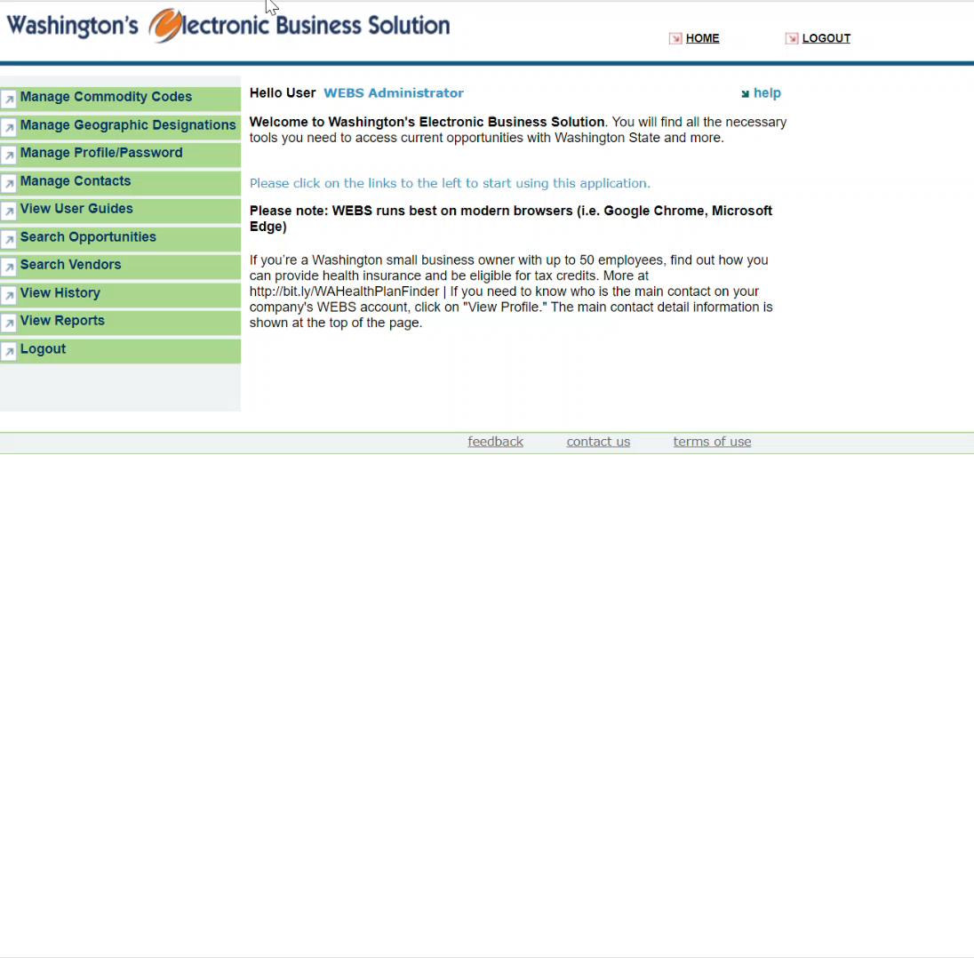
WEBS For vendors
MANAGE GEOGRAPHIC
DESIGNATIONS
Notes:
Click on “manage geographic designations” on the left-hand menu. A list of all counties your account has previously selected will appear. This is a list of counties that your company is able to provide goods/services in. You can click Remove to the right of the county name to remove that county from your account. Additionally, at the bottom of the list is a menu of all the non-selected counties. Click on a county (or press ctrl + click on more than one to select more than one at the same time) and press the Add button to add these counties to your account.

Slide 14
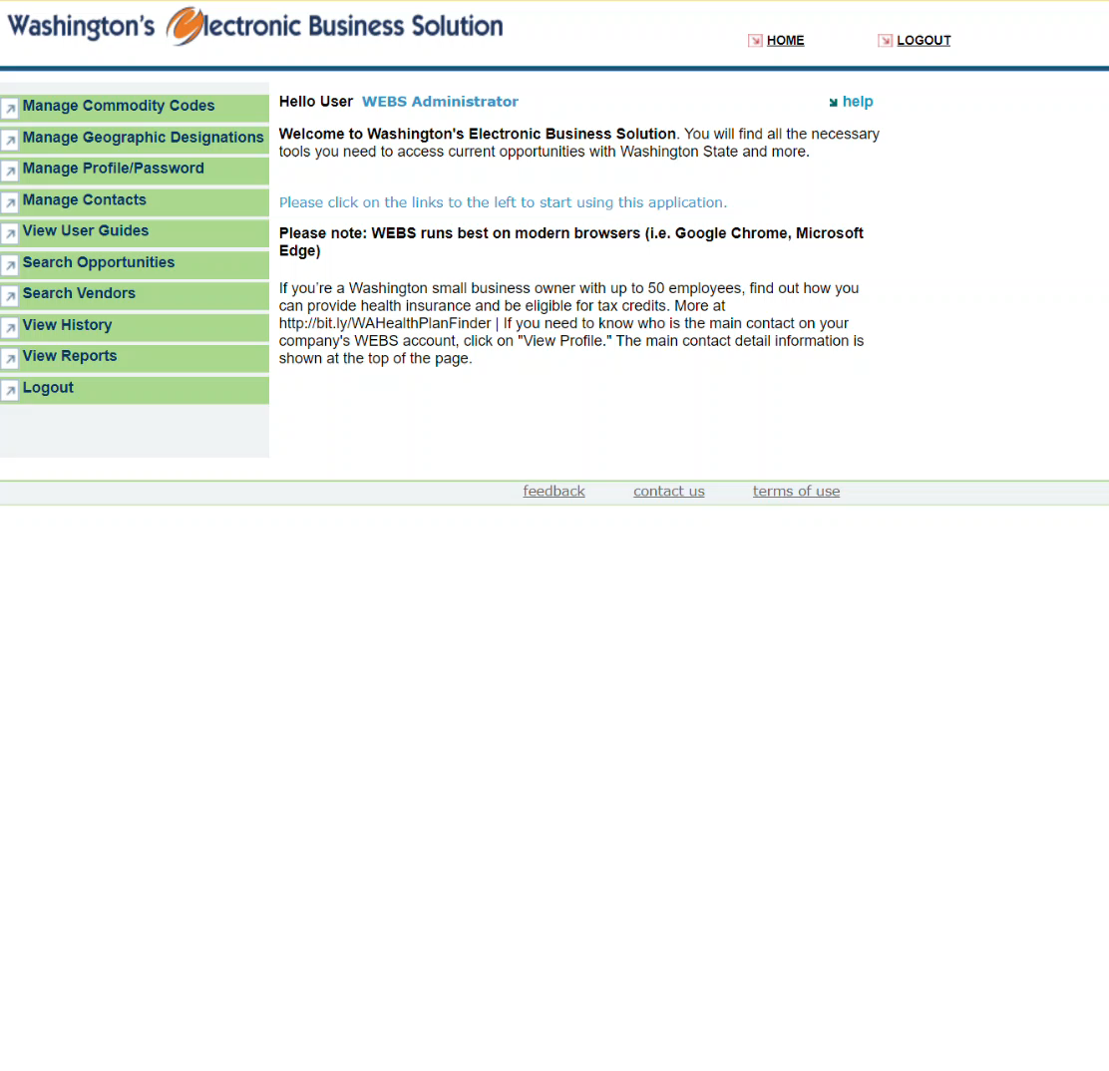
WEBS For vendors
MANAGE PROFILE/PASSWORD
Notes:
Click on “manage profile/password” on the left-hand menu. Your account information will appear, such as administrator name, email, option to receive notifications, option to display your company information, registration date, federal identification number, company name, ownership profile information, and corporate location. To change any information, click the red Make Changes to Profile button on the top right of the screen. Edit any information necessary and then scroll to the bottom and click Save to save your changes.

Slide 15
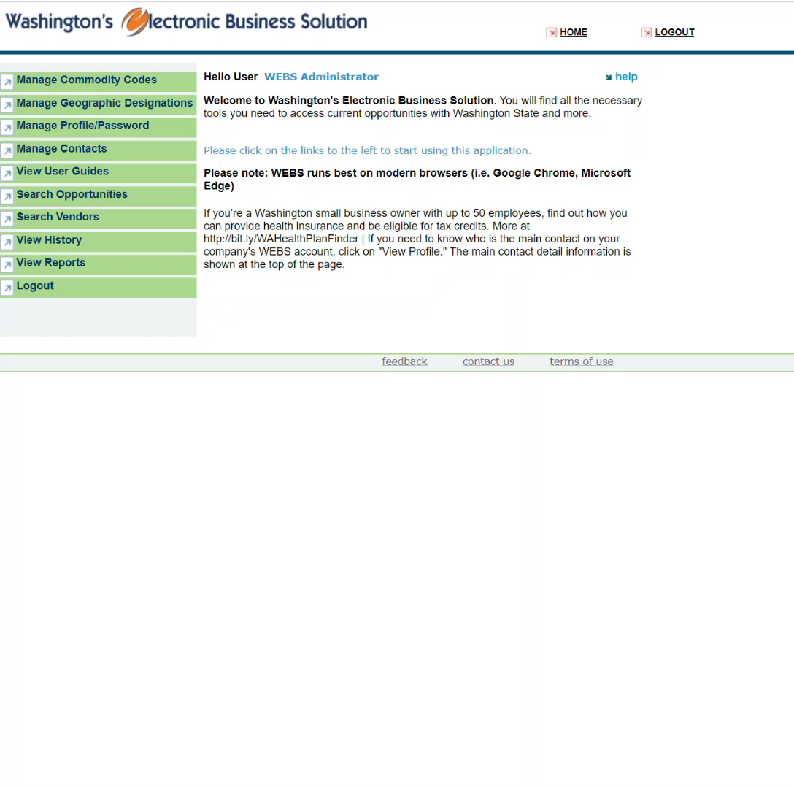
WEBS For vendors
MANAGE CONTACTS
Notes:
Click on “manage contacts” on the left-hand menu. A list of current additional contacts will appear, including their name, email, and if they are receiving notifications or not. You can edit the contact information by clicking Edit. If you make any changes, click Save at the bottom of the page to save changes. You can also remove the contact by clicking the Remove button to the right of the contact info. You can also add more contacts by clicking the Add button below the current contacts.

Slide 16
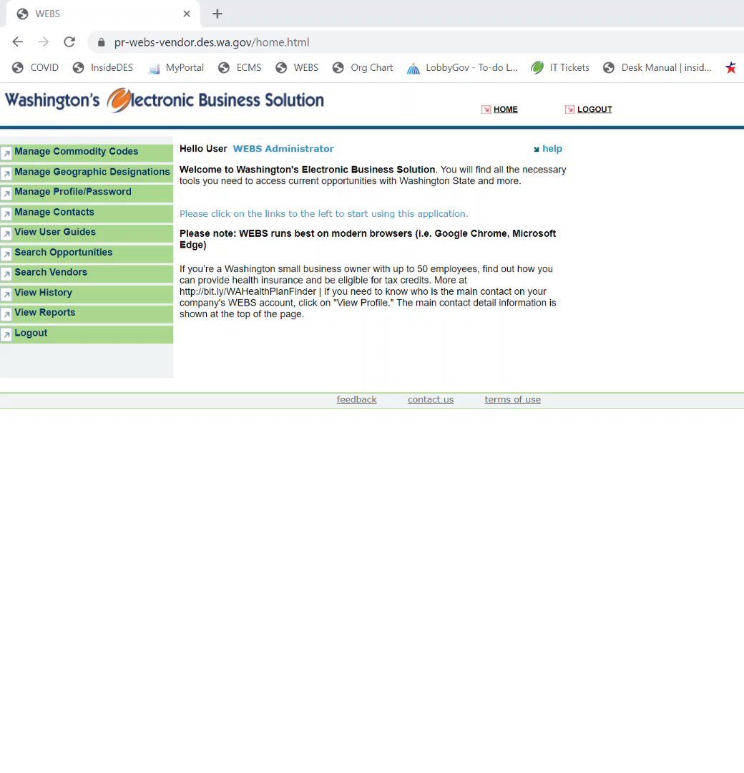
WEBS For vendors
VIEW USER GUIDES
Notes:
Click on “View User Guides” on the left-hand menu. A list of documents will appear: WEBS handouts, NIGP Commodity Codes, WEBS Manual – for Government Customers, and WEBS Manual – for Vendors. To the right of the form name, you can see when it was Last Updated. To the right of Last Updated, you can download the document by clicking the download button.
The NIGP Commodity Codes form, when downloaded, displays an entire list in Excel of codes, their title, category, and keywords. You can use this document as another option to search for what commodity codes you should select in your WEBS account.
The WEBS manual for vendors, when downloaded, is a step-by-step document that explains how to register and navigate the vendor account.

Slide 17
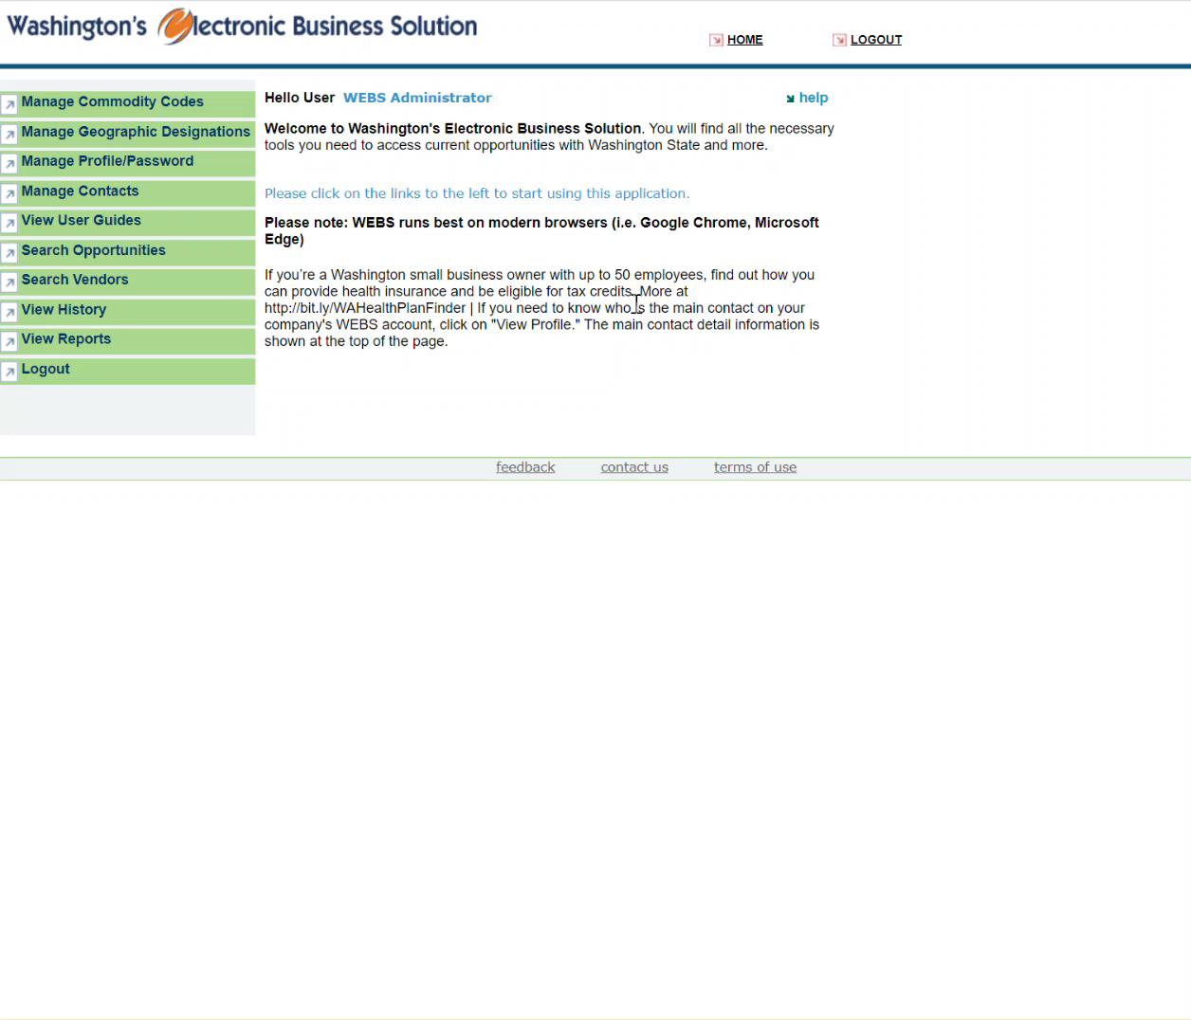
WEBS For vendors
SEARCH OPPORTUNITIES
Notes:
Click on “search opportunities” on the left-hand menu. This tab allows you to search for current opportunities posted to WEBS. A page will appear that allows you to select the option to search by your account’s commodity codes/counties, or all commodity codes/counties. Below that, you can select/filter for a specific government organization by using a dropdown menu (otherwise it defaults to all). Below that is a search box where you can type in a keyword, for a keyword search. Click on the search button located at the bottom of the section.
This displays a list of current opportunities with your search criteria. There are 5 columns: title, organization, organization contact, reference number, and date posted. You can click in the first column on the title to view more information about the opportunity such as: organization name, title of opportunity, description of opportunity, date open and closed, contact name, contact email, contact phone number, commodity codes and counties, and any attached documents/amendments.
If you click back to the search opportunities menu option, you can also use an advanced search button which will pull up a page where you can search by organization name, keyword, county, solicitation status, date range, and/or solicitation type. Press the search button at the bottom of the section. The same 5 columns as described above will appear, but for older/archived opportunities instead of current opportunities.

Slide 18
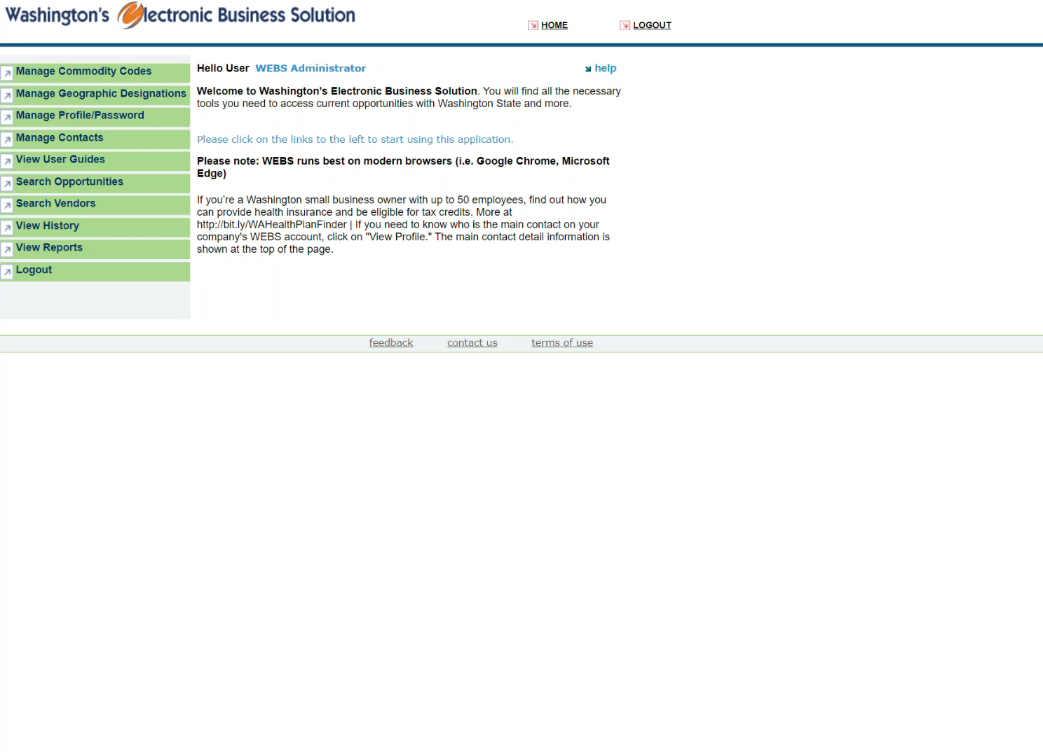
WEBS For vendors
SEARCH VENDORS
Notes:
Click on “search vendors” on the left-hand menu. This allows you to search for vendors who have checked yes in WEBS to share their contact information. You can search the vendor by name, city, state, zip code, keyword or code, category, diversity type (OMWBE, small business, veteran owned, or all), and county. Click search at the bottom of the page.
A page will appear showing you the total number of records (businesses) returned, including number of: minority owned, women owned, minority and women owned, small business, mini business, micro business, and veteran owned records. Below that is a list of vendors that match your criteria. The first column displays company name, followed by columns for DBA name, email address, city, state, web address, certification status, and phone number.
If you click on a company name in the first column, more information about that business will appear such as: vendor name, DBA name, account administrator email, certification status, commodity codes that the vendor is registered under, counties the vendor is registered under, city, state, zip code, phone number, and web address.

Slide 19
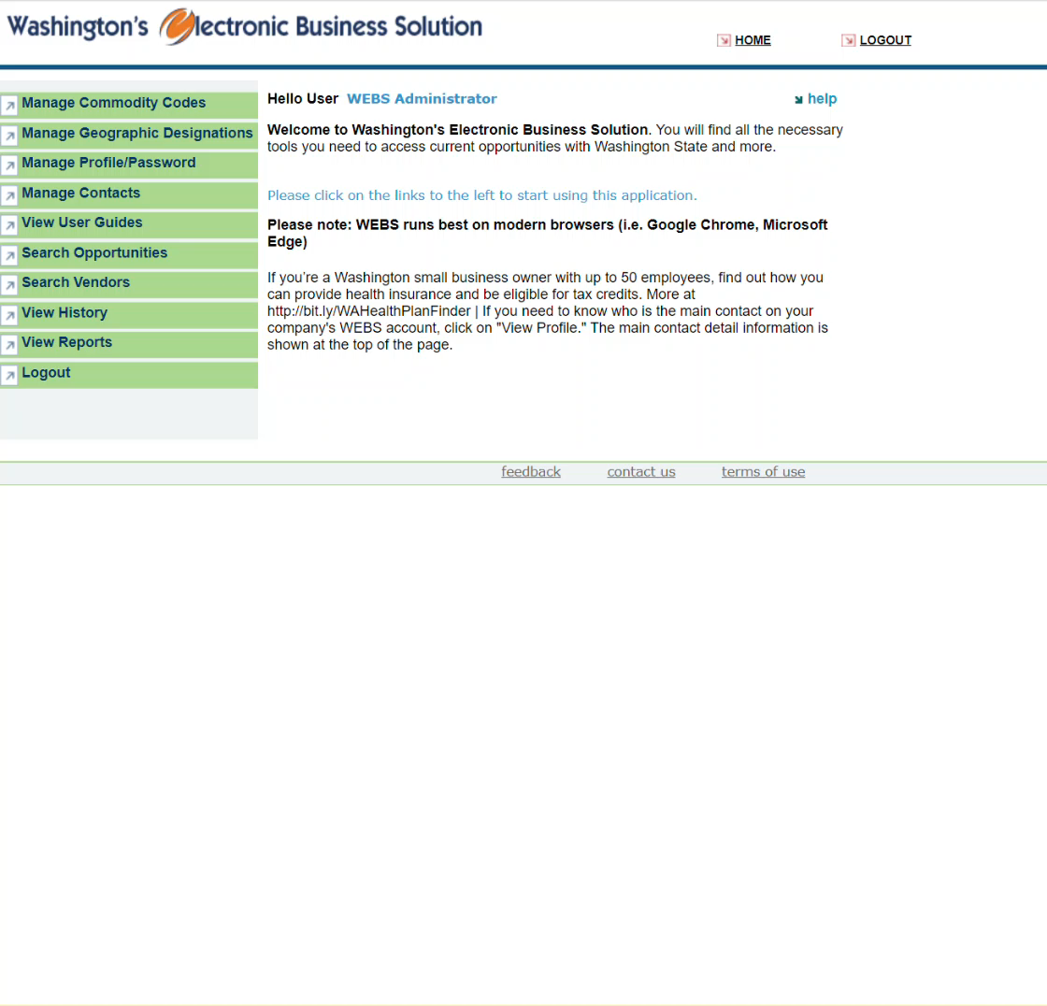
WEBS For vendors
VIEW HISTORY
Notes:
Click on “view history” on the left-hand menu. A page will appear that shows your account’s history. There is a dropdown menu at the top that allows you to select to view any downloaded opportunities, and opportunities that you were notified of, opportunities that you responded to, or opportunities that you were awarded on. To the right is a search button to click which will display a list of corresponding opportunities below. They are listed in 3 columns: document title, description, and date closed. If you click on the document title more information will appear such as organization name, title and description of opportunity, date posted and closed, contact name, phone number, and email, as well as any attachments.

Slide 20
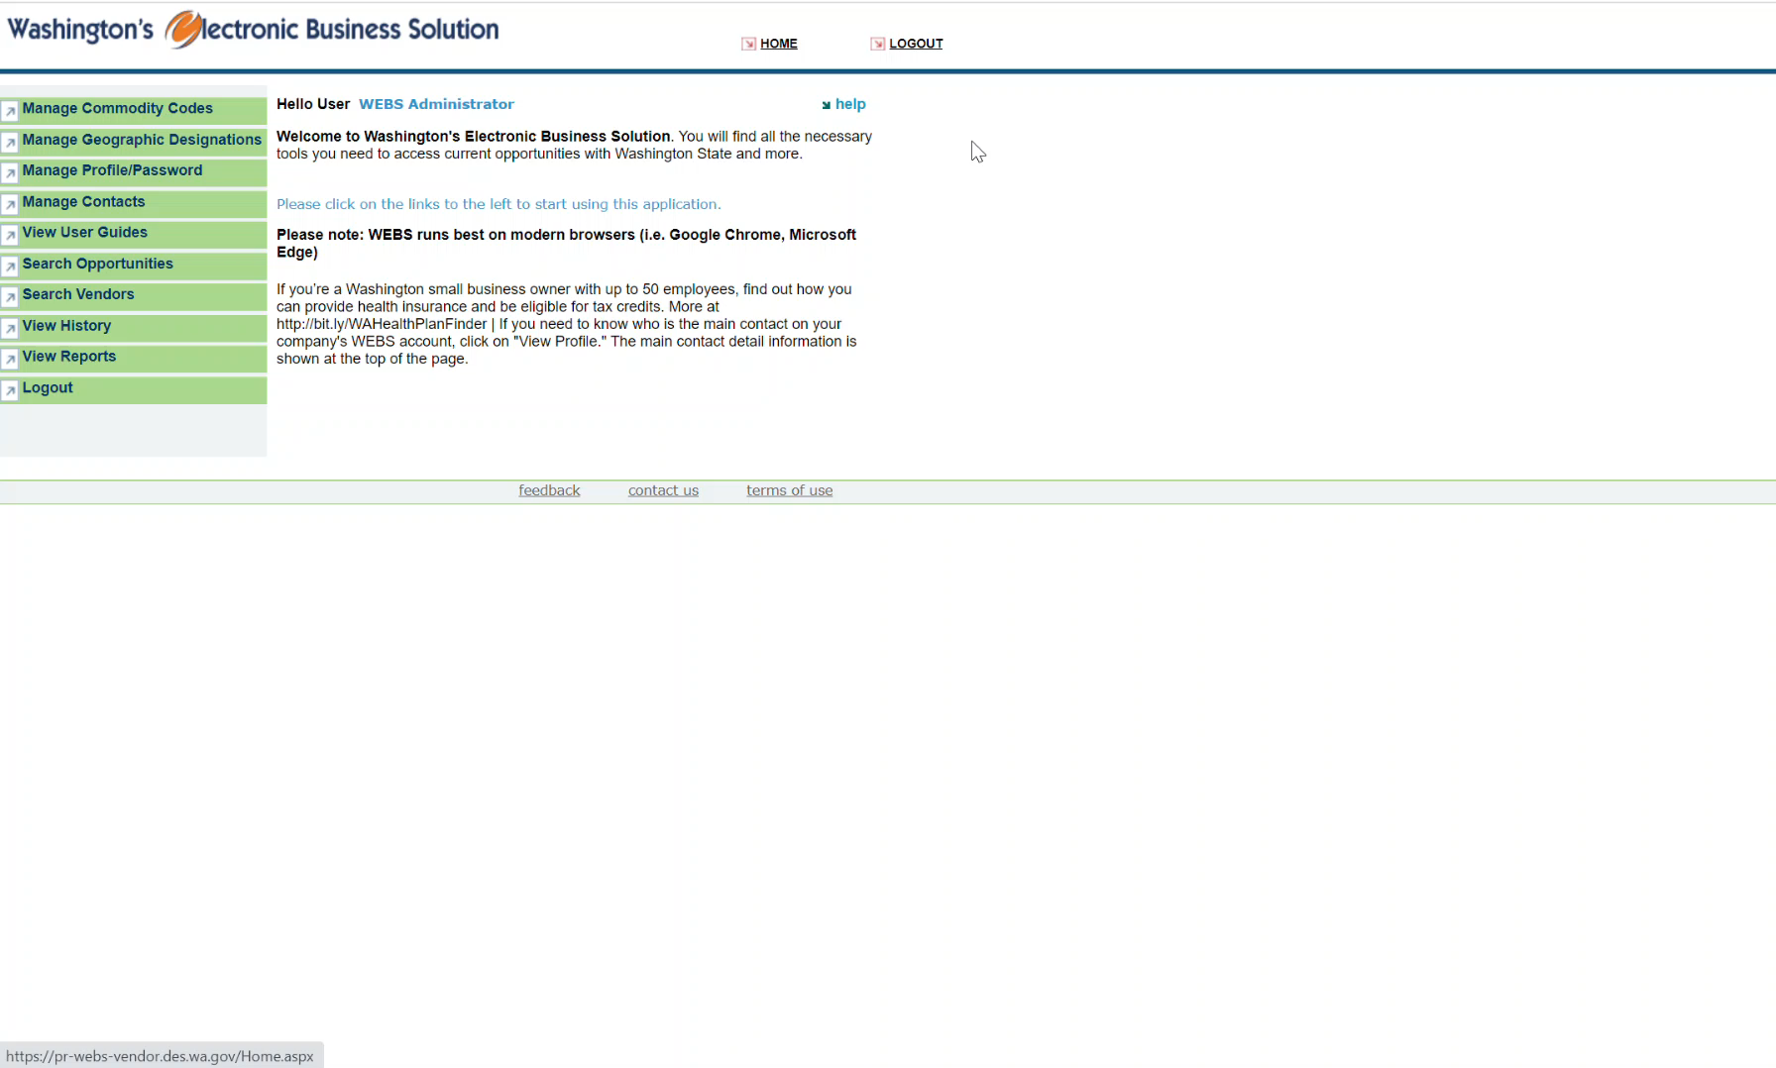
WEBS For vendors
VIEW REPORTS
Notes:
Click on “view reports” on the left-hand menu. A list of reports you can run will appear. Right now, there is only one which is Award Information Summary which will allow you to see a list of solicitations and their awarded vendors. To run the report, click on the report name and a new page will appear where you will use a drop-down menu to select an organization, solicitation type, status, beginning date and end date, and a search box for commodity code/keyword.
When you’re done entering your search criteria, there is a view report button on the right. Running the report will display a list of solicitations that match your search criteria. The solicitations will be display in a table with 13 columns: organization name, customer reference number, solicitation title, contact person, solicitation type, status, active date, inactive date, estimated value, vendors notified, requested, responded, and awarded. If a vendor was awarded, below that row you will see the company name of the awarded vendor.

Slide 21
thank you
WEBSCustomerService@des.wa.gov
360-902-7400
https://pr-webs-vendor.des.wa.gov/

