Slide 1
The Statewide Payee Help Desk

Slide 2
New Statewide Vendors
Vendors need to fill out both forms completely
Accurate and legible information
Processing will take 3-5 business days

Slide 3
Update/unblock/Reactivate
Please have the Vendor fill out both forms in order to update, unblock or reactivate a record.
Banking must be on registration to keep existing EFT on record.

Slide 4
Send Backs
No address on the W9
No Tax Type (box 3) on the W9
TIN Mismatch
No Signatures on the forms
Electronic Signatures

Slide 5
STATEWIDE VENDOR TABLE
TOTAL | ACTIVE | BLOCKED
257,158 | 111,204 | 145,954

Slide 6
Blocked /Archived Records
Records are Archived 2 years after the last payment.
Blocked records are blocked for the following reasons:
  Tin Mismatch
  No W9
  Agency/ Vendor
  Bad Address per USPS

Slide 7
2015 ARCHIVING reduces chance of keying errors @ agency level

Slide 8

Processing
If all forms are correct and legible, forms take between 3-5 business days to process.
Prenote (Banking) takes additional 7-10 business day to process in addition to the 3-5 days.
Vendors may receive a warrant (paper check) while Prenote is processing.

Slide 9
EFT
Prenote process takes 7-10 business days to clear after the initial 3-5 business days.
If banking is dormant for 100 days, an automatic Prenote is sent and EFT is turned off until the process is cleared.
EFT is turned off when there is an update. Vendor can still receive payments during this time in a form of a warrant (paper check).

Slide 10
Foreign Vendors
We can’t process foreign banking.
All Foreign Vendors must fill out a W-8 with a US TIN.

Slide 11
Fraud
OFAC – Office of Foreign Asset Control
Calling the contact on record in order to make the new changes to the record.
TIN Matching

Slide 12
SWV Facts
Volume (March 1st –March 29th)
Forms Received – 3301 Vendors
Send backs – 120 forms were sent back.
Only 3.6% are being sent back.

Slide 13
Payee Help Desk Information
Ph. 360.407.8180 Fax: 360.664.3363
Statewide Payee Registration
    http://des.wa.gov/services/ContractingPurchasing/Business/VendorPay/Pages/default.aspx
    Vendor Look Up
    http://des.wa.gov/services/ContractingPurchasing/Business/VendorPay/Pages/VL.aspx
ER Reporting
    https://rp.des.wa.gov/
WEBI Report
    https://reporting.des.wa.gov/BOE/BI/custom.jsp

Slide 14
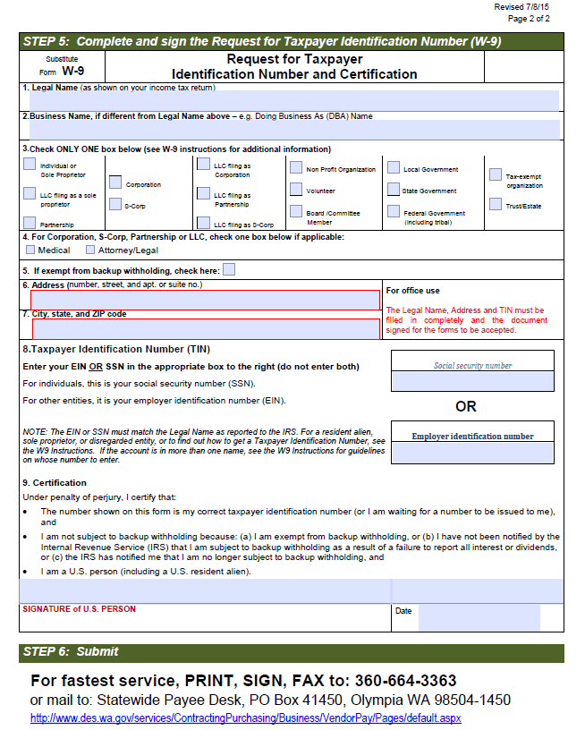
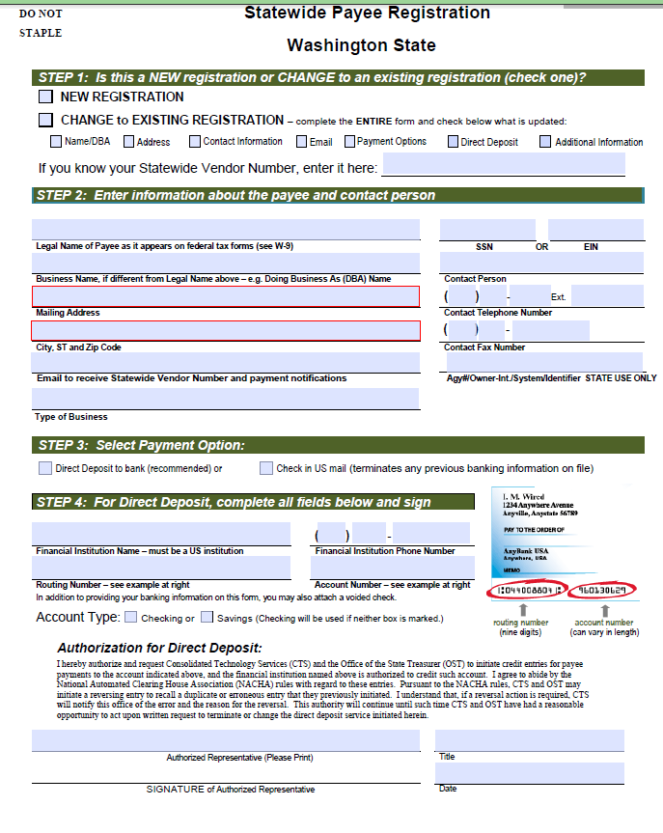
http://des.wa.gov/SiteCollectionDocuments/HRPayroll/SACS/SWV_Reg_W9.pdf

Slide 15
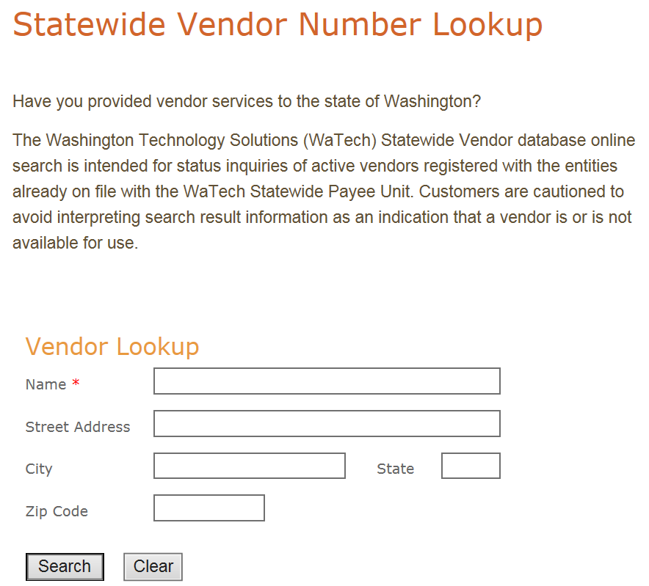
http://www.des.wa.gov/services/ContractingPurchasing/Business/VendorPay/Pages/VL.aspx

Slide 16
Thank You For Coming!
Any Questions?

