Slide 1
Website and User Experience Services
Small Agency Summit
February, 2018
Wendy Wickstrom

Slide 2
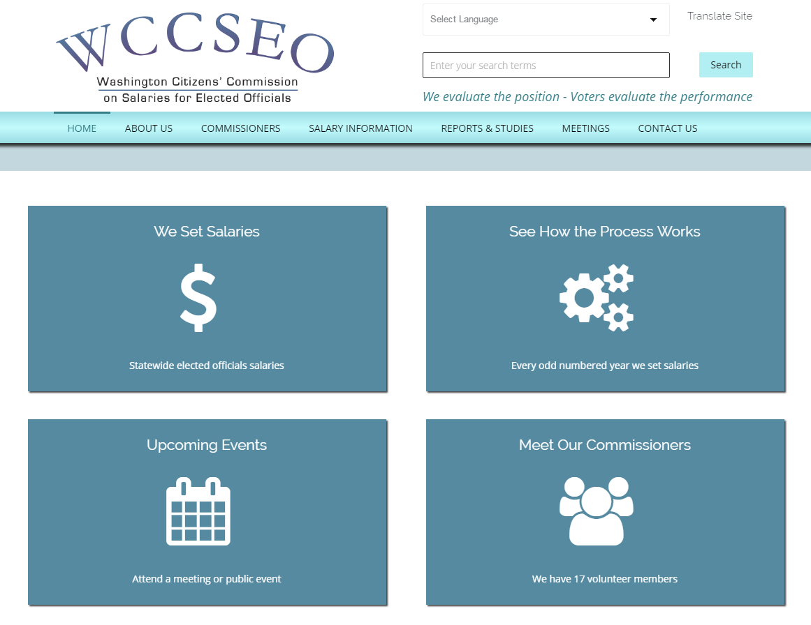
Website Services: Developing mobile, modern, accessible and usable websites
All-in-one Services
  Web design, development, maintenance and hosting services
  Drupal or WordPress Content Management System (CMS)
  Cloud-based web hosting
À la carte services also available
Service Highlights
  Responsive, mobile web design
  Accessible webpage templates and layouts
  Rapid deployment
  Easy content authoring environment for customers
  Ongoing monthly technical support for minor enhancements, training or troubleshooting

Slide 3
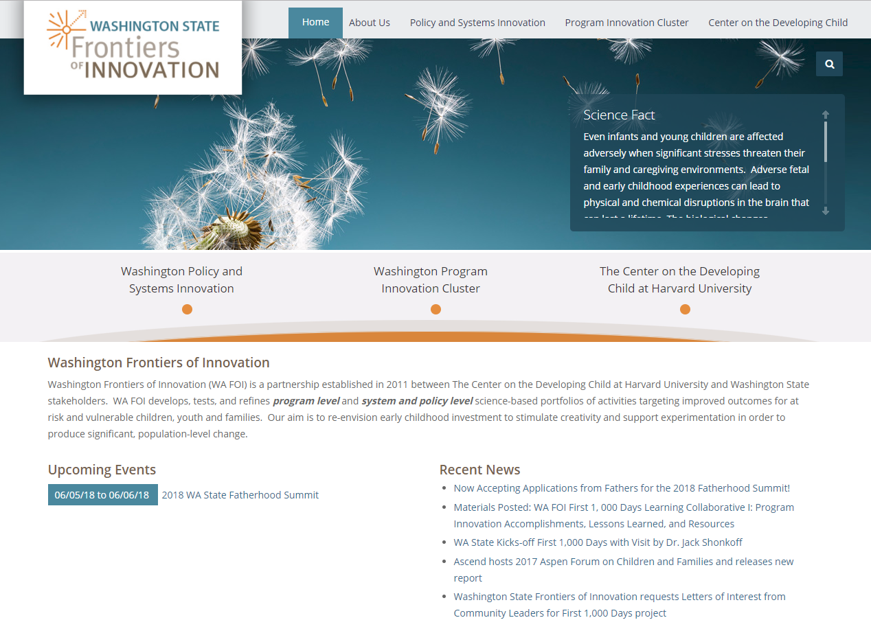
Website Services: Developing mobile, modern, accessible and usable websites
Why WaTech Website Services?
  Little to no resources needed from Agency IT
  Drupal Base Installation which is responsive and accessible out-of-the box
  Rapid deployment
  Experienced team of web developers who specialize in Drupal and WordPress
  Secure hosting platform (passed Office of Cyber Security’s security design review)
  All sites receive an SSL certificate (HTTPS)
  SSL and ADFS integration available
  In-person training for content authors included, as well as step-by-step written documentation
  Flexible service offering
  No formal procurement (RFx) required

Slide 4
Website Services: Developing mobile, modern, accessible and usable websites
Features | Simple | Standard | Complex
Simple theme catalog | X | X | X
Web page search | X | X | X
Contact form | X | X | X
Content tagging | X | X | X
Extended theme catalog |  | X | X
Document search |  | X | X
Custom content types | X | X | X
Calendar | X | X | X
Social Media integration |  | X | X
Dynamic content |  | X | X
Custom website design |  |  | X
External integration |  |  | X
Custom modules |  |  | X
Training for content authors | X | X | X
SSL/HTTPS | X | X | X
Setup Fee (one-time) | $5,000 - $8,000 | $10,000 - $13,000 | By estimate
Monthly Fee (hosting and ongoing support) | $200 | $400 | By estimate

Slide 5
Website Services: Developing mobile, modern, accessible and usable websites
We currently support over 50 agency websites and are taking on new customers!
See a full list of our customers and samples of our work at:
https://watech.wa.gov/solutions/it-services/Website-Services

Slide 6
User Experience: Ensuring our web products are both usable and accessible
Usability Services
  Designing and developing prototypes of websites and applications (low- medium fidelity)
  Conducting user research activities including user surveys, interviews, focus groups, etc.
  Designing and facilitating usability studies on websites and applications
  Analyzing data from usability studies and preparing formal reports of findings and recommendations
Accessibility Services
  Accessibility evaluations and testing of websites and applications:
    Automated testing of web code with report of code errors
    Professional testing of website templates, forms and other functionality with formal report of findings and recommendations
    End-user testing of websites with formal report of findings and recommendations
    Implementation of fixes

Slide 7
User Experience: Ensuring our web products are both usable and accessible
Services are à la carte
Rates vary based on the project and service.
  Estimated and charged hourly at the WaTech Professional Services rate of $150/hr

Slide 8
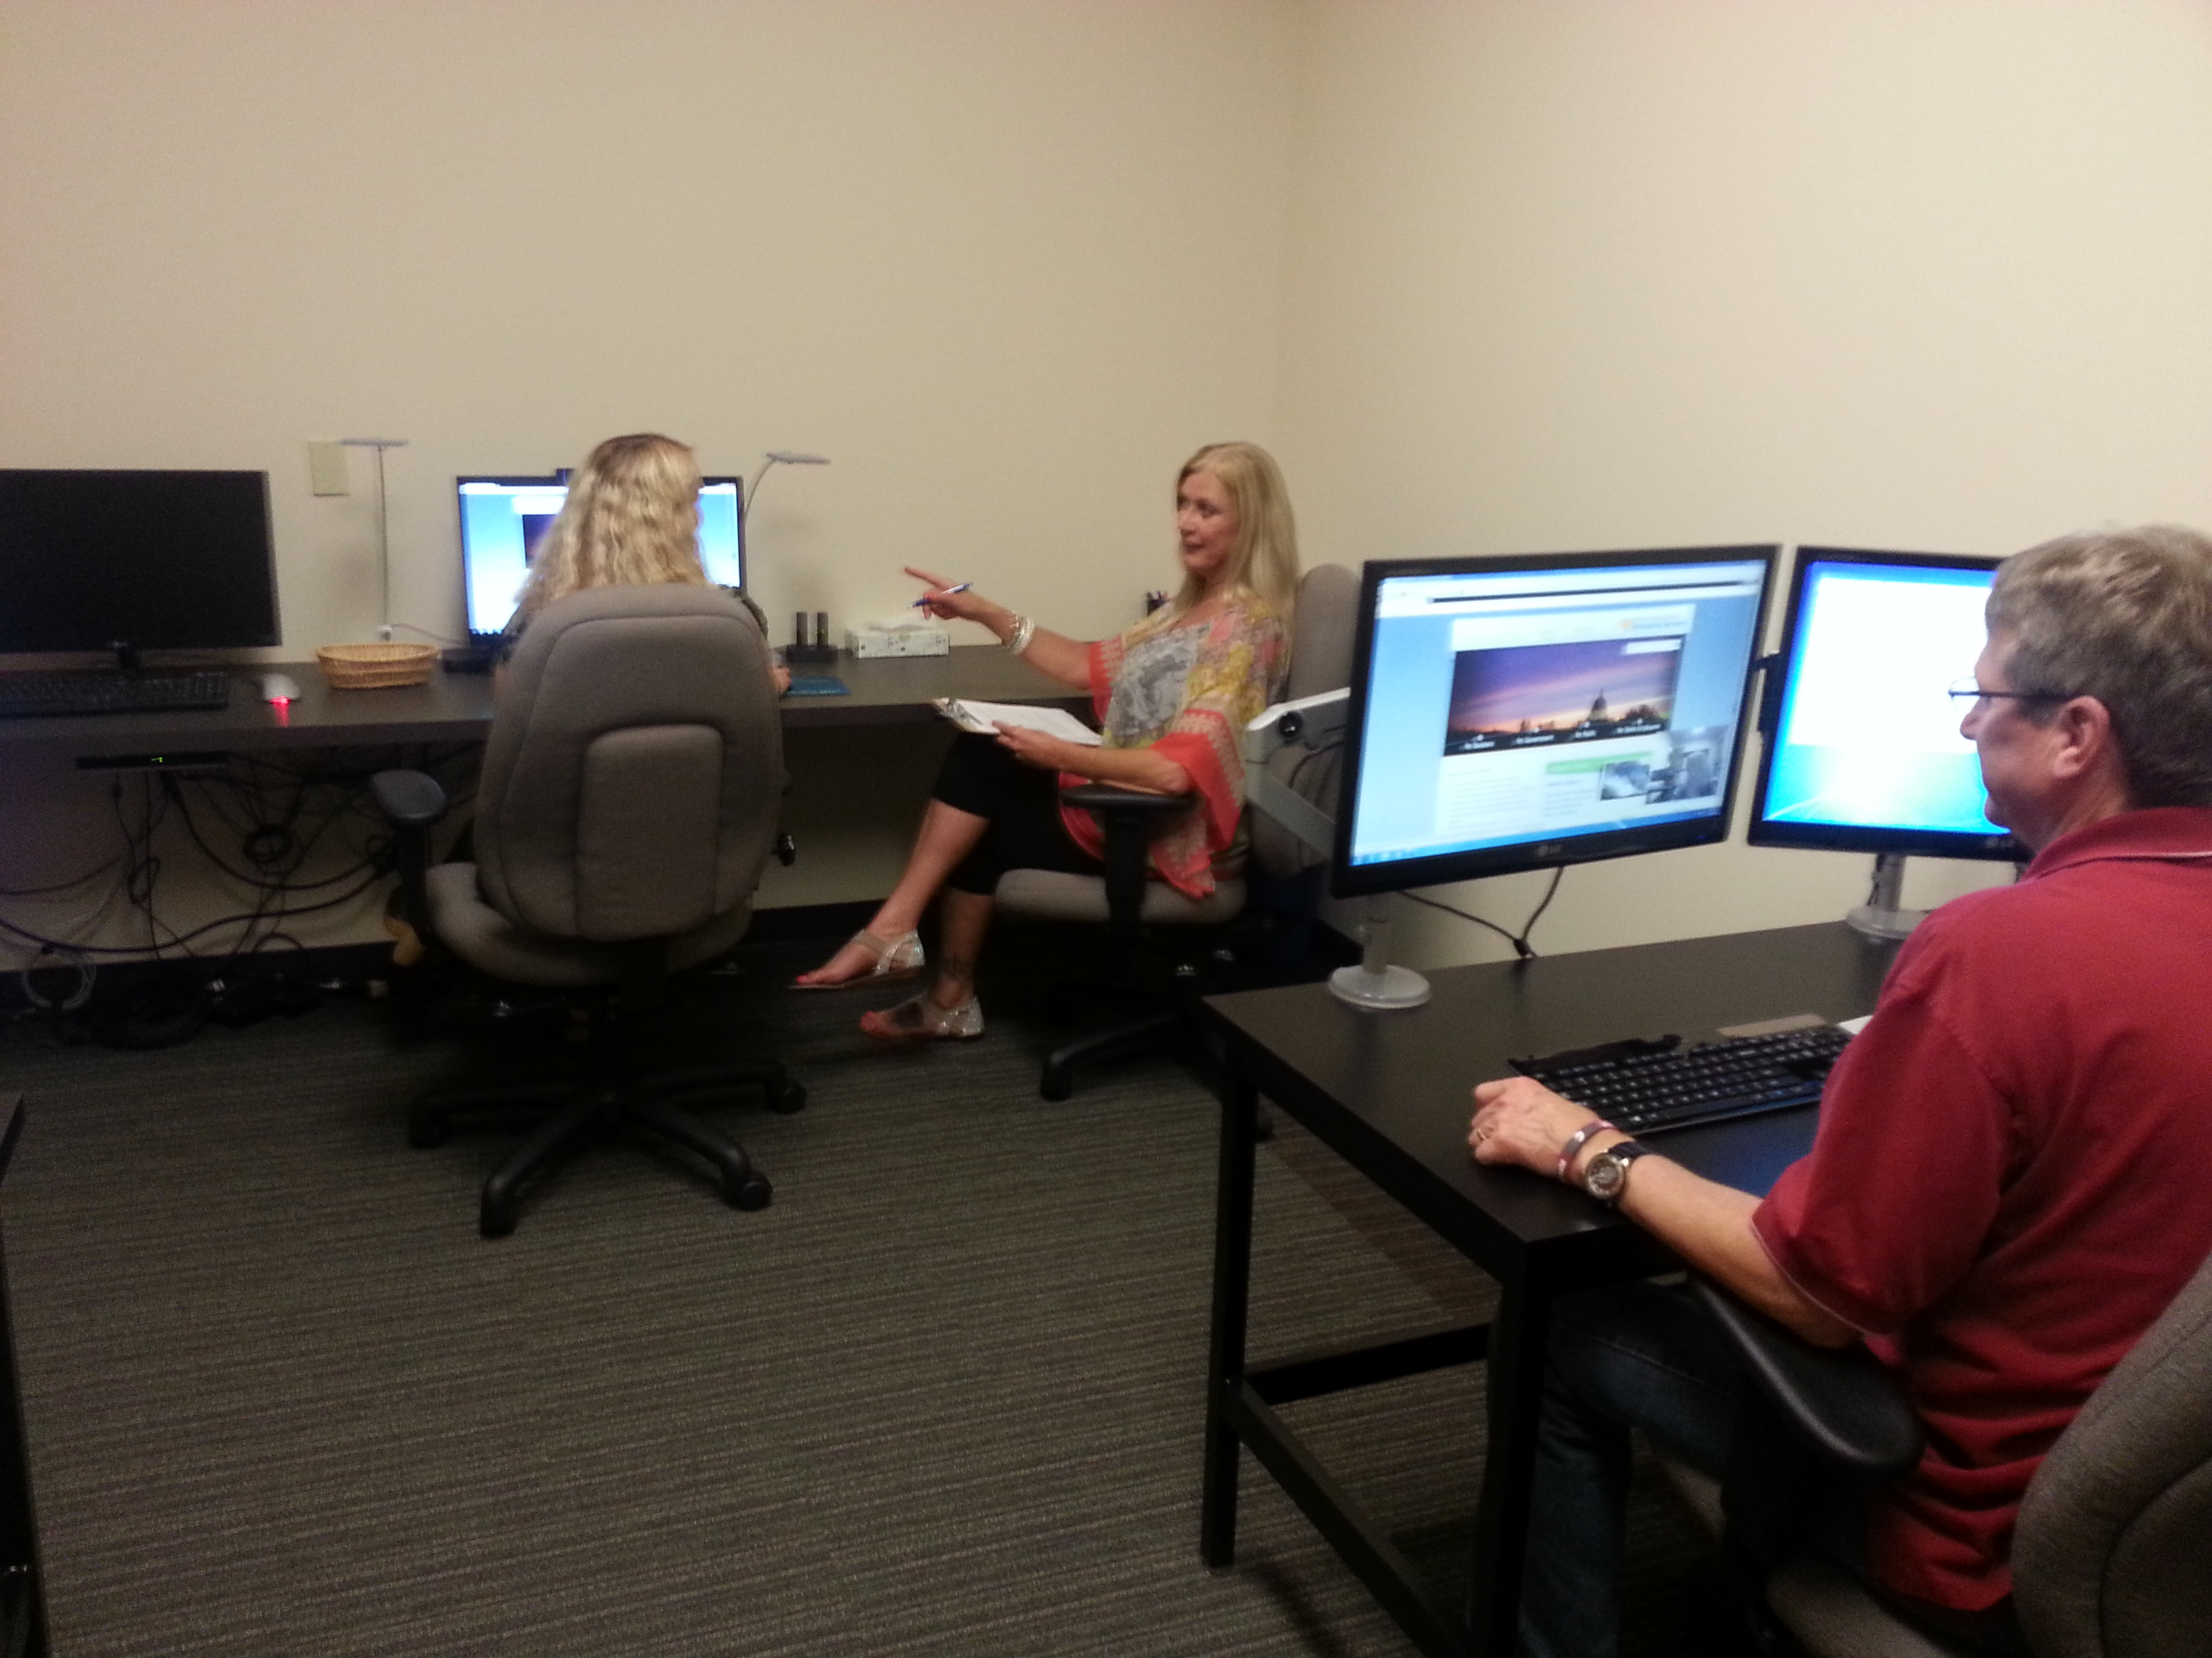
Usability Lab
WaTech offers a state-of-the-art Usability Lab free to all state agencies, boards and commissions
Notes:
The lab is right across the hall and can accommodate up to three usability studies at a time.
We can accommodate group activities like focus groups or card sorting.
One-on-one usability testing, on-screen or paper.
We have separate observation rooms so you can invite your stakeholders, developers, testers and other interested folks to watch sessions in real-time.
We provide training on how to use the facility and on-site technical support during your study.
The lab is available to all state agencies who pay the Enterprise System Fee at no additional cost, and those who do not at $78/hr.

Slide 9
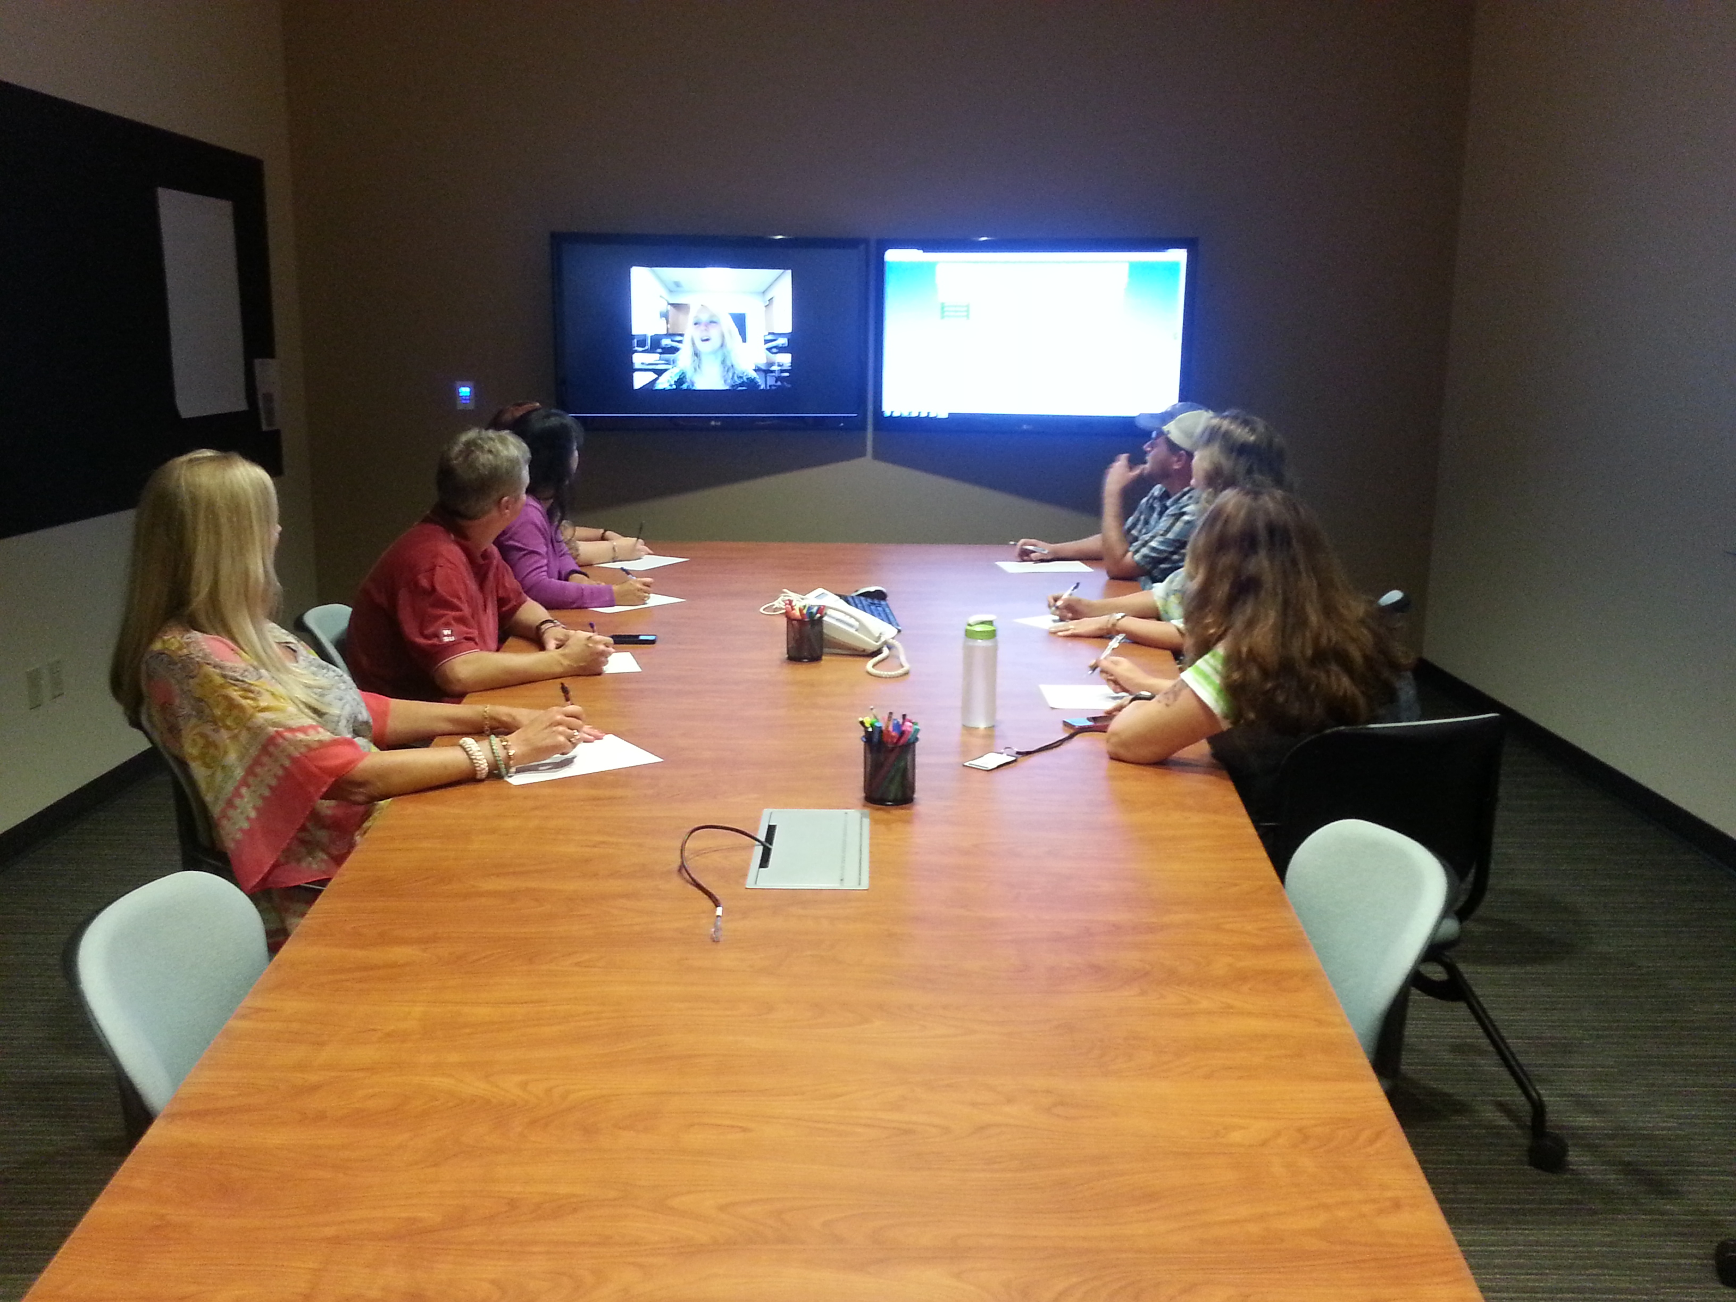
Usability Lab
WaTech offers a state-of-the-art Usability Lab free to all state agencies, boards and commissions

Slide 10
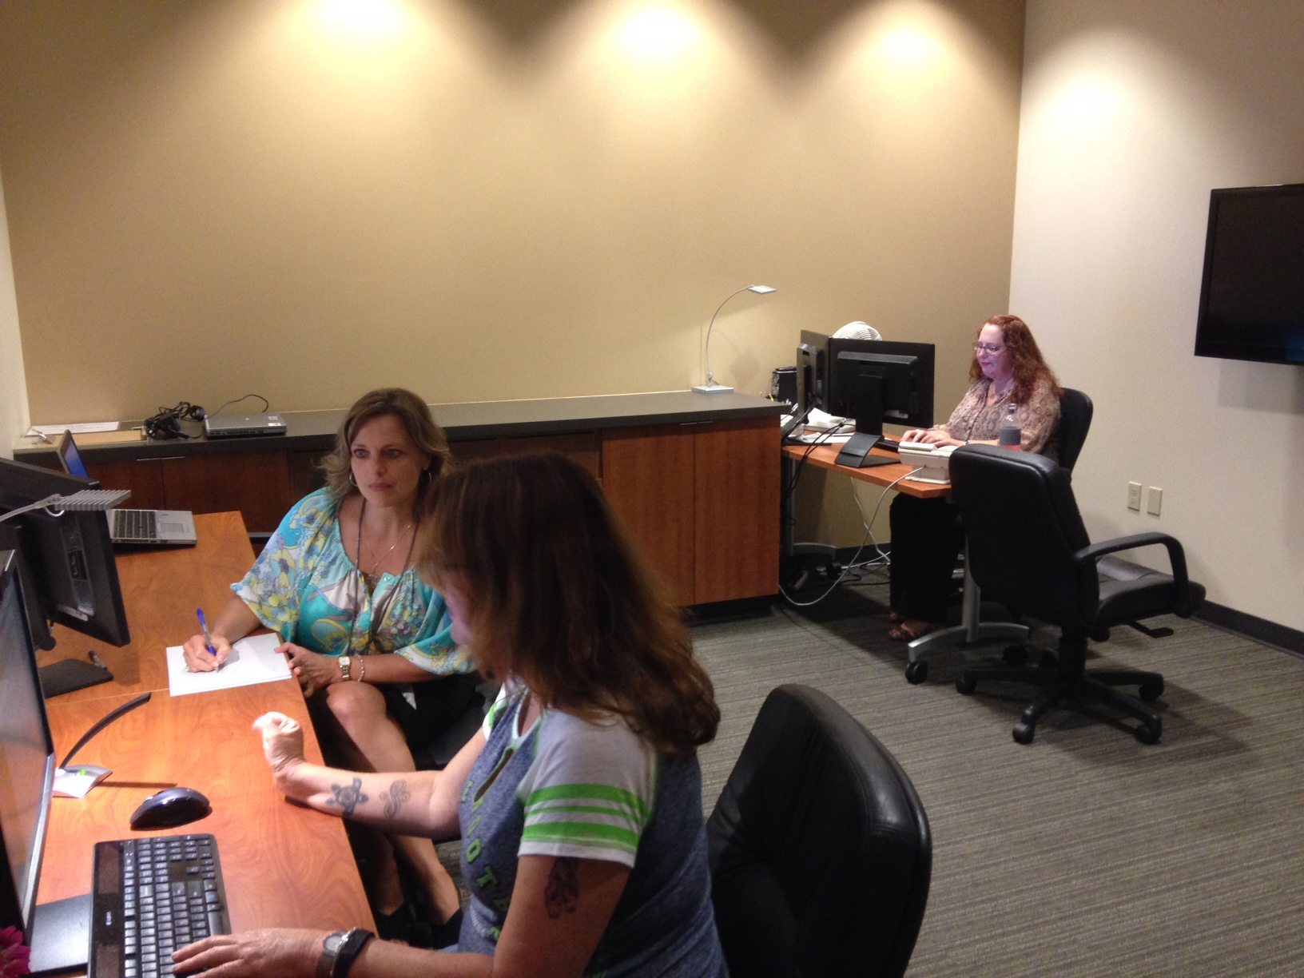
Usability Lab
WaTech offers a state-of-the-art Usability Lab free to all state agencies, boards and commissions

Slide 11
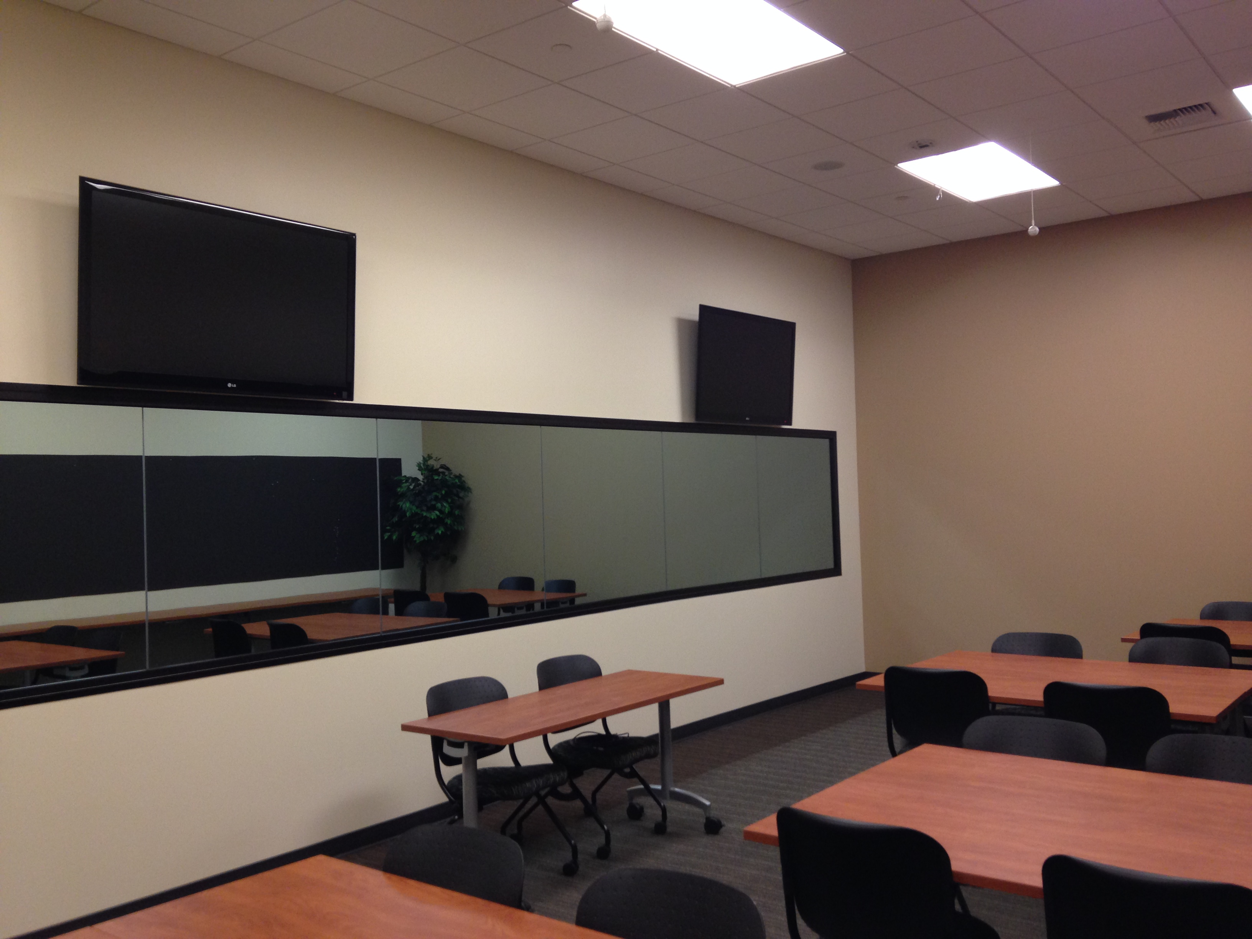
Usability Lab
WaTech offers a state-of-the-art Usability Lab free to all state agencies, boards and commissions

Slide 12
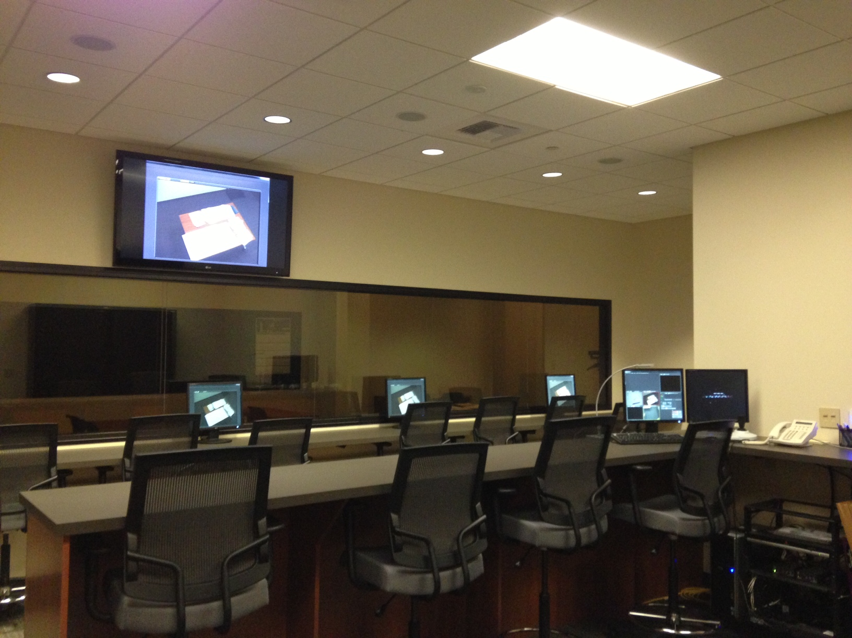
Usability Lab
WaTech offers a state-of-the-art Usability Lab free to all state agencies, boards and commissions

Slide 13
If you are interested in learning more please contact:
support@watech.wa.gov
or call
360-407-8731

