Slide 1
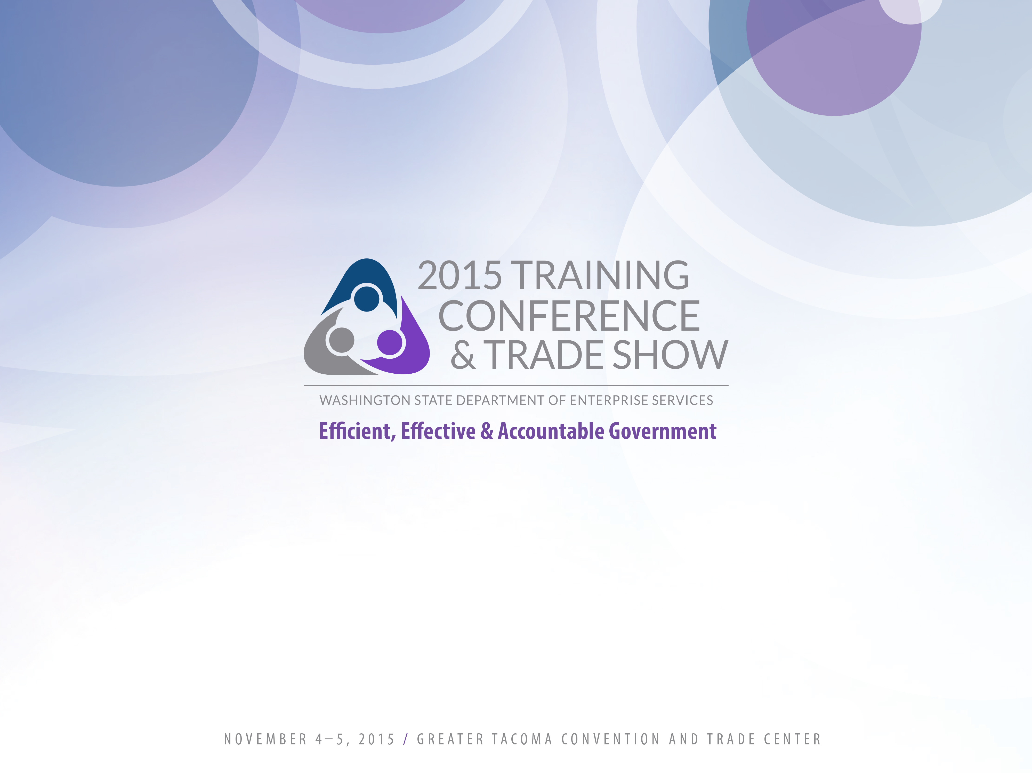
Surplus Operations
What can Surplus do for you?
Presented by David Baker

Slide 2

What do we do?
We help agencies manage property in an environmentally friendly, cost-saving manner.
Agencies include:
State and local governments
Municipalities
School Districts
and
Non-profits are often eligible

Slide 3
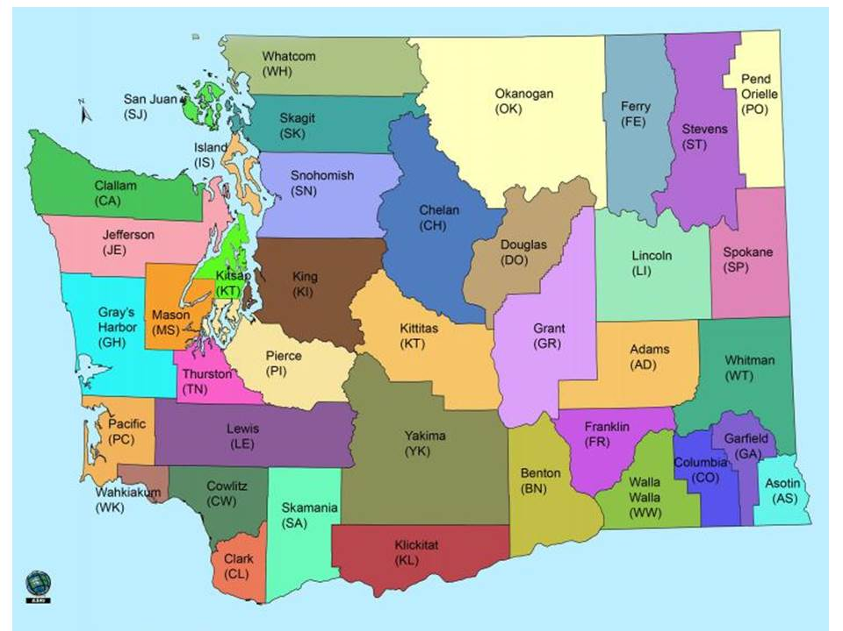

Our service area

Slide 4
How do we help?
Our mission is to recover for reuse or to recycle property and avoid disposal.
For every item we can put back into service, that is less money paid out by an agency partner.
We sell items and return 75% of the funds to the agency.

Slide 5
Basic funding for Surplus
Not appropriated
Fee for service
Federal guidelines of 60 day operating reserve

Slide 6
The relay race
Your agency submits a disposal request
We pick it up or sell it from your site
We connect the item to the customer
We process the paperwork and sale
Sometimes, we send you money!

Slide 7
If my agency has surplus:
Who does this (internally) -find out!
Contact surplus@des.wa.gov
Create/login
Submit request
http://des.wa.gov/services/Surplus/Dispose
(for the step by step in more detail)

Slide 8
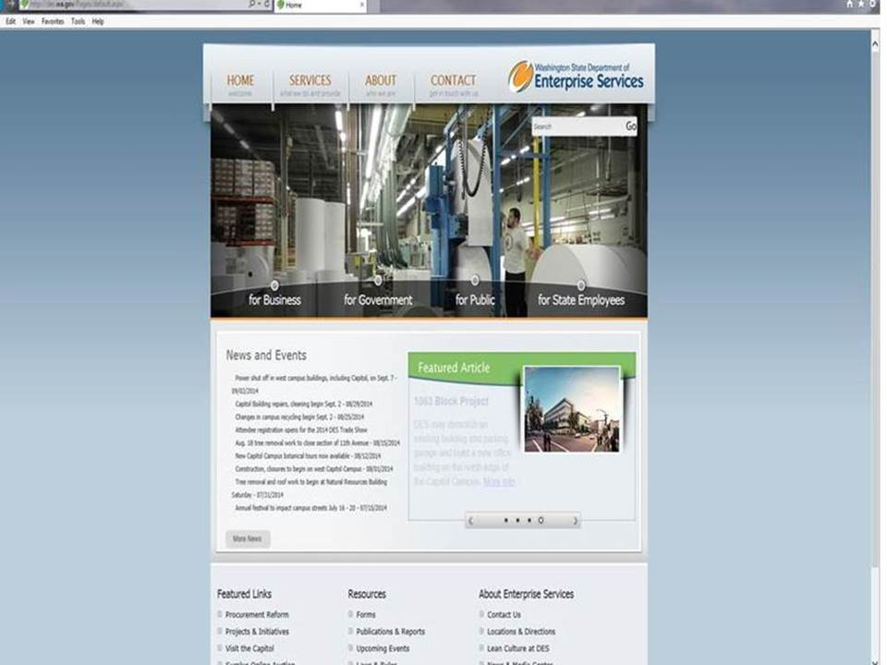
Step 1

Slide 9
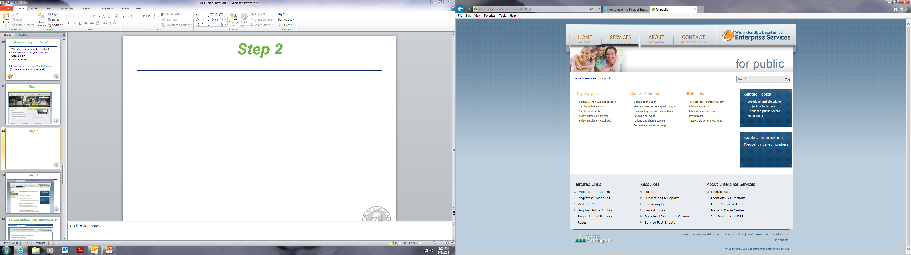
Step 2

Slide 10
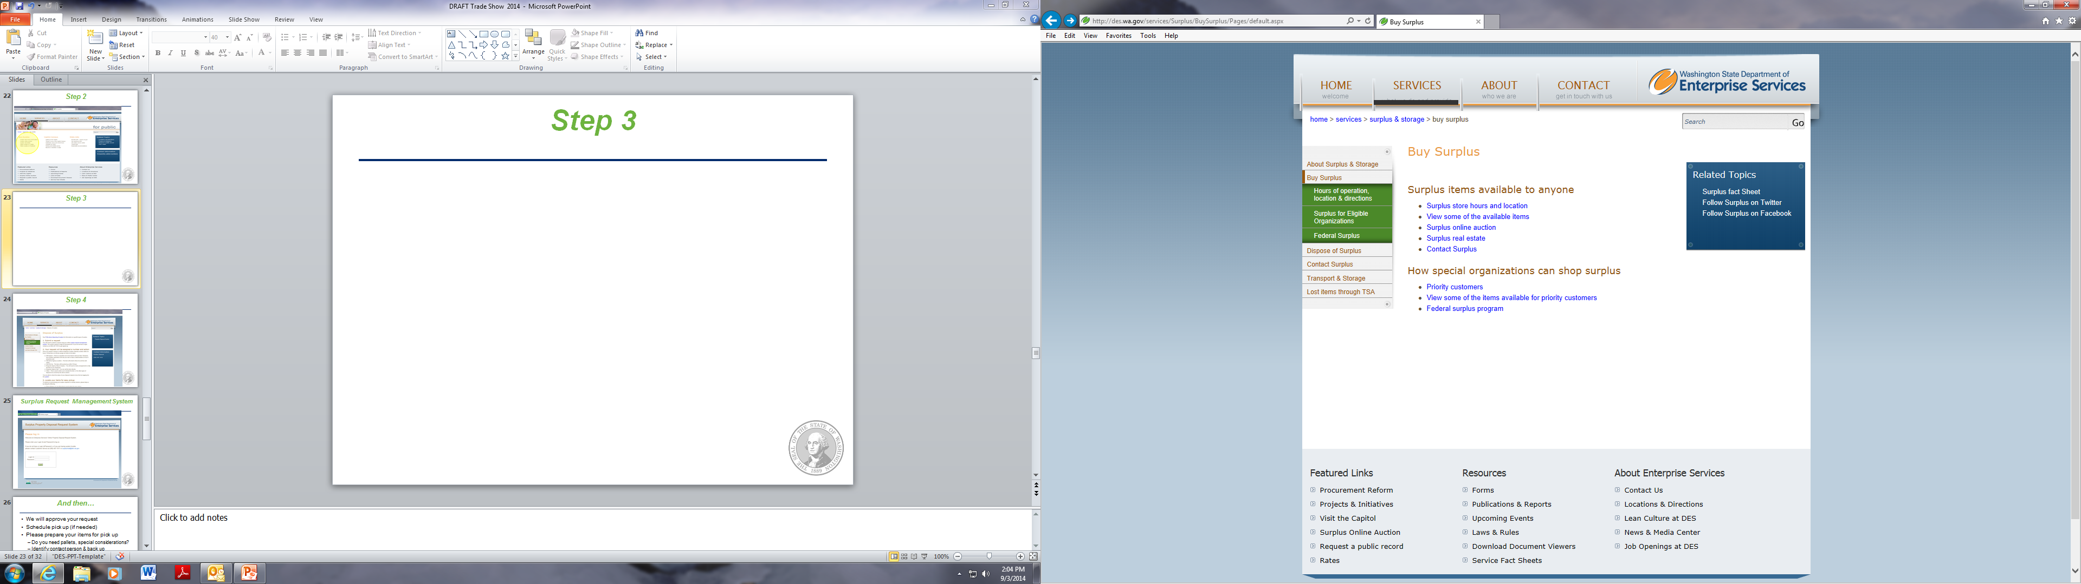
Step 3

Slide 11
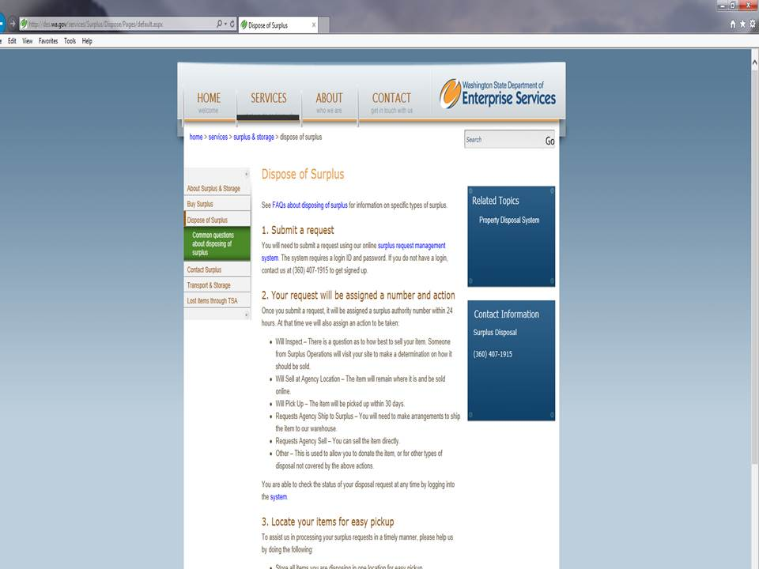
Step 4

Slide 12
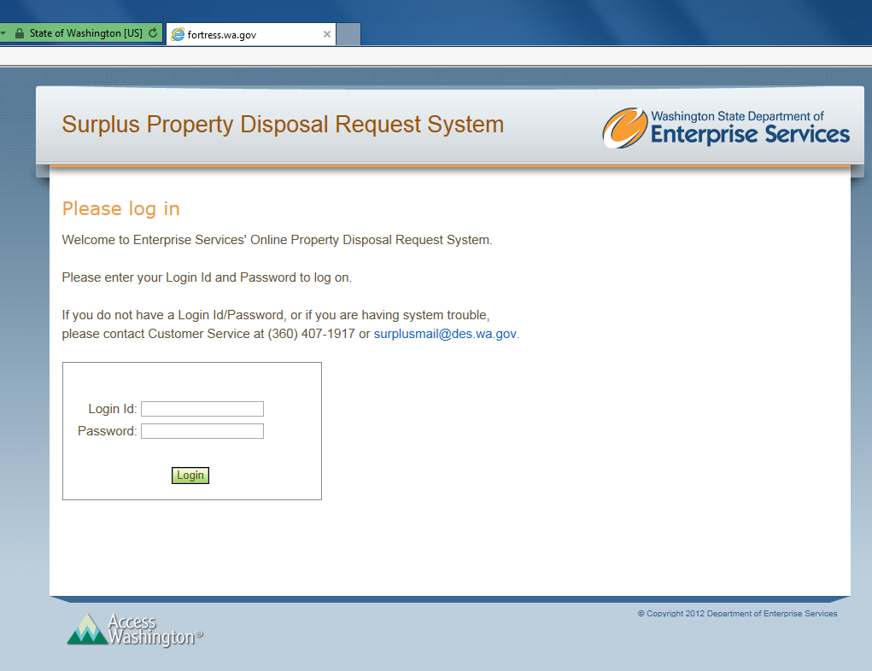
Surplus Request Management System

Slide 13
And then…
We will approve your request
You will get a surplus approval number
Schedule pick up (if needed)

Slide 14
What happens next?
Move to transfer area, on line auction area, or retail store
If it is determined there is no resale value, it gets recycled
Surplus landfills between 2,000 and 2,500 pounds annually

Slide 15

Transfer
Transfer of property
  If a State agency has turned in property, other State agencies are first in line
  It may be transferrable without fees
  In the case of items with depreciation, a State agency can acquire the item for the depreciated value

Slide 16
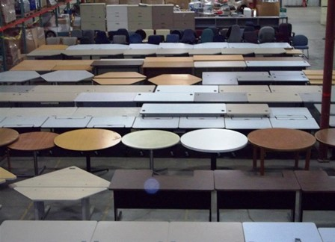
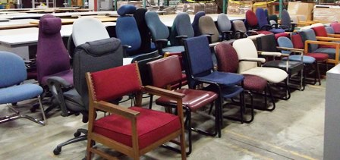
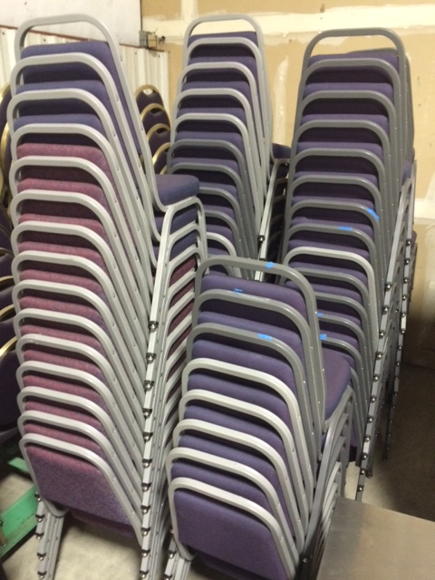
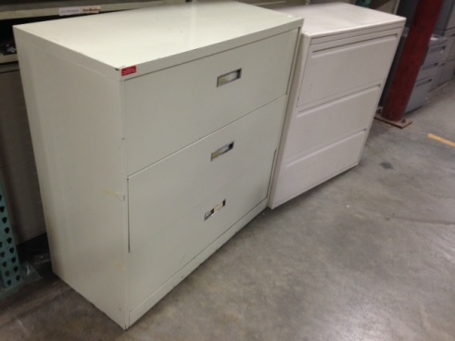
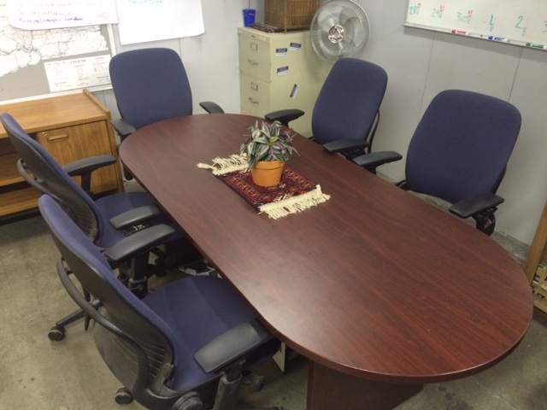
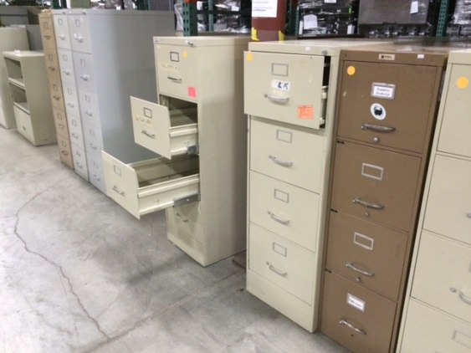
Transfer area

Slide 17
Public sales
2. Surplus to public sale
  Online auctions
  Retail store

Slide 18
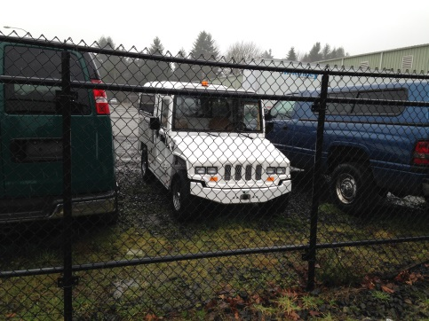
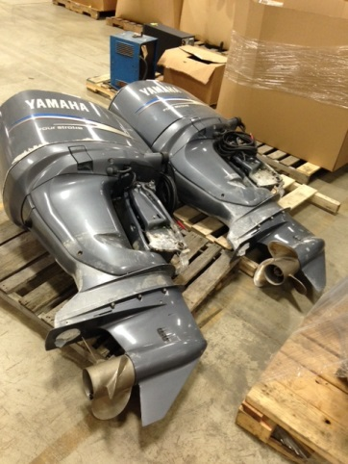
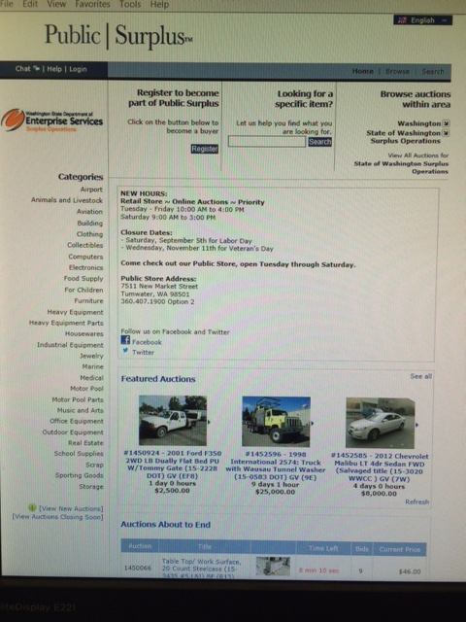
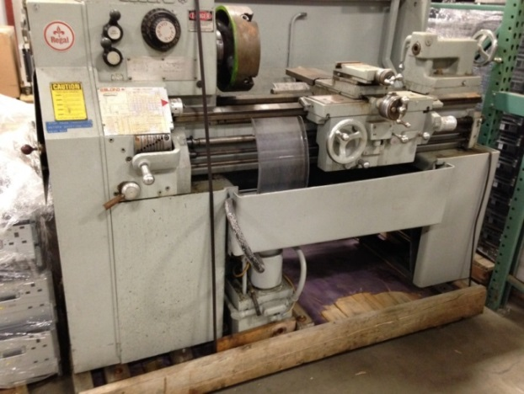
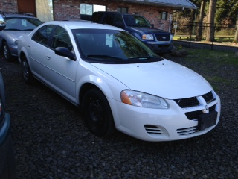
Online auctions
www.govdeals.com

Slide 19
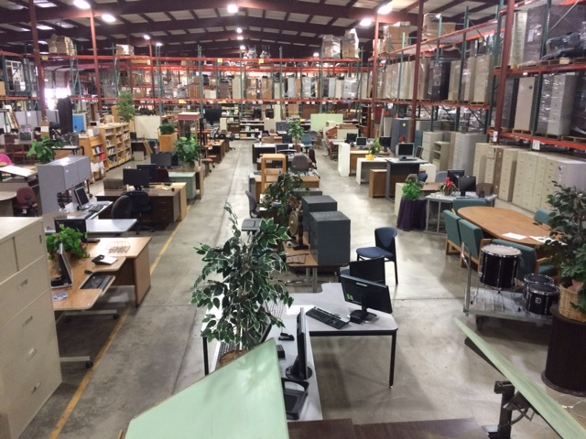
Retail store

Slide 20
Priority sales
3. State Agency to non-State agency sale
  not free to transfer
  wish lists
  in store benefits
  on line benefits
  Federal surplus

Slide 21
Federal Surplus
General Service Administration (GSA) has a parallel program for Federal property
Federal agencies get first priority
We can request property on behalf of an agency

Slide 22
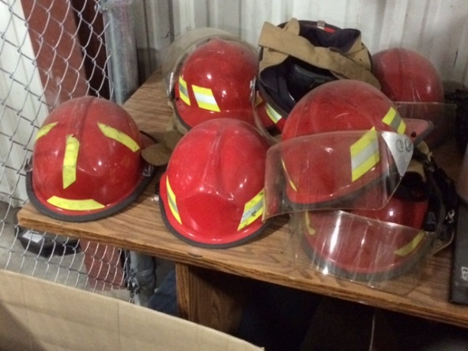
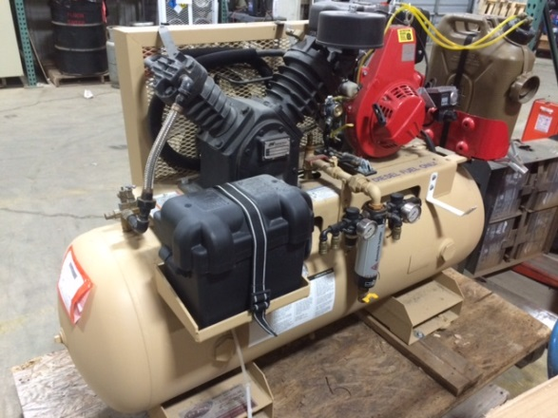
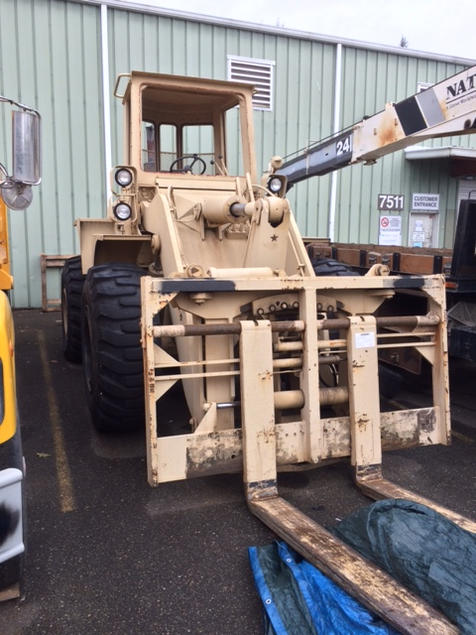
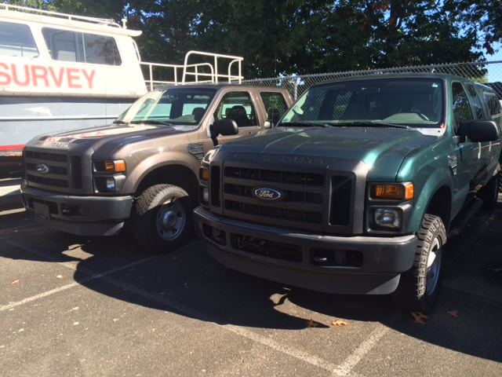
Examples of GSA items

Slide 23
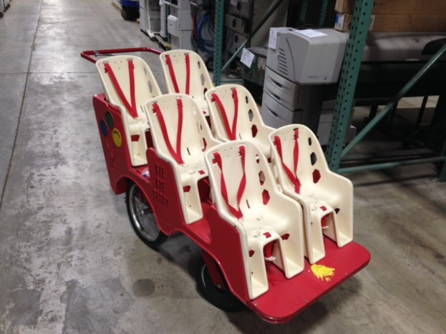
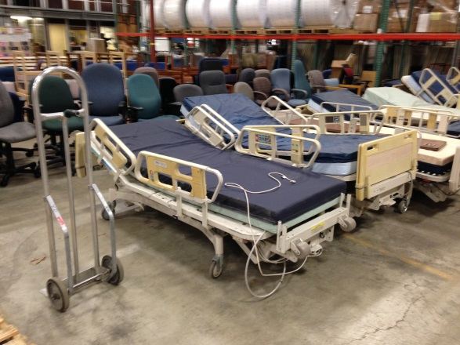
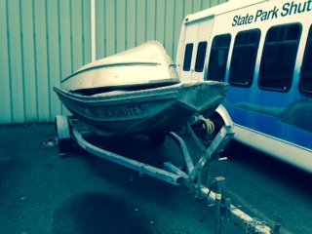
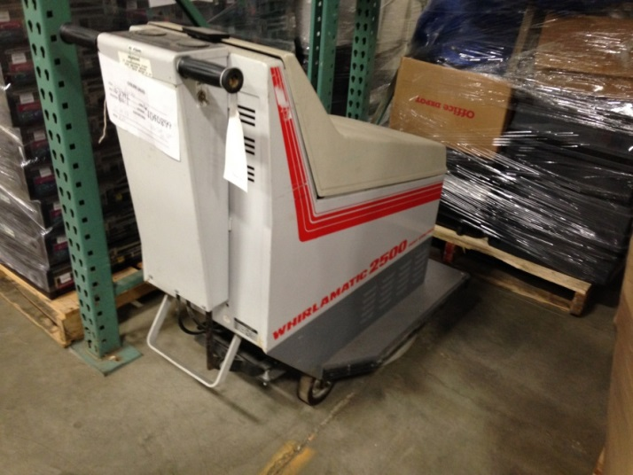
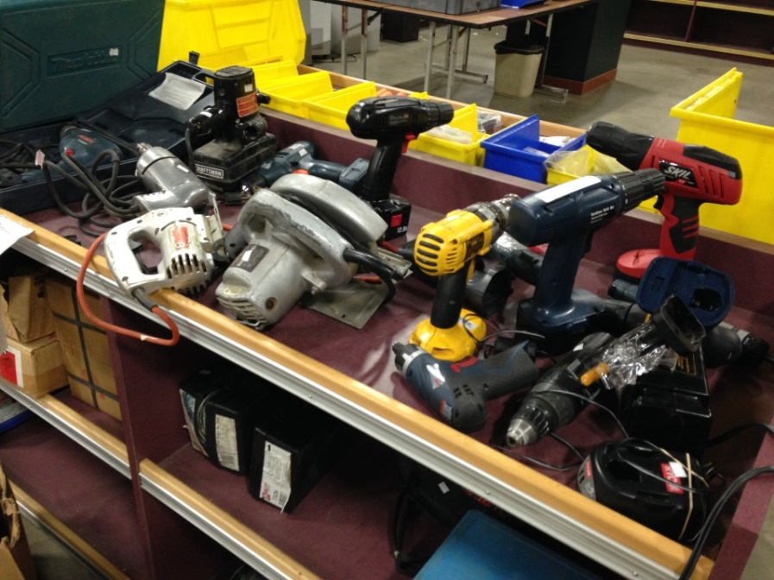
Examples of Surplus items

Slide 24
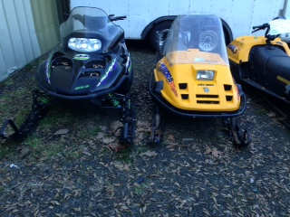
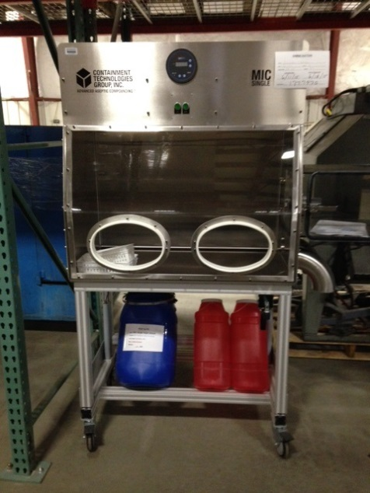
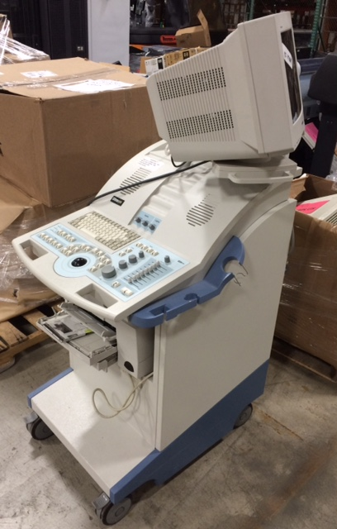
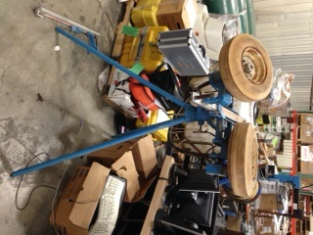
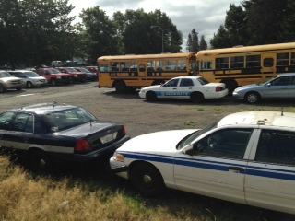
Examples of Surplus items

Slide 25
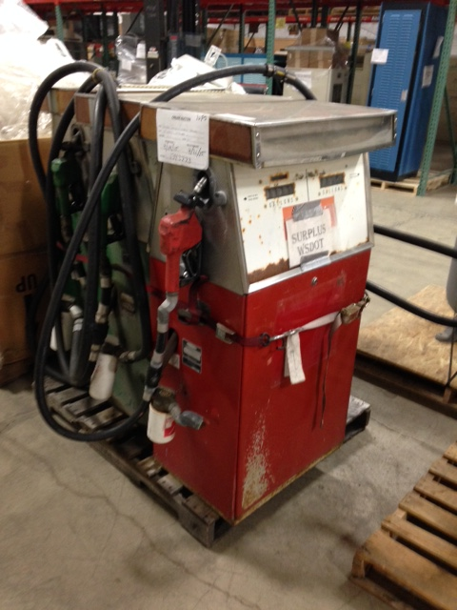
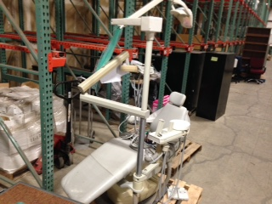
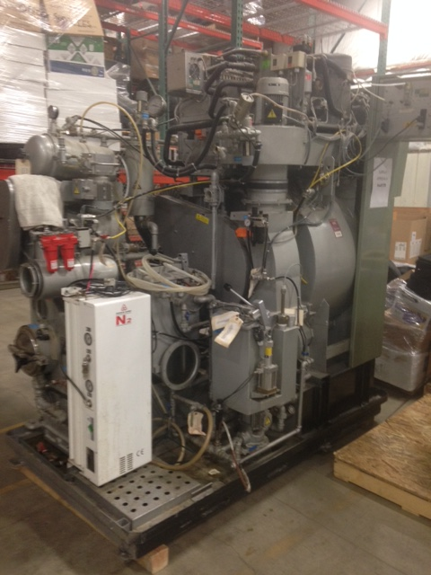
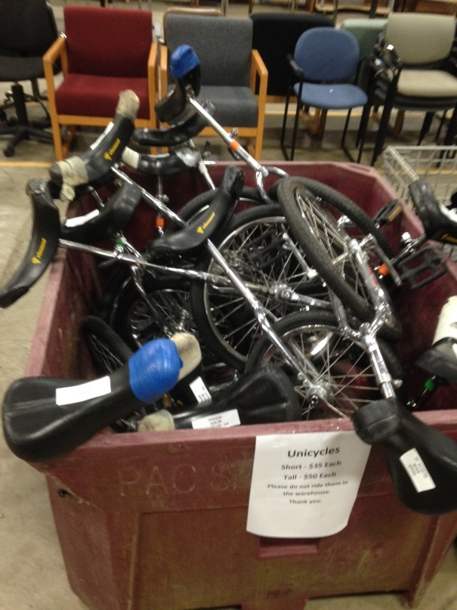
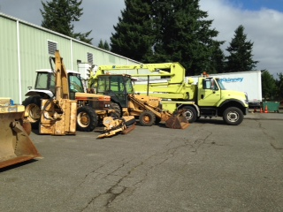
Examples of Surplus items

Slide 26
Transportation Security Administration
Agencies we work with include Ports
Non-liquid items confiscated at the airport by TSA are sold through our retail store
We do get a lot of corkscrews, pocket knives and Alaskan ulu knives

Slide 27
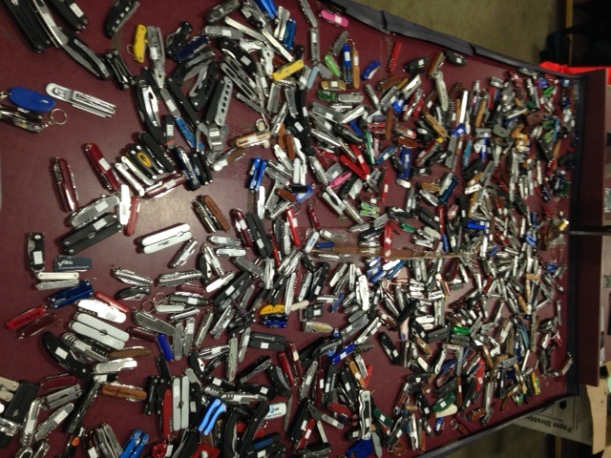
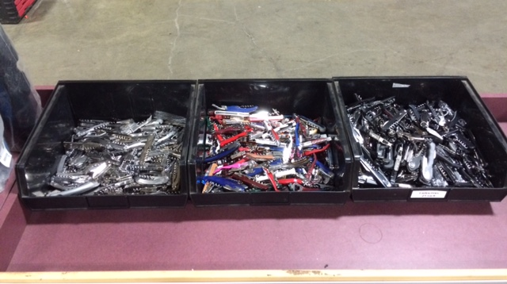
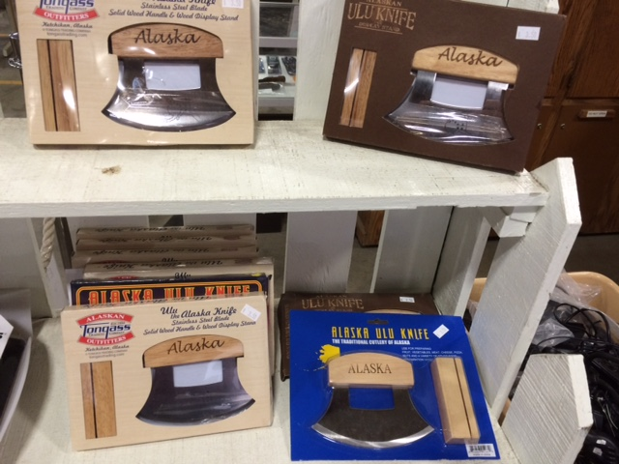
Examples of TSA items

Slide 28
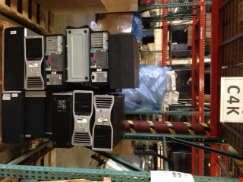
Computers for Kids
C4K provides low income schools and students with inexpensive computers-
Cost is less than $30 for 1 CPU, monitor, mouse
& keyboard

Slide 29
Computers for Kids
3,492 full systems delivered to qualifying schools in 2014
For more information:
http://www.k12.wa.us/EdTech/Computers4kids

Slide 30
Shopping hours
All services available
Tuesday - Friday, 10:00 - 4:00
Saturday 9:00 - 3:00
Priority customers can make appointments for Mondays!

Slide 31
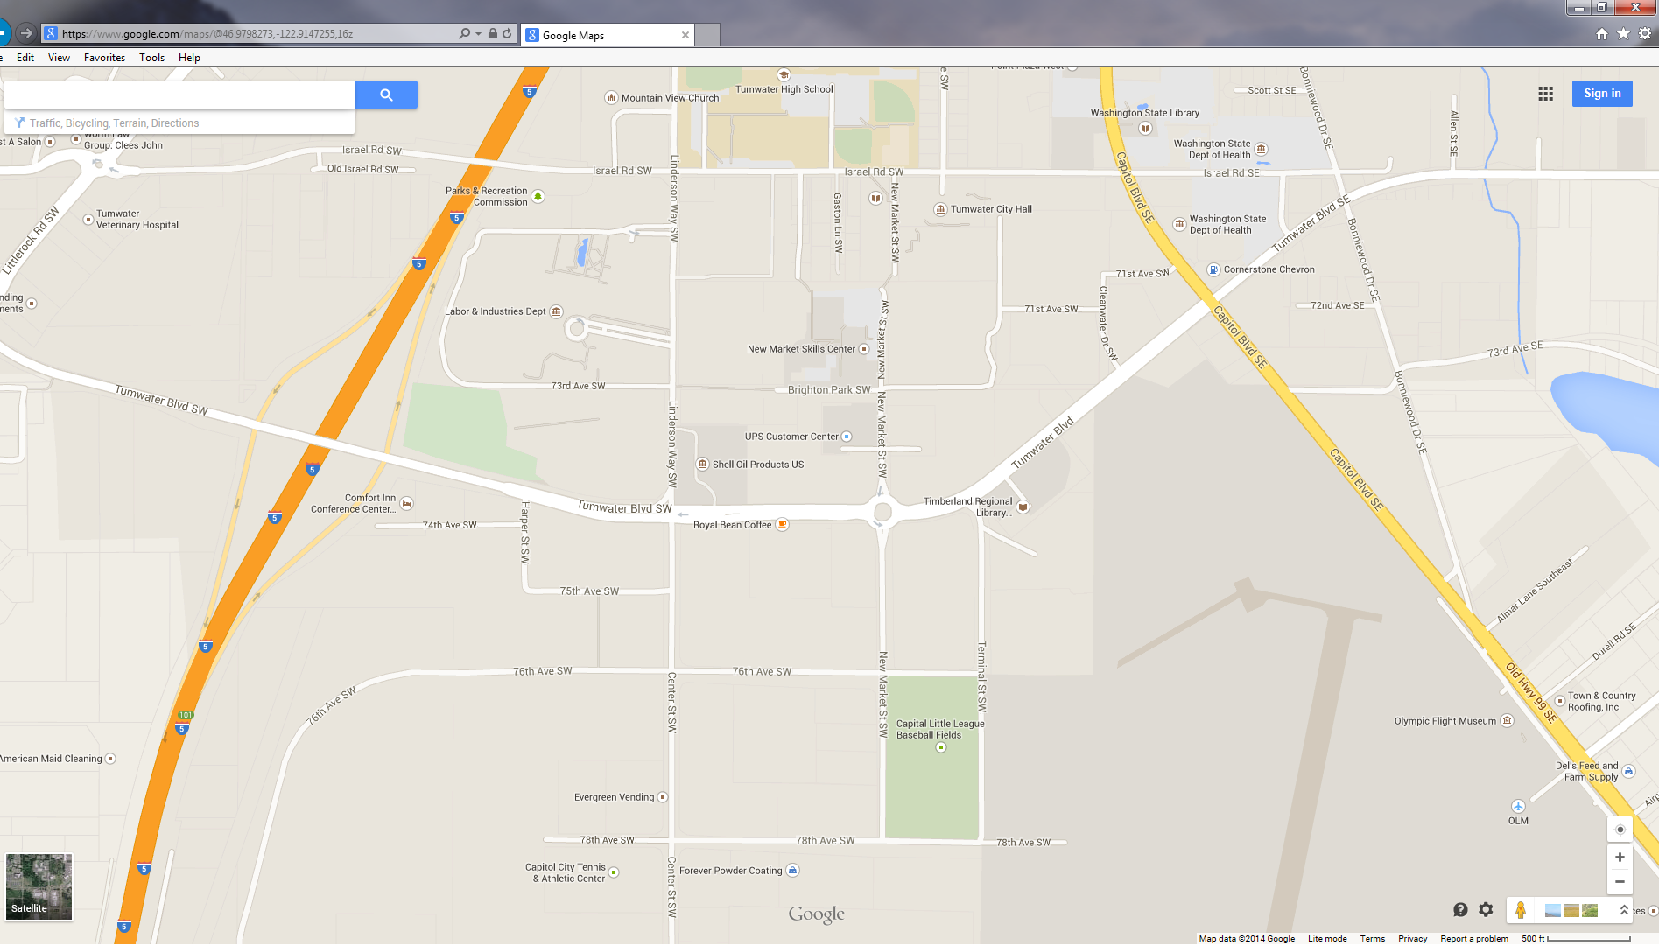
Surplus operations location
DES Surplus Operations
7511 New Market St SW
Tumwater, WA 98501
360-407-1900
2 minutes from I-5

Slide 32
N
Exit 101
surplus

Slide 33
Thank you
Questions?
david.baker@des.wa.gov
john.hedgers@des.wa.gov
www.des.wa.gov/surplus
www.govdeals.com

Slide 34


