Slide 1
What’s New for State Agencies at Department of Enterprise Services
Kari Qvigstad, Business Development Director
Location or Date

Slide 2
Introduction
Efficient, Effective & Accountable Government
Notes:
The Department of Enterprise Services (DES) delivers high quality, cost-effective support services to meet the needs of local, tribal and state governments, as well as qualified nonprofit organizations.
We focus on finding the best value for our customers, using a consultative approach to meet the diverse needs of the public sector.
The theme for this year’s conference is “Efficient, Effective and Accountable Government” – reflecting both DES and Results Washington goals.

Slide 3
Our Panel Members
Anita Bingham – Small Agency Services, WSD
George Schuetz – Small Agency Services, Finance Technology Leasing Program, Finance
Don Chavez – Recruitment Services
Renee Smith-Nyberg, Lean Transformation Services
George Carter III, Fleet Services
Notes:
INTRODUCE PANEL MEMBERS:
Anita Bingham – Small Agency Services WSD, Operations/Labor Relations Manager
George Schuetz – Small Agency Services - Finance
Don Chavez – Recruitment Services
Renee Smith-Nyberg, LTS
Aaron Pittelkau, Finance/Technology Leasing Program

Slide 4
Agenda
Who is Enterprise Services & What drives our organization?
Overview of Services
What’s New for State Agencies at Enterprise Services?
Questions and Answer Session
Notes:
The session will provide an overview of DES programs available to state agencies, featuring how agencies have benefited to become more Effective, Efficient and Accountable. I will present an overview of programs and our panel will be available for questions.

Slide 5
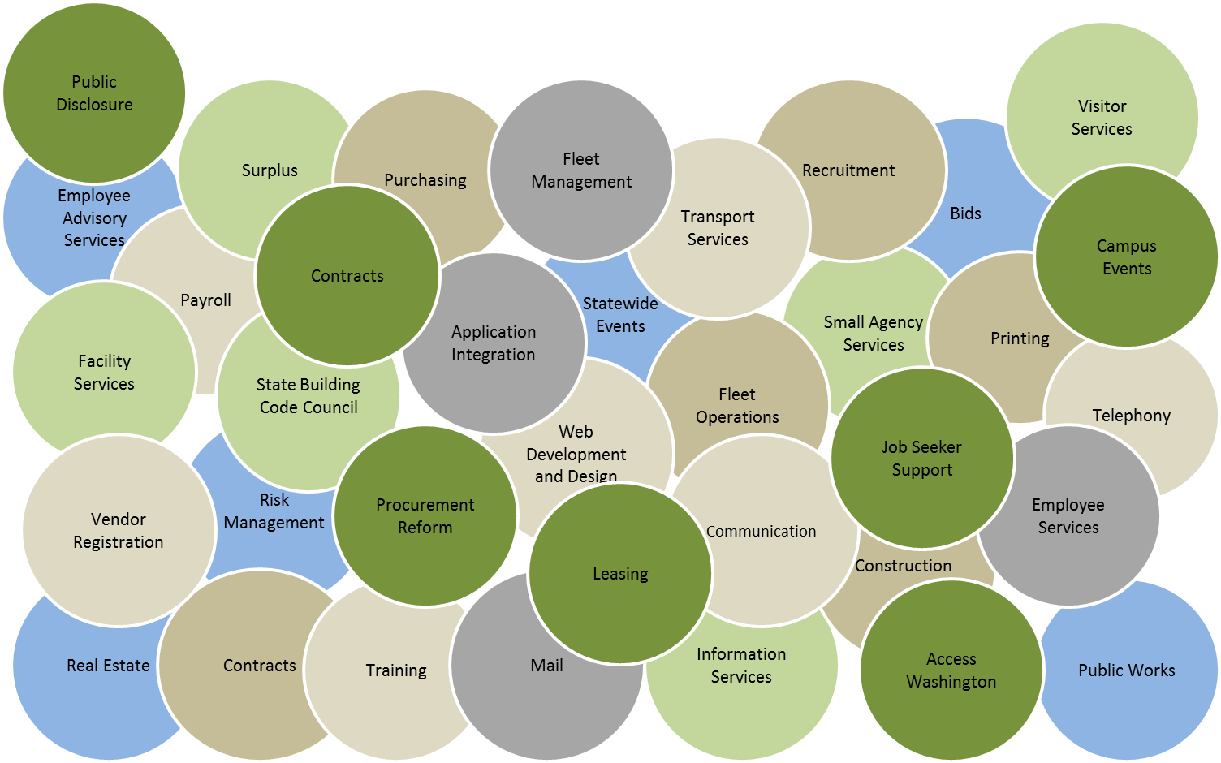
Who is Enterprise Services
Notes:
The Department of Enterprise Services (DES) is one of the newest agencies in Washington state government. Created by the Legislature in 2011, the department provides a variety of support services to state government and Washington residents. It is also charged with creating greater overall operating efficiencies.
Enterprise Services combines services from the former departments of General Administration and Printing and sections of the former departments of Personnel and Information Services. Several divisions from the Office of Financial Management are also part of the new agency. Enterprise Services began official operations in October 2011.

Slide 6
What you need. How you need it. When you Need it.
We deliver Exceptional Services
Focus on understanding client needs
Innovative problem solvers
Committee partners
We reduce the overall Cost of Government Operations
Leverage the purchasing power of the state
Competitively priced for value delivered
We focus on Improvement
State role model in Lean Culture
Employee empowered to solve problems
Team focus on continuous improvement
Notes:
What you need. How you need it. When you need it.
We focus on finding the best value for our customers, using a consultative approach to meet the diverse needs of the public sector.
We Deliver Exceptional Services Customers call us first for support service needs, knowing we are innovative problem-solvers and committed partners. We focus on understanding client needs so we can exceed expectations and deliver integrated services and solutions with ease.
We Reduce the Overall Cost of Government Operations We provide substantial value that reduces the cost of government operations. All Enterprise Services are competitively priced for the value delivered.
We Focus on Improvement Enterprise Services is a role model in Lean culture and improvement results for state government. Continuous improvement is infused in all aspects of agency culture. Every team member is empowered to solve problems. Through knowledge, coaching and support, our team is equipped to make improvements every day.

Slide 7
Overview of Services

Slide 8
Small Agency Services
Workforce Support and Development
New name!
Consultations on organizational issues
Online Tools and Checklist
Customer Feedback – on-site service
Notes:
Small Agency Services Enterprise Services provides efficient, centrally located human resource, financial, and recruiting services to small state agencies, boards, and commissions. Our support allows small agencies to focus their limited resources on their core missions and strategic plans. Programs include:
Workforce Support and Development/Anita Our HR team offers consultations on performance appraisals, performance communication strategies, corrective and disciplinary actions, assistance in setting expectations, and guidance for strategic decisions regarding reorganizations, layoffs and other organizational issues. We also provide helpful online tools and checklists.
What’s New? The Workforce Support and Development Team interviewed customers to establish mutually agreeable customer expectations. Customers were asked to rate our services and we now have a baseline score that will help us identify improvements that can be put into place. One of the things we heard from the HR customers is that some of them would like us to provide on-site service. We have been able to accommodate this request and the feedback has been very positive.
Seed Question
What HR challenges do you see for small agencies?

Slide 9
Small Agency Services
Finance
Budgeting and financial management services
Accounts payable services
Invoicing, accounts receivable and cash receipts services
Payroll services
Accounting Services Manager
Jim Morgan
Jim.morgan@des.wa.gov
(360) 407-9458
Budget Services Manager
Gwen McClanahan
Gwen.mcclanahan@des.wa.gov
(360) 407-8132
Notes:
Finance/George Our finance team offers budgeting and financial management services, accounts payable services, invoicing, accounts receivable and cash receipts services, and payroll services to Small State Agencies and Commissions.

Slide 10
Small Agency Financial Services
What’s New?
Effeciencies
99% - Employee Self Service (ESS) leave tool
90% - Travel reimbursement requests electronically
90% - “Delegated authority” - automatically pay bills
100% - Automated electronic notification of payments
94% - Standardized automated budget status reports
100% - All general ledgers reconciled
Notes:
99% - Using the Employee Self Service (ESS) leave tool to enter leave directly into HRMS. Reduced paperwork, shortened turnaround time for leave approval, increased efficiency, and eliminated keying errors. 90% - Submitting travel reimbursement requests electronically via the Travel Expense Management System (TEMS). Reduced redundancy/errors, streamlined processes, and saved time by the system being equipped with all the travel regulations, policies, and reimbursement rates. 90% - On “delegated authority” giving DES authority to automatically pay regular reoccurring bills. Saved the customer agency handling and processing, and shortened processing time.
100% - Receive automated electronic notification of payments and deposits processed. Eliminated manual copying and mailing of information to the agencies, saved staff time, copy costs, and postage fees. 94% - Receive standardized automated budget status reports. Eliminated manual entry and potential keying errors. 100% - All general ledgers are reconciled and old balances cleaned up. Eliminated any unknown accounting issues, and ensured accurate and complete financial information.

Slide 11
State Recruitment
Recruitment services
Posting of positions
Support of candidate assessment and selection
Notes:
Recruitment/Don We offer expert recruitment services, posting of positions, support for candidate assessment and selection activities (typically at exec level)
What’s new?
In transition: with a decentralized model, some agencies do their own recruitment, but we are still here to consult. Are working with agencies to determine their expectations – future needs.
Seed Question
Provide an example of how you are doing this and how it’s working….
IT example: State DICE

Slide 12
Lean Transformation Services
Washington is leading the way in adapting Lean principles and tools to state government operations so we can deliver better value to Washingtonians and make public service a delightful experience.
Notes:
Lean Transformation Services. We offer state agencies and local governments High value, cost effective consulting services – including building a Lean program, developing a scientific problem-solving skills and mindset, developing Lean leader coaching habits and mindset, introducing and maturing huddles, guiding program and agency fundamentals mapping, generating strategic and business plans, coaching development, organizational change management, strengthening visual management and communication, deploying Lean methods at the jobsite, and institutionalizing Lean through HR systems and practices.
How is this Lean transformation different? Lean Transformation Services builds capability and culture for a comprehensive Lean program that focuses on scientific problem solving skills, coaching habits and strategies and business plans for organizations.
Our Lean consultants are state employees
We “get” what it means to apply Lean to government
We are guiding government to a new way of working!
“What’s new from Lean Transformation Services?”
Culture building support
Experiential leadership and employee development
Training to build capability and confidence
Expert facilitation to improve processes
Customized services adapted to your agency’s unique needs
Goal: Everyone uses the scientific method to solve problems, improve and innovate. So that… Every leader is a coach. Every employee is a problem solver
Seed Question: My agency hasn’t done much with Lean yet. How can we get started?

Slide 13
Procurement Policy and Training
What’s New?
Upcoming policies, guidelines and process
Upcoming training plans
NEW! IT Training
More info at training session Nov. 5
Notes:
Steve: Current and upcoming policies and guidelines and the policy process
Cheryl: Phase 1 Procurement Training and accomplishments and upcoming training plans
Melanie: NEW! IT Training: Mission and plans for setting up training around IT procurement policy and process with the first initial training session planned for early 2016.
More info at training session Nov. 5 Procurement Policy and Training – Now What? 9:45 Rm 316

Slide 14
Risk Management
Risk Assessment Assistance
Claims handling and loss prevention
Technical support, training and incident reviews
Consultation
Develop proactive strategies that reduce risk
State agency insurance plans
Facility/Equipment rental insurance
Travel polices
Out-of-state worker polices
Notes:
Risk Management We provide risk management assistance to state agencies including claims handling and loss prevention through technical support, training, and incident reviews. We also work with agencies to develop proactive strategies that reduce risk. Enterprise Services offers state agency insurance plans including facility/equipment rental insurance, travel policies, out-of-state worker policies and even policies for fine arts. And, we can help local government self-insurers ensure they have sufficient funding to pay claims.
We’re here to help everyone become better stewards of public resources.
What’s new?
Limited cyber- liability insurance is available this year under the state’s property insurance program. If you have insured property on the policy you have this added coverage. It is limited -- but if not exhausted by other claimants, it can provide help with costs associated with responding to a data breach.
Seed Question:
How does Risk Management assist with claims and loss prevention?

Slide 15
State Vehicle Fleet Services
Provide state drivers with safe, reliable, lowest cost vehicle options
A 4,000+ vehicle fleet
70 state agencies
What’s new?
Pilot project for Data Driven Fleet Management
Notes:
State Vehicle Fleet Services Our agency oversees a 4,000+ vehicle fleet operation that provides efficient and environmentally friendly transportation options to state agencies, colleges, boards, and commissions. We also provide contracted services for state business travel. Fleet vehicles are currently assigned to about 70 WA State government entities
Fleet has a team of 23 fleet management professionals providing vehicle management services
Vehicles leased to agencies long term on permanent assignment
Vehicles leased to agencies for projects lasting 30-180 days
Daily rental vehicles for rentals of 30 days or less
Maintenance shop to service all Fleet Operations vehicles
Our Goal: Provide state drivers with safe, reliable, lowest cost vehicle options
What’s new: How Vehicle Fleet Services has upgraded its fleet with environmentally friendly transportation options.
Data Driven Fleet Management: Nov 5 @ 1:30 pm

Slide 16
Technology Leasing Program
Stay current with technology needs while managing cash flow
Expansion of product offerings
Now offering services outside State Agencies
Notes:
Technology Leasing Program helps agencies stay current with IT needs while managing cash-flow.
What’s new with Tech Leasing:
Expansion of product offerings – in the past the program only leased desktops, laptops, and servers, however product lines have been expanded to printers, network infrastructure, backup recovery storage devices, and other types of technology that may or may not be on the master contracts
K-12, higher ed, polic subs, and local governments – organizations within these government classifications now have the ability to access Technology Leasing’s full range of product offerings
New Master Lease Agreement (MLA) – The contract has been rewritten in order to provide customers with more flexibility at the end of the lease. Customers now have three options rather than the lone option of surplussing the leased hardware: turn the equipment back in to Technology Leasing for surplussing; extend the lease for up to 12 months at the cost of $1.75 per unit; or transfer ownership of the hardware from DES Tech. Leasing to the lessee.

Slide 17
Services for diverse government needs
Contracting and Purchasing
Facilities and Leasing
Architecture & Engineering Services
Real Estate Services
Workforce Development Services
Employee Assistance Program
Print and Mail Services
Surplus Operations
Travel Services
Notes:
Local and tribal governments, higher education institutions, school districts, state agencies and qualified non-profits can also take advantage of consolidated bargaining power and government efficiencies through the following programs.
Contracting & Purchasing
Agencies save time and resources by using master contracts. Our master contracts make public dollars stretch as far as possible while creating opportunities for 1,200 vendors. We provide expertise on statewide initiatives like green purchasing and supplier diversity.
Our team provides procurement support, training and consulting services. Customers benefit from economies of scale. State agencies can also benefit from rebates and discounts thanks to cooperative purchasing power. Local and tribal governments, higher education institutions and school districts, and state agencies can also take advantage of consolidated bargaining power for reliable vehicle purchases.
Facilities & Leasing
Project Management Services We offer expertise on a wide range of facility issues including managing nearly 800 design and construction projects for public agencies throughout Washington valued at more than $580 million. Our staff has an established record of completing projects on time and within budget.
Energy Program Our Energy Program is recognized for its expertise in managing energy and water conservation projects in public buildings. Since the program’s inception in 1984, the energy team has helped public agencies avoid nearly $120 million in utility costs.
Real Estate Services Our Real Estate team helps public agencies reduce their lease costs and consolidate services. In the past year, DES has helped its customers avoid $1.1 million a year in future lease costs by aggressively negotiating lease renewals against existing local market rates.
Workforce Development Services
Employee Assistance Program Enterprise Services administers the statewide Employee Assistance Program (EAP) helping state government employees and their family members resolve personal and work-related issues.
Training We host statewide online and classroom training and provide other employee development services.
Business Resources:
Printing & Mail
Enterprise Services offers a wide range of communication, print and mail assistance
Printing A wide range of services are available including variable printing, quick copy, offset and digital printing, warehousing and shipping, and binding and finishing. Our expert print buyers help customers develop economical product specifications and manage the competitive bidding process to find the highest quality job at the best price. And, online ordering makes it easy for customers to place orders and manage order history. A professional print staff with an average of 14 years of experience is available to consult on more complex jobs.
Mail Mailing services include maintaining and cleansing distribution lists, boxing and shrink-wrapping, inserting and other services designed to reduce postage, shipping and handling costs. We provide pick-up and delivery service for interagency documents and packages to 45 cities in 10 counties. Our dispatch drivers cover more than 1,800 miles and make 1,135 separate deliveries and pickups.
Surplus
Recycling, reuse, and sales of surplus assets benefit all public organizations. Our overall sales of goods returned more than $12 million to state and local government agencies over the last three fiscal years. The sale, reuse and recycling of goods also keeps hundreds of thousands of pounds of materials from being dumped in landfills. Enterprise Services works with the Department of Corrections and the Office of Superintendent of Public Instruction to refurbish computers and redistribute them for use by school districts across the state. In 2013, 5,950 computers were sold Washington Schools for $27 each.
Surplus Operations can facilitate transfers of surplus properties from one agency or institution to another, allowing clients to invest more of their resources in serving the public. Between July 2013 and August 2014, more than 900 items were transferred through DES at a value of nearly $50,000.
Travel Services
We offer travel services--including air travel, lodging, rental vehicles and travel agent assistance— to local and tribal governments, higher education institutions and school districts, state agencies and qualified nonprofit corporations through state contracts.

Slide 18
Questions for Panel Members
Notes:
Gwen McClanahan, Small Agency Services - Finance ?
Anita Bingham – Small Agency Services – HR. Tell us more about the new on-site service that customers asked for. How is this making HR more efficient, effective & accountable?
Don Chavez – Recruitment Services
Renee, LTS
Lucy Isaki, Risk Management How does Risk Management assist with claims and loss prevention as well as insurance plans? We can consult on claims or loss prevention issues such as cyber liability. We can provide you with on-site review of your existing insurance coverage and advise on additional coverage your agency may want to consider.
George Carter III, Fleet Services
Aaron Pittelkau, Finance/Technology Leasing Program
Build on the What’s New with the Master Contract question

Slide 19
Thank you!
Kari Qvigstad
DES Business Development Director
360- 407- 8126
kari.qvigstad@des.wa.gov
What you need
How you need it
When you need it

