Slide 1
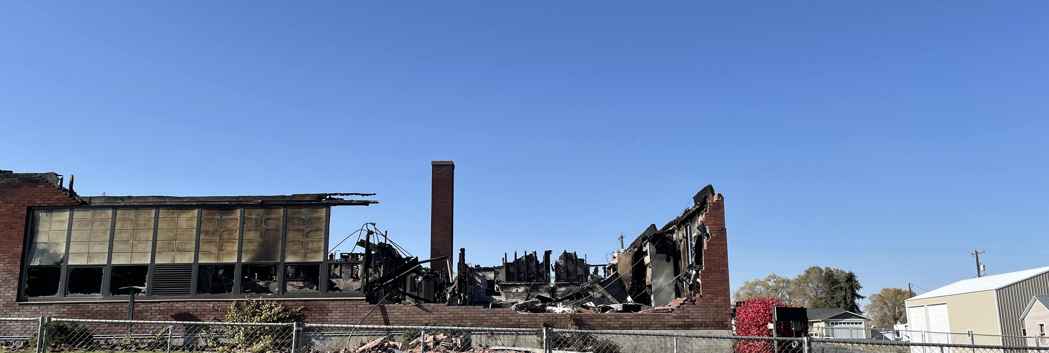
Almira School District
Application for Project Approval for Progressive Design Build
K8 School Replacement Project

Slide 2

Agenda
  Team
  Scope
  Why Progressive Design Build
  RCW 39.10
  Schedule
  Budget and Funding
  Questions

Slide 3
Project Team
Almira School District
Board of Directors and Superintendent
Gene Sementi
Project Assistant to Super.
Emergency Fire Items
Graehm Wallace
Perkins Coie Attorney
>5%
Dan Chandler, OAC
Fire Claim and Insurance Negotiation
Jeff Jurgensen, OAC
Temp Housing & DB Procurement & Construction
Damon Gardella
Program Manager
OAC
PDB Team
Garco/ALSC
Sub Consultants
TBD
Subcontractors
TBD

Slide 4
Design Build Experience of Team
Jeff Jurgensen – Sr. Vice President, DBIA, CCM
  Six major capital design-build projects plus several smaller projects
Damon Gardella – Program Manager, CCM, Assoc. DBIA, PMP
  Currently managing a $20+M PDB project with Ellensburg SD and $2.5 M PDG with Spokane Conservation District
Graehm Wallace – Perkins Coie
  Over a dozen RCW 39.10 design-build projects
  Numerous private design-build projects
Dan Chandler – Sr. Vice President, OAC, CCM (working insurance claim)
  Over a dozen RCW 39.10 design-build projects
  Numerous private design-build projects
  Industry pioneer with alternative project delivery

Slide 5
Scope of DB Team & Project
Negotiate the scope of work and replacement cost with Insurance as part of the owner team
  Build back exactly what was there with all code upgrades (ADA, Energy Code, Seismic, Fire, etc.)
Work with the Owner and team to program and scope and price a new facility for up to 150 K8 students.
Work with the Owner and team to assist in pursuing grants and other funding opportunities with the legislators etc.
Ultimately program, price and build a new K8 facility for 150 students.

Slide 6
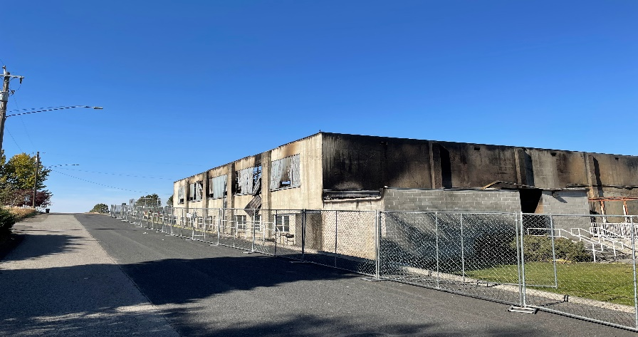
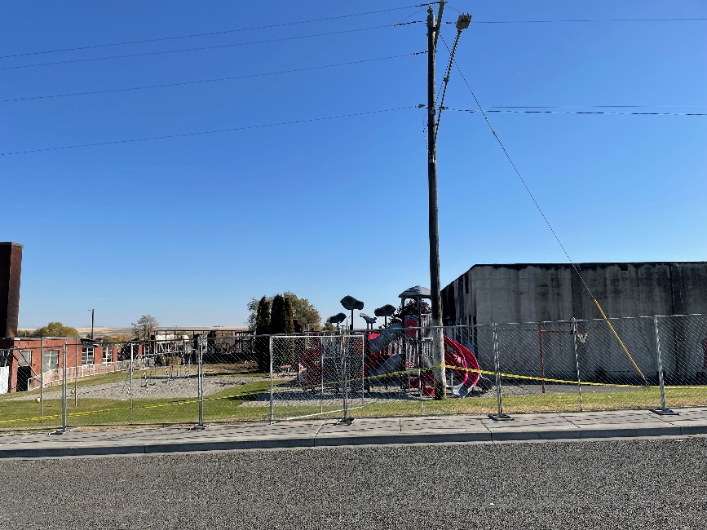
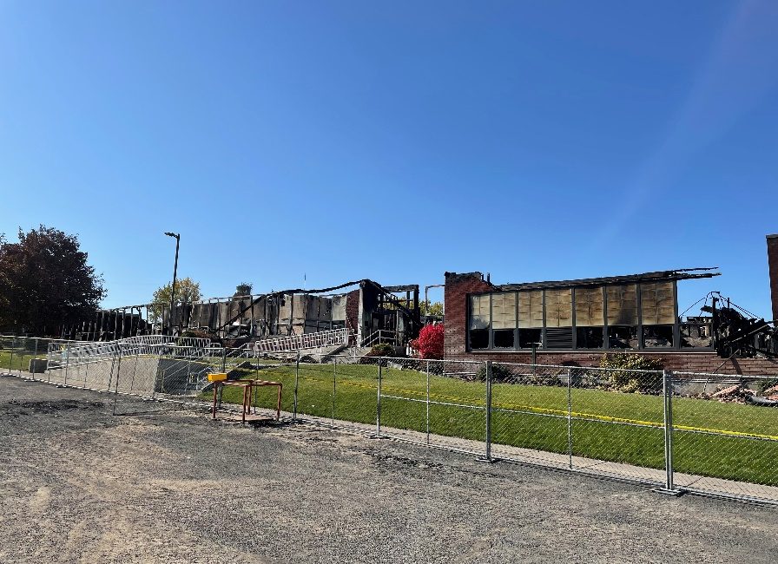
Existing Site Today

Slide 7
Why Progressive Design Build?
Predictability: Align Budget and Scope with Insurance & funding
Assistance with funding request from legislature & Insurance
Efficiency and Innovation: Design Development
Time to Market and Expedited Schedule (FLEXIBILITY)
Early Cost Certainty
Single Point of Responsibility for Owner

Slide 8
RCW 39.10.300
The project meets all three of the RCW criteria:
Design-build approach is critical in developing the construction methodology due to work with insurance.
The project will be provided opportunity for greater innovation and efficiencies by utilizing the Progressive Design Build methodology.
This project will realize significant savings in project delivery time which will show progress to the community. By utilizing PDB, we get the benefit of early cost certainty, while beginning the procurement of materials, early site packages, and “mini-GMP’s”. Flexibility is crucial with insurance company.

Slide 9
Almira SD Schedule
Description | Duration | Start | Finish
PRC Meeting and Approval | 1 day | 12/02/2021 | 12/02/2021
Advertise RFQ & Collect SOQ’s | 1.5 weeks | 10/31/2021 | 11/09/2021
SOQ’s Scoring | 4 days | 11/09/2021 | 11/12/2021
Interviews | 1 day | 11/17/2021 | 11/17/2021
Fee Proposal and Opening | 1 day | 11/29/2021 | 11/29/2021
School Board Approval of Design Build Team | 1 day | 11/29/2021 | 11/29/2021
Protest Period before executing agreement | 4 days | 11/29/2021 | 12/03/2021
Negotiate Scope of work & costs with insurance | 6 months | 12/03/2021 | 05/01/2021
Program & Design & Negotiate New Facility | 6 months | 01/01/2022 | 06/01/2021
Construction | 1.5 Years | 05/01/2022 | 09/01/2023

Slide 10
Almira SD Budget
It should be understood this budget is dependent on the funds received from legislature as well as the negotiated reimbursement from the insurance company.
Costs for Professional Services (A/E, Legal etc.) $1.5 M
Estimated project construction costs (including construction contingencies): $14.0 M
Equipment and furnishing costs $1.0 M
Off-site costs $.5 M
Contract administration costs (owner, cm etc.) $.75 M
Contingencies (design & owner) $1.5 M
Other related project costs $.25 M
Sales Tax $1.5 M
Total $21.0 +/- M

Slide 11
By the schedule in section 3, the entire PDB procurement process is already completed prior to PRC approval. Please explain.
Response: You are correct in the schedule. This selection process will be completed by the time the PRC presentation occurs. We did notify all teams the process was being done at risk without the official approval and we did notify CPARB and PRC leadership of the need to move quickly. It was a thorough and comprehensive selection process that was set up in a manner to not require much in terms of deliverables from the teams and instead was based on qualifications and interviews with a fee portion. Almira is a small district therefore has no buildings to place kids while we negotiate with insurance or rebuild the facility. They are bussing the middle school kids to Coulee City while the smaller kids are being housed in a church and community center. One of the benefits of progressive design build is the ability to have the design build team working with the owner to help negotiate the settlement while progressing with the design of the new facility. The insurance adjuster and insurance company both recommended design build to the school district as the best way to give the designer and builder involved in the entire process to help it progress smoothly. Teams submitted their qualifications on an A3 form and then were asked to interview and lastly was the fee submittals. Another reason for starting prior to the approval of the PRC is due to the start of the legislative session starting in January 2022 and the need to have cost estimates and budget requests to the legislators prior to the start of the session. If we wait until January after PRC approval we will be too late for the request as it is a short session. This project also fits the exceptions to normal bidding requirements under RCW 39.04.280(1)(e), public works in the event of an emergency.

Slide 12
To what extent is the insurance company involved in contractor and subcontractor selection and negotiation? Explain their role in this process in detail as it pertains to decision making and authorizations.
Response: They are not involved. They recommended the design build process as the smoothest way to proceed allowing the entire team to be involved in the process and help maximize the settlement from the loss.
Budget currently allocates <$300/sf for building construction costs, what level of estimating has been done to validate the budget?
Response: Historical costs were used in developing the numbers in the PRC application. However, the number within the PRC application is not all the project costs. For instance, the football and baseball fields will have portables placed on them and all costs to remediate the fields will be paid for by the insurance company. All the contents of the facility such as furnishings, books, uniforms, PE equipment, etc. are to be purchased by the insurance company upon negotiation between the district and the adjuster. Flexibility is another great advantage for this delivery method.

Slide 13
What training has Almira SD leadership undertaken to prepare themselves for delivery of a PDB project?
Response: They have hired a consultant in OAC that has numerous design build projects as well as multiple projects which were insurance losses.
What owner entity with experience in this delivery method is Almira SD working with for owner guidance?
Response: They have hired the former superintendent of West Valley School District in Spokane WA to assist them with the rebuild. Gene Sementi is familiar with many of the superintendents in the Spokane area and the projects they have completed using alternative delivery. He has spoken with Central Valley School District, Mead School District and East Valley School Districts. As a result of the work OAC has done in those districts we were selected for this project.

Slide 14
Questions?

