Slide 1
Post Point Resource Recovery Project
Application for Approval to Use GC/CM Delivery
January 27, 2022

Slide 2
Presentation Overview
Team Introductions – Mike Olinger (Bellingham)
Project Overview – Tadd Giesbrecht (Carollo)
Schedule and Budget – Mike Olinger
Equity and Inclusion – Chad Schulhauser (Bellingham)
Why GC/CM Delivery – Jason Garside (Carollo)
Team Qualifications and Experience – Chad Schulhauser
Closing – Chad Schulhauser

Slide 3
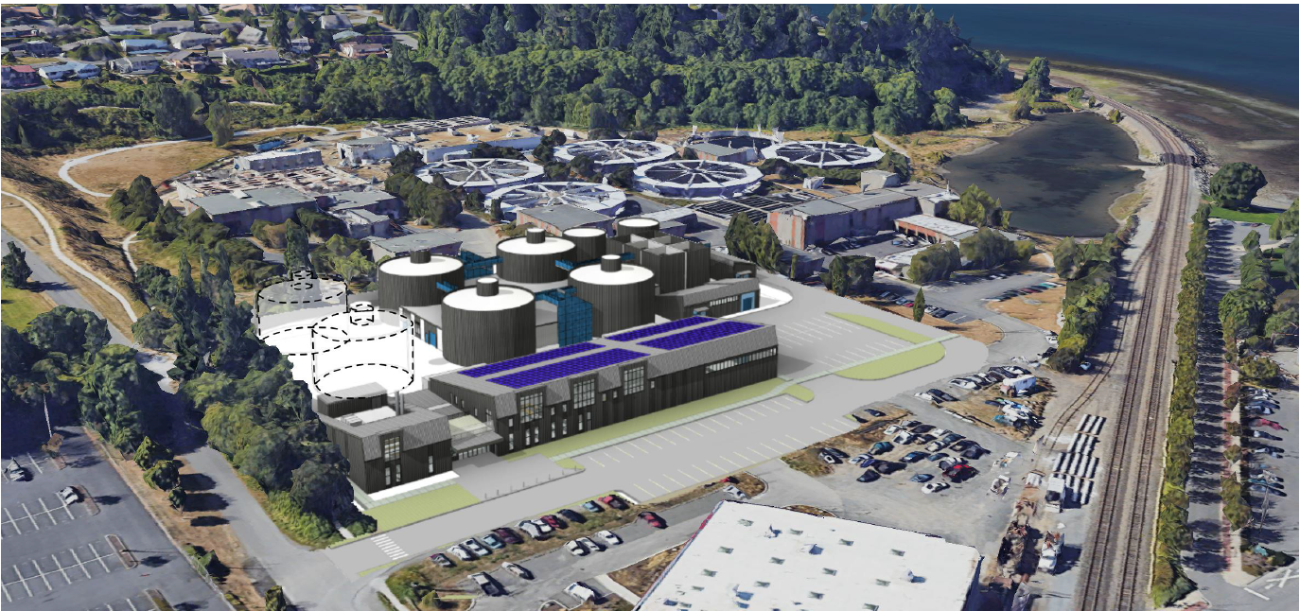
Introductions
City of Bellingham
Mike Olinger, Assistant Director of Public Works - Operations
Chad Schulhauser, Assistant Director of Public Works – Engineering/City Engineer
Steve Day, Project Manager
Steve Bradshaw, Plant Superintendent
Matt Stamps, General Counsel
Brown and Caldwell
Mike Thorstenson, Project Manager
Carollo
Jason Garside, GC/CM Advisor
Tadd Giesbrecht, Owner’s Advisor Services Lead

Slide 4
Resource Recovery Project Overview

Slide 5
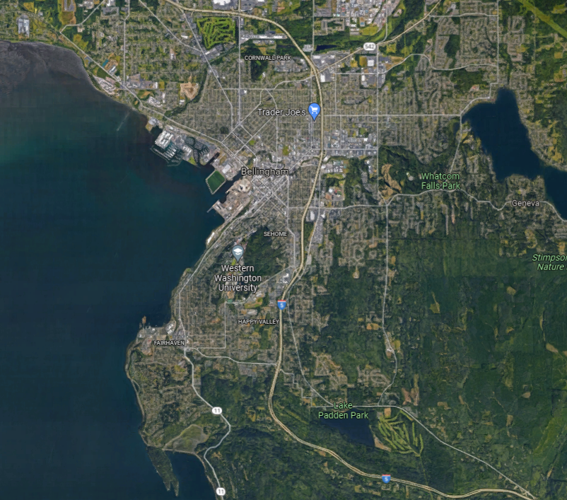
Post Point Resource Recovery (PPRR) Plant

Slide 6
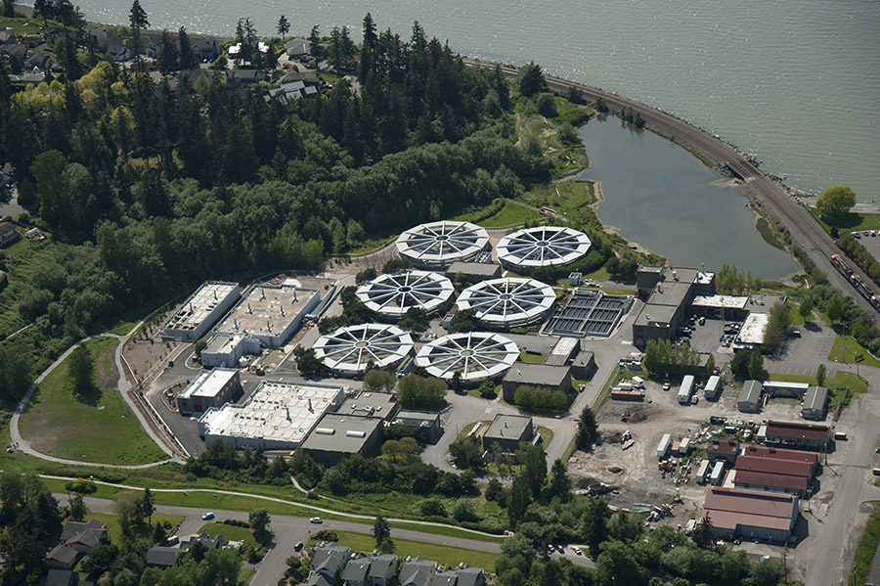
PPRR – Critical Component of Sewer System
Population served: ~100,000
10 – 72 million gallons per day
Sensitive environment
  Great Blue Heron rookery
  Public hiking trail loop

Slide 7
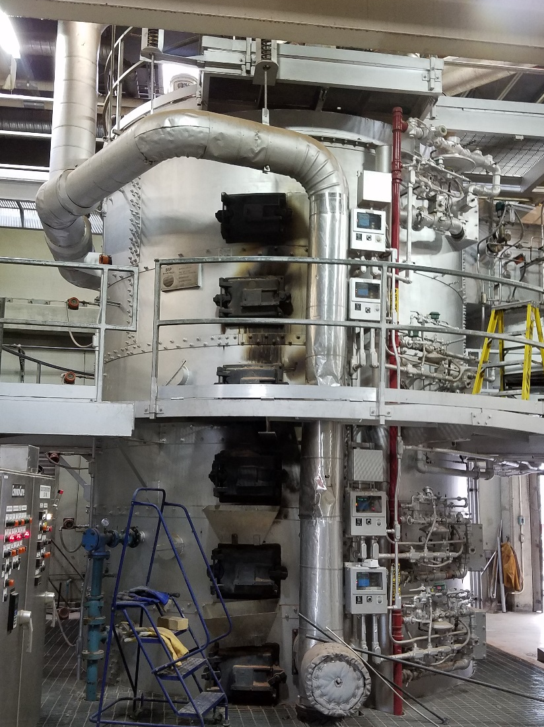
Current Incineration Process
    At end of useful life (1974 and 1993)
      Expensive to repair and maintain
      Stringent air quality permitting
      Poses a reliability and redundancy risk
      Limited capacity for growth
    Incinerates resources
      GHG emissions: ~3,900 tonne CO₂/year (~800 cars on road/year)
      Pollutants: metals, NO_{x}, CO, SO₂ etc.
      End “product” is ash in landfill

Slide 8
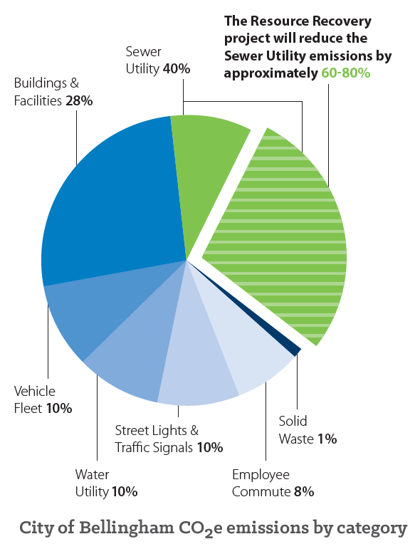
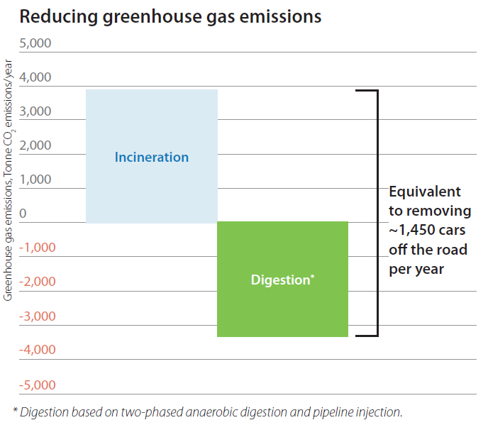
Digestion-Based Solution Supports Climate Action Plan Goals

Slide 9
Project Scope
The project will largely replace the entire solids treatment “stream” at the Post Point Resource Recovery Plant.
Anaerobic digestion system
Biogas treatment system
Solids screening, thickening and dewatering systems
Sidestream nitrogen removal process
Resource Recovery Center (administration, operations, laboratory, education center, offices, maintenance shop)
Electrical and instrumentation system upgrades

Slide 10
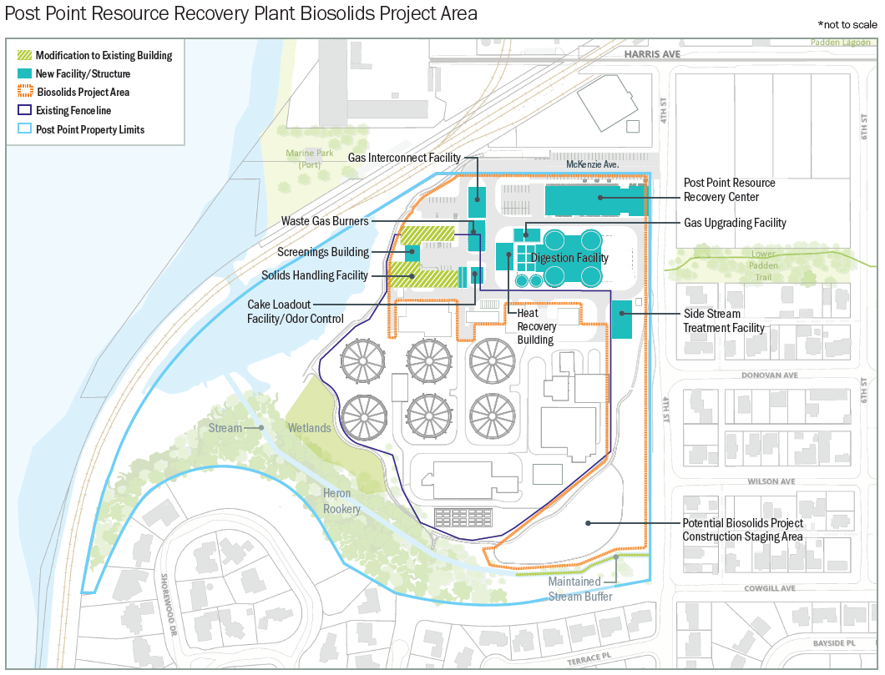

Slide 11
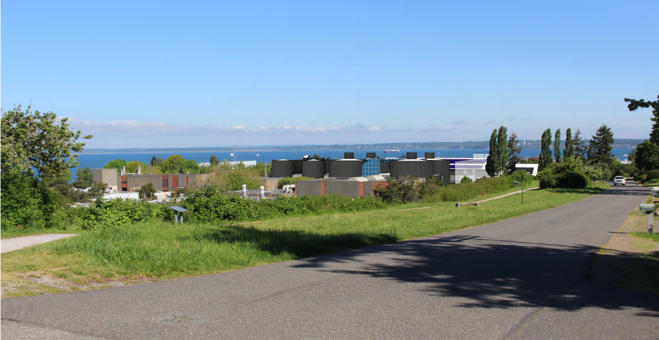
View to North

Slide 12
View to South

Slide 13
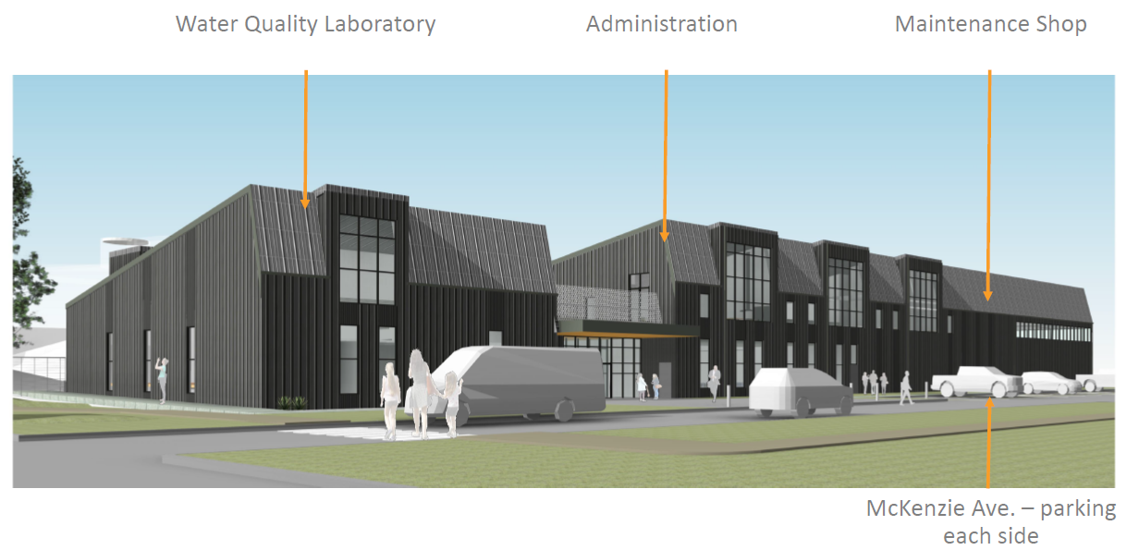
Resource Recovery Center

Slide 14
Project Schedule
GC/CM Schedule | Start | Finish
Facility Plan – submittal to Ecology and approval |  | May 2022
Preliminary Design | April 2021 | October 2022
Detailed Design: 60 percent | October 2022 | April 2023
Detailed Design: 90 percent | April 2023 | December 2023
Final Design | January 2024 | June 2024
Construction | July 2024 | June 2027

Slide 15
Project Budget
Category | Budget
Cost for Professional Services (A/E, Legal etc.) | $28,000,000
Estimated project construction costs (including 30-40% contingency) | $156,000,000
Equipment and furnishing costs | Included
Off-site costs | $1,000,000
Contract administration costs (owner, CM etc.) | $14,000,000
Contingencies (Owner’s Reserve for Change Orders at 5%) | $9,000,000
Other related project costs | N/A
Sales tax | $13,000,000
Total | $221,000,000

Slide 16

Project Funding
$15M in cash reserves to fund engineering, Owner’s Advisor services, and GC/CM preconstruction services
Invited to apply for 2021 Water Infrastructure Finance and Innovation Act (WIFIA) loan
Issue tax exempt municipal bonds
Rate increases anticipated in 2022

Slide 17
Equity and Inclusion
The City of Bellingham encourages disadvantaged, minority and women-owned companies to respond to all bids.
Projects are advertised with the Washington State Office of Minority and Women’s Business Opportunities.
The procurement documents will require the contractor to provide their approach for outreach and inclusion.
Will meet funding program requirements
Apprenticeship program

Slide 18
Why GC/CM Delivery

Slide 19
Project Delivery Analysis Resulted in GC/CM
Highly complex construction and sequencing to maintain reliable, on-going operation of the existing plant operations
Contractor involvement during design critical (constructability, risk avoidance, and cost/schedule savings identification)
City’s successful experience with GC/CM on Post Point liquids stream project
Certainty in applying a proven digestion treatment process (little value of performance risk transfer)
Value perceived in maintaining design team continuity

Slide 20

Project Complies with RCW 39.10.340
Implementation of the project involves complex scheduling, phasing, or coordination;
The project involves construction at an occupied facility which must continue to operate during construction;
The involvement of the general contractor/construction manager during the design stage is critical to the success of the project;
The project encompasses a complex or technical work environment;
The project requires specialized work on a building that has historic significance; or
The project is, and the public body elects to procure the project as, a heavy civil construction project.

Slide 21
Heavy Civil Contracting Procedure (RCW 39.10.908)
Specialized construction, including the supply and installation of specialized process equipment (equates to significant portion of the overall cost of construction)
GC/CM self-performing of specialty work and equipment supply allows for better control of the project schedule, quality of the construction and project performance
Specialty work includes mechanical equipment/piping, yard piping, structural concrete install, structural steel install, etc.
High-level of Self-performance allows GC/CM to:
  assign specialized staff
  sequence the work to optimize the schedule
  control the installation of critical systems and equipment
  avoid subcontractor quality issues on critical work
  assume warranty responsibility of process equipment

Slide 22
GC/CM Schedule
GC/CM Schedule | Start | Finish
PRC Presentation |  | January 27, 2022
GC/CM RFQ Advertisement | March/April 2022 | May 2022
Project Information Meeting | April 2022 | April 2022
RFQ Submittal Deadline |  | May 2022
Qualifications Review and Notification of Shortlist | June 2022 | July 2022
GC/CM RFP Advertisement | July 2022 | August 2022
RFP Submittal Deadline |  | August 2022
Evaluation of Proposals | August 2022 | September 2022
Notify Submitters of Scoring and Most Qualified GC/CM |  | September2022
Council Approval to Contract | September/ October 2022 | September/ October 2022
* Note the GC/CM schedule shown in this table has been revised from the dates presented in the application based on a recently updated project schedule.

Slide 23
Public Body Qualifications

Slide 24
Bellingham’s Project Delivery
This will be the City’s second GC/CM project
  Successful completion of major liquids stream upgrade in 2012
Contracted with BC/Carollo team for Owner’s Advisor services
Will engage external legal counsel to supplement internal general counsel
City has strong track record of delivering complex infrastructure projects

Slide 25
Project Management Plan
City has documented protocols and procedures for:
  Change orders
  Design milestone reviews
  Contract approvals
  Invoicing
The current PPRRP Project Management Plan will be updated to include GC/CM team
  Defined roles and lines of authority

Slide 26
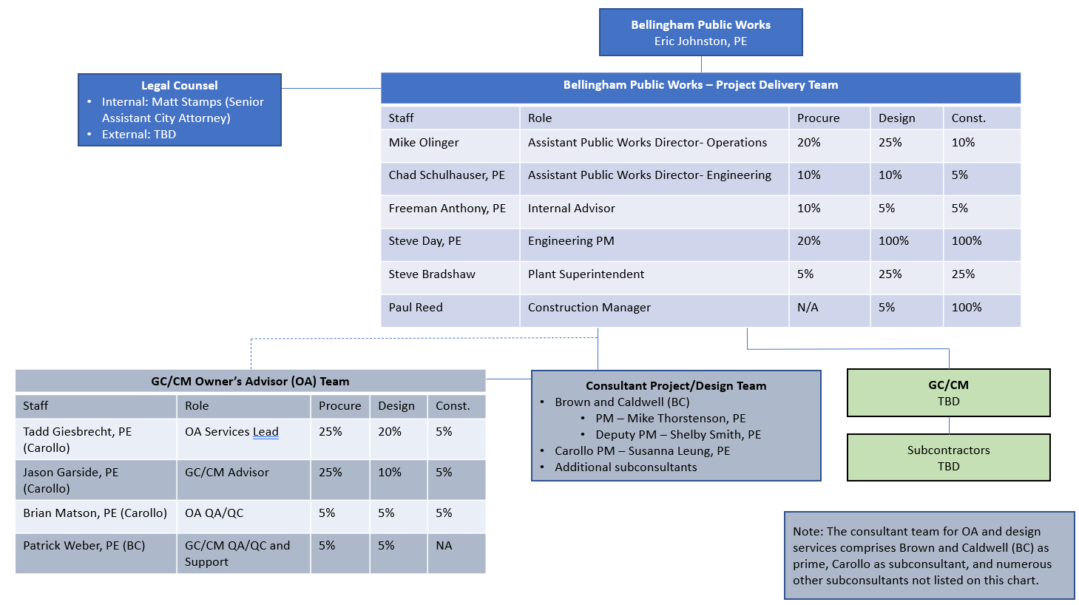

Slide 27
Team Member | Experience
Owner’s Advisor Team
Jason Garside, PE GC/CM Advisor | Over 25 years of experience in the water/wastewater industry GC/CM: Alternative Delivery Advisor for Oak Harbor, WA Clean Water Facility project. GC/CM: Procurement Advisor for Willamette (Oregon) Water Supply Program. GC/CM (referred to as CM/GC): Program Manager for the City of Fort Collins (Colorado) wastewater capital improvements program. GC/CM (referred to as CMAR): Alternative Delivery/Procurement Advisor for Bee Ridge (Florida) WRF Expansion and AWT. Progressive Design-Build: Owner’s Advisor Manager for the Los Angeles Advanced Water Purification project. Progressive Design-Build: Owner’s Advisor Manager for the Thornton Water Treatment Plant Replacement project.
Tadd Giesbrecht, PE Owner’s Advisor Lead | Over 23 years of experience in the water/wastewater industry Design-Build (Washington): Project Manager for the City of Everett Reservoir 6 roof replacement design-build project. Design-Build (Washington): Project Manager for the City of Everett Water Filtration Plant East Clearwell roof replacement design-build project. Progressive Design-Build (Washington): Principal-in-Charge for the City of Everett’s Reservoir 3 progressive design-build project. GC/CM (Washington): Design engineer for elements of the City of Everett’s Water Pollution Control Facility GC/CM project. ESCO (Washington): Project manager or principal-in-charge for multiple Energy Services Company (ESCO) projects (a form of design-build delivery). CM/GC (Idaho): Project manager for the City of Boise’s Dixie Drain CM/GC nutrient removal project.

Slide 28
Team Member | Experience
Brian Matson, PE OA QA/QC | GC/CM (Washington): Project Manager for the City of Bellingham Post Point WWTP Secondary Expansion GC/CM (Washington): Project Manager for the City of Oak Harbor Clean Water Facility GC/CM (Washington): Principal in charge of the City of Everett WPCF Secondary Expansion CM/GC (Oregon): Project Manager for the Willow Lake Water Pollution Control Facility Expansion
Susanna Leung, PE Design PM | Over 21 years of experience in the water/wastewater industry GC/CM (Washington): Project Manager for the construction phase of the City of Everett WPCF Expansion GC/CM (Washington): Assistant Project Manager for the Bellingham Post Point WWTP Secondary Expansion. GC/CM (Washington): Permitting lead for the City of Oak Harbor Clean Water Facility.
Mike Thorstenson, PE* Project Manager *Registered in states outside of WA | Over 20 years of experience in the water/wastewater industry Design-Build: Project Officer for Metro Vancouver Iona Wastewater Treatment Plant Dewatering Facilities Project GC/CM (Colorado): Interim PM for design of the Hillcrest Reservoir and PS Replacement
Patrick Weber, PE QA and Support | Over 14 years of experience in the water/wastewater industry GC/CM: Owner’s Advisor for the City of Walla Walla Mill Creek Water Treatment Plant project. GC/CM, DBB: Owner’s Advisor/Project Engineer for the City of Seattle Morse Lake Pump Plant Progressive Design-Build: Project Manager/Owner’s Advisor for the City of Everett Reservoir 3 Structural Improvements project. Progressive Design-Build: Project Manager/Owner’s Advisor for the City of Tacoma Jefferson and Hood Street Surface Water Interceptor project. Progressive Design-Build: Owner’s Advisor for the City of Middletown Lakeside Redirect Project

Slide 29
Team Member | Experience
City of Bellingham
Mike Olinger Assistant Director of Operations | 27 years of experience in the delivery of public works projects CM on the City’s 2012 GC/CM liquids treatment project
Chad Schulhauser, PE City Engineer | 28 years of experience in the delivery of public works projects 5 years of experience as City Engineer
Steve Day, PE Project Manager (for design) | 25 years of experience in the delivery of public works projects
Steve Bradshaw Plant Superintendent | 12 years of experience in the delivery of public works projects
Paul Reed Construction Manager | 30 years of experience in constructing public works projects Lead Inspector on the 2012 GC/CM liquids treatment project
Matt Stamps General Counsel (Senior Assistant City Attorney) | 18 years of experience as an attorney, including 10 years providing contracting advice to Bellingham

Slide 30
Closing

Slide 31
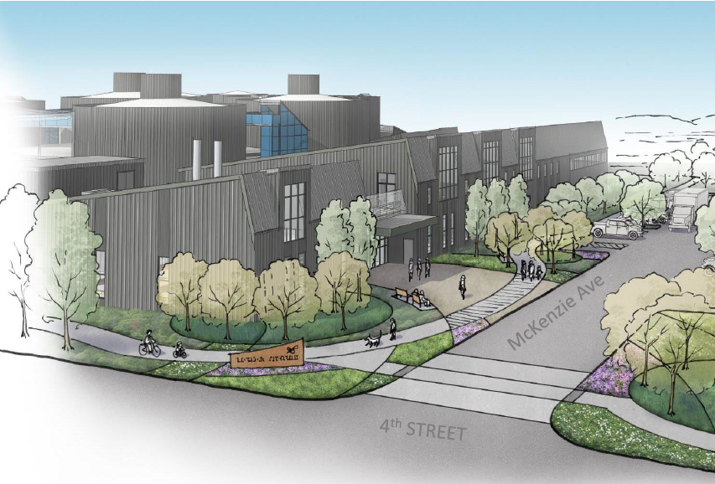
The City requests approval to use GC/CM and Heavy Civil
Project meets qualifying RCW 39.10 criteria for GC/CM delivery
GC/CM delivery would result in substantial fiscal benefit
The City has successfully implemented GC/CM on a complex upgrade at Post Point treatment plant (2012)
Highly qualified project team with significant WA State alternative delivery and GC/CM experience
Key advisors and team committed to the project through completion

Slide 32
Thank you!

Slide 33
PRC Questions

Slide 34
PRC Questions (1,2)
Will the City pay an additional fee markup for self-performed work on top of the regular GC/CM fee? If yes, will this be set by the City or be included by the proposer in their RFFP?
No. As a contract requirement with the GC/CM, the cost of self-performed work will consist of raw labor (with fringe benefits cost included) and construction equipment costs. The GC/CM fee (overhead and profit markup) percentage will be allowed to be applied to the raw labor and construction equipment costs so that the fee is applied only once.
2. Will the City be dictating any scopes of work that must be self-performed by the Heavy Civil GC/CM firm?
The City does not intend to dictate the scope or required level of self-performed work, but rather collaborate with the selected GC/CM to determine which elements of the work should be self-performed to provide the overall value to the project and comply with RCW 39.10.908. As part of the GC/CM selection, the City intends to request that proposers provide information about the proposer’s ability and experience to self-perform work. Based on previous experience, examples of self-performed work for this type of project consists of yard and mechanical piping installation, process equipment supply and installation, and concrete installation.

Slide 35
PRC Questions (3)
3. How will the City ensure fair competition and competitive pricing for sub packages in which the selected GC/CM firm will be competing against the market?
The City will include a contractual requirement that both the GC/CM and City will determine which work packages are allowed for bidding by the GC/CM. The scopes of work will be clearly defined and will not include conditions that dissuade potential bidders or provide the GC/CM an unfair advantage. The City will review the work package procurement documents for fairness prior to solicitation. A public opening of sealed bids will be conducted by City to ensure transparency and fairness.

Slide 36
PRC Questions (4)
4. How has public outreach of the anticipated substantial rate increases gone so far and what is the plan for future outreach? This substantial rate increase is very important to the budget, and it seems the budget is large for just rate increases. More detail of funding of the budget would be appreciated. Additionally, is contingency of about 4% adequate?
From the outset of the planning effort, the City engaged the public through a series of stakeholder meetings. Based on the project needs and benefits, the public conveyed support for the project. As cost information became available and initial rate impacts were determined, the team presented information to the public and City Council. The public and Council continue to support the project based on the benefits and an understanding that there isn’t a “do nothing” alternative (i.e., the existing incinerator system needs to be replaced), so major capital project is forthcoming. It’s a question of what solids stabilization technology is selected, not whether a major project is needed or not.
To get an early understanding of the rate impacts, the City directed the team to develop a planning level cost estimate to inform an initial rate study. This rate study was later updated to also include an “affordability analysis” that compared sewer rate metrics and benchmarks across multiple Washington jurisdictions.
Based on the rate study and affordability analysis, the City anticipates the following funding package for the project:
$15M in cash reserves to fund engineering, Owner’s Advisor services, and GC/CM preconstruction services
Water Infrastructure Finance and Innovation Act (WIFIA) low interest loan. In 2022, the City was invited to apply for a loan up to 49% of the project cost.
Issue tax exempt municipal bonds
Implement sewer rate increases
Pursue other sources of grant funding for environmental/resource recovery projects. A grant funding specialist is on the project team to review appropriate funding options.
Estimator’s contingency ranged from 30-40% of total direct construction costs and is included under “Estimated project construction cost (including construction contingencies)”. The $9 million listed in the table for “Contingencies” represents a 5% contingency for Owner's Reserve for Change Orders (based on Estimated project construction cost plus sales tax).

Slide 37
PRC Questions (5)
5. What other outreach has been done to stakeholders, tribes, and environmental agencies that use the area proposed for the project, and/or have significant resources to protect? How have these concerns or impacts been incorporated? This seems like a high-risk aspect to the project.
In addition to the proactive outreach described above, the City has developed a project website (https://engagebellingham.org/resource-recovery) to facilitate stakeholder outreach during Covid. Through this effort and newsletters, the City has received public feedback on the project.
Letters were also sent to the Tribes on November 12, 2021. To date, no project comments have been received. Informal tribal outreach will continue to occur as applicable; formal outreach, including any required cultural resource mitigation or memorandum of agreement associated with the project will be as developed as required per state and federal statutes.
The City currently occupies the entire Post Point Resource Recovery Plant site where the upgrades will occur. As part of improvements, upgrades to the public right of way along McKenzie Avenue will be required. In addition, we anticipate that there will be an “off-site” (within the Bellingham area, but not directly on the City’s Post Point property) component to the project. The City is currently assessing the possibility of partnering with a private entity to haul the biosolids from Post Point, further processing them to make the biosolids suitable for residential use, marketing the product, and delivering the product to its final end use.
Through frequent and on-going discussions with Ecology, there is full support of the project from a regulatory standpoint. Per the Revised Code of Washington (RCW 70.95), Ecology discourages disposing of biosolids in the landfill and instead encourages pursuing maximum beneficial use. This project epitomizes these goals and is expected to reduce the City’s Sewer Utility CO₂ emissions by over 50 percent. Beyond local regulatory support, EPA has also shown significant support for the project by inviting the City to apply for a loan up to 49% of the project costs through the highly competitive WIFIA program.
Through the outreach process, the City has specifically engaged with RESources (environmentally focused non-profit organization) and Sierra Club regarding their concerns about land application. As part of this discussion, the City has conducted additional wastewater testing and intends to pursue on-going PFAS source control measures as part of the Resource Recovery project to ensure a successful and sustainable Class A biosolids program.

Slide 38
PRC Questions (6,7)
6. More details of the Outreach to and enhancement of MWBE is needed.
The GC/CM contract will require that the GC/CM identify subcontractor packages that support MWBE participation, and that the GC/CM will be required to perform outreach to potential and interested MWBE firms. Accordingly, a Subcontractor Procurement Plan will describe the GC/CM’s approach for both subcontractor market outreach along with targeted MWBE participation. The Plan will be submitted by the GC/CM to the City for review and approval. To further support the goal of MWBE participation, the City is seeking project funding through Federal programs (e.g., WIFIA, SRF) that will require the GC/CM to perform good faith efforts in both outreach and MWBE and disadvantaged business enterprise participation.
7. It seems Mike Thorsten and Shelley Smith have DB experience from their short bios, it would also been good to get a description of their GC/CM experience.
Mike served as the interim PM during the design phase of the City of Denver Board of Water Commissioners’ [Denver Water’s] Hillcrest Reservoir and Pump Station Replacement, a $150M project that used GC/CM delivery. Shelby has not supported a GC/CM project yet, however her prior Owner’s Advisor and design-build experience will be leveraged for the City’s preferred GC/CM collaborative efforts.
The City purposely engaged the Owner’s Advisor’s Panel from within the Brown and Caldwell Team (Tadd, Jason, Brian and Patrick) to lead the services associated with the GC/CM delivery. The OA Panel’s expertise and oversight of the OA team are responsible for leading the GC/CM procurement and contractual coordination during the GC/CM’s involvement during design and eventually construction.

Slide 39
PRC Questions (8)
8. Could you highlight Tadd's GC/CM experience more since only one line of his relevant experience was a WA state GC/CM.
Tadd was a design engineer for the City of Everett Water Pollution Control Facility GC/CM project. In this capacity, Tadd worked with the GC/CM contractor during the design process, including collaborating on design elements to facilitate preferred construction techniques.
Tadd was also the consultant PM for a CM/GC project in Idaho. In this role, Tadd also provided Owner’s Advisor services, working with the City of Boise to establish the recommended project delivery approach and support the City’s administering of the CM/GC process. Tadd worked closely with the GC/CM contractor during the design to refine the design approach to align with the contractor’s preferred construction methodology. Tadd also supported the City in reviewing the GC/CM contractor’s pricing.
As the OA Services Lead, Tadd will have direct access to key resources who have extensive Washington State GC/CM experience. Tadd will serve as the primary point person for the City on Owner’s Advisor matters and engage these GC/CM resources as appropriate for developing content, conducting reviews, and advising the City through the process.

Slide 40
PRC Questions (8 contd.)
These resources with Washington GC/CM experience include the following:
Jason Garside (GC/CM Advisor): Jason has extensive GC/CM experience, including an advisor role for the Oak Harbor, WA GC/CM project.
Brian Matson (Owner’s Advisor QA/QC): Brian has significant Washington State GC/CM experience, including serving as PM for major GC/CM wastewater treatment plant projects for Bellingham ($50M), Oak Harbor ($120M), and Everett ($25M). In this capacity, Brian worked closely with the Owner’s Advisor teams, including reviewing procurement related documents.
Susanna Leung (Design Project Manager): Susanna also has leadership roles on the Bellingham, Oak Harbor, and Everett projects. Through these partnerships with the GC/CM contractors, Susanna (and Brian) successfully completed these complex, Washington State GC/CM WWTP projects.
Patrick Weber (QA and Support): Patrick was the Owner’s Advisor for the Walla Walla, WA Mill Creek Water Treatment Plant GC/CM project.
Coupling these Washington State GC/CM experiences, including direct experience on Bellingham’s 2012 GC/CM liquid stream project, with intimate knowledge of the City’s goals for this Resource Recovery project, will provide the City with a highly-qualified and strong team to successfully implement GC/CM.

