Slide 1


City of Richland | PRC Presentation
Project Approval Under RCW 39.10.280

Slide 2
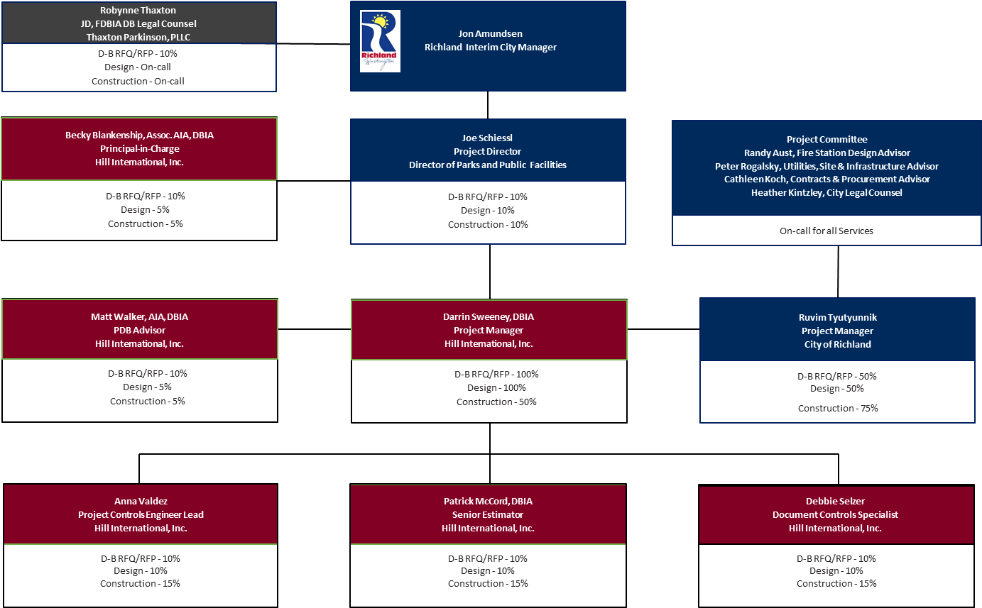
Organizational Chart
Notes:
Joe

Slide 3
Richland Design Build History
Fire Station #74 2015
BUDGET/SCOPE
  D-B-B Construction estimate w/ 3 bays > $4.2M
  D-B Construction cost w/ 4 bays = $3.4M
SCHEDULE
  D-B-B Construction duration - 18 months
  D-B Project duration - 12 months
Use DB for future fire stations
Met intent of pilot program
Notes:
Joe

Slide 4
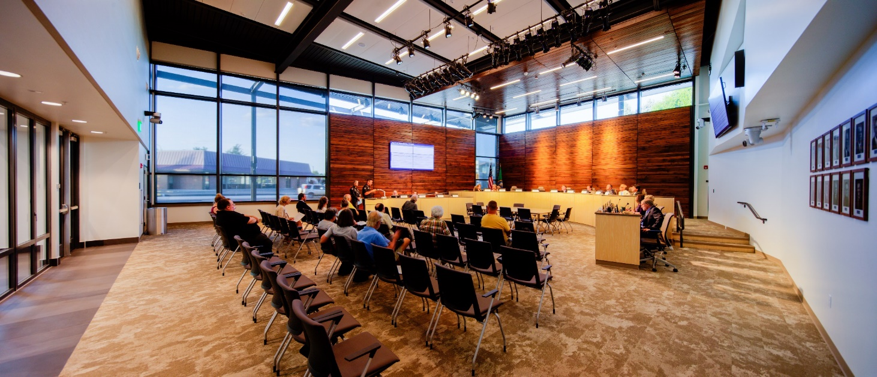
Richland Design Build History
City Hall 2019
BUDGET/SCOPE
  Final D-B Construction cost = $16.1M
  Validation GMP was $15.8M – increase due to unforeseen environmental conditions and owner added scope
SCHEDULE
  D-B Project duration - 18 months, met original schedule
Notes:
Joe

Slide 5
Richland Design Build History
Public Safety Stations 73 & 75
Location in service area that doesn’t meet GMA requirements
Site is in a rapidly growing neighborhood, near 30-acre regional park
Badger Mountain South: 3600 new residential units and several commercial projects in the next 10 years (650 Residential units in the next 2 years)
Sienna Hills- 500 new residential units in the next 6 years
Harvest Ridge- 145 new residential units in the next 4 years
Over 4200 new residential units and commercial buildings in this area over the next 10 years
Notes:
Joe

Slide 6
Facility 76 Overview
Increased area in facility for police
Other public services include community meeting room and space for Richland Public Library services and programming
Implements City of Richland Comprehensive Plan and Station Deployment Model
Fulfills obligations of the Master Development Agreement for Badger Mountain South Community
SAFER Grant for station staffing
Notes:
Randy

Slide 7
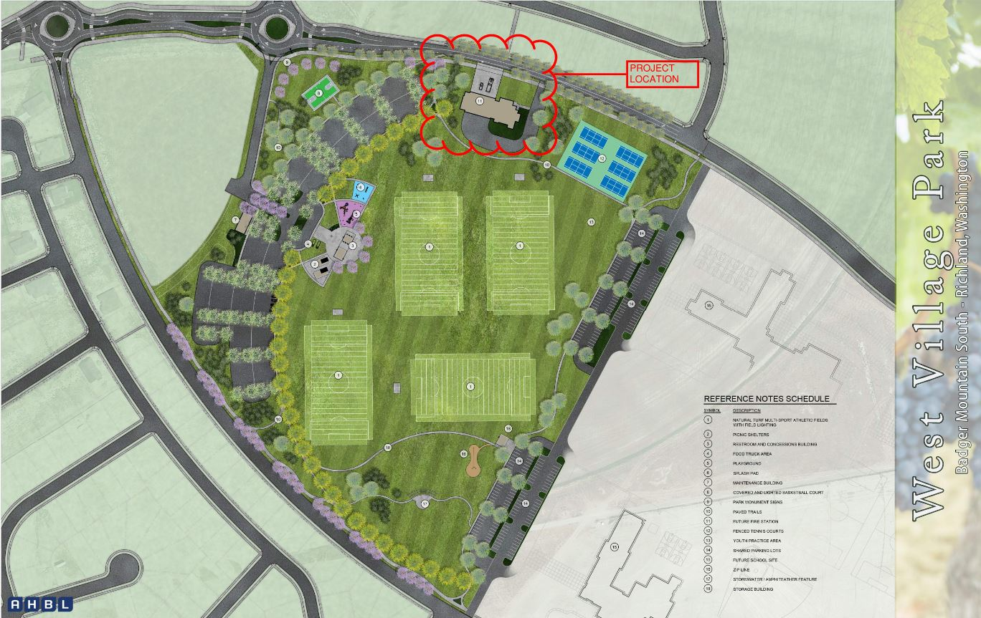
Preliminary Site Plan
Notes:
Randy

Slide 8
Preliminary Budget
  Professional Services $ 90,000
  Construction Cost $ 9,160,000
  Owner FFE $ 300,000
  Contract Admin/Other $ 200,000
  City Contingency $ 400,000
  Other Related Project Expenses $ 90,000
  WSST $ 950,300
  Total Project Cost $ 12,000,300
Notes:
Ruvim

Slide 9
Project Schedule
  PRC Presentation Jul 22, 2021
  D-B RFQ Advertisement Jul 28, 2021
  D-B SOQ Due Aug 30, 2021
  Shortlist Finalists, Issue RFP Sep 03, 2021
  Proprietary Meeting Sep 15, 2021
  Proposal Due Sep 29, 2021
  D-B Team Interviews Oct 05, 2021
  Selection of D-B Team Oct 08, 2021
  Notice to Proceed Nov 01, 2021
  Design Phase Nov 2021 thru Jul 2022
  AHJ Approval Phase Feb 2022 thru Apr 2022
  Construction Phase Apr 2022 thru Apr 2023
  Close Out Phase May 2023 thru Jun 2023
Notes:
Hill

Slide 10
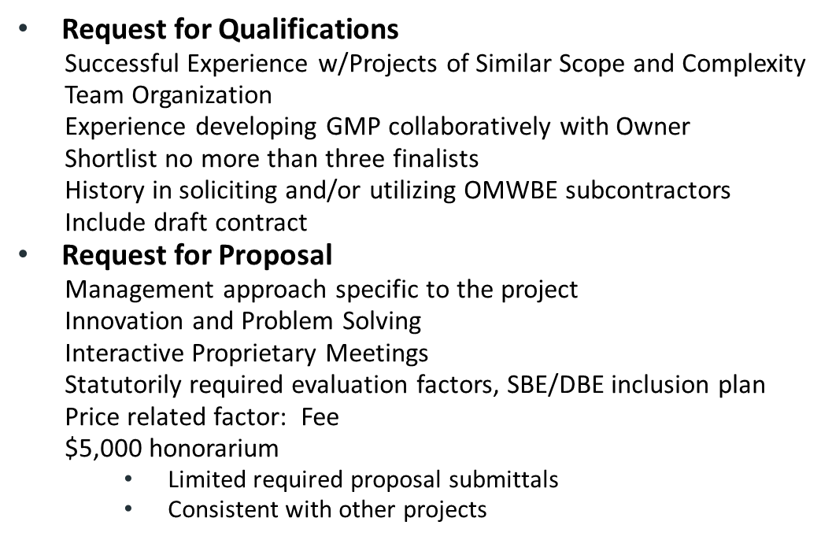
Procurement Approach
Notes:
Hill

Slide 11
OMWBE Inclusion Strategy
  Outreach to industry organizations (AGC, ASCE, etc.), encourage participation of OMWBE Certified & small businesses
  RFQ: past performance of utilization of OMWBE Certified Businesses
  RFP: Inclusion Plan for Certified & small businesses, included in scoring criteria
Notes:
Robynne

Slide 12
Benefits of Design-Build Delivery
RCW 39.10.300(1)(b) “Greater innovation or efficiencies between the designer and the builder”
  Maximum possibility for coordination of design and construction phasing to reduce impacts to the neighboring church, school and public park.
  Opportunity for innovation and efficiencies in the interface between fire, police, and library operations.
RCW 39.10.300 (1)(c) “significant savings in project delivery time”
  Progressive Design-Build is the fastest delivery method. Starting construction work prior to completion of design results in a significantly reduced schedule.
  An earlier completion date for Public Safety Facility 76 will allow the City to more quickly provide expanded fire, medical and police protection coverage. This is critical for protecting the life safety of the Badger Mountain community as soon as possible.
RCW 39.10.280(2)(a) “Substantial Fiscal Benefit”
  The budget is limited to fit within the City’s project budget. The Design-Builder will be required to design within that budget.
  The Design-Builder’s involvement in the development of the scope shifts more risk of the performance of the project to the design-build team.
Notes:
Robynne

Slide 13
PRC Committee Questions & Responses
QUESTION
XXX
QUESTION
XXX
QUESTION
XXX
Notes:
TBD

