Slide 1
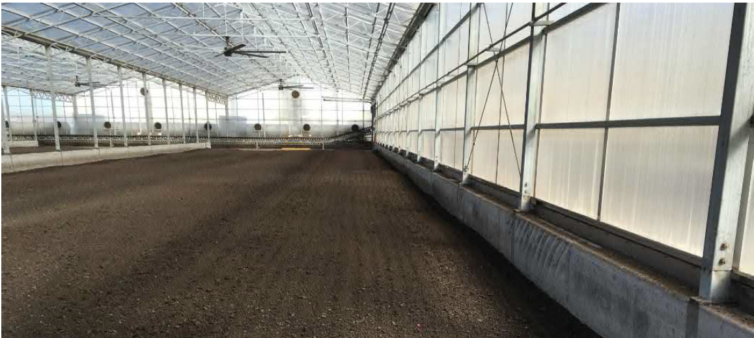
Wastewater Treatment Plant Biosolids Management - Using Progressive Design-Build
City of Kennewick
July 22, 2021
Project Review Committee Presentation
Greenhouse Biosolids Drying Project - Pasco County, Florida 2019

Slide 2
Presentation Overview
Team Introductions Cary M. Roe, PE
Project Goals and Background John A. Cowling, PE
RCW 39.10 Requirements Michael S. Lasko, PE
Project Schedule / Closing Cary M. Roe, PE

Slide 3
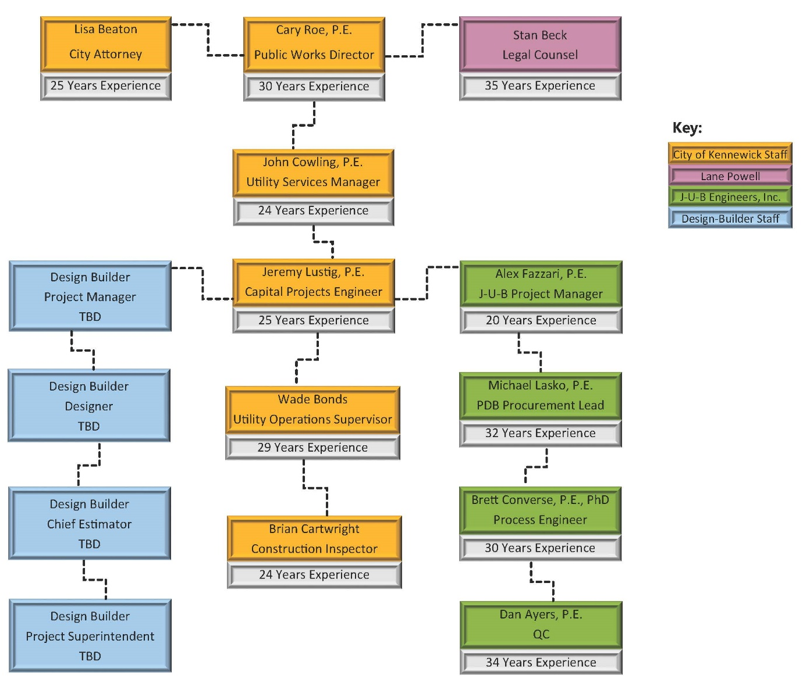
Key Leadership Team and Roles
Mr. Beck has more than 35 years of experience in construction law and also has a civil engineering background. He represents Sound Transit, the Port of Seattle, and many other public entities in their projects, including progressive design/build contracting.
The Kennewick, J-U-B Engineers and Lane Powell team members have collaboratively worked together for 20+ years

Slide 4
Project Goals and Background

Slide 5

Project Goals
The City, J-U-B and its Progressive Design Build Partner work collaboratively together throughout the project cycle.
Provide a quality and sustainable project that meets the performance requirements and follows Washington State’s Design Build guidelines and rules.
Plan, design and construct the project on time and within the City’s allocated budget.
Maximize project benefits (i.e. Class A biosolids used for fertilizer while reducing capital expenditures)

Slide 6
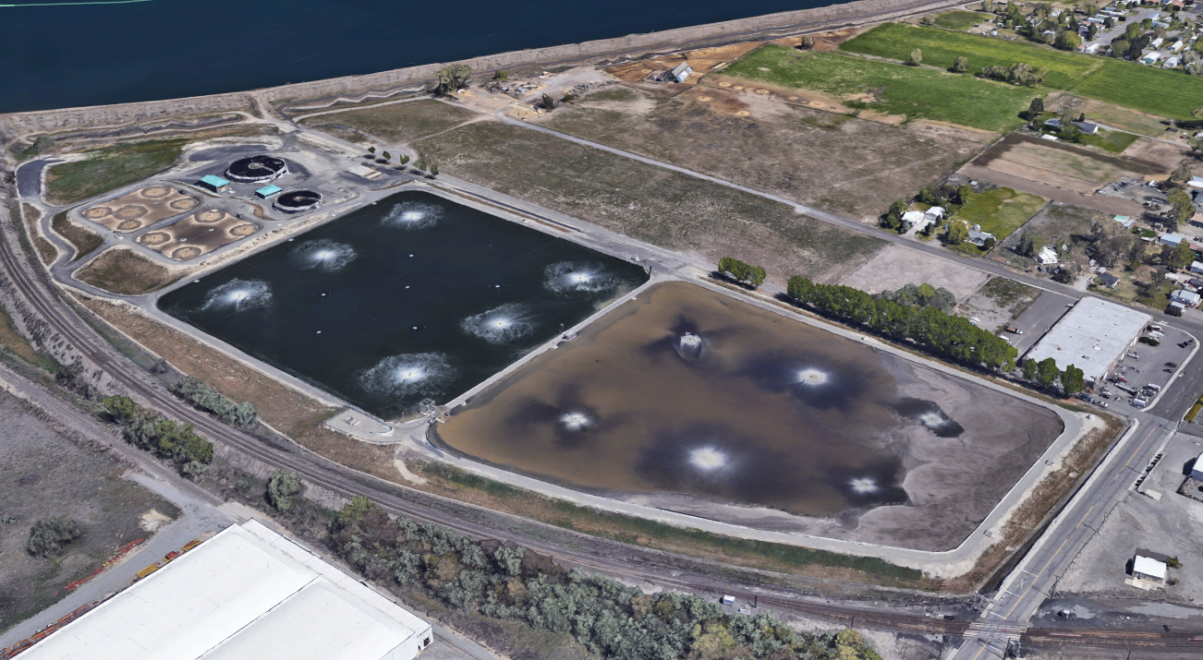
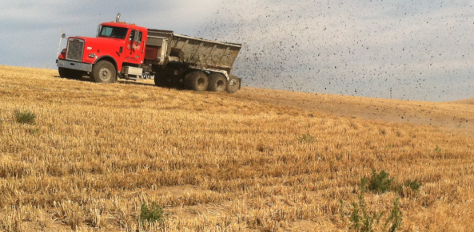
Background - WWTP Biosolids
Current lagoon system treats 10,000 pound per day of biosolids
Solids are stored in ponds for 3-4 years
Significant odors produced from process
Periodic dredging and land application increasingly more expensive
Existing Kennewick Wastewater Treatment Plant Lagoons
Land Application – Natural Selection Farms

Slide 7
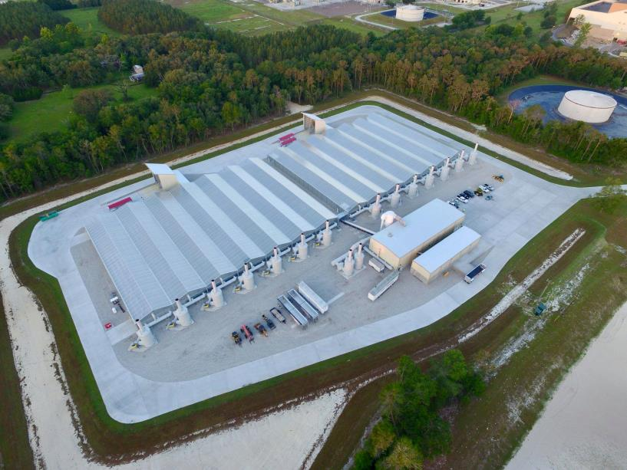
Project History
2014 - WWTP Facility Plan selected a multi phased approach with Anaerobic Digesters for Phase 2 – addition of greenhouses in Phase 4
2018 – City made aware of new alternative project in Pasco County, FL
2019 – City visited Pasco County, FL project
2019/2020 – City pilot tested greenhouse (summer and winter)
2021 – Pairwise Comparison – including cost – new alternative ranked as preferred method
2021 – Facility Plan Amendment
Biosolids Processing Plant, Pasco County, FL

Slide 8
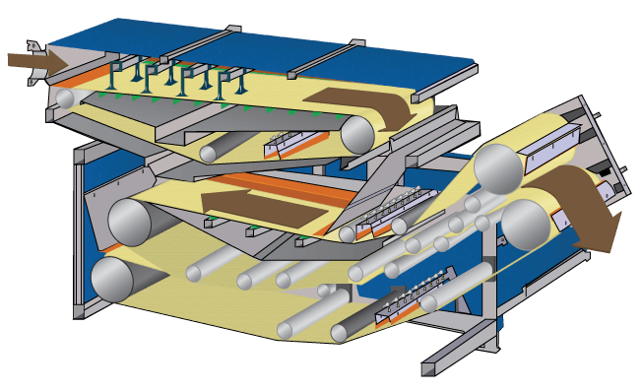
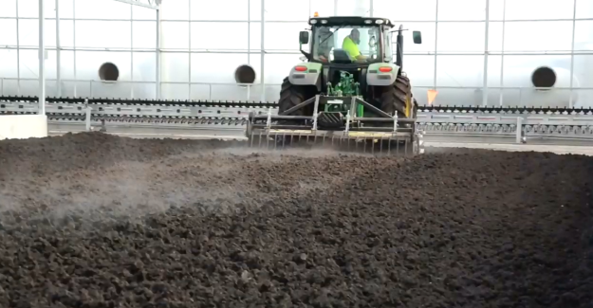
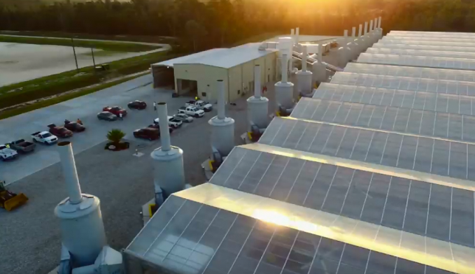
Biosolids Treatment Process
How it works:
  Step 1: WWTP Sludge is dewatered by belt filter press to achieve ~20% solids
Step 1
  Step 2: Dewatered biosolids are spread in a greenhouse for pre-drying to achieve ~60% solids through evaporation by solar heat, tilling and air circulation
  Step 3: Air is moved through the green house and is scrubbed through an activated carbon filters to emit odor free air
Step 2
Step 3

Slide 9
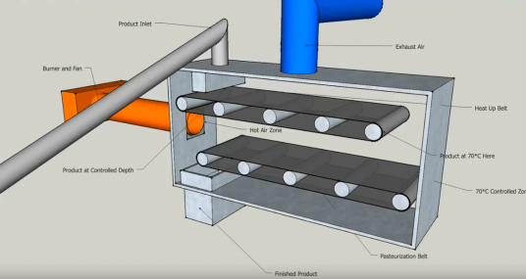
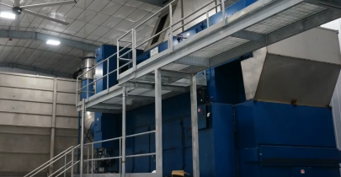
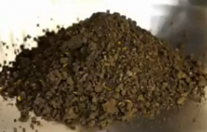
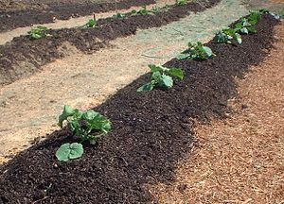
Biosolids Treatment Process
How it works:
  Step 4: Biosolids are transferred from the greenhouses to a day hopper and finally a thermal dryer. The thermal dryer is designed to meet EPA regulation for pasteurization of 70°C (158°F) for 30 minutes.
Step 4
  Step 5: Final product is Class “A” biosolids that do not have the same use or application restrictions as Class “B” due to pathogen reduction
  Class A can be used as fertilizer for crops.
Step 5

Slide 10
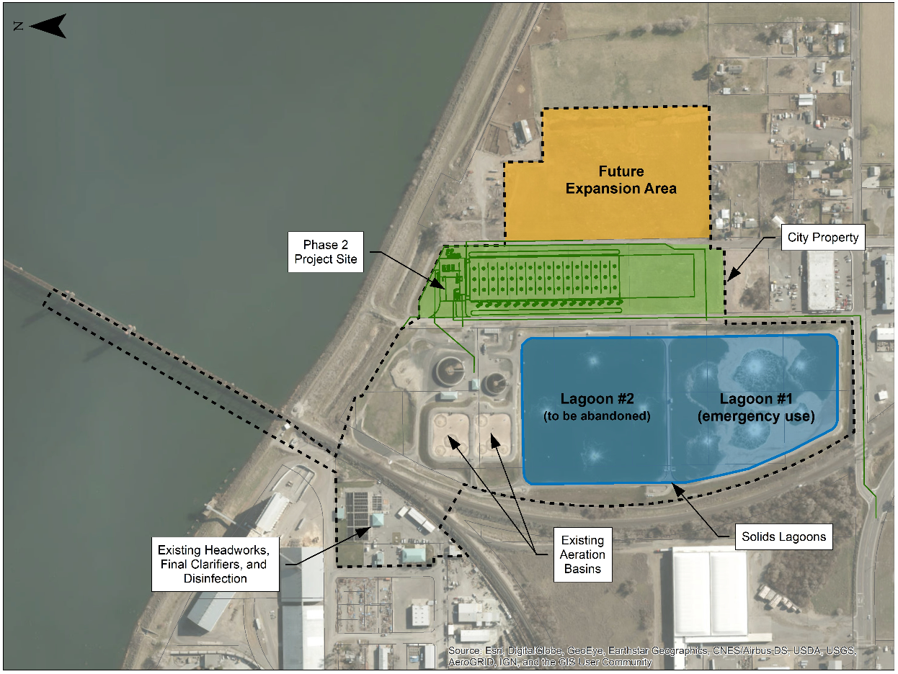
Existing and Proposed Site Plan
Proposed project to be built on existing City property

Slide 11
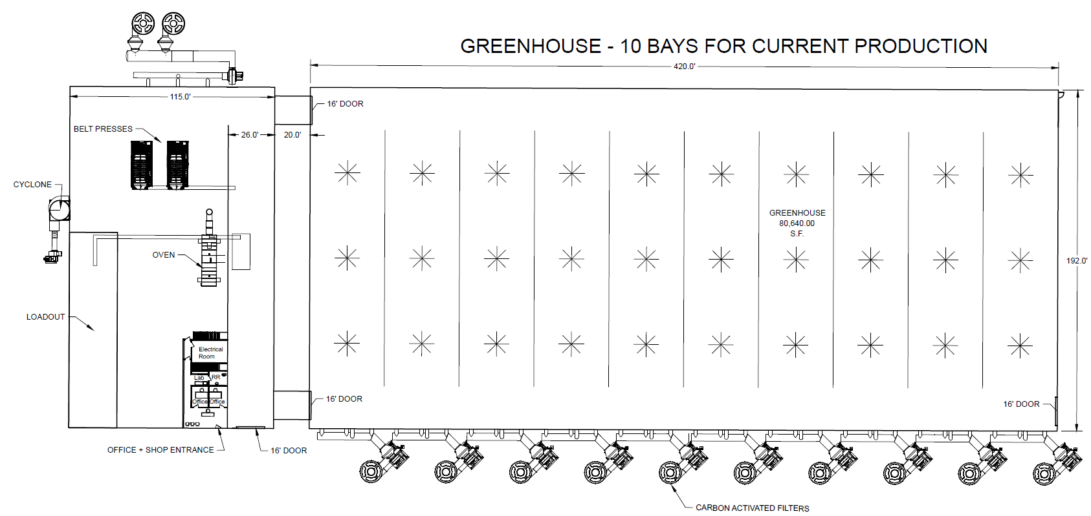
Solids Building and Greenhouse
Highlights of the pairwise comparison:
  Cost savings of ~$20 Million to produce Class A Biosolids vs Anaerobic Digestion option
  Ease of ability to expand (only additional greenhouse space needed)
  Ease of operations (not complicated for staff)

Slide 12
Revised Code of WA (RCW) 39.10 Requirements

Slide 13
Project Satisfies RCW 39.10
City Requests PRC review and certification (RCW 39.10.270 and 280)
Substantial fiscal benefit: less risk, greater opportunities for cost and schedule savings and long-term benefits (RCW 39.10.280 2a)
Qualified public body and consultant team with alternative project delivery experience (RCW 39.10.280 2c and 2d)
Resolved audit findings – Kennewick has had no audit findings (RCW 39.10.280 2e)
Total Project Cost of $29M exceeds $2M (RCW 39.10.300(1))
Project provides for greater innovation and efficiency between design and builder with owner input (RCW 39.10.300(1b))
Significant savings in project delivery time would be realized – long lead time equipment (RCW 39.10.300(1c))
Project Team has worked together for 20+ years and has the alternative delivery expertise to manage and deliver the project (RCW 39.10.320)

Slide 14
Project Satisfies New Changes
SHB 1259 Signed by the Governor on May 3, 2021 and effective July 25, 2021
  Advertised Procurement Package will include Diversity, Equity, Inclusion and Belonging contracting opportunities and requirements that comply with the Washington State’s Office of Minority and Women’s Business Enterprises (OMWBE)
  Progressive Design Builder will be required to provide a Project Management Plan that meaningfully integrates women and minority business enterprises and will be evaluated by the City’s selection process

Slide 15
Project Schedule / Closing

Slide 16
Project Schedule
Procure PDB Owner Advisor Completed
CPARB PRC Presentation Today!
Ecology Funding Application October 2021
Ecology Funding Announcements January 2022
PDB RFQ Announcement March 2022
PDB SOQs Due April 2022
RFP Announce/Shortlist May 2022
Proposals Due June 2022
Selection July 2022
Notice to Proceed September 2022
Start Construction Spring 2023
Anticipated Construction Duration 12-18 months

Slide 17
Closing
The WWTP Phase 2 project is ideal for delivering with PDB
  Critical infrastructure
  Will provide economic development for growth – including pending industrial growth
  Innovative solids management concept
  Vetted carefully with site visits, pilot testing, cost analysis
  Byproducts useful for agricultural industry
  Collaboration between operators, designers, and builders could save significant cost and improve operations
  Diversity involvement
Highly qualified project team with significant alternative delivery experience and history of working together

Slide 18

Project Review Committee Questions:
Q: Will JUB Engineers be allowed to compete for the project as a part of a PDB team?
A: JUB Engineers will not compete to be on the PBD team, however, will act as an owner representative assisting in contract and project review and oversight.
Additional Questions

