Slide 1

City of Liberty Lake
Application for Project Approval for Progressive Design Build
Trailhead Golf Course Reconstruction Project
Notes:
Katy to give an opening statement and direct the team in introductions.

Slide 2
Agenda
  Team
  Scope
  Why PDB
  RCW 39.10
  Schedule
  Budget and Funding
  MWBE Strategy
  Questions
Notes:
Katy to address.

Slide 3
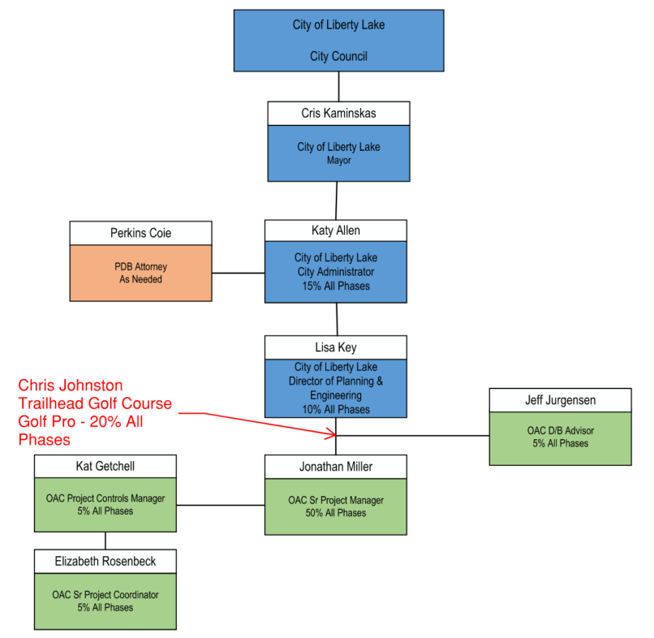
Project Team
Notes:
Katy to talk about organization chart, and reporting structure.

Slide 4
Design Build Experience of Team
Katy Allen – PE, City Administrator
  $1.3B San Jose Airport utilized PDB
  Serves on the DRB at SEATAC for International Arrival Facility which is utilizing PDB
Jeff Jurgensen – Sr. Vice President, DBIA, CCM
  Six major capital design-build projects
Jonathan Miller – Sr. Project Manager, CCM, PMP
  Currently managing a $6.5M PDB project with Spokane Valley Fire Department
Graehm Wallace – Perkins Coie
  Over a dozen RCW 39.10 design-build projects
  Numerous private design-build projects
Notes:
Katy to explain her background on construction projects, and her experience in design build. Other’s highlight their DB experience.

Slide 5
Scope of Trailhead Project
Replace existing 7,200 sq. ft. clubhouse built in 1972, with a new, larger, more functional and code compliant clubhouse
Expand current parking lot
Reorient existing driving range to accommodate additional parking
Replace existing driving range poles and netting with larger and taller poles/netting
Possibility of double decker driving range
Notes:
Chris to discuss the inadequacies the existing clubhouse, driving range and parking limitations, the consultant who examined options for upgrading the golf course, and tie in what the city council desires.

Slide 6
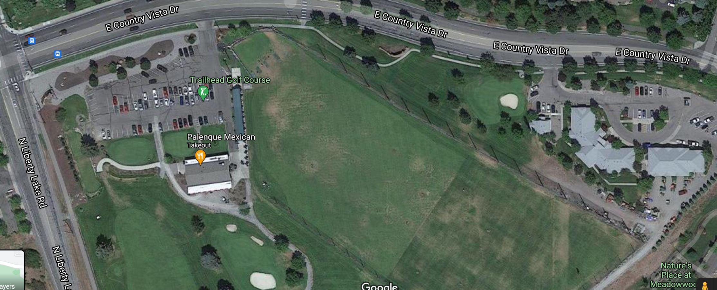
Existing Site Today
Notes:
Chris to discuss the current golf course, driving range, parking and clubhouse.

Slide 7

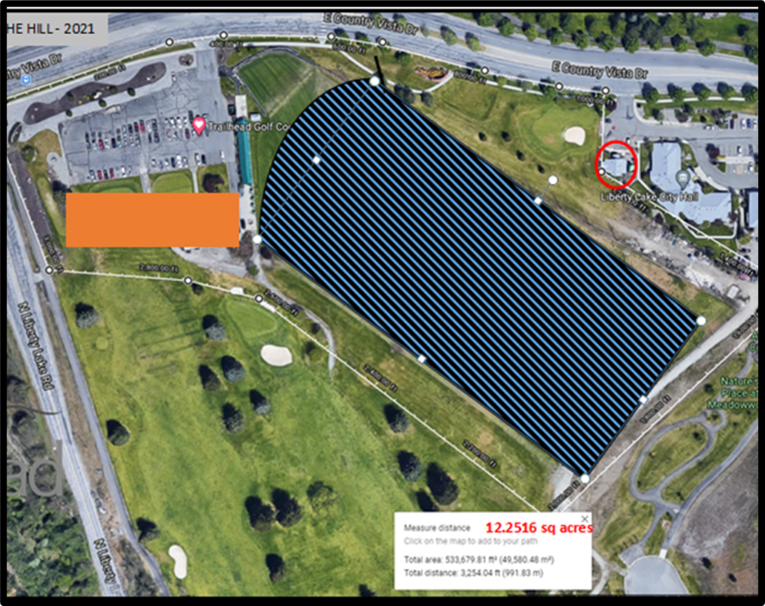
Project Elements
Parking Lot Expansion
New Clubhouse
  Pro Shop
  Restaurant Shell
  Flex Space
  Cart Storage
Driving Range
Add’l Parking
Club House
Updated Driving Range
Notes:
Chris to briefly cover project elements. Katy to address restaurant vendor RFP and broker.

Slide 8
Why Progressive Design Build?
Predictability: Align Budget and Scope
Efficiency and Innovation: Design Development
Time to Market and Expedited Schedule
Early Cost Certainty
Single Point of Responsibility for Owner
Risk Management
Notes:
Katy to explain our delivery method evaluation and why PDB was chosen; with assistance from Jonathan. Under “Risk Management” Graehm to explain the dispute resolution process identified within the contract.

Slide 9
RCW 39.10.300
The project meets all three of the RCW criteria:
Design-build approach is critical in developing the construction methodology.
The project will be provided opportunity for greater innovation and efficiencies by utilizing the Progressive Design Build methodology.
This project will realize significant savings in project delivery time which will show progress to the community. By utilizing PDB, we get the benefit of early cost certainty, while beginning the procurement of materials, early site packages, and “mini-GMP’s”.
Notes:
Katy to address this with help from Jonathan. We need to get the best “value” possible based on the money we have. PDB will allow the team to be as innovative as possible to generate the greatest value.

Slide 10
Trailhead Schedule
Description | Duration | Start | Finish
PRC Meeting and Approval | 1 day | 9/23/21 | 9/23/21
Advertise RFQ and Collect SOQ’s | 4 weeks | 9/26/21 | 10/22/21
Score SOQ’s and Shortlist | 1 week | 10/22/21 | 10/29/21
Interviews | 1 day | 11/9/21 | 11/9/21
Fee Proposal and Opening | 1 week | 11/16/21 | 11/16/21
City Council Approval of Design Builder | 1 day | 11/23/21 | 11/23/21
Programming and Validation | 3 months | 11/24/21 | 2/25/22
Negotiate GMP | 1 week | 2/28/22 | 3/4/22
Design Completion/Permitting | 6 weeks | 3/7/22 | 4/15/22
Construction | 1 year | 4/18/22 | 5/1/23
Project Completion | 4 weeks | 5/1/23 | 5/31/23
Notes:
Jonathan to talk about schedule. Emphasize we have met with DB community for input and agree this is a realistic and fair schedule for all.

Slide 11
Trailhead Budget
Of the $8.4M total project budget, $2M will come from the General Fund and the remaining $6.4M will come from a Councilmanic Bond.
Costs for Professional Services (A/E, Legal etc.) $675,000
Estimated project construction costs (including construction contingencies): $6,000,000
Equipment and furnishing costs $150,000
Off-site costs $35,000
Contract administration costs (owner, cm etc.) $320,000
Contingencies (design & owner) $500,000
Other related project costs $150,000
Sales Tax $570,000
Total $8,400,000
Notes:
Katy to explain where the $8.4M comes from. Jonathan to cover the budget overview.

Slide 12
MWBE Strategy
MWBE approach will be a scoring criteria for PDB Firms
Will utilize and reach out directly to Certified Firms identified on the Washington State Office of Minority & Women’s Business Enterprise website
Will work with the local AGC to get this project out to the contractor community
Notes:
Jonathan to cover our engagement strategy for MWBE firms.

Slide 13
Questions?
Notes:
We should try to be complete in 15 minutes

