Slide 1

La venture middle school addition
RCW 39.10 Alternative Public Works Contracting Progressive Design/Build
January 28, 2021

Slide 2
Agenda
Introductions
Mount Vernon School District
Capital Project History
The Project
Project Budget
Project Schedule
Why Design Build
Public Body Qualifications
Summary

Slide 3
Presenting Team
Mount Vernon School District
Bill Nutting – Assistant Superintendent
Parametrix
Jim Dugan – Alternative Project Delivery Program Advisor
Dan Cody – Design Build Procurement and Advisory
Jeremy Woolley – Project Manager/Construction Manager
Maggie Anderson – Project Documentation Controls

Slide 4
Additional Team Members
Mount Vernon School District
Chris Johnson – Maintenance Supervisor
MVSD Capital Projects Support Staff
Project Leadership Team (Board Members; Superintendent; Admin.)
Perkins Coie
Graehm Wallace – External D/B Legal Counsel

Slide 5
Mount Vernon School District
Comprised of:
    6 Elementary Schools
    2 Middle Schools
    1 High Schools
    Alternative & Special Programs
          Aspire Alternative Secondary School
          Northwest Career & Tech Center
          Skagit Academy
Approximately 6,700 students
Over 1,000 employees
Serving Pre-K thru 12th grade

Slide 6
Capital Project History

Slide 7
MVSD Project Delivery Experience & Qualifications
Since 2016, MVSD has successfully delivered 4 large capital projects valued at nearly $98.8 Million.
MVSD has utilized alternative delivery for all major 2016 Bond projects: GC/CM (3), & D/B (1) methods of project delivery.
Notes:
Controls
-Weekly Staff Meetings
-Weekly progress meetings
-One on one PM daily and weekly meetings
-Standing daily and weekly meetings with COO
-Multi Vista- Photographic Interactive As-Built
-Digitized As Builts and OEM Manuals in the Cloud (Skisite)
-Chalk Schools- Soup to nuts process for Project approvals

Slide 8
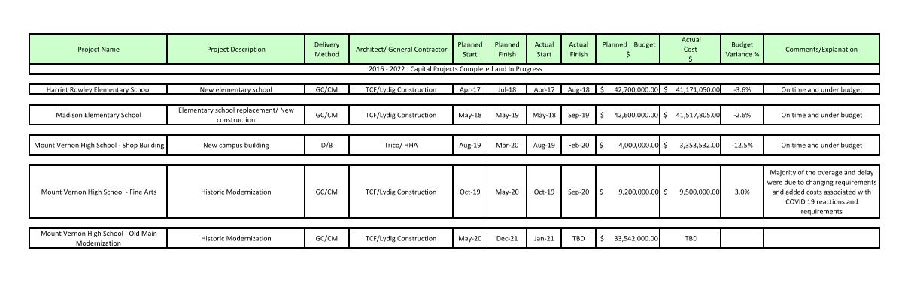
MVSD Public Body Experience – 2016 Bond
Notes:
As a public body depth of public works experience
TPS is a major capital project builder

Slide 9
The project

Slide 10
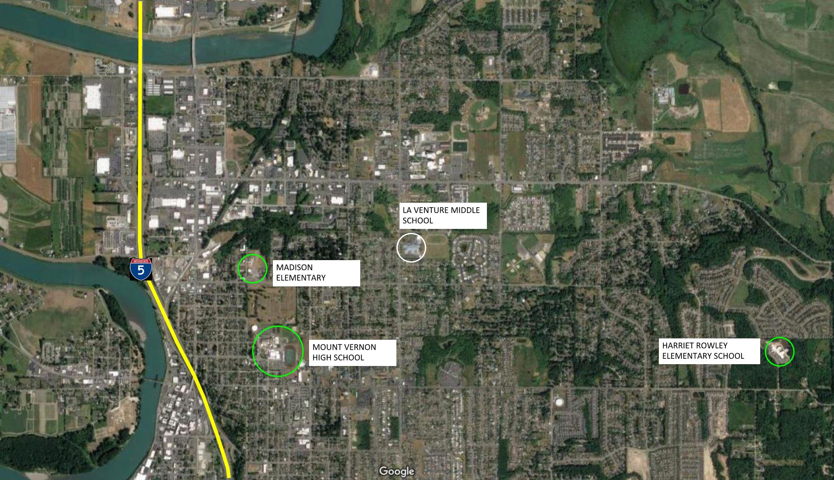
Project Location

Slide 11
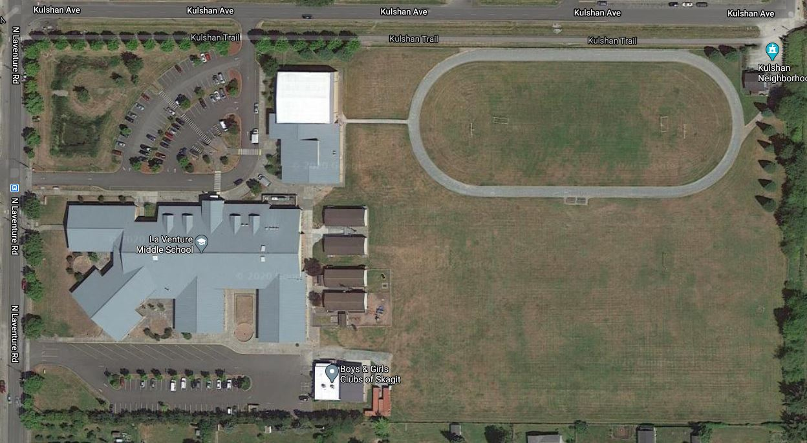
Current Site Overview

Slide 12
Project Description
Located in Mount Vernon, Washington
20-acre site
Expand lunchroom and library
Build 8 new classrooms
Board approved budget: $9.6M (construction & soft costs)
Construction timeline: January 2022 - July 2022
Occupancy - August of 2022

Slide 13
Project Description
If funding is available
Community Resource Center
Medical & Dental Services
Mental Health
Counseling Service
Legal Services
Financial Counseling
Translation Services
Food Bank/Community Closet

Slide 14
Project Budget
Category | Budget
Costs for professional services (A/E provided by D/B) | $960,000
Estimated project construction cost (including 3% D/B contingency) | $6,410,000
Equipment & furnishing costs (includes technology) | $432,000
Off-site costs | $134,000
Contract administration costs (Owner, CM etc.) | $192,000
Contingences (Owner Project Contingency @ 5%) | $480,000
Other soft costs (Owner’s consultants, permits/fees, etc.) | $433,030
Sales Tax (@ 8.7% of A/E + Construction Cost) | $557,670
TOTAL: | $9,600,000

Slide 15
Project Schedule
PRC Application | December 21, 2020
PRC Presentation | January 28, 2021
Request for Qualifications Advertised | February 2 & 9, 2021
Pre-Submittal Meeting | February 16, 2021
Statement of Qualifications Due | March 15, 2021
Score SOQs/Shortlist Finalists | March 16 - 18, 2021
Notify Submitters/Release RFP | March 19, 2021
Proprietary Meetings w/Finalists | March 29, 2021
Proposals Due – Cost Factors and Approach | April 9, 2021
Interviews | April 14, 2021
Score/Identify Most Qualified D/B | April 15 – 16, 2021
Notify Submitters | April 16, 2021

Slide 16
Project Schedule
Contract Negotiations (3 weeks) | April 19 – May 10, 2021
NTP/Board Approval of D/B Contract | May 2021
Phase 1 & Preliminary Design Service (60%) | May 2021– August 2021
Negotiate GMP (1 month) | September 2021
Phase 2: Final Design & Permit (6 months) | September 2021 – February 2022
Site Permitting (4months) | September 2021 – December 2021
Building Permitting (4 months) | November 2021 – February 2022
Construction (7 months) | January 2022 – July 2022
Occupancy/Move In | July 2022 – August 2022
First Day of School | September 2022

Slide 17
Project Schedule
Procurement schedule allows for team formation, questions, addenda as needed prior to SOQ’s due
Assumes qualifications-based selection – design concepts discouraged.
Interviews will focus on qualifications and approach.
Assumes cost-reimbursable contract – negotiated GMP
Early release of key bid packages and long lead items

Slide 18
Why d/b delivery method

Slide 19
Market Conditions
In Washington State, Between 2014 and 2020, Voters Were Asked to Approve $31.3B in Public K-12 Capital Bond Funding
Approximately $13.8B Were Approved – 44.2%
Public K-12 Capital Bond Measures Were Presented to the Voters in February, April and November Annually
In February 2020, WA State Voters Were Asked to Approve $9.4B in Public K-12 Capital Bond Funding
Approximately $1.8B Were Approved – 18.8%

Slide 20
Market Conditions
No Public K-12 Capital Bond Measures Went to the Voters in April and November of 2020
100% of the .4B Asked of the Voters in August 2020 Failed
Mount Vernon School District’s $106 M Was Approved in February 2016
Assuming the Market Slows 2019-2023 Owners Market
Time for Innovation

Slide 21
Cost Certainty
Need to “Lock Down” the Project Cost Earlier
Project Budget and Program Drive Design
In D/B, the Contractor Holds the Design Contracts and Warrants the Design
Limited Risk of Change Orders – Only Change in Scope or Unforeseen Conditions
Design/Build is the Owners Best Strategy to Minimize Risk and Expedite Cost Certainty

Slide 22
Statutory Compliance
(5.1) If the construction activities are highly specialized and a D/B approach is critical in developing the construction methodology
(5.2) If the project provides opportunity for greater innovation and efficiencies between the designer and builder
(5.3) If significant savings in project delivery time would be realized

Slide 23
Public Benefit
Cost Certainty
Risk Mitigation
Earlier Occupancy

Slide 24
Public body qualifications

Slide 25
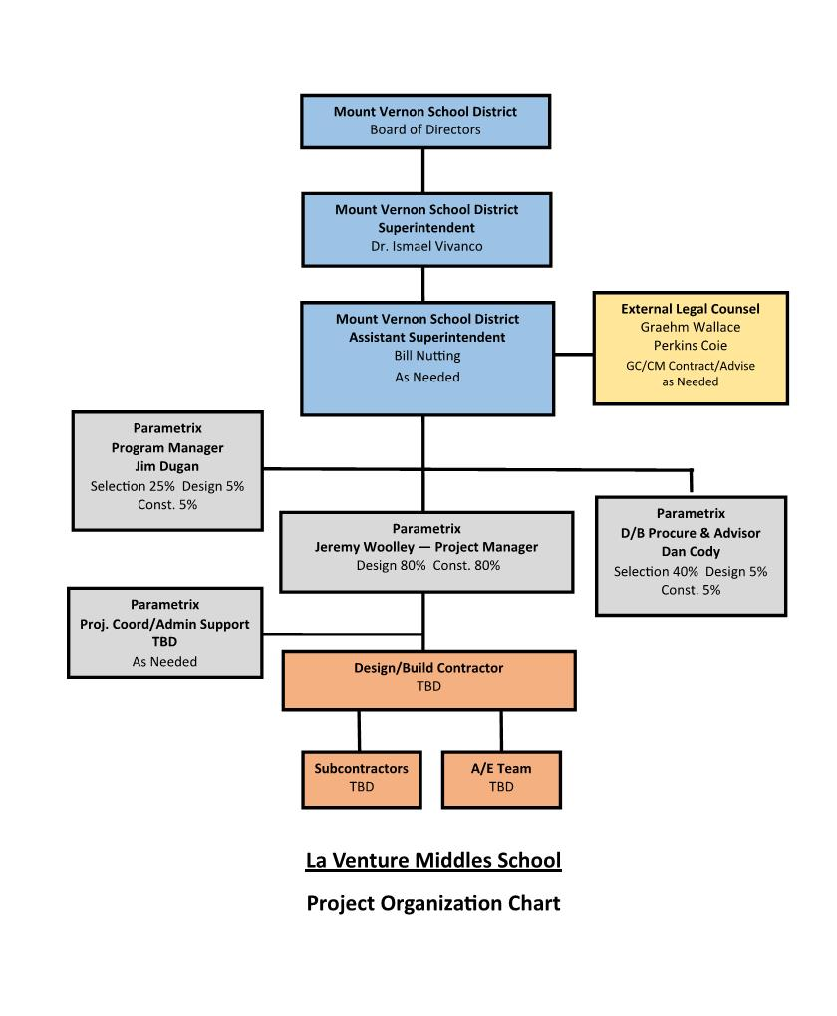
Project Organizational Chart

Slide 26
Leadership Team
Recent K-12 capital projects experience on projects of similar scope and complexity
  All of which have been delivered using GC/CM & PDB
  Track record of building projects on-time and within budget.
  Track record of RCW 39.10 compliance
MVSD completed Harriet Rowley ES, Madison ES, and Mount Vernon High School’s Fine Arts modernization using alternative delivery methods (GCCM), and utilizing the DB delivery method with the MVHS Shop building.
MVSD satisfies the public body qualifications by staff augmentation with consultants.

Slide 27
Design Build Experience

Slide 28
Summary
Project meets qualifying RCW criteria
Project Management Plan is developed and has clear, logical and proven lines of authority
Appropriate funding is in place for the project
Project Schedule allows for appropriate time to manage and complete the project
Project team has the required and necessary experience
Project team has the workload capacity

Slide 29
Thank you

