Slide 1

JOHN STANFORD CENTER FOR EDUCATIONAL EXCELLENCE
CENTRAL KITCHEN RENOVATION PHASE II
Project Review Committee Presentation
JUNE 23, 2022

Slide 2
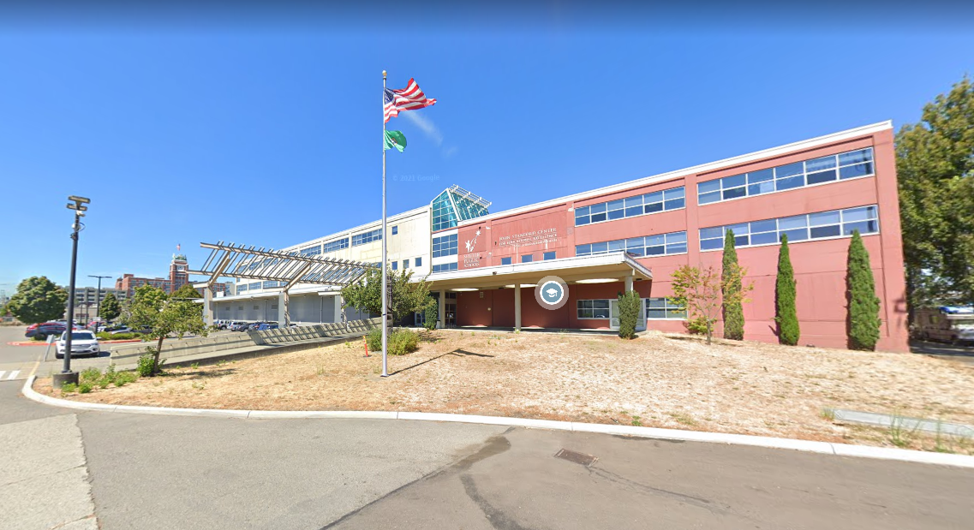
Presentation Agenda
Introductions
Alternative Public Works Criteria
Project Overview
GC/CM as Appropriate Method
Public Benefit of GC/CM
Agency experience
Team Organizational Chart and Qualifications
Summary
Questions
RB

Slide 3
RCW 39.10 Alternative Project Works Criteria
At least one of the following:
Involves complex scheduling, phasing, or coordination
Construction at an occupied facility which must continue operation
GC/CM during the design stage is critical to the project’s success
Complex or technical work environment
(No historic significance and Heavy civil construction not applicable)
RB

Slide 4
Project Overview - Scope and Budget
Funding Source: Building Renovations, Technology and Academic/Athletics V Capital Levy (BTA V), approved February 2022
The proposed project is to renovate the central kitchen to create an efficient culinary kitchen, to modernize cooking and refrigeration equipment, and to address plumbing and health code requirements.
The 30,000 square foot central kitchen serves approximately 50,000 meals each day during the school year and 6,000 meals each day for City of Seattle programs during the summer.
$18.8 M total project cost
$13.5 M construction cost (including construction contingencies)
$6.1 M kitchen equipment cost
RB

Slide 5
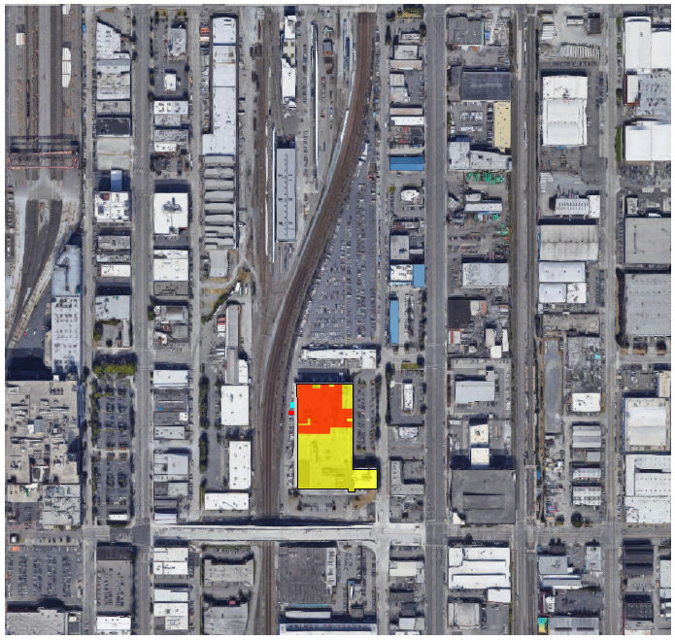
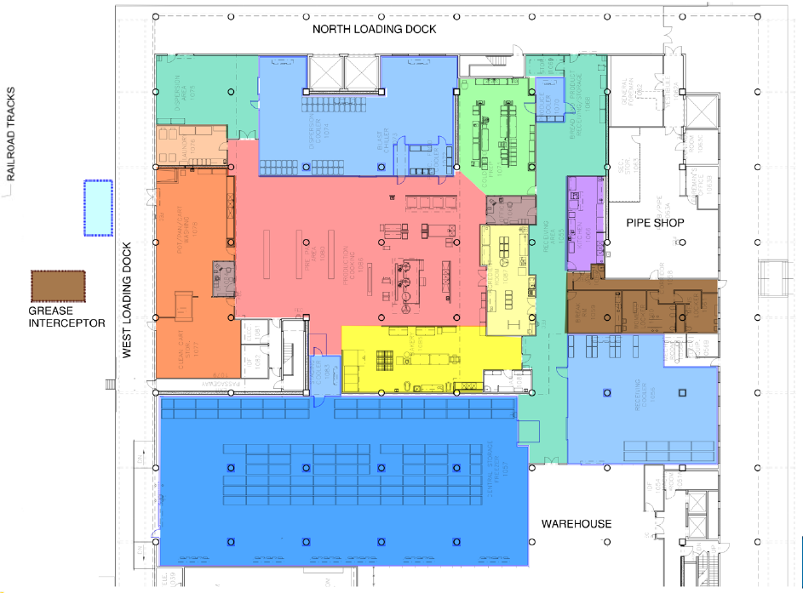
Project Overview -
Floor Plan/Site Location
PARTIAL FIRST FLOOR PLAN
N
SITE PLAN
VG

Slide 6
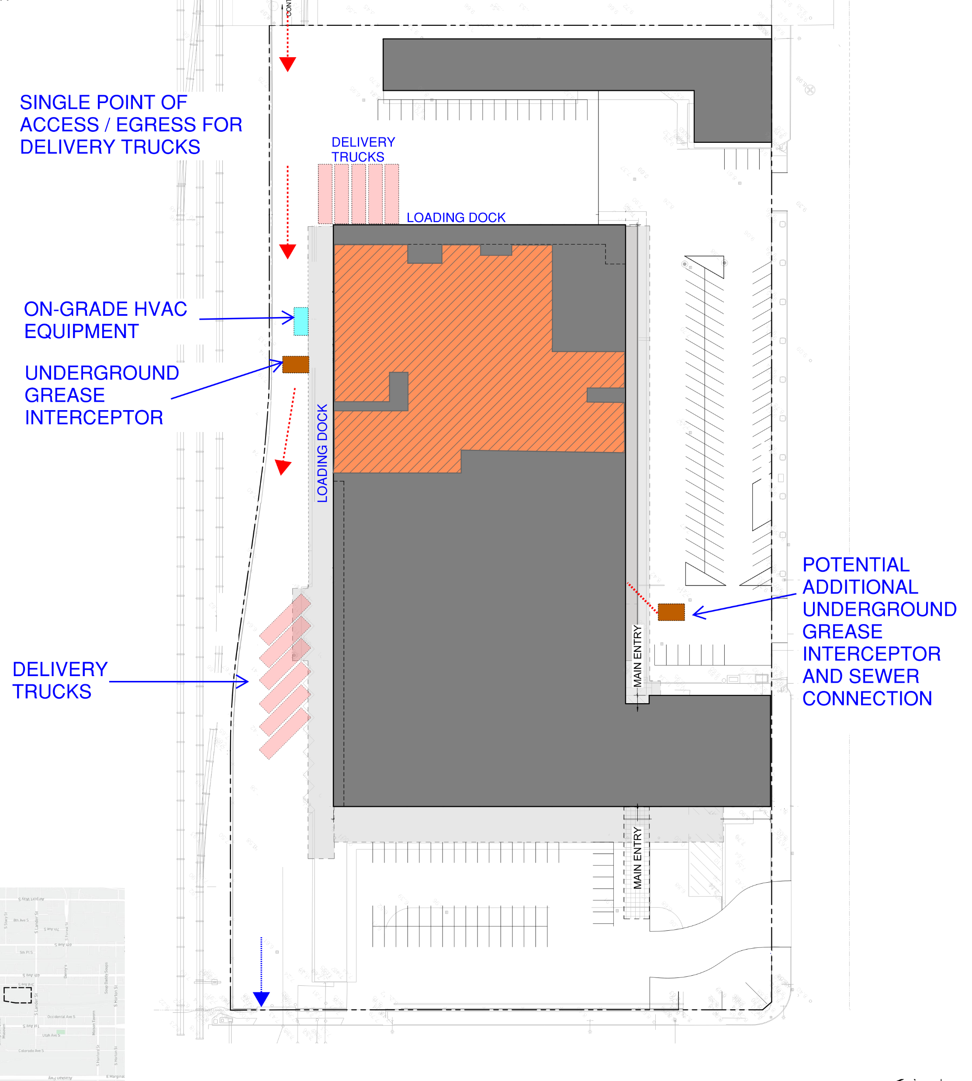
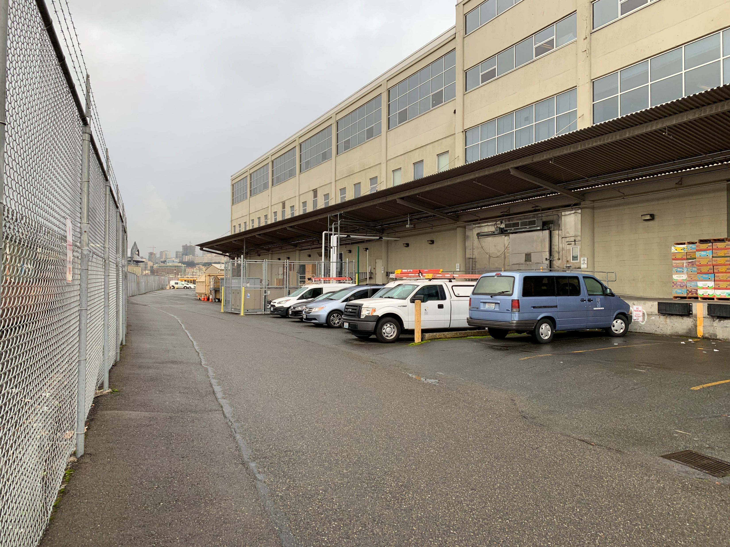
Project Overview - Site Evaluation
To be worked on further
SITE PLAN
PHOTO OF WEST SIDE OF BUILDING ADJACENT TO RAILROAD TRACKS
VG

Slide 7
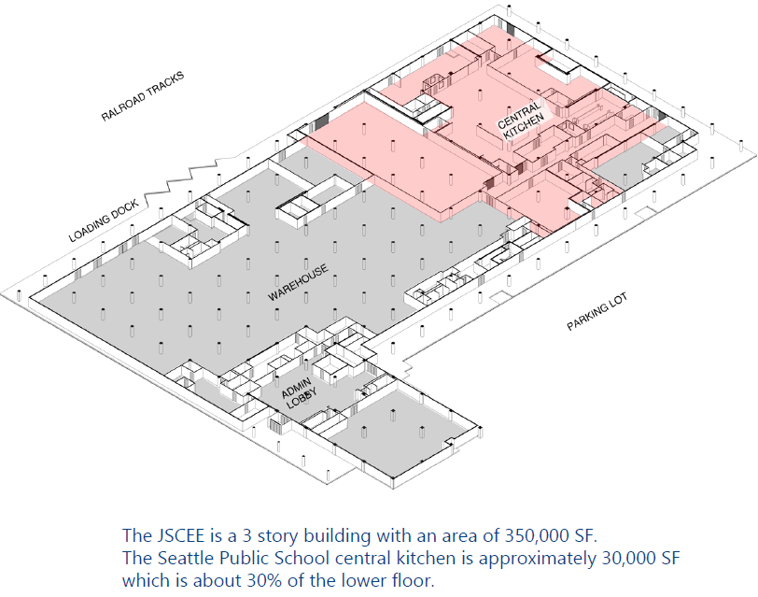
Project Overview
The project involves construction within an existing occupied facility.
The current kitchen layout and major equipment were installed circa 2001.
Revise kitchen layout to flow more naturally as goods arrive, goods are processed, and meals are stationed then trucked to schools.
Update kitchen equipment to be reliable, energy efficient, and safe. Reuse newer existing equipment when possible.
VG

Slide 8
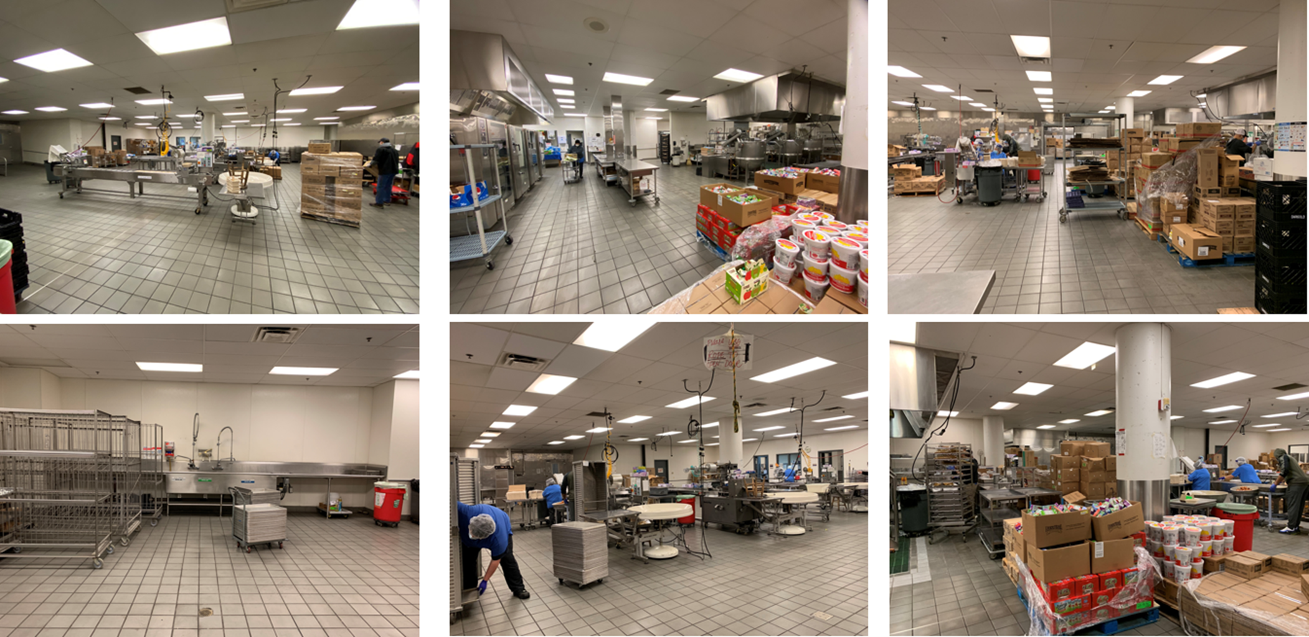
Project Overview — Existing Kitchen Photos
VG

Slide 9
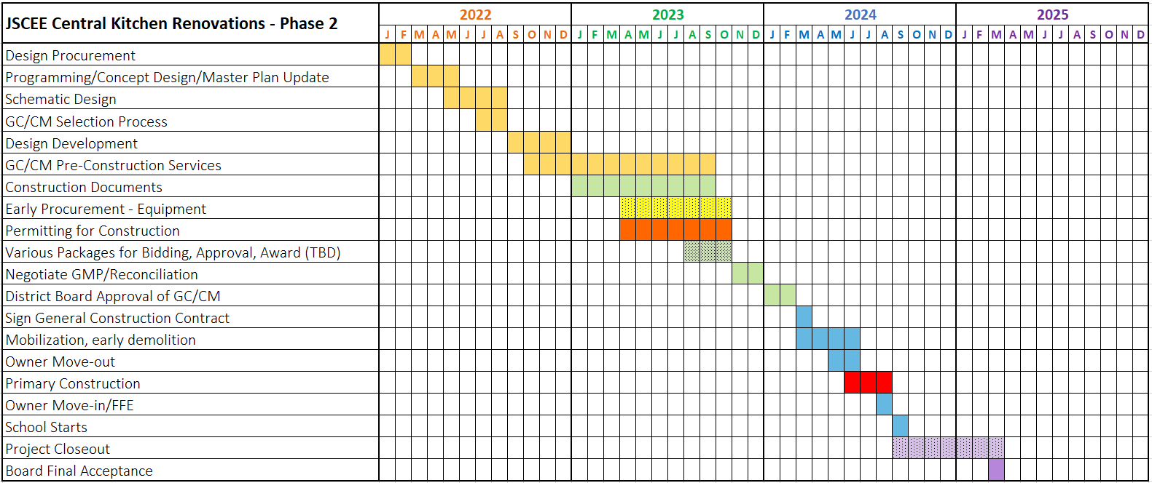
Project Overview — Preliminary Schedule
VG

Slide 10
GC/CM as Appropriate Delivery Method
Extensive GC/CM planning to ensure work will be completed within a 10-week construction period to ensure daily meals to the school district will not be interrupted at the start of the school year.
Design team and GC/CM can collaborate early to identify and prioritize critical design areas, resolve complex existing building and equipment questions and concerns, and develop a project design/procurement schedule and concise construction schedule
GC/CM can conduct existing conditions evaluations requiring semi-invasive investigations or partially-destructive testing in occupied areas during preconstruction.
GC/CM and design team can work together evaluating, selecting, and procuring long lead equipment and materials early in current supply chain-challenged climate
GC/CM to forecast and evaluate current market conditions related to labor shortages; bidders more reluctant to hard bid technically challenging project within narrow construction time frame
VG

Slide 11
Public Benefit of GC/CM
GC/CM selection based on qualifications and relevant experience will be critical to success of project with significant time constraints, schedule requirements, adjacent to central warehouse
Design participation will improve GC/CM familiarity with issues and reduce omissions, thus saving cost and improving quality
GC/CM will participate in developing the schedule and packaging scopes to help ensure timely construction and turn-over of completed project
Top-tier contractors are more likely to compete for this project as a GC/CM, leading to likelihood of improved quality, timely completion, better sub coverage, and better safety
Earlier cost information will help better manage budget and prioritize needs
Discuss how to position project for greater W/MBE participation
VG

Slide 12
Agency Experience
Major Capital Projects
Major Capital Projects (continued)
Project Name | Scale/Description | Delivery Method | Completion | Project Cost
Rainer Beach High School | New Building | GC/CM | 2025 (in Design) | $238.2 M
Mercer Middle School | New Building | GC/CM | 2025 (in Design) | $152.5 M
Van Asselt School | Modernization & Addition | GC/CM | 2023 (in Design) | $44.2 M
Northgate Elementary School | New Building | GC/CM | 2023 (in Const.) | $90.1 M
Viewlands Elementary School | New Building | DBB | 2023 (in Const.) | $88 M
Kimball Elementary School | New Building | DBB | 2023 (in Const.) | $84.5 M
Lincoln High School phase II | Modernization | GC/CM | 2023 (in Const.) | $30.1 M
Lincoln High School | Modernization | GC/CM | 2019 | $101 M
Loyal Heights Elementary | Modernization & Addition | GC/CM | 2018 | $37.3 M
Cascadia Elementary & Robert Eagle Staff Middle Schools | Two New Schools | GC/CM | 2017 | $118.2 M
Olympic Hills Elementary School | New Building | GC/CM | 2017 | $45.2 M
Denny Middle School/Chief Sealth High School, projects I and II | Sealth 230K SF Modernization/Denny New Building | GC/CM | 2010/2011 | $149 M
Denny Middle School/Chief Sealth High School, project III | Community/Sealth Athletic Fields | GC/CM | 2011 | $5.9 M
Hamilton Middle School | Complete Renovation | DBB | 2010 | $72.2 M
Ingraham High School | New Addition | DBB | 2012 | $25.8 M
Hale High School Project I | Modernization & New Library Addition | DBB | 2009 | $14 M
Hale High School Project II | Major Modernization | GC/CM | 2011 | $72.8 M
Project Name | Scale/Description | Delivery Method | Completion | Project Cost
South Shore K-8 School | New 130K SF Building | DBB | 2009 | $64.7 M
South Lake High School | New Building | DBB | 2008 | $14.4 M
Garfield High School | Complete Renovation | GC/CM | 2008 | $87.5 M
Cleveland High School | Complete Renovation | GC/CM | 2007 | $67 M
Roosevelt High School | Complete Renovation | GC/CM | 2006 | $84.5 M
Hale High School Auditorium | New Addition | GC/CM | 2004 | $10 M
Other Capital Projects
Type | Scale/Description | Funding/Years | Cost
Buildings | Roof Replacements | BTA II 2005-2012 BTA III 2010-2016 BTA IV 2016-2022 | $200 M
 | Exterior Renovations
 | Mechanical/Air Quality
 | Life Safety/ADA
 | Interior Finishes/Flooring
Technology | Technology, Computers, Networks | BTA II 2005-2012 BTA III 2010-2016 BTA IV 2016-2022 | $141 M
Academics | Literacy, Arts, Science Facilities | BTA II 2005-2012 BTA III 2010-2016 BTA IV 2016-2022 | $102 M
 | High School Modernization
 | Athletics Improvements
BF

Slide 13
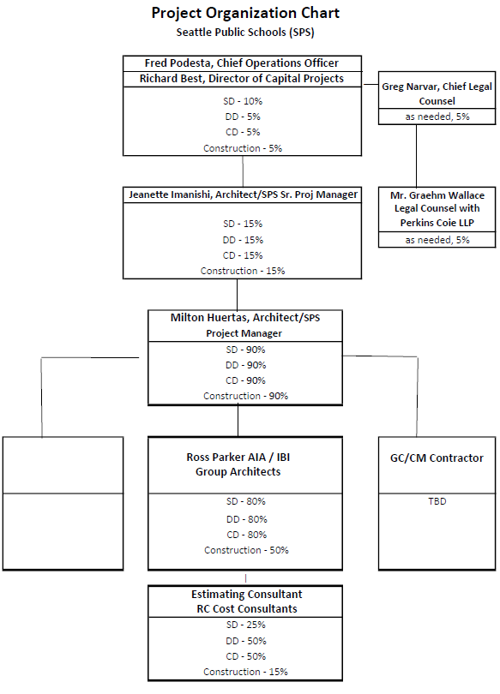
Project Team -
Organizational Chart
BF

Slide 14
Project Team - Qualifications
Seattle Public Schools
Richard Best, Director of Capital Projects and Planning
  40 years of industry experience, 11 GC/CM projects
Milton Huertas, Project Manager
  40 years of industry experience
Ross Parker, IBI Group, A/E Consultant Team Project Manager
  35 years of industry experience, 8 GC/CM projects
BF

Slide 15
Summary
Project meets criteria for GC/CM
Project team has necessary qualifications
GC/CM delivery provides a fiscal benefit for an occupied site with tight schedule constraints
RB

Slide 16

Questions
RB

