Slide 1

Spokane Conservation District
Intrinium Building
CPARB
Project Review Committee
Progressive Design Build Application for Project Approval
March 25, 2021
Notes:
Vicki thanks PRC panel for opportunity
Present team introductions at the table.

Slide 2

AGENDA
Project Team and SCD Overview
Project Overview
Why Progressive Design Build
Project Concept Site Plan
Project Budget
Project Schedule (Progressive Design Build/ Design/Construct)
Owner Summary
Questions and Answers
Notes:
Vicki slide

Slide 3
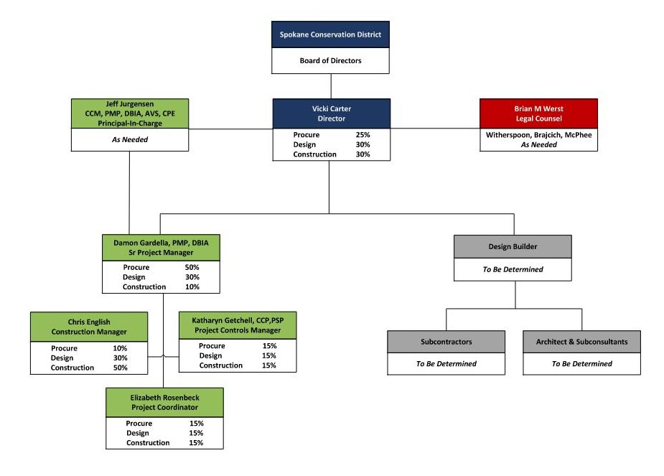

PROJECT TEAM
Notes:
Vicki: Clear mgmt. plan and lines of communication
SCD is the decision maker; OAC manage/facilitates the process
Note Brian Werst from Witherspoon Brjcich, McPhee;
Note % of effort on each phase of the projects

Slide 4
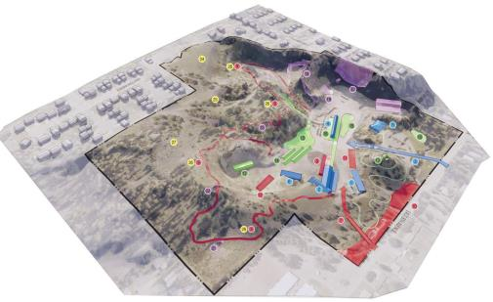

SCD OVERVIEW
Located in Spokane Near Fairgrounds
Purchased 50 Acres at base of South Hill Spokane
Completion of first building, new home office
Plans to construct campus on new property
Strong Board and Community support for Conservation
475 Students
Notes:
Vicki; BRIEF synopsis of the SCD organization and new campus
This site is a former rock quarry that was mined from the 1930s to 1970s and was more recently used as a batch asphalt plant.
The Spokane Conservation District purchased in 2017 to naturally restore the site and build out a campus and business park.
The site has very UNIQUE geologic and hydrologic features. Two major geologic formations exist on the east and west sides of the property.
Hydrologically, it serves the Glenrose watershed and has several open stream areas and ponded areas which benefit the wildlife on the property and native plant communities but also present some construction challenges.
CONSERVATION CAMPUS AND BUSINESS PARK
The 50-acre project has been broken into 5 phases over a 10-year plan
Our goal is reclaim, redeem, revitalize, reinvest, and revamp!
Phase 1 – Look at what was there and build out our new facility
Phase 2 – Building out our private partnership building for Intrinium and integrating a trail system and interpretive signage for guest use
Phase 3 – Add educational and demo sites and projects like establishing field stations for educational use in soil health, pond ecology, pollinators, etc. ADD: Regional conference center
Phase 4 – Open up ideas for recreational activities: hiking, climbing, confidence course, ampitheater
Phase 5 – Explore innovative housing ideas/conservation low-impact. ADD: Art in nature park utilizing the remnants of the property’s former life
BUILDING
Design features an east/west axis to maximize a passive solar approach for heating/cooling
Integrated systems for energy efficiency and sustainability
Materials to be used should be unique to the site

Slide 5
PROJECT OVERVIEW
$3.75M New construction project
$3M in Loan Assistance
$375k Match from Intrinium
The Project
  New 13,000 Sq/Ft Office Building
  Offices, Hotel Space, Laboratory
  Exterior landscaping incorporating campus layout and natural area.
Notes:
Vicki: Successfully secured loan and tenant
Talk in detail about Project, site constraints, etc.
Segue to Damon next slide

Slide 6
WHY PDB– RCW 39.10.300
The earthwork and foundation activities are highly specialized and a DB approach is critical in developing the construction methodology.
Provide opportunity for greater innovation or efficiencies between the designer and the builder.
Significant savings in project delivery time will be realized, critical for meeting loan requirements.
Notes:
Damon SLIDE

Slide 7
PROJECT OVERVIEW
Spokane construction market saturated 2021/2022, multiple competitive bids on DBB difficult
Marketing outreach to Design Builders
SCD loan based on new office construction with GMP signed no later than 7/15/2021.
Program/Project Criteria for PDB
  Defined Scope of Work with Specialized earthwork construction activities
  Market conditions – GC and Subcontractor availability
  Mitigate fiscal/construction escalation risk and time constraints.
Notes:
Damon Slide
Intrinium just announced aquisition 4 new businesses and urgency for this space.

Slide 8
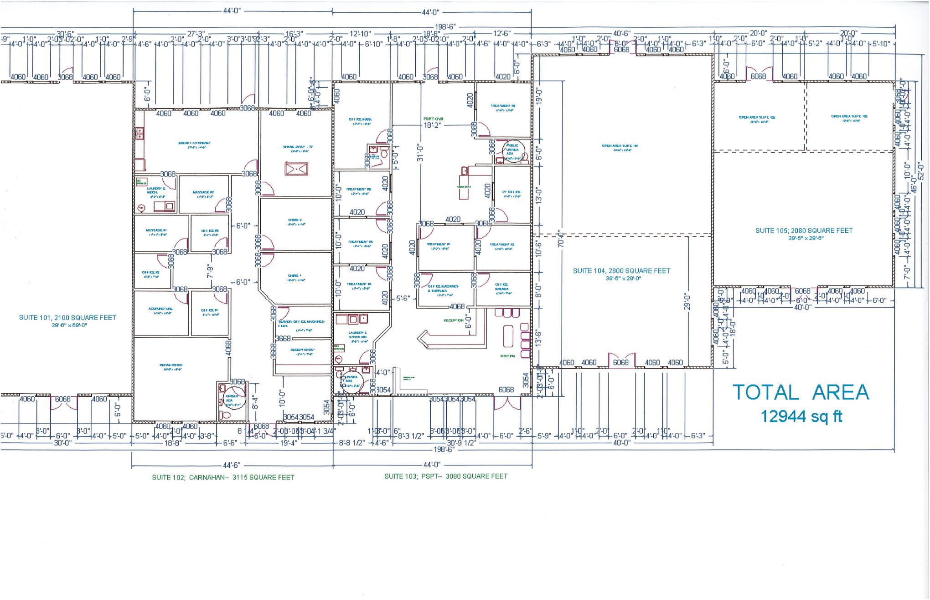
PROJECT OVERVIEW
Scope of Work
13,000 square foot office building
Construct new offices
“Hotel” space for field staff
ADA Compliant
WSEC Compliant
Laboratory
Exterior landscape complimenting campus design
More
Notes:
Damon:
Site, stakeholders, challenges, WHY PDB is critical
SEGUE TO Damon IN BUDGET

Slide 9
PROJECT BUDGET
Notes:
9
Damon MACC/GMP and contingencies

Slide 10
PDB PROCUREMENT, DESIGN, AND CONSTRUCTION SCHEDULE
Description | Duration | Start | Finish
PRC Meeting/Approval Letter | 1 day | 3/26/2021 | 3/26/2021
Draft RFQ/Ad/Outreach/Q&A | 2 weeks | 3/29/2021 | 4/9/2021
PDB RFP Process | 2 weeks | 4/12/2021 | 4/23/2021
PDB Interviews | 1 weeks | 4/26/2021 | 4/30/2021
Design Builder Selection | 1 day | 4/30/3021 | 4/30/2021
PDB Contracting | 1 months | 5/1/2021 | 6/1/2021
Early Site Package Design | 6 weeks | 6/1/2021 | 7/15/2021
Early Site Package Construct | 2 months | 7/15/2021 | 9/15/2021
Ongoing PDB Design/Permitting | 3 months | 7/15/2021 | 10/15/2021
Final Design | 1 day | 10/15/2021 | 10/15/2021
Negotiate GMP | 2 weeks | 7/01/2021 | 7/15/2021
PDB Construct | 6 months | 9/15/2021 | 3/15/2022
Project Completion/Punch/Move -in | 1 months | 3/15/2022 | 4/15/2022
Closeout | 1 months | 4/15/2022 | 5/15/2022
Notes:
Damon – Where we are in the process and then on board w/ PRECON SVCS

Slide 11
OWNER SUMMARY
Substantial fiscal and time benefit critical for funding.
Meets qualifying criteria under RCW 39.10.300
Public body has necessary experience or team
  Project knowledge and experience
  Sufficient contract admin staff & experience
  Clear management plan & logical lines of authority
  Necessary/appropriate funding & time
  Continuity of PM team with PDB experience
  Zero audit findings
Notes:
Vicki ; Short and sweet; hit all points, qualified team, right budget, right experience

Slide 12
QUESTIONS
&
ANSWERS
Notes:
Damon: Fields Q&A time.

