Slide 1


Application for certification of a public body Agency using the design-build method
RCW 39.10.270 Alternative Public Works Contracting
January 28, 2021

Slide 2

Agenda
Introductions
The School District
Capital Project History
2020 – 2028 Capital Bond Program
Why Agency D/B Certification?
Lessons Learned
Summary

Slide 3
Presenting Team
Tacoma Public Schools:
Morris Aldridge – Executive Director of Planning and Construction
Kristine Anderson, AIA LEED AP BD+C DBIA - Capital Projects Supervisor
Julius Pallotta- Capital Projects Supervisor
Parametrix:
Jim Dugan – APD Advisor / Capital Program Manager

Slide 4
Additional Team Members
Tacoma Public Schools
Carla Santorno- Superintendent
Chris Williams – Chief Operating Officer
Anne Cumings- Senior Financial Analyst
Perkins Coie
Graehm Wallace – External D/B Legal Counsel

Slide 5

The school district

Slide 6
Tacoma Public Schools
Founded in 1869
Comprised of:
    - 36 Elementary Schools
    - 11 Middle Schools
    - 10 High Schools
    - Numerous Special Programs
    4th largest school district in the State of Washington
    Approximately 30,000 students
    Over 5,000 employees
    Serving Pre-K thru 12th grade
    One of the largest employers in Tacoma

Slide 7
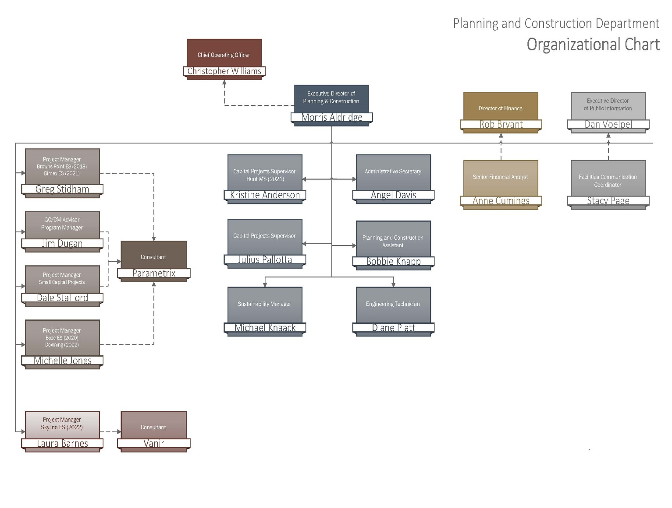
Planning & construction departmental Organizational Chart

Slide 8
Planning & construction Team
  Morris Aldridge, Executive Director of Planning and Construction
    34 Years of K-12 Experience
    3 Years D/B Experience
    4 Years CM/AR & GC/CM Experience
    President of the Western Washington Chapter of DBIA
    Tacoma Public Schools Capital Project Supervisors
    Julius Pallotta
    Kris Anderson
    Michelle Jones
    Greg Stidham
    Laura Barnes

Slide 9
Capital Project History

Slide 10
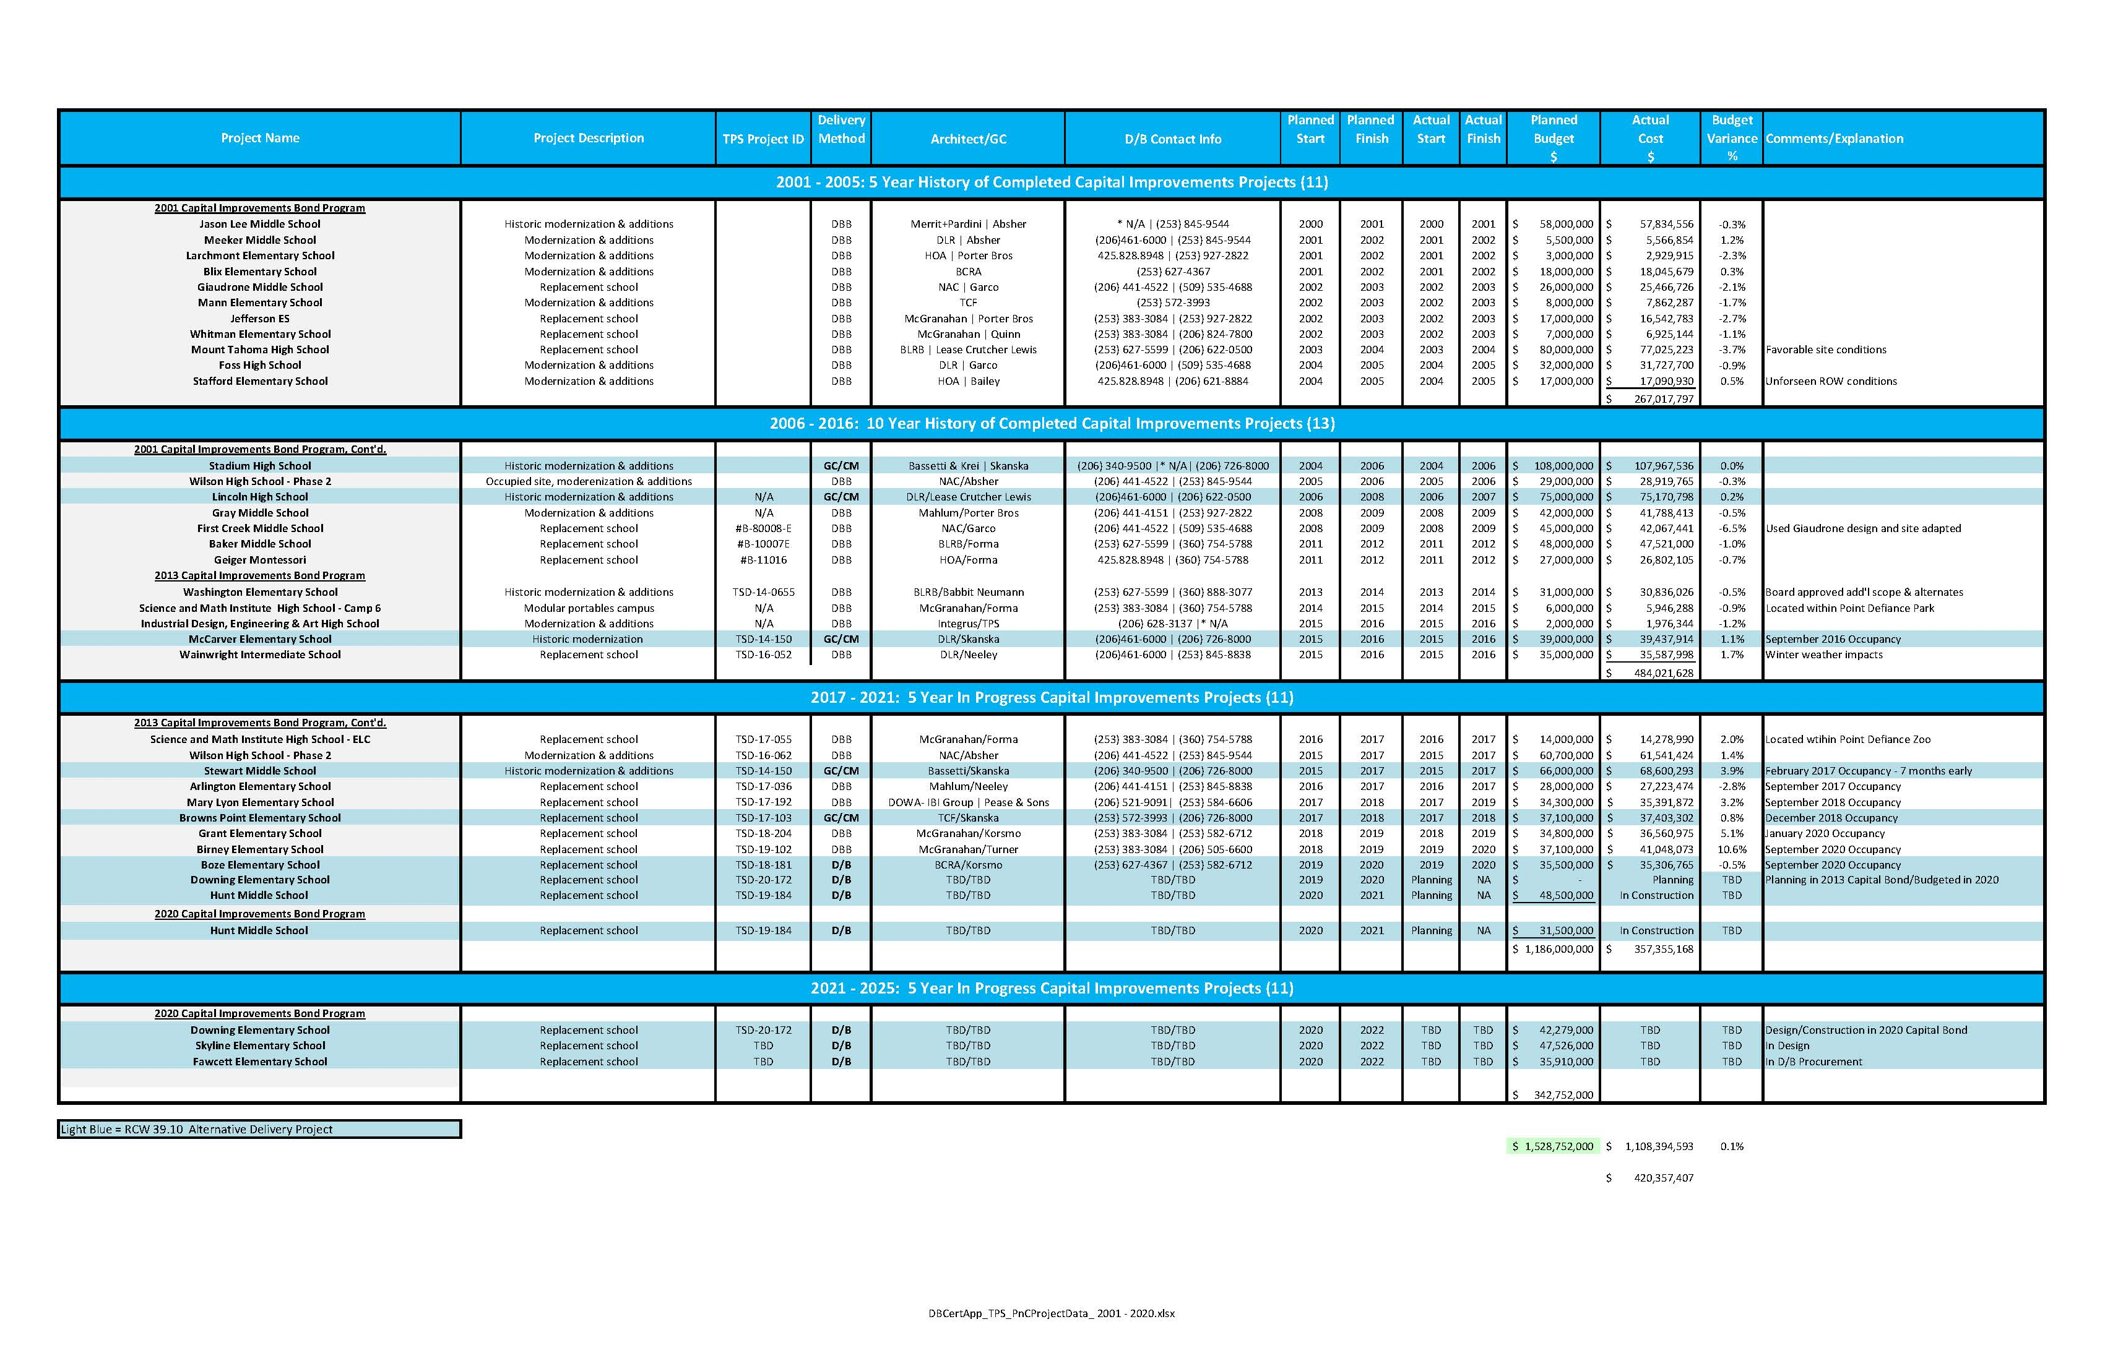
TPS Public Body Experience: 2001 - 2020
Notes:
As a public body depth of public works experience
TPS is a major capital project builder

Slide 11
APD Experience & Qualifications
2001 – 2020: TPS delivered 36 large capital projects valued at nearly $1.5 billion
Comprised of D/B/B (24), GC/CM (8), & D/B (4) methods of project delivery
TPS DBIA Associate - Greg Stidham
TPS DBIA Professional – Kris Anderson
All staff have completed the AGC Design-Build Workshop
TPS is committed to providing continuing training opportunities for our staff
Morris Aldridge - President of the Western Washington Chapter of DBIA.
Notes:
Controls
-Weekly Staff Meetings
-Weekly progress meetings
-One on one PM daily and weekly meetings
-Standing daily and weekly meetings with COO
-Multi Vista- Photographic Interactive As-Built
-Digitized As Builts and OEM Manuals in the Cloud (Skisite)
-Chalk Schools- Soup to nuts process for Project approvals

Slide 12
Business Equity:
TPS Community Inclusion Plan
Tacoma Public Schools is committed to Community Inclusion, as partnerships are critical to student education and community health and sustainability.
In 2018, Tacoma Public Schools committed to maintain and increase contracts with local businesses by:
    Increasing local share of total construction from 15% to 30%
    Adopt Governor’s diverse business goals, including:
      10% Minority-Owned Business Enterprises
      6% Woman-Owner Business Enterprises
      5% Small Business Enterprises (SBE)

Slide 13
Business Equity:
TPS Community Inclusion Results
The Tacoma Public Schools actual performance against goals beginning in 2017 and summarized as of EOY 2020 is as follows:
MBE: Goal: 10% Actual: 25.3% Actual/Goal: 253%
WBE: Goal: 6% Actual: 8.2% Actual/Goal: 137%
SBE: Goal: 5% Actual: 12.2% Actual/Goal: 244%
Local Share: Goal: 30% Actual: 64% Actual/Goal: 213%
Apprenticeships:
All major construction projects are exceeding apprenticeship utilization requirements

Slide 14
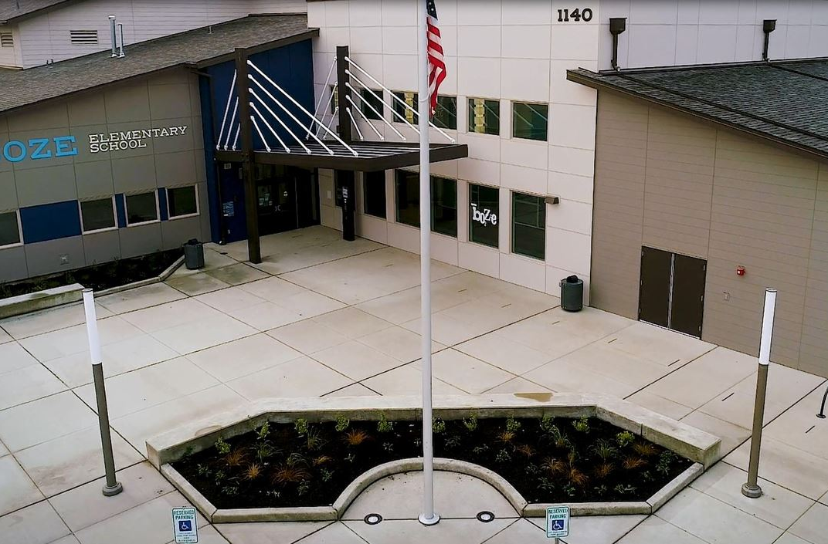
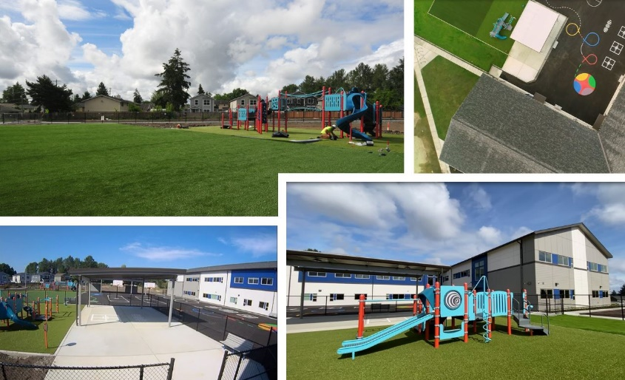
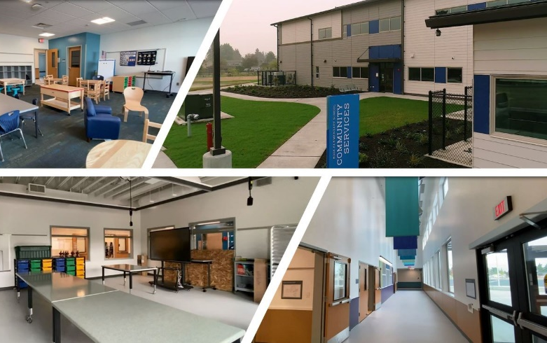
Completed Design-Build project
Boze Elementary School – Progressive D/B
PRC approved May 2017
Construction Start: Q3 2018 Completed: Q1 2020
Design-Builder: BCRA Architecture / Korsmo Construction
7 RFI’s
No Change orders
Delivered Under Budget
Delivered 3 Months Early
Utilized $1.2 M in Unspent Contingency for Addition of Playground Amenities
D/B Success: Innovation, Reduced Schedule and Cost Control
Notes:
ALAN:
Henderson North CSO Reduction
Why selected: Contractor input was critical for constructability, sequencing, and risk management.
Benefits:
Reduced impact to public & Park revenue.
Risk management of unknown groundwater conditions.
Lessons learned: Value of pre-con risk management and stakeholder outreach to project cost and execution.

Slide 15
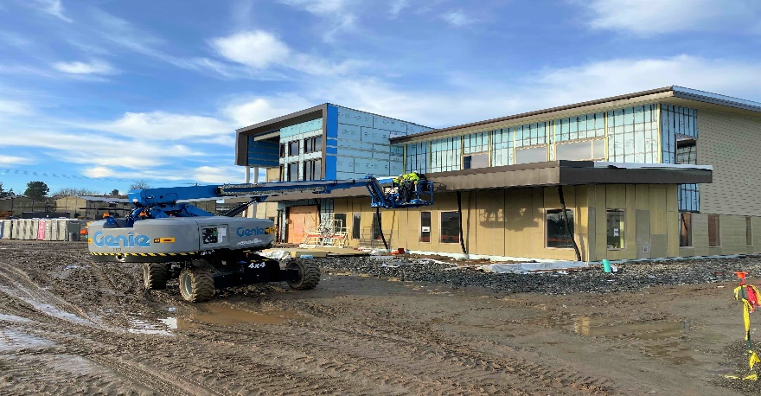
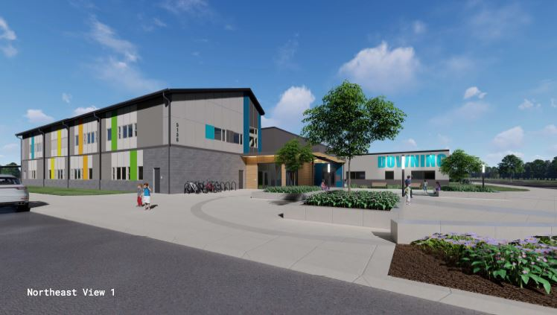
current design build projects
Hunt Middle School (P/DB)
  PRC approved October 2017
  Project Budget: $58 M
  Status: In Construction
  Occupancy: Fall 2021
  Design-Builder: Absher/BCRA
  Downing Elementary School (P/DB)
  PRC approved February 2019
  Project Budget: $42.3 M
  Status: In Design
  Construction Start: Q2 2021
  Occupancy: Fall 2022
  Design-Builder: Korsmo/TCF
Notes:
MARK
Thank you, Lloyd.
We also want to touch on our three recently approved projects, demonstrating our ability to meet the requirements of RCW 39.10. All projects so far are progressing smoothly.
You can read the full details on each slide.
Overlook Walk was approved by your committee May 2018. Overlook Walk is currently in preconstruction services.
Boundary Dam was approved in October 2017 and started construction last month. Contract completion is on schedule.
Cedar Falls was approved September 2018 and is in the contract execution phase.
All of these projects will give quarterly updates to the Internal Review Committee as part of our new structure, so we will be able to continue to assess the progress of these projects and their compliance with 39.10.

Slide 16
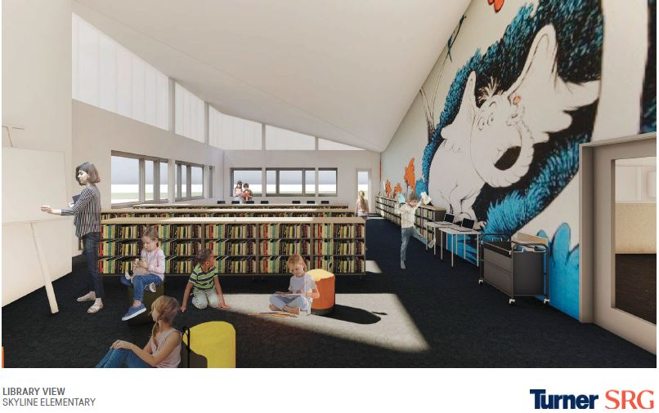
current design build projects
Skyline Elementary School (P/DB)
  PRC approved October 2019
  Project Budget: $48 M
  Status: In Design
  Construction Start: Q2 2021
  Occupancy: Fall 2022
  Design-Builder: Turner/SRG
  Fawcett Elementary School (P/DB)
  PRC approved December 2020
  Project Budget: $36 M
  Status: In DB Procurement
  Construction Start: Q2 2022
  Occupancy: Fall 2023
  Design- Builder: TBD
Notes:
MARK
Thank you, Lloyd.
We also want to touch on our three recently approved projects, demonstrating our ability to meet the requirements of RCW 39.10. All projects so far are progressing smoothly.
You can read the full details on each slide.
Overlook Walk was approved by your committee May 2018. Overlook Walk is currently in preconstruction services.
Boundary Dam was approved in October 2017 and started construction last month. Contract completion is on schedule.
Cedar Falls was approved September 2018 and is in the contract execution phase.
All of these projects will give quarterly updates to the Internal Review Committee as part of our new structure, so we will be able to continue to assess the progress of these projects and their compliance with 39.10.

Slide 17
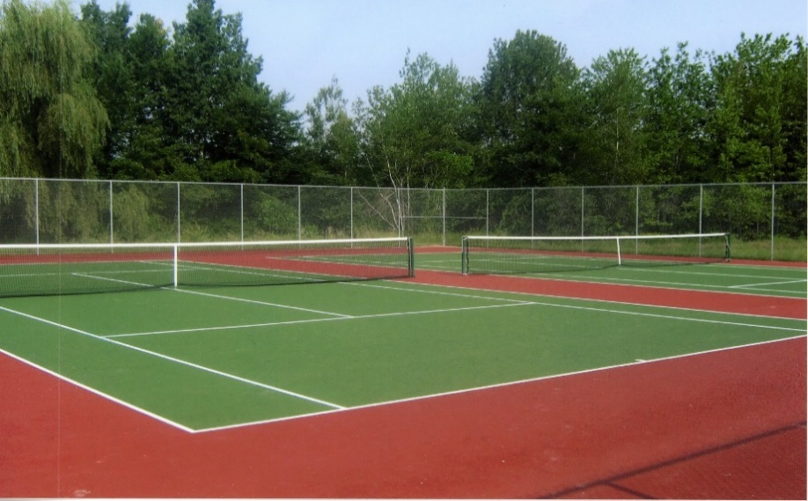
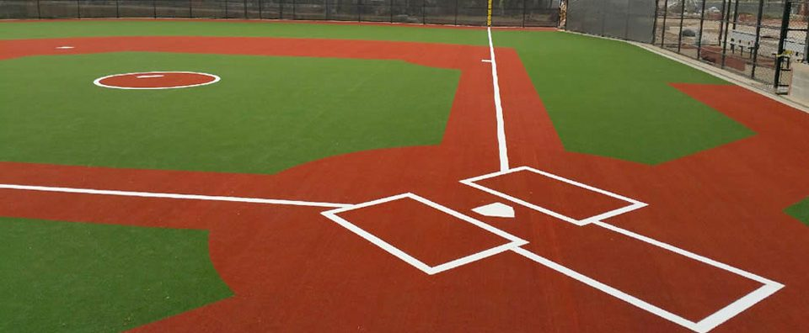
current design build projects
Synthetic Fields, Track and Tennis Courts Bundle (P/DB)
  PRC approved December 2020
  Project Budget: $26M
  Status: In D/B Procurement
  Construction Start: Summer 2021
  Completion: Summer 2022
  Design-Builder: TBD
Notes:
MARK
Thank you, Lloyd.
We also want to touch on our three recently approved projects, demonstrating our ability to meet the requirements of RCW 39.10. All projects so far are progressing smoothly.
You can read the full details on each slide.
Overlook Walk was approved by your committee May 2018. Overlook Walk is currently in preconstruction services.
Boundary Dam was approved in October 2017 and started construction last month. Contract completion is on schedule.
Cedar Falls was approved September 2018 and is in the contract execution phase.
All of these projects will give quarterly updates to the Internal Review Committee as part of our new structure, so we will be able to continue to assess the progress of these projects and their compliance with 39.10.

Slide 18
Planning & construction departmental Organizational Chart

Slide 19
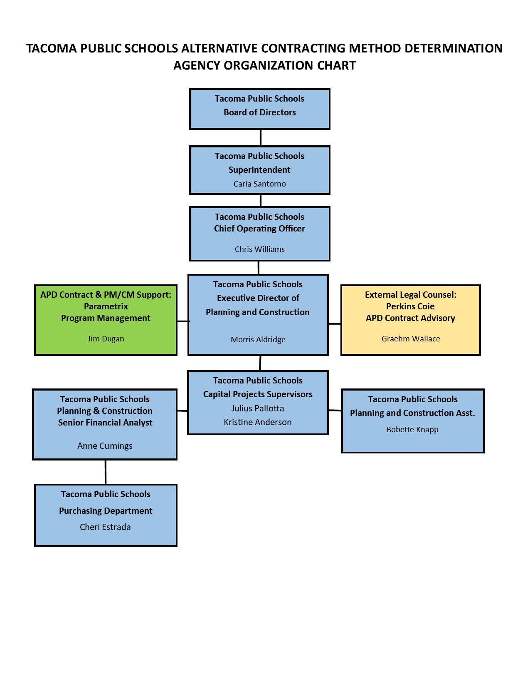
Agency
Project delivery method determination Organizational Chart

Slide 20
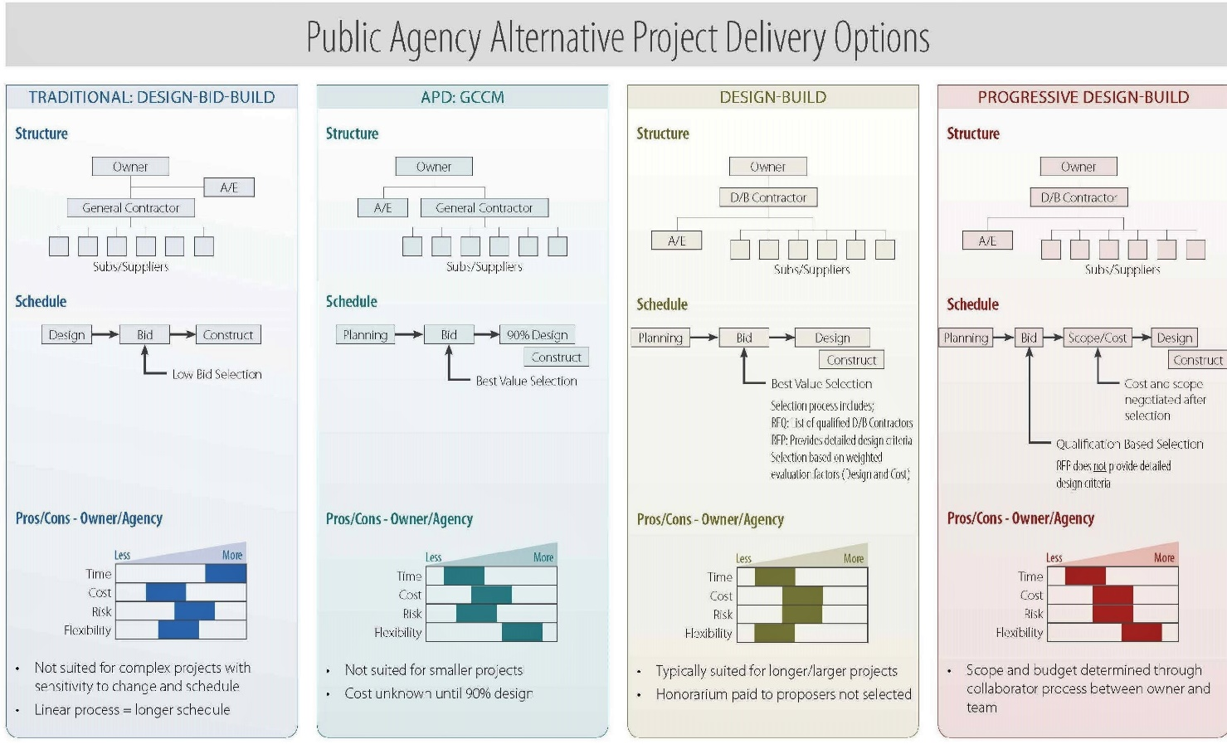
Alternative Delivery method Options

Slide 21
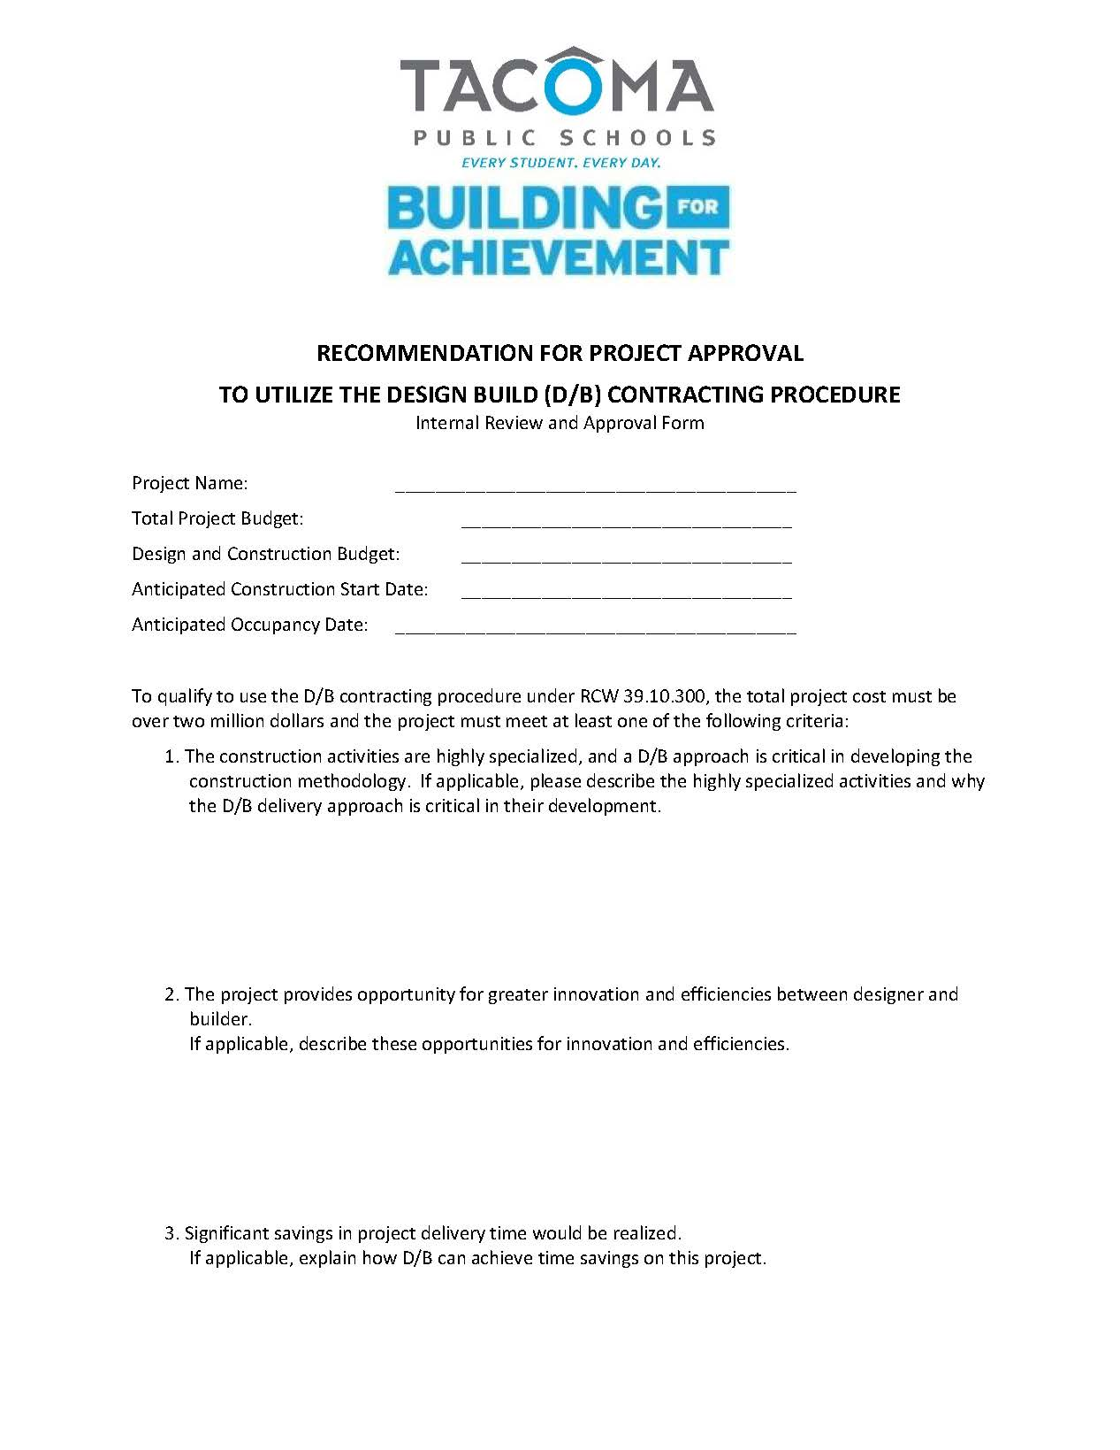
Delivery method Recommendations

Slide 22
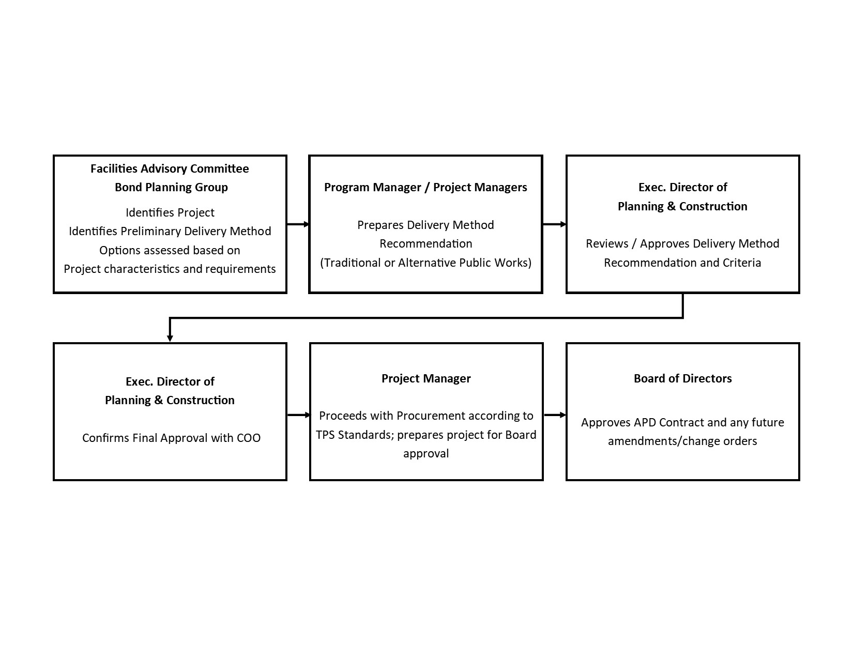
Delivery method decision workflow

Slide 23
The 2020 – 2028 Capital Program

Slide 24
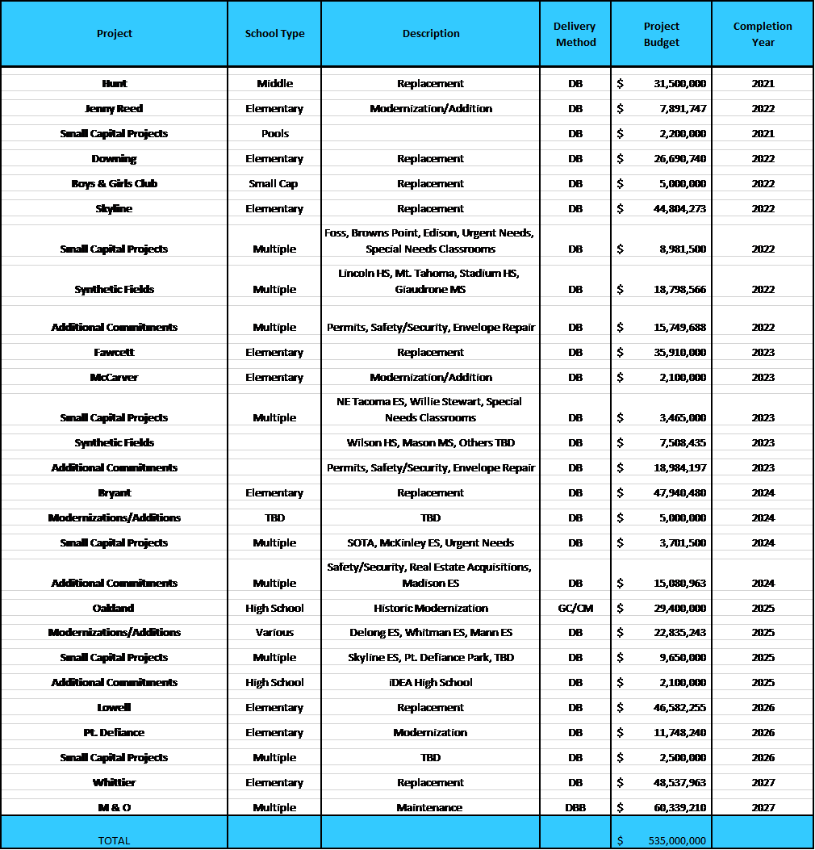
TPS 2020 Capital Bond Program - $535M Approved FEB 2020
Notes:
Yellow Highlighted GCCM Projects
Green Highlighted- Just beginning or starting in the next couple of years
May or may not be occupied

Slide 25
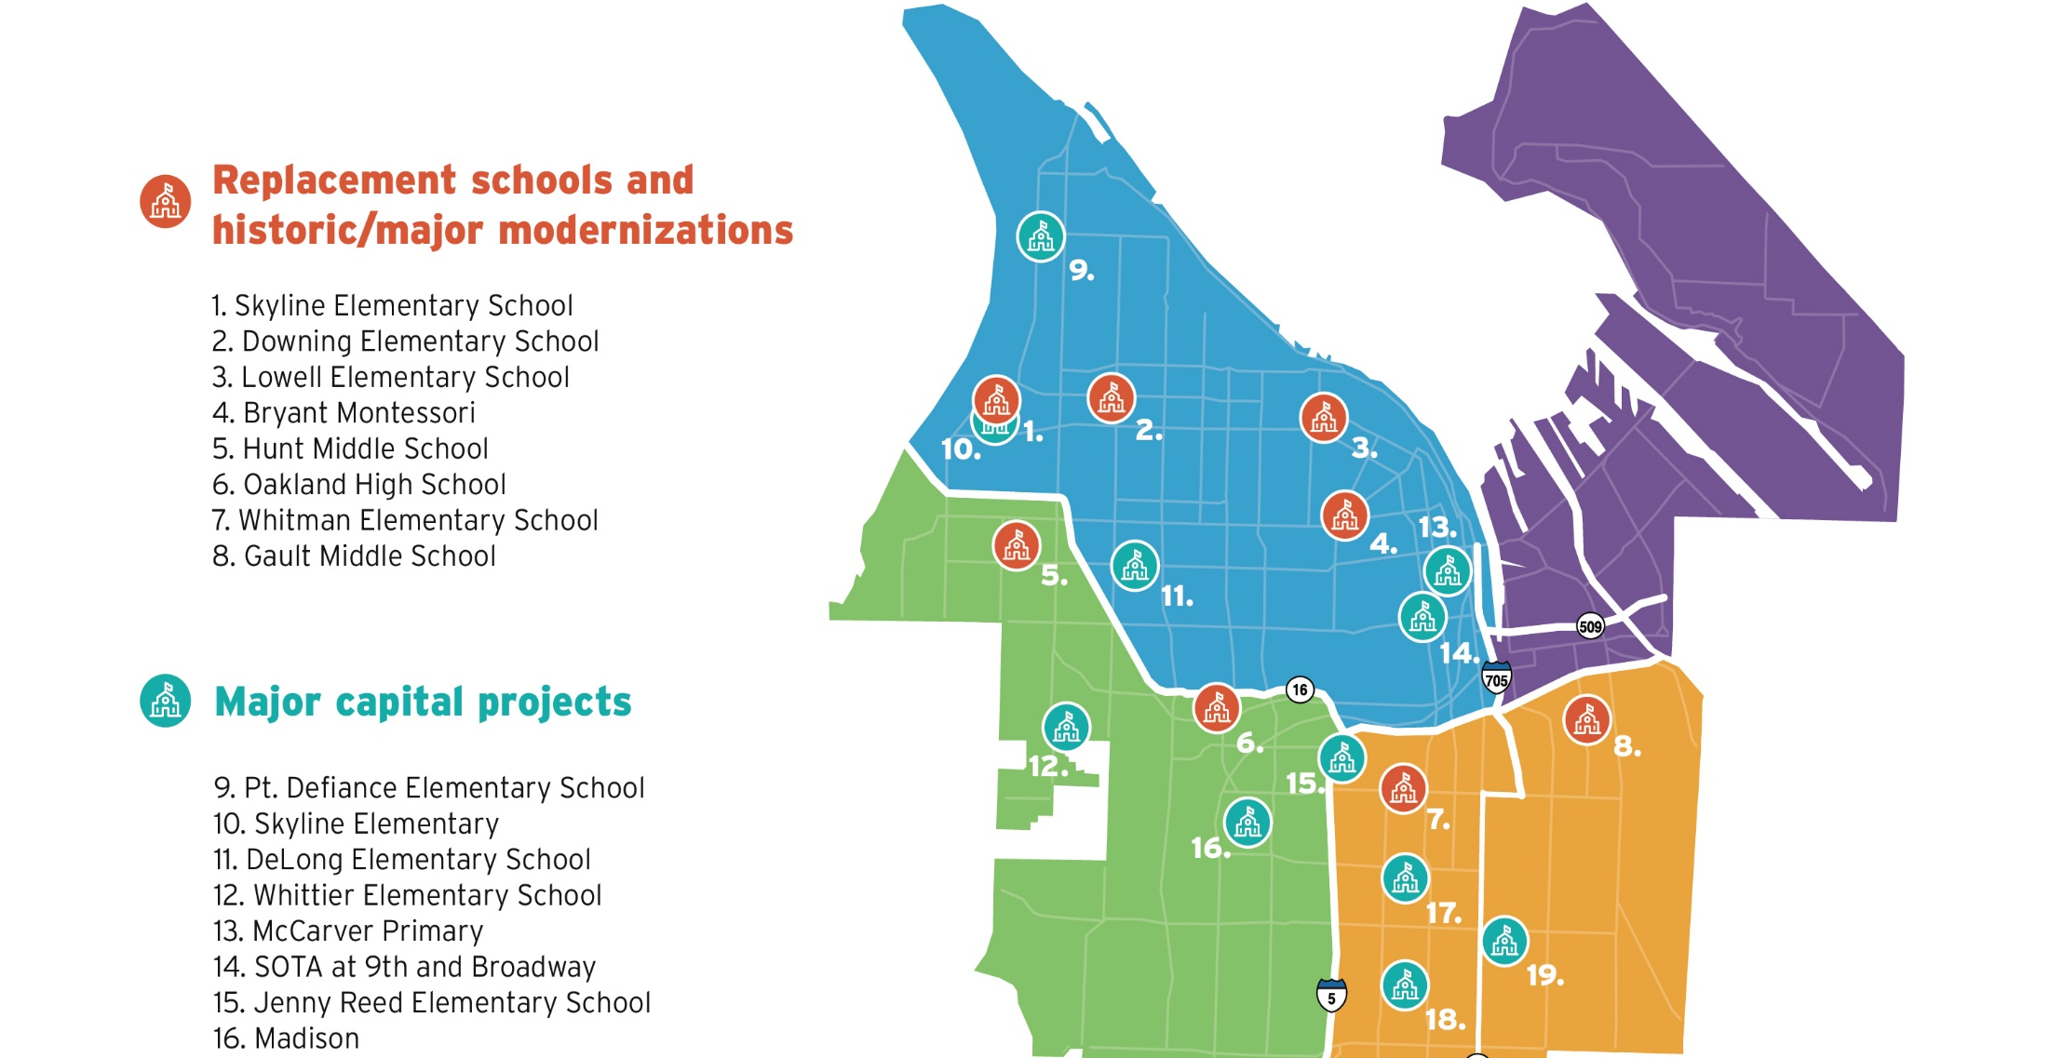

2020 Bond program

Slide 26
Planned design build projects
Project Occupancy Year Budget
  Bryant Montessori 2024 $48 M
  Oakland High School 2025 $30 M
  Lowell Elementary School 2026 $47 M
  Whittier Elementary School 2027 $48 M
Notes:
MARK
Thank you, Lloyd.
We also want to touch on our three recently approved projects, demonstrating our ability to meet the requirements of RCW 39.10. All projects so far are progressing smoothly.
You can read the full details on each slide.
Overlook Walk was approved by your committee May 2018. Overlook Walk is currently in preconstruction services.
Boundary Dam was approved in October 2017 and started construction last month. Contract completion is on schedule.
Cedar Falls was approved September 2018 and is in the contract execution phase.
All of these projects will give quarterly updates to the Internal Review Committee as part of our new structure, so we will be able to continue to assess the progress of these projects and their compliance with 39.10.

Slide 27
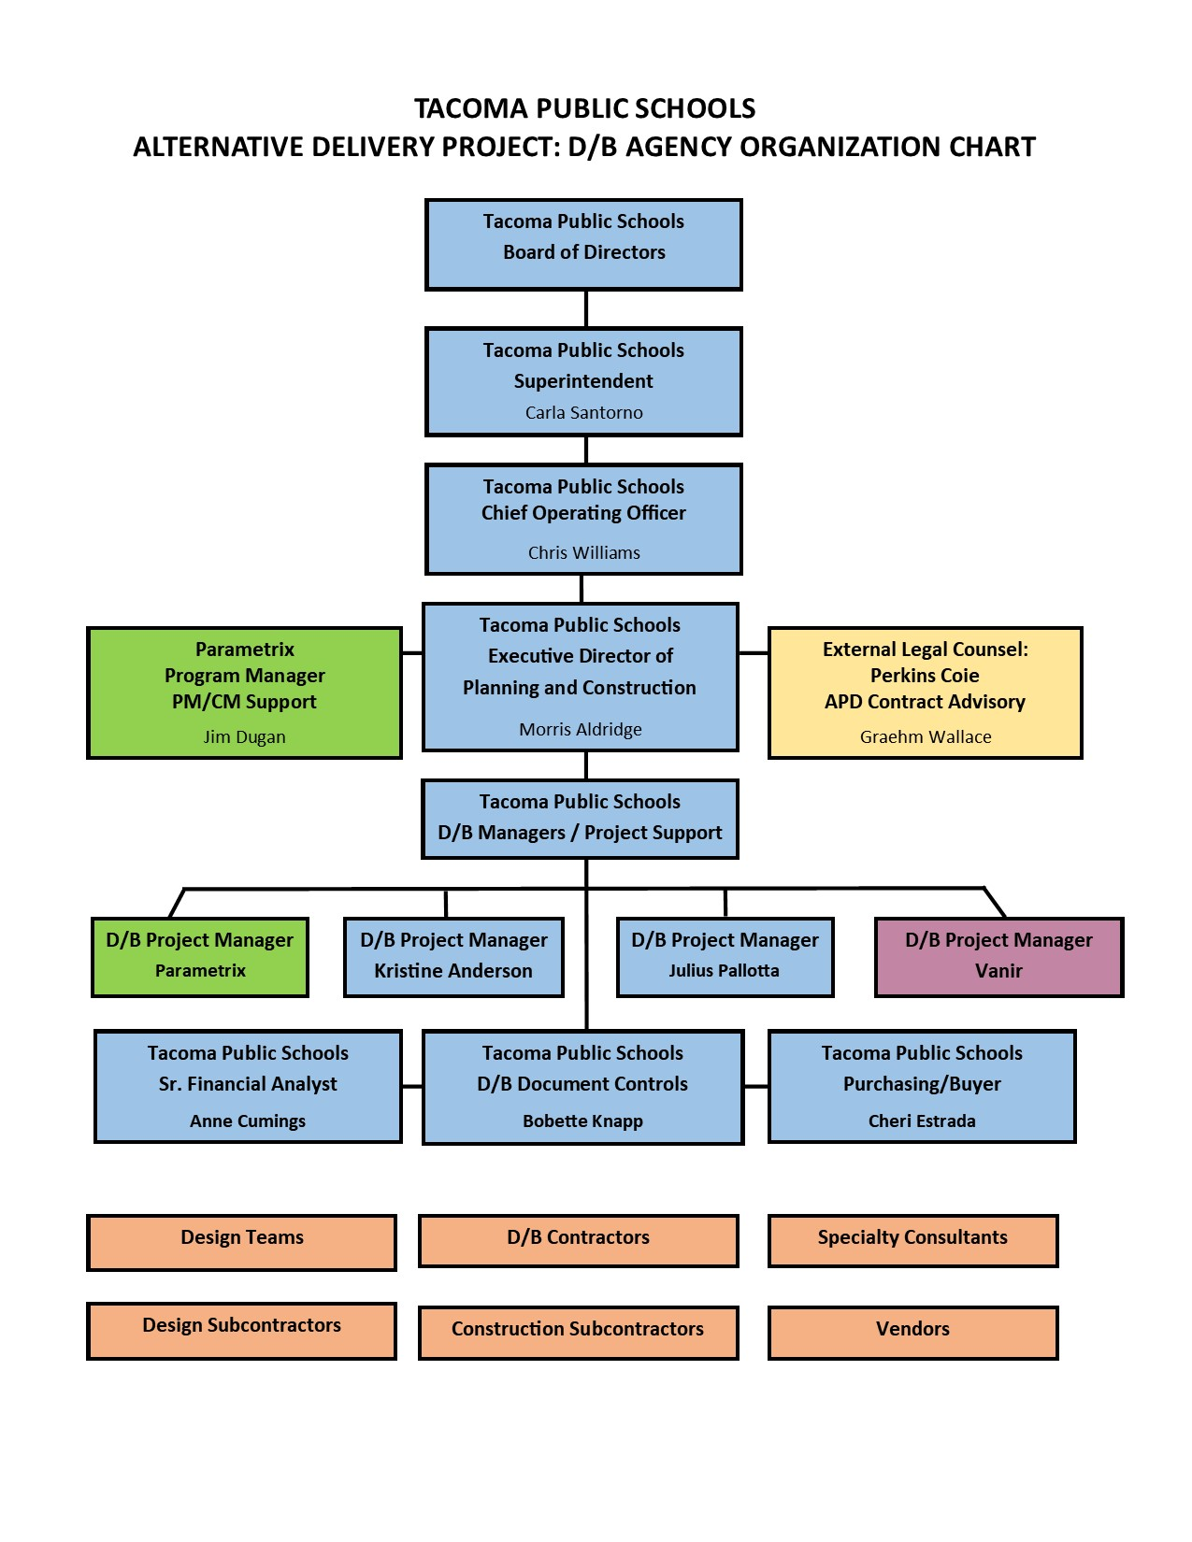
Program Organizational Chart

Slide 28
Why D/B Agency Certification?

Slide 29
Multiple funded capital projects
Demonstrated success using design-build
Funded program
Multiple large and small capital projects
Capital Bond Program spanning multiple years
Continuing focus on improved local share
and Inclusion performance
Emerging focus on energy conservation & sustainable design
2020 – Time of incredible change
2021 and on - Time for innovation
Time to prepare for the 2028 capital bond

Slide 30
Cost and schedule controls
Increased Innovation
Cost Modeling versus Cost Estimating
Early Cost Certainty
Schedule Compression/Decrease in Time
Risk Shift from Owner to DB

Slide 31
Lessons learned
Choose your design build contractor carefully
Trust the design build team you choose
A good general contractor does not always make for a good design-build general contractor – the latter must have more of a developer approach to scope within budget.
The Design-Build Project Manager is a crucial role
Not every design team understands the subordinate role within the design-build team
Fast Tracking of projects saves significant time and money; better accountability for the public dollar
Bundling projects keeps contractor pool engaged and interested
The D/B delivery method allowed us to substantially exceed the District’s inclusion goals.

Slide 32
Summary
Agency has successfully completed a DB project, and
Agency has multiple DB projects in progress, and
Agency has multiple DB projects planned
Our Program Management Plans are developed with clear and logical and proven lines of authority
Funding is in place for current AND future projects
Project Schedules allow for appropriate time to manage and complete each project
Agency team has the required and necessary experience and enhanced added bench strength with experienced consultant partners
Team has the workload capacity to manage Bond Program – well planned out
TPS Business Equity Performance – increasing with every project

Slide 33


Thank you

